Slide 1

Crisis Management in the
City of Gothenburg
Lennart Bernram

Slide 2
Information from the municipalities’ crisis and risk group

Slide 3
May 26, 2015
The world from our point of view
How the city is organized
The three golden rules
Risk- and vulnerability analysis
Connections
The nine areas at risk
Our challenges

Slide 4
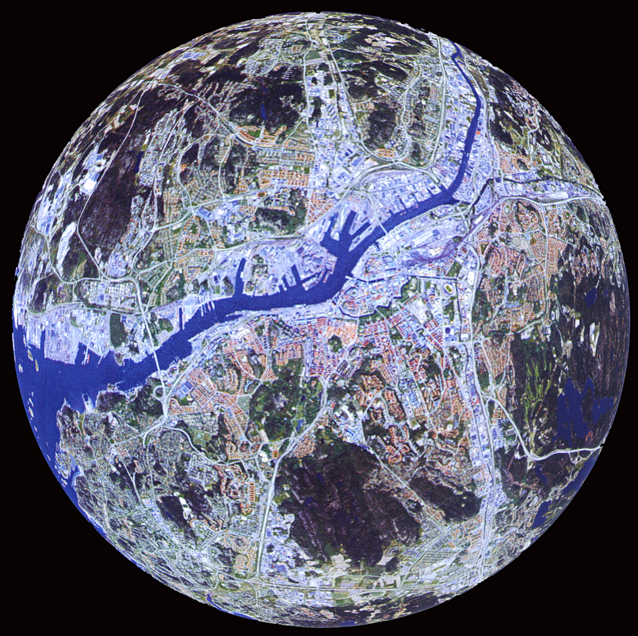

Slide 5
The City of Gothenburg’s organisation
^{City Council}
^{Nominations Committee}
^{City Executive Board}
^{Delegations}
^{City Executive Office}
^{The City Audit Office}
^{Election Committee}
^{Committees}
^{Göteborgs Stadshus AB}
Notes:
SPEAKER TEXT:
Election Committee
The Election Committee is organising and carrying out parliament, County Council, City Council and EU Parliament elections, along with any additional elections and referenda.
The City Audit Office
The City Audit Office examines and assesses the operations of the City Council, the committees and the company boards to ensure, for example, that the assignments the City Council have decided on are carried out efficiently and purposefully.
Politicians work in different committees
The City Council decides which committees to have and elects members to them. The committees are responsible for the day-to-day work in the municipality, they prepare matters to be decided by the City Council and implement decisions made by the Council.
The municipality owns several companies
The City of Gothenburg has both direct and indirect interests in a large number of companies which provide everything from apartments to cultural experiences. Some of the companies are wholly owned, others are partly owned. Göteborgs Stadshus AB is the City of Gothenburg’s Group company and, therefore, the owner of all City of Gothenburg companies.

Slide 6
The City of Gothenburg’s organisation
^{Committees}
^{City district committees}
Pre-schools, Compulsory Schools, Social Services, Social Care,
^{Local Culture & Leisure}
^{Leisure}
Sports & Associations Committee
^{Park & Nature Committee}
^{Transport}
^{Mobility Committee}
^{Transport Committee}
^{Education}
Education Committee Adult Education Committee
^{Technical Provision}
^{Eco-cycle & Water Committee}
^{Other Committees}
^{Archive Committee}
^{Committee for Consumers}
^{Citizen Services}
^{Intraservice Committee}
^{Chief Guardian Committee}
Committee for Allocation of Social Welfare
^{Environment}
Environment & Climate Committee
^{Land & Housing}
Planning Committee Real Estate Committee
^{Commercial Premises Committee}
^{Culture}
^{Culture Committee}
Notes:
SPEAKER TEXT:
The city district committees decide
The city district committees decide on issues regarding libraries, pre-schools, compulsory schools, individual and family care, leisure activities and social care for the elderly and those with disabilities.
The specialist administrations provide services
The specialist administrations are responsible for carrying out the work decided by the committees. Each administration is governed by a committee or board appointed by the City Council. The City of Gothenburg’s specialist administrations provide services, primarily in the fields of technical provisioning, transport, leisure, the environment, real estate/housing, culture and education.
The district councils carry out the services
Gothenburg is divided into 10 district councils, each of which has its own city district committee. The district councils implement and carry out services relating to libraries, pre-schools, compulsory schools, individual and family care, leisure activities and social care for the elderly and those with disabilities. So each district council is responsible for running the district’s libraries, pre-schools, housing for the elderly and so on.
The specialist administrations provide services
The specialist administrations are responsible for carrying out the work decided by the committees. Each administration is governed by a committee or board appointed by the City Council. The City of Gothenburg’s specialist administrations provide services, primarily in the fields of technical provisioning, transport, leisure, the environment, real estate/housing, culture and education.

Slide 7
The City of Gothenburg’s organisation
^{Göteborgs Stadshus AB}
^{Energy}
^{Göteborg Energi AB}
^{+ 18 subsidiaries}
^{Tourism, Culture, Events}
Göteborg & Co Kommunintressent AB
^{Göteborg & Co Träffpunkt AB}
^{Got Event AB}
^{Liseberg AB}
^{Göteborgs Stadsteater AB}
^{Public transport}
^{Göteborgs Spårvägar AB}
^{GS} ^{Buss AB}
^{GS Trafikantservice AB}
^{GS} ^{Spårvagn AB}
^{Housing}
^{Förvaltnings AB Framtiden}
^{Bostads AB Poseidon}
^{Familjebostäder i Göteborg}
^{Gårdstensbostäder}
^{Göteborgs Stads bostads AB}
^{Göteborgs Egnahems AB}
^{Rysåsens Fastighets AB}
^{Störningsjouren} ^{i} ^{Göteborg} ^{AB}
^{Internal companies}
^{Göteborgs Gatu AB}
^{Göteborgs Upphandlings AB}
^{Försäkrings AB Göta Lejon}
^{Kommunleasing i Göteborg AB}
^{AB Gothenburg European Office}
^{Port}
^{Göteborgs Hamn AB}
^{Regional companies}
^{Renova AB, Gryab AB, GREFAB}
^{Boplats Göteborg}
^{Temporary placement}
^{Business}
^{Business Region Göteborg AB}
^{Lindholmen Science Park AB}
^{Johanneberg Science Park AB}
^{Göteborgs Tekniska College AB}
^{Cityflygplatsen i} ^{Göteborg AB}
^{Utveckling Nordost AB}
^{Commercial premises}
^{Älvstranden Utveckling AB}
^{HIGAB}
^{Scandinavium AB}
Förvaltnings AB Göteborgslokaler
^{Göteborgs Stads Parkerings AB}
Notes:
SPEAKER TEXT:
The municipality owns several companies
The City of Gothenburg has both direct and indirect interests in a large number of companies which provide everything from apartments to cultural experiences. Some of the companies are wholly owned, others are partly owned. Göteborgs Stadshus AB is the City of Gothenburg’s Group company and, therefore, the owner of all City of Gothenburg companies.

Slide 8
The Three Golden Principles
Principle of Responsibility
A unit having responsibility for activities under normal conditions shall also have it during a crisis situation
Principle of Similarity
During a crisis the activities shall proceed as normal as possible. It shall also take place on the normal premises, if possible
Principle of Proximity
A crisis should be handled where it occurs and by the people who are most concerned

Slide 9
Risk Management
Emergency Management

Slide 10
Risk Management
Emergency Management

Slide 11
All committees and companies have their own responsibility and shall plan and practice to be able to handle a crisis situation
When a crisis occurs Police, Rescue Services and Emergency Care are quickly on the site
Other public services are called in when they are needed
A staff with people from the City of Gothenburg {The City Chief Executive on Duty}, Police, County Administrative Board, Rescue Services will coordinate the information within themselves and to the public

Slide 12
City Executive Board/Crisis Management
Board
Political decisions, overall level
Emerg. Coord Group (KSG)
Inter-departmental coordination
Support functions
Basic staffing
Cooperating agencies
Communication Dept
Coordinator
IT & telecom support
Maintenance
Logistics
City director
Rescue Services
Infra structure
DC coordination staff
Comm. Director
Parks and Nature
Others dep. on siuation
Police
Health services
County Adm. Board
Sw. Armed Forces
SOSAlarm
Swedish Church
Others dep. on siuation
Traffic Energy Water/ sewerage Environment
District Committees Staff
Field Unit (staff for KSG)
coordination, joint action
Departments and companies, situation-specific activities
under responsibility principle
10 district committees
Other depart-ments, ca 20
Companies,
ca 60

Slide 13
The City Chief Executive on Duty
Make sure that all actors are active and on the go
Inform and make proposals for decisions to the politicians,the municipal executive committee
To vouch for information to the participating actors
Surveil that the Golden Rules are followed
Control that the Committees and the Municipal Companies are cooperating
Ensuring information to citizens and media

Slide 14
Risk management
Emergency management

Slide 15
Crisis preparedness postulates an accomplished riskstudy

Slide 16
Why Risk- and vulnerability analysis
It gives increased knowledge of:
Risks and consequences
Important activities
Critical functions
Creates preconditions to institute the correct arrangements

Slide 17
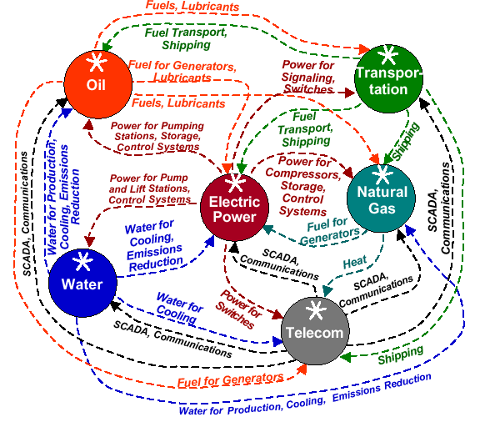
How is it all linked together ?

Slide 18
Risk- and vulnerability analysis for the City of Gothenburg
      Nine areas at risk

Slide 19
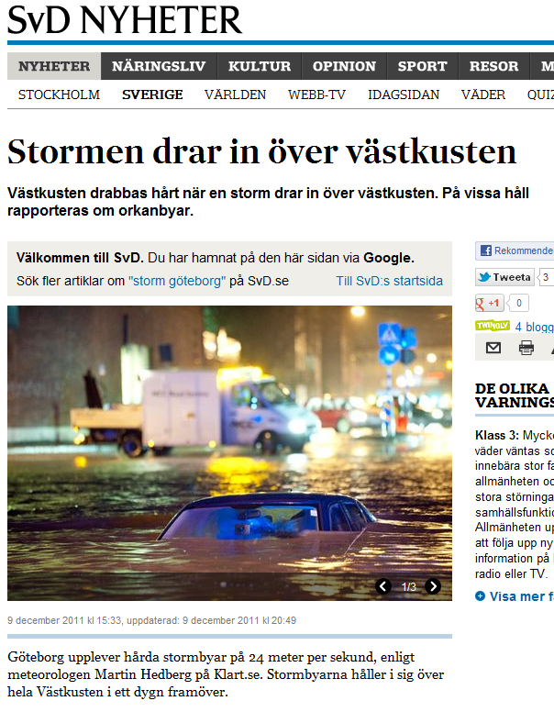
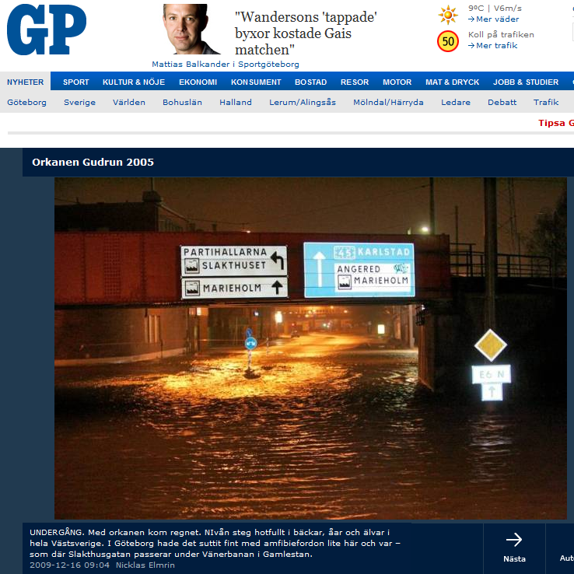
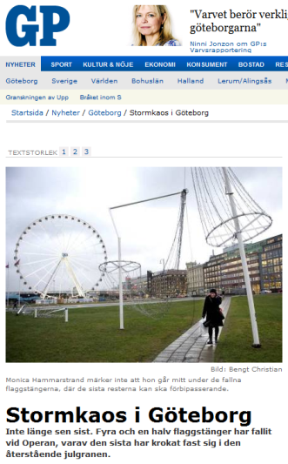
No. 1 Extreme Weather Situations
Depending on air pressure
Raising sea levels
Increased or decreased
amount of water in the river
Rain or snowfall
”Storm 1969”
Berit – Dagmar – Emil!

Slide 20
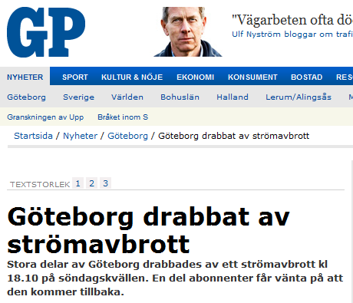
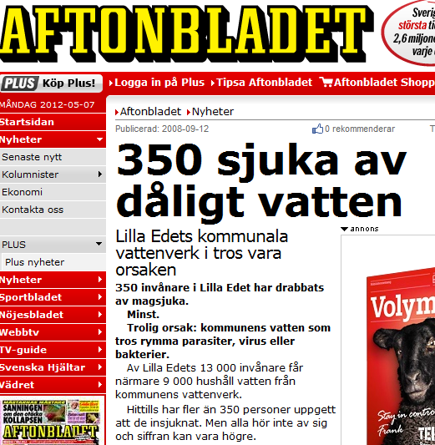
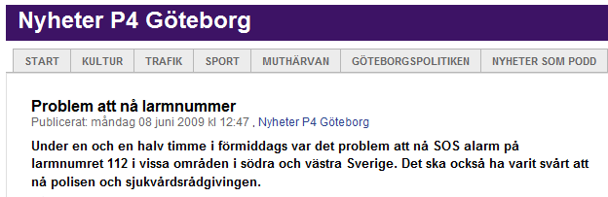
No. 2 Energy – Water –Telecom/IT
Shortage of power
Only 50% of electricity!
Prioritization – Styrel!
Water/drainage
Old water- and drainagepipes
Muddy water in the river, Göta Älv

Slide 21
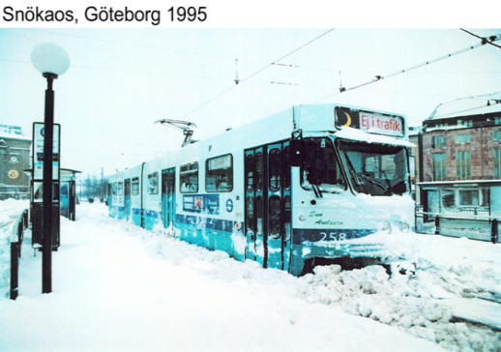
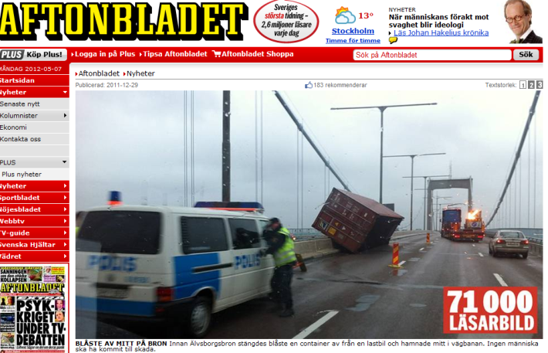
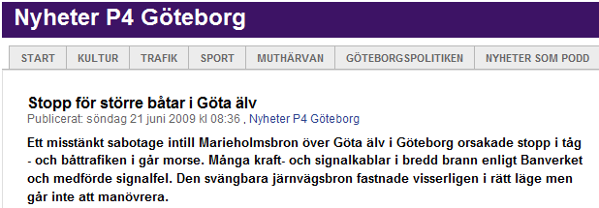
No. 3 Transportation
Road, train/tram
Tunnels, bridges
Shipping
Harbour, fairway
Aeronautical

Slide 22
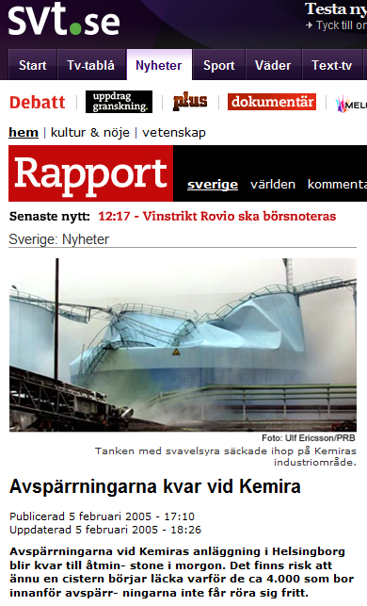
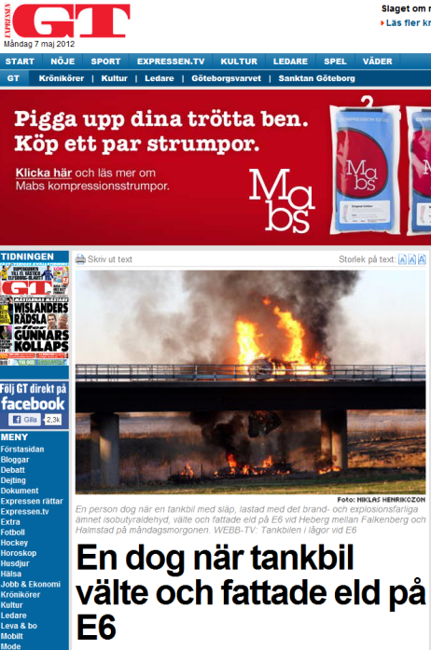
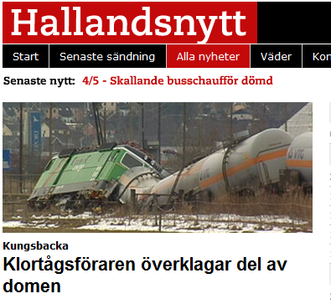
No. 4 Manufacturing, transport and use of hazardous substances
Accidents can cause
uncontrolled spillage

Slide 23
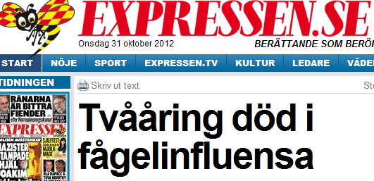
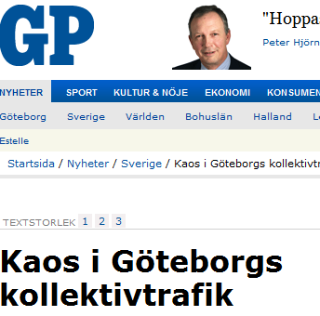
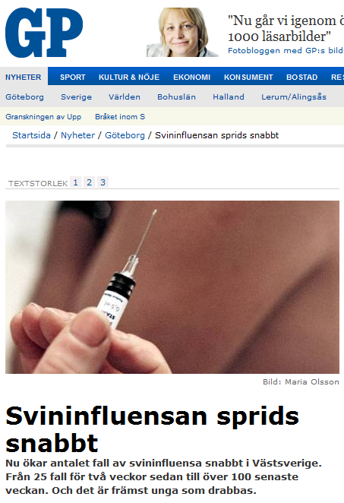
No. 5 People not coming to work
50% of the workforce can not come
to work due to illness or other
reasons!

Slide 24
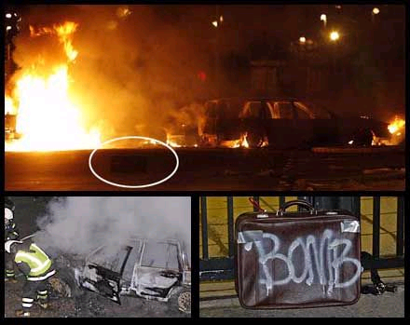
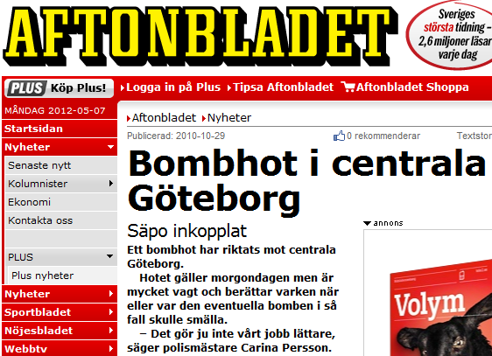
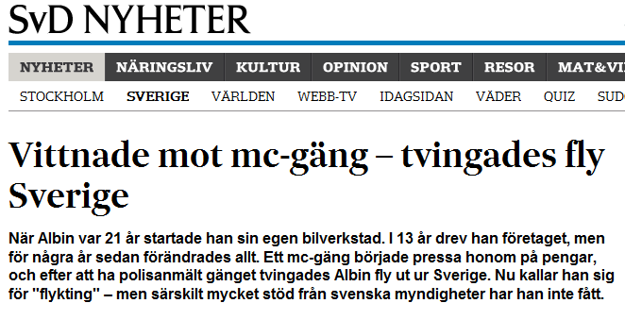
No. 6 Gangcrime, organized criminality, threat against persons and elected representatives , sabotage and terrorism
Unauthorised influence on the democratic
process and when normal life for the
citizens is disturbed!
- Armed robbery in the Postterminal 2008!
Bomb scare ”Nordstan” Christmas 2010!

Slide 25
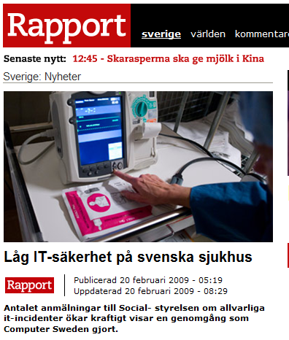

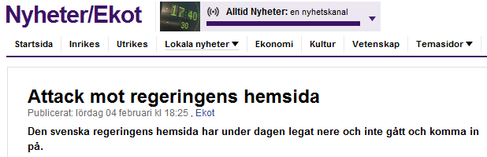
No. 7 Information Security
Feasibility to maintain
• Availability
• Integrity
• Confidentiality
• Accountability

Slide 26
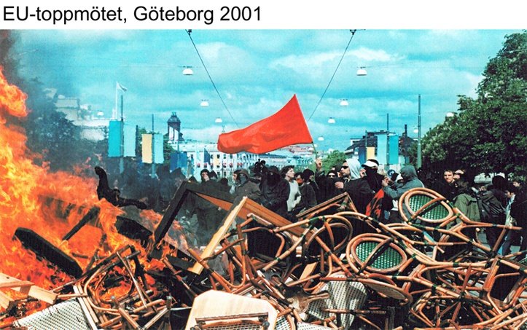
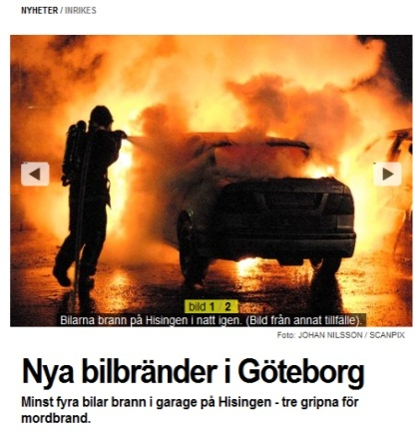
No. 8 Social imbalance
When established guidelines
are sidelined by the citizens!

Slide 27
No. 9 Unpredictable Events
? ?
? ?
? ? ? ? ? ?
? ? ?

Slide 28
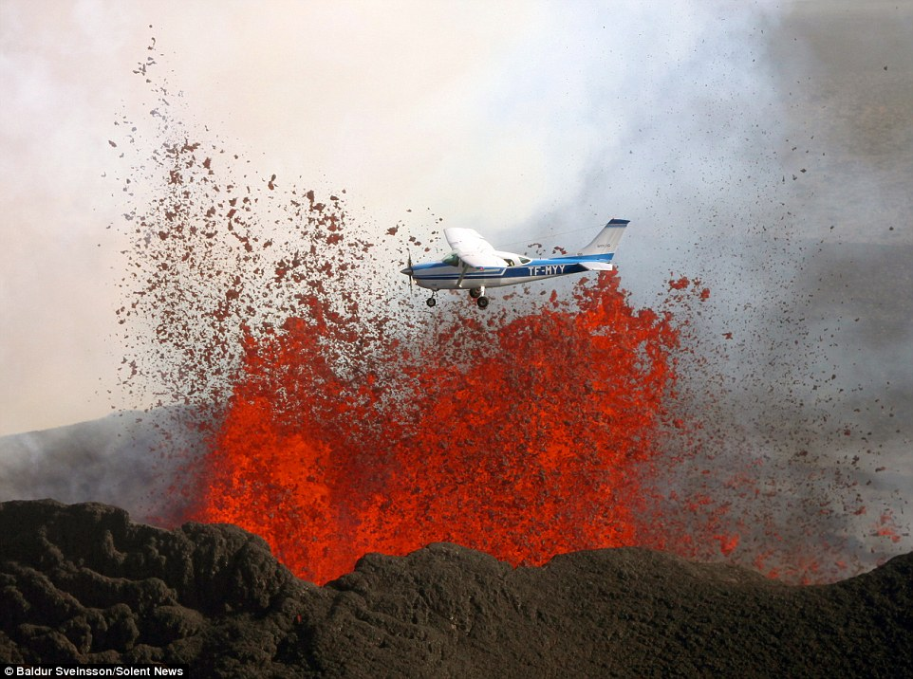

Slide 29
One of the challanges is…
You need a complete new way of thinking to solve the problems you have created with the old way of thinking!
Albert Einstein

Slide 31
CONTACT:
Samhällsskydd och Beredskap
Lennart Bernram
lennart.bernram@stadshuset.goteborg.se

