Slide 1
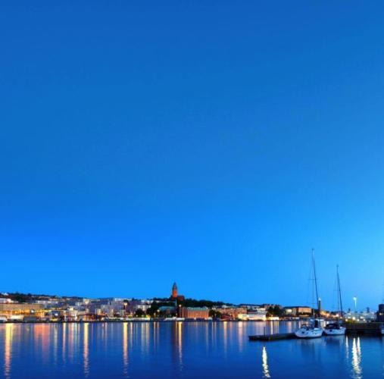
Gothenburg
Orientation Sweden and the City

Slide 2
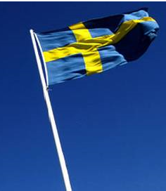
Sweden
Fith largest country in Europe. The size of California and Oregon together
9700 000 inhabitants, sparsely populated, 22 people/sq.km
85 % in the southern half
21 counties and 290 municipalities

Slide 3
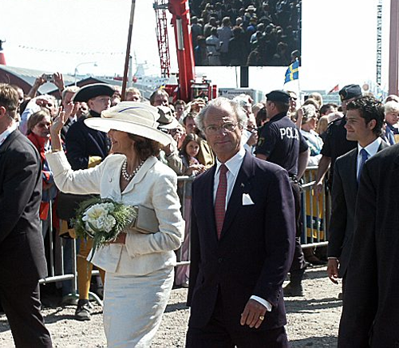
Constitutional monarchy
King Carl XVI Gustaf
King since 1973
No political power
Representative /ceremonial

Slide 4
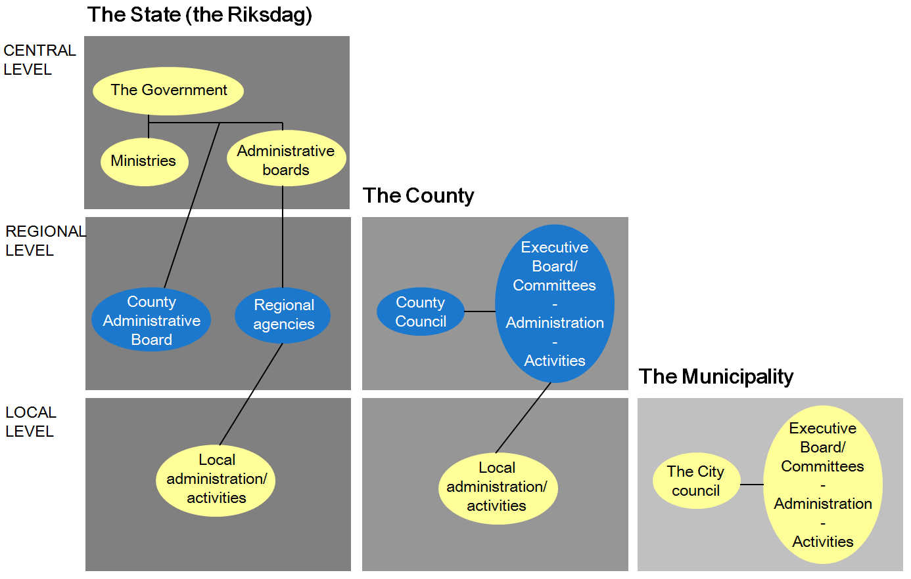
Levels in the administration

Slide 5
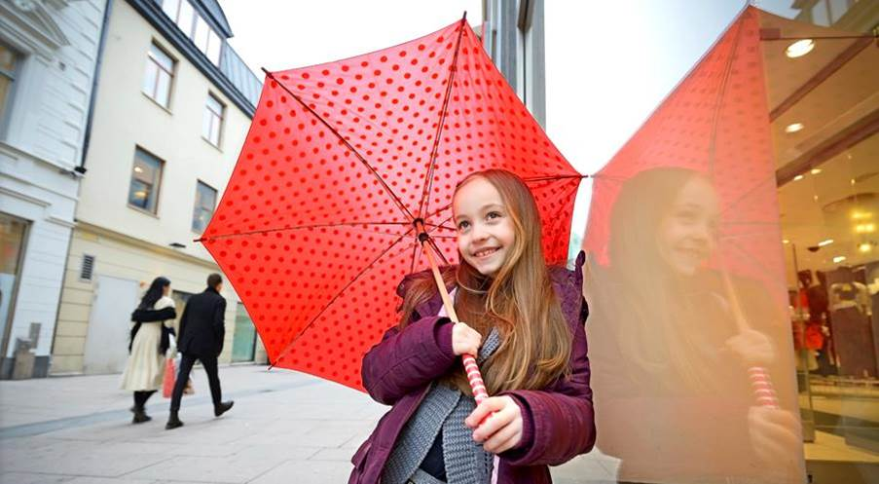
City of Gothenburg – in brief
10 city district committees
Appx 20 specialist administrations
Appx 60 public companies
Appx 49 000 employees
of which 30 000 in the city district committees
A sustainable city – open to the world
Notes:
SPEAKER TEXT:
The City of Gothenburg is an organisation comprised of administrations and companies. It has a total turnover of 34 billion Swedish kronor a year and more than 49,000 employees.
The municipality is divided into 10 city districts. The district councils are responsible for community services for the people living in the district.
Services include municipal pre-schools, compulsory schools, care of the elderly and libraries, and accounts for 85% of the municipality’s total budget.

Slide 6
City of Gothenburg – in brief
34 billion
SEK turnover
1 175 politicians
appx 1,300 – 1,400 assignments
A SUSTAINABLE CITY – OPEN TO THE WORLD
Notes:
SPEAKER TEXT:
The City of Gothenburg is an organisation comprised of administrations and companies. It has a total turnover of 34 billion Swedish kronor a year and more than 49,000 employees.
The municipality is divided into 10 city districts. The district councils are responsible for community services for the people living in the district.
Services include municipal pre-schools, compulsory schools, care of the elderly and libraries, and accounts for 85% of the municipality’s total budget.

Slide 7
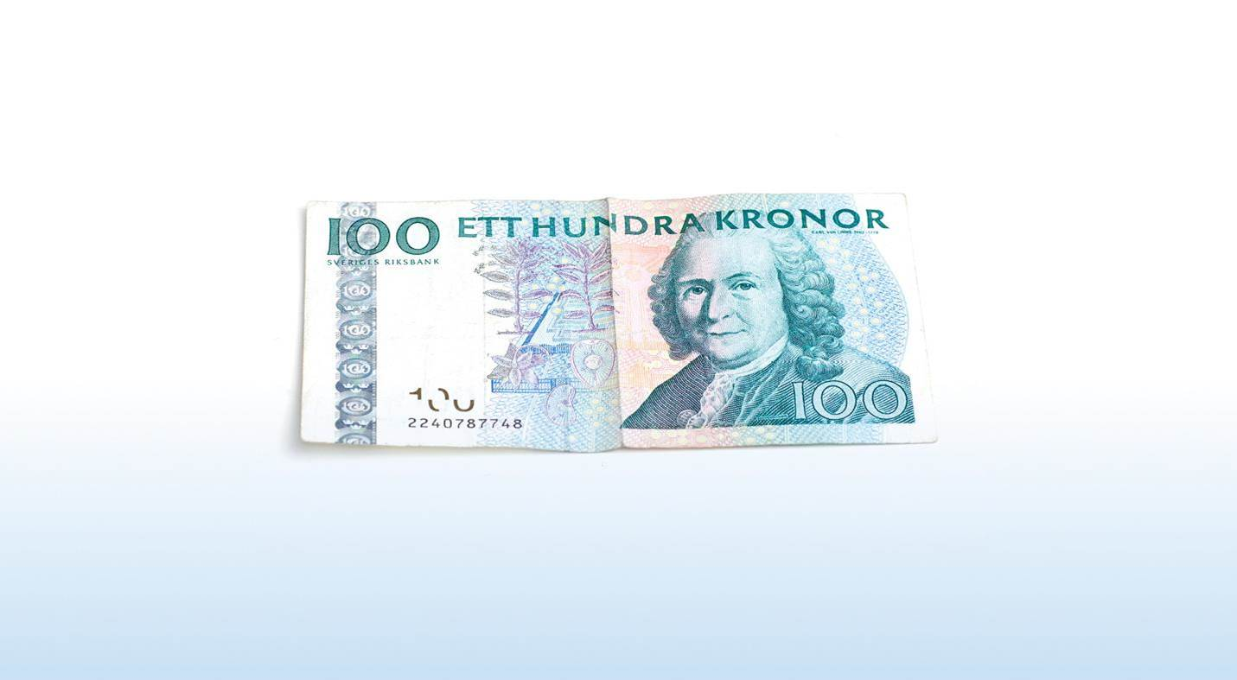
Where does the money go?
^{16%}
^{18%}
^{11%}
^{Pre-schools and childcare}
^{Care of the elderly}
^{Other}
^{14%}
^{17%}
^{Individual}
^{and family care}
^{Compulsory schooling}
^{7%}
^{4%}
^{13%}
^{Upper secondary}
^{and adult education}
^{Culture and leisure}
^{Disabilities}
Health, schools and social care account for 85% of the City of Gothenburg’s costs.
Notes:
SPEAKER TEXT:
Health, schools and social care account for 85% of the City of Gothenburg’s budget. The municipality’s money comes from tax revenues and general state subsidies provided by the government to even out differences between municipalities in revenue or structural conditions, such as population and age structure.

Slide 8


Gothenburg
– an evolving city of the future
23%
born outside of Sweden
533,300
residents
10 districts
Majorna-Linné the largest
1,1
million residents in the Gothenburg labour market region today
1.75 million residents
in the Gothenburg region in 2030
Notes:
SPEAKER TEXT:
Gothenburg is a port city with a strategic location between Oslo and Copenhagen. It has a population of around 533,000 and is Sweden’s second largest city.
Gothenburg is the core and growth engine of the Gothenburg region and Region Västra Götaland. It is home to a variety of strong industries and Scandinavia’s largest port.
Gothenburg is divided into 10 districts, Majorna-Linné being the largest both in the number of people and homes. The largest by area is Norra Hisingen, while Centrum is the smallest. The city districts are large units from a Swedish municipality perspective: if Majorna-Linné were a separate municipality it would be the 35th most densely populated of Sweden’s 290 municipalities. Lundby would come 56th, between Kungälv and Enköping.
23% of the people living in Gothenburg were born outside of Sweden. The most common countries of origin are Iraq and Iran, followed by Finland, Bosnia & Hercegovina, the former Yugoslavia, Poland, Somalia, Turkey, China and Norway, and many other countries.
There’s plenty going on in Gothenburg right now! The city is growing strongly and is preparing to make space for 150,000 more residents by the year 2035. A lot of people want to move here, both from the local area and from abroad. New companies want to set up here. More tourists want to come and visit Gothenburg.
In the past decade the city has enjoyed steady growth with a population increase of 55,000; the figure for the whole Gothenburg region is 125,000. In particular a lot of young people want to move here – the predominant group is young adults aged 20-27. During the same period more than 90,000 new jobs have been created in the Gothenburg region. This equates to 20% growth, which is more than in either Stockholm or Malmö region.
The Gothenburg region, which spans 13 municipalities in Greater Gothenburg, has a population of 1.1 million.
One important goal for Gothenburg is to create a bigger labour market region, and strategies are currently focusing on a population of 1.75 million in the Gothenburg region by 2030. There are currently 315,894 jobs in Gothenburg. Gothenburg’s biggest employer is the City of Gothenburg authority. It employs a full 49,000 local people working in over 100 different professions in city districts, specialist administrations and municipal companies. Their (or ‘Our’ if you work for the City of Gothenburg!) job is to create opportunities for a good life for all the city’s residents and to develop Gothenburg for the future.
As the city grows, it is also evolving. New houses are being built, and new residential areas and city districts are emerging on land previously used for industrial purposes.

Slide 9

A city open to the world
18th century
Built by Dutch and Germans Developed
into a shipping and trading city, partly
thanks to the Swedish East India Company
19th century
The industrial city evolves thanks to
expertise from England and Scotland
20th century
The economy grows with workers from countries like Italy, Greece, the former Yugoslavia and Finland
Notes:
SPEAKER TEXT:
Gothenburg is a city that has always been ‘open to the world’. Throughout our history we have embraced people and influences from outside, and through the ages the city has developed with ideas and knowledge from around the world.
Gothenburg first started being built in 1619 on the initiative of King Gustaf II Adolf, and it received its city charter in 1621. The city was built and organised by the Dutch and Germans, and during the 18th century it developed into a prospering shipping and trading city, partly thanks to the Swedish East India Company. The company’s first ship set sail from Gothenburg port in 1732, and the last in 1806.
The industrial city then developed in the 19th and 20th centuries with technology and expertise from England and Scotland, and the economy expanded through worker migration from countries like Italy, Greece, the former Yugoslavia and Finland.
Our geographical location is excellent for reaching the entire Baltic region, the whole of Scandinavia as well as the North Sea and Atlantic. Seventy per cent of the Nordic industry and population is within 500 kilometres. This area includes the capitals of Stockholm, Oslo and Copenhagen. Gothenburg boasts Scandinavia’s largest port. Between 10 and 15 per cent of cargo passing through Gothenburg port comes from a country outside of Europe and is bound for a Nordic country other than Sweden.

Slide 10
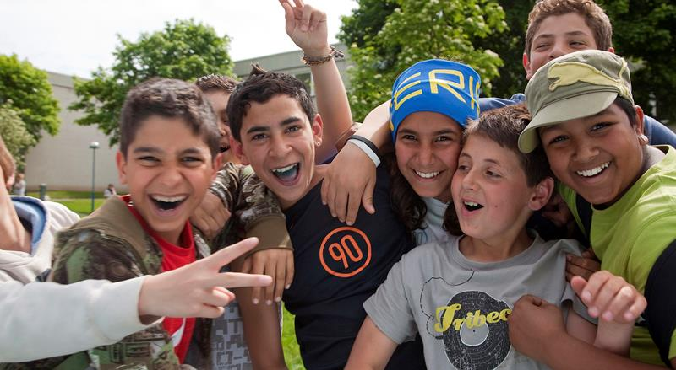
A city open to the world
21st century
migration from around the world and diversity among residents of Gothenburg
7,200 new residents in 2013
Notes:
SPEAKER TEXT:
International contacts, new influences and new people are, and always have been, a strength for Gothenburg. The city’s future and its growth depend entirely on us staying at the forefront and collaborating with players around the world who can think of new ways and create opportunities for Gothenburg to develop. By being open to the world and collaborating with other cities and countries, we share our knowledge and experiences, and learn from the best.
International influences are also clearly evident in the city’s and region’s business sector. Several major companies in Gothenburg are owned by international players and we have several local companies that are world leaders in their industries. The city receives migrants from all over the world, and diversity among residents is greater than ever. In 2013 the population increased by 7,200, one of the highest figures of the last 40 years.
Now, as before, it is the residents’ varying experiences, perspectives and their commitment that enrich the city and comprise its most important asset.

Slide 11
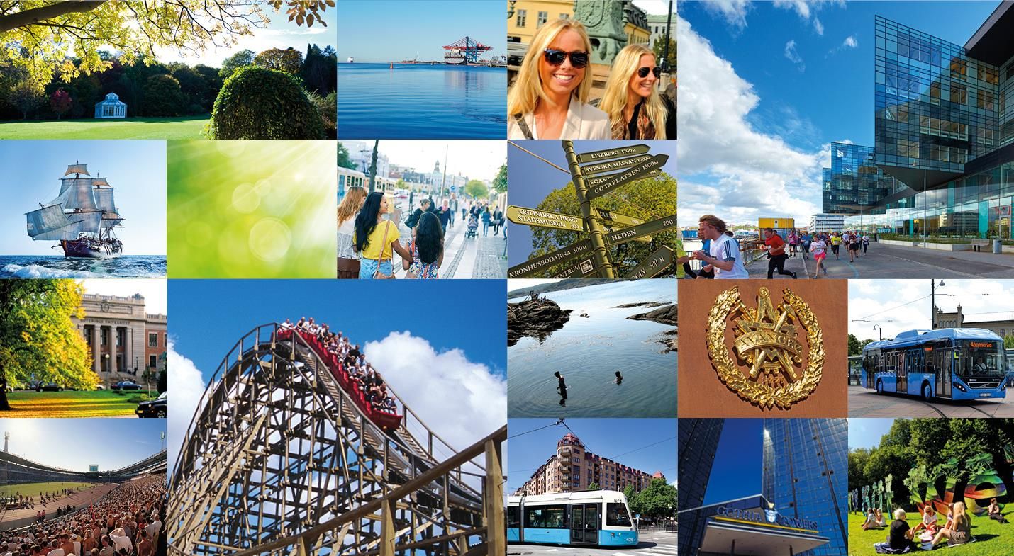
Great strengths and opportunities
Creativity
Green
Port
Entrepreneurship
Good food
Innovation
Close
Together
Water
Industry
Entertainment
Events
Notes:
SPEAKER TEXT:
The Gothenburg region’s economy is among the best in the world for growth. Growth here is higher than anywhere else in Sweden, and the Gothenburg region came fifth in a comparison of 119 regions in Europe for future potential.
The city has many different areas of strength, both in terms of geography and business operations. A number of areas and industries in particular excel, for example through well-established clusters and networks. These include the automotive industry, information and communication technology, logistics, medical technology, environmental technology and the maritime industries.
Gothenburg’s hallmarks include:
Water:
The water is never far away in Gothenburg. The Göta River runs straight through the city and the archipelago is less than an hour from the city centre. The sea has always left its mark on Gothenburg be it food, trade, industry or leisure.
Green:
Gothenburg is a green city in both senses of the word.
There are plenty of central parks and green spaces. There are currently plans for a fifth park in Frihamnen: the jubilee park, which will open when Gothenburg celebrates 400 years in 2021. Neighbourhood greenhouses and community gardens can be found in many places in Gothenburg, and more and more green meeting-places will be created in the future for people to meet and socialise in the heart of the city. Gothenburg is investing in becoming Sweden’s leading garden city and in 2016 it will host Göteborgs Lustgårdar, a major international garden exhibition. Gothenburg is also a green city in terms of ecology. Environmental and climate issues are high priorities. A wide range of activities are under way to improve the environment in Gothenburg and make it easier for residents to live climate-smart.
Close:
Gothenburg is big enough to offer the opportunities and choice of a big city. Yet is has the charm and personality of a far smaller city, and shorter distances. The relatively small traffic jams, the cycling opportunities and the reasonably short travel times to and from work mean a better quality of life for many. The quality of life is also demonstrated in a SIFO survey from 2014, where as many as 92% of those asked said they are happy or very happy living in Gothenburg.
Industry:
Gothenburg has a strong industry and a large, varied business sector. It is home to Scandinavia’s largest port. Industries here are characterised by a high technical and knowledge content. Gothenburg is currently home to around 750 different sectors; the equivalent figure for London is around 1,000. Many large cutting-edge companies in industry are also based here: Volvo Cars, Volvo Trucks, SKF, Volvo IT and Ericsson. Other large corporations in the region include Mölnlycke Health Care and Astra Zeneca.
Innovation, creativity, entrepreneurship:
Strong industry is a hallmark of the city, and innovation, creativity and entrepreneurship are a way of life in Gothenburg. World-famous gaming companies and advertising agencies are based here. Within 250 metres of the cathedral there are 113 creative companies with 1,300 creatives who turn over around 2.4 billion Swedish kronor. The City of Gothenburg actively works to strengthen and develop trade and industry to improve the business climate. For example, the city has established a One Stop Shop, a free service to make it easy to start up and run a business in Gothenburg. The service assists with contacts with the local authority.
Events:
Gothenburg is also famous for staging major events in sport, culture and entertainment. Events are important to Gothenburg. They strengthen the brand and bring people here from all over the world. The key to our success is the close proximity between the arenas and hotels, coupled with the close collaboration between different stakeholders. The city has been good at offering organisers smart, simple solutions including everything from hotels, transport companies, arenas, restaurants, municipal administrations and institutions. The so-called ‘event zone’ featuring Liseberg, the Swedish Exhibition & Congress Centre, Scandinavium and Ullevi stadiums, Universeum Science Discovery Centre and the Museum of World Culture attracts over 6.5 million visitors every year. Museums, theatres, shopping, restaurants and hotels are all within walking distance.
Annually recurring events include the GöteborgsVarvet Half Marathon – the world’s largest half marathon race, the Science Festival – Sweden’s biggest festival of knowledge, the Gothia Cup in football with 37,400 young participants from 75 countries, the Way out West music festival, the Hammarkullen Carnival – a festival with music, food and people that attracts 40,000 visitors every year, the GLBT festival West Pride, Gothenburg Dance and Theatre Festival and the Gothenburg Culture Festival – one of Scandinavia’s biggest festivals of its kind.
Hospitality is one of Sweden’s most important industries. It is estimated to have created 16,100 jobs in Gothenburg. Hospitality is very important for the city and the focus is on international marketing. The number of guest nights has increased for 22 consecutive years, and more and more visitors are coming from other countries. One segment that has shown particularly strong growth in recent years is cruise tourism to Gothenburg. Port of Gothenburg and Göteborg & Co have been working together here to promote the city as a cruise destination – with good results.
Knowledge:
Gothenburg is home to two universities and 50,000 students, many of whom are international. Gothenburg also boasts three science parks which are jointly owned by the local community, the academic world and the business sector, creating a bridge between research and manufacturing. They are exciting innovation and entrepreneurial environments.
Together:
Gothenburg has a strong tradition and ability to create collaborations between the local community, academia and the business sector. They often attract international recognition.
Food and entertainment:
Gothenburg is also a popular city for food lovers. There is Feskekörka seafood and fish market, several food markets and five Michelin-starred restaurants. Avenyn has a higher proportion of restaurants than any other street in Sweden. The city has a multitude of restaurants, pubs and bars, and the local music scene is thriving with many club stages and club festivals.

Slide 12
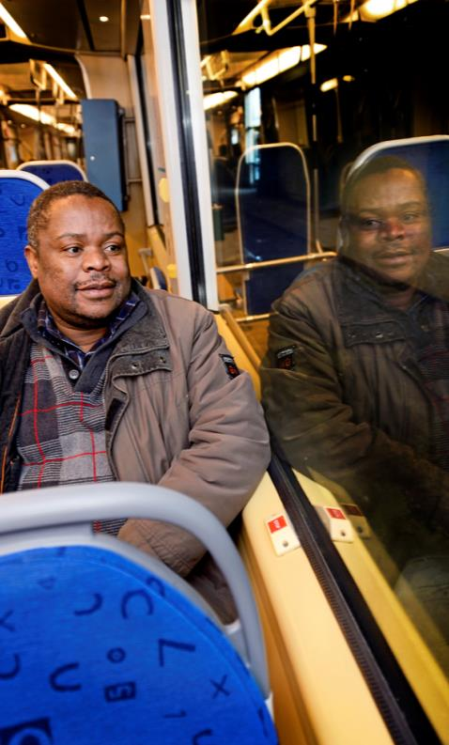
Gothenburg is growing
– but the aim is to shorten distances
New roads, bridges, cycle paths and expanded public transport will make it easier to get around
in the city, both for private individuals and the business sector.
Better public transport and new hubs will make it easy for local people to travel in a sustainable way – within the city, in the wider region and to the world beyond.
We will continue to grow – but not at the expense of the environment.
Notes:
SPEAKER TEXT:
We will develop better public transport and new hubs to make it easy for people to travel in a sustainable way – within the city, in the wider region and to the world beyond.
We will continue to grow, but not at the expense of the environment.

Slide 13
A close city – Gothenburg 2035
680,000
residents of Gothenburg in 2035
70–80,000
new homes, including 50,000
in the existing city, of which
25,000 in River city
80,000
more jobs of which 50,000 in River city
Source: Expansion planning 2013
Notes:
SPEAKER TEXT:
At a local level Gothenburg is preparing to make space for almost 700,000 residents by the year 2035. This requires planning for 70-80,000 new homes, 50,000 of which will be in already developed city areas. 15,000 of these are to be built up until 2022.
25,000 new homes will be built in the new Älvstaden area, which encompasses large parts of central Gothenburg on both sides of the Göta River. Forecasts suggest we may also have 80,000 more jobs in Gothenburg in 2035. 50,000 of those will be in Älvstaden.

Slide 14
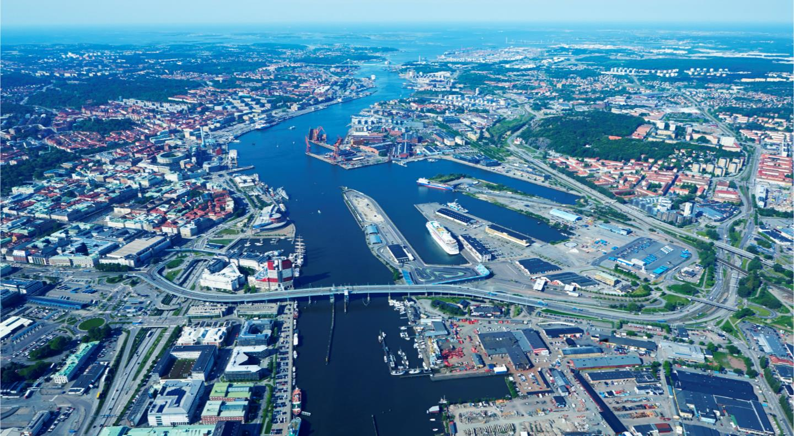
River city – inclusive green dynamic
Economic
sustainability
Social sustainability
Ecological
sustainability
Notes:
SPEAKER TEXT:
Älvstaden is an area which encompasses large parts of Gothenburg on both sides of the Göta River. Vision Älvstaden was adopted by the City Council in 2012. Work is now under way to implement the vision. Building up and developing an area as large as Älvstaden is comparable to building a medium-sized city in the middle of Gothenburg. The goal is for Älvstaden to have at least 15,000 homes and 45,000 workplaces.
Vision Älvstaden is a benchmark and value foundation for the kind of city we want. Älvstaden will be a sustainable city, open to the world. The strategies are the way we will achieve this. The vision and strategies have been developed in dialogue with the entire Gothenburg community in order to gain the whole city’s perspective.

Slide 15
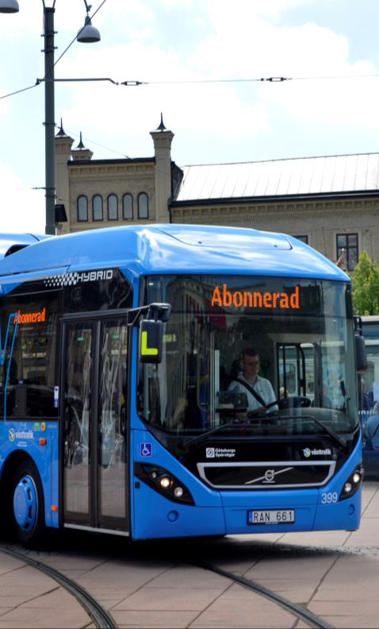
ElectriCity – a collaboration for sustainable public transport
New bus route from 2015; noiseless, emission-
free electric buses from Volvo will run between Johanneberg Science Park and Lindholmen Science Park.
The buses can drive in places in the city that are not currently accessible – the bus route therefore also opens up new opportunities for how cities
and densely-populated areas are planned.
It is also a way for the Volvo Group to test new technology. For the City of Gothenburg it is about contributing to sustainability, and developing services that can benefit residents.
Notes:
SPEAKER TEXT:
Another collaborative project that recently attracted a lot of attention for Gothenburg, both in Sweden and internationally, is ElectriCity, a co-operation between the City of Gothenburg, the Volvo Group, Region Västra Götaland and others for sustainable public transport. The project involves a brand new bus route which will start in 2015, serviced by electric buses that glide along noiselessly and pick up and drop off passengers indoors.
Three of the 15 buses will be completely electric-powered, the others will be around 80% electrically run. Above all this means lower emissions and less noise. For the Volvo Group the collaboration with the City of Gothenburg represents an opportunity to test new technology that could present brand new possibilities for public transport in the cities of the future. And for the City of Gothenburg it is important to contribute to sustainable development, and to develop services that can benefit residents. Passengers will benefit from the electric buses in several ways, such as the opportunity to have indoor bus stops and wireless services linked to them.

Slide 16
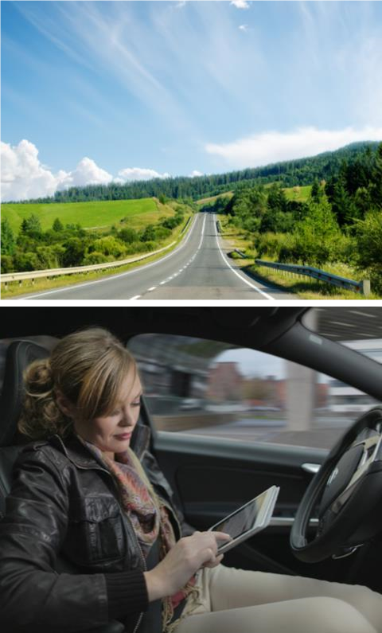


DriveMe – self-driving cars for sustainable mobility
Gothenburg is also an arena for the world’s biggest large-scale pilot project in autonomous driving. It involves 100 self-driving Volvo cars which will be driven on public roads in Gothenburg in 2017.
In addition to improving traffic safety, self-driving cars are considered an eco-friendly choice.
Notes:
SPEAKER TEXT:
Another collaborative project that has attracted attention is “Drive me – self-driving cars for sustainable mobility”, the world’s biggest large-scale pilot project in autonomous driving.
It involves 100 self-driving Volvo cars which will be driven on public roads in Gothenburg in 2017. The aim is to study the benefits to society of self-driving cars, and is a way for Volvo Cars to develop its technology to be a leader in sustainable mobility. Self-driving cars are viewed by the Swedish government and by Volvo Cars as an important solution in achieving the vision of zero fatalities in traffic.
The pilot project’s self-driving cars will roll out on around 50 kilometres of selected stretches of road in and around Gothenburg – multi-lane roads with busy commuter traffic and frequent jams. The goal is for the self-driving car to be able to handle all conceivable traffic situations independently. It must also be able to leave the flow of traffic safely if the driver is unable to regain control of the vehicle for some reason. Self-driving cars are also expected to be an important function in planning the future city environment. They result in more efficient use of land, restrict the need for investments in infrastructure and improve the urban environment through safer traffic and lower emissions. Fuel consumption could decrease by up to 50% in some situations, which is well in line with the City of Gothenburg’s aim to reduce the city’s environmental impact.

Slide 17
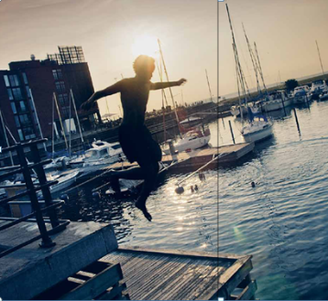
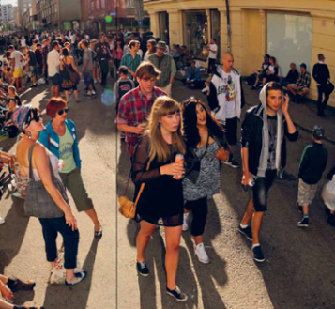
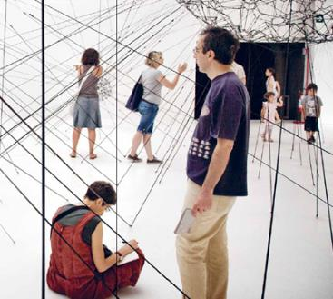

2021 – more than an anniversary
In 2021 Gothenburg will be 400 years old, and we are
celebrating by making our city into an even better place,
together. All the way up to the anniversary. And far beyond.
Close to the water
Building bridges
Open spaces
A SUSTAINABLE CITY – OPEN TO THE WORLD
Notes:
SPEAKER TEXT:
Ideas for the city’s 400th anniversary celebrations have been developed in an open process, partly by seven work groups with a wide range of different specialisations, and partly by thousands of dreams and ideas of residents of the city on how Gothenburg can manifest its 400 years. The essence have been put together in a plan for celebration and in a book called “1680 ideas about Gothenburg’s 400th anniversary”, which can be bought at various places around the city.
Three themes have been highlighted as being important for the celebrations:
• Close to water – to get close to the water in all forms. Sea, islands, harbour, lakes, canals, river and rain.
• Building bridges – both literally and figuratively. Building bridges between people and reducing the distance.
• Open spaces – to develop an open and tolerant city through new creative venues.

Slide 18
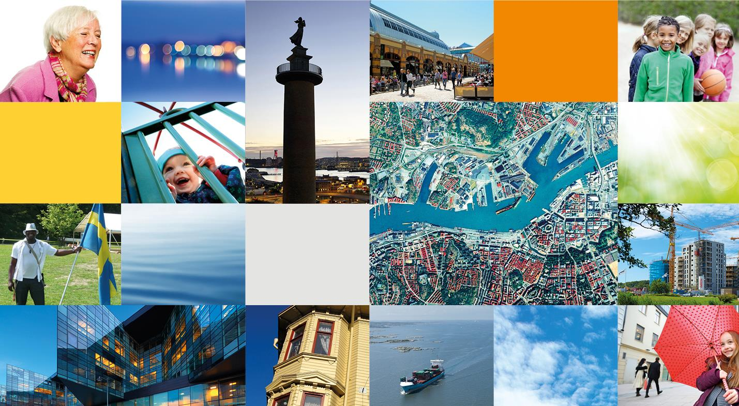

A sustainable city – open to the world
Notes:
Final slide, the same as the first. If you prefer to show the film at the end, that’s fine. Click on go: to get to YouTube. The film lasts 2 minutes and 27 seconds.
When the movie ends, turn down the film and you're back on this slide.

Slide 19
The city is expanding over low land
Future extreme weather means consequences
Hydromodel
Strategy and protection
Lack of national level

Slide 20
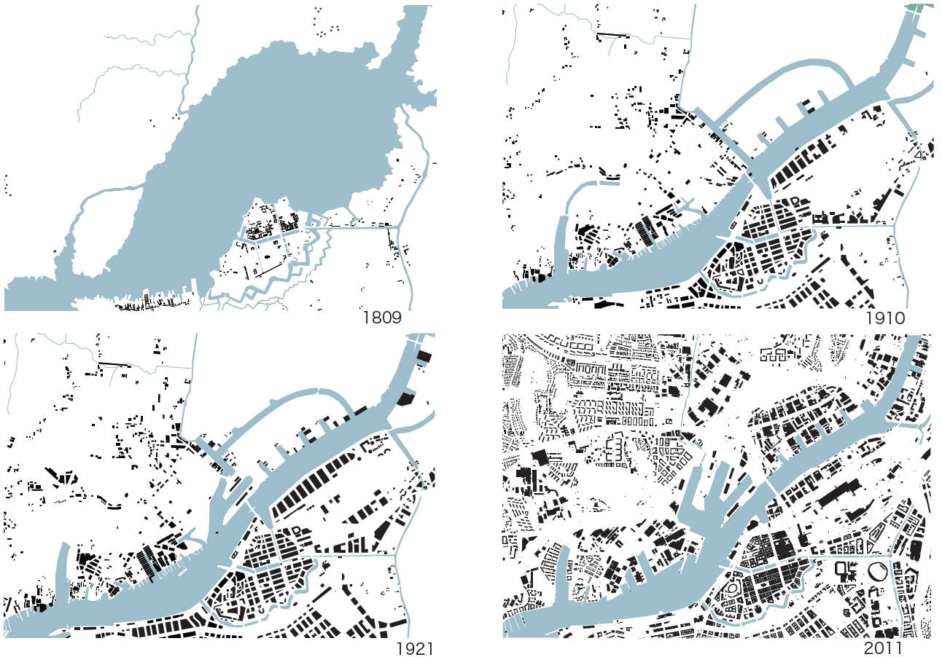
The City has expanded over wetlands

Slide 21
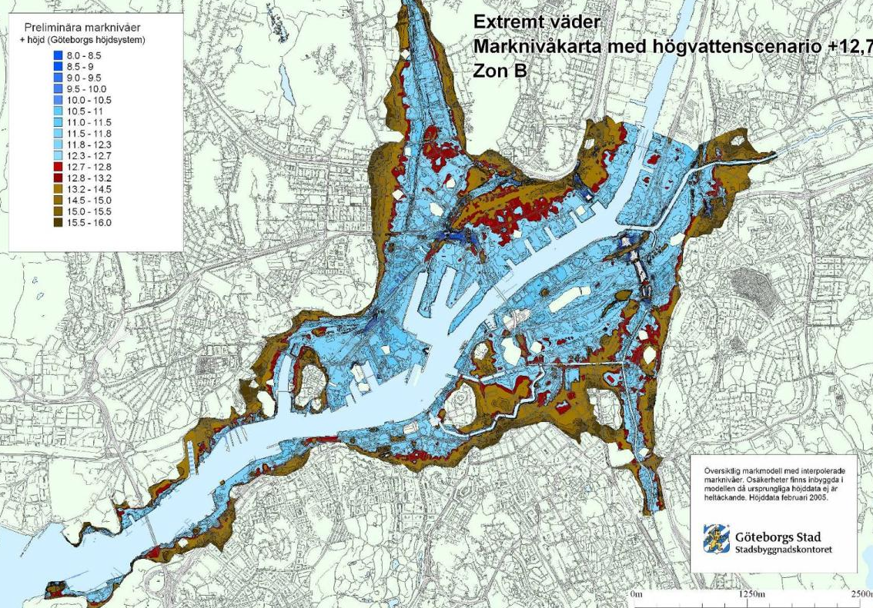
A future extreme weather event

Slide 22
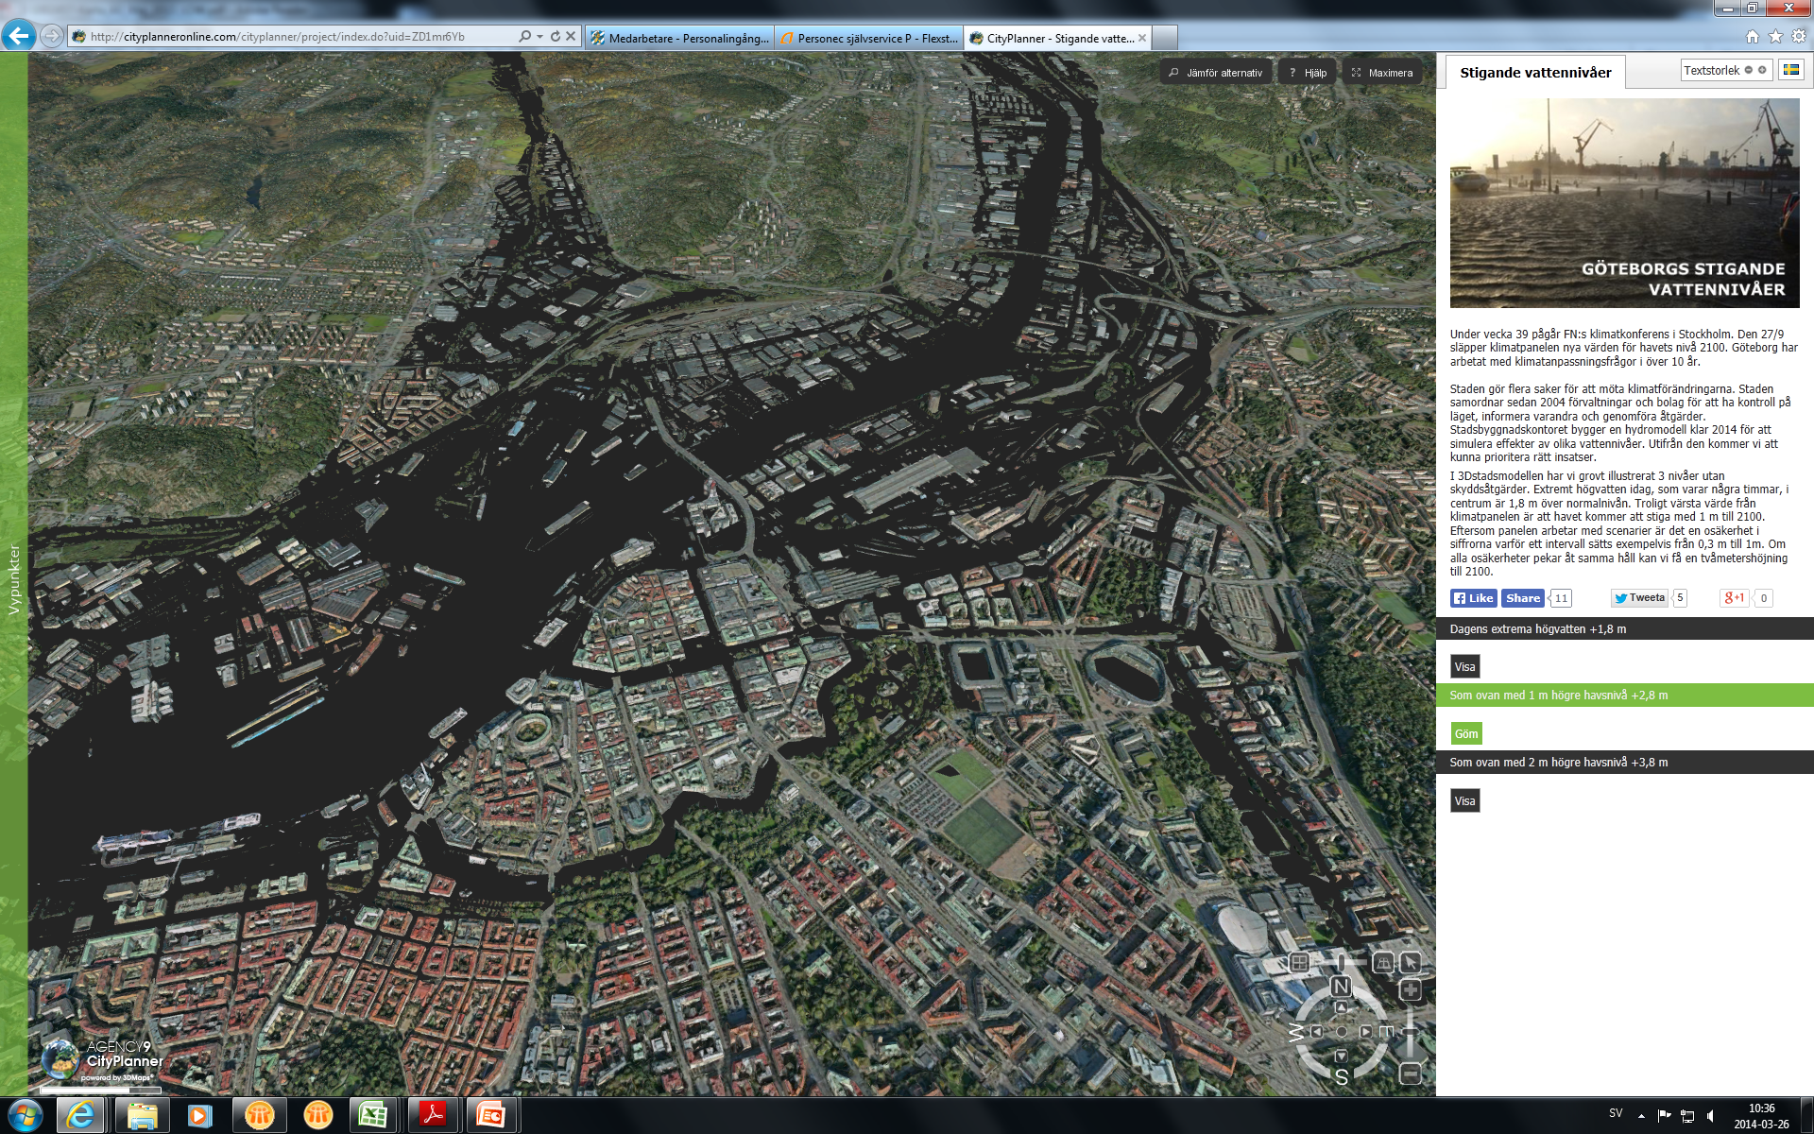
From www.goteborg.se

Slide 23
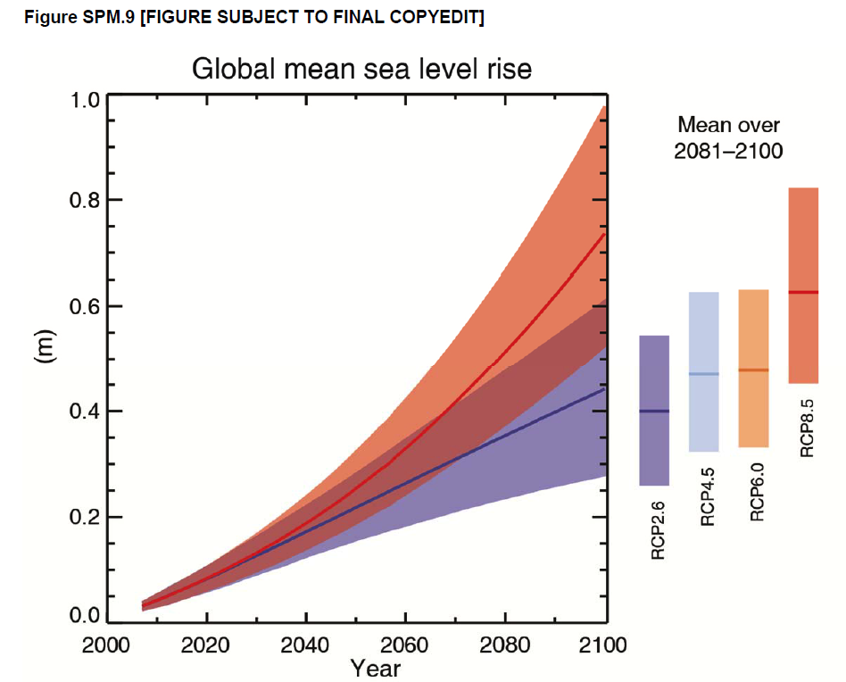
Climate change Rising sea levels
Mean water level 2100 + 0,7 m (0,98 m)
Land rise effect about 0,3 m
RCP 8,5
• Carbon dioxide emissions three times today.
• Methane emission rises sharply
• Earth population is 12 billion
• Slow technology development
•High depence on fossile fuels
• No additional climate policy

Slide 24
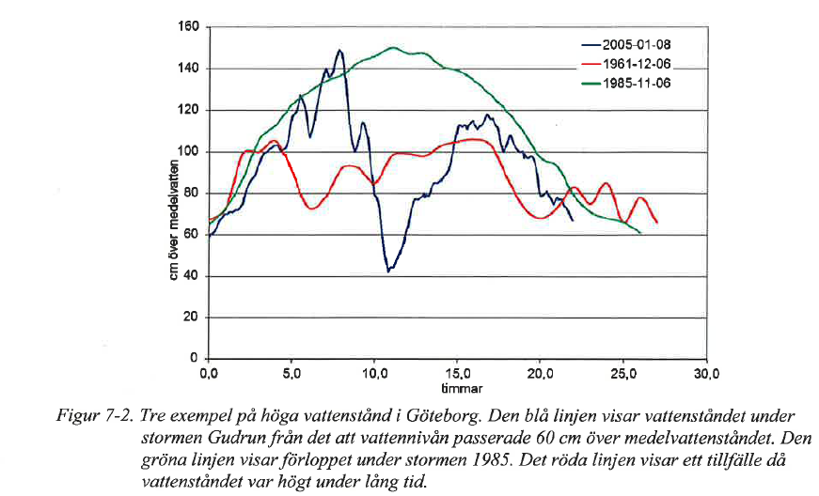
High water levels
+2,4 m above todays MW
200 years value 2100 according to SMHI
Gudrun
+1,35 m above todays MW

Slide 25
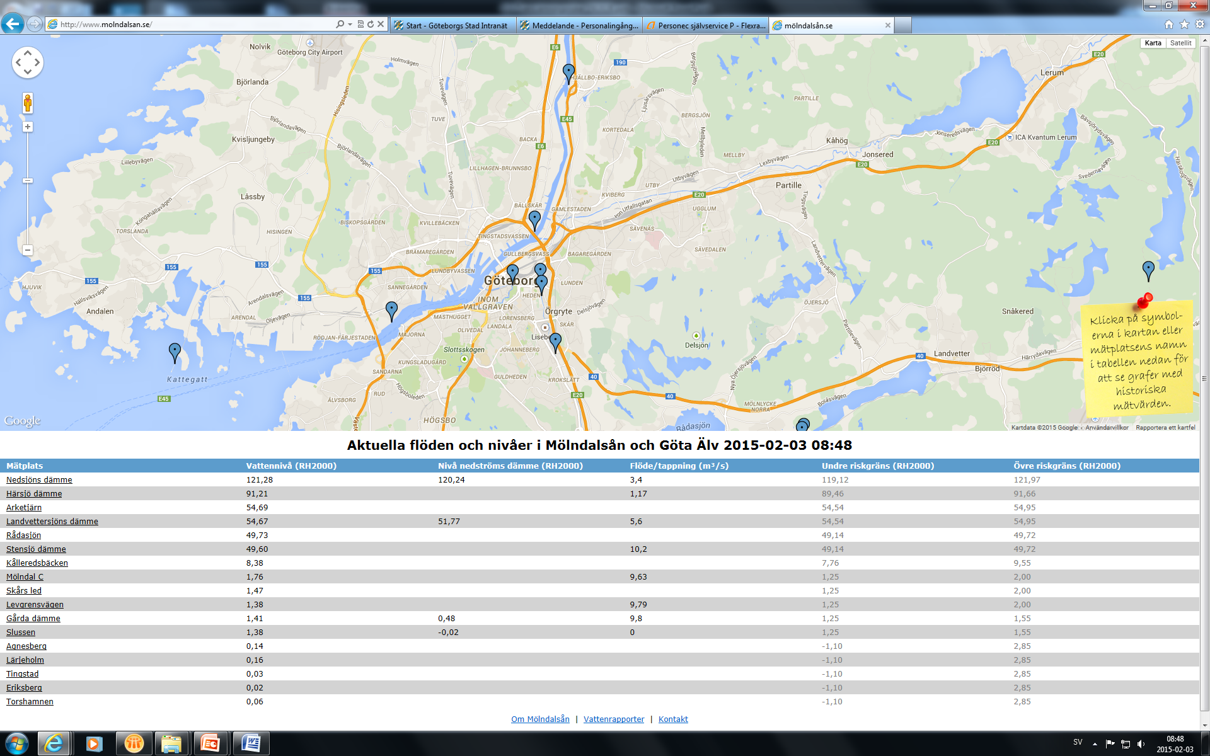
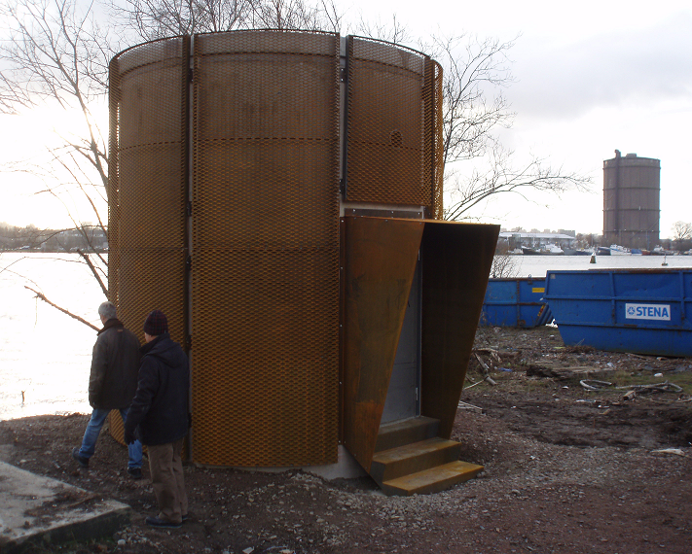
Water level meters

Slide 26
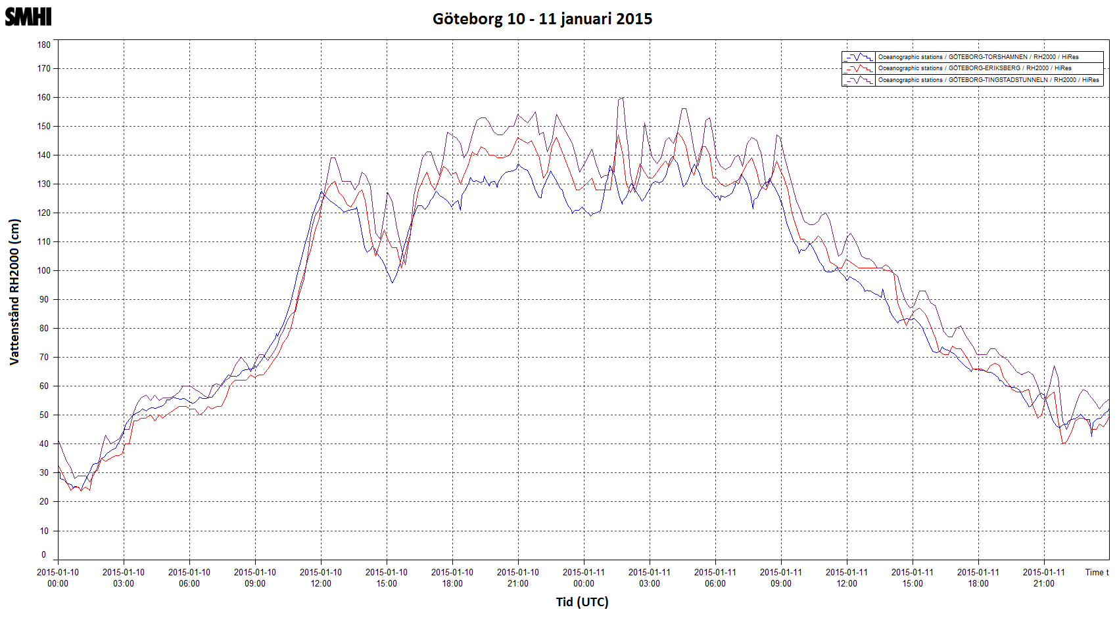
Egon

Slide 27
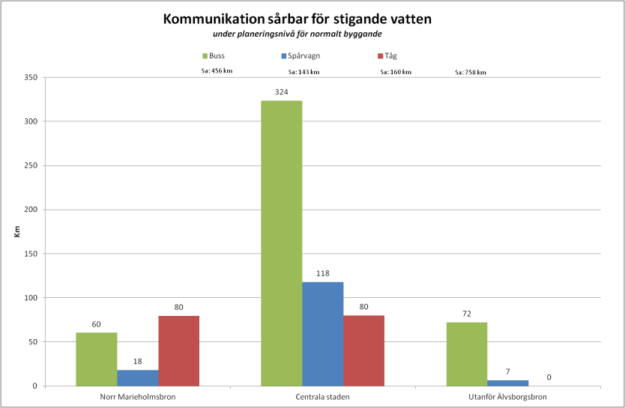
Vulnerability communication

Slide 28
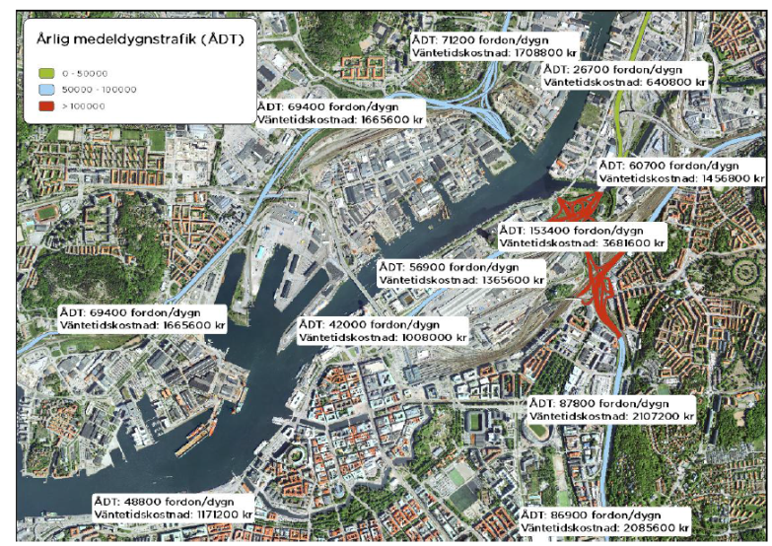
Damage costs for traffic standing still

Slide 29
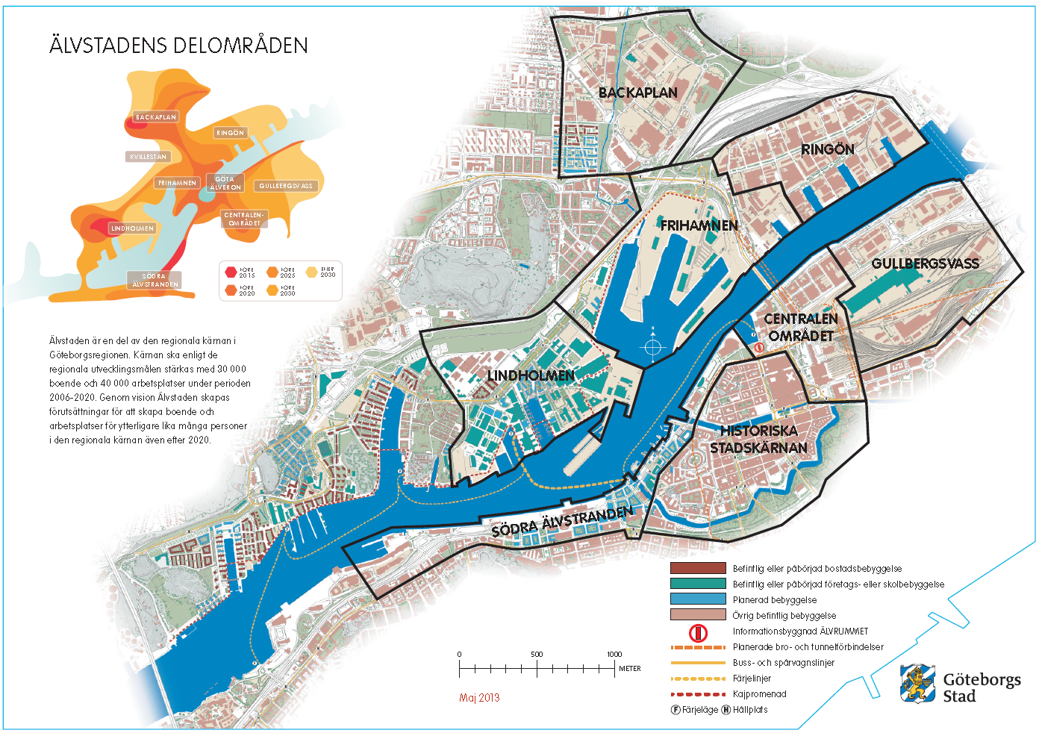
Expansion plans

Slide 30
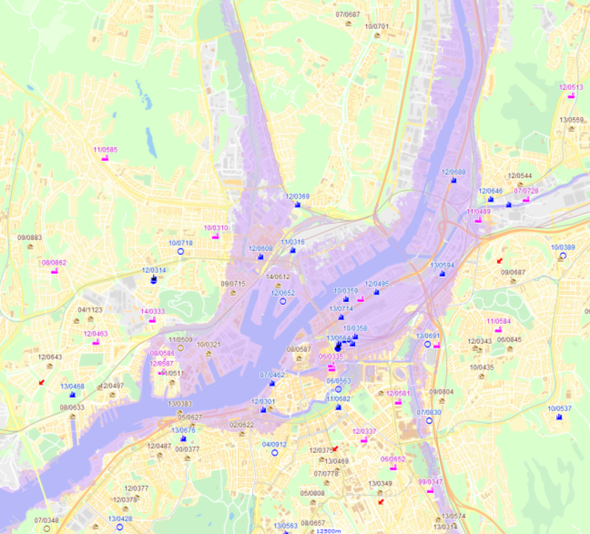
Planning levels
Central City
+3
+2,8
+2,5

Slide 31
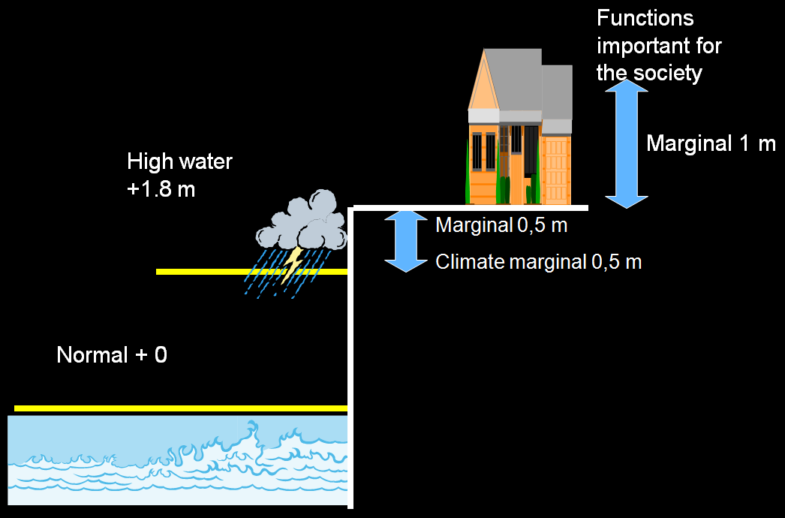
Criteria for selection of protection- current planning levels

Slide 32
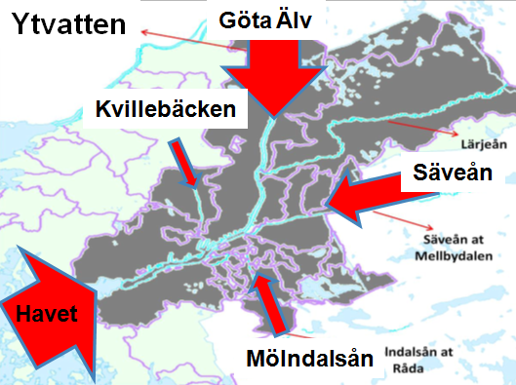
The hydro model
Simulates future water levels
Flows, rainfall high sea levels etc
Evaluate protection measurments
Basis for climate adaption strategis

Slide 33
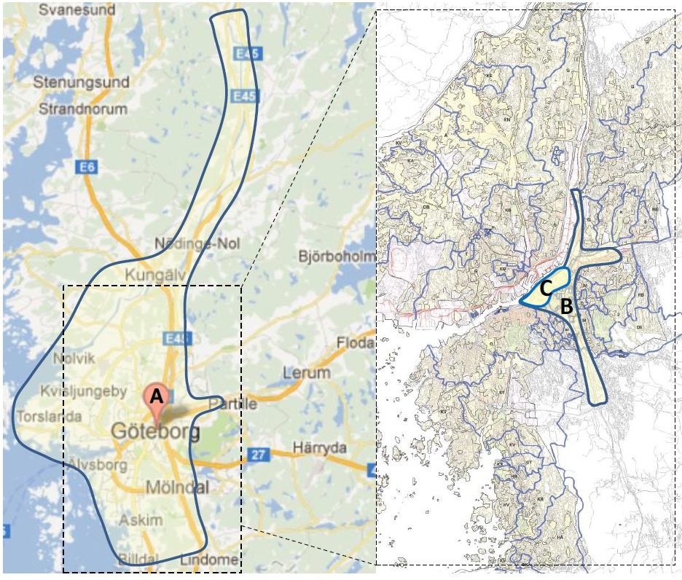
Hydro model - parts
Central GBG– heavy rainfall and high sea levels
Mölndalsån and Säveån – high water from sea and high flow
River side protection and local dams year 2100
Storm surge barriers year 2100
CBA
4 independent models
48 simulations

Slide 34
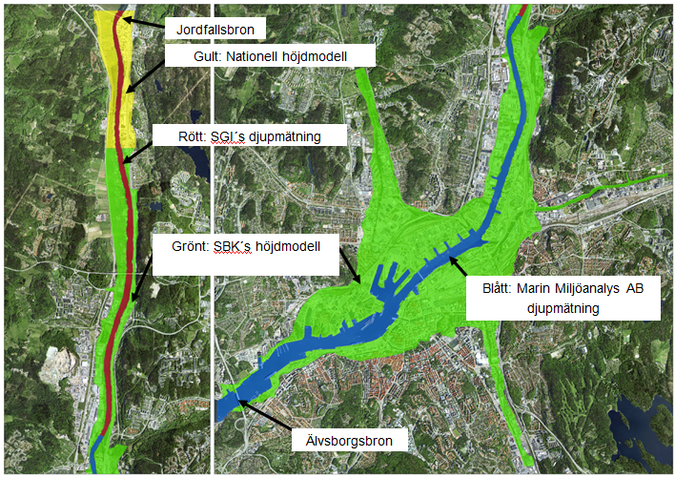
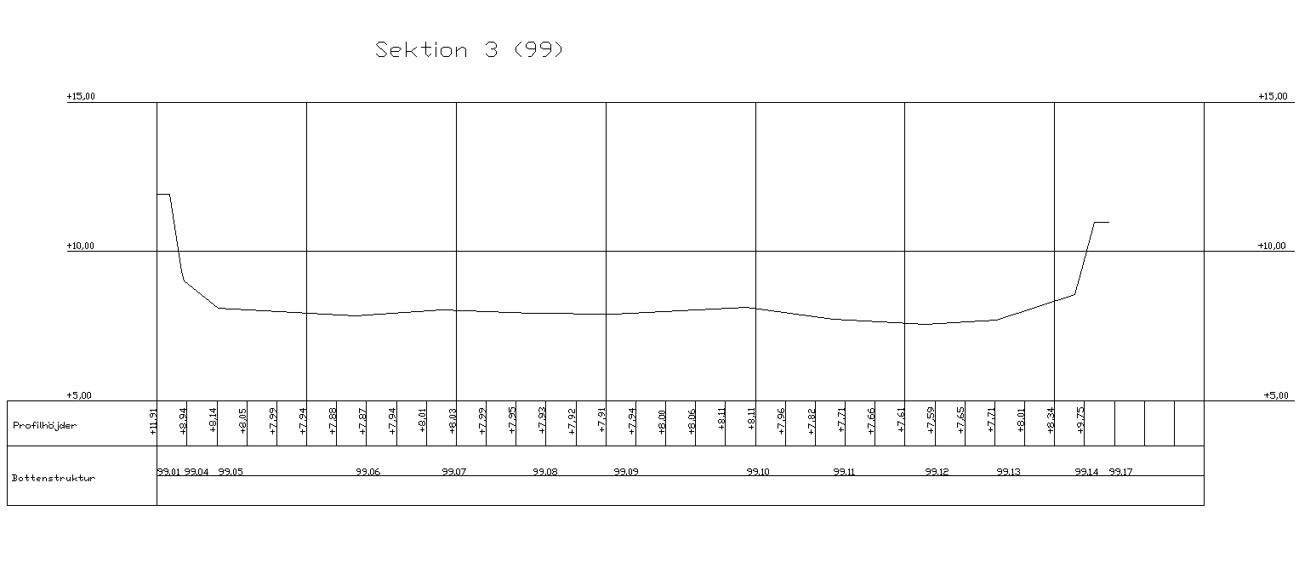
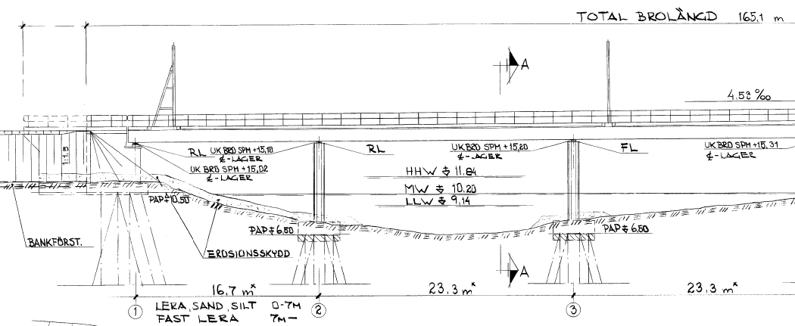
Input - data
  Bathymetri
  Elevation data
  Pipes under the ground
  Bridges/structures in water
  Existing hydraulic models
  Land use
  Ariel photographs
  Contour of buildings
  Functions important for the society
  Damage costs

Slide 35
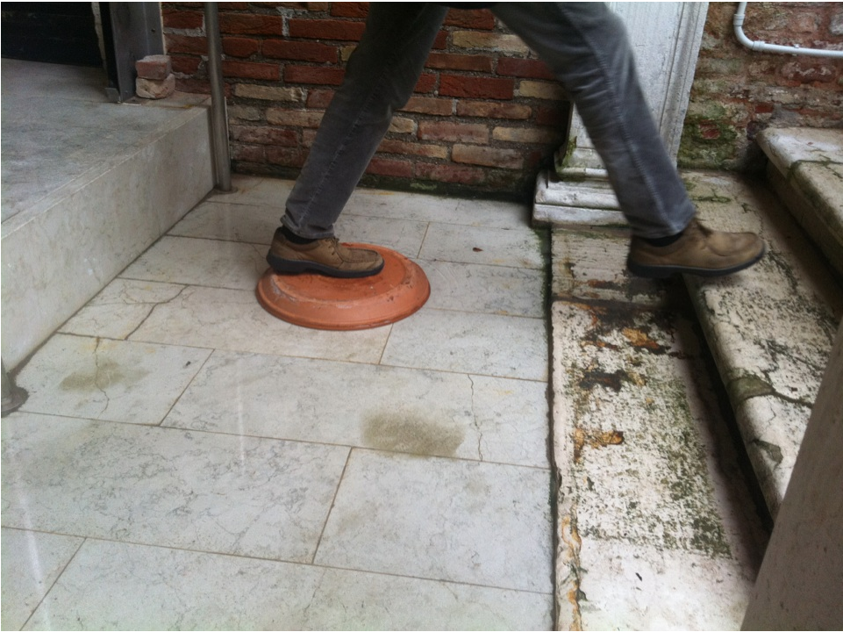
Current work
Risk assessment for a robust society
Tools for administration and make the hydromodel available
Decision process
Lobbing against the national level
Deepend comprehensive plan on the theme water

Slide 36
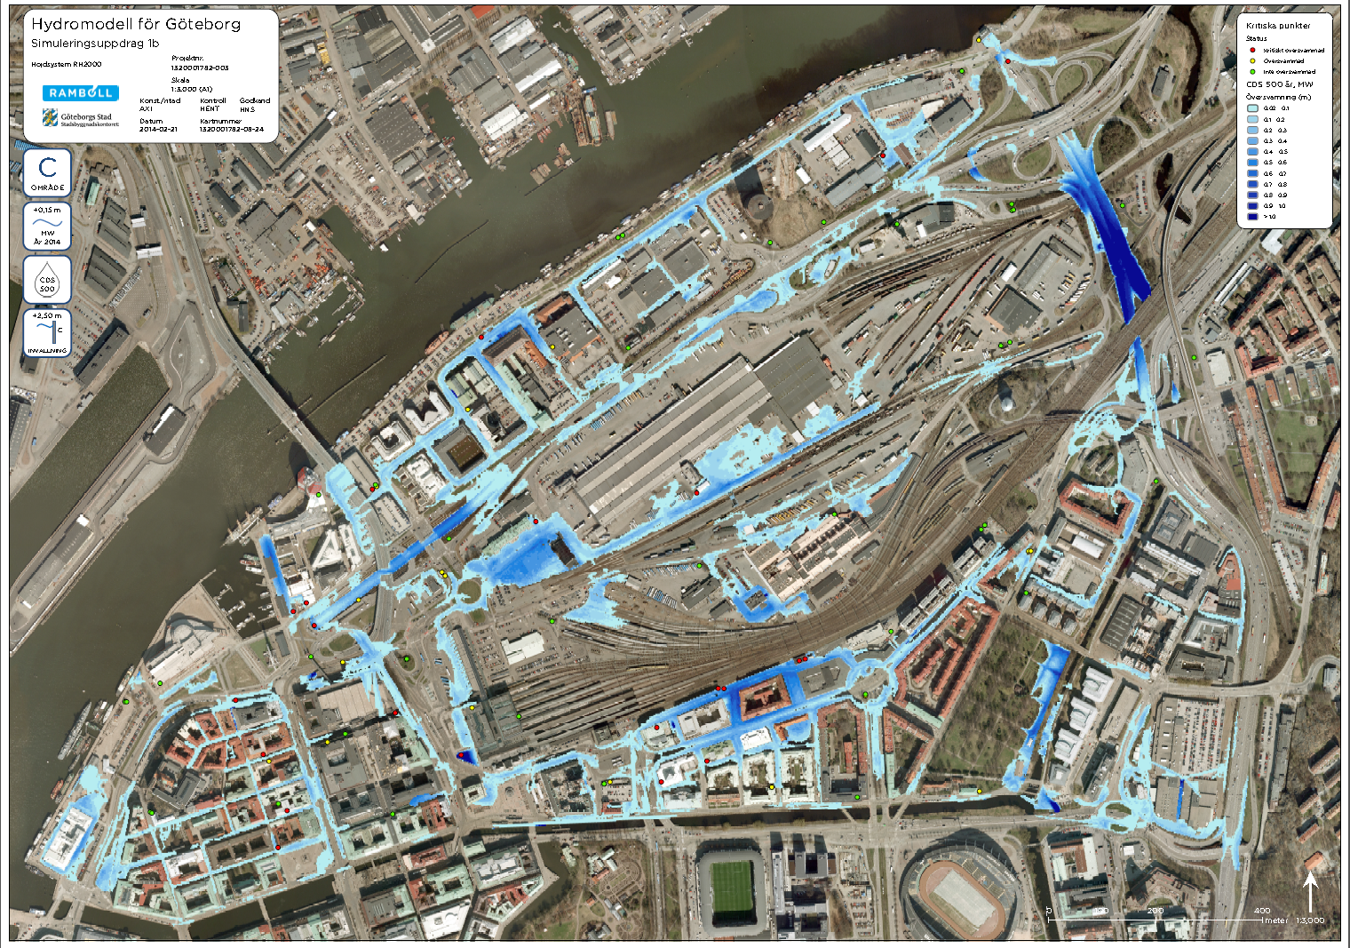
Heavy rain fall 500 year return time

Slide 37
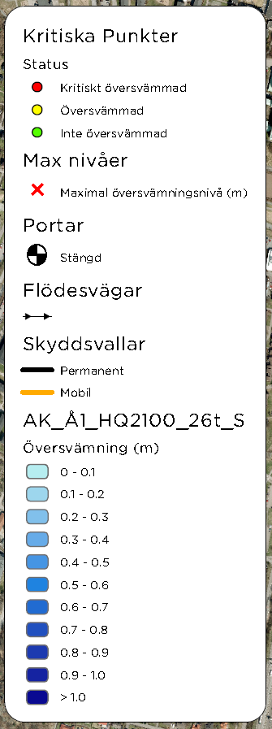
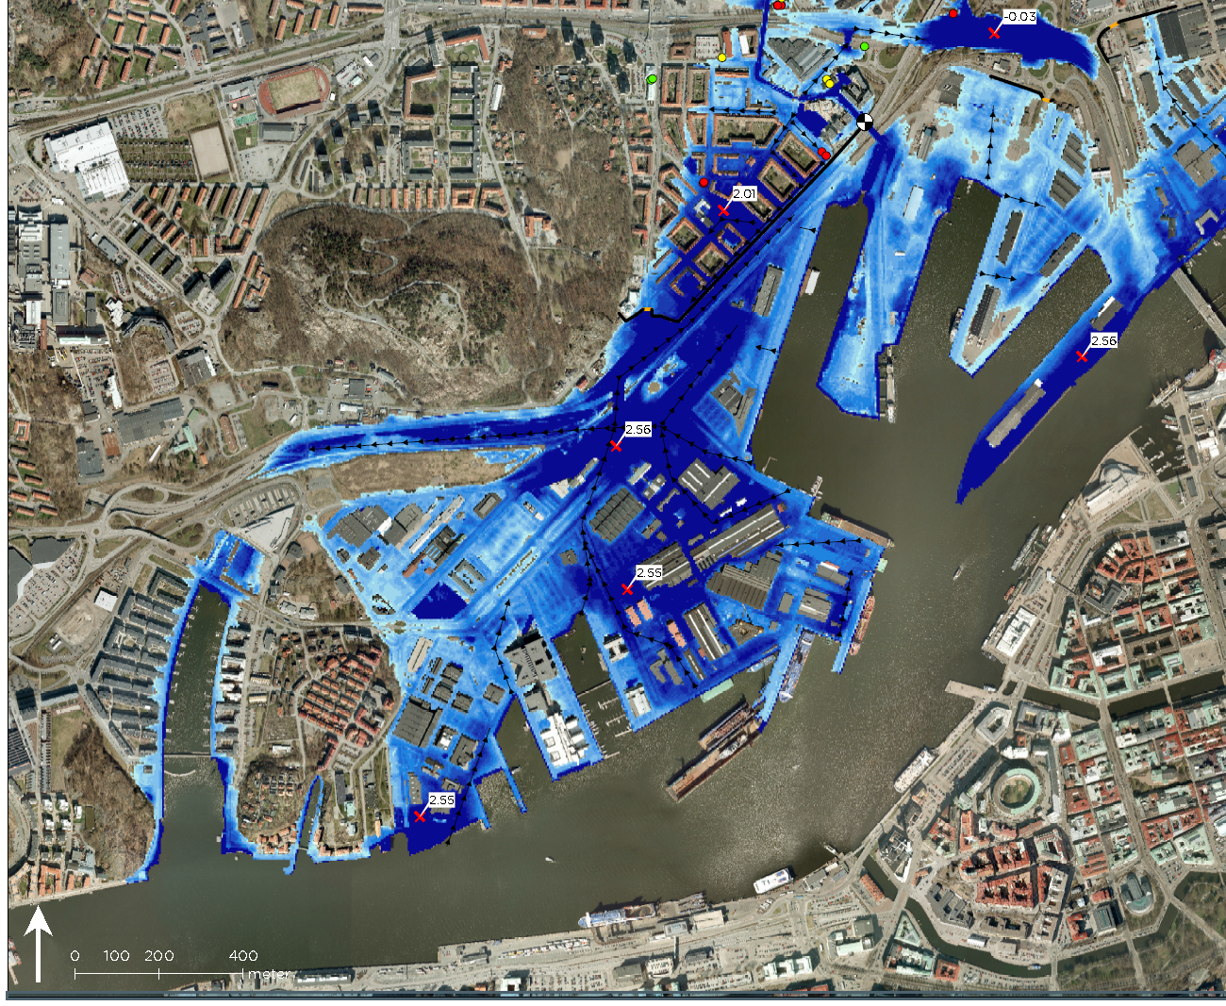
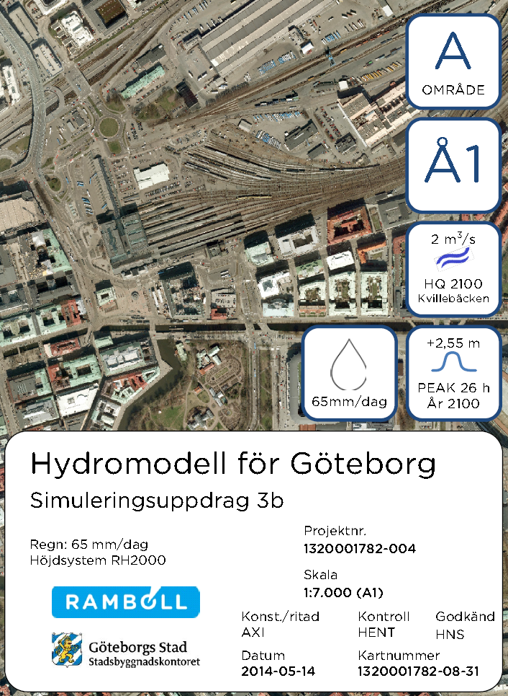
High sea level, combined with high flow in the stream

Slide 38
Important conclusions
Storm surge barrier requires river side protection
Large utility regulation Säveån, the Göta River
Long periods of closure - requires pumping
Closing criteria controlled by frequency
Flood Level behind barrier
Pump capacity
Control Ability
Prediction Ability
Example +1.5 m
2014: 1.6 years
2100: 14 times / year

Slide 39
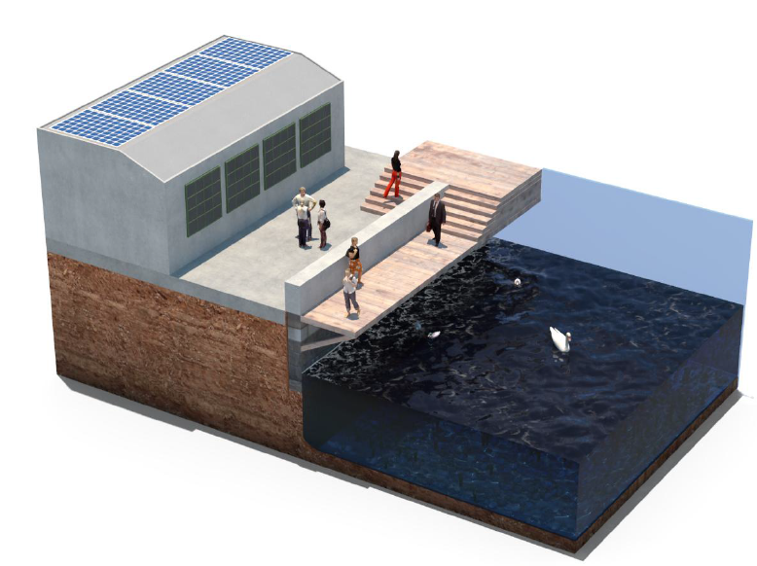
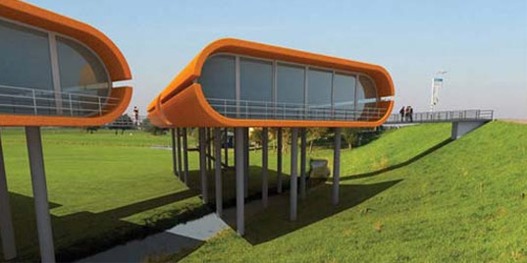
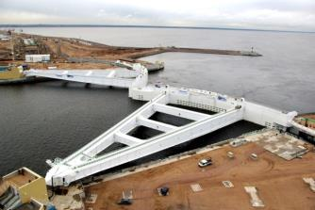
Strategy
Critical time
Mid term
Long term
HHW +1,8
HHW +2,3
HHW +2,6
År 2014
År 2050
År 2100

Slide 40
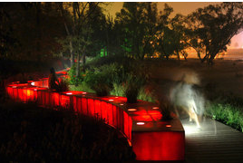
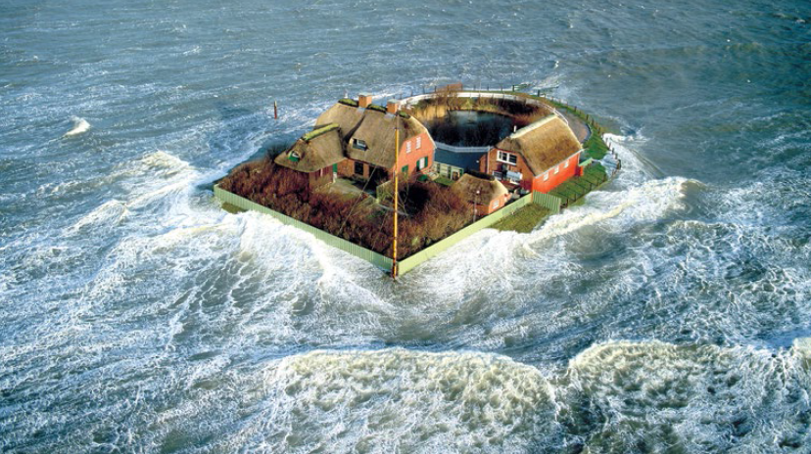
Strategy mid long term
New buildings
        Apply existiong levels of planning
        Basic principle protection through elevation
        Function based approach
        Deviations require risk assesment
        Technical protection– possible to bild 1 m higher level
        Set aside land for future protection
  Existing buildnings
        Risk assesment
        Risk Picture determines the need for object protection

Slide 41
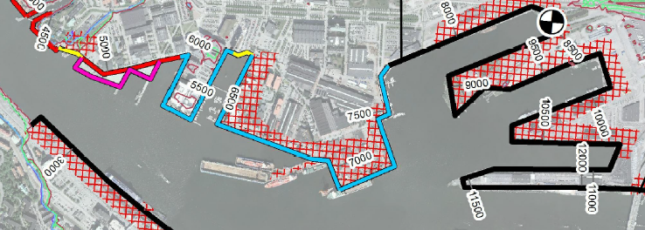
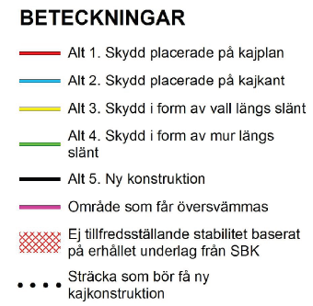
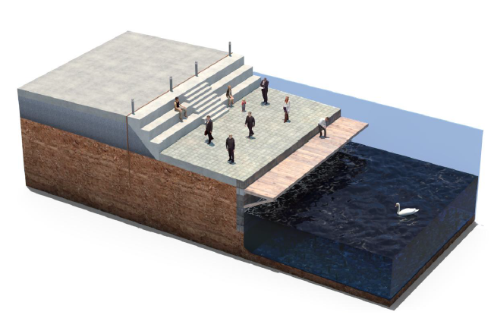
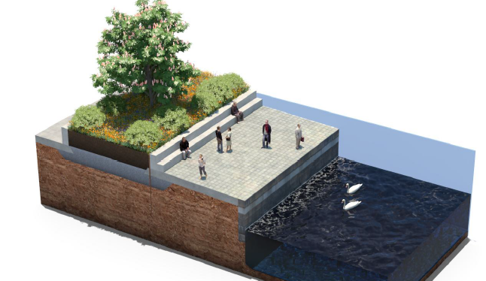
Principal solution for river side protection

Slide 42
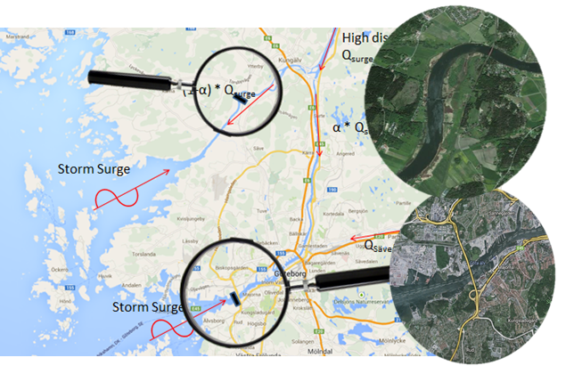
Storm surge barrier

Slide 43
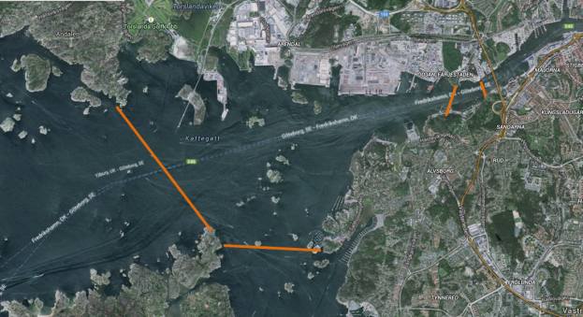
Älvsborg storm surge barrrier
“Robust” alternative:
  Segment gates (Thames barrier)
“Navigational alternative:
  Horizontal sector gates (Maeslant-barrier)

Slide 44



Technical specification
3 submerged segment gates
Connecting levee between gates and pumping station
11 pumps 115 m long

Slide 45



Second option
2 sector gates
  Each gate ~ 75m long
  Total span 150 meters
Pumping station integrated with abutment (but complex)
Abandoned in view of cost and complex integration of pumping station
Preferred option for maritime navigation

Slide 46



Visitor centre
Visitors centre close to the barrier
Example Maeslantbarriären in Netherlands

Slide 47

Barrier Älvsborgsbron

Slide 48

Barrier Älvsborg

Slide 49

Barrier Nordre Älv
Location 3 is adopted (at existing Ormoskärmen). Existing salinity control barrier can be replaced and the function taken over by the new barrier
Locations 1 and 2 are of limited added value in view of flood protection, but are within protected habitat

Slide 50



Nordre Älv
Submerged segment gate located in the river bed
Pumping station at floodplains
Levees on the floodplains

Slide 51


Slide 52


Slide 53


Slide 54

Costs million Swedish Crowns
Älvsborgsbron
  Barrier: 1940 (1360-2920)
  Pumping station: 1100 (775 – 1650)
Barrier Nordre älv
  Barrier: 790 (550 – 1190)
  Pumping station: 1410 (990 – 2120)
Total: 5259 (3680 – 7870)

Slide 55

Risks and uncertainties
Geotechnical information is scarce, especially at Älvsborgbron (possible consequence: increased cost of foundation)
Projections of future sea levels and discharges
Discharge from the smaller streams
Political decision-making process
Permitting (especially related to environmental aspects)

Slide 56

Experiences from the Netherlands
Decision-making on (large) storm surge barriers is complex
Historic examples show decades of decision-making (several “false starts”)
Transparency/traceability is crucial in all studies undertaken

Slide 57

On the national level
Laws and regulations need to be adapted; roles and responsibilities as well as strategies and goals should be made clearer.
There is a need to outline how the costs of adaptation should be distributed among actors and how resources for prioritized measures can be guaranteed.

Slide 58

No distinct flood governance policy domain on national level
Fragmented flood risk governance
  Municipalities and private persons as
  main actors
  Support from the state
  Dispersed legislation
  EC, PBL, LAV, LSO, LXH, etc.

Slide 59

Division of responsibilities between national and local level
Strengths and weaknesses with municipal self-government:
+ Flexibility to account for local
risks and conditions
- Lack of resources
national
local

Slide 60
Remarks
Growing national concern – local level forerunner
Fragmented across policy areas (discourses, actors, rules and resources)
Strengths and weaknesses with the municipal self-government
The lack of coordination and integration on the national level may limit the adaptive capacity of the country as a whole
- limited guidance from the national level (authorities, private actors and the general public)
- investments in permanent defence structures costly also for large
municipalities
- public awareness is low while expectations on public authorities are high

Slide 61

More water in the future
We have got the tools
We still have some time

Slide 62
Contact: Ulf Moback
City Planning Authority
ulf.moback@sbk.goteborg.se

