Slide 1

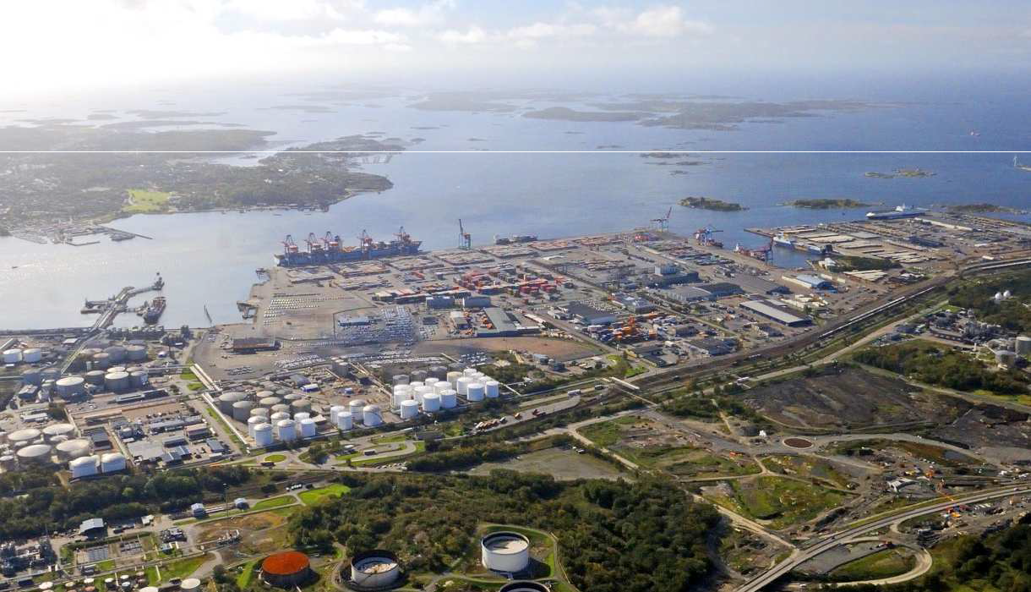
Securing Seaports: Interrogating Security Governance at the Port of Gothenburg and the Port of New York and New Jersey
(URBSEC) Maria Stern, Mark Elam, Joakim Berndtsson

Slide 2
Harbor Security?
Border protection has become an area of increasing global importance and technological sophistication.
Port security has undergone substantial change; the threat of ships being used as means to deliver weapons of mass destruction or terrorist operatives has prompted increased security measures
The International Maritime Organization’s (IMO) International Ship and Port Facility Security (ISPS) Code (2004)  the assessment of risks to shipping and port facilities a mandatory activity for all international seaports.

Slide 3
Harbor Security?
Bethann Rooney (2012:2), Port Security Manager in New York and New Jersey: ‘Shippers want their goods moved in the fastest, most reliable, cheapest and most secure method. The challenge for the past ten years has been to integrate security into the efficient and economic flow of commerce’.
Ports are simultaneously sites of institutionalized security and transnational mobility, interaction and exchange which must be committed to ‘distinguishing between good and bad global mobilities.
Under reseearched wihtin social sciences (security studies)

Slide 4
Proposed Project: Security Governance at the Seaport
Focus on mapping and understanding security work - at the Port of Gothenburg, Sweden (SEGOT) and the Port of New York and New Jersey, USA (USNYC)
SEGOT is he largest port in Scandinavia through which approximately 30% of Swedish foreign trade passes
USNYC six major port facilities comprise the third largest port in the United States and the largest on the East Coast.
Critically compare how the optimization of security is pursued.

Slide 5
Research Questions
How is port security governed in practice today at the Port of Gothenburg and the Port of New York and New Jersey through novel combinations of social and technological arrangements?
Who governs seaport security determines how security is variably imagined and enacted.
The question of how security is governed becomes a matter of how a competing range of security projects are articulated and defended in relation to each other.

Slide 6
Theoretical Framing
Security as a discursive– security logics
Security as a technological and technocratic practice that is integral to the work of governing populations, regulating flows, mapping dangers, managing risks and contingency.

Slide 7
Theoretical Framing
Security Risk Management.
Risk (and disaster, emergency) management necessitates techniques of calculation and analysis and preemptive security work so as to manage risks associated with the onset or the aftermath of danger or catastrophic events.
Adjusting to sudden change requires the building up of resilience.

Slide 8
Global security assemblages (Abrahamsen and Williams)
Characterized by a unique mix of global, regional and national, as well as public, private, and public-private security actors and interests;
they are governed by competing, intersecting and coinciding security logics or rationalities.
Actors in the assemblage are continuously involved in shaping the ways in which risks and threats are perceived, acted upon, or framed.
Architectural, scientific, technological and administrative arrangements.

Slide 9
Security Assemblages: Landlord Ports
Both SEGOT and USNYC are ‘landlord ports’ hosting a wide array of public-private actors involved in the security work of the seaports
SEGOT: Responsibility for coordinating port activities is shared between the Gothenburg Port Authority (Göteborgs Hamn AB, owned by the City of Gothenburg), which owns the land and infrastructure and a number of international terminal operators who only handle the freight.
The Energy Port remains in the hands of the Port Authority.

Slide 10
SEGOT
Security at SEGOT is provided by a range of private and public actors where private companies like G4S, and the international terminal operators play important roles in securing Sweden’s borders together with the Swedish Customs; the Swedish Coast Guard and other government agencies
The port is divided into a number of facilities dedicated to providing different services.
The APM Terminal(s) in Gothenburg is the largest container- terminal in the Nordic regionone of the first 20 ports to become certified in the Container Security Initiative (CSI), thus being allowed to ship containers directly to the US.
The Gothenburg Energy Port is the largest energy port for open access in Scandinavia and is spread out over a number of facilities (actually three ports).
Regular ferry traffic carried out by Stena Line on 19 different routes in Northern Europe as well as cruise ships.

Slide 11
To be explored:
To what extent have the security concerns emphasizing terrorist- related threats and scenarios outlined in ISPS code come to impact on the commercial and environmental imperatives otherwise ruling over contemporary seaport governance?
What different security projects have emerged (and are emerging) at the harbour, and how do they coexist, collude, or clash?
How are the security logics, techniques, and temporal and spatial scope of port security projects governed in the different ports in light of the enactment of the ISPS code?
How can we understand – and what can we learn from—the discrepancies or similarities?

Slide 12
Methodology
1) Query the logics that can be identified as underlying and framing different security projects.
2) Map the diverse techniques and combined processes of social and technological innovation rendering security projects operable. ( E.g. Practices connected to the training of security personnel; The introduction of new screening and surveillance technologies--A focus on the ‘chain of technology’)
3) Interrogate the temporal and spatial scale and scope of port security projects encompassing crucial issues of jurisdiction over security governance. (The zoning of port time/space?)

Slide 13
Thank You!

