Slide 1
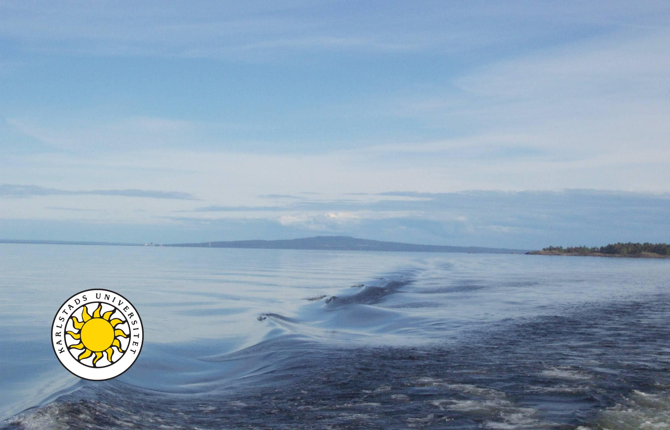
Sustainability Aspects of Water Regulation and Flood Risk Reduction in Lake Vänern
Lars Nyberg
Centre for Climate and Safety
Karlstad University
Notes:
Centrum för klimat och säkerhet är ett kompetenscentrum vid Karlstads universitet.

Slide 2
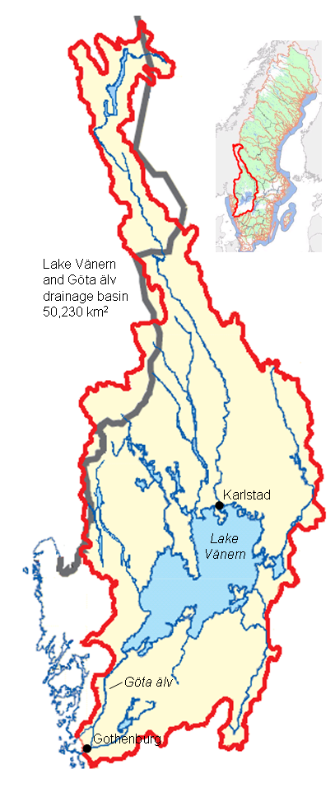
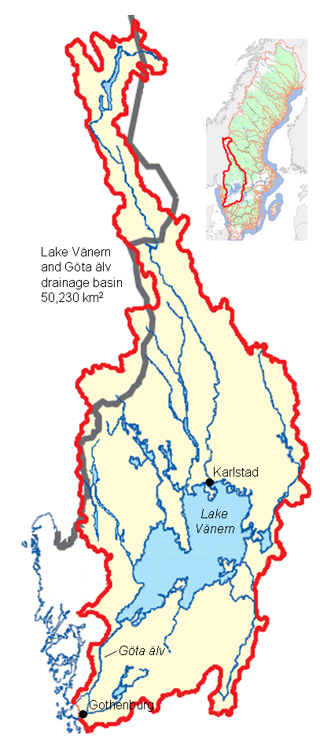
Lake Vänern
50,200 km² catchment
Lake area 5,600 km²
Flood risk in the lake and most tributaries
Flood 2000/2001
Landslide risks along Göta älv and Klarälven
Hydropower dams
Heavy industry/Polluted soil
Drinking water supply
Notes:
The lake Vänern catchment is the largest in Sweden. The lake is also the largest in Sweden and also within the EU. There are flood risks around the lake, in most of the 13 tributaries and in the outlet river down to Gothenburg. The risk system is complicated with large landslide risks in the outlet river, substantially limiting the discharge out of the lake. The inflow could during wet periods be 3 times the allowed outflow.
Since the lake is regulated for hydropower (the largest reservoir in Sweden) the water-level, under non-extreme situations, could be controlled and decided by the hydropower company. There are also industries and polluted soils along the lake and rivers, and the water is used as drinking-water for the almost the entire region.
There are obvious ecological, social and economical values in the lake, upstream and downstream. The 22000 islands create unique habitats for many species. The water adds to life quality in 13 municipalities around the lake and the recreational and tourism activity is large. The economic values are large with the hydropower, fishing, shipping and tourism. Many of these economic activities are also relevant for the GHG reduction, thinking of hydropower, local food production in fishing and energy-efficient shipping. With a drinking-water quality in the lake, you can expect a development of the summer tourism and other types of exploitation in the near future.

Slide 3
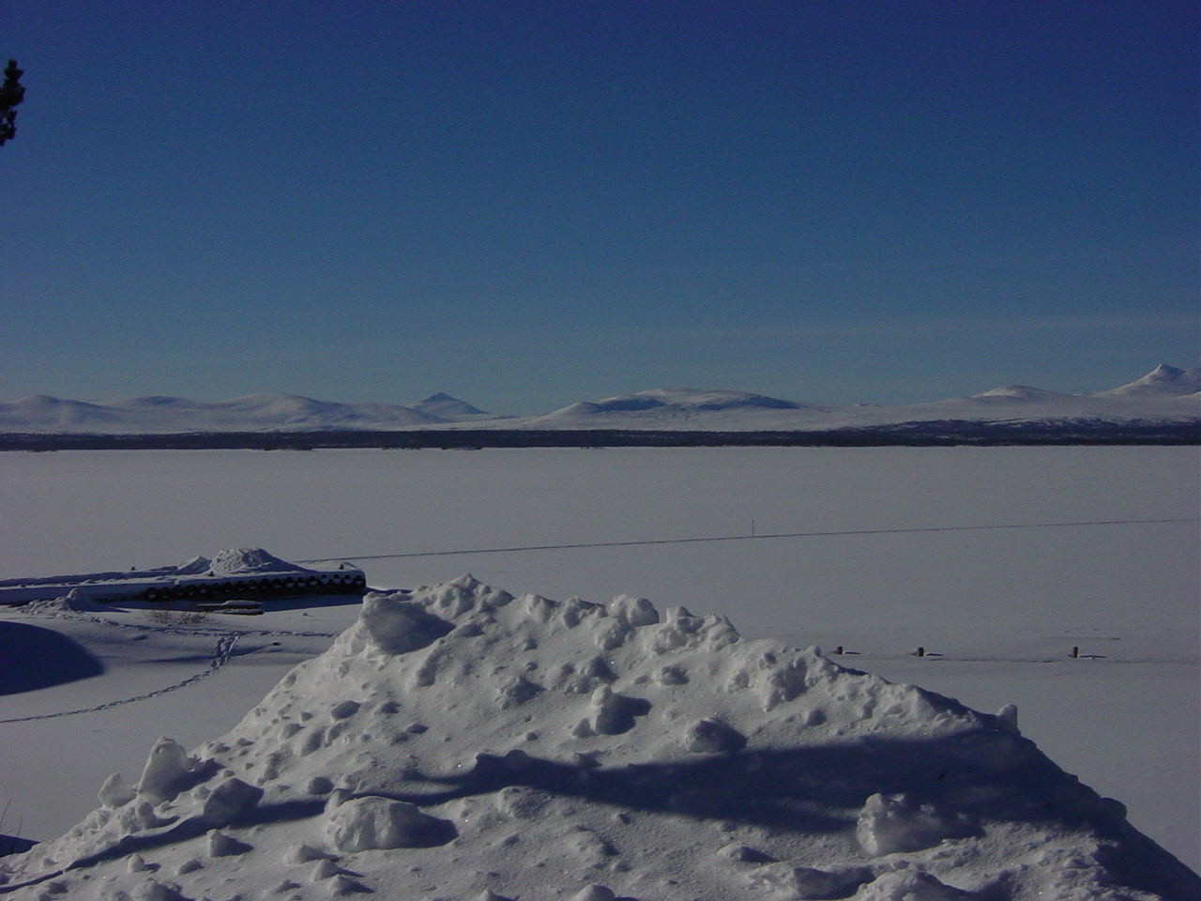

Slide 4
Europe’s largest natural lakes | Area (km²)
1. Ladoga (Russia) | 17 670
2. Onega (Russia) | 9 670
3. Vänern (Sweden) | 5 648
4. Saimaa (Finland) | 4 400
5. Peipus (Estonia/Russia) | 3 555
6. Vättern (Sweden) | 1 893
7. Vygozero (Russia) | 1 285
8. Mälaren (Sweden) | 1 122
9. Ilmen (Russia) | 1 120
10. Beloje (Russia) | 1 119
Källa: www.vattenportalen.se
Notes:
Ladoga nr 17 i världen
Kaspiska havet (saltsjö) – 374 000 km2
Lake Superior – 83 000 km2
Lake Superior – störst i USA – är 5 ggr större än Ladoga och 15 ggr större än Vänern

Slide 5
Lake Vänern risk topics
Flood risks
Discharge limitations
  Landslide risks Göta älv
Regulation regime
  Landscape and ecosystem effects
Protection of cities
  Existing settlements
  New developments

Slide 6
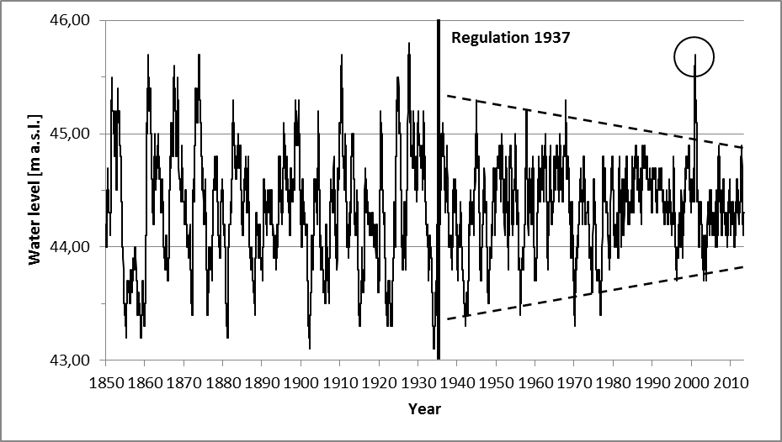
Water level 1850-2013

Slide 7
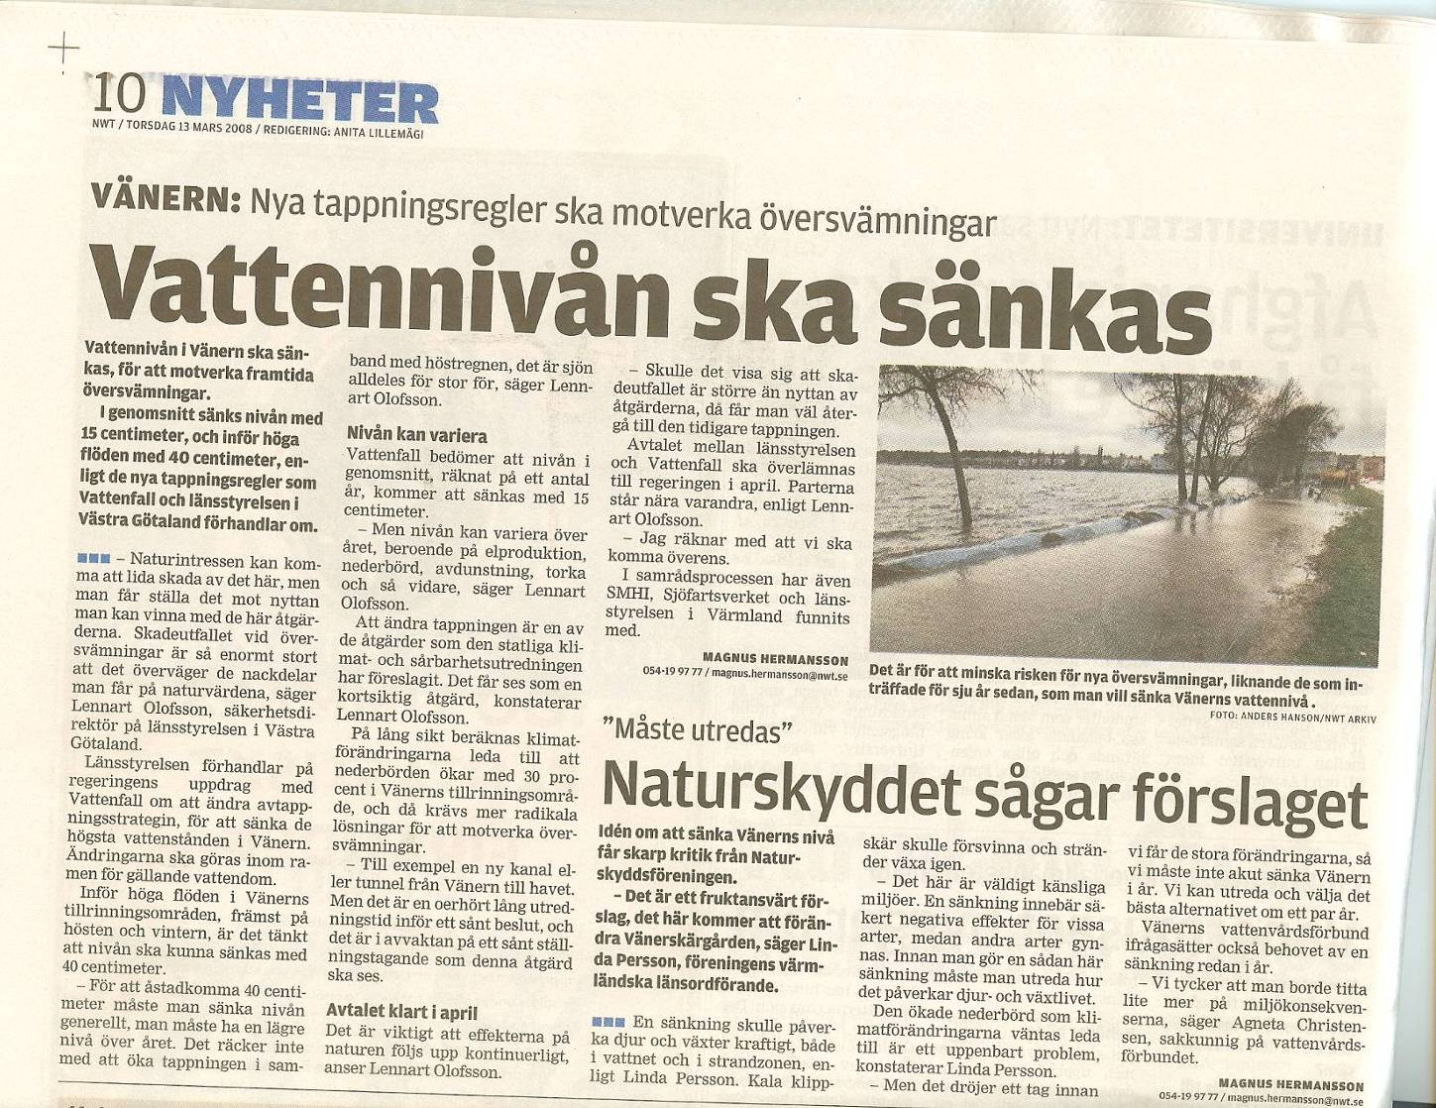
Notes:
I want to start with two examples from the case studies we used to identify positive and negative relations between different interests and dimensions regarding the use and users of the water system.
Our first example from the Elbe river is a photo showing a high-positioned politician with the chain-saw in his hands taking away vegetation from the Elbe floodpain, to reduce the roughness and the resistance for the water. The thing is that this area is a reserve under UNESCO’s MaB-programme. The removal of vegetation from this floodplain has occurred some years ago as a response to the large floods in the last decade. The removal also caused demostrations among a nature-interested public.
Elbe has been heavily flooded several times the last decade and there are really sgtrong incentives to reduce the flood risks to save lives and large econoic assets.
The second example is from Lake Vänern in Sweden. This article says that there is a criticism against low water levels which causes problems for the social use of the lake and also – more long-term – for ecosystems and landscape development. The reaction has come after a decision to lower the water level with 15 cm in average.
The water-level engage the users: The risk-managers want a low and stable level, the social users and the shipping want a stable and average level and the nature conservationists want a varying level with both dry and wet periods.
Both this quite big water systems have complex risk systems and my intention is not primarily to question the ongoing flood management, but to ask for a wide assessment before decisions about different measures are taken. These kind of considerations are also needed when you go from ’flood protection’ with a mainly technical perspective to flood risk management including also soft tools as communication, education, planning, etc.

Slide 8
Photo: Länsstyrelsen

Slide 9
Values and interests
Ecology och landscape | Economic values
Landscape | Hydropower
Unique habitats and species | Fishery
Recipient | Agriculture
 | Shipping
Social values | Tourism
Life quality in 13 municipalities | Critical infrastructure
Recreation | Industry
Drinking water
Nyberg L, Evers M, Dahlström M, Pettersson A. 2014. Sustainability aspects of water regulation and flood risk reduction in Lake Vänern. Journal of Aquatic Ecosystem Health and Management.

Slide 13
Conflicting interests
Interest |  | Preferences
Flood protection | → | Low level and low amplitude
Hydropower, shipping | → | Average level and low amplitude
Nature and landscape protection | → | Larger amplitudes and seasonal variation

Slide 14
Tids-rumsdiagram
Havsnivå-höjn.
Stor-region
Havsnivå
vind+lufttr.
Region
Dammbrott
Väneröversv.
Vänern
vindeff.
Flera kommuner
Älvöversv.
Kommun
Del av kommun
Skyfall
Timmar
Dagar
Veckor
Månader
År
Decennier
Sekel
Notes:
Så vad är då en översvämning? Översvämning är ett samlingsbegrepp.
Man kan finna olika typer. Diagram i tid och rum över hur länge de varar (varaktighet!) och hur stort område som berörs.

Slide 15
Thanks for your attention!
Lars Nyberg
lars.nyberg@kau.se
www.kau.se/klimat-och-sakerhet
www.cnds.se

