Slide 1
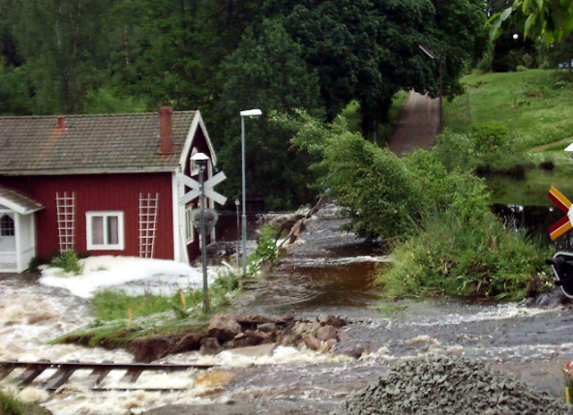
Eva Liljegren, PhD
The Swedish Transport Administration (STA)
The Maintenance Division

Slide 2

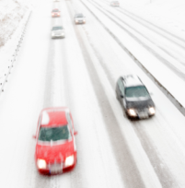
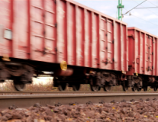
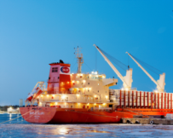
The STA`s mandate
To be responsible for the long-term planning of the traffic system for road and rail transport, shipping and aviation .
To be responsible for the construction, operation and maintenance of State roads and railways.

Slide 3

The STA´s responsibilities
  11 900 km (7 400 miles)
  of State railway tracks
6 500 employees
  40 ferry lines
  16 000 bridges
  (3 781 railway bridges)
  98 400 km (61 000 miles)
  of State roads

Slide 4
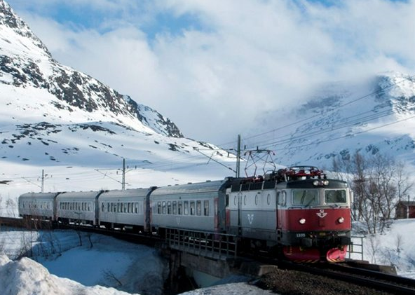
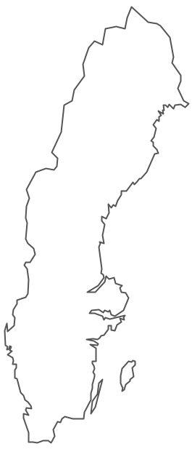
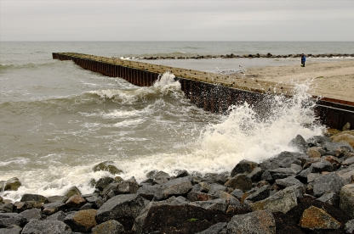
Flooding
Torrential rain
Increased precipitation
Storm surge
Mud slides
Land slides
Higher water table
Heat
Draught
Wild fires
Thunder and lightning
Storms/wind
Altered conditions for frozen ground

Slide 5
EU:s strategy on adaptation to climate change
In April 2013 the European Commission adopted an EU strategy
It focuses on three key objectives:
Promoting action by Member States
'Climate-proofing' action at EU level
e.g. ensuring that Europe's infrastructure is made more resilient.
Better informed decision-making
by addressing gaps in knowledge about adaptation.

Slide 6
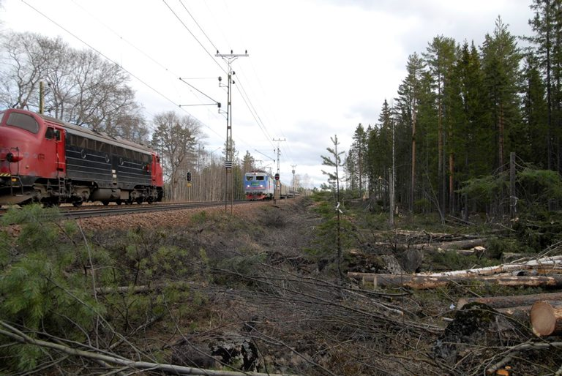
The STA`s Climate Change Adaptation Strategy
Create the conditions for efficient climate change adaptation work.
Prevent negative consequences of climate impact through the creation of robust systems.
Manage the effects of climate impact.

Slide 7
Create the conditions for efficient climate change adaptation work
A clear mandate and responsibility for climate change adaptation work within the STA.
Continuous acquisition of knowledge about climate impact on roads and railways, through monitoring, research and development.
Regional, national and international cooperation.
Dissemination of information on climate impact and climate change adaptation throughout the organization.
Planning takes into account the need of resources for work on climate impact on roads and railways.
Acquisition and analysis of information and data concerning natural hazards.
Stocktaking and documentation of those component parts of the road and rail infrastructure that are pertinent to work on climate change adaptation.
Development of methods to determine when and where various measures are cost-effective as regards to climate change adaptation.

Slide 8
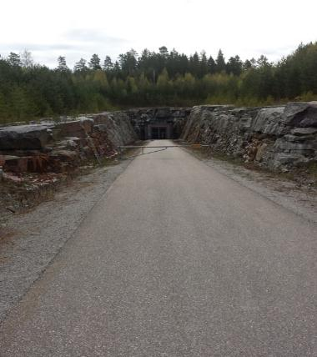
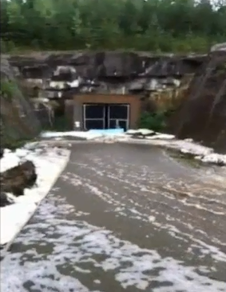
One example of natural hazard related events
The flooding of the Norrala railway tunnel, August 2013

Slide 9
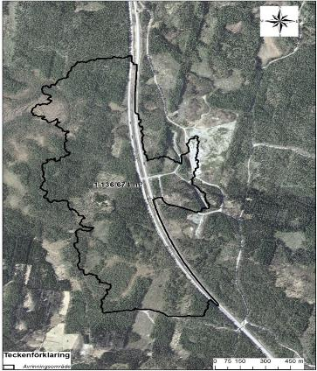
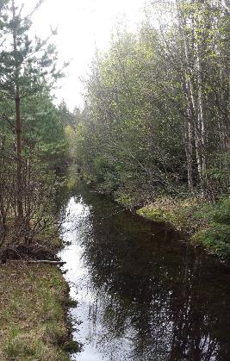
Why was the tunnel flooded?
The catchment area for the service tunnel was 20 times larger than the catchment areas for any of the other five tunnel entrances.

Slide 10
Prevent negative consequences of climate impact through the creation of robust systems.
A written policy and framework that takes climate impact into consideration.
Adapting new construction work and conversions to the present and future climate.
Stocktaking and assessment of places and sections at risk in the existing road and rail infrastructure.
Increasing the resilience of existing road and rail infrastructure to climate stress.
Addressing systematic weaknesses, such as inadequate culverts.
Adjusting maintenance practices to changes in climate impact.
Adapting supervision practices and safety inspections to climate impact.

Slide 11
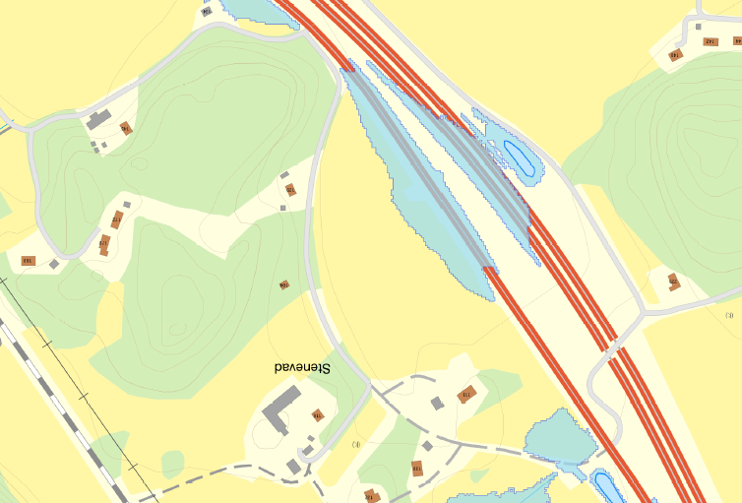
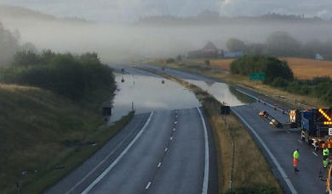
Risk identification methods
Blue Spot
Robustness planning
Historical data from events

Slide 12
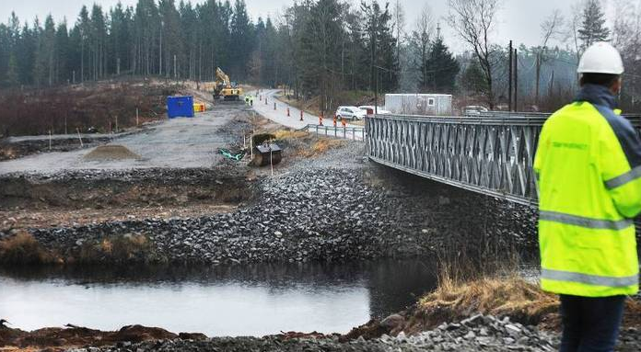
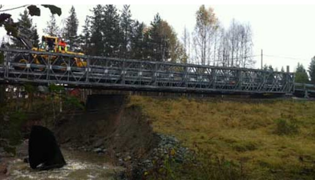
Manage the effects of climate impact
Maintaining a high state of readiness and expertise for managing acute effects of climate impact.
Provision of traffic information and rerouting.
Emergency response planning that takes account of climate impact.
Emergency-drills for climate-related scenarios.
Using depot equipment, e.g. emergency bridges, in urgent situations.

Slide 13
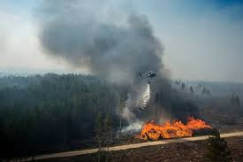
Thank you for listening!

