Slide 1
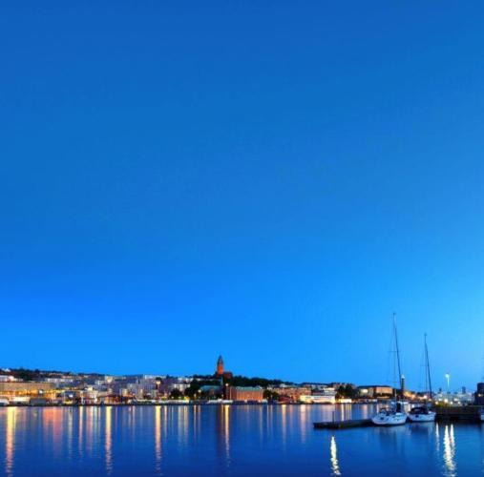
Traffic in Gothenburg
Mikael Ivari
Urban Transport Administration
Notes:
SPEAKER TEXT:
My name is Mikael Ivari and I work for the City of Gothenburg at the Urban Transport Administration
I’m going to give you a brief presentation of the Gothenburg traffic/transport system, the strategies we are working with and the challenges we face.

Slide 2


Gothenburg – an evolving city of the future
533,300
residents – 23% born
outside of Sweden
1,1
million residents in the Gothenburg labour market region today
+10 000
residents in the Gothenburg
labour market region today
1,75
million residents in the Gothenburg labour market region 2030
Notes:
SPEAKER TEXT:
Gothenburg is a port city with a strategic location between Oslo and Copenhagen. It has a population of around 533,000 and is Sweden’s second largest city. The Gothenburg region, which spans 13 municipalities in Greater Gothenburg, has a population of 1.1 million.
Gothenburg is the core and growth engine of the Gothenburg region and Region Västra Götaland. It is home to a variety of strong industries (including VOLVO, Volvo Cars, SKF) and Scandinavia’s largest port.
There’s plenty going on in Gothenburg right now! The city is growing strongly and is preparing to make space for 150,000 more residents by the year 2035. A lot of people want to move here, both from the local area and from abroad. New companies want to set up here. More tourists want to come and visit Gothenburg.
In the past decade the city has enjoyed steady growth with a population increase of 55,000; the figure for the whole Gothenburg region is 125,000. In particular a lot of young people want to move here – the predominant group is young adults aged 20-27. During the same period more than 90,000 new jobs have been created in the Gothenburg region. This equates to 20% growth, which is more than in either Stockholm or Malmö region. One important goal for Gothenburg is to create a bigger labour market region, and strategies are currently focusing on a population of 1.75 million in the Gothenburg region by 2030.
As the city grows, it is also evolving. New houses are being built, and new residential areas and city districts are emerging on land previously used for industrial purposes. This also stresses the need for the city to work with climate change adaption.

Slide 3
Gothenburg’s labour market region
– potential
NO CSA
NO CSA
~1,5 million
Residents 2000
Gothenburg
Gothenburg
1,1 million residents 2010
1,75 million residents including Borås, Trollhättan och Uddevalla 2030
Notes:
SPEAKER TEXT:
These maps illustrate the potential of growing the Gothenburg labour market region geographically until 2030.
CLICK
Compared with the New Orleans Combined Statistical Area (New Orleans MSA + Washington and Tangipahoa parishes) – the potential is about the same size

Slide 4
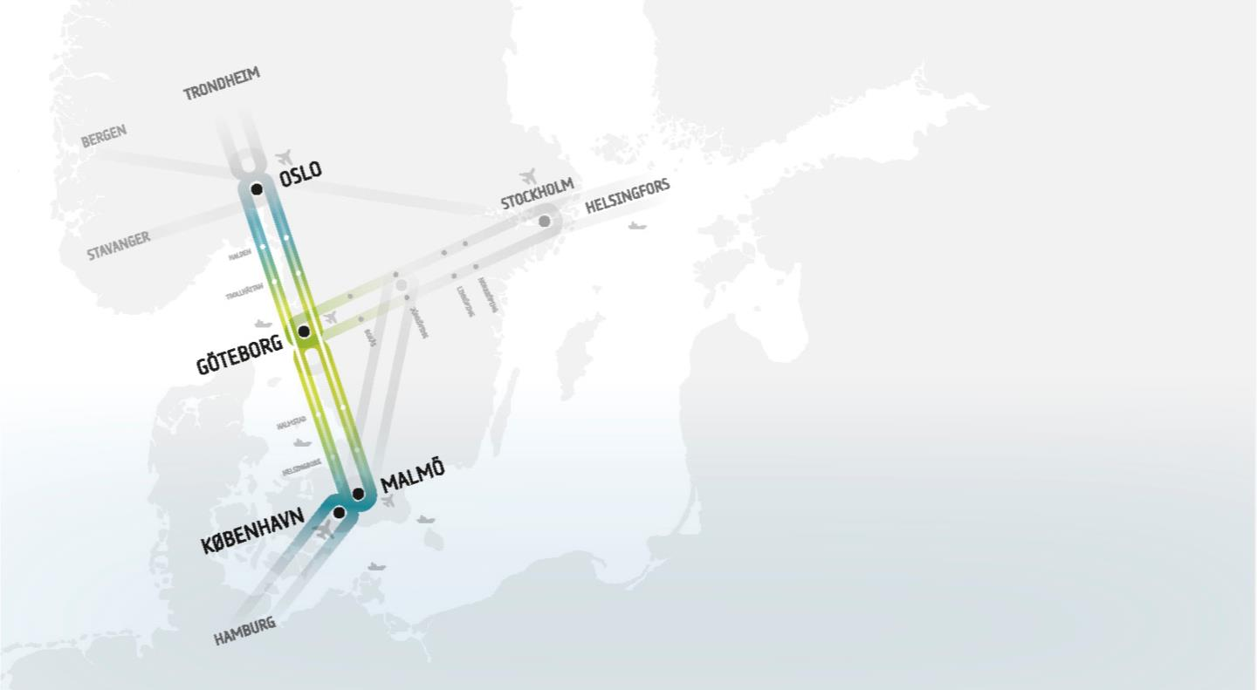
A close city
– in the middle of Scandinavia
The 8 million city
The Götaland line
(Gothenburg – Stockholm)
Notes:
SPEAKER TEXT:
Looking out from Gothenburg towards our nearest major cities, we have Oslo, Malmö, Copenhagen and Stockholm. Right in the middle is Gothenburg, like a hub, a port, a centre point.
There are thoughts, visions and projects striving to link together Oslo, Gothenburg, Malmö and Copenhagen via advanced infrastructure into a new European future region. Three countries, four city regions and three capitals – this is The Scandinavian 8 million city. Due to its geography Gothenburg would be like a hub, a centre point in the region.
Parallel efforts are under way to link together Gothenburg and Stockholm via what’s known as the Götaland line. This would create yet another link between Sweden’s two largest cities and bring millions of people closer together.

Slide 5
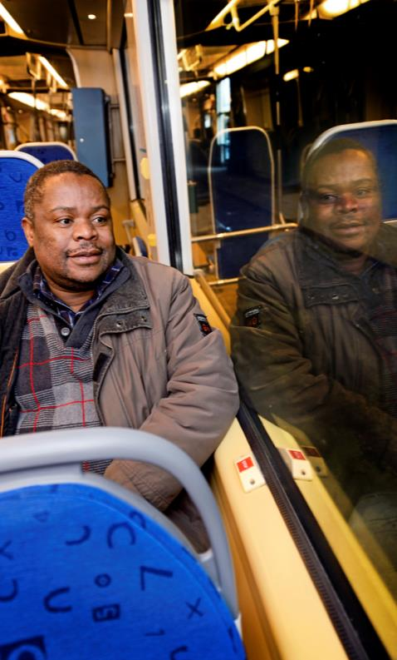
Gothenburg is growing
– but the aim is to shorten distances
New roads, bridges, cycle paths and expanded public transport will make it easier to get around
in the city, both for private individuals and the business sector.
Better public transport and new hubs will make it easy for local people to travel in a sustainable way – within the city, in the wider region and to the world beyond.
We will continue to grow – but not at the expense of the environment.
Notes:
SPEAKER TEXT:
We will develop better public transport and new hubs to make it easy for people to travel in a sustainable way – within the city, in the wider region and to the world beyond.
We will continue to grow, but not at the expense of the environment.

Slide 6
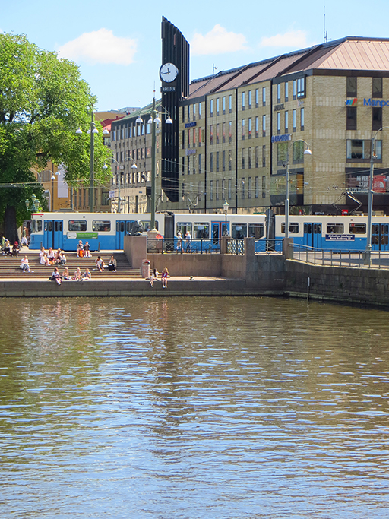
Modal split in Gothenburg
Färdmedelsfördelning bland Göteborgs invånare
Travel mode | 2014 | 2013 | 2012 | 2011
Car | 41% | 41% | 44% | 44%
PT | 28% | 28% | 26% | 26%
Biking | 7% | 7% | 6% | 6%
Walking | 24% | 24% | 25% | 25%
Notes:
SPEAKER TEXT:
The modal split today amongst Gothenburg citizens is about 41% by car, 28% by PT, 7% biking and 24% walking. Numbers are steady over the years but there was a slight change from 2012 to 2013. This was due to the introduction of congestion charges in the city.

Slide 7
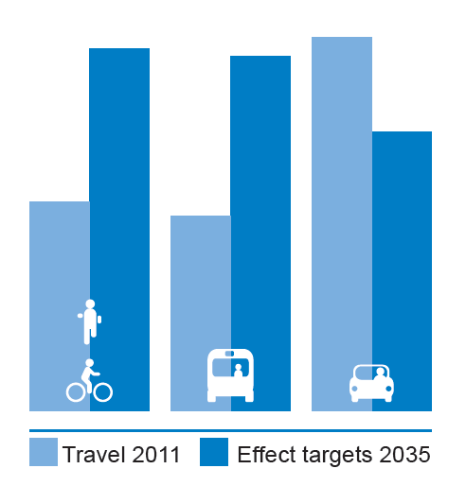
Target modal split by 2035
Travel
Future Modal Split
Notes:
SPEAKER TEXT:
The long term target for the future modal split in the city set by the local politicians is an increase in PT, walking and biking by 50% and a reduction in car use by 25%.
This is of course a challenging task for the planners as well as for the citizens. The city, the regional and the national authorities have signed an agreement on future investments (named the West Swedish Agreement), which has the potential to boost a shift in the modal-split.

Slide 8
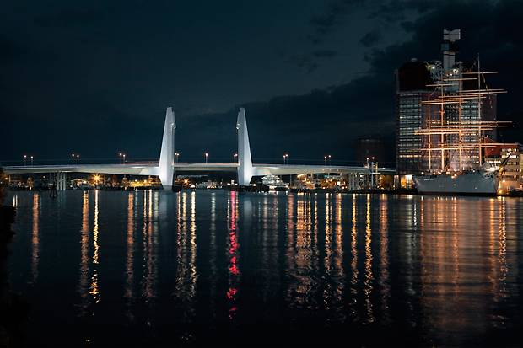
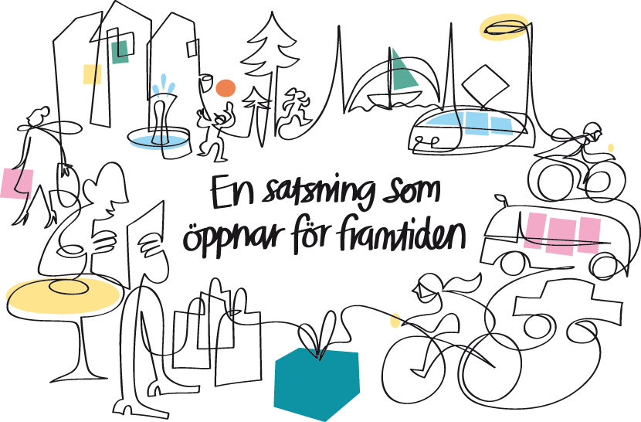
The West Swedish Agreement
Investing for
the future
A SUSTAINABLE CITY – OPEN TO THE WORLD
Notes:
SPEAKER TEXT:
The planned investments in public transport, roads and railways as part of the West Sweden Agreement are the largest in the Gothenburg region since the 1960s, when the Tingstad Tunnel and Älvsborg Bridge were built. About 6 billion USD will be invested in infrastructure through the upcoming decade.
Up until year 2028 ​​a series of major investments will be made in public transport, railways and roads in the Gothenburg region. The investments are necessary in order to enable a growing Gothenburg to face the future in a sustainable way.
The West Sweden Agreement includes:
• A more sustainable transport
• Expanded public transportation
• Congestion tax
• New bridge over Göta Älv
• Marieholmstunneln
• The West Link railway – a part of Gothenburg’s future
The task for the West Sweden Agreement is to provide a good living environment, more competitive public transport, including the West Link, adapted to our growing city and to strengthen the competitiveness of the industry in the region.
For Gothenburg the agreement is necessary to be able to provide a viable, attractive, green and dense city. Gothenburg is the capital of the region with a growing number of people moving in and out of the city and inside the city center - it should be easy to travel in an environmentally friendly manner. The transport system needs to be efficient because we want more people working, visiting, staying and living in Gothenburg.
The agreement is also important for us to develop the city for the future. This is partly through the West Link draw where three stations located at various places in the city's central parts - in close proximity to other public transport and functions that are important for us as a city and region centre (including exhibition and event area, universities and schools, trade and enterprise, and the new neighborhoods that will be created in the central parts of the city).

Slide 9
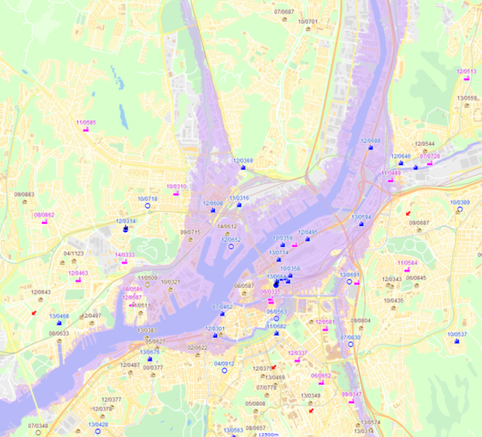
Climate change challenges
Notes:
SPEAKER TEXT:
As I mentioned before, city and regional strategies put a pressure on climate change adaptation.
Rising sea levels + low-pressure in combination with winds from the nort-west cause flooding today and the situation will worsen in the future. Due to overall strategies city growth will primarily take part in the central parts. These are low-lying areas and most prone to flooding. This constitutes an engineering challenge for infrastructure development.
Existing major transportation facilities are also at risk, for example:
Highways E45 and E6 including the Tingstad tunnel, The Central Station and the Bohus rail line.

Slide 10
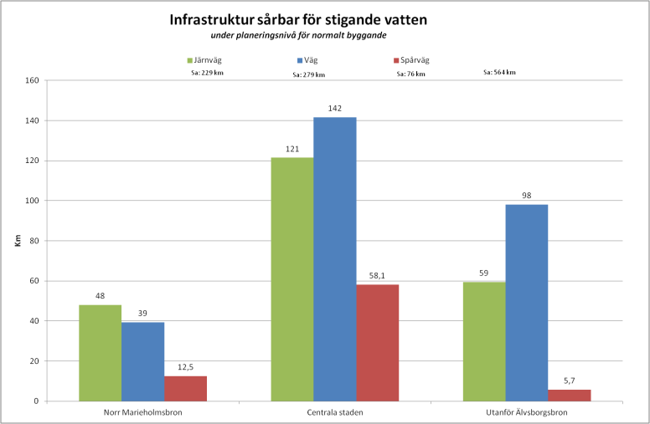
Infrastructure with a risk of flooding
Rail
Road
Tramway
In total 940 miles
370 miles
450 miles
120 miles
Upstreams
Central parts
River mouth
Notes:
SPEAKER TEXT:
A lot of the existing infrastructure is already vulnerable to flooding. About 370 miles of railway, 460 miles of roads and 120 miles of tramway has a risk of flooding. The city is about to start planning how to secure the functionality of the infrastructure to ensure that safe evacuation is possible if or when needed.

Slide 11
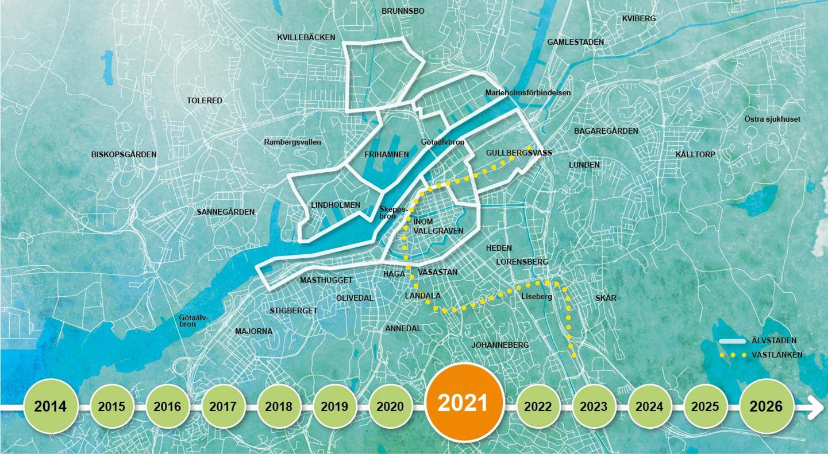
Together we are developing a close city!
Notes:
SPEAKER TEXT:
Gothenburg has embarked on a journey of which we have seen only the beginning. Over the next 15 years, Gothenburg will grow and evolve into a close city – open to the world. Feel free to come along and become a citizen of Gothenburg. Thank you for listening!

Slide 12
CONTACT:
Development & International Affairs
Urban Transport Administration
Mikael Ivari
mikael.ivari@trafikkontoret.goteborg.se

Slide 13
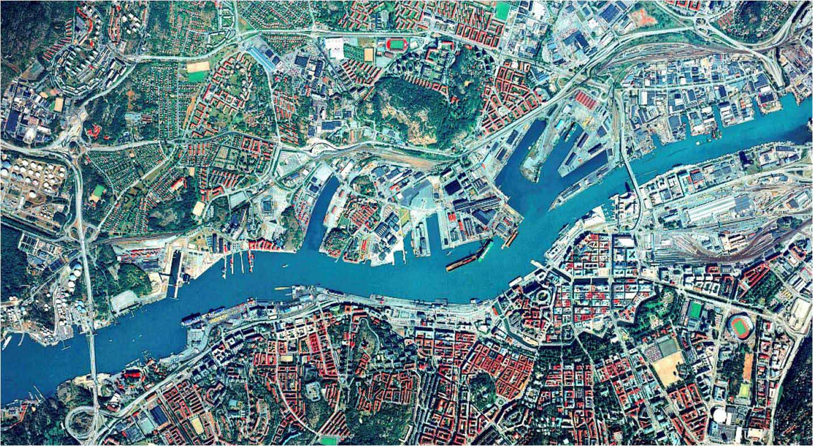

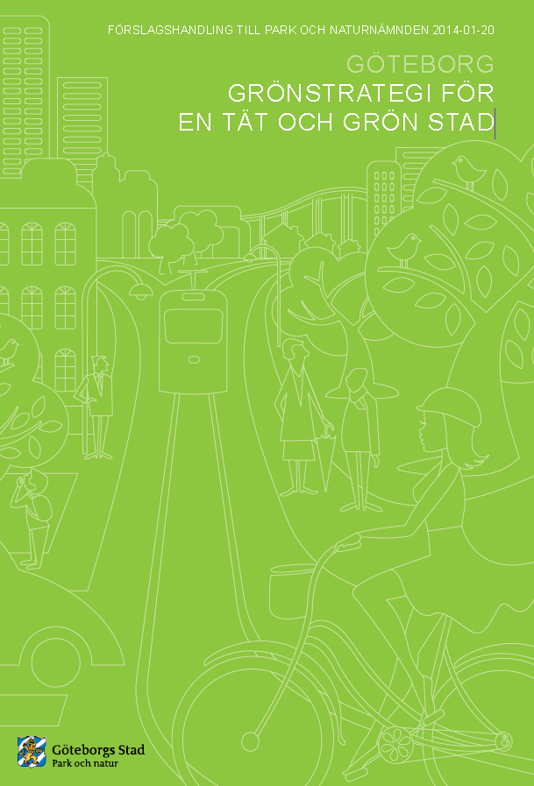
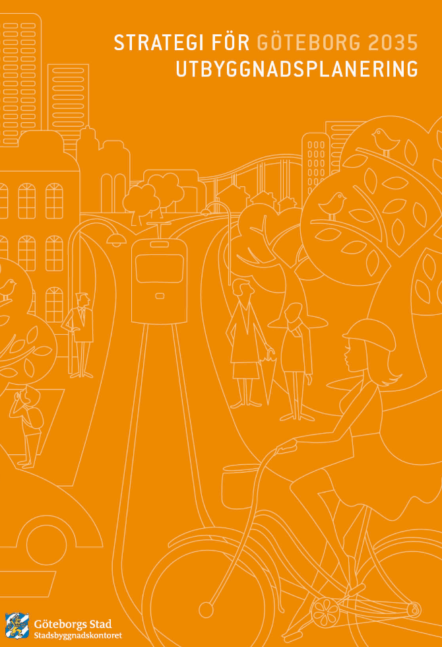

From large town – to green and close city where nothing’s far away
A growing city
Vision River City
Traffic Strategy
Green Strategy
Expansion Planning
Jointly indicate the
direction Gothenburg
will develop in up to 2035.
Proceeds on the Comprehensive Plan for
Gothenburg.
Notes:
SPEAKER TEXT:
Gothenburg is growing dramatically at the moment and is preparing to make space for almost 700,000 residents by the year 2035 – that’s 150,000 more than today. This also means that Gothenburg is evolving. New houses are being built, and new residential areas and city districts are emerging on land previously used for industrial purposes. New roads, bridges, cycle paths and expanded public transport will make it easier to get around in the city, both for private individuals and the business sector. Gothenburg will go from being a large town, to a green and close city, where nothing is far away.
The planned investments in public transport, roads and railways as part of the West Sweden Agreement are the largest in the Gothenburg region since the 1960s, when the Tingstad Tunnel and Älvsborg Bridge were built. Schools and pre-schools are being built for future residents.
The Comprehensive Plan for Gothenburg is the overall strategy for how the city will develop sustainably. The four guiding documents – Vision Älvstaden, Traffic Strategy for a Close City, Green Strategy for a Dense and Green city and Strategy for Gothenburg 2035 Expansion planning – jointly indicate the direction Gothenburg will develop in over the next 20 years. Taking advantage of what exists and densify at places with good public transport is the basic idea. It is within the already built city and around the strategic nodes that Gothenburg will grow.
At regional level, the Gothenburg Region Association of Local Authorities (GR), has developed a long term strategy for sustainable growth, which extends to 2030.

Slide 14
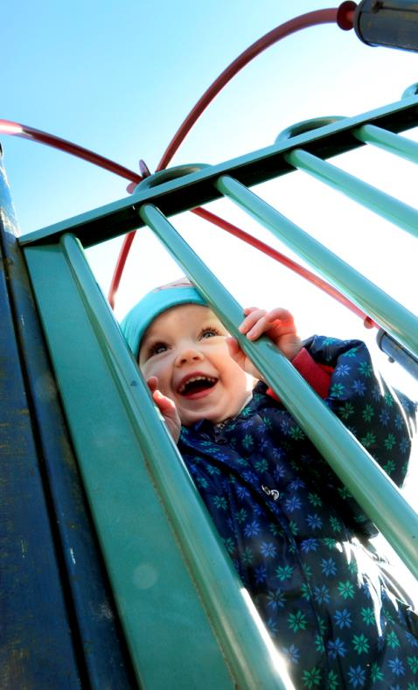
Gothenburg is growing
– but the aim is to shorten distances
New residents are being born and many are migrating here from local areas and other countries. More companies want to set up business here, more tourists want to visit.
The aim is to shorten distances, both between places and people. The city will be brought
closer together – both physically and socially.
The city will be more compact with new homes, workplaces and meeting-places.
Notes:
SPEAKER TEXT:
Global competition is increasingly about competition between growing city regions. International trade, economic regeneration and growth are concentrated into larger and larger city regions. Our region has to hold its own in this arena. This is why Gothenburg will grow. Major strategic infrastructure investments will make it easier for people to get around the city, create a better environment and more reliable transport for trade and industry, in Gothenburg, to the region and the world beyond.
Gothenburg is growing but the aim is to shorten distances – both between places and people. The city will be brought closer together – both physically and socially. We will connect the city across the river, with a central city environment on both sides. The city will be more compact with new homes, workplaces and meeting-places.

Slide 15
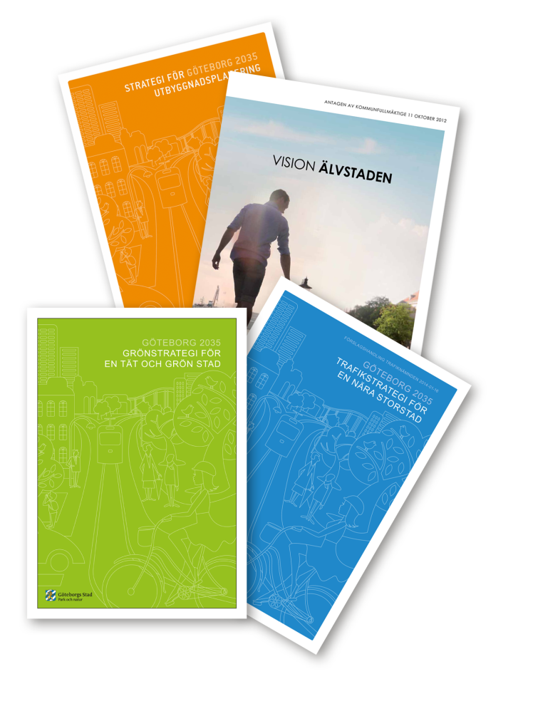
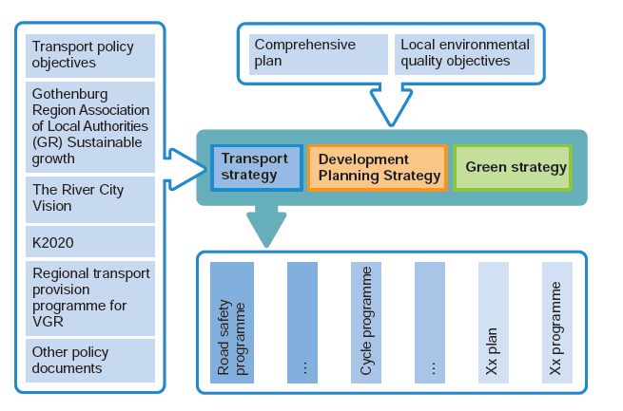
City strategies

Slide 16


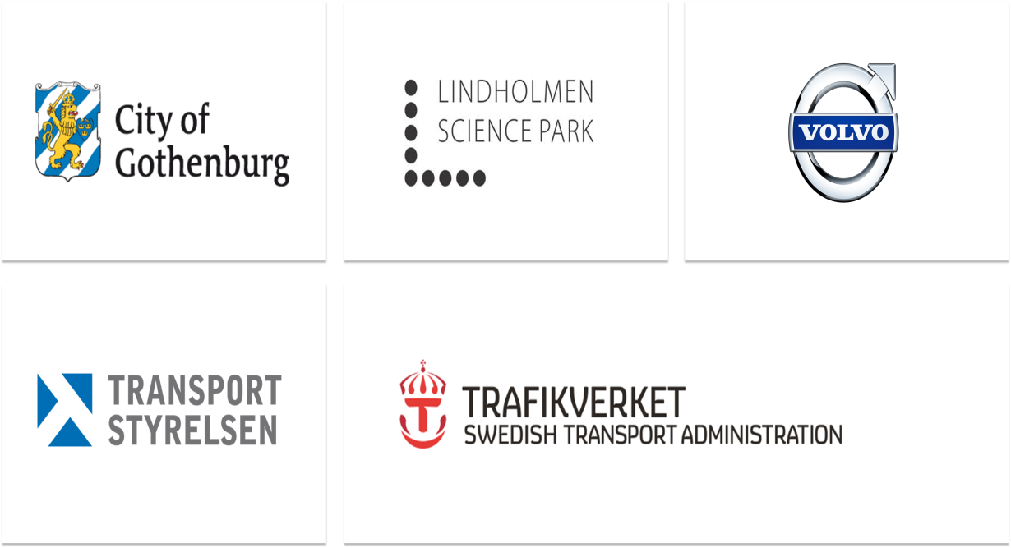

Slide 17
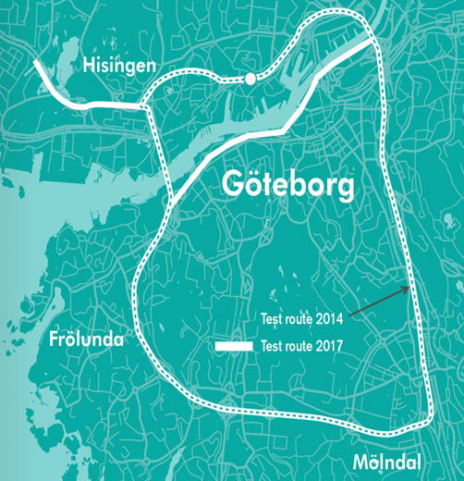
DriveMe project
The world´s first large scale project for self-driving cars
Project started in 2014
Self-driving cars on public roads in 2017
100 customer cars
50 km highways, max speed 70 kph
Automatic parking in 2015

Slide 18
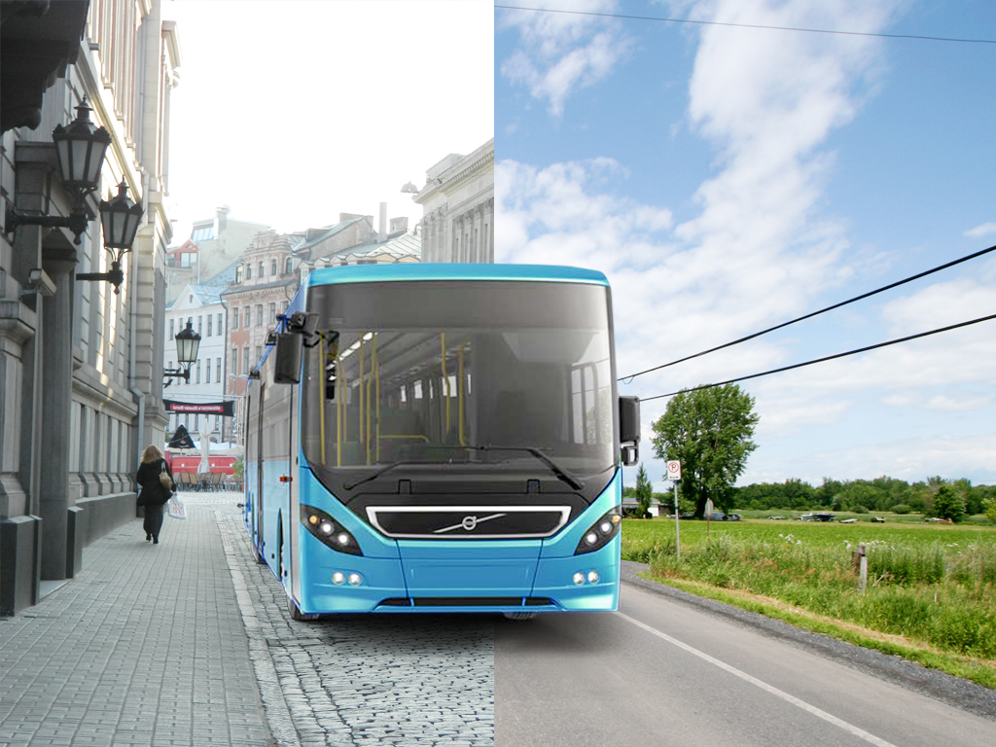


The bus adapts to the city/environment based upon it’s position using a GPS.
From diesel on the motorway or major arteries to quite and clean electric mode within the city or densely populated areas.
We can even limit speed or drive mode dependant upon time of day.
Better usage of shared spaces
Better air quality
Less noise pollution
Better safety
Geofencing / smart zones
Göteborgs Stad | Trafikverket | Volvo Buss AB | Volvo Technology AB
GO:SMART
Notes:
By Geofencing the public authorities can secure electric operation in the city center and speed control in front of schools, residential areas and high polluted areas as well as load-and emission regulations in citylogistic areas and environmental zones. The demonstrator will addresses both buses and goods distribution vehicles. In 2018 there is a new buss procurement. What if it geofencing could be krav?

Slide 19


Incident Warning System
– making the bus safer !
Göteborgs Stad | Trafikverket | Volvo Buss AB | Volvo Technology AB
GO:SMART
Notes:
Men när den ljudlösa el-bussen glider fram på torget så uppstår ett nytt säkerhetsproblem. Även om hastigheten regleras till exempelvis 30 km/h så kan olyckor uppstå. Därför kompletterar vi bussen en ny typ av kollisionsvarningssystem som inte bara tar hänsyn till andra fordon utan även till fotgängare och cyklister. Ett system speciellt utvecklat för kollektivtrafik i ”shared spaces”. Detektorerna talar dels om att ett objekt befinner sig i bussen möjliga körbana, men identifierar också vilken typ av objekt det handlar om (fotgängare, cyklist) och vad det i sin tur kan innebära för säkerheten. När kollektivtrafiken ökar på shared spaces blir den här typen av kollisionsvarning nödvändig.

Slide 20
Utveckling av persontrafiken i Göteborg
Skattningar av antal personresor inom och till/från Göteborg.
Medelantal resor under vardagar.
Diagrammet avser årsmedelvärden. Från 2001 används en ny metod vilket innebär svårighet att göra jämförelser med tidigare år.

Slide 21
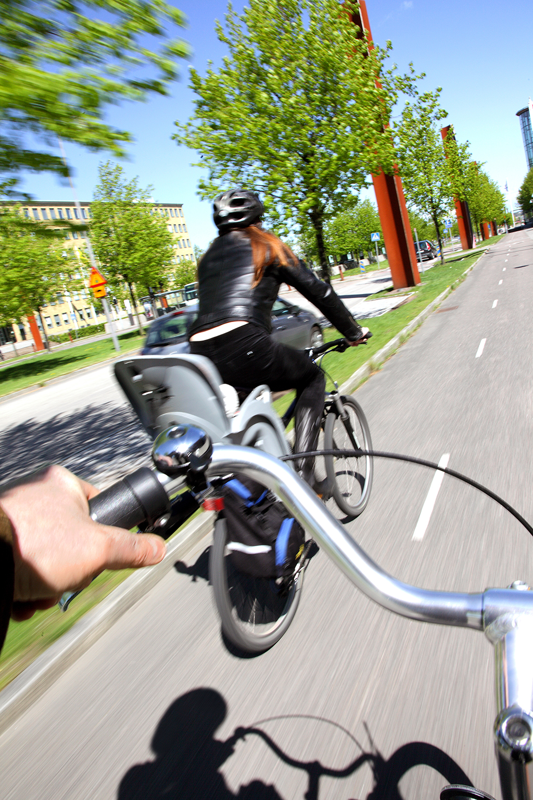
Cykeltrafik över året

Slide 22
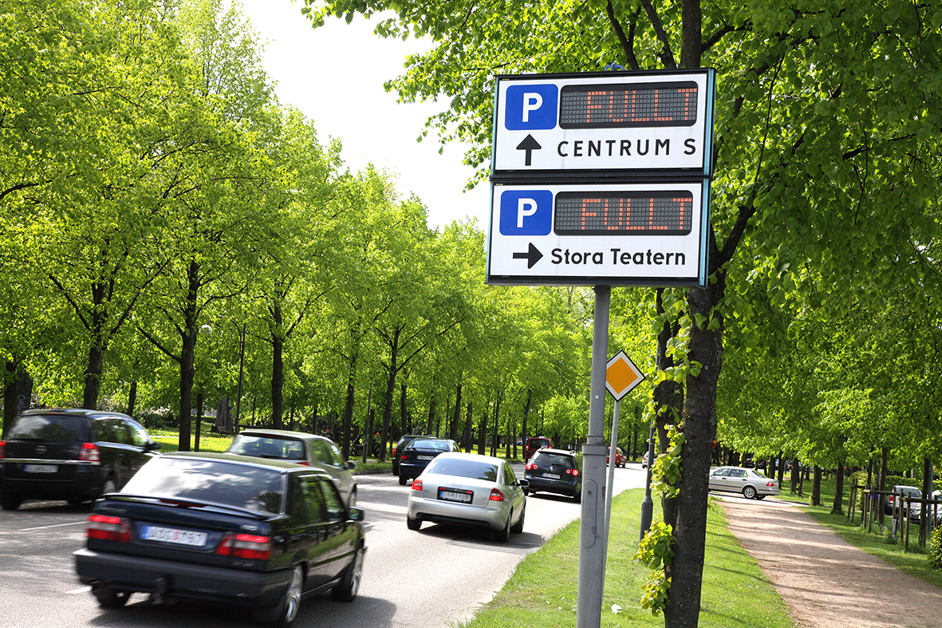
Biltrafikutveckling
Biltrafikutveckling i de fasta snitten.
2,2%
2,4%
1,2%
-1,8%
-7,1%

Slide 23
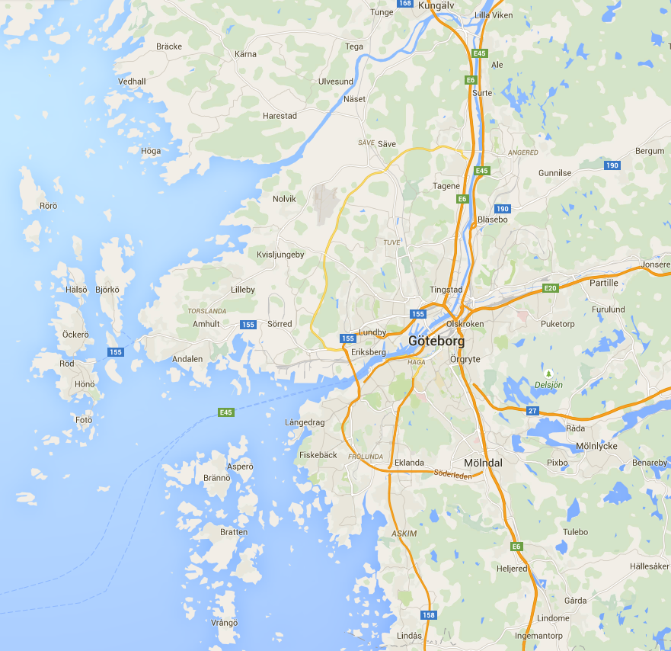
Rubrik
Eventuell underrubrik
Eventuellt namn på föredragshållaren

Slide 24
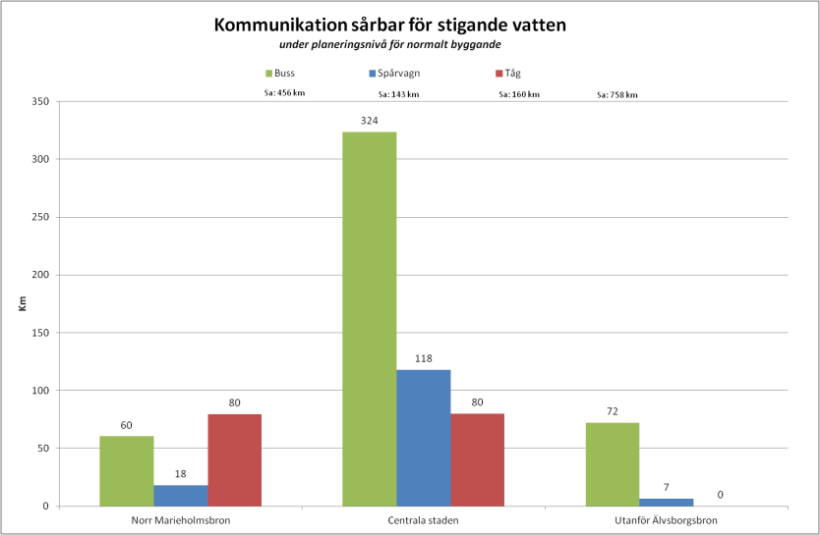
Sårbarhet kommunikation
TK alla linjer

Slide 25
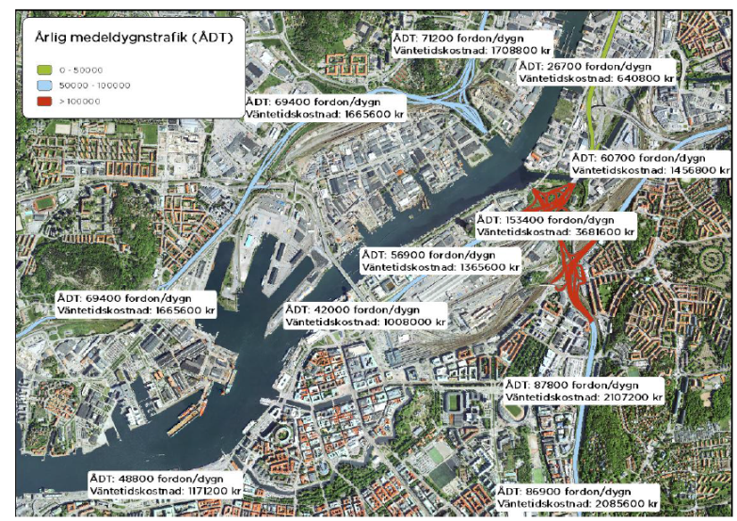
Stilleståndskostnader vägtrafik

Slide 26
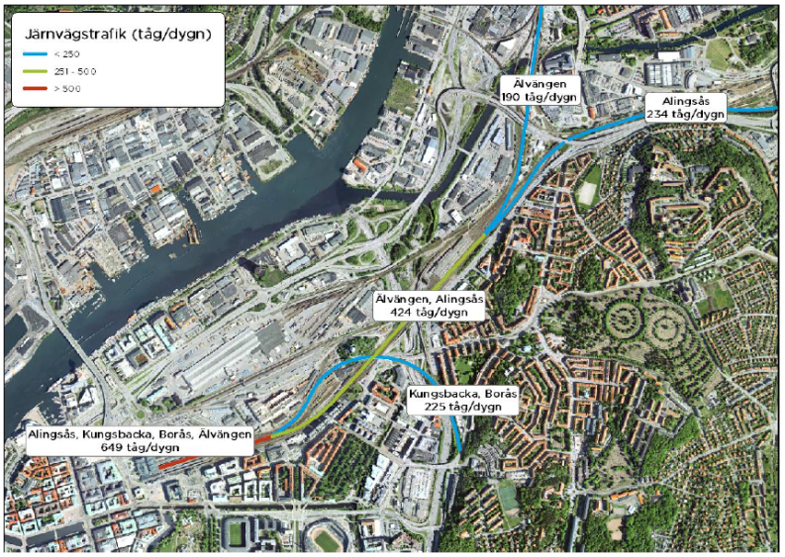
Konsekvenser järnväg

