Slide 1
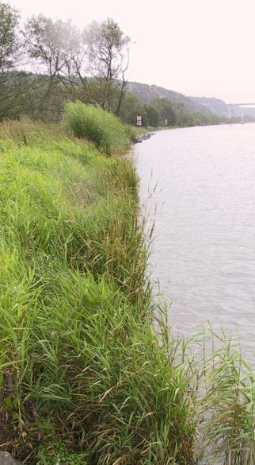


Biological Bank Protection
Per Danielsson
per.danielsson@swedgeo.se
Göta älv, Foto: SGI
Notes:
Centrera bilden, lägg ev på en ram

Slide 2
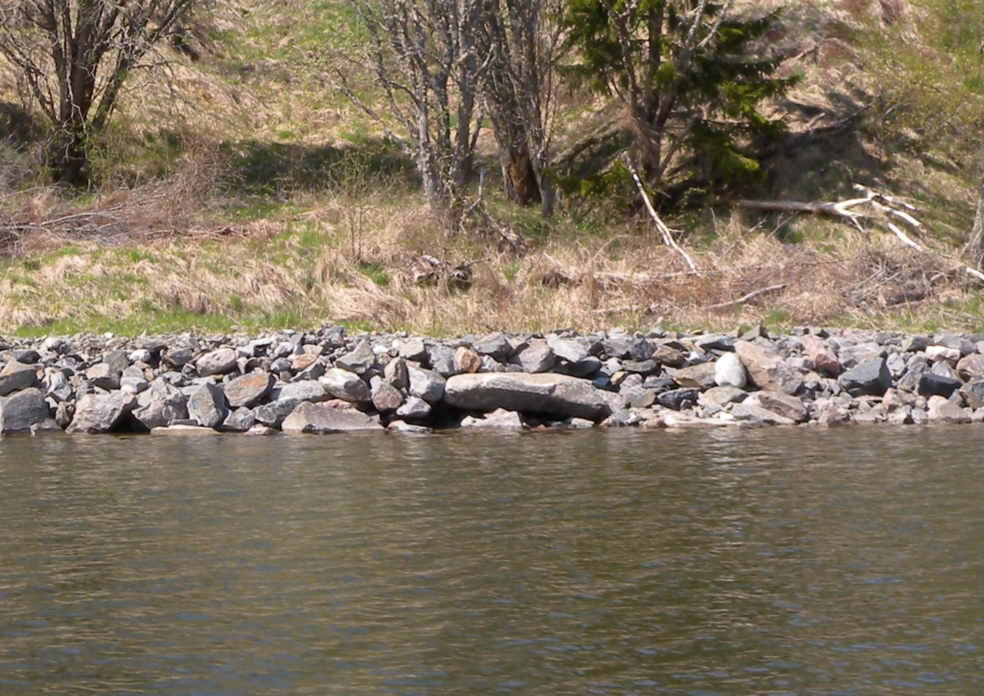
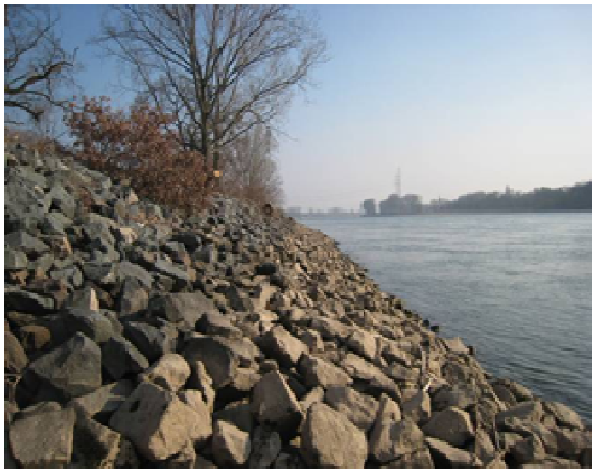
Rip rap construction
Foto: SGI
Foto: BAW

Slide 3
Biological bank protection
Sweden
Europe
US / Canada
Foto: BAW

Slide 4
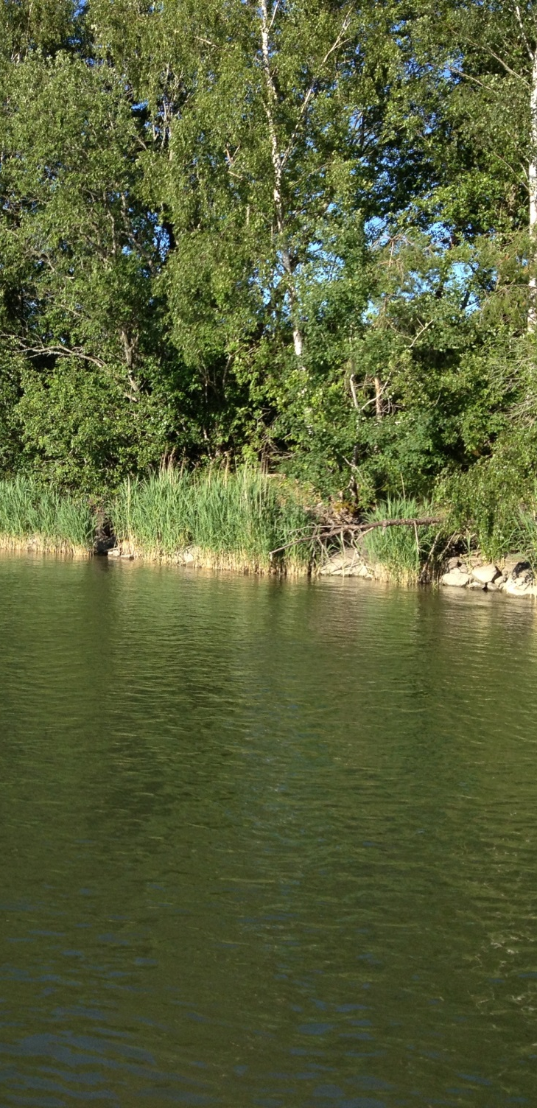
Biological bank protection
Material, plants, etc.
Construction requirements,
Design, slope, etc.
Soil type
Resistance
Environmental impact
Foto: SGI

Slide 5
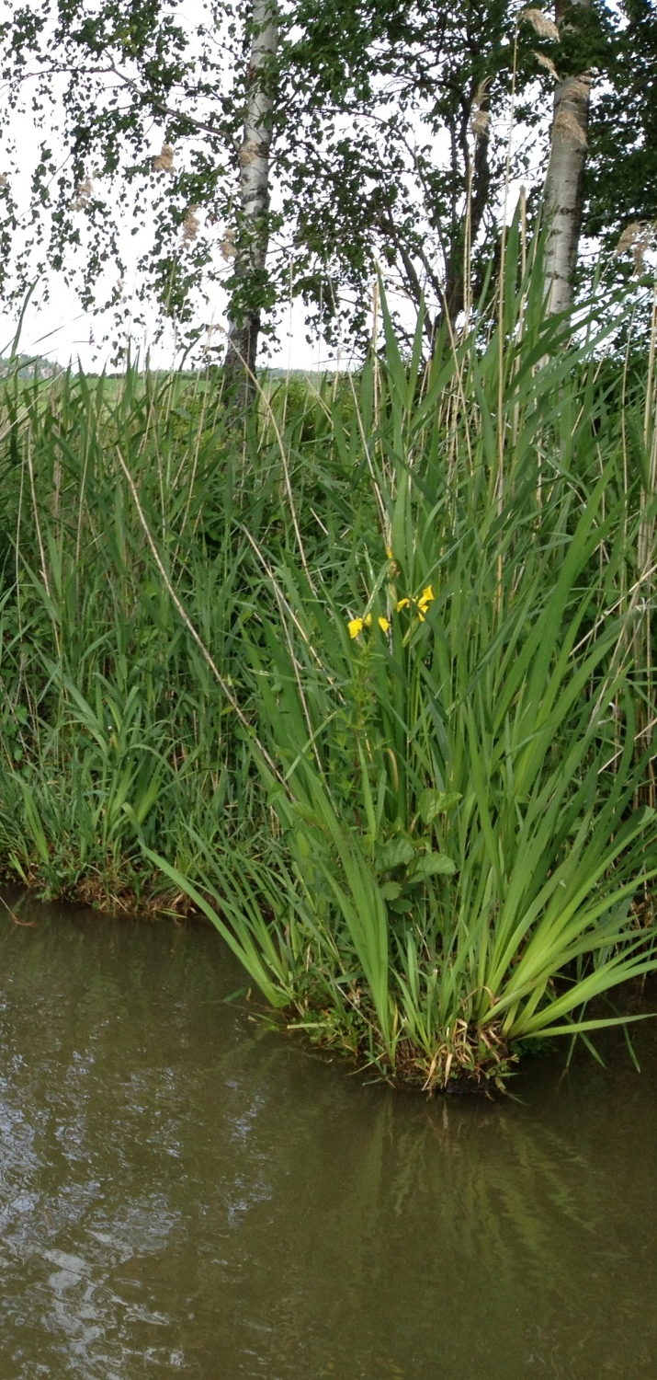
Goal
Existing bank protection methods
Classify according to use
Joint work between:
  Swedish Agency for Marine and Water Management
  Swedish Environmental Protection Agency
  Swedish Transport Administration
Foto: SGI

Slide 6
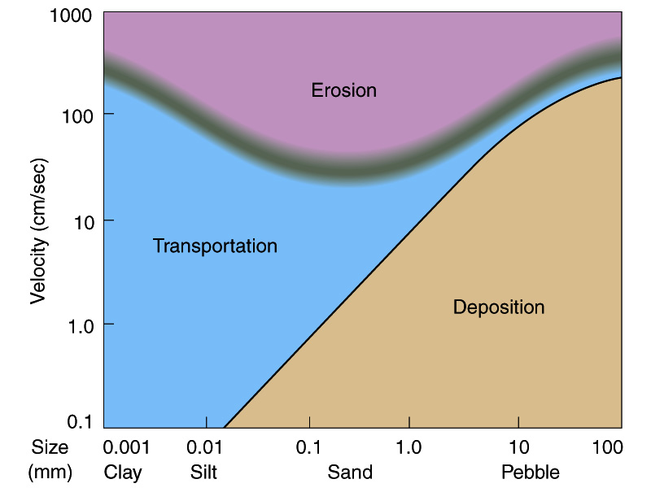
Water flow
Hjulström diagram

Slide 7
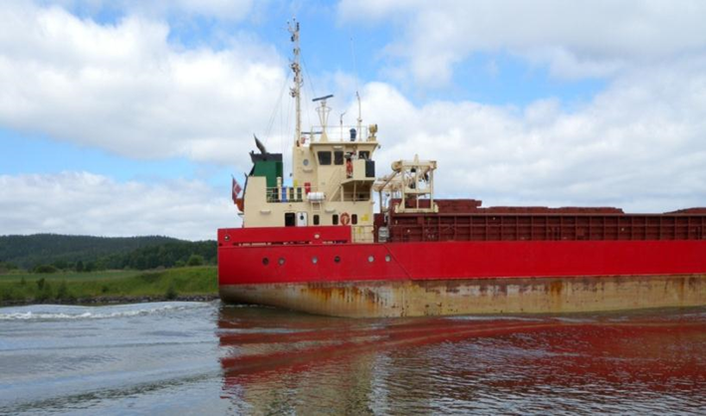
Ship generated waves
Foto: SGI

Slide 8
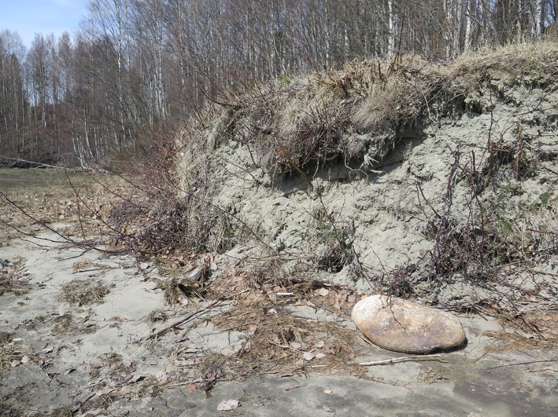
Ice induced erosion
Foto: SGI

Slide 9
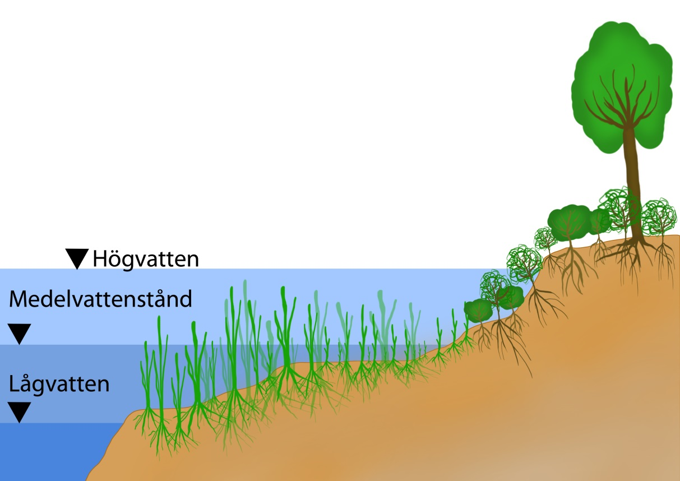
Biological bank protection
Illustration: K. Gellerstam

Slide 10
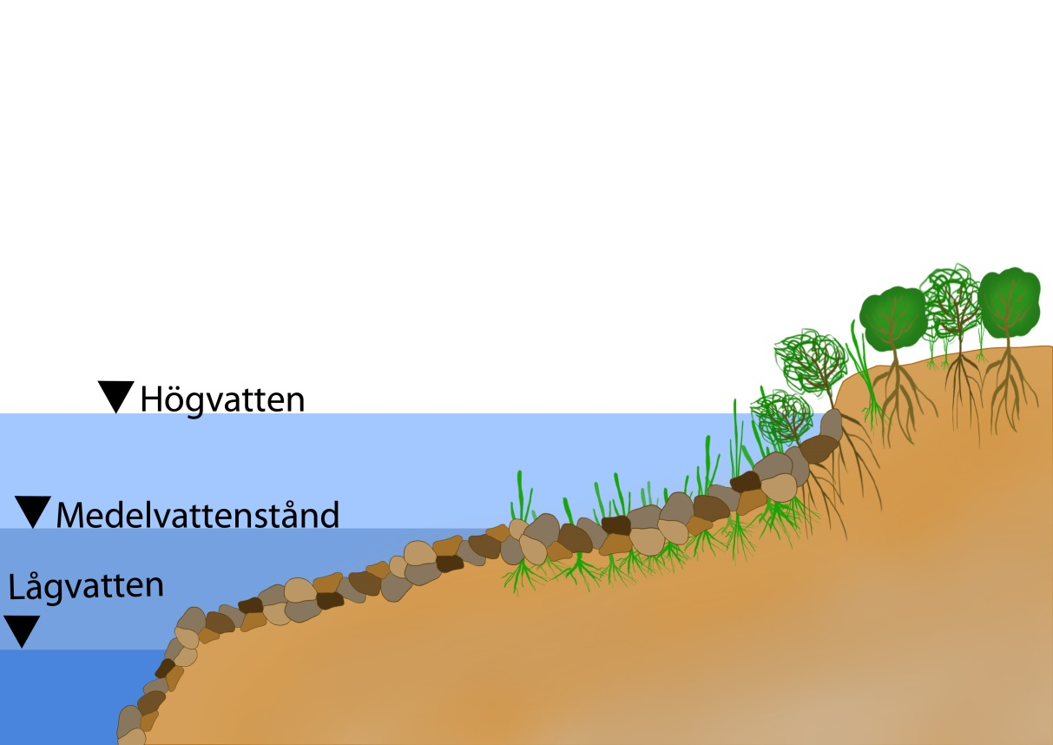
Technical-biological bank protection
Illustration: K. Gellerstam

Slide 11
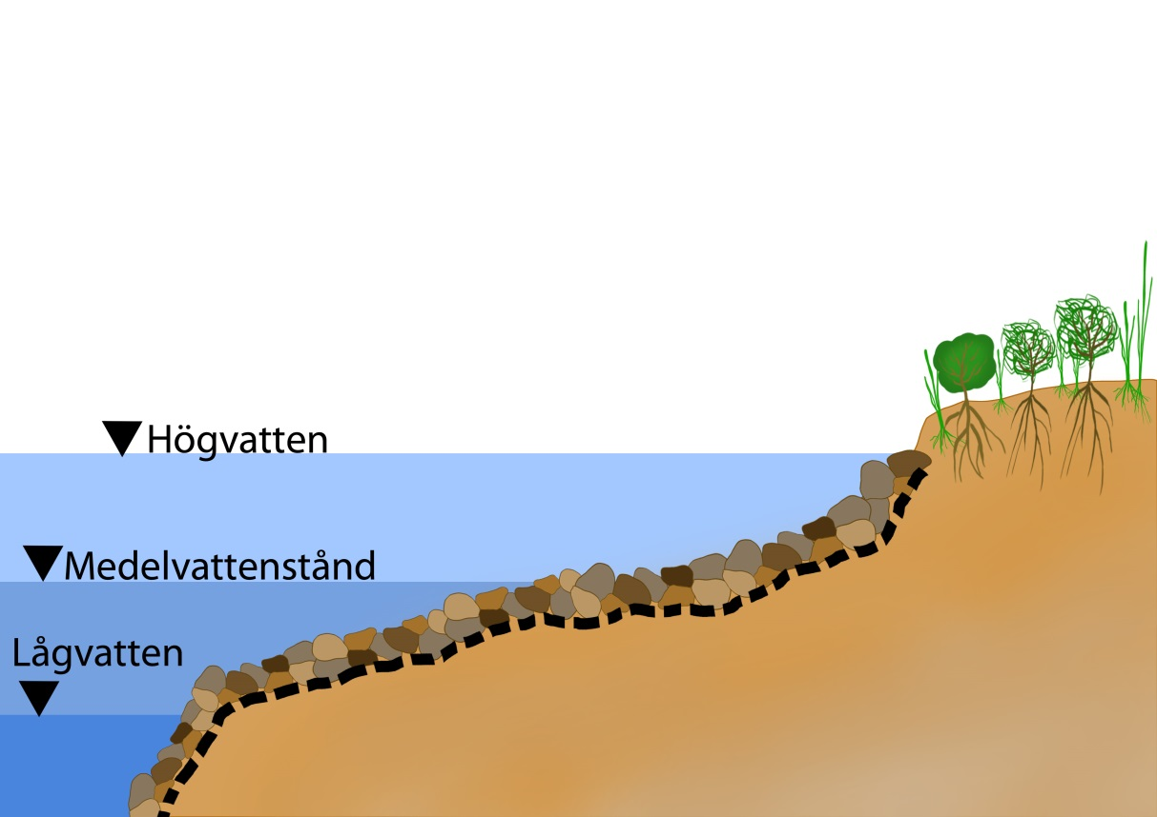
Hard structures, Rip-rap
Illustration: K. Gellerstam

Slide 12
Methodology
Socio-economic values?
No
No action
Yes
Should the bank be protected?
Authorising procedure
Identifying erosion
No
Yes
Type of bank protection:
- Biological
- Tech-biological
- Hard structure
Environmental impact analysis
Biological
Retreat or adaptation
Tech-biological
Hard structures
Construction
Design
Design
Construction
Construction
Design
Naturanpassade erosionsskydd

Slide 13
Biological bank protection
Illustration: K. Gellerstam

Slide 14
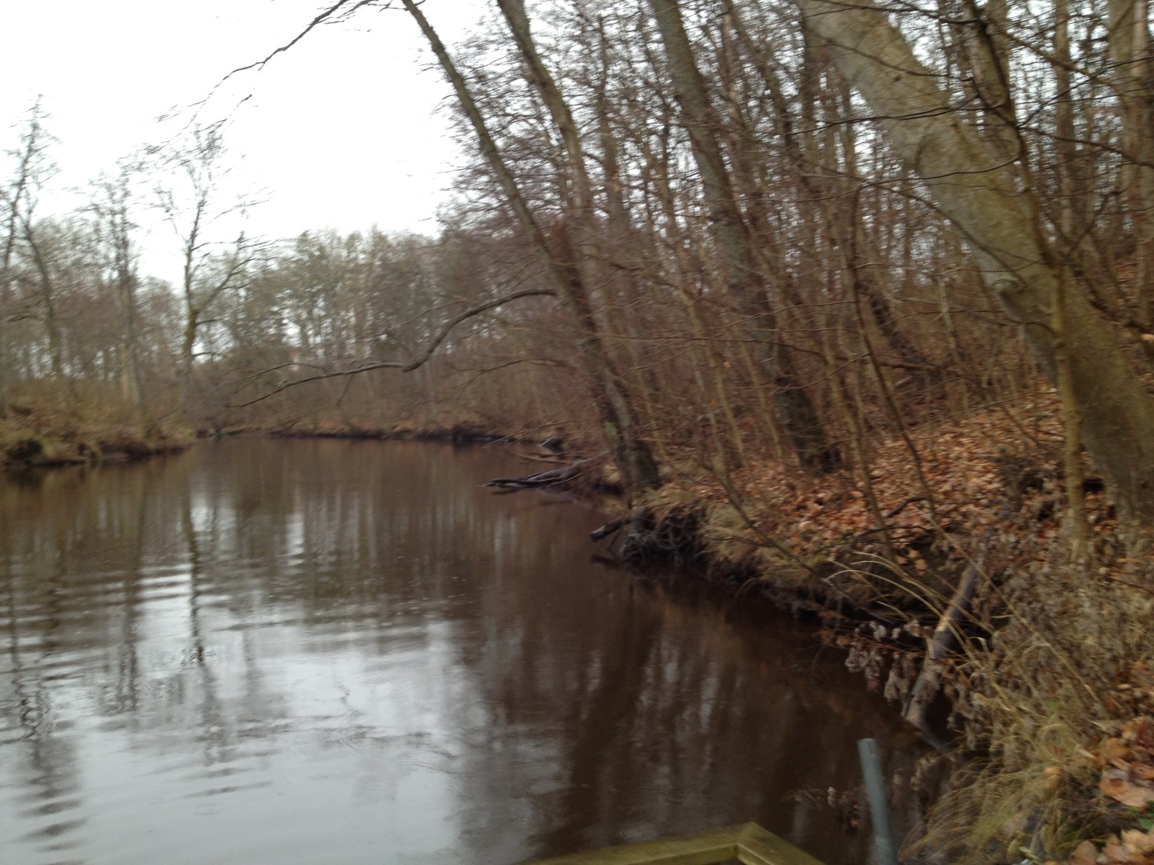
Natural vegetation Rönne å
Foto: SGI

Slide 15
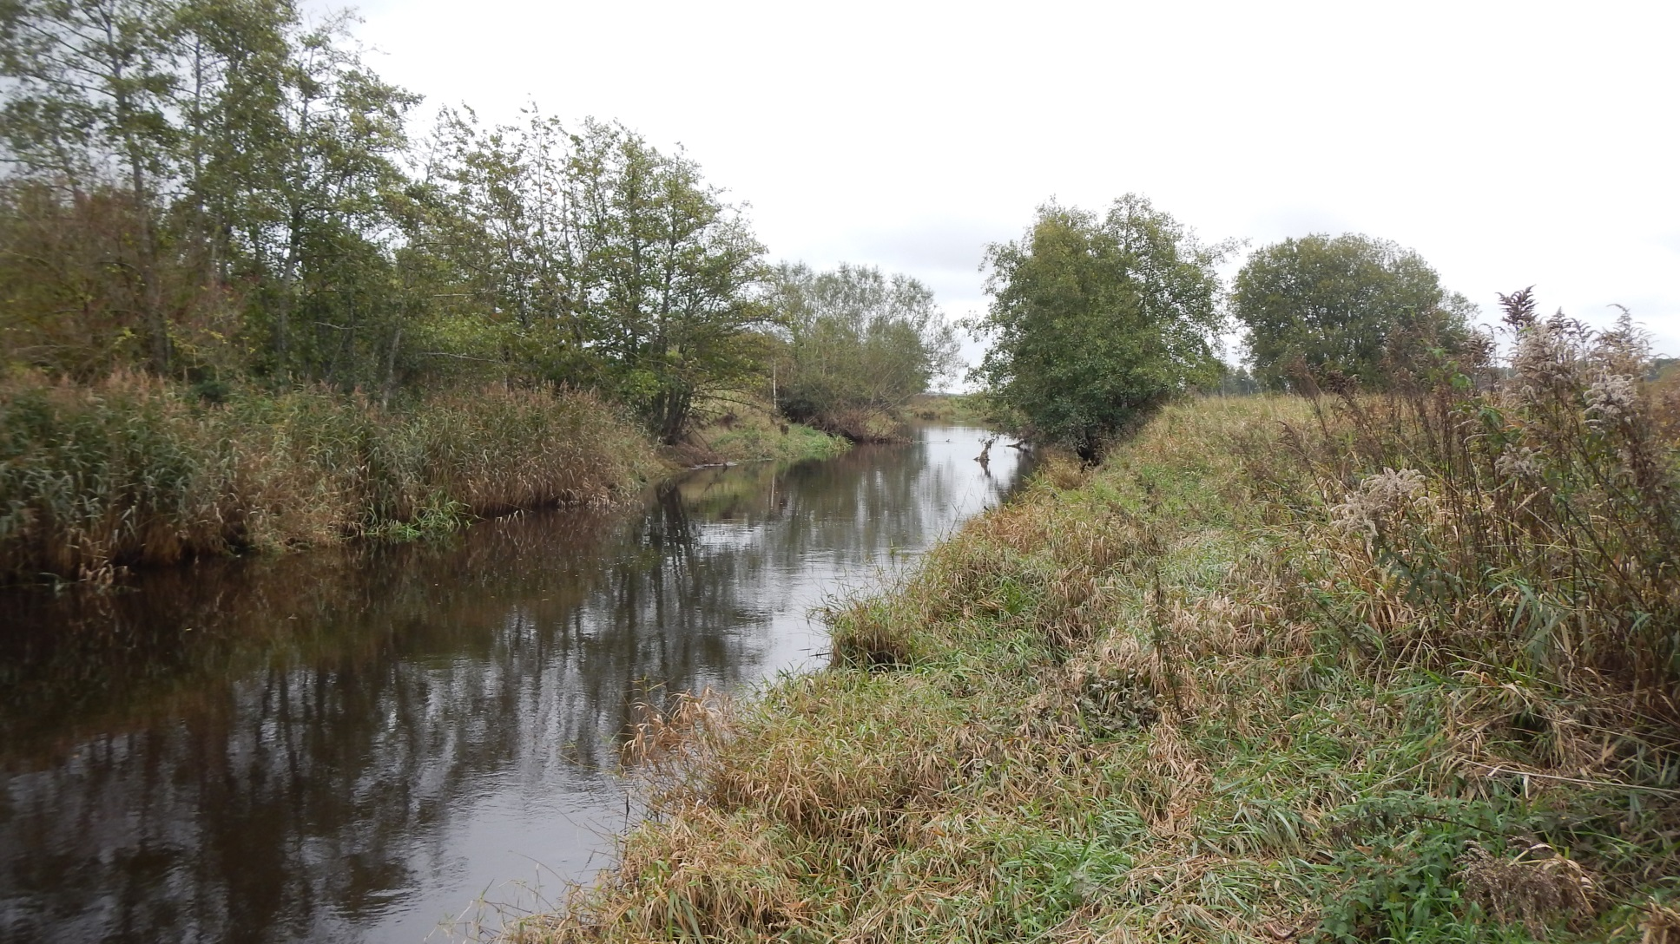
Natural vegetation Suseån
Foto: SGI

Slide 16
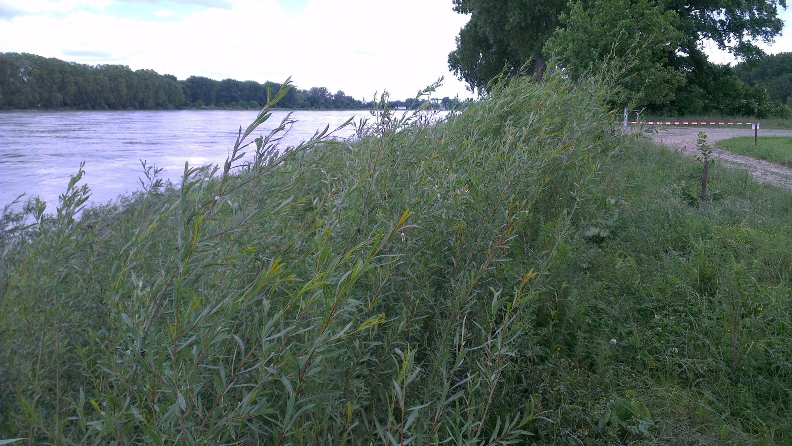
Salix
Foto: SGI

Slide 17
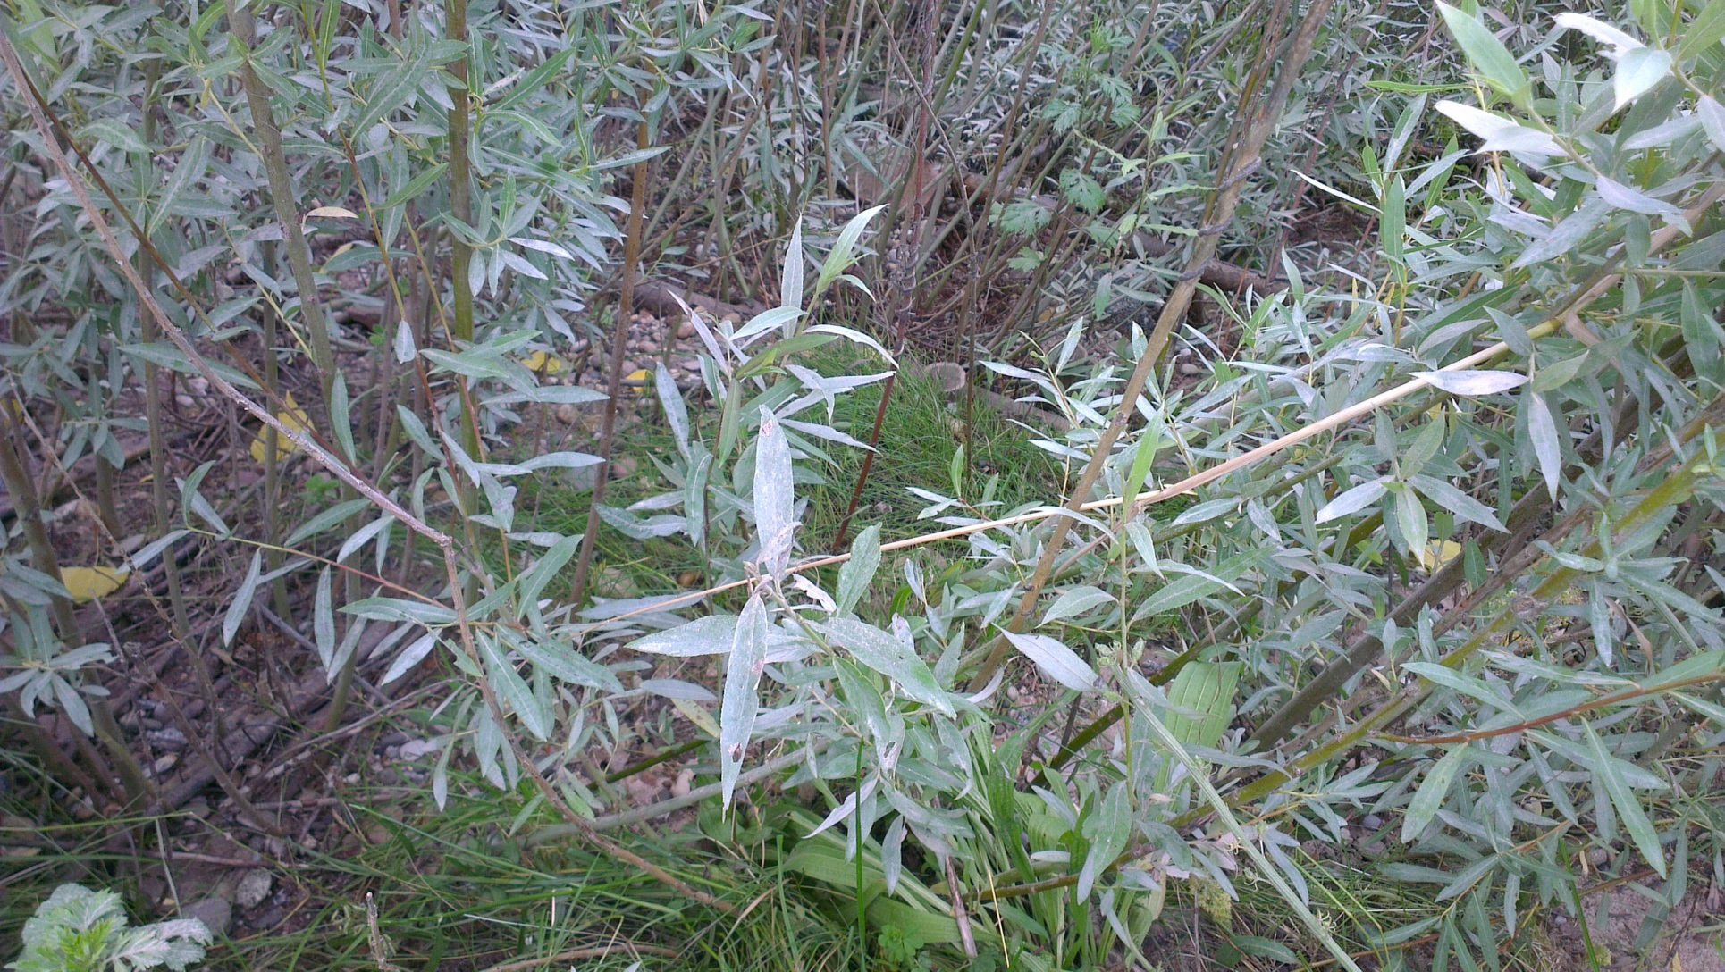
Salix
Foto: SGI

Slide 18
Tech-biological bank protection
Illustration: K. Gellerstam

Slide 19
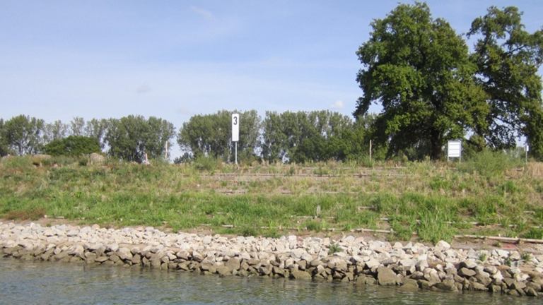
Rip-rap and vegetation
Foto: BAW

Slide 20
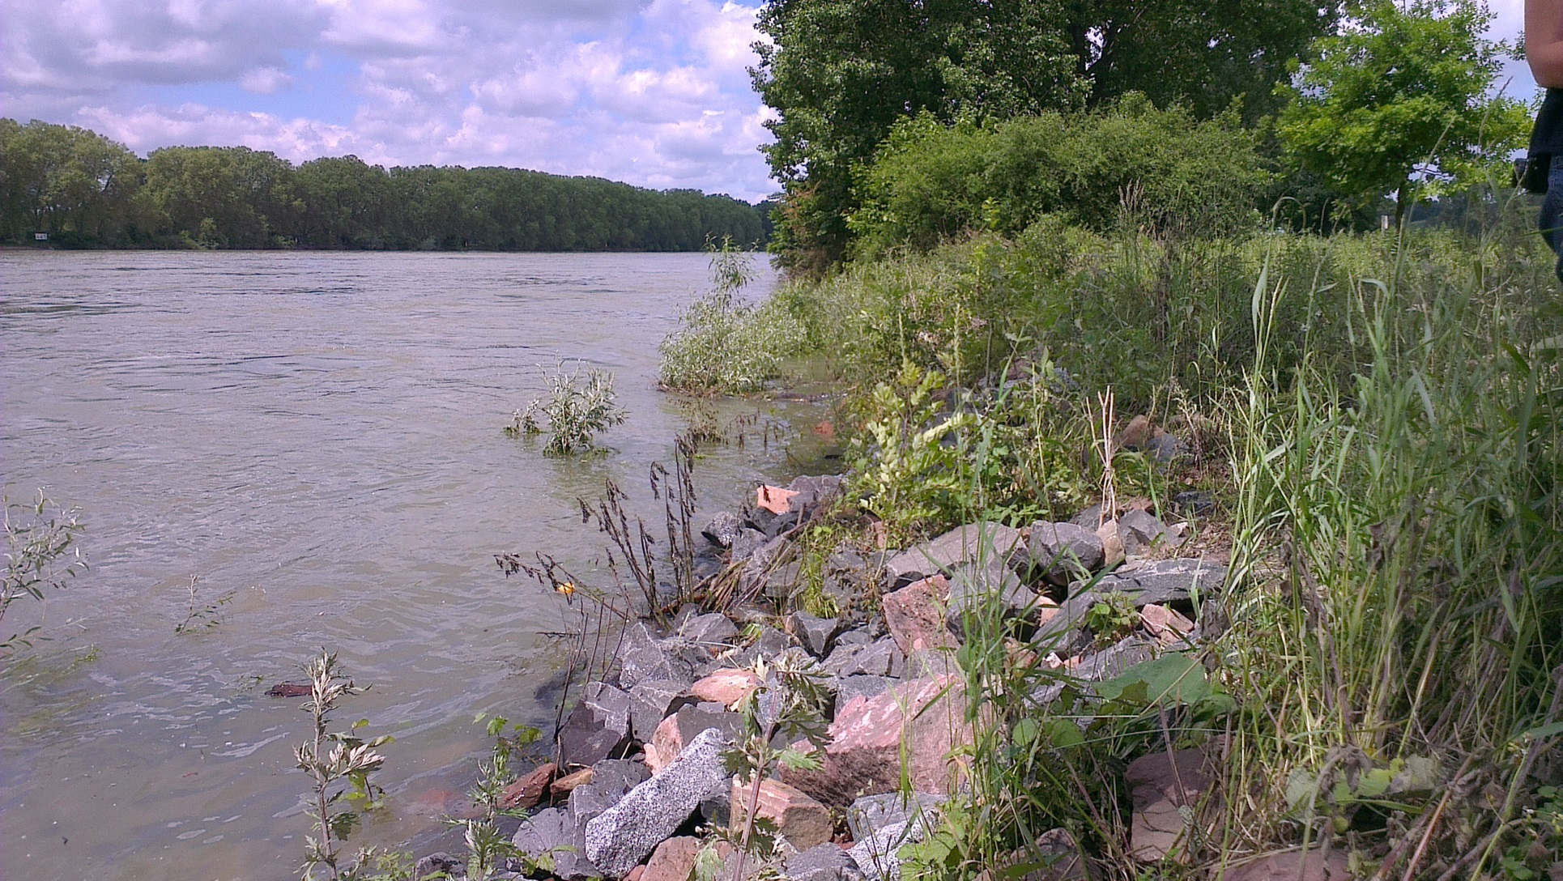
Rip-rap and plants
Foto: SGI

Slide 21
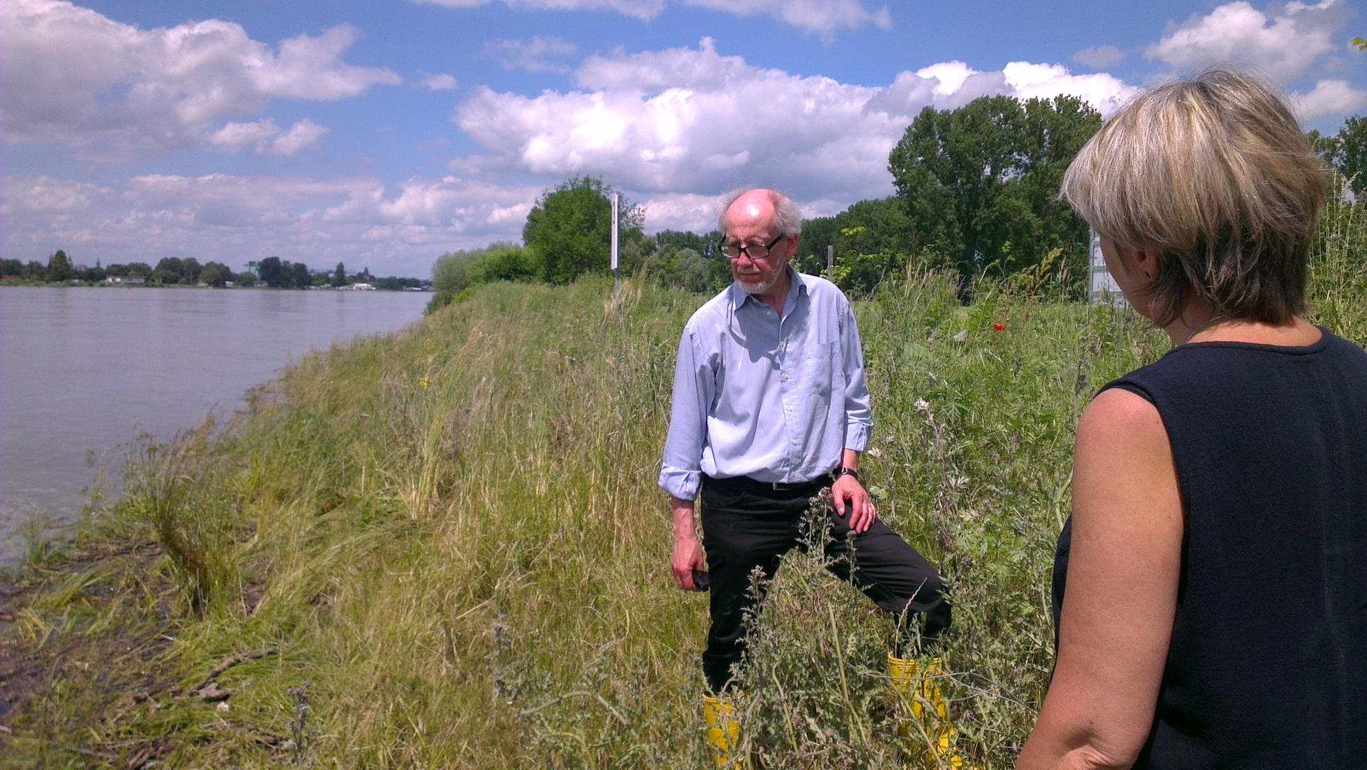
Geotextile and vegetation
Foto: SGI

Slide 22
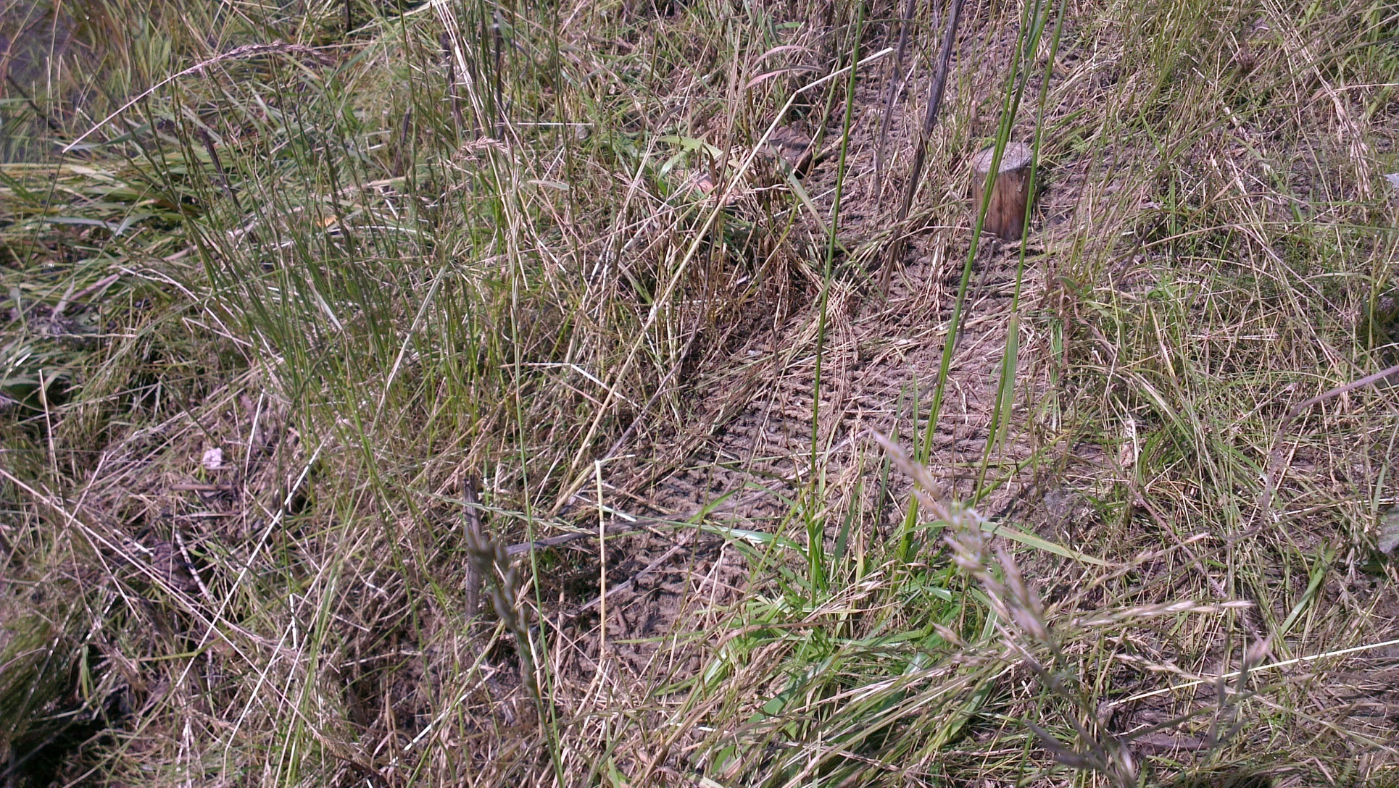
Geotextile and vegetation
Foto: SGI

Slide 23
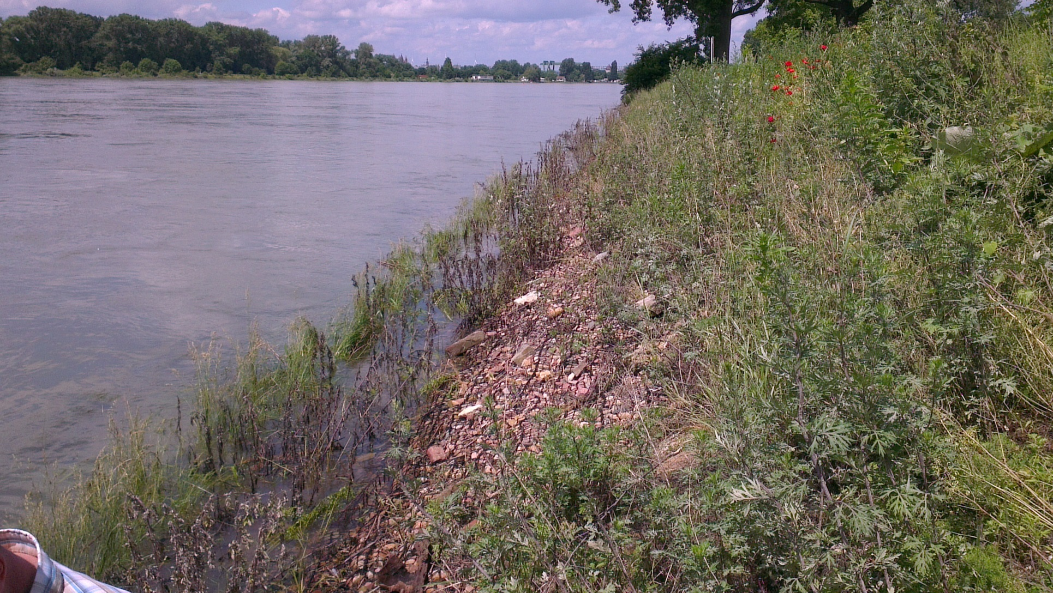
Gabions and vegetation
Foto: SGI

Slide 24
Tech-biological bank protection
Lerån, Lerum
Foto: Norconsult

Slide 25
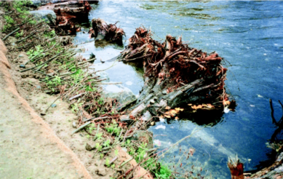
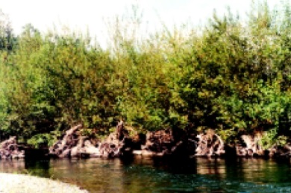
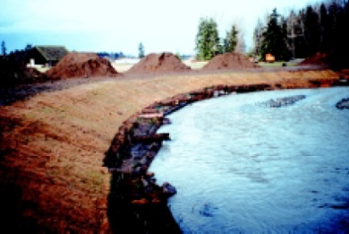
Logs and roots
Photo:
Washington State Aquatic Habitat Guidelines Program
Integrated Streambank Protection Guidelines, 2003

Slide 26
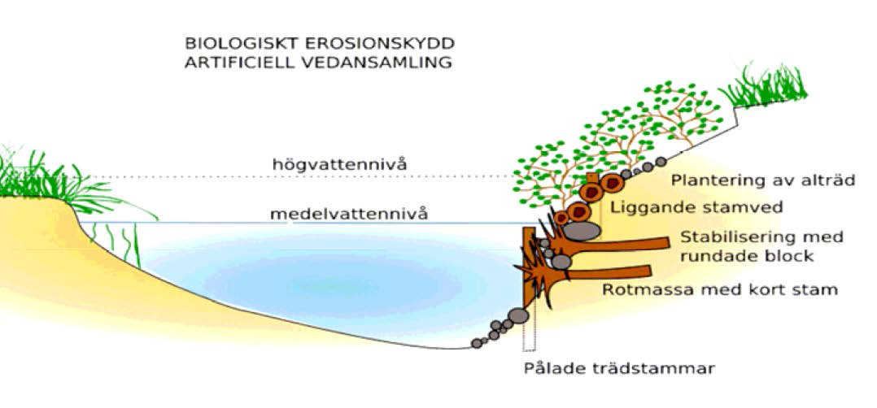
Roots and logs, Ätran
Illustration: Swedish Agency for Marine and Water Management

Slide 27
Roots and logs, Ätran

Slide 28
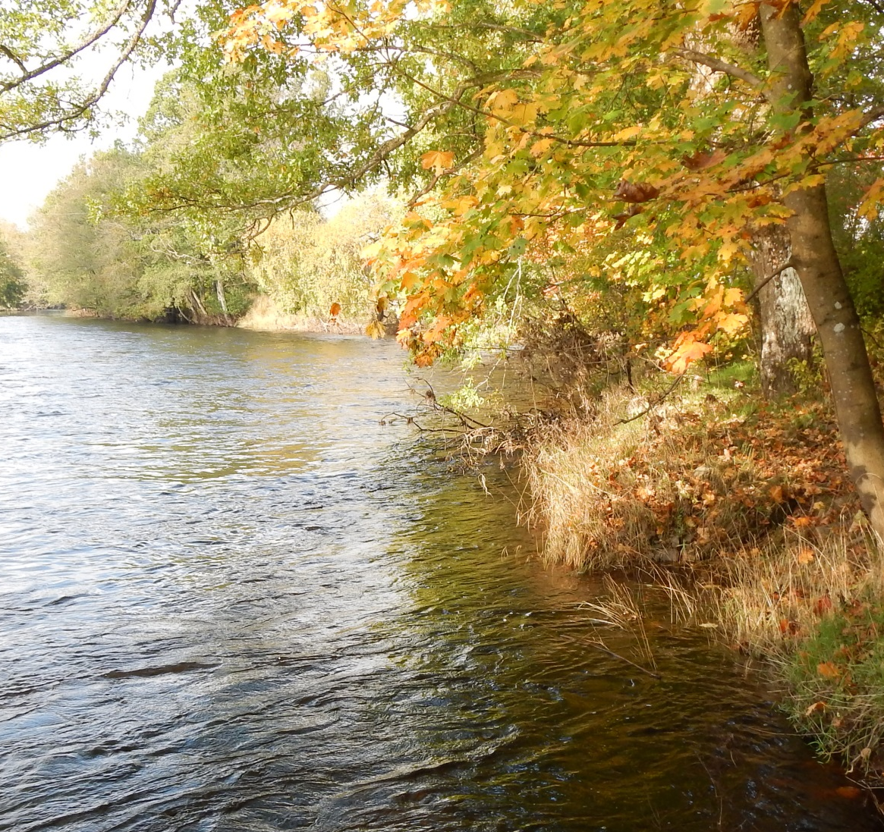
Thanks!

