Slide 1
Bo Lind, Swedish Geotechnical Institute
Exchange New Orleans - Gothenburg

Slide 2
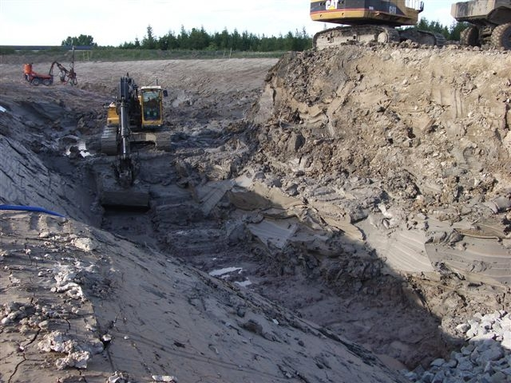
Glaciated landscape with soft sediments
(silt-clay)
Valleys and
Low-lands

Slide 3
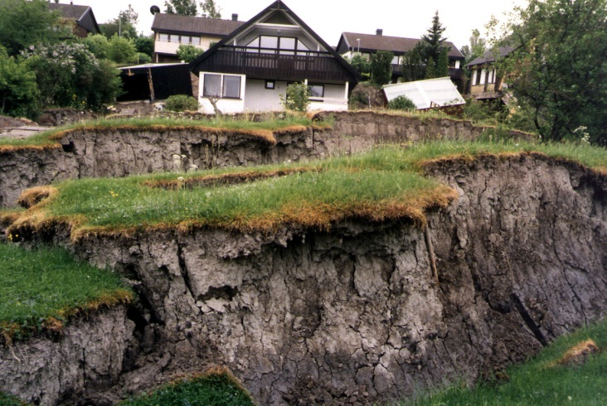
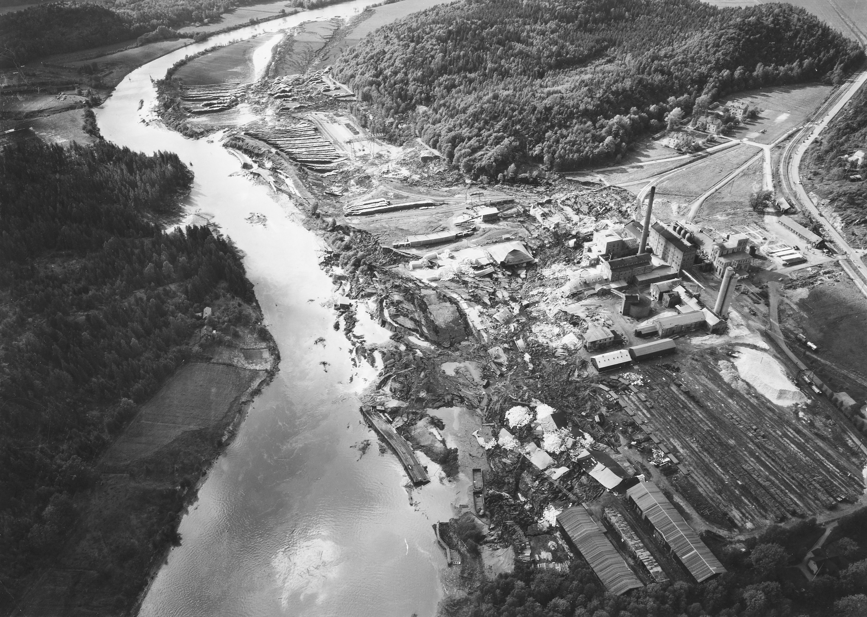
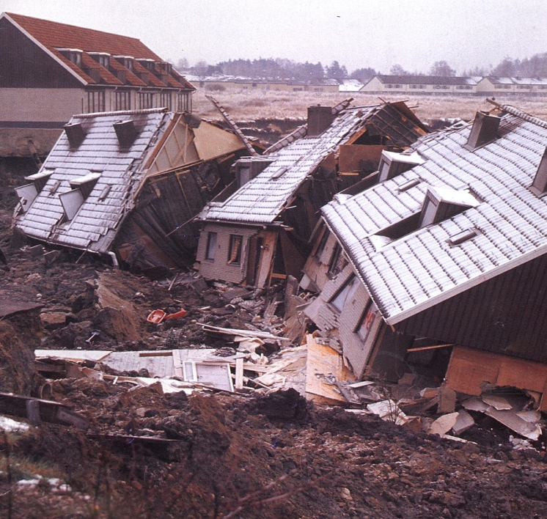
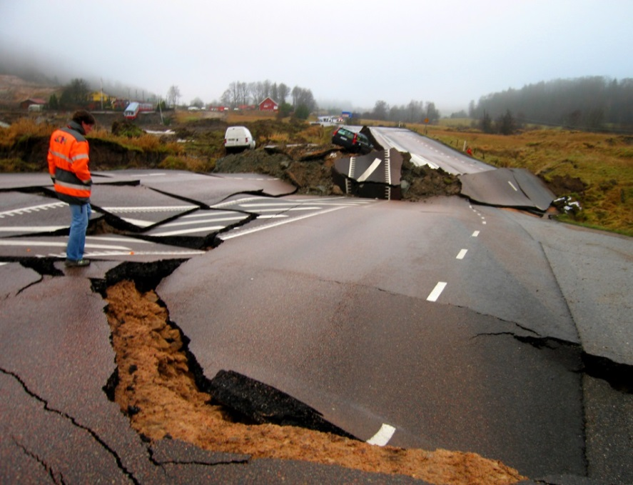
Post-glacial rebound – Erosion and landslides
Göta 1957
Vagnhärad 1997
Småröd 2006
Tuve 1977

Slide 4
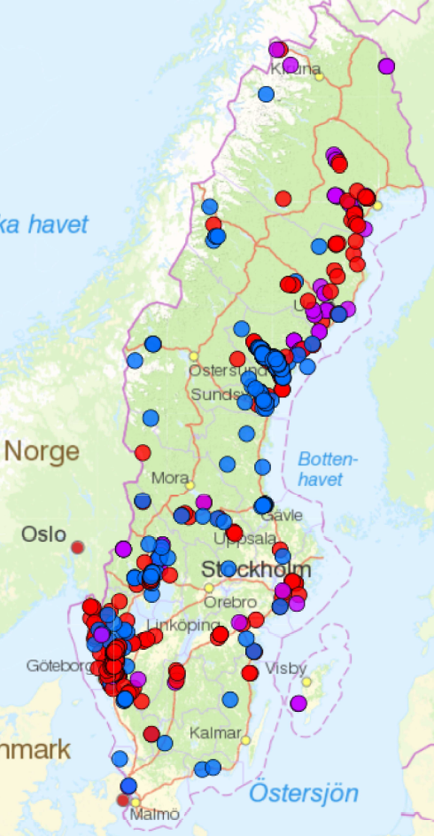
Landslides and
mudflows in Sweden

Slide 5
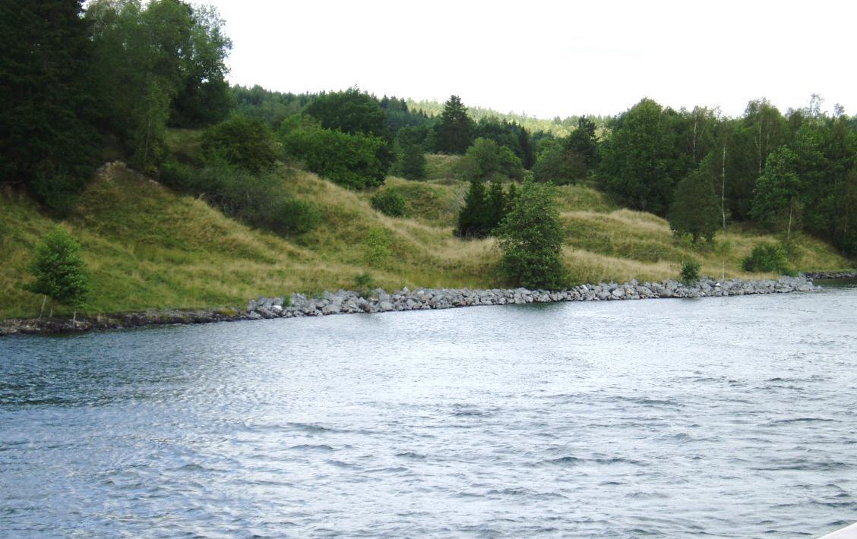
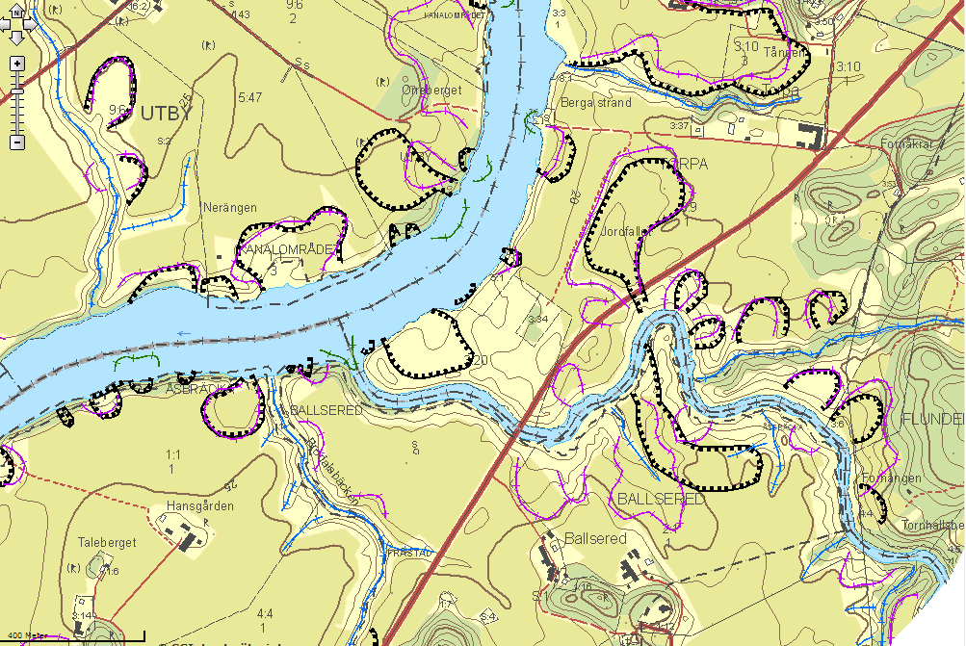
Dynamic landscape of
landslide scars

Slide 6
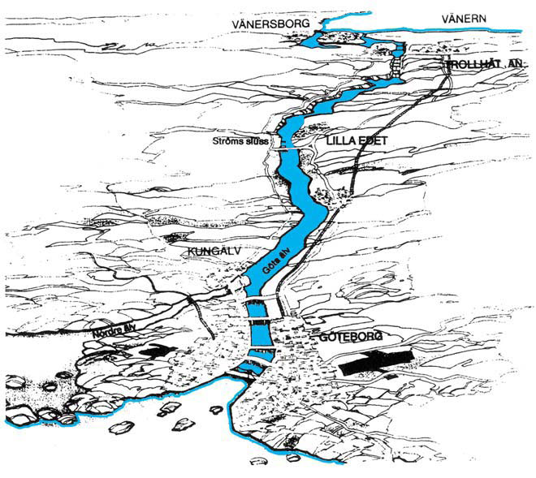
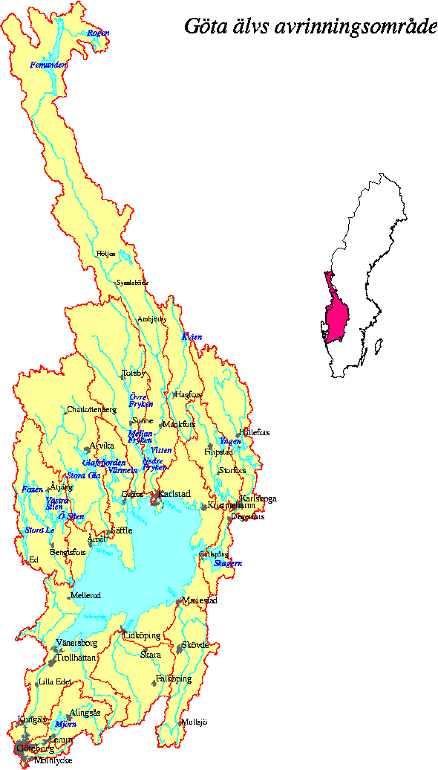
The Göta river valley
Run-off area
Large run-off area
Source of water supply for 8% of the population
Important infrastructure and settlements
Sensitive to landslides

Slide 7
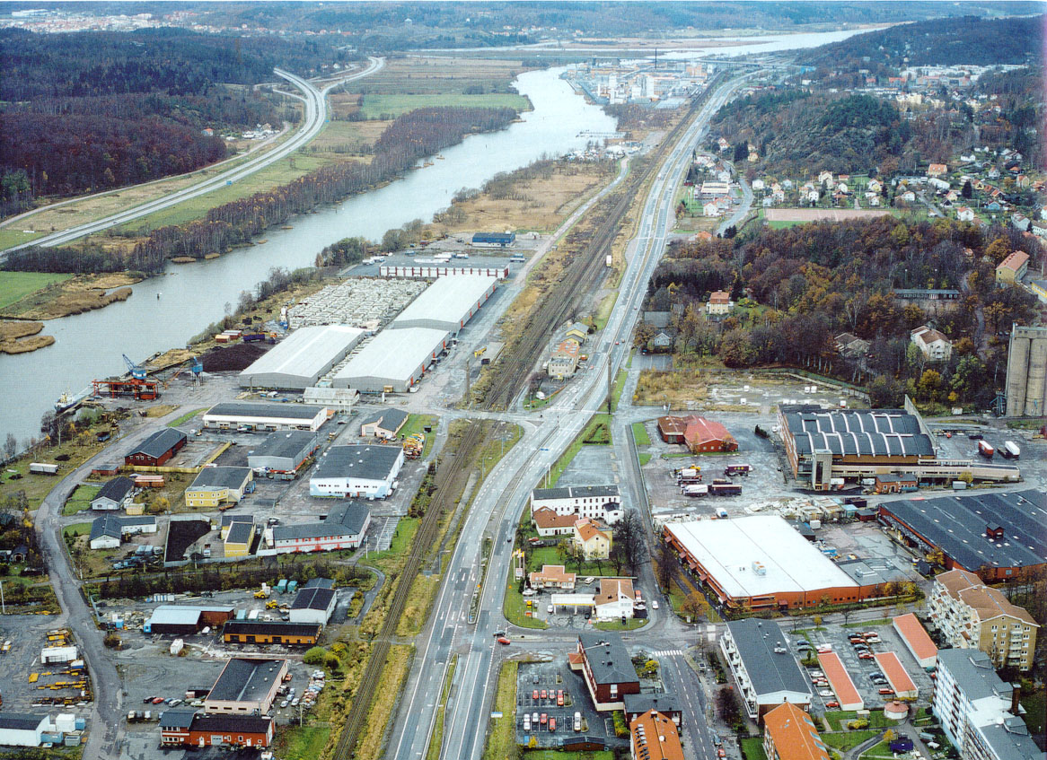
Catastrophic consequences of landslides
Foto: Thomas Samuelsson
Notes:
To meet climate change and increased water flow in the river, a comprehensive inventory of landslide risk is conducted.
The project is commissioned by the Swedish Government.
This 3-year project ending in December 2011 has a budget of c 12 million euro.
The outcome will be made public once the project is finished.

Slide 8
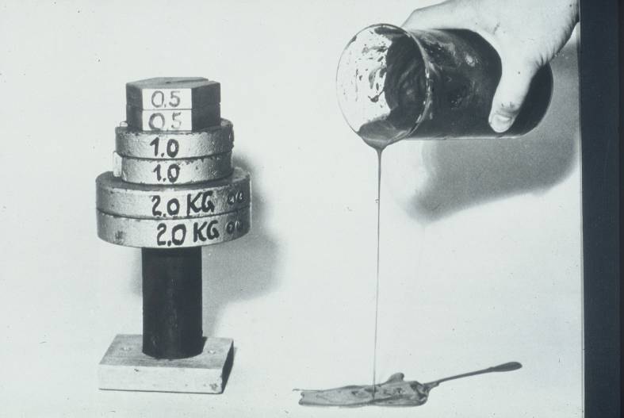
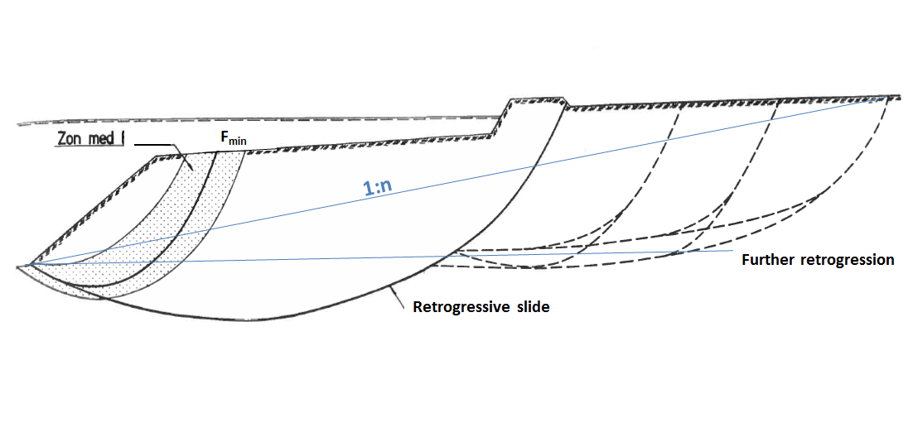
Landslide retrogression in areas with highly sensitive clay

Slide 9
Relative change in precipitation for a period of 30-years i the Vänerns runoff area (moving average)

Slide 10
Mapping of landslide risks - The Government's commission
“In order to address forthcoming climate changes and handle increased flow in the Göta River, greater understanding is required of the stability conditions along the entire Göta River. The funding is to be used for the improvement and production of landslide analyses and stability mapping along the Göta River.”

Slide 11
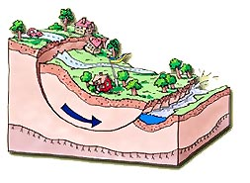
Landslides in a changing climate
Driving forces affected by:
Increased groundwater pressure – climate related
Flow and river erosion – climate related
Loading by houses and infrastructure – development

Slide 12
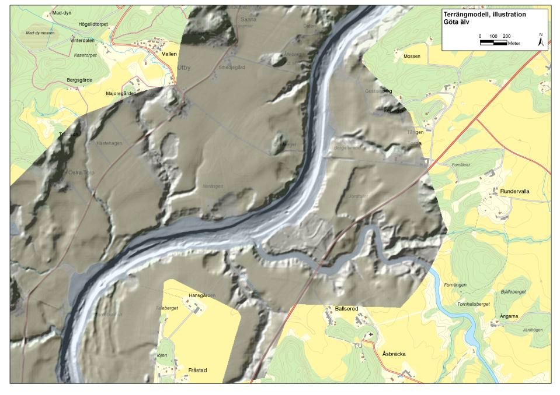
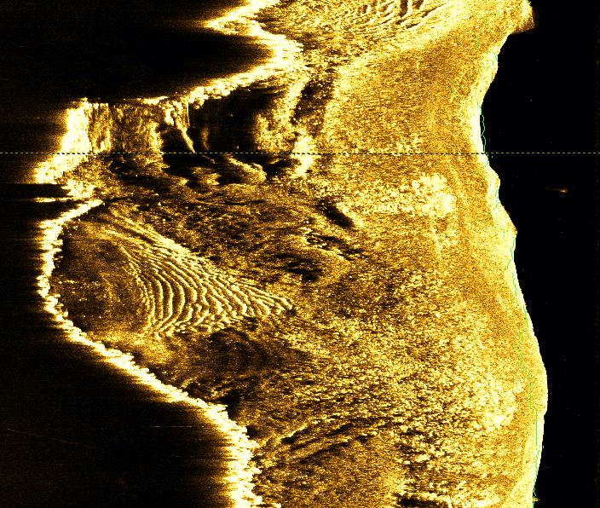
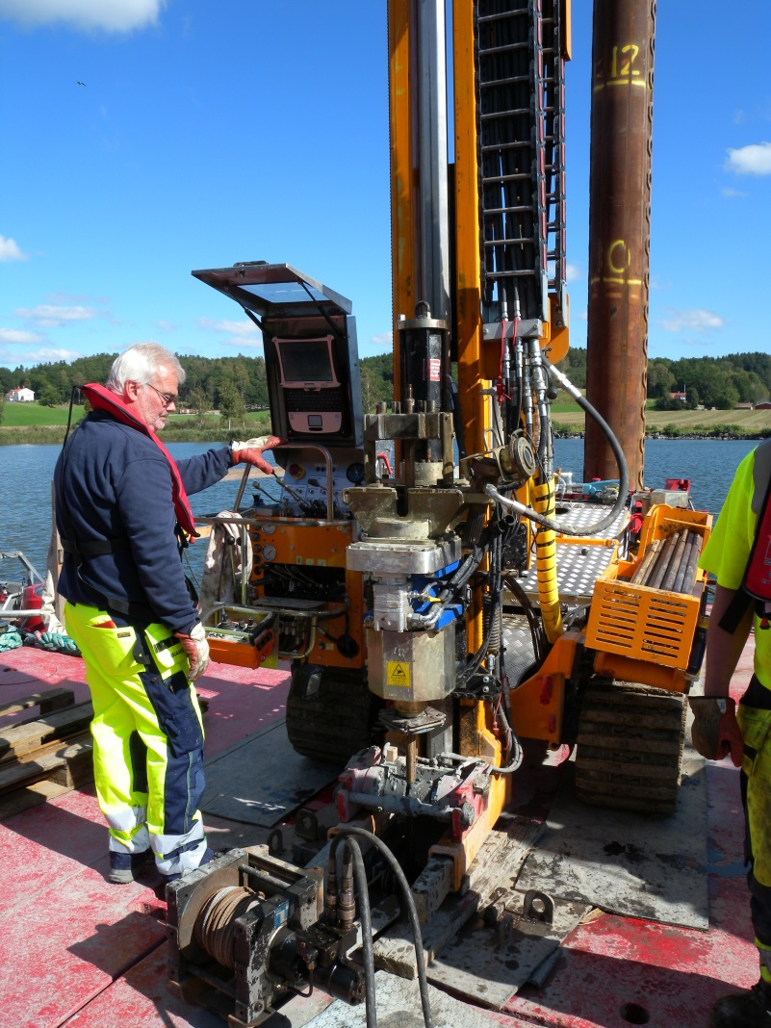
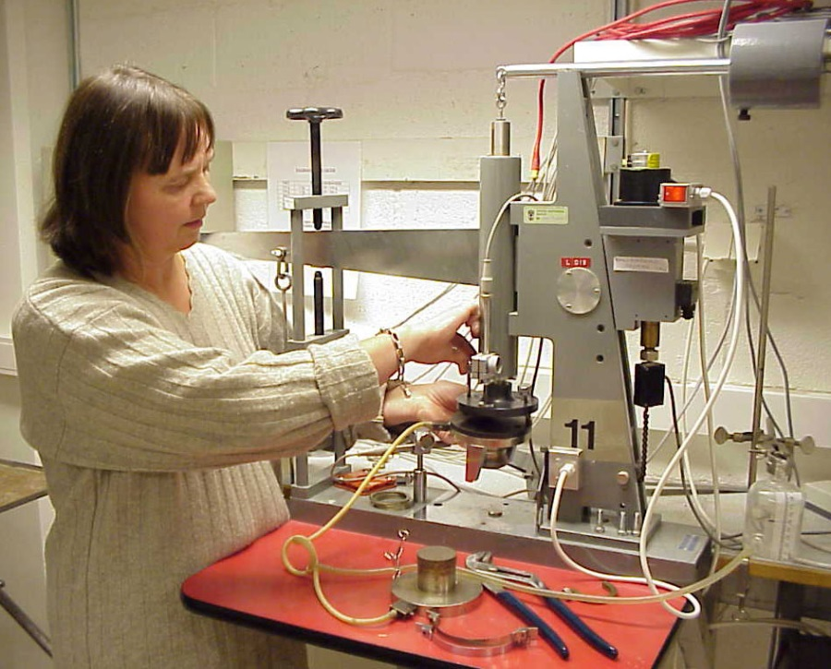
Field and laboratory investigations
Notes:
In investigation area has been divided into 10 subareas.
Sounding, groundwater measurements and sampling
Further investigations in the laboratory

Slide 13
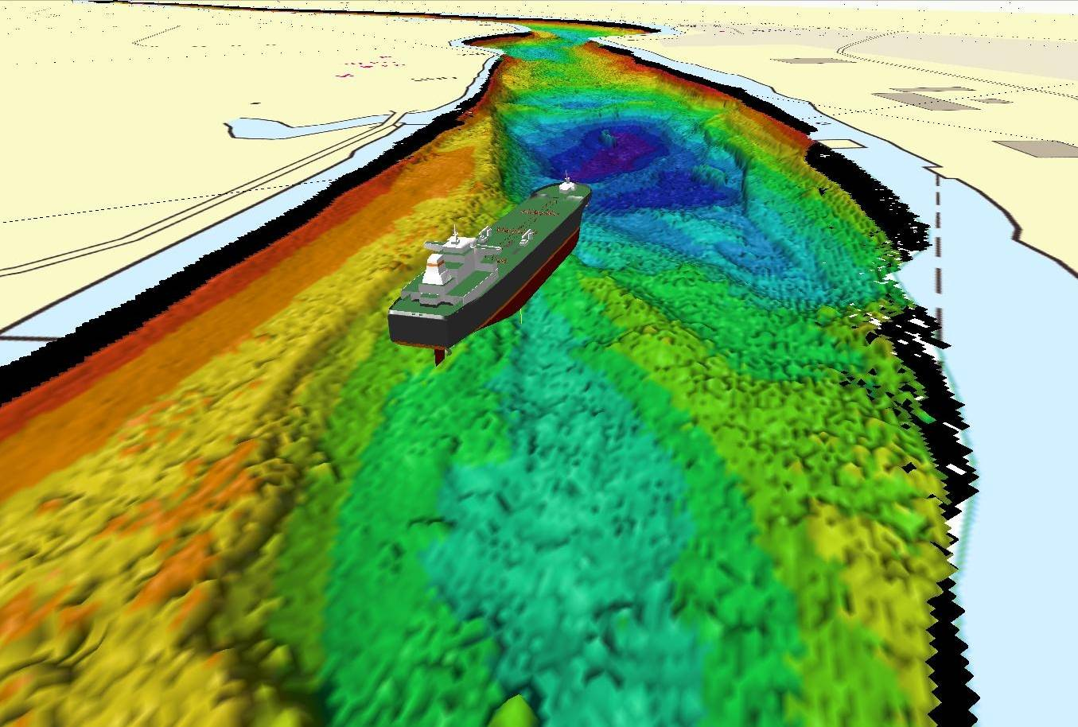
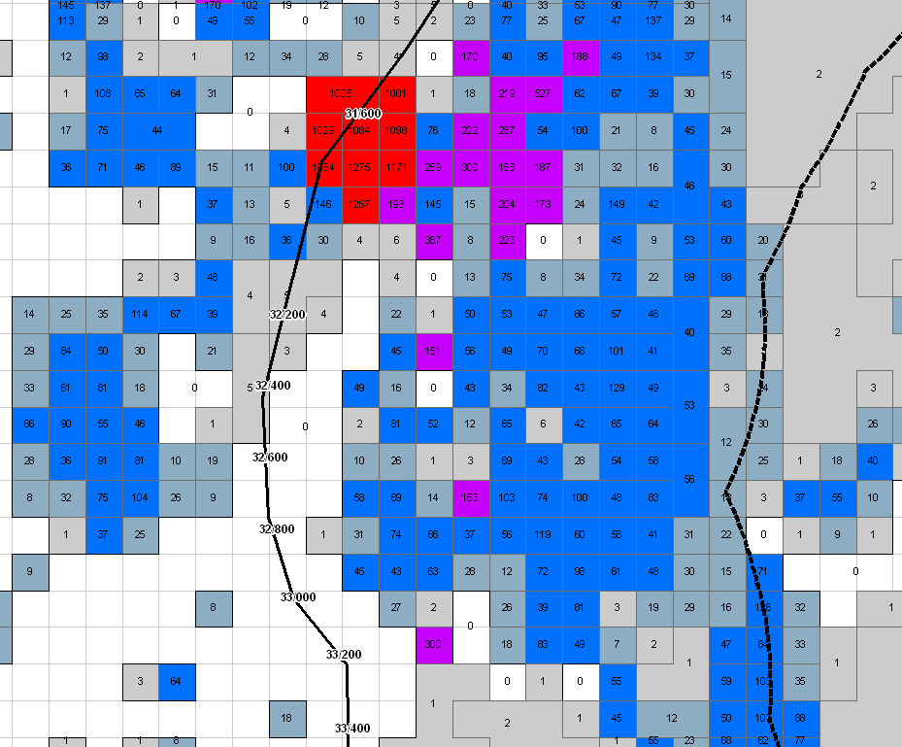
Methodology
Extension of quick clays
Geometry of the river
Groundwater modelling
Erosion
Consequences
Life
Buildings
Industry
Energy supply
Water supply
Roads and railroads
Shipping
Contaminated sediments
Bild: Sjöfartsverket

Slide 14
Stability calculation

Slide 15
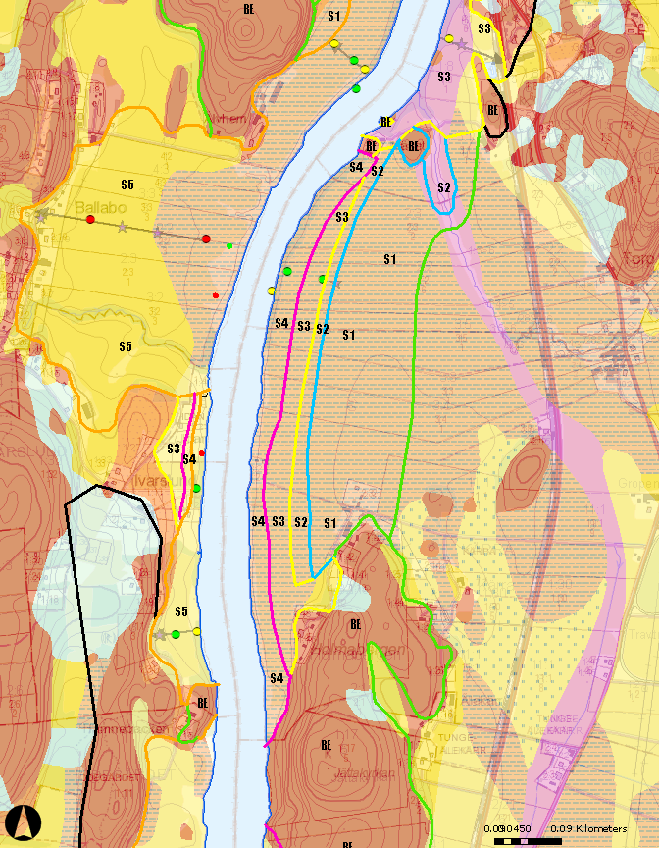
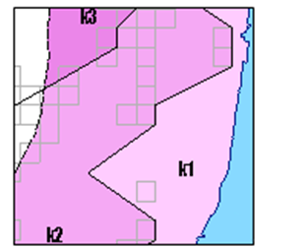
probability
consequence
Statistical analysis
Stability factor
Amount of data
Uncertainty
Valuation/Calculation
Life
Buildings
Industry
Energy supply
Water supply
Roads and railroads
Shipping
Contaminated sediments
Level of risk

Slide 16
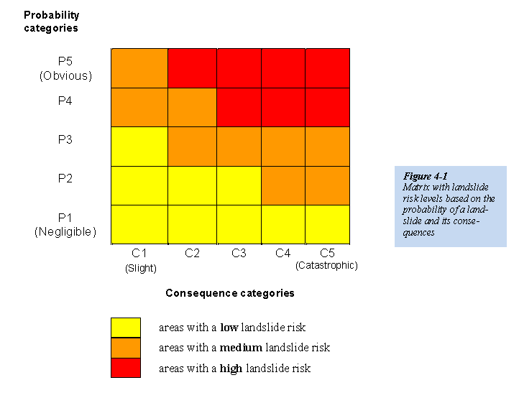

Slide 17
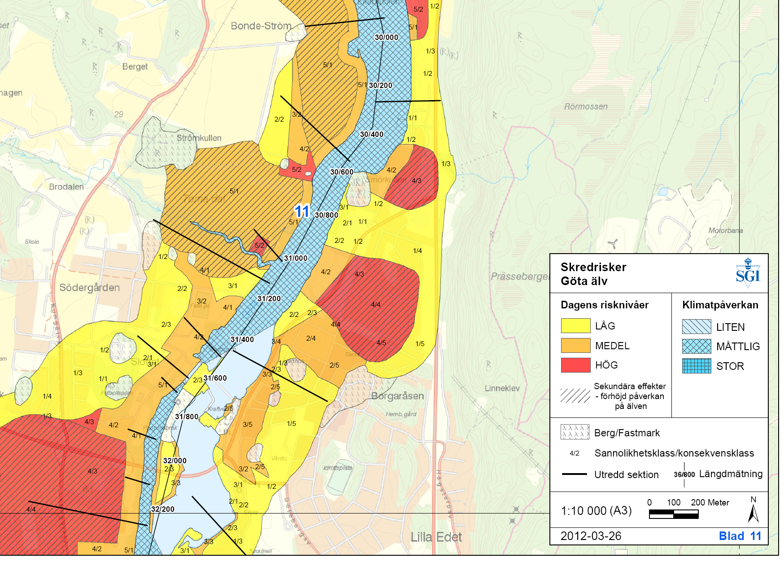

Slide 18
Conclusions
Current conditions:
- Many areas with high risk (red)
- High risk also in built-up areas
- Large areas with poor stability closest to the river and conditions for large landslides
Future conditions:
Climate change means that the risks increase
The area with the highest risk level (red) increases 10%
The probability of landslides further increases in high-risk areas - unless action is taken

Slide 19
Suggestions
Necessary to take actions to reduce the current landslide risks which also provide opportunities for increased flows in the future
The estimated cost for the entire Gota River and the Northern River:
4-5 billion SEK at today's maximum flows
5-6 billion SEK for increased maximum flows

Slide 20
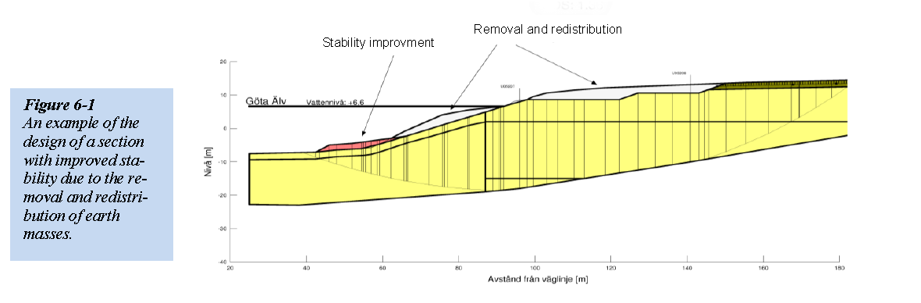
Example of what can be done

Slide 21
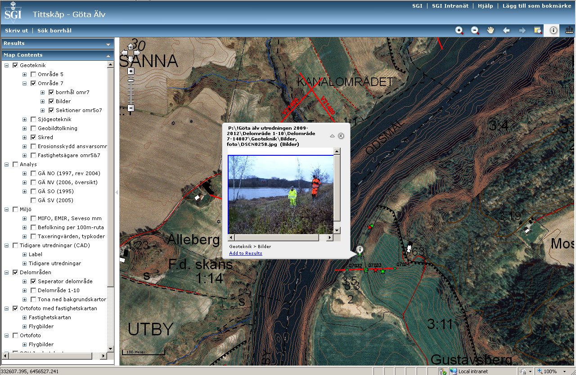
GIS platform
Notes:
A special GIS platform has been designed for collecting existing data and new data produced in the project
High precision elevation data, complete terrain model inculding submarine river topography
Data from automatic stations measuring slope inclination, groundwater- and porewater pressure and water level in and around the river

Slide 22
Thank you

