Slide 1
Risk Management
Physical planning
Lars Westholm, Samhällsbyggnad, Länsstyrelsen Västra Götaland

Slide 2
Swedish Planning
Planning and Building Act, PBA
  Sets the demands on physical planning
  Addressing several issues; participating, ecological, environmental
  Municipalities have monopoly on planning! (zoning)
Comprehensive plan
Detailed plan

Slide 3
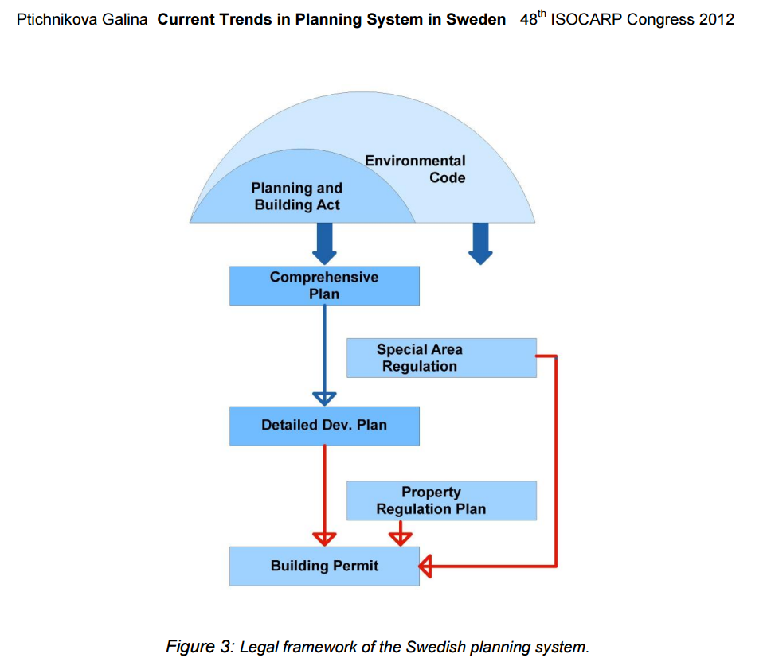
Swedish Planning

Slide 4
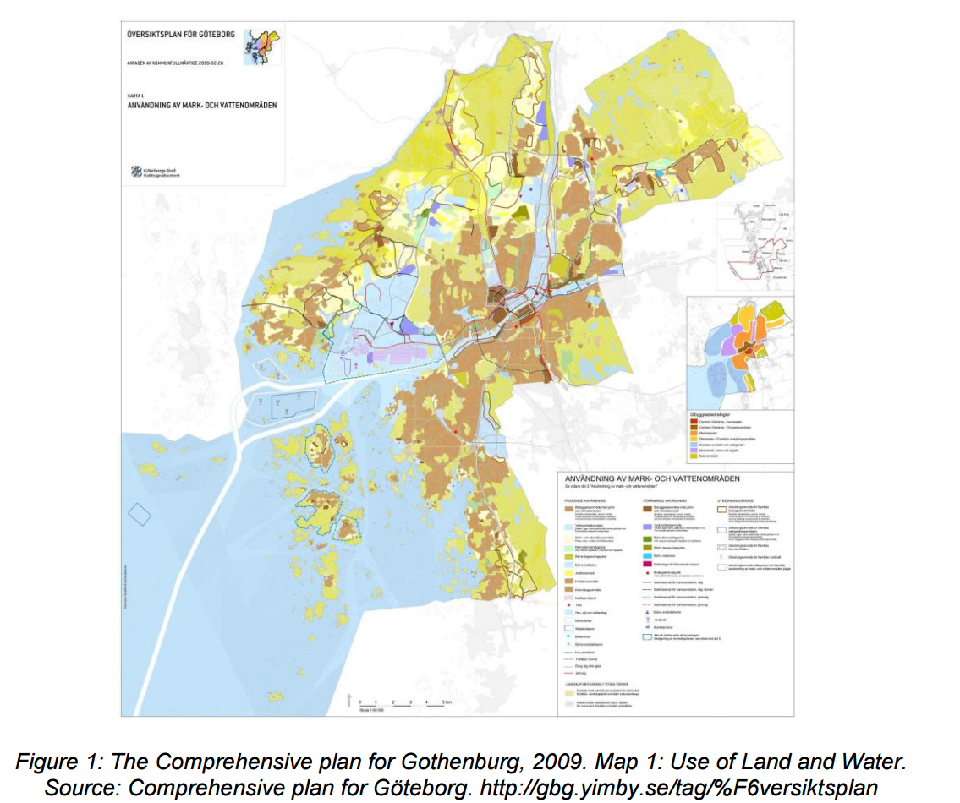

Slide 5
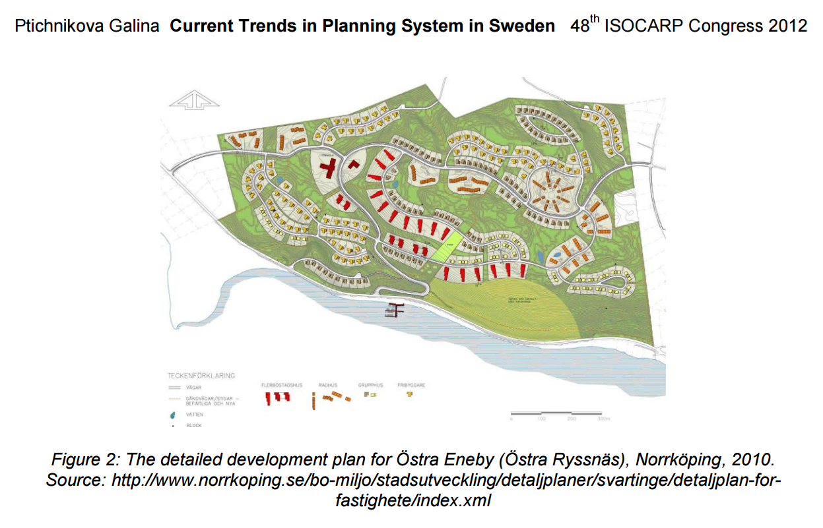

Slide 6
Swedish Planning
Municipal monopoly
County:
-advising
-supplying
-reviewing
The governments representative!

Slide 7
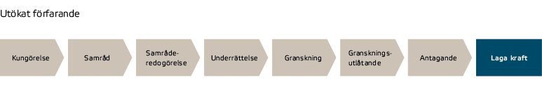
The Planning process
If the plan is not up to codes:
Special review and worst case:
Revoking the plan
The county administrative board
reviews and advice!
The municipality does all the planning.

Slide 8
What are the Länsstyrelse looking at?
Objectives and guidelines from the government
  Sustainable development
  Social aspects
  ”Wishing list”
Especially important issues:
  Areas of National interest
  Cross border issues
  Environmental quality
  Shore protection
  Health and safety

Slide 9
Health and safety
Noise
Air quality
Dangerous goods
Dangerous enterprises
Erosion
Landslides
Flooding
Environmental impact assessment and/or
Risk analysis

Slide 10
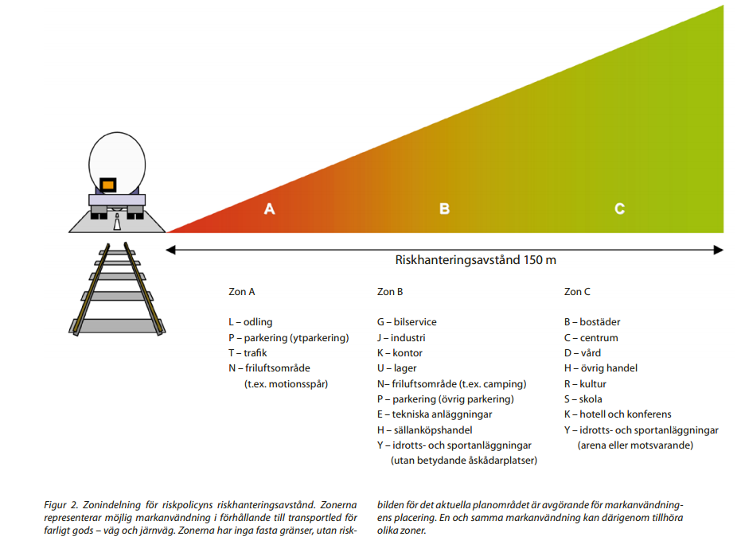
Health and safety
Dangerous goods
  Recommended
  roads

Slide 11
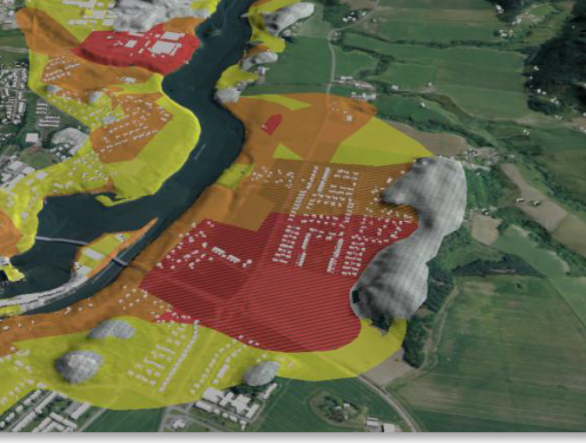
Health and safety
Erosion, landslides
  Geotechnical
  surveys

Slide 12
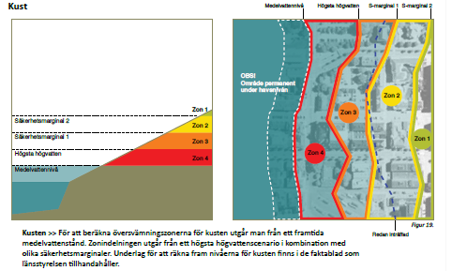
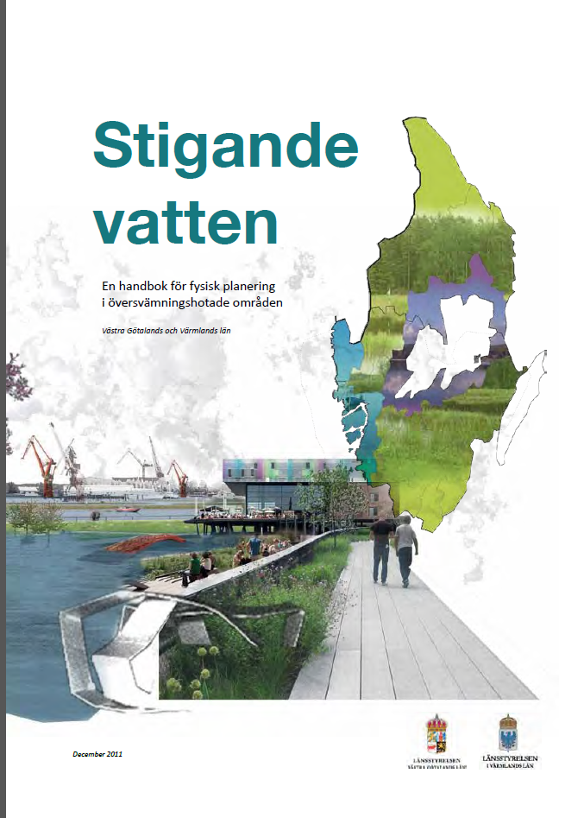
Health and safety
Flooding
  Base line: 100 years flood
  Zoning
  Adapted buildings or
  enterprises

Slide 13
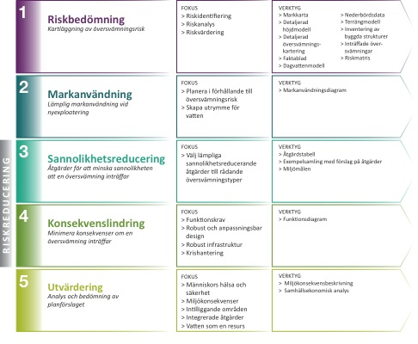
Planeringsmodell

Slide 14

Översvämningstyper

Slide 15
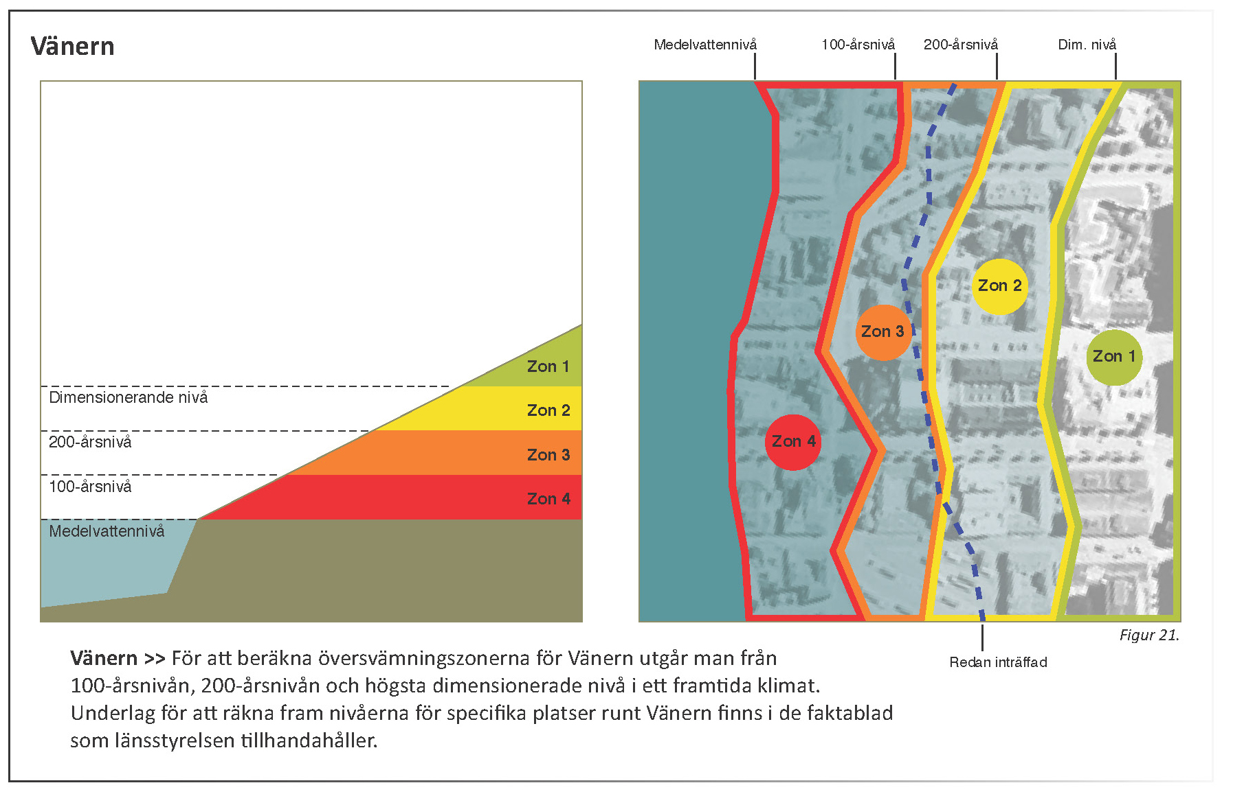
Exempel: Vänern

Slide 16

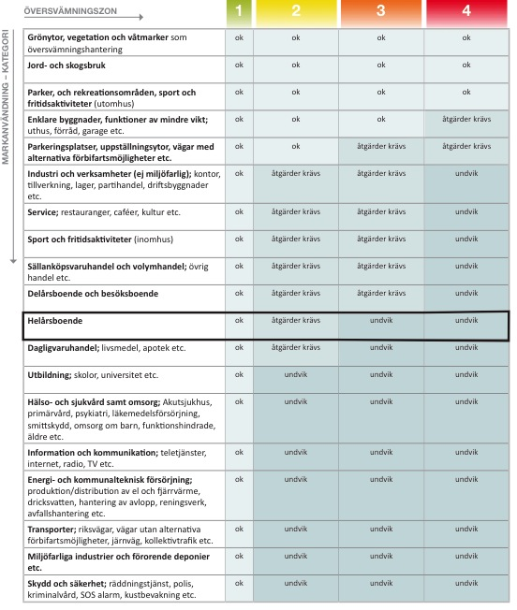

Slide 17

Risk = sannolikhet x konsekvens
(probability)

Slide 18

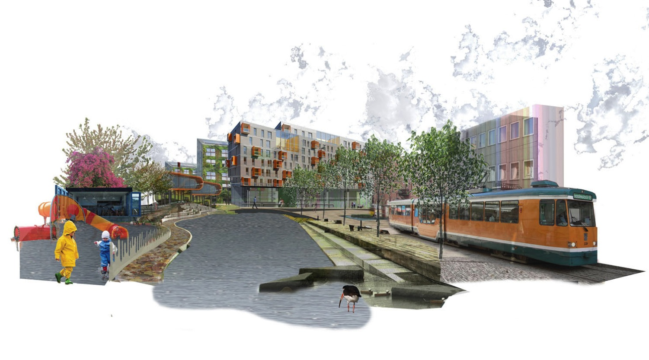

Slide 19

eller
Upprätthålla funktionen och kunna ta sig till och från
Tillfälligt överge…
Funktionskrav

Slide 20
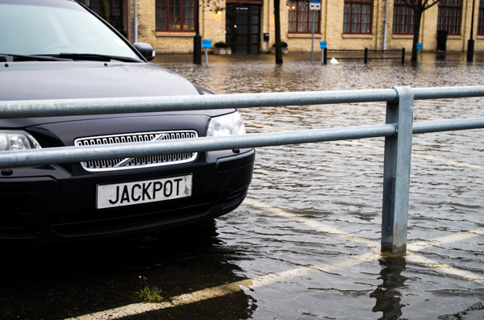

Jetty coffe shop
During floods take road 160 towards
Uddevalla and take left at Nöteviken.

