Slide 1

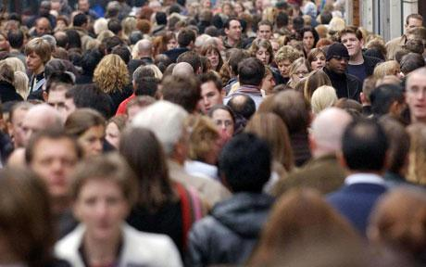
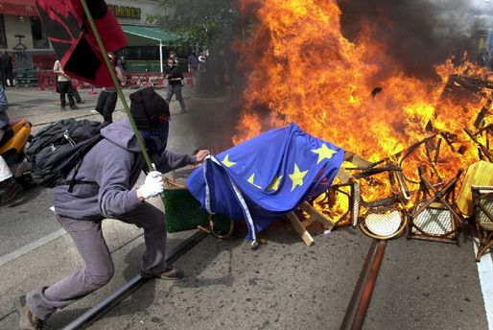
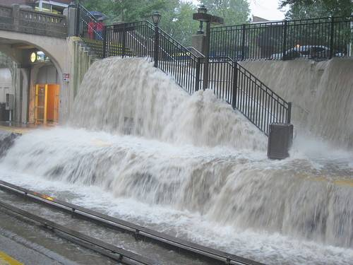
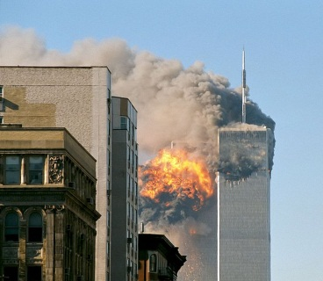
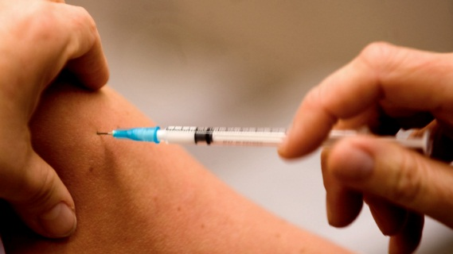
Emergency Management Unit
Charlotta Källerfelt
Deputy Emergency Management Director
(represented by Lars Westholm, Project Manager)

Slide 2
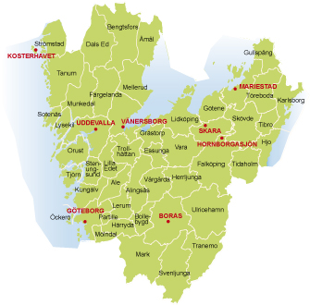
County of Västra Götaland
1,5 million citizens
49 municipalities
240 km from south to north
800 employees

Slide 3
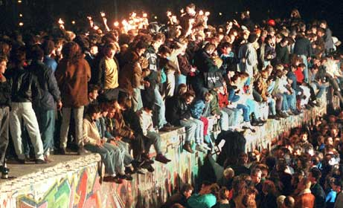


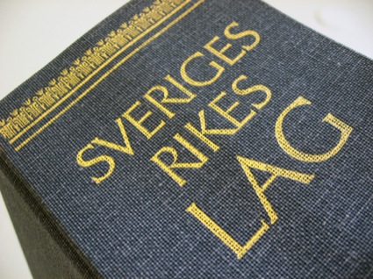
The civil emergency planning
– before – during – after –
Protect peoples life and health
Protect critical functions in the society
Prepare for emergencies and try to reduce consequences
From everyday accidents to major disasters!
Notes:
You are probably familiar with the swedish civil emergency planning structure already. The aim of the CEP is to ,,,,,,,,,,. And the same structure is to be used for both the everyday accident and for major disasters.

Slide 4
Basic principles
The principle of responsibility
  Whoever is responsible for an activity during normal conditions should assume the same responsibility during emergencies
The principle of parity
  During major emergencies authorities should, as far as possible, be organized in the same way as they are during normal conditions
The principle of proximity
  Emergencies should be managed at the nearest decision making level
Notes:
The swedish civil emergency plannning system is based in three basic principles.

Slide 5
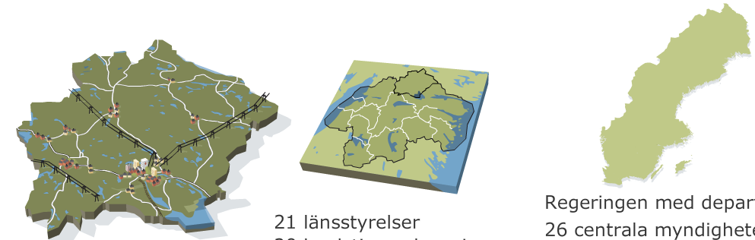
Geographic area responsibility
290 municipalities 21 counties Government & authorities
Notes:
An other important part of the CEP is the geographic responsibility.
The responsibility for CEP is managed by three different levels of government – national, regional, and local.
The authority is res
Coordinate and Support different actors response. Those actors are authorities, companies, volunteers
Coordinate confirmed information

Slide 6


The work of county administrative board before an emergency
Risk management in spatial planning
Training, exercises and information
County Risk- and Vulnerabilities Analysis
Auditing and follow-up
  Municipalities duties within CEPS
  Local Fire and Rescue Services
Civil-Military Cooperation
Responsible for planning
  For rescue operation after release of radioactive substances from NPP
  complex rescue operations
Notes:
Markus

Slide 7


During an emergency
Duty Officer 24/7
Responsibilities during an emergency
  Initiate Command group
  Coordinate and Support different actors response
  Coordinate confirmed information
  Coordinate governmental and international resources
  Report to the Government offices of Sweden

Slide 8
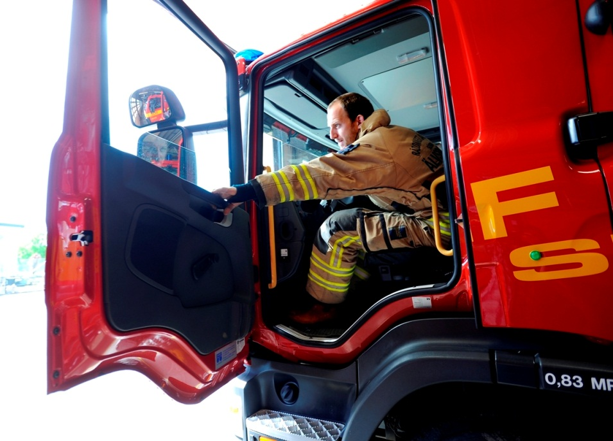
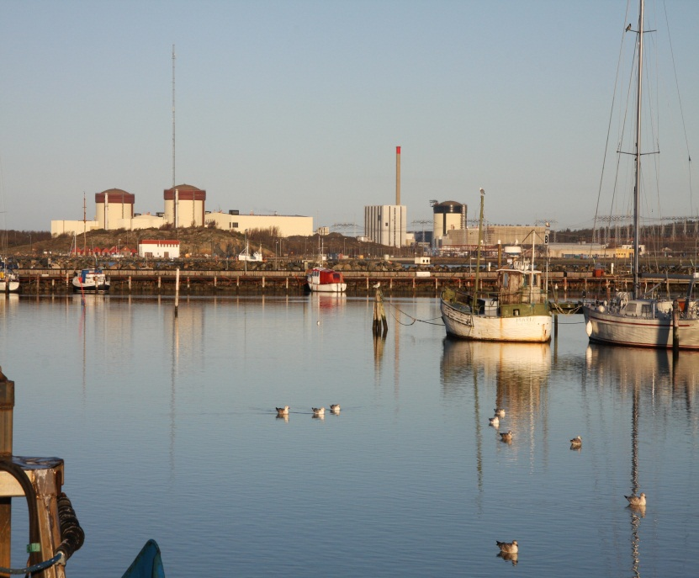
Responsible for the rescue operations
Complex rescue operations if needed
Release of radioactive substances from NPP

Slide 9
Accidents with foreign casualties
Duty Officer receives information about major accidents from SOS Alarm (911 system)
IF involving information about foreign casualties the Duty Officer informs the President of the Consular Corps of Western Sweden (CCWS)
The Swedish Police is responsible for registration of casualties. They inform the Ministry for Foreign Affairs.
Notes:
When we meet the consuls stationed in Gothenburg they usually want to know how they will be informed at accidents with foreign casualties.
The Consular Corps of Western Sweden (CCWS)

Slide 10
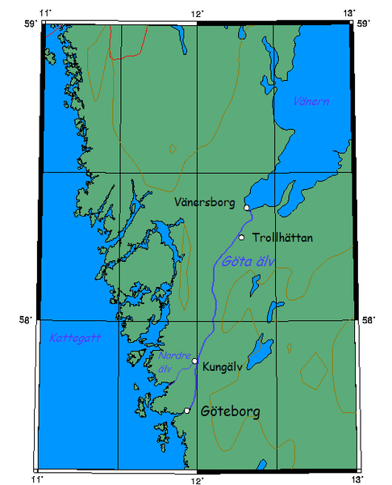
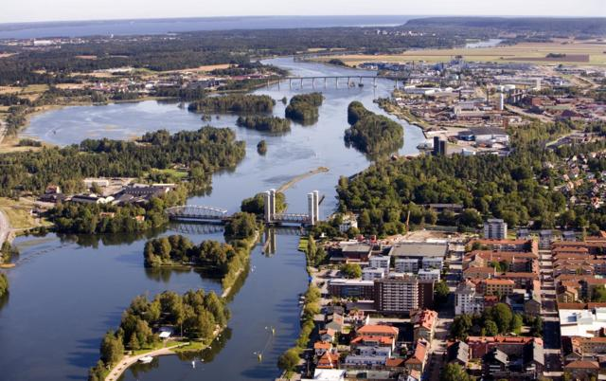
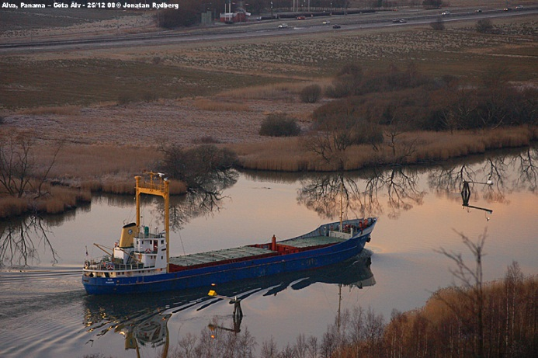
River and Valley of Göta Älv
Vulnerabilities
  Critical functions
    drinking water for 800 000 people
    Important transportation routes by
    road, train and boats
  Densely populated area
Threats
  Most landslide-prone area in Sweden
  Failures of big dams
  Major flooding
  Contaminated industrial sites

Slide 11
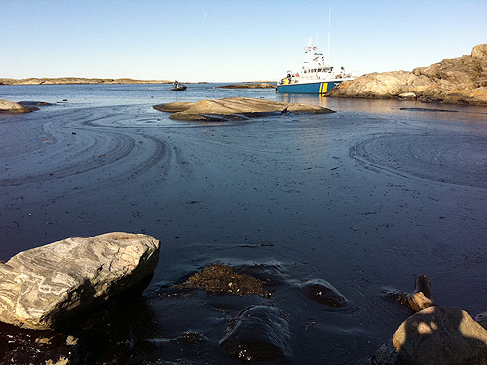
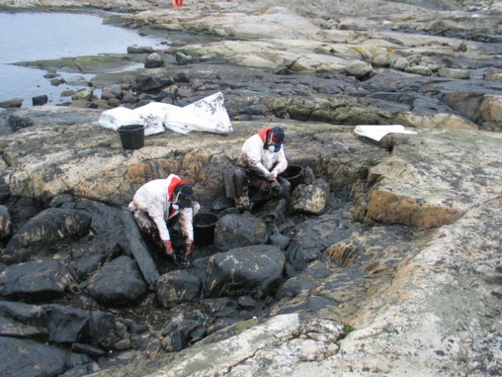
A long coast line
Notes:
Tjörn 2011
Approx. 1000 ton of oil collected
Area with vulnerable nature
Need for extra resources
(Support from Swedish Armed Forces)
Good cooperation between local
Fire and Rescue Services and Coast Guard
Complex to respond to oil spill in archipelago
during hard weather
Decontamination is time consuming and costly

Slide 12
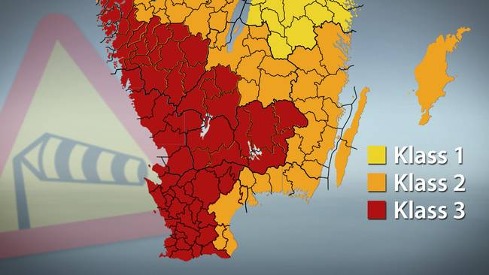
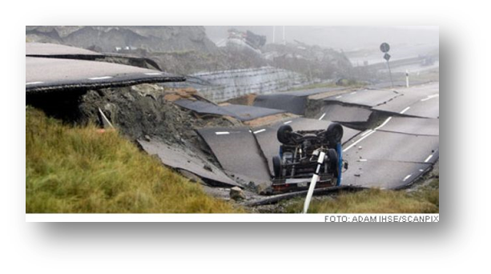
Storms, flooding and natural disasters
Conferences for coordination of actions and
information
Weather warning system – indication of wind speed and consequences
Land slides
Notes:
The category 1, 2, or 3 is of great importance for what the actions the authorities take, However, the storm warning is issued when there is a 50% chance for a storm. The consequences are not only a result of the wind speed, its also dependent of the wind direction, where the storm hits, precipitation, temperature etc.
Recommendations from authorities are followed
A lot of media attention
Lessons learned from the storms 2013
The preparedness has improved

Slide 13
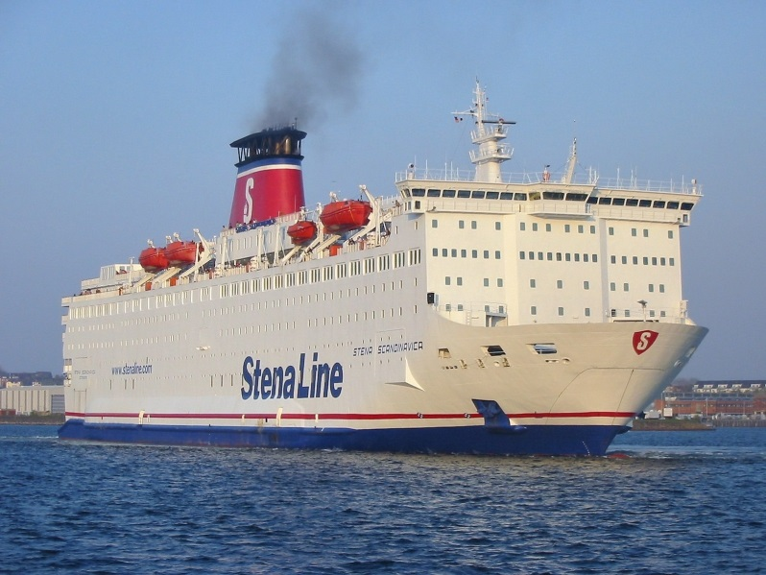
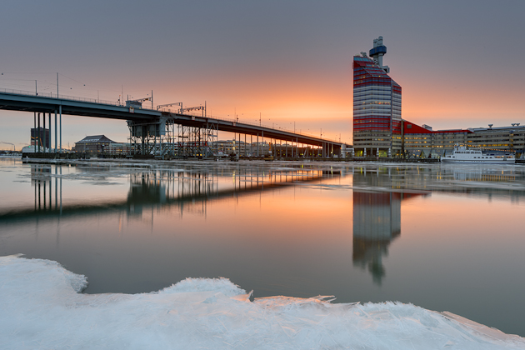
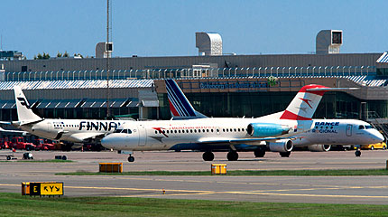
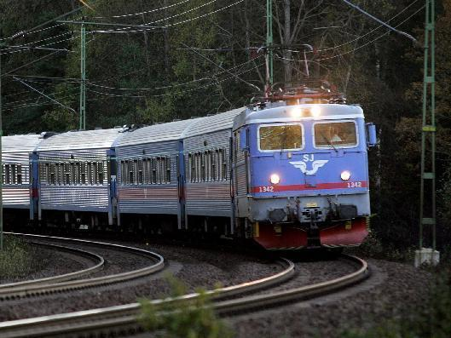
Transport system

Slide 14
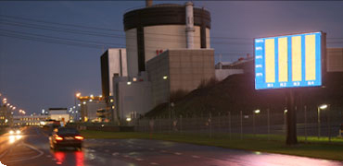
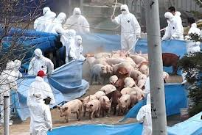
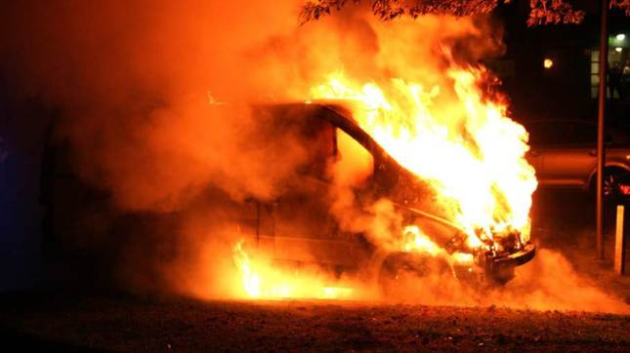
Other risks
Ringhals Nuclear Power Plant
60 km south of Gothenburg
Epizootic and Zoonosis
“Social risks”

Slide 15
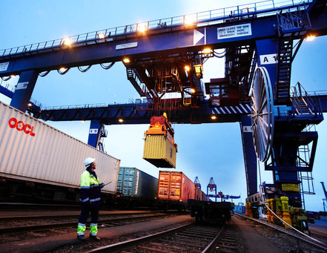
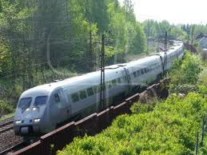
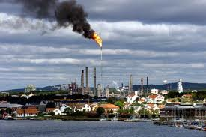
Important to protect
Sweden's functionality
The Port of Gothenburg (largest port in Scandinavia)
30 % of foreign trade
11 000 ships / year
Important transportation routes through the County
Refinery of raw oil at the west coast
Approx. 90 % of Swedens fuel request
Petrochemical centre of Sweden in Stenungsund

Slide 16
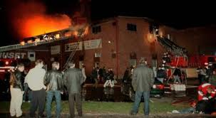
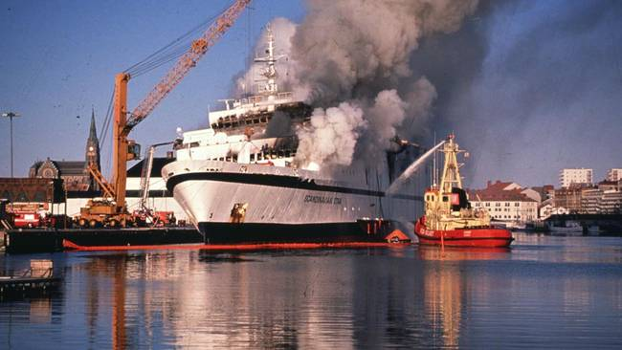
Fires with many causalities
Fire at a party for youngsters (1998)
  63 dead and 200 injured.
  Difficult care of victims and relatives during many years.
Fire at sea M/S Scandinavian Star (1990)
  159 dead
  Capacity of smaller municipalities to receive ships during emergencies.
  RITS (Rescue Operations at Sea) was established.

Slide 17
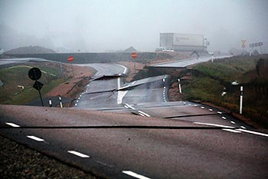
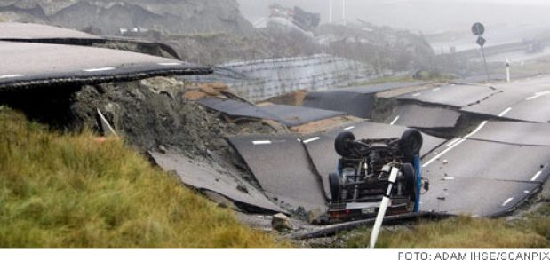
Landslide of E6 Småröd (2006)
500 x 200 m and affected road and railway
Apprx. 10 vehicles (one truck with HS) in the area but no severe injuries.
It was difficult for the Fire and Rescue Service to overview the area when arriving to the scene.
Dangerous to rescue victims from their vehicles.
Good cooperation after to restore road and railway in the planning process.

Slide 18

Exercise Gothia Cup April 2014
Gothia Cup
  Football tournament
  37 000 participants
  70 nations
Organized by the municipalities in the Gothenburg region.
Major accident during a disco at a footballl arena
Great international interest
Notes:
Focus of the exercise was the local and regional response. However such an accident would get great attention abroad and we had within our own organisaiondiscusion a very rutifull discussion about the needs and expectations of foreign authorities.

Slide 19
Thank you!

