Slide 1

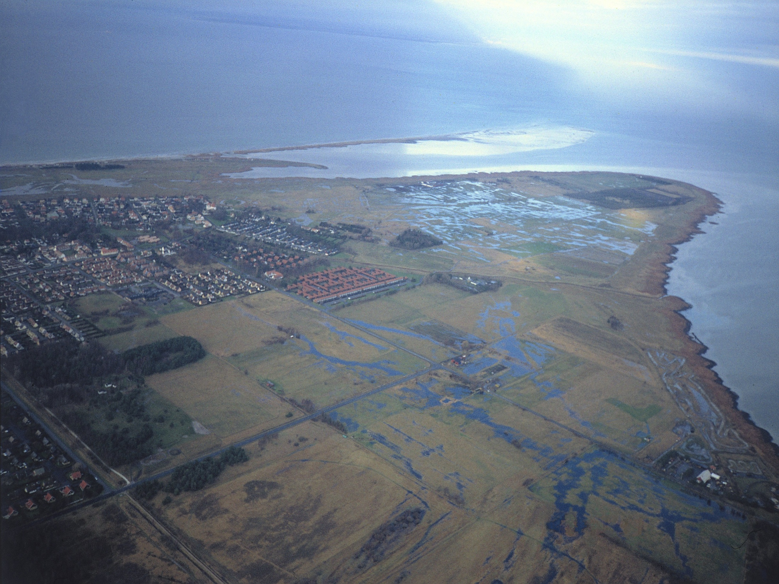
Water Levels in Skanör/Falsterbo -
Present & Future,
Impacts & Measures
Hans Hanson - Gothenburg 150527

Slide 2






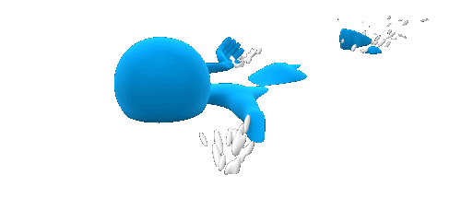
LECTURE OVERVIEW
Sea Level Rise
Protective Measures
Beach Nourishment
Sand as Storm Protection
Value of Beaches
Water Levels and Consequences in Skanör/Falsterbo

Slide 3
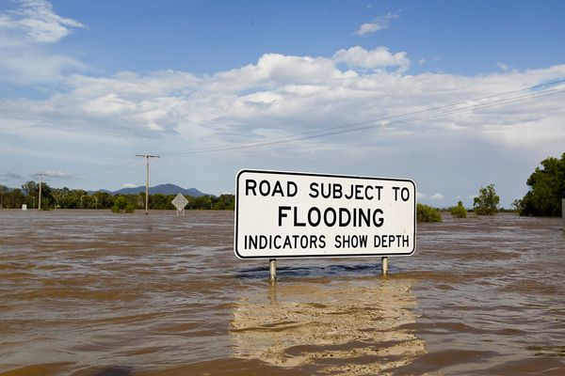
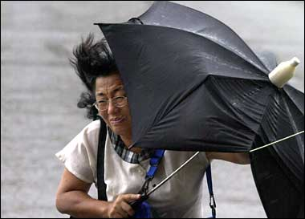

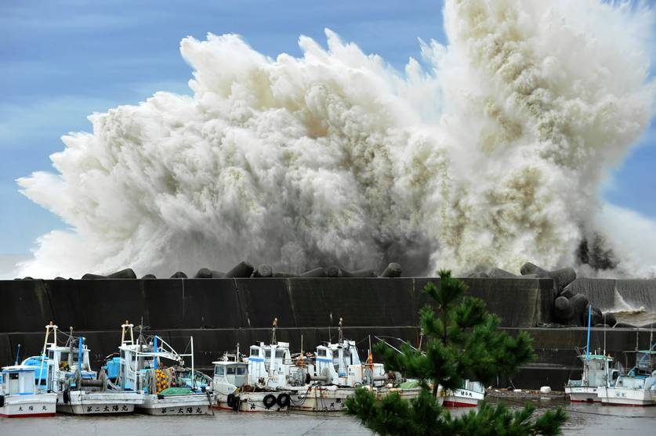
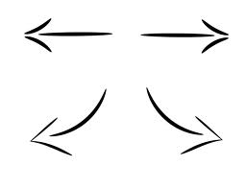
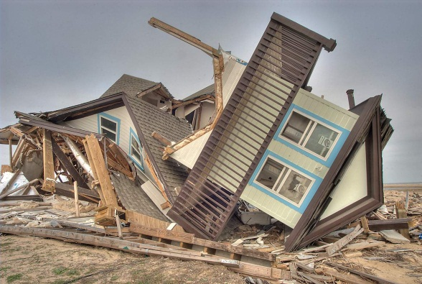
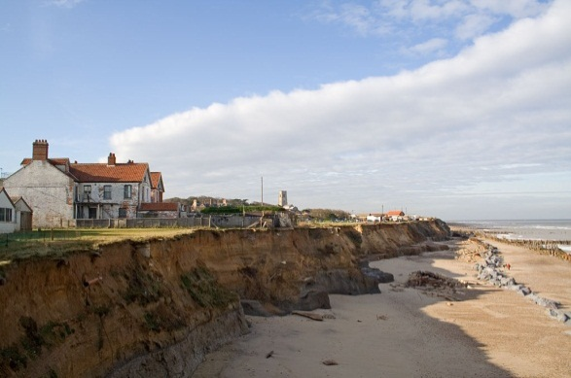
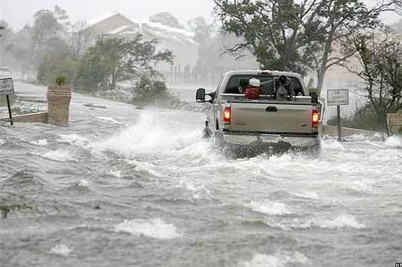
EXPECTED CLIMATE CHANGE ISSUES ’OF INTEREST’
Rising sea levels! Increased storminess?
Bigger waves
More storm damages
More coastal erosion
More flooding

Slide 4
CLIMATE CHANGE vs. VARIABILITY
MSL

Slide 5
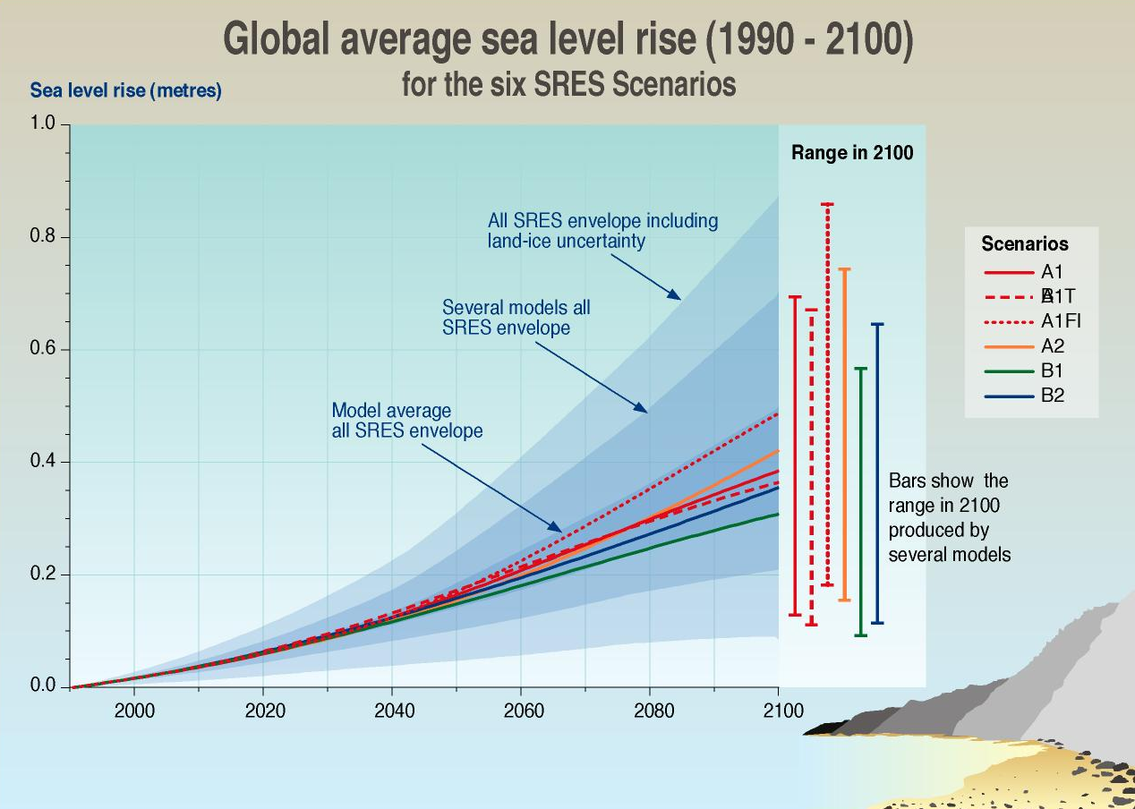
FUTURE SEA LEVELS! – WE THINK!
SMHI 2009
estimation 100 cm
for The Baltic Sea
Historical Trend
IPCC

Slide 6
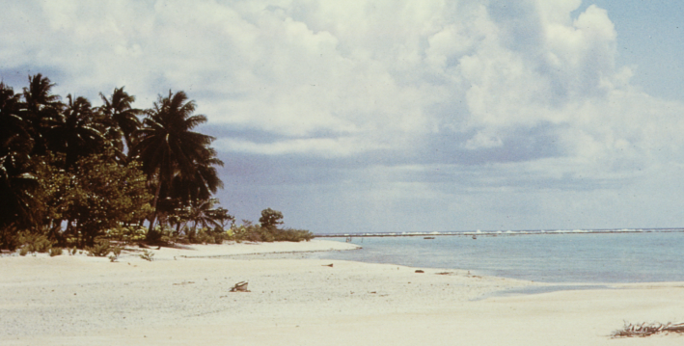
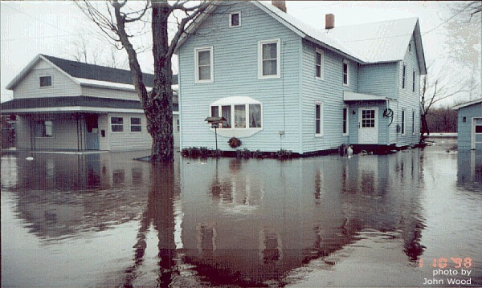
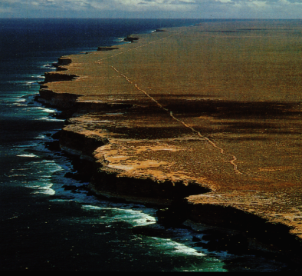

CONSEQUENCES OF SEA LEVEL RISE
Shoreline
Recession
Shoreline Recession
Higher Sea Level
Low, flat coast High, steep
coast
Lower Sea Level
Sea

Slide 7


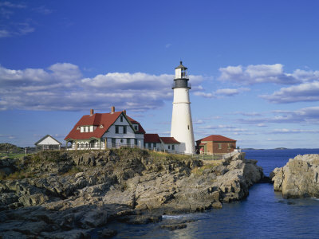
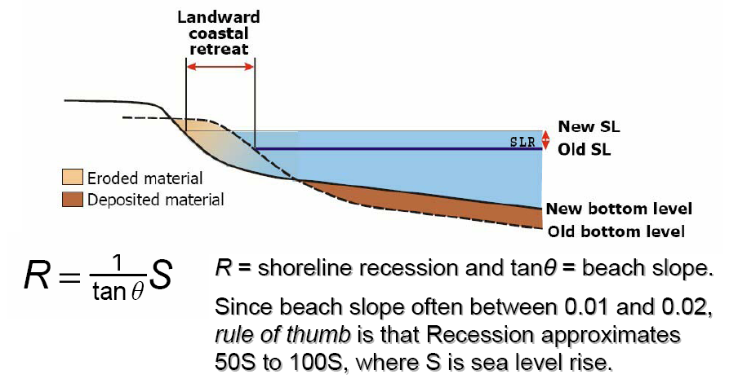
SEA LEVEL RISE! WHAT HAPPENS TO THE BEACH?
R₁
New SL
Present Sea Level
Rocky shore
New bottom?
Present Bottom Level
1
1

Slide 8
SEA LEVEL RISE! WHAT HAPPENS TO THE BEACH?
R
R₁
New SL
Future Sea Level
Present Sea Level
Rocky shore
New bottom?
Present Bottom Level
1
1

Slide 9
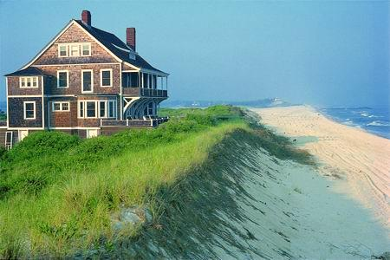
SEA LEVEL RISE! WHAT HAPPENS TO THE BEACH?
R₁
New SL
Present Sea Level
Sandy shore
New bottom?
Present Bottom Level
1
1

Slide 10
SEA LEVEL RISE! WHAT HAPPENS TO THE BEACH?
R₁
New SL
Future Sea Level
Present Sea Level
Sandy shore
New bottom?
Future Bottom Level
Present Bottom Level
1
1

Slide 11
SEA LEVEL RISE! WHAT HAPPENS TO THE BEACH?
R
Eroded material
Future Sea Level
Ackumulated material
B
A
Present Sea Level
S
Present beach profile
Future beach profile
R = S/bottom slope
Sandy shore
Bruun rule: An increase S of MSL => coastal erosion R = S/bottom slope.
If bottom slope = about 1/100 =>
A sea level rise of 1 m => erosion R = 100 m.

Slide 12
PERMANENT COASTAL RETREAT IN YSTAD 2100?
Legend
Coast line today
Coast line 2100
W treatment plant
W marina
Legend
Coast line today
Coast line 2100
Sandskogen
beach
Hans Hanson – Ystad 150213
Notes:
Bilderna visar hur stranden förväntas dra sig tillbaks om havet stiger 0.9 m längs olika kustavsnitt.

Slide 13
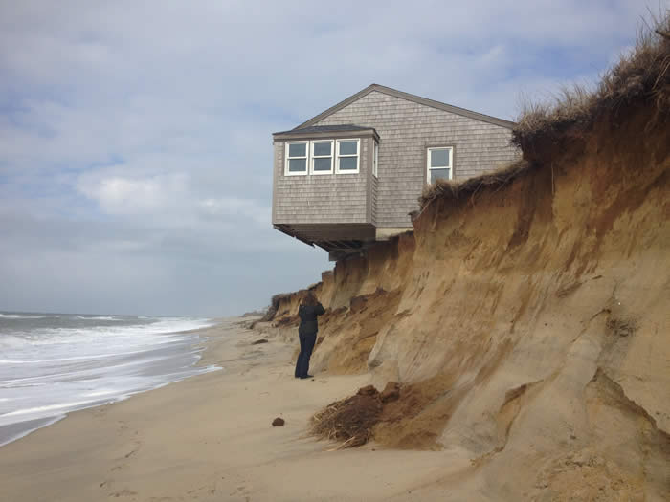

What can we do?
What should we do?

Slide 14
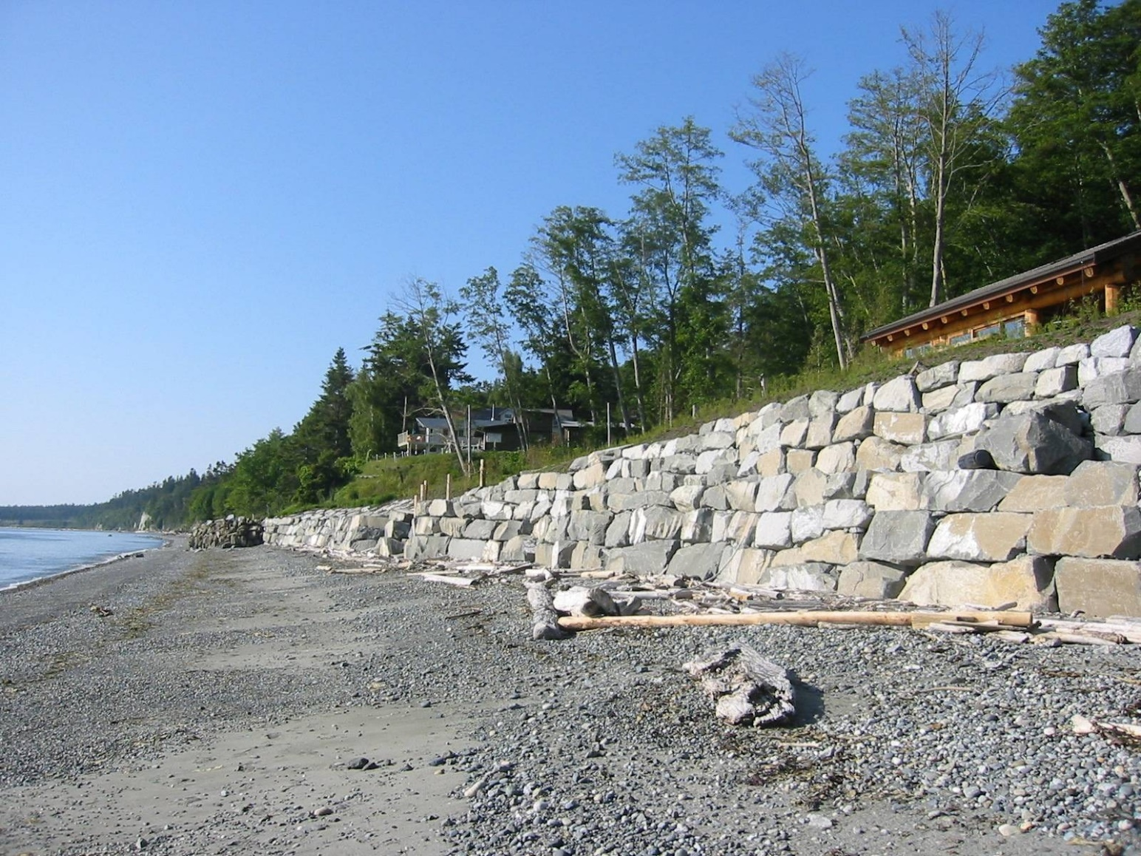


EXPECTED SLR! SOLUTION? SEAWALL?

Slide 15



SEAWALL – AN APPROPRIATE ALTERNATIVE?
Land
Sea

Slide 16

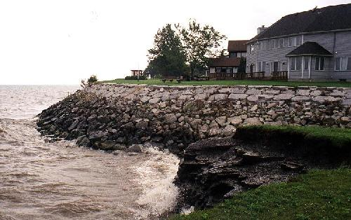

SEAWALL – AN APPROPRIATE ALTERNATIVE?
Land
Sea

Slide 17
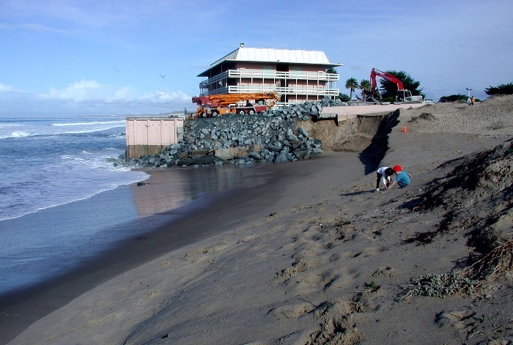
SEAWALL – AN APPROPRIATE ALTERNATIVE?
Land
Sea

Slide 18
SEAWALL – AN APPROPRIATE ALTERNATIVE?
Land
Sea

Slide 19
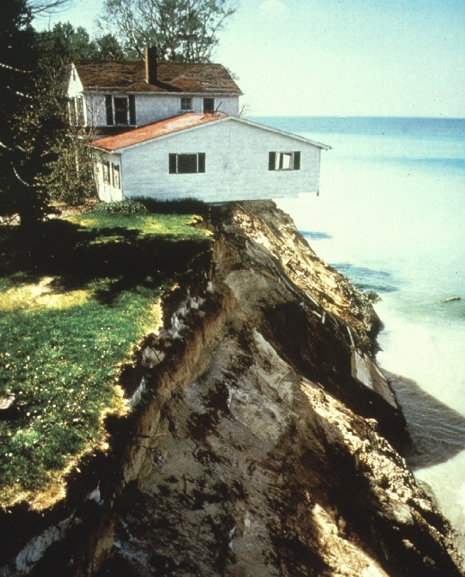
SEAWALL – AN APPROPRIATE ALTERNATIVE?
Land
Sea

Slide 20
SEAWALL – AN APPROPRIATE ALTERNATIVE?
Land
Sea

Slide 21
SEAWALL – AN APPROPRIATE ALTERNATIVE?
Land
Sea

Slide 22
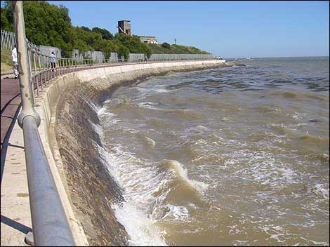
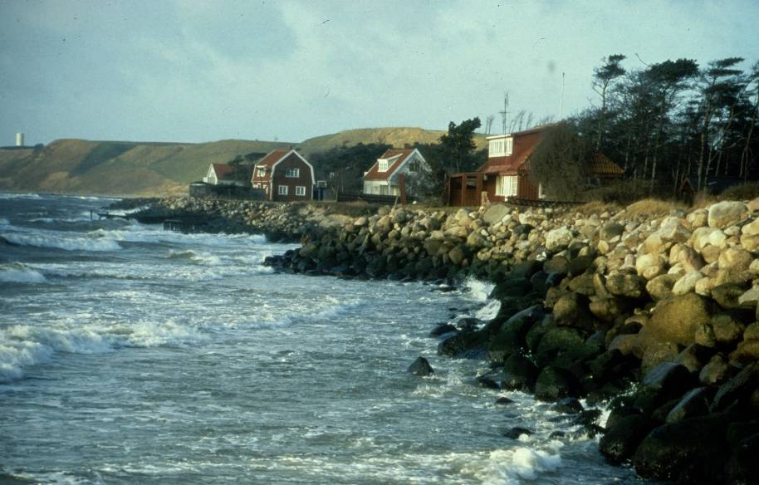

SEAWALL – AN APPROPRIATE ALTERNATIVE?
Maybe not so good!
Land
Sea

Slide 23
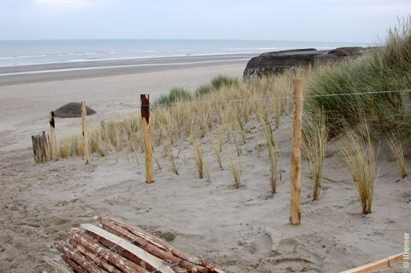
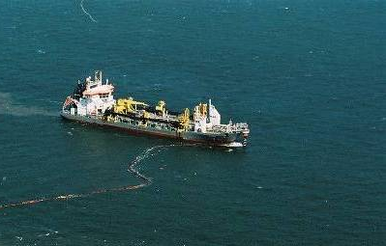
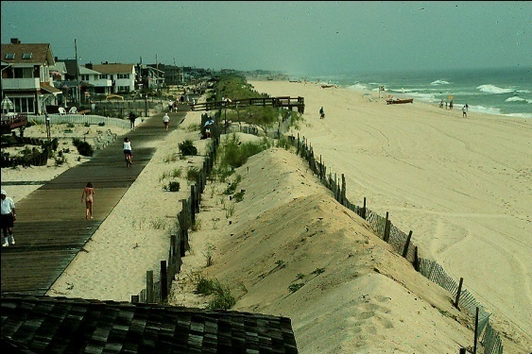
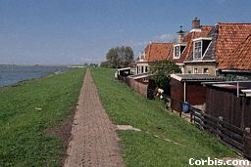
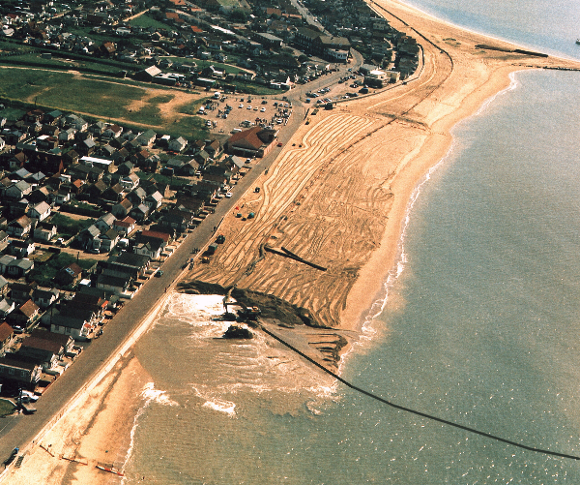
STABILIZING – SOFT MEASURES
Construction,
Beach fills reinforcement Vegetated & vegetation earth dams
of dunes
Plan
Profile

Slide 24
SOFT MEASURES AGAINST RISING SEA LEVELS?

Slide 25
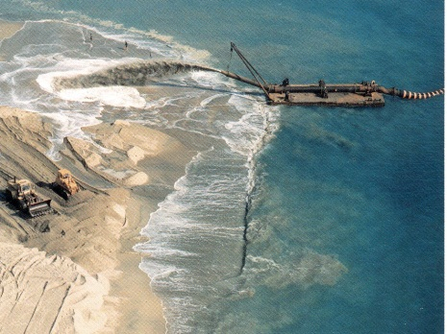
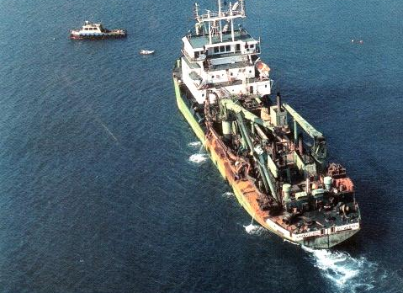
SOFT MEASURES AGAINST RISING SEA LEVELS?
s
s
L ~ 300 m ~ 1,000 ft
S ~ 1 m year 2100
Added volume V = S*L m³/m beach
V ~ 300 000 m³/km ~ 3 300 m³/km per yr ~
$33,000 /km/yr over 90 yrs!

Slide 26
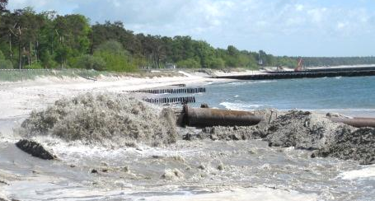
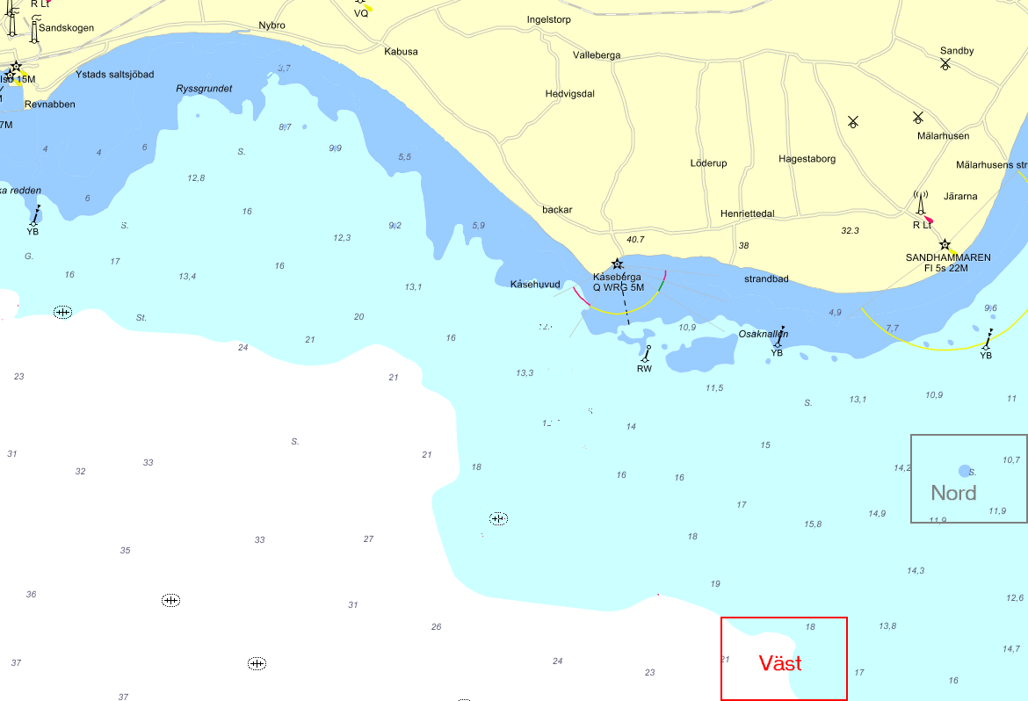
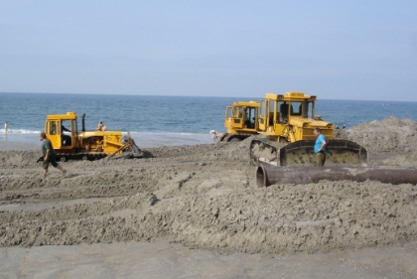
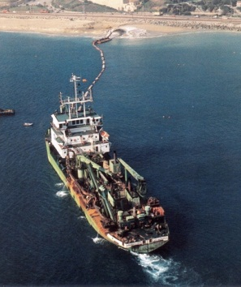
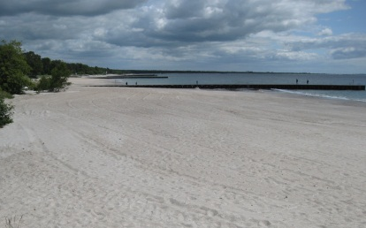
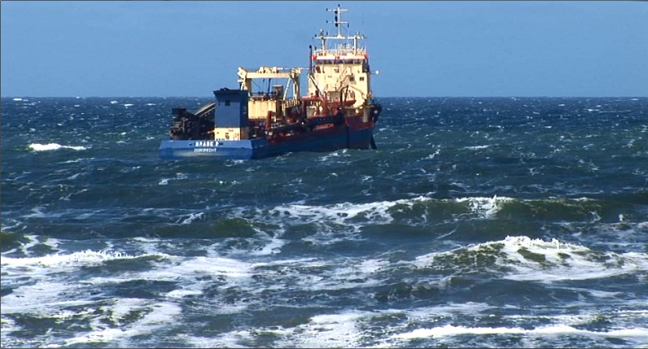
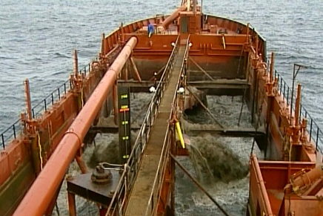
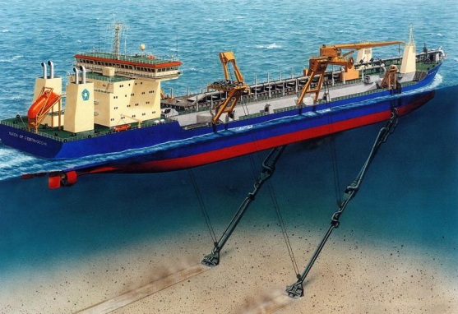
BORROW SAND – FROM SEA BOTTOM TO NOURISHED BEACH

Slide 27
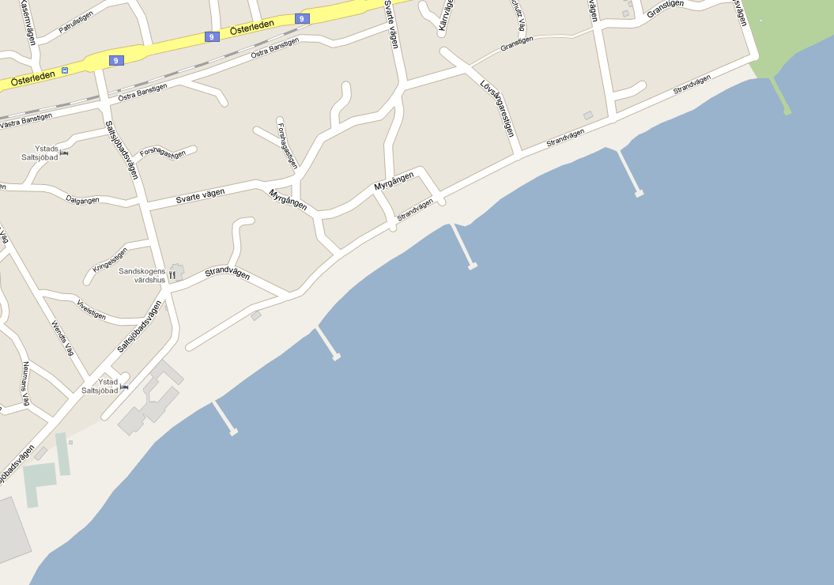
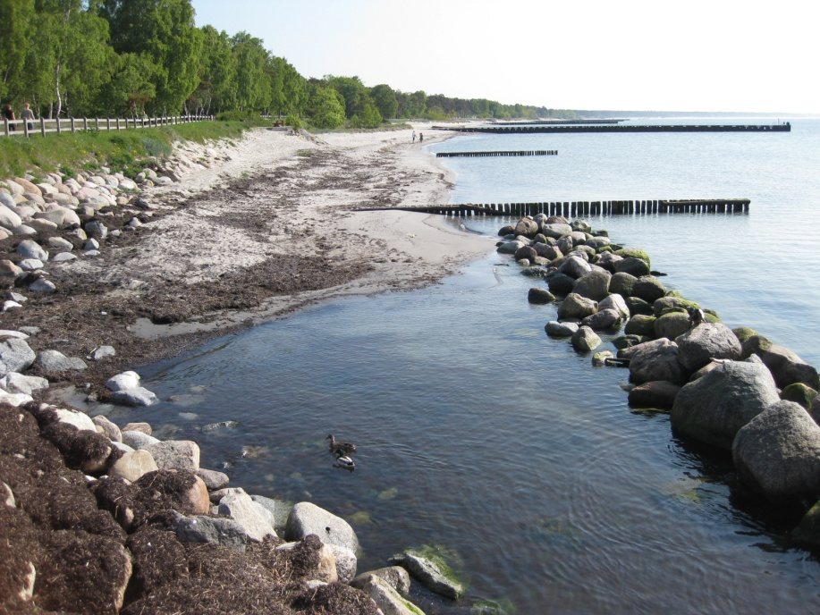
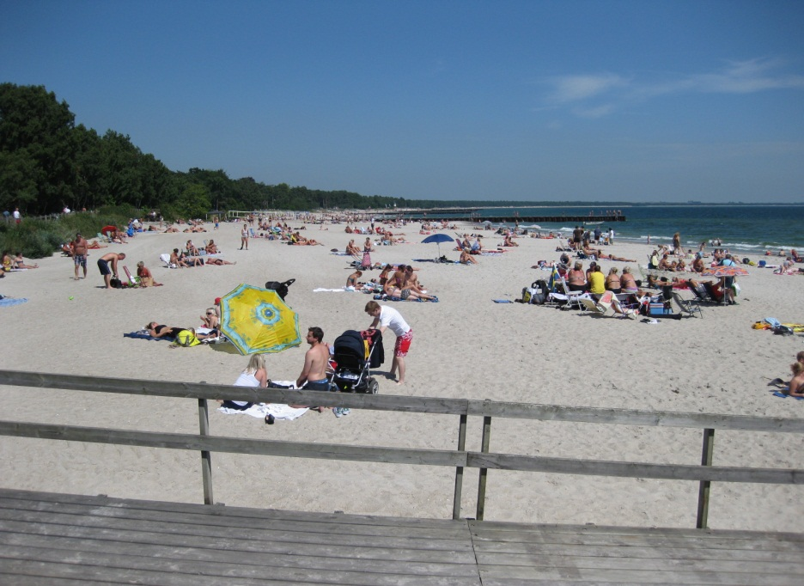
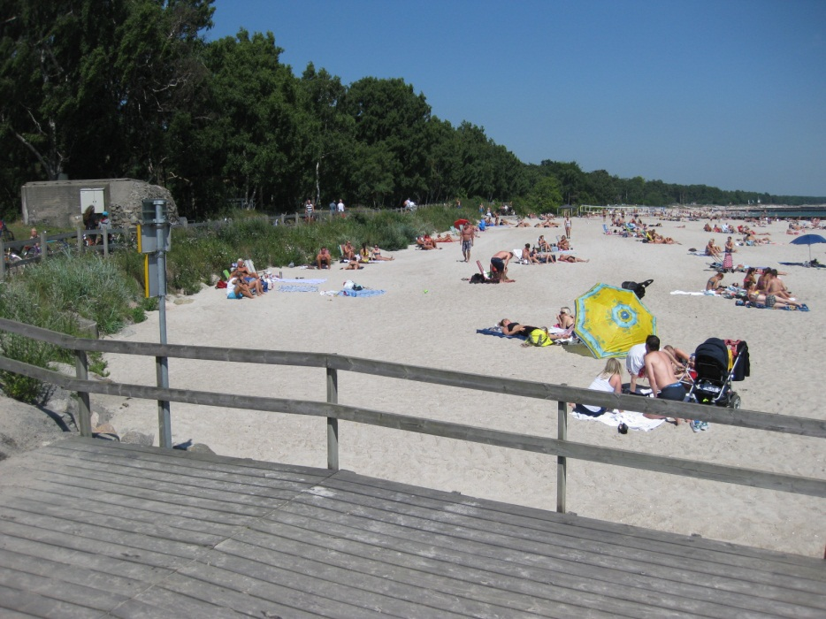
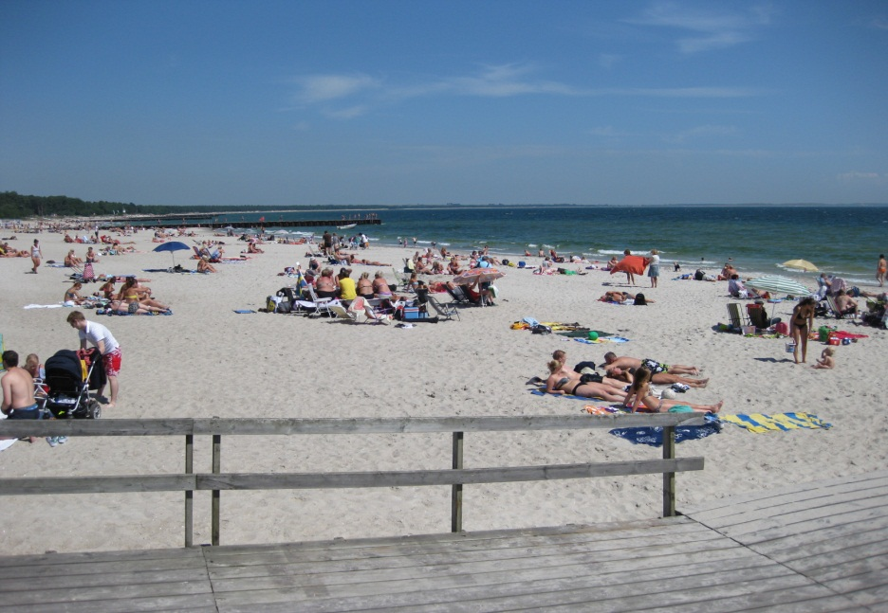
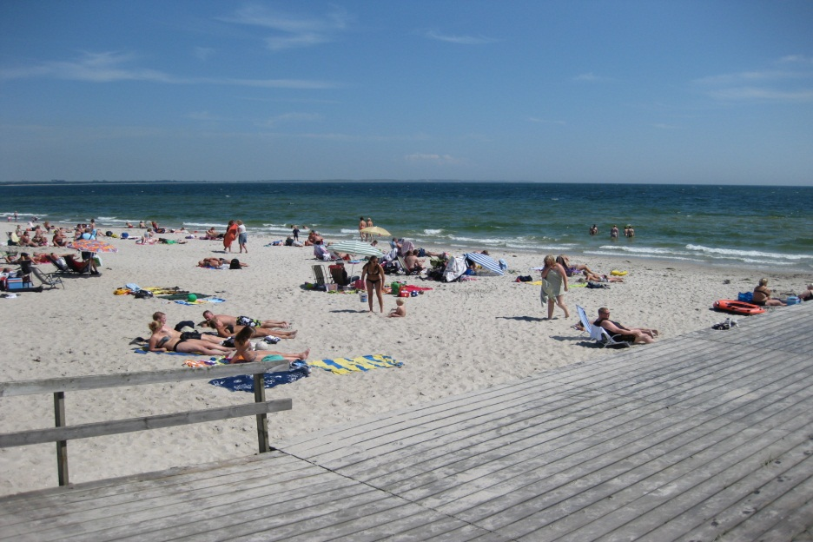


NEW BEACH IN YSTAD – PIER 0 EAST
Before After
100 000 m³ á $10 = $1M
Normal main’t ~ $0.3 M/yr

Slide 28
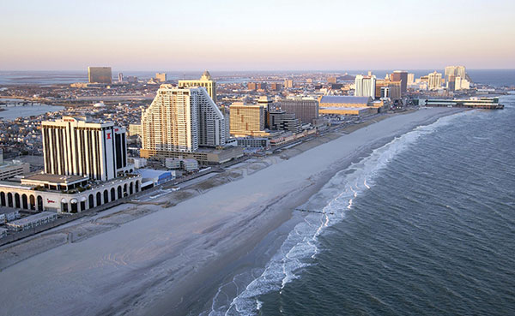
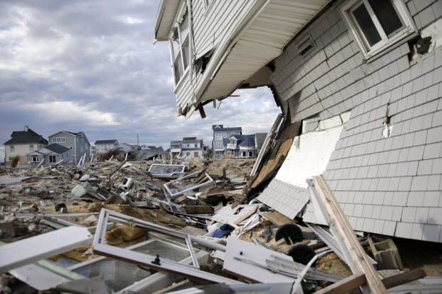
SAND FOR STORM PROTECTION?
In Atlantic City, NJ, with wide nourished beach, tourist industry working again
4 days after hurricane Sandy 2012.
In Ortley Beach, NJ, without wide nourished beach, the coast was still in shreds
6 months after Sandy.
Sandy

Slide 29
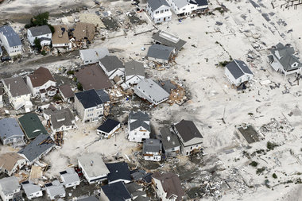
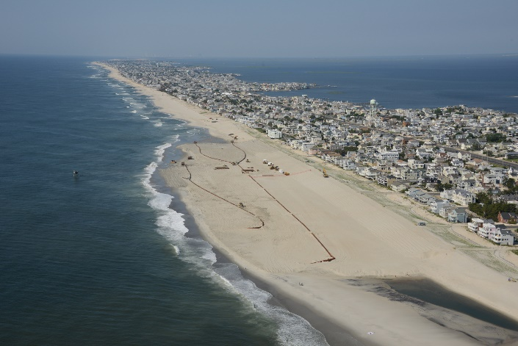
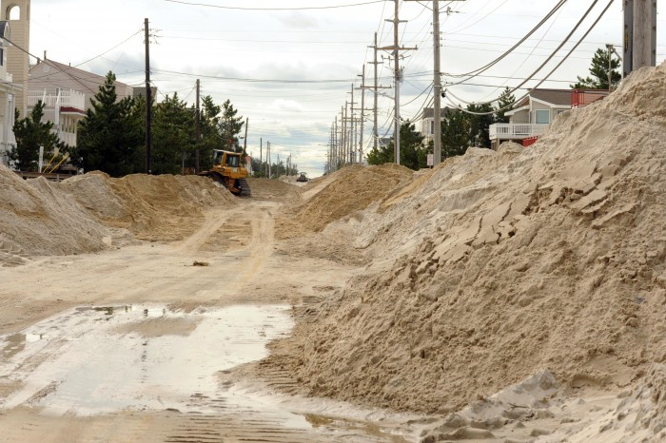
SAND FOR STORM PROTECTION?
USACE nourished
just prior to Sandy
6 miles N, Brant Beach, NJ,
“No overwash or wave damage”
Hurricane Sandy
Holgate, NJ, “Complete destruction – it’s like a war zone”
Mayor Mancini estimated that if the entire Long Beach coast (18 miles) had had the same beach as Brant Beach they would have saved ~$500M.
Houston (2013)

Slide 30
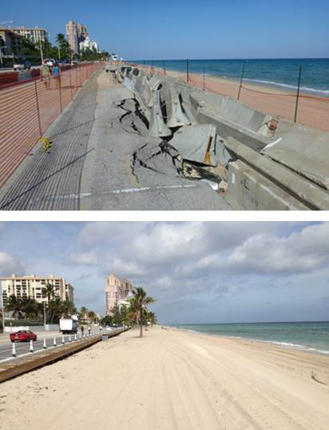


SAND FOR STORM PROTECTION?
Concrete seawall in Ft. Lauderdale, FL, destroyed by hurricane Sandy 2012.
Concrete seawall replaced by beach nourishment to hold for the 100-yr storm.
Ft. Lauderdale, FL.

Slide 31










WHAT IS A BEACH WORTH?

Slide 32






VALUATION OF TURISM IN YSTAD
Calculations according to the ’Halmstad model’ showed
Ystad beaches sales 2010 ~ $44M!

Slide 33

BEACH INCOME YSTAD 2010
Turist income Ystad:
Income ~ 12% of sales = $5.5M/yr
Assume 80% over 10 summer weeks => $450 000/week.
Nourishment cost:
$1M every 3 yrs
Tax income from inhabitants in Ystad:
Total taxation ~ $115M/yr
Assume 20% because of its beaches → ~ $23M/yr!!
Of these, assume 2/3 refer to 10 summer weeks => 1.5 $M/week.
Thus, total beach income = $28.5M/yr!!
During summer $2M/week!

Slide 34



WHAT IS A BEACH WORTH?
Visitors/year (million)
2000 2012
Ft. Meyers Beach, FL
Florida beaches
USA National parks
USA Theme parks
Miami Beach, FL
Florida’s beaches have an estimated annual value of $50 billion (Houston, 2013).
For every $ in annual cost for beach nourishment, the return is $1800 per yr from international tourists alone in Miami Beach (Houston, 2013).

Slide 35



N
WATER LEVELS IN FALSTERBO CANAL
Gothenburg
166 000 data points!

Slide 36
ANNUAL HIGH WATER LEVELS (CORRECTED FOR MSL CHANGE)
Trend = 0.45 cm/yr

Slide 37
FUTURE SEA LEVELS?
P (Annual high > level)
1.0
0.8
0.6
0.4
0.2
0.0
0.6
0.8
1.0
1.2
1.4
1.6
1.8
2.0
2.2
2.4
Level relative present MSL (m)
Present situation

Slide 38
NORMAL DISTRIBUTION
Cumulative normal
distribution (inverted)
Normal distribution

Slide 39


INCREASE IN WL 2000 – 2050 – 2100
Trend in NHW
Trend in MSL

Slide 40
FUTURE SEA LEVELS?
P (Annual high > level)
1.0
0.8
0.6
0.4
0.2
0.0
0.6
0.8
1.0
1.2
1.4
1.6
1.8
2.0
2.2
2.4
Level relative present MSL (m)
Present situation
2050, 57-yr trend+
increased GHE
2100, SMHI

Slide 41


RISING SL – WHAT IS FLOODED?

Slide 42




DIGITAL ELEVATION MODEL
Based on 18,000 known points (x, y, z).
Vertical scale exaggerated to enhance 3D-effekt.

Slide 43





SKANÖR/FALSTERBO – FLOODED REAL ESTATE FOR DIFFERENT SEA LEVELS...
P(annual high level > level)
2010
2050
2100
Level relative present MSL (m)
18%
67%
0%

Slide 44
IS IT ECONOMICALLY DEFENDABLE?
Cost dams/dunes (50 yr):
about 0.6 MEuro/km =
$10M ~ $0.2M/yr
Cost sand (~10 km):
$15M over 50 yrs = $0.3M/yr
$0.5M/yr
Protected values (c:a) (2012):
$6,000M
Cost ~ 0.4% ~ 0.008%/yr
Total number of houses ~ 3,100
Home insurance premiums 2012 ~ $450/yr/house (avg SE) ~ $1.5M/yr
Living expences 2011 (avg SE) ~ $12,000/month/house ~ $37M/yr
Commute cost (10 000 out, 3 000 in, 1.5 pers/car, 15 km*2) ~ $0.1M/day!
NL: Protective measures $1,600M/yr ~ 0.1%/yr

Slide 45


Questions?
Thank you for your attention!
Hans.Hanson@tvrl.lth.se

