Slide 1
Greater New Orleans
Hurricane and Storm Damage Risk Reduction System
Mike Park
Chief
Task Force Hope
U.S. Army Corps of Engineers
February 24, 2015

Slide 2
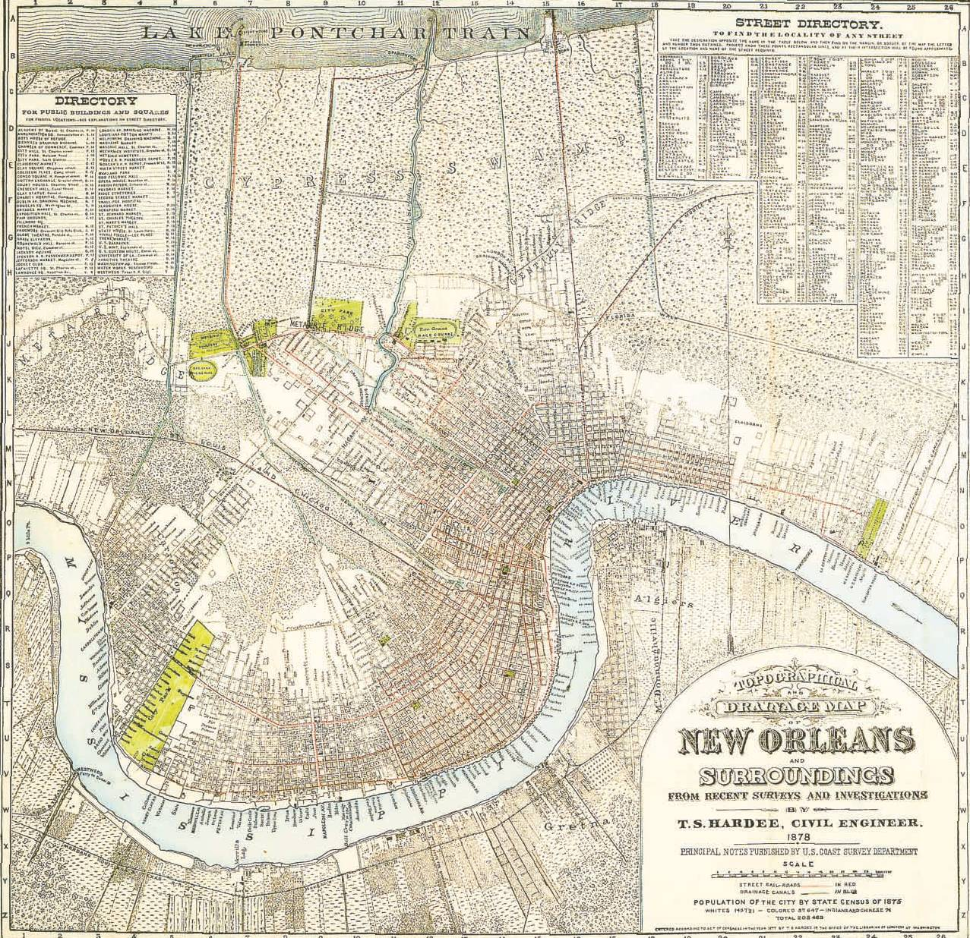
1878
London Canal
17TH St. Canal
Orleans Canal
Gentilly Ridge
Metairie Ridge

Slide 3
New Orleans Topography
LAKE PONTCHARTRAIN
B
City of New Orleans
Ground Elevations
From Canal St. at Mississippi River
to the
Lakefront at U.N.O.
A
FLOODWALL ALONG
MISSISSIPPI RIVER
NEW
ORLEANS
R.
A
MISS.
30
30
23 FT
B
20
MR&T
PROJECT DESIGN
FLOWLINE (18 FEET)
20
LONDON AVENUE CANAL FLOODWALL
10
HURRICANE LEVEE / FLOODWALL (14.0 FEET)
10
ELEVATIONS IN FEET NGVD
0
0
RIVER BANK
-10
LAKE
PONTCHARTRAIN
SHORE
-10
-20
CANAL ST AT RIVER
DERBIGNY AT I-10
GENTILLY BLVD
AT ALLEN
ST ANTHONY AT
FILMORE AVE
-20
ESPLANADE AT
ST. CLAUDE
UNO SIDE OF
WAINWRIGHT DR
MISSISSIPPI
ST LOUIS
CATHEDRAL
DILLARD UNIV
CAMPUS
WAINRIGHT DR
AT L. C. SIMON

Slide 4
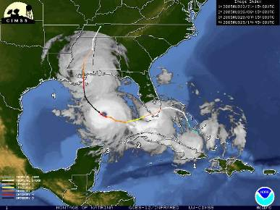
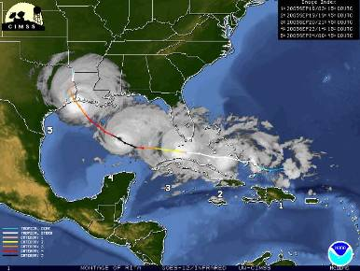
Hurricane Katrina
Aug 29, 2005
Hurricane Rita
Sep 24, 2005
One of America’s largest natural disasters
Cat 5 less than 12 hrs before landfall
127 MPH wind at Louisiana landfall
Maximum surge of 28 to 30 feet along Mississippi coast
80 percent of the city of New Orleans flooded
Cat 4 less than 12 hrs before landfall
175 MPH max sustained winds in Gulf of Mexico
120 MPH max sustained winds at landfall
Cat 3 strength at landfall

Slide 5
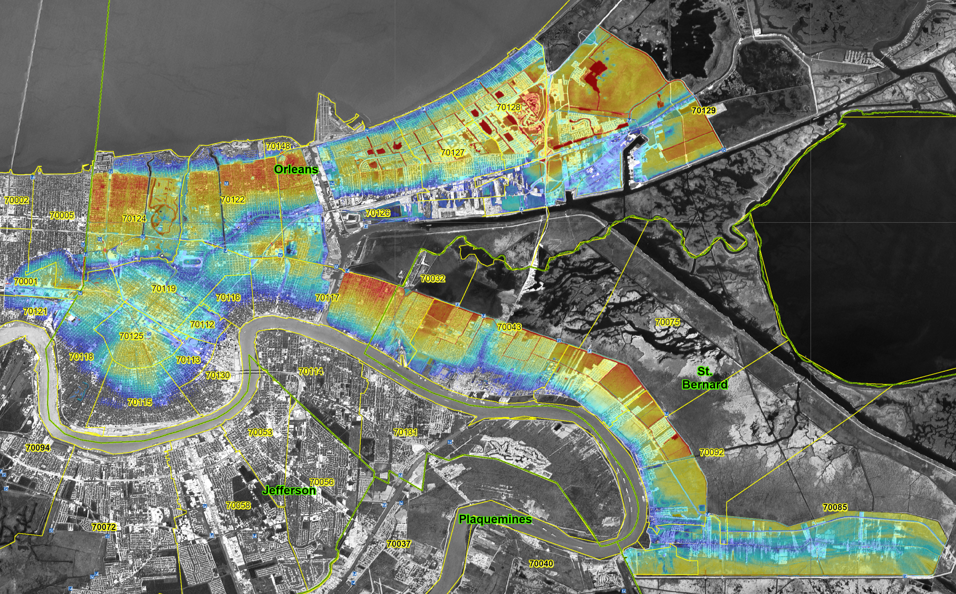
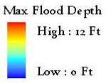
New Orleans
Maximum Flooding Depth
10 to 13 feet
8 to 15 feet
12 to 15 feet
High: 15 Ft.
Low: 0 Ft.
9 to 11 feet
Design Failure Breach Locations
Notes:
**75 percent of the city of New Orleans flooded (per IPET)
**Illustrated flood depths based on preliminary data and high water marks. Numbers will become more specific as data is verified.
(maximum New Orleans flood depths pending from MVN hydrology)

Slide 6
New Orleans
Levee and Floodwall Breaches
10 to 13 feet
8 to 15 feet
High: 15 Ft.
Low: 0 Ft.
12 to 15 feet
9 to 11 feet
Breach Locations
Notes:
**75 percent of the city of New Orleans flooded (per IPET)
**Illustrated flood depths based on preliminary data and high water marks. Numbers will become more specific as data is verified.
(maximum New Orleans flood depths pending from MVN hydrology)

Slide 7
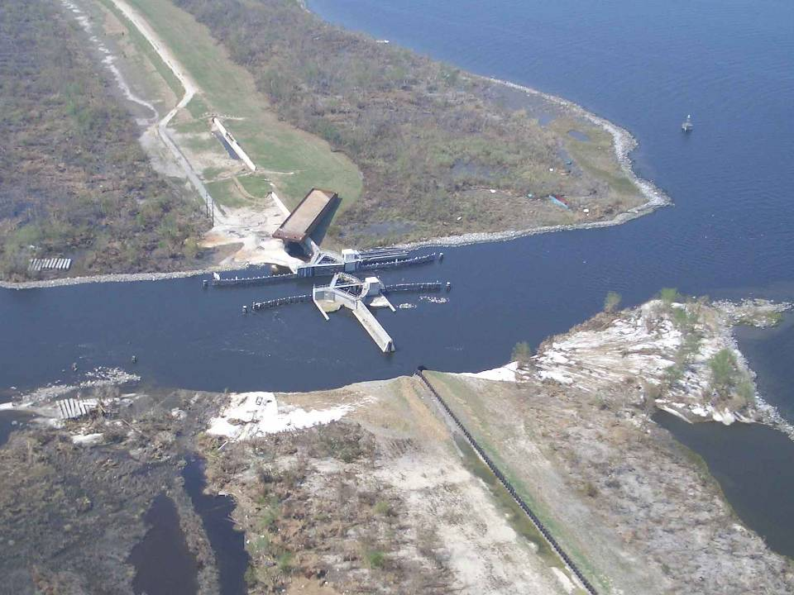
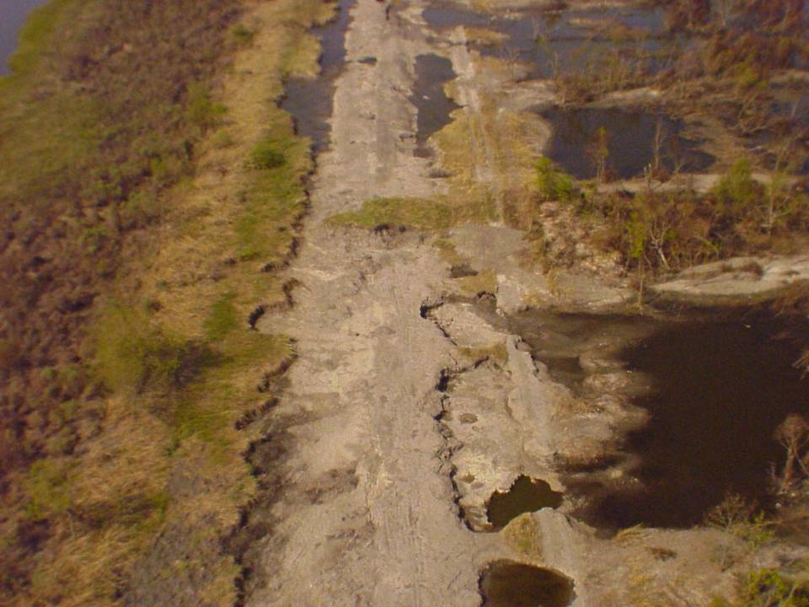
Effects of Hurricane Katrina
Levee Erosion
Transition Erosion

Slide 8
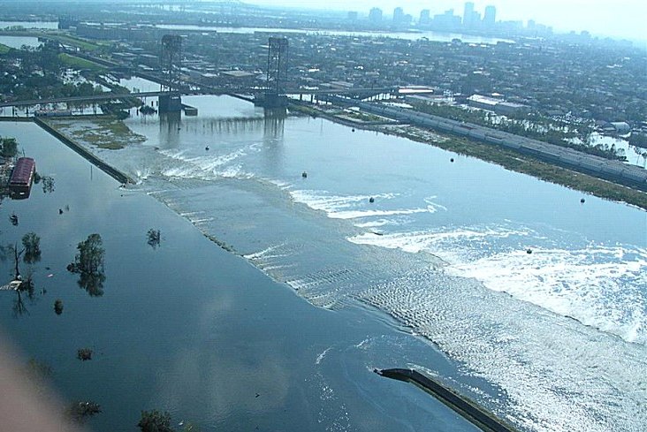
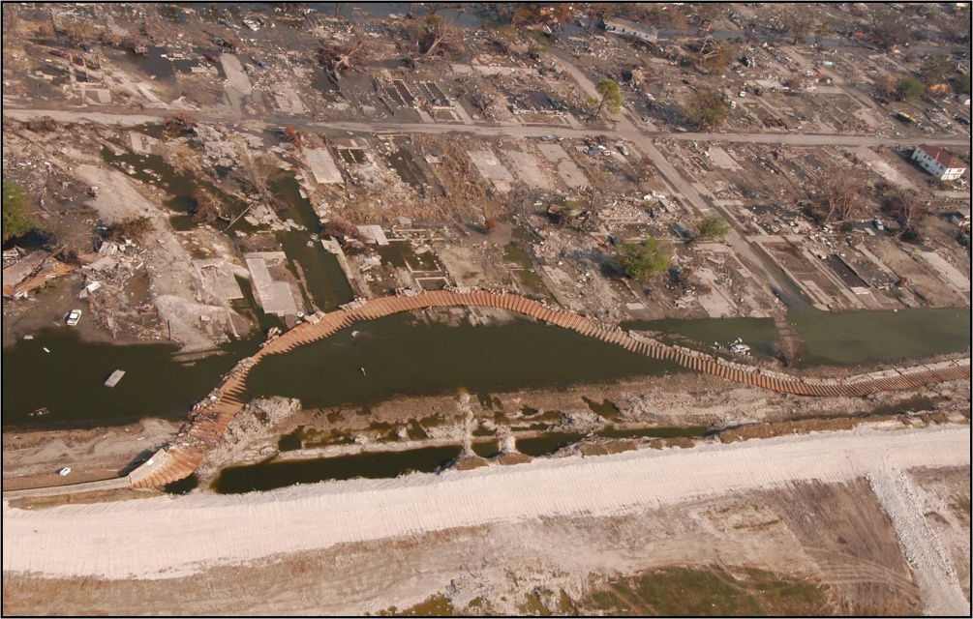
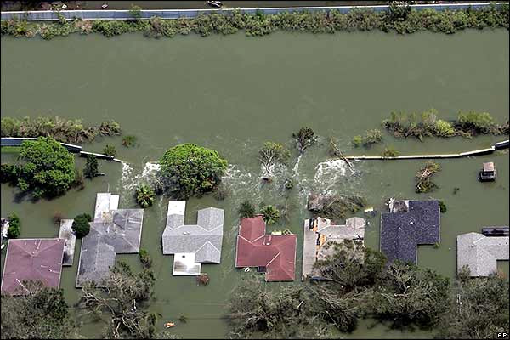
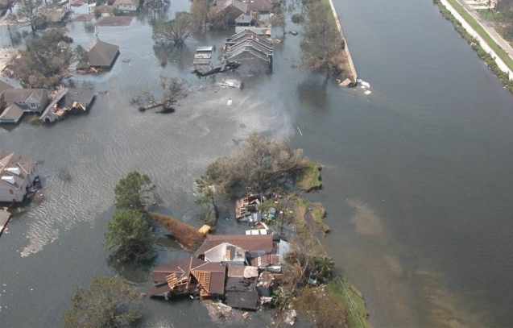
Katrina Floodwall Breaches
Inner Harbor Navigational Canal
Inner Harbor Navigational Canal
London Ave. Canal
17th St. Canal

Slide 9
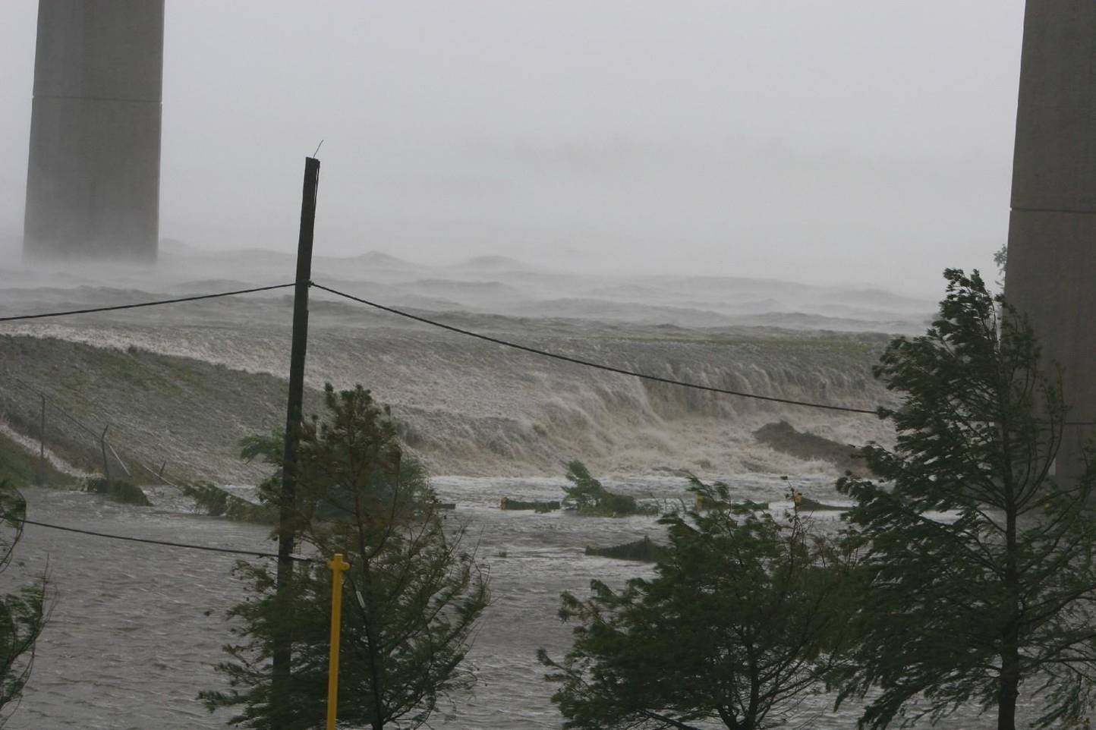
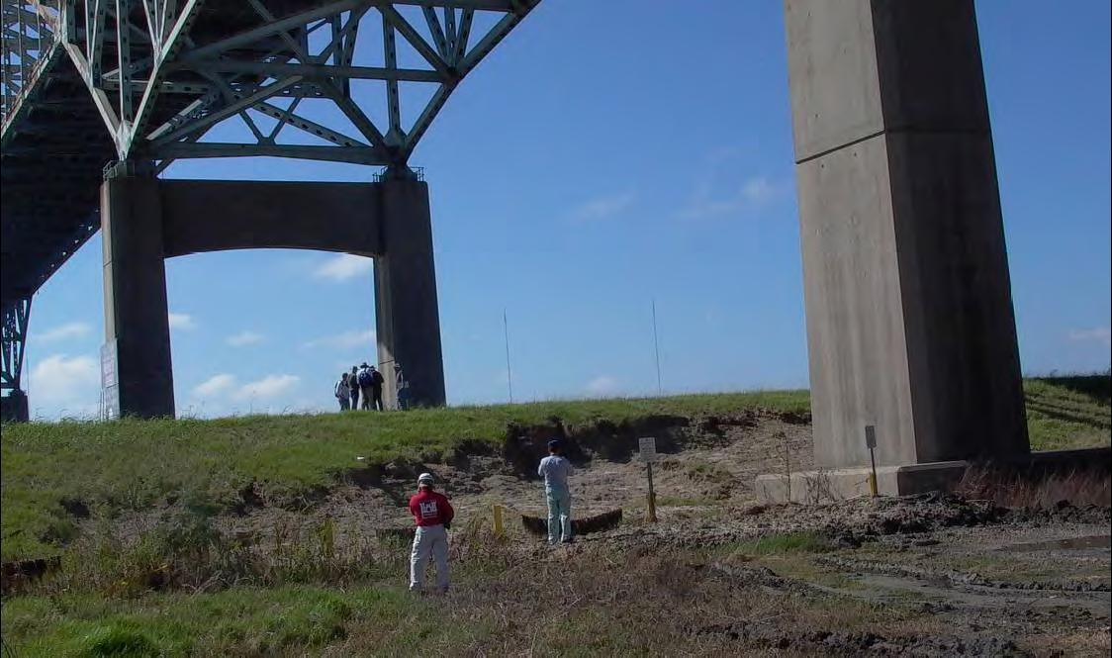
Wave Overtopping Effects

Slide 10
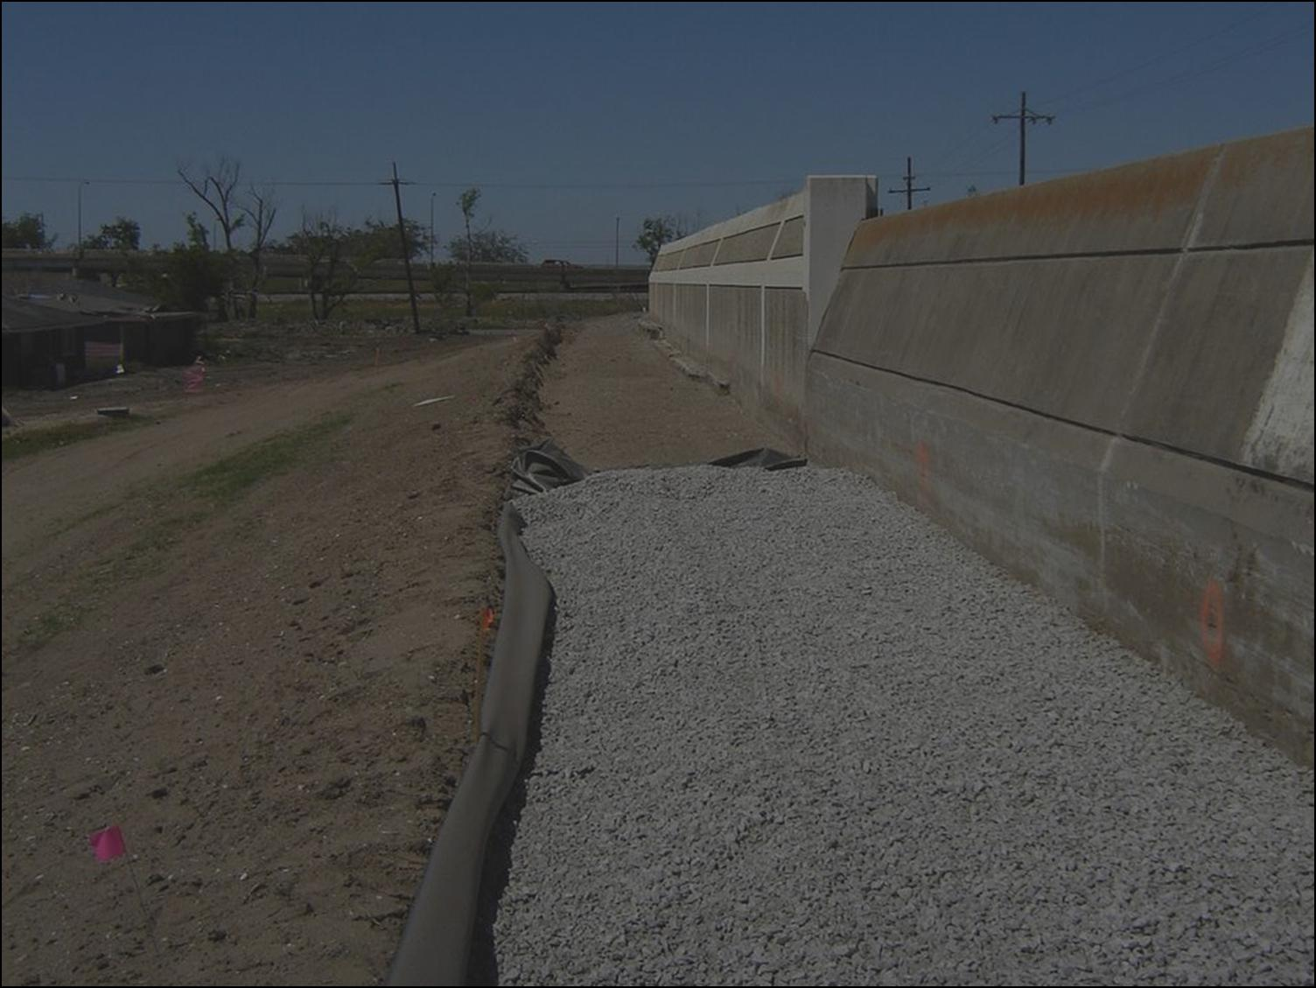
IPET – Interagency Performance
Evaluation Task Force
Over 150 members: academia, industry, state and federal agencies
Charged to answer 5 Questions:
  Flood Protection System
  Storm
  Performance
  Consequences
  Risk
Peer review by National Academy of Sciences and ASCE
Draft report June 2006
Final report released spring 2009

Slide 11
Hurricane Protection Decision Chronology
Key Decision Influences
Tyranny of Incremental Decisions
Shared Sensitivity
to Cost Concerns
=
Institutional
Response

Slide 12
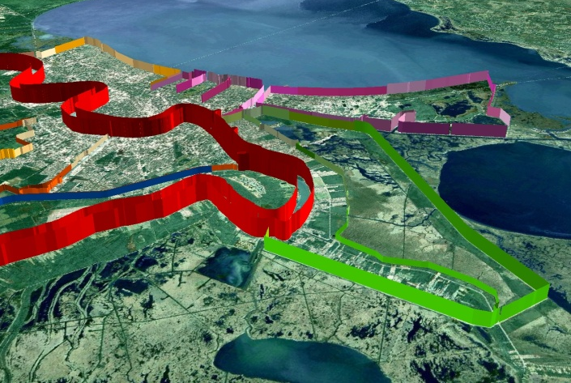
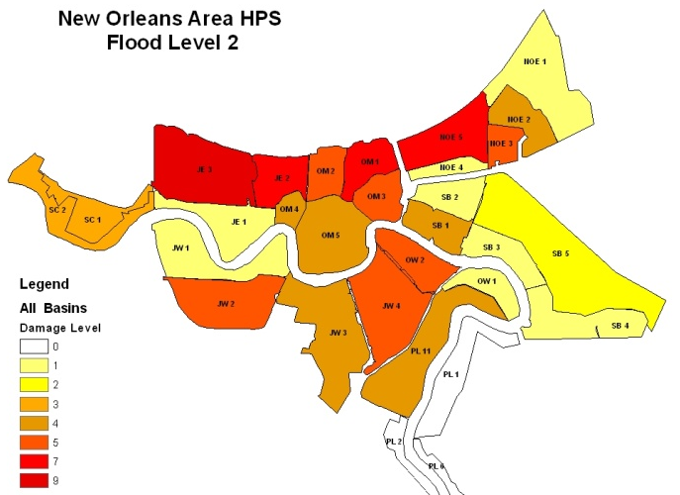
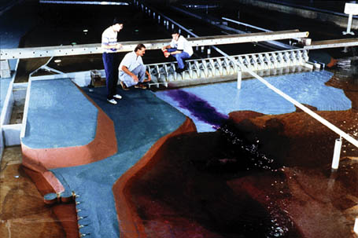
USACE’s Actions for Change
Comprehensive systems approach
Risk-informed decision making
Communication of risk to the public
Professional and technical expertise

Slide 13
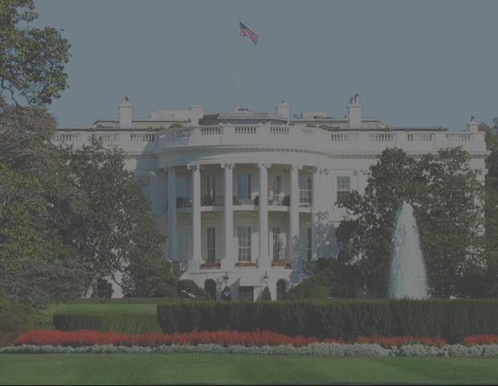
HSDRRS:
Our Mission and Commitment
Repair the damages, making what was there before whole again.
By 1 June 2011, strengthen and improve the system and provide 100-year level of risk reduction capable of withstanding the effects of a storm having a 1% chance of occurring each year.
Current funding level $14.48 B (fully funded).

Slide 14
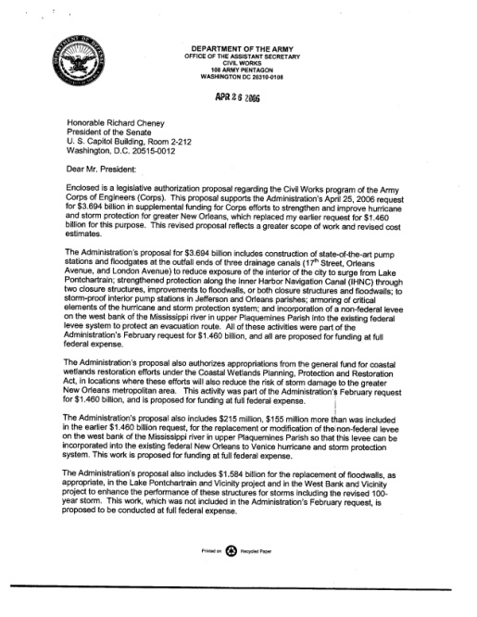
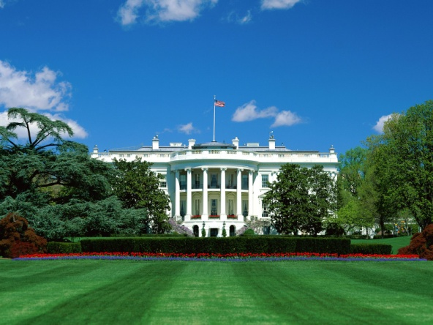
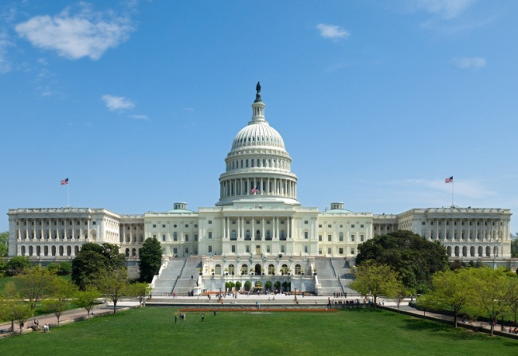
HSDRRS Authorization
4th Emergency Supplemental (June 2006)
…authorized to raise, as appropriate, levee heights and otherwise enhance the existing Lake Pontchartrain and Vicinity project and the existing West Bank and Vicinity project to provide the levels of protection necessary to achieve certification required for participation in the National Flood Insurance Program…

Slide 15
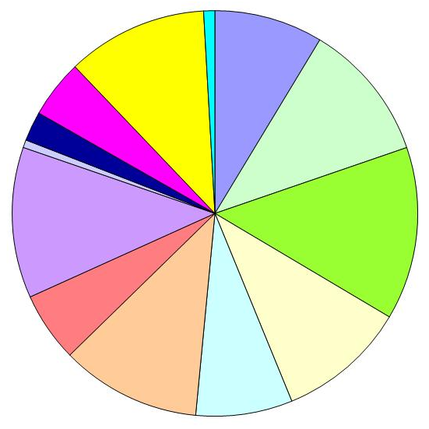
HSDRRS Funding Breakdown
TOTAL APPROPRIATED FUNDS: $14.48 B
COMPONENT | $ (M)
SELA (Interior Drainage) | $1,155
WBV 100-year Level of Protection | $2,010
LPV 100-year Level of Protection | $1,690
Repair Existing System | $1,483
Restore to Design Height | $1,010
Complete Authorized System | $1,643
Permanent Pump Stations | $854
IHNC | $1,603
Selective Armoring | $414
Storm-proof Existing Pump Stations | $340
Incorporate non-Fed Levees in Plaquemines Parish | $671
Reinforce or Replace Floodwalls | $1,481
Other | $110
Other
SELA
Floodwalls
Armoring
Non-fed
WBV 100-yr
Storm Proof
IHNC
LPV 100-yr
PCCP
Repair
Complete
Restore

Slide 16
NEPA Alternative Arrangements
Alternative Arrangements Approved by CEQ – to facilitate expedited construction of the 100-year level HSDRRS to abate extreme risk to life and property
NEPA Environmental Review – achieved through concurrent development of multiple Individual Environmental Reports (IERs) for segments of the system in lieu of comprehensive Environmental Impact Statement (EIS)
Consolidated Environmental Document – compilation of IERs into a single document assessing cumulative environmental impacts of HSDRRS

Slide 17
NEPA Compliance Schedule Impact
NOTIONAL
Estimated NEPA Compliance and Construction Times
100-yr Completion Operational Goal
~3-5 years saved in completion of 100-yr System
Total spent on achieving NEPA compliance: ~$20 million.
38 Individual Environmental Reports (IER), 22 Supplemental IERs.
Hosted 200+ public meetings.
IER A
LPV Polder A Construction
Alternative Arrangements
IER B
LPV Polder B Construction
IER C
LPV Polder C Construction
IER D
LPV Polder D Construction
IER E
LPV Polder E Construction
LPV Polder A Construction
Traditional NEPA Procedures
LPV Polder B Construction
LPV EIS (~5 years)
LPV Polder C Construction
LPV Polder D Construction
LPV Polder E Construction
1 | 2 | 3 | 4 | 1 | 2 | 3 | 4 | 1 | 2 | 3 | 4 | 1 | 2 | 3 | 4 | 1 | 2 | 3 | 4 | 1 | 2 | 3 | 4 | 1 | 2 | 3 | 4 | 1 | 2 | 3 | 4 | 1 | 2 | 3 | 4
2007 |  |  |  | 2008 |  |  |  | 2009 |  |  |  | 2010 |  |  |  | 2011 |  |  |  | 2012 |  |  |  | 2013 |  |  |  | 2014 |  |  |  | 2015

Slide 18
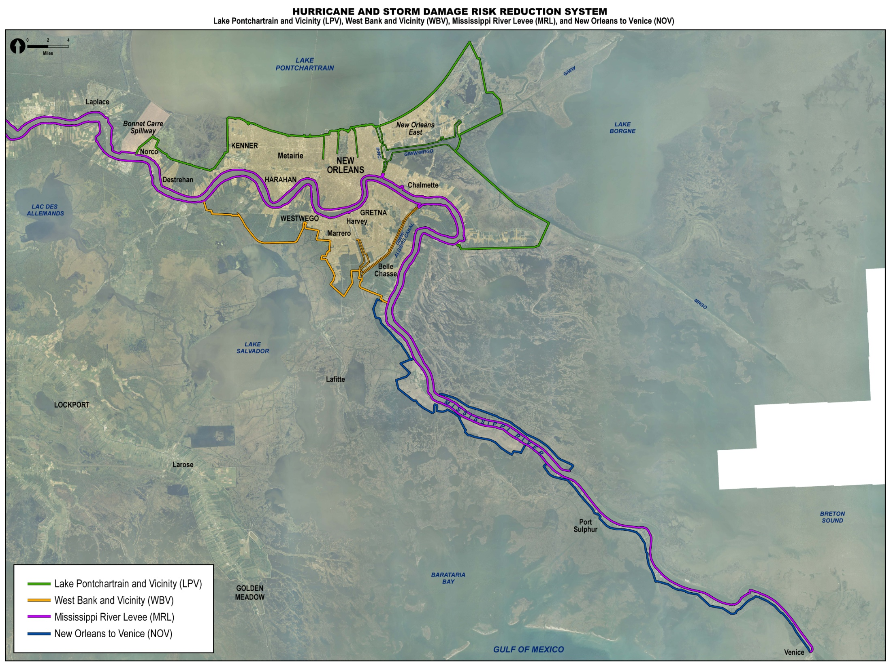
5 Parishes
350 Miles of Levee/Floodwall
130 Miles of 100-yr Perimeter
78 Pumping Stations (Fed & Non-Fed)

Slide 19
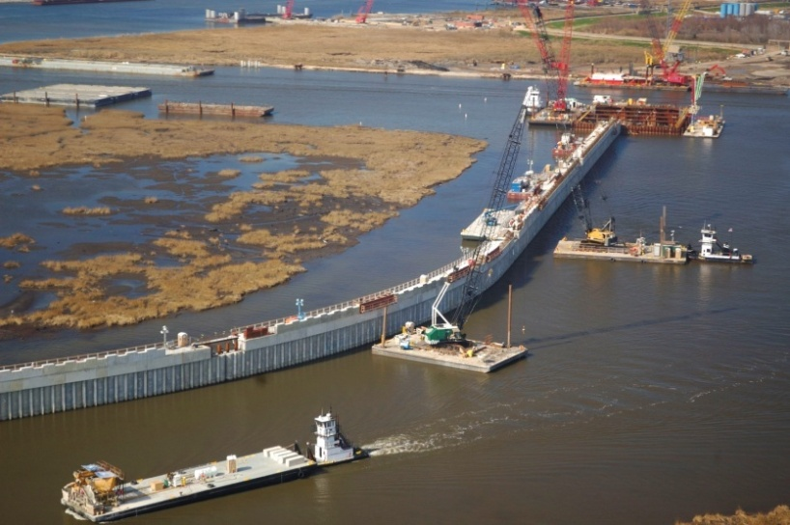
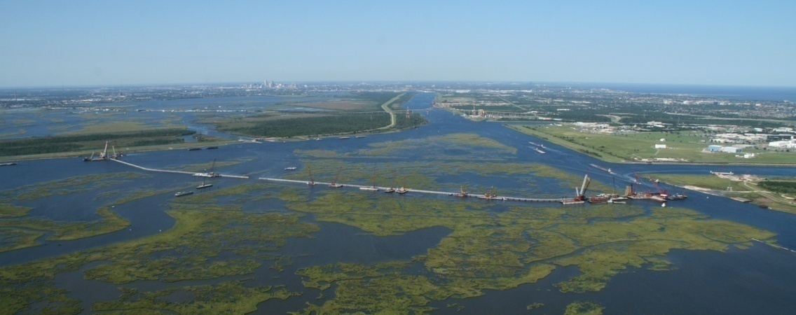
Deliver the Greater New Orleans HSDRRS Mission
Challenges
Mandate to deliver $14.6B construction program within budget and on schedule
Form design criteria, program cost estimate, acquire funding
Intense scrutiny / oversight
New governances
NEPA compliance
Deliver a comprehensive system
Enablers
Administration / Congressional commitment
Fully funded program
National / Regional Corps capabilities
Local partners and stakeholders capabilities
NEPA Alternate Arrangements
Full host of acquisition strategies
Favorable bidding climate

Slide 20
Hurricane Paths Considered in the Risk Analysis
3 HSDRRS Geometries
  Pre-Katrina
  Current (1 June 07)
  100-year LOP (~2011)
152 storms
  25 yr to 5,000+ yr
350+ features
  Floodwalls
  Levees
  Pumps Stations
62,928 Hurricane
Hydrographs

Slide 21
HSDRRS 100YR Design Elevation Criteria
Elevation set to higher of:
  That required to limit wave overtopping associated with a 100-yr storm surge to 0.01 cfs/ft with 50% confidence of non-exceedance
  Or
  That required to limit wave overtopping associated with a 100-yr storm surge to 0.1 cfs/ft at 90% confidence of non-exceedance
  Or
  The 500-yr still water elevation with a 50% confidence of non-exceedance

Slide 22
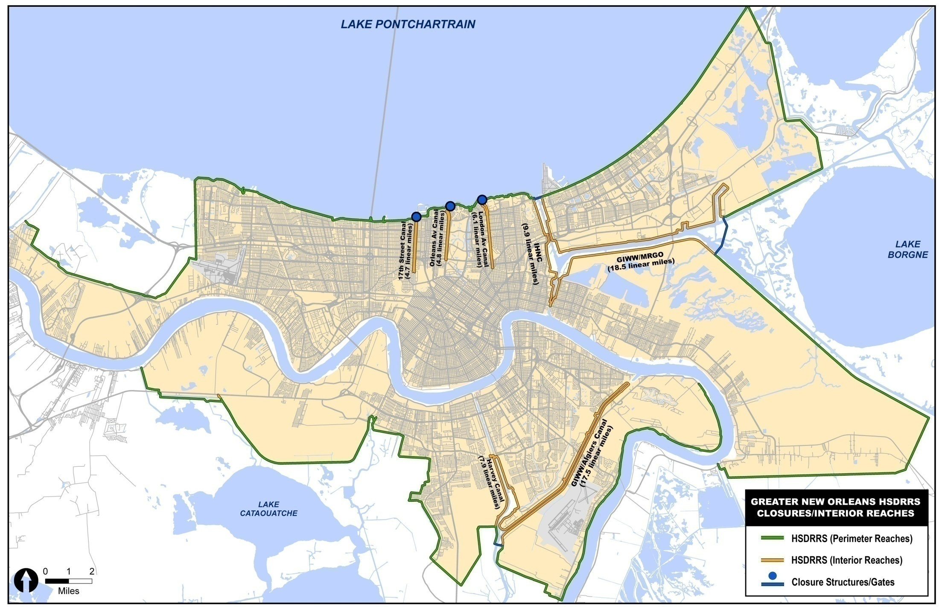
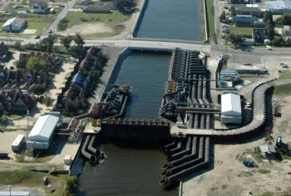
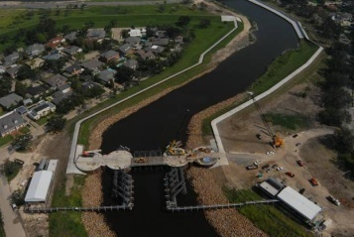
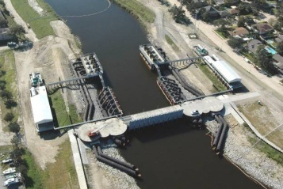
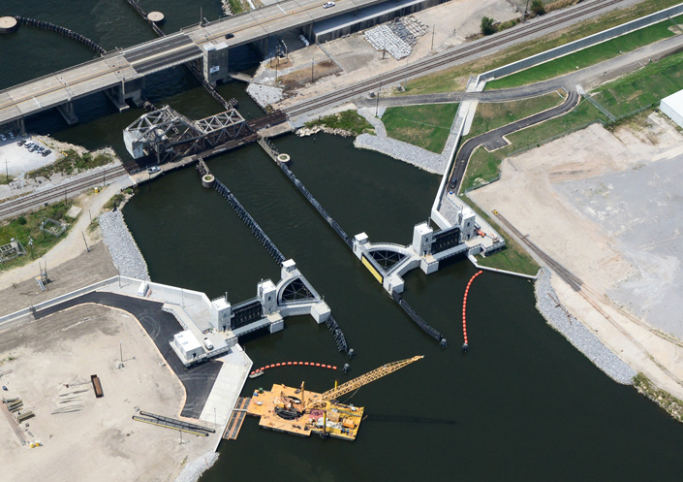
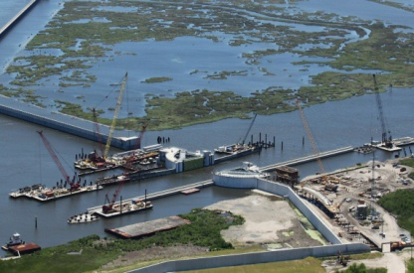
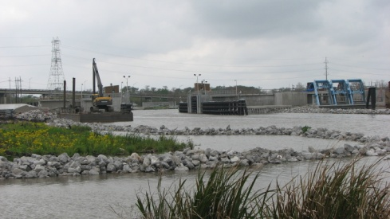
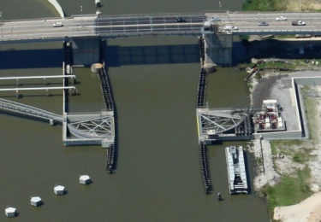
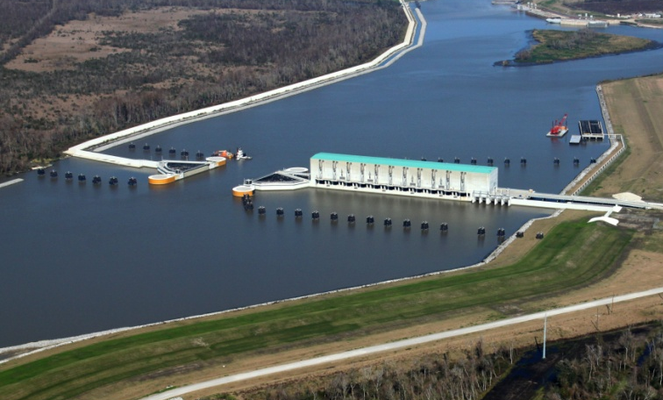
A Stronger System Than Ever Before
Total System Openings: 493
Navigable Openings: 11
Roadway Openings: 144
Railroad Openings: 45
Access Openings: 134
Drainage Openings: 159
17th St.
Orleans
London
Seabrook
Developed new HSDRRS hydraulic, geotechnical and structural design criteria.
Floodwalls and hardened structures built for 2057 hydraulic conditions
Pre-Katrina system: 200 miles
Post-Katrina 100-yr system: 130 miles
→35% shorter perimeter exposed to surge
IHNC Surge Barrier
Bayou Verret
Caernarvon
Harvey Floodgate
West Closure Complex
Bayou Segnette
Hero Canal

Slide 23
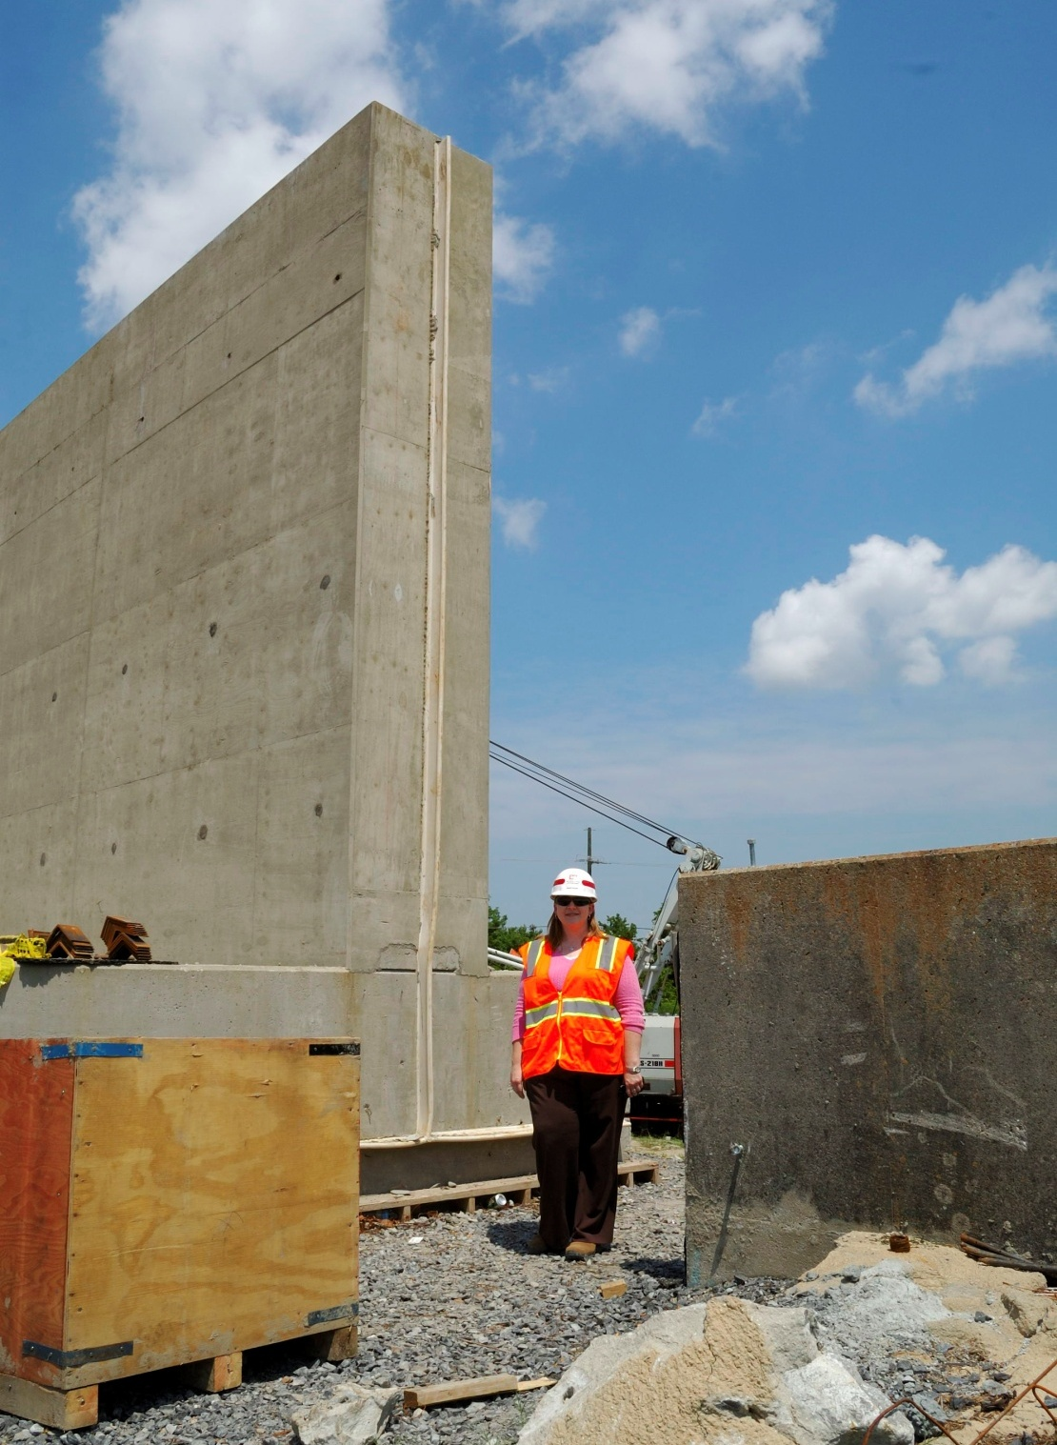
New Orleans
East
Surge Barrier
Tie-In
New Floodwall
Old Floodwall

Slide 24
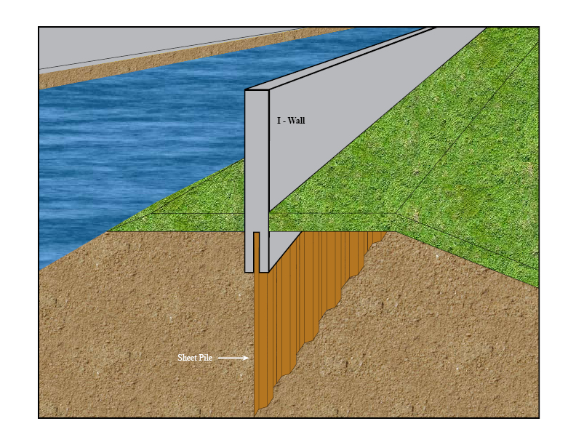
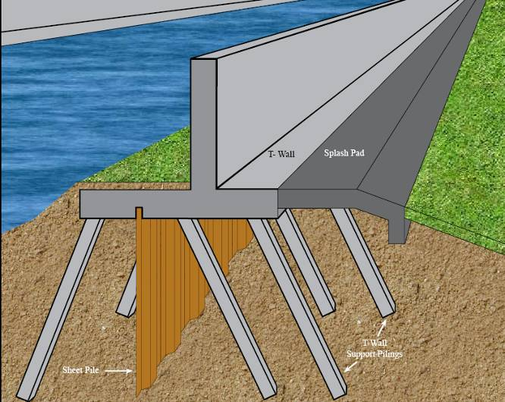
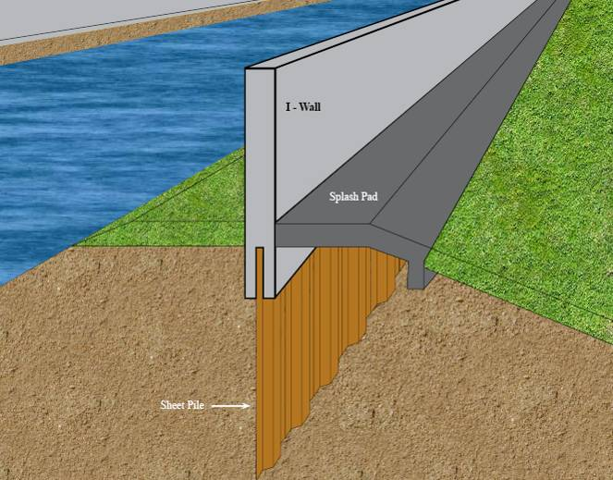
Design Improvements
T/I wall design
Scour protection
Before
After

Slide 25
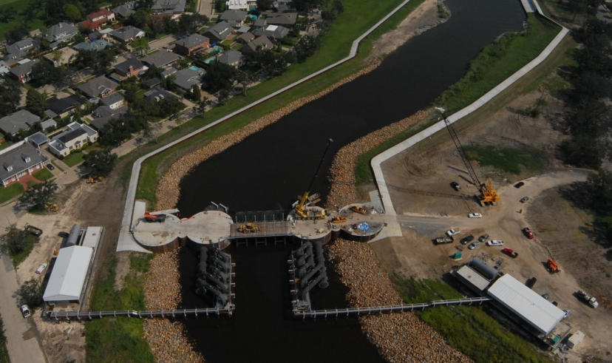


Interim Closure Structures
Orleans Ave. Canal
London Ave. Canal
17th St. Canal
All structures completed June 2006
Provide interim 100-yr level of risk reduction

Slide 26
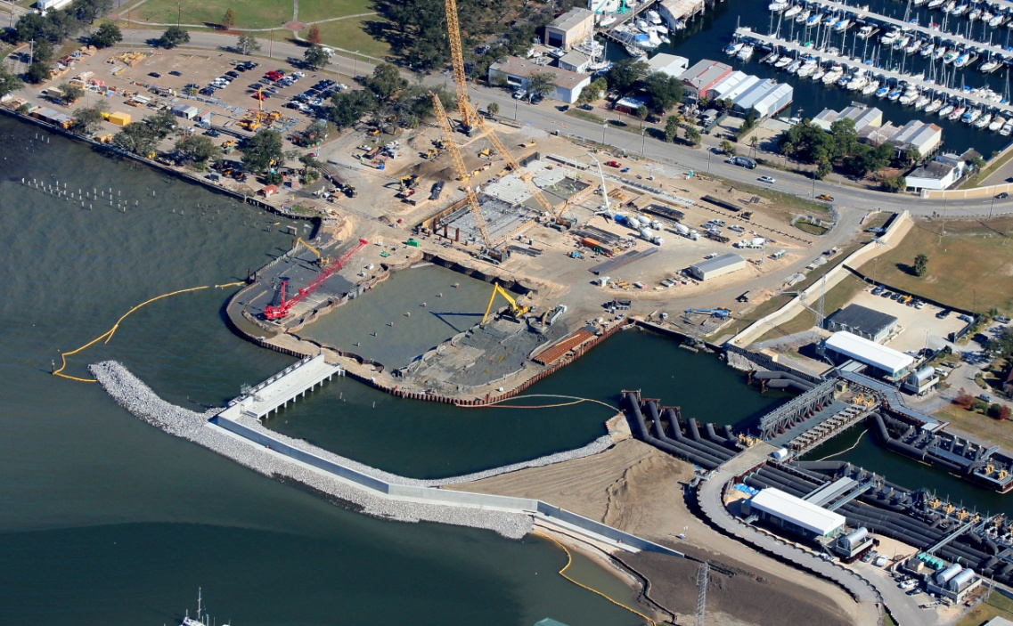
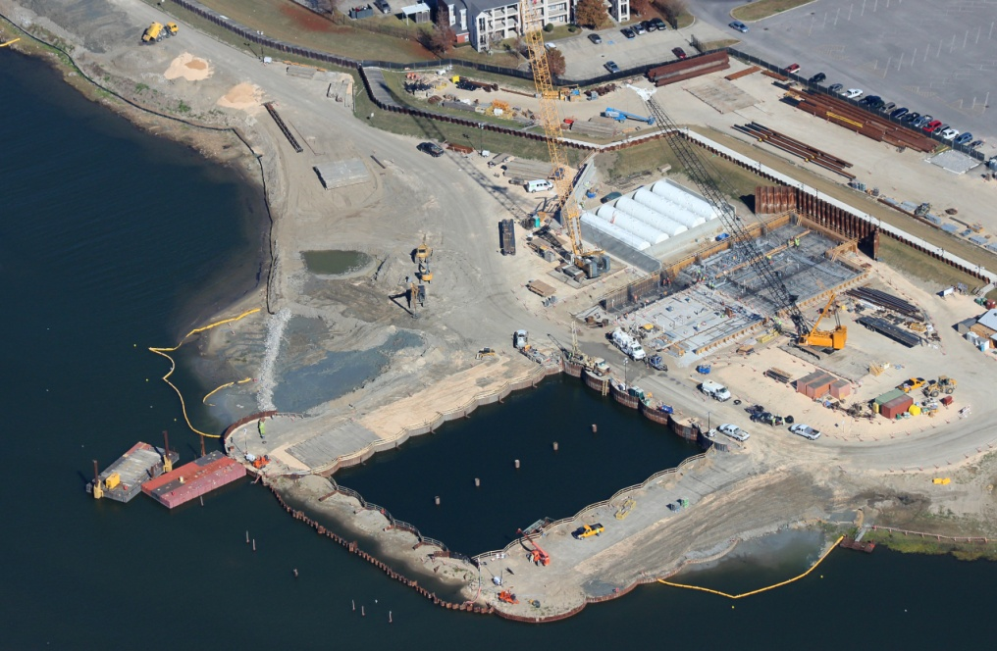
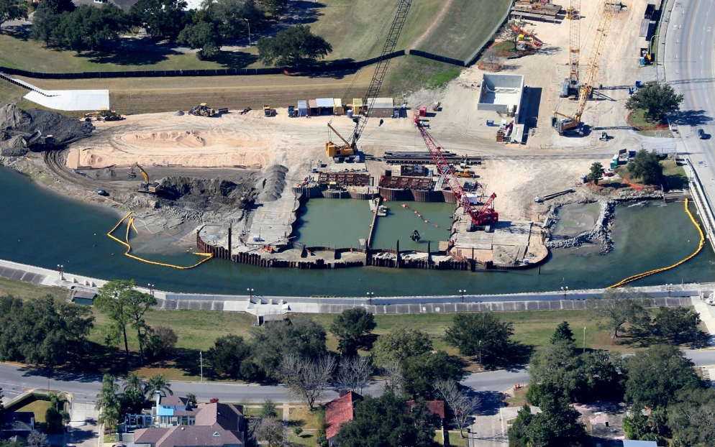
Permanent Canals Closures and Pumps
17th St. Canal
London Ave. Canal
Orleans Ave. Canal

Slide 27
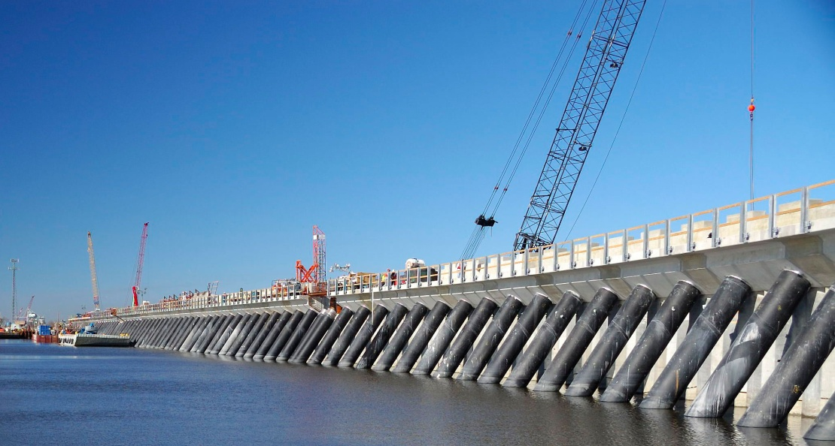
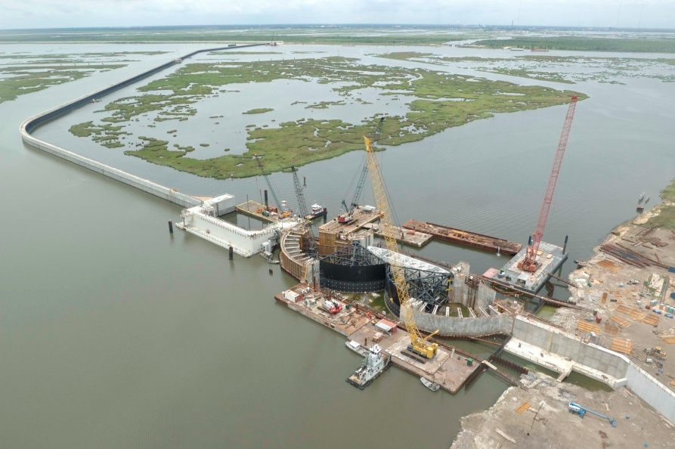
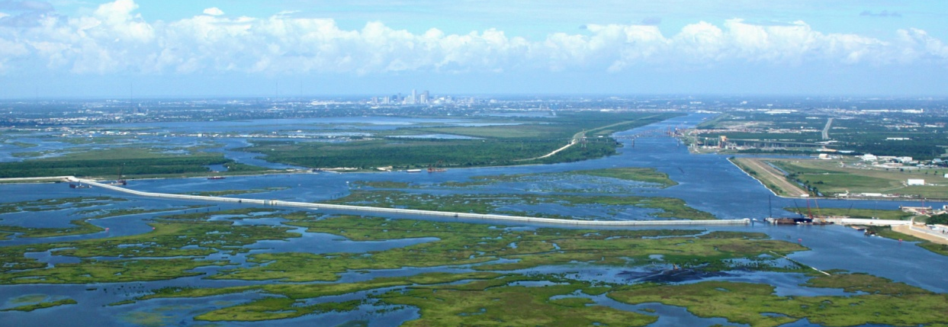
IHNC Lake Borgne Surge Barrier
36 in dia steel pipe battered piles (240 ft long)
66 in dia spun cast concrete soldier piles (140 ft long)
Precast and cast in place deck and parapet wall
$1.3 B Delivery cost
Design-Build Cost Reimbursable
1.8 mile span
150 ft sector gate and barge gate
54 ft vertical lift gate
Notes:
Achieving 100-year level of defense at the Inner Harbor Navigation Canal Surge Barrier Project, USACE’s largest-ever design-build civil works construction contract and one of the largest surge barriers in the world (nearly two miles).

Slide 28
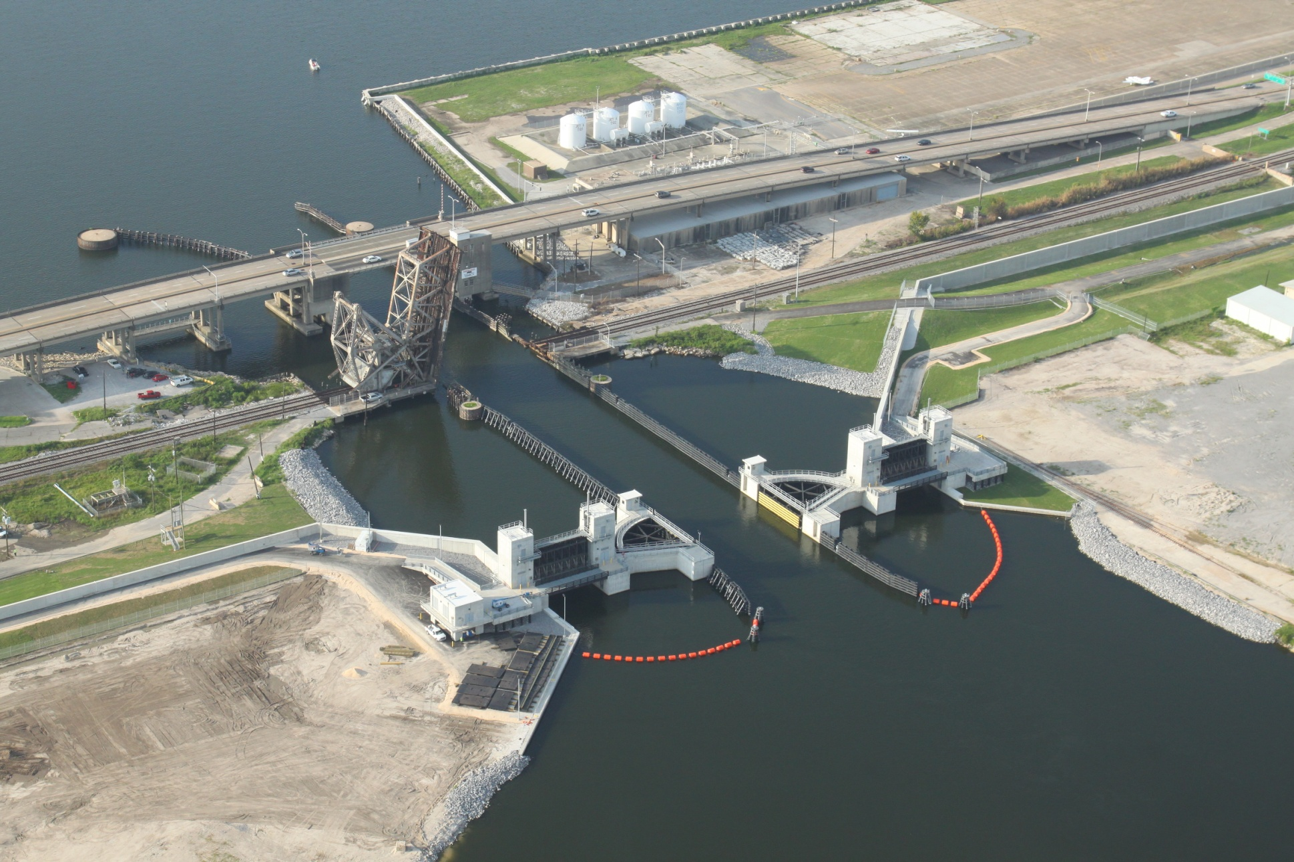
Seabrook Gate Complex
95 ft sector gate
Two 50 ft vertical lift flow control gates
~$200 M Delivery cost
Early Contractor Involvement (ECI)

Slide 29
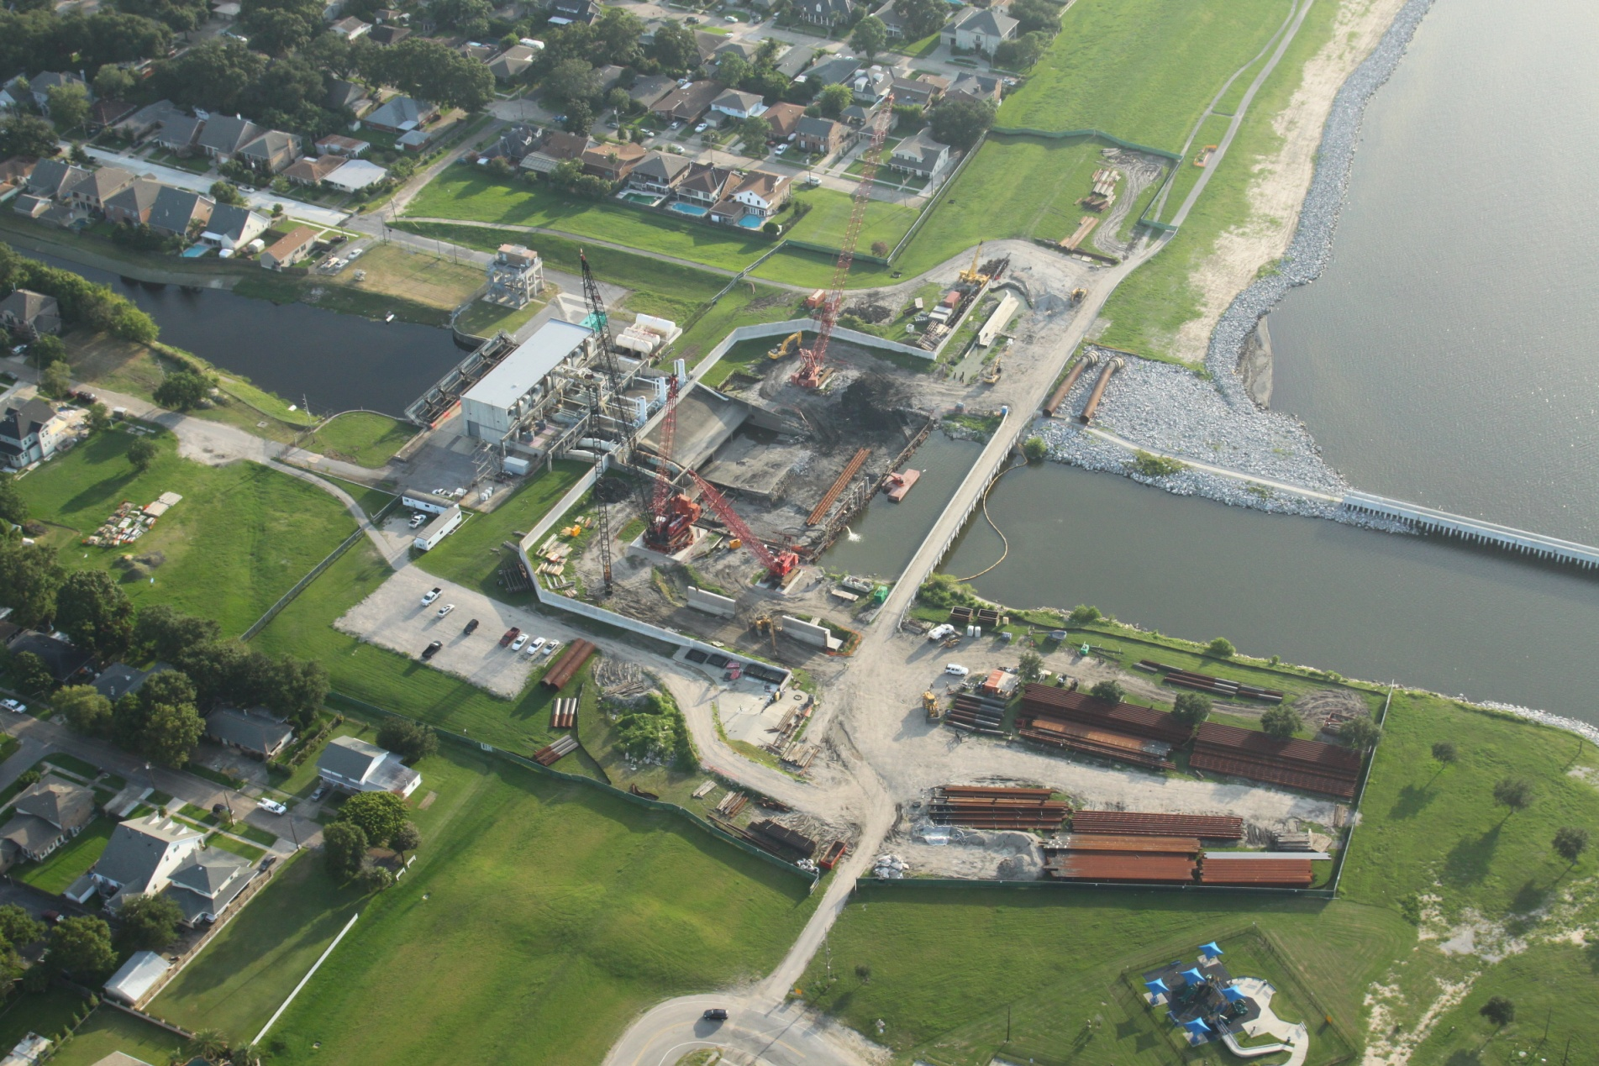
Pump Station Fronting Protection

Slide 30
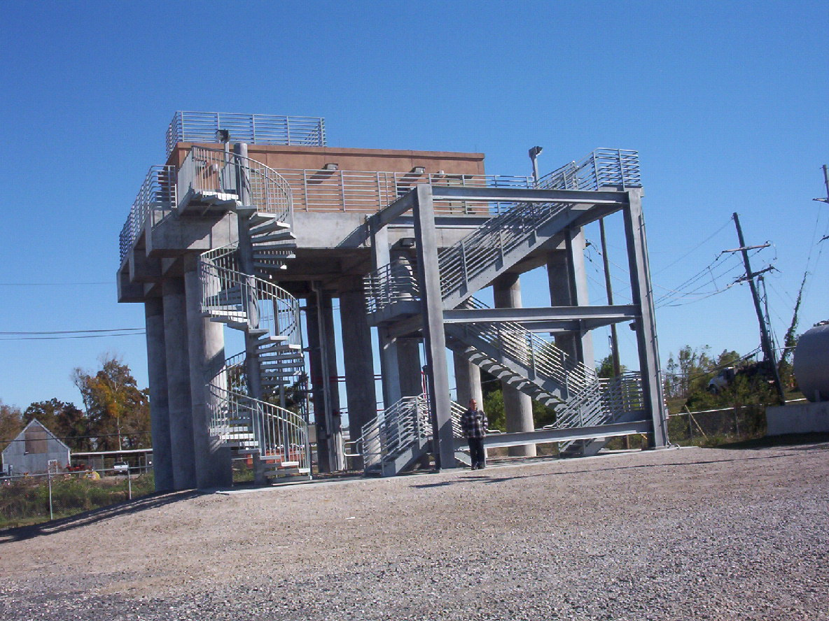
Bayou Segnette Pump Station
Completed Safe House
5 new safe houses built
5 existing safe houses improved / hardened

Slide 31
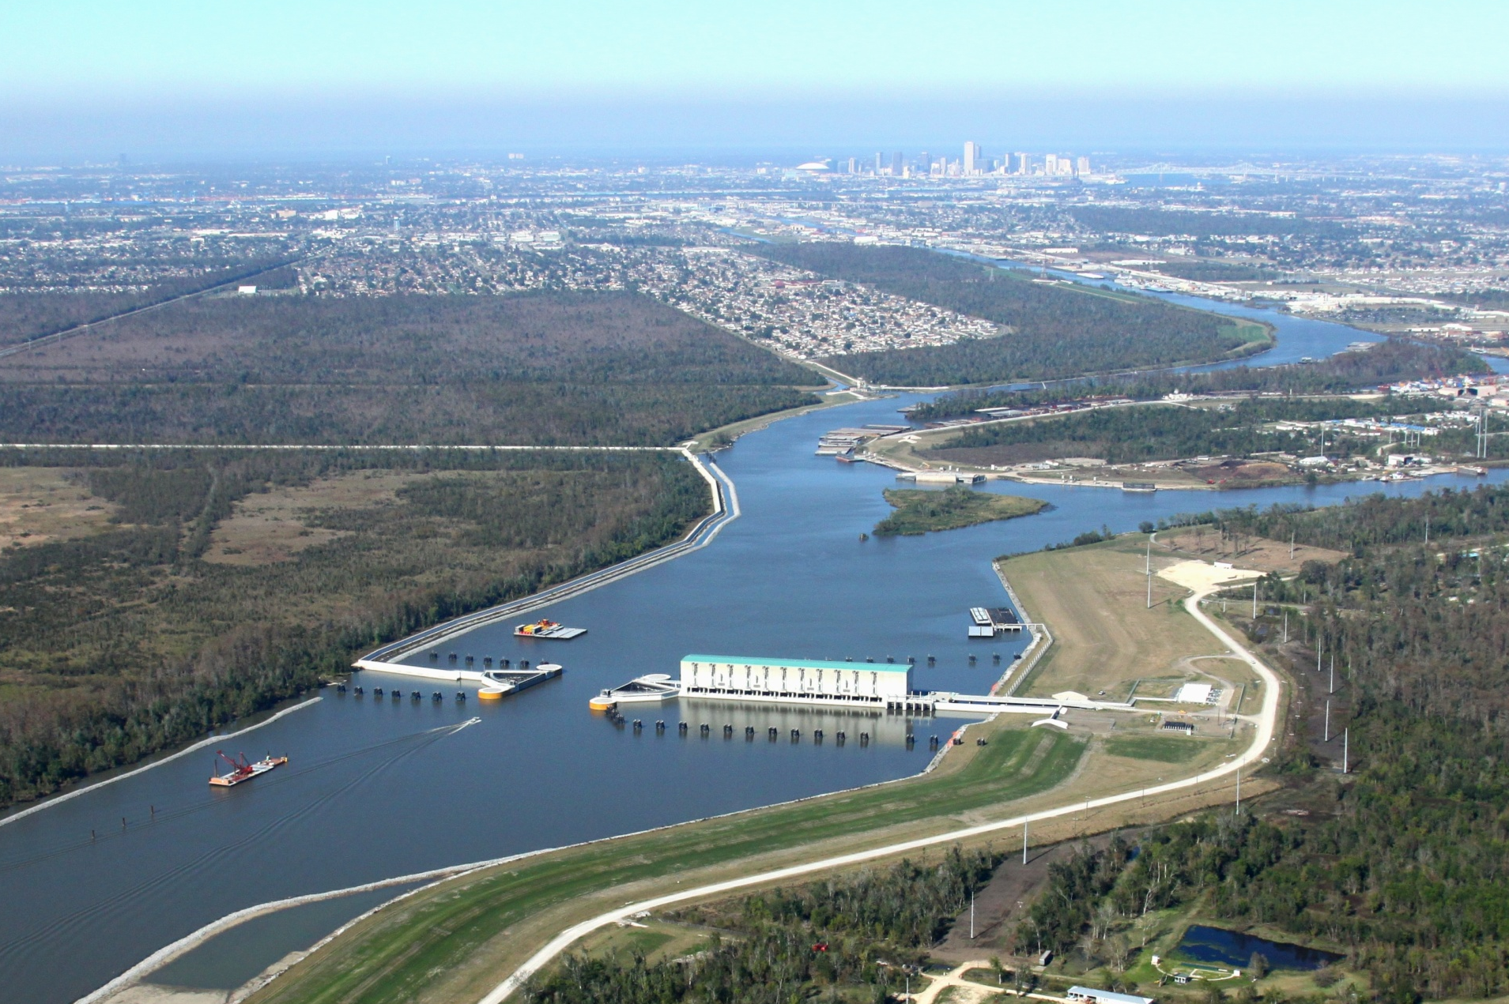
West Closure Complex
Largest drainage pump station in the world – 19,140 cfs
Largest sector gates in US – 225 ft clear width
Removed 26 miles of levees and floodwalls from the first line of defense
~$1 B Delivery cost
Early Contractor Involvement (ECI)

Slide 32
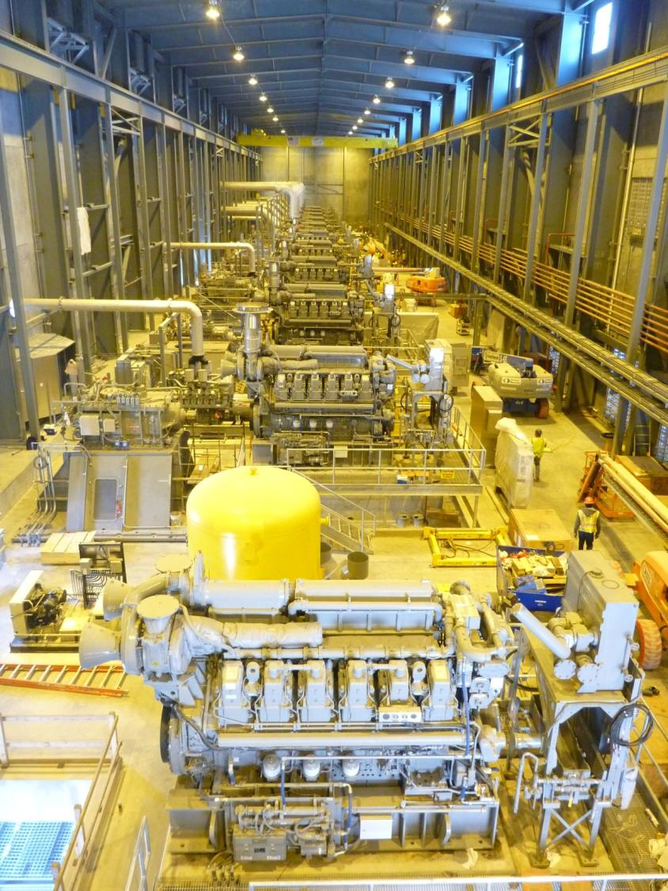
West Closure Complex
Pump Station
5400 hp diesel engines drive 11 flowerpot pumps

Slide 33



New Orleans East Deep Soil Mixing
Largest ever deep soil mixing application in US
1.7 million cubic yards of land treated
500,000 tons of cement used
5.3 mile stretch
ECI

Slide 34

New Orleans East Levee
2 ft. thick sand blanket with 9 in. layer of gravel on top
1,000,000 total cubic yards of sand
Bayou Sauvage National Wildlife Refuge
Old
Levee
New Levee
Over 1 Superdome of Clay
(4.9 mil cy) Required
~1 Football Field

Slide 35

Wick Drains
Largest ever wick drain application in USA
250,000 wicks
ECI

Slide 36

St. Bernard Floodwall,
near the IHNC Tie-In
Top of Floodwall: EL +32’
Katrina Storm Surge: EL +25’
500-yr Still Water Elevation*: EL +22’
100-yr Still Water Elevation*: EL +18’
* Still water elevation does not include waves
DESIGNED FOR A 100-YR STORM SURGE EVENT

Slide 37


St. Bernard Floodwall
3 contracts
~$1 B
23 miles (2 mi completed per month at peak of construction)
ECI

Slide 38

St. Bernard Floodwall Construction – Southern Reach

Slide 39






HSDRRS Remaining Work
~$1.4 B
~$850 M
$380 M
SELA Interior Drainage
Permanent
Pump Stations
Mississippi River / HSDRRS Co-located Levees
$414 M
$280 M
~$1.35 B
Armoring
Environmental Mitigation
New Orleans to Venice / Non-Federal Levees

Slide 40





Armoring at
Control Structure
Transition Armoring
Armoring at
Floodgates
Armoring at
Railroad Floodgate
Armoring Behind I-Wall / T-Wall
Slide 40

Slide 41


Armoring
Turf Reinforcement Mat
Wave Overtopping Testing
Sod / Enhanced Grass

Slide 42




HSDRRS Environmental Mitigation
Project Construction Value: $190 M
Impacts (2,295 acres)
LPV – 1,179 acres
WBV – 1,116 acres
Current Plan
3 Mitigation Bank projects
10 Corps constructed projects
Challenges
Lack of in-basin mitigation bank credits for all impacted habitats
Some Corps Constructed projects potentially require condemnation for investigation/construction
Bottomland Hardwoods Wet
Swamp
Marsh
Bottomland Hardwoods Dry
Notes:
Budget is $25M for HSDRRS Mitigation, the Construction value is listed on the slide.

Slide 43


In 2007, you had a 1% chance every year
of flooding this deep from Hurricanes
Notes:
The depth map tool is a relative indicator of progress, over time, demonstrating risk reduction as a function of construction progress
The water surface elevations are mean values
The scale sensitivity of the legend is +/- 2 feet
The info does not depict interior drainage modeling results
The storm surge is characterized as the result of a probabilistic analysis of 5 to 6 storm parameters of a suite of 152 storms and not a particular event
Assumes 50% Pumping Capacity
March 08

Slide 44

With the 100-year level of protection, you have a 1% chance every year of flooding this deep from Hurricanes
Notes:
The depth map tool is a relative indicator of progress, over time, demonstrating risk reduction as a function of construction progress
The water surface elevations are mean values
The scale sensitivity of the legend is +/- 2 feet
The info does not depict interior drainage modeling results
The storm surge is characterized as the result of a probabilistic analysis of 5 to 6 storm parameters of a suite of 152 storms and not a particular event
Assumes 50% Pumping Capacity
March 08

Slide 45


With the 100-year level of protection, you have a 0.2% chance every year of flooding this deep from Hurricanes
Notes:
The depth map tool is a relative indicator of progress, over time, demonstrating risk reduction as a function of construction progress
The water surface elevations are mean values
The scale sensitivity of the legend is +/- 2 feet
The info does not depict interior drainage modeling results
The storm surge is characterized as the result of a probabilistic analysis of 5 to 6 storm parameters of a suite of 152 storms and not a particular event
Assumes 50% Pumping Capacity
March 08

Slide 46
Buying Down Risk
Initial Risk
Zoning / Building Codes
Coastal Protection and Restoration
Outreach
Evacuation Plan
Insurance
Risk
Levees / Floodwalls / Structures
Residual Risk

Slide 47
Discussion / Questions

