Slide 1


Hurricane Katrina & Hurricane Response in Louisiana
February 24, 2015

Slide 2
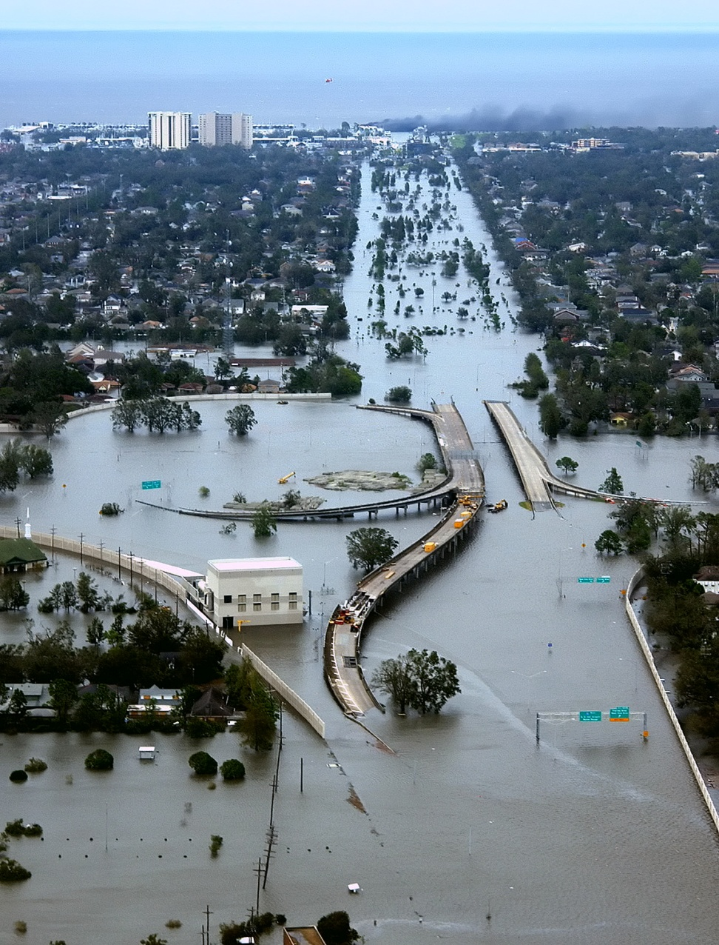
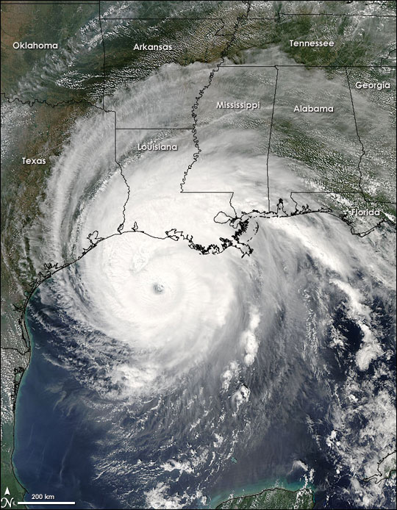
Louisiana August/September 2005
Hurricane Katrina/Rita

Slide 3

  Pre-Katrina
    No State pre-event assisted transportation plan
    No State run General Population Shelters
    (Superdome considered “last resort”)
    Shelter Task Force coordinated sheltering parish shelters primarily above I-10
      Citizens transported themselves to Information Points along the evacuation routes
      Information Points provided shelter location info to evacuees

Slide 4
  Pre-Katrina
    State was prepared to open several Medical Special Needs Shelters
    No pet plans or pet shelters
    Parishes provided shelters within their own jurisdictions citizens seeking safety from wind and/or water

Slide 5
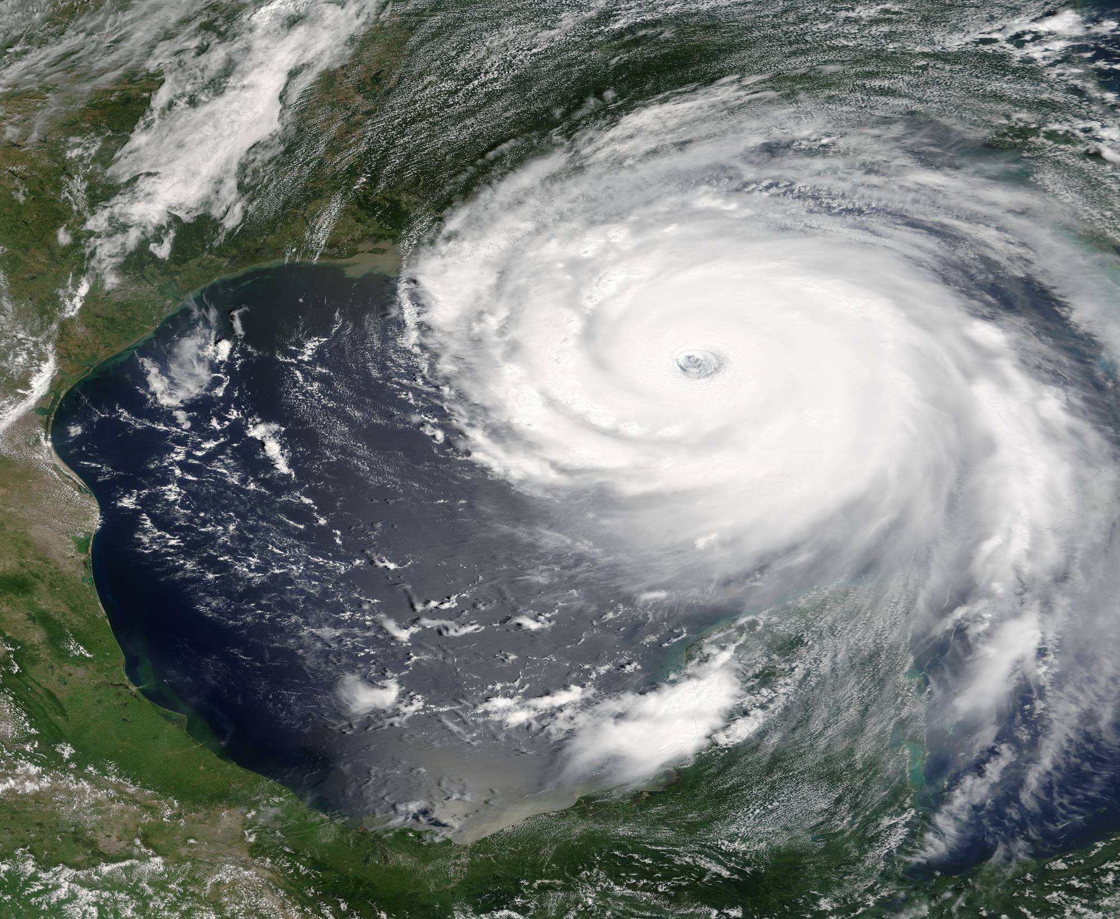
Hurricane Katrina
August 2005

Slide 6
Hurricane Katrina
Overall area impacted - 108,456 square miles
80% of New Orleans submerged
1500+ Louisiana casualties
200,000+ Louisiana homes substantially damaged or destroyed
71,000+ Louisiana businesses impacted
300,000+ job losses in Louisiana

Slide 7
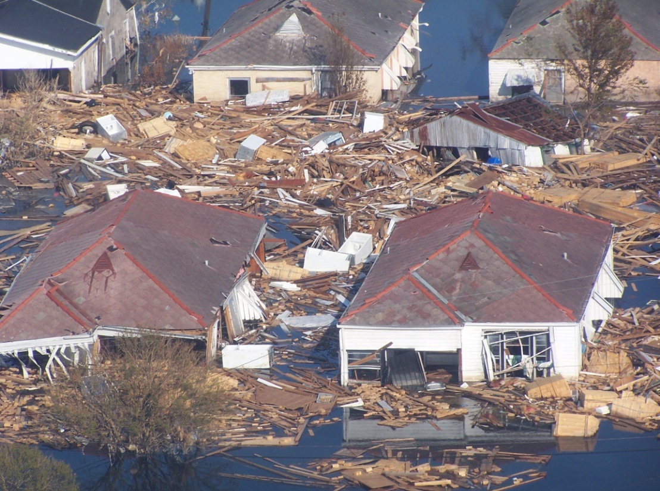
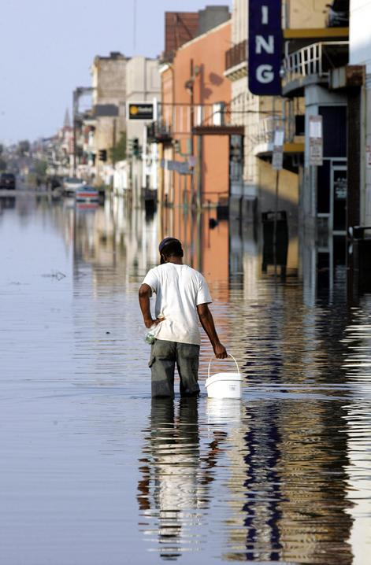
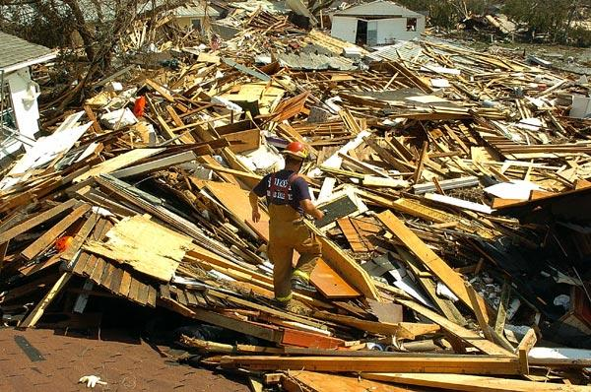

Slide 8

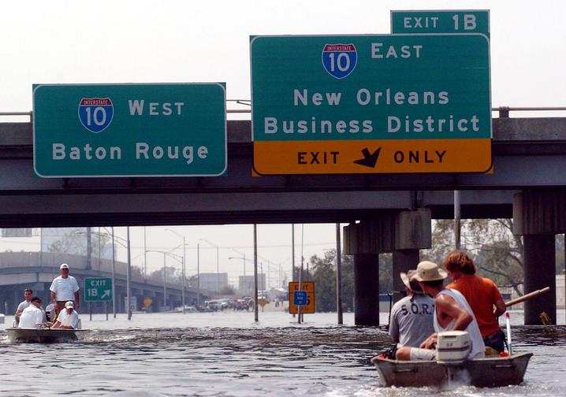
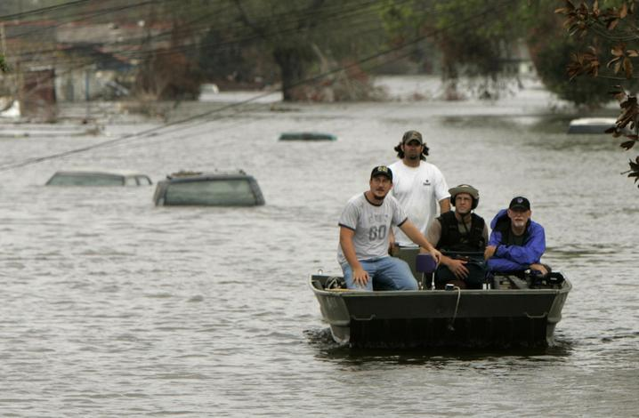

Slide 9
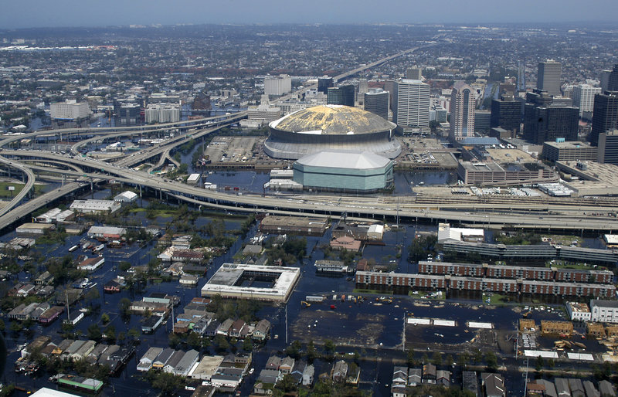
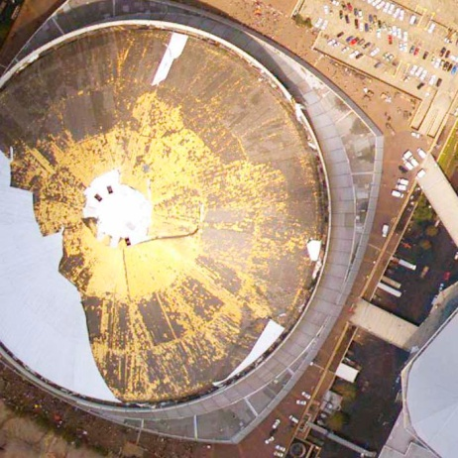
New Orleans Superdome

Slide 10
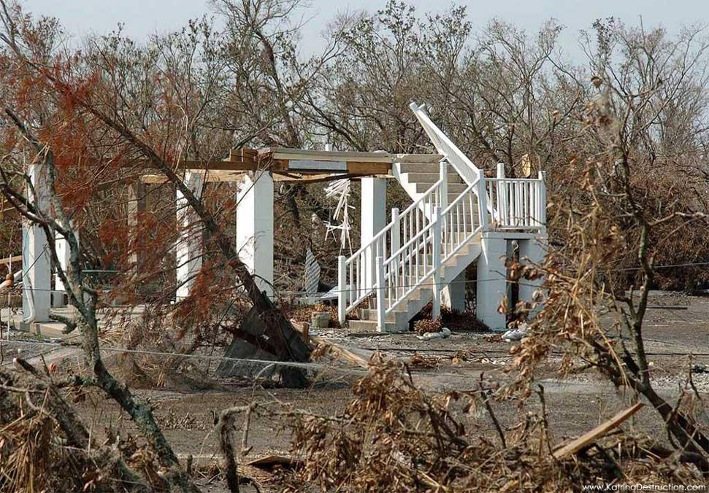
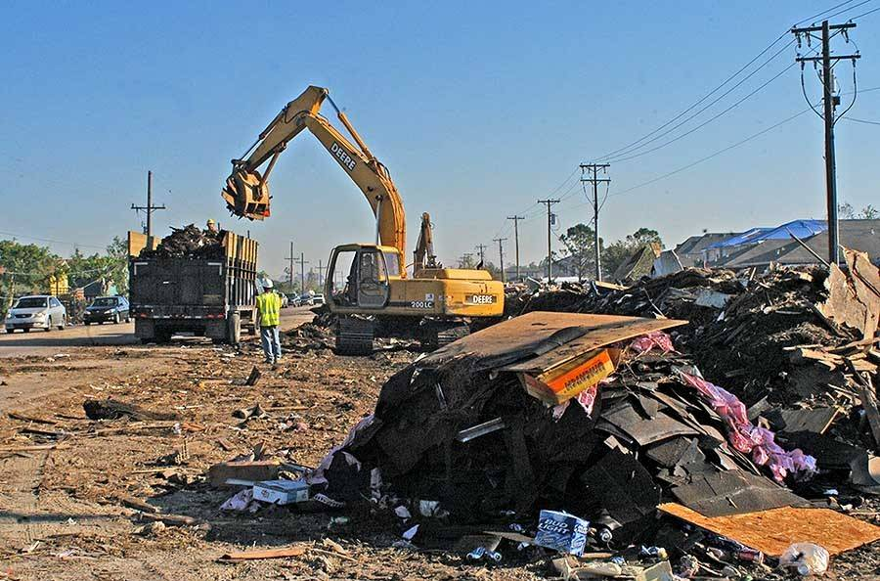
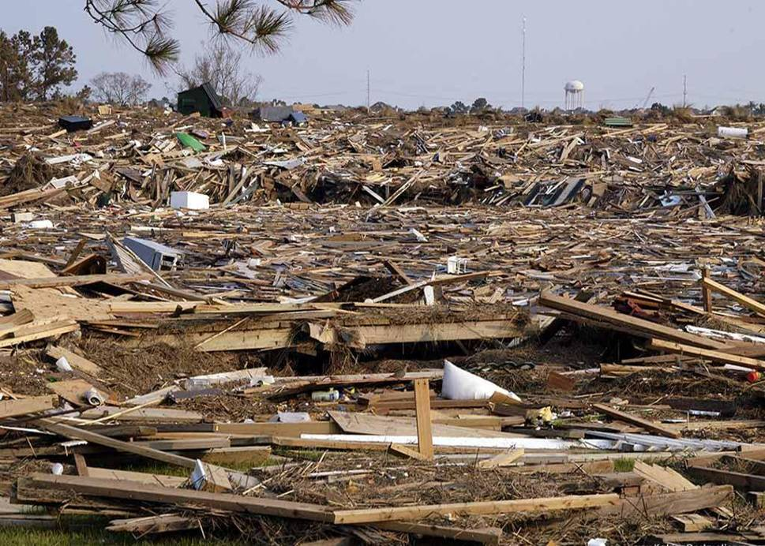
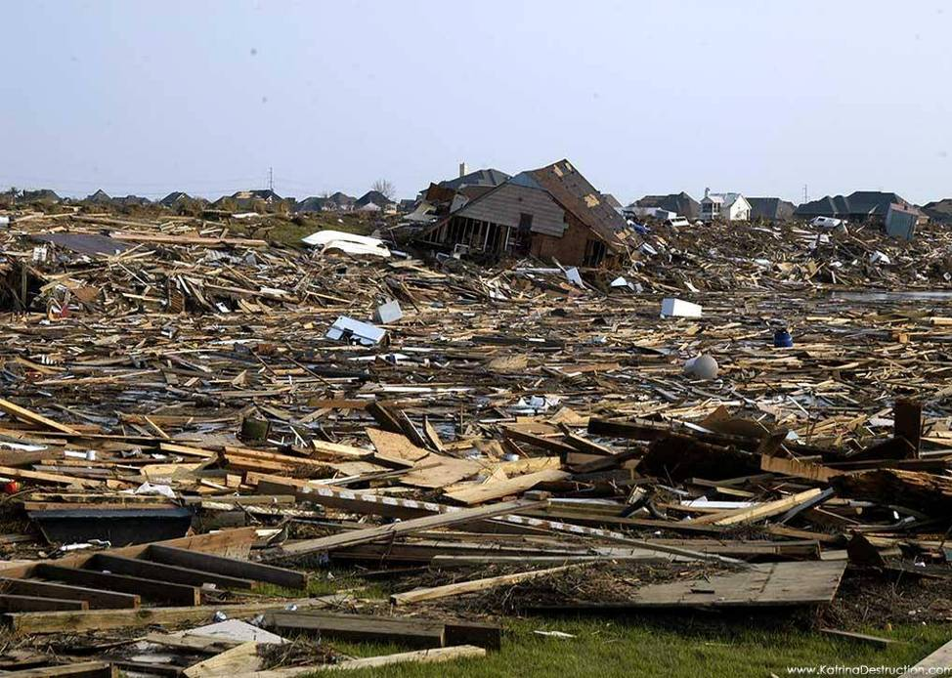
Slidell, St. Tammany Parish

Slide 11
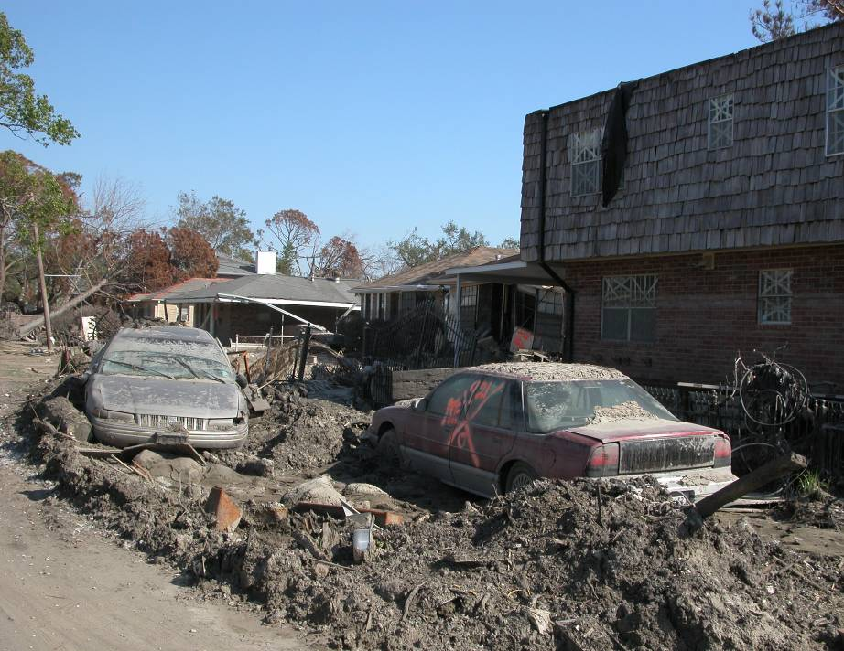
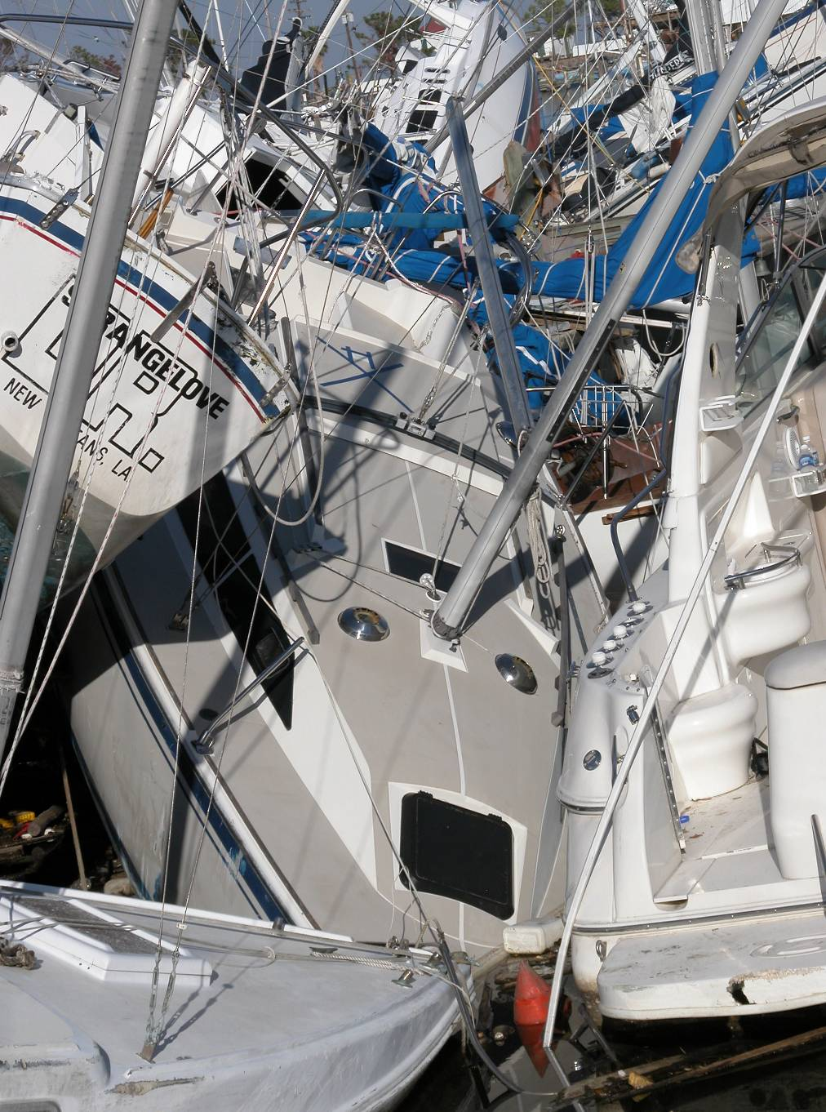
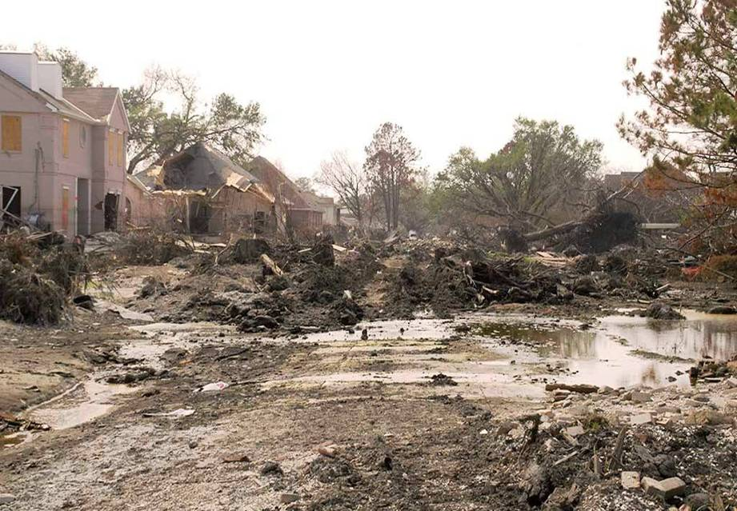
Lakeview (17th St. Canal), New Orleans

Slide 12
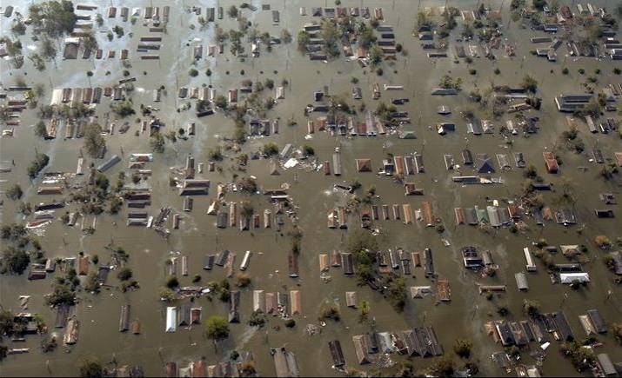

Slide 13
Understanding the Impact of Hurricane Katrina
$ Damage
(2005 Dollars)
$150 B
# Homes
(Destroyed)
1349
$124 B
352,930
400,000
1500
$75 B
300,000
Casualties
1000
200,000
500
100,000
Camille (Cat 5) 1969
250
Andrew (Cat 4) 1992
310,098
Ivan (Cat 3) 2004
150,000
Katrina (Cat 3) 2005
300,000
Katrina w/o New Orleans
1,000,000
# Homes
(Damaged)
1,000,000
# Displaced
(After impact)
2,000,000
# Evacuated
(Prior to impact)
2,000,000
Notes:
Using the next few slides to help illustrate how much bigger Katrina was than previous storms, I will set the stage for FEMA’s strategic preparation for future emergency operations.
For years, Camille was used as the baseline for major hurricanes along the Gulf Coast. This category 5 storm that struck in 1969 resulted in 250 deaths.

Slide 14
  Post-Katrina
    State begins growing shelter capacity with “mega-shelters” located in Central & North Louisiana
      1st State owned shelter built on LSU-A campus
    Post Katrina plans used during Hurricane Gustav were successful but improvements necessary, areas of focus included evacuee tracking & reentry

Slide 15
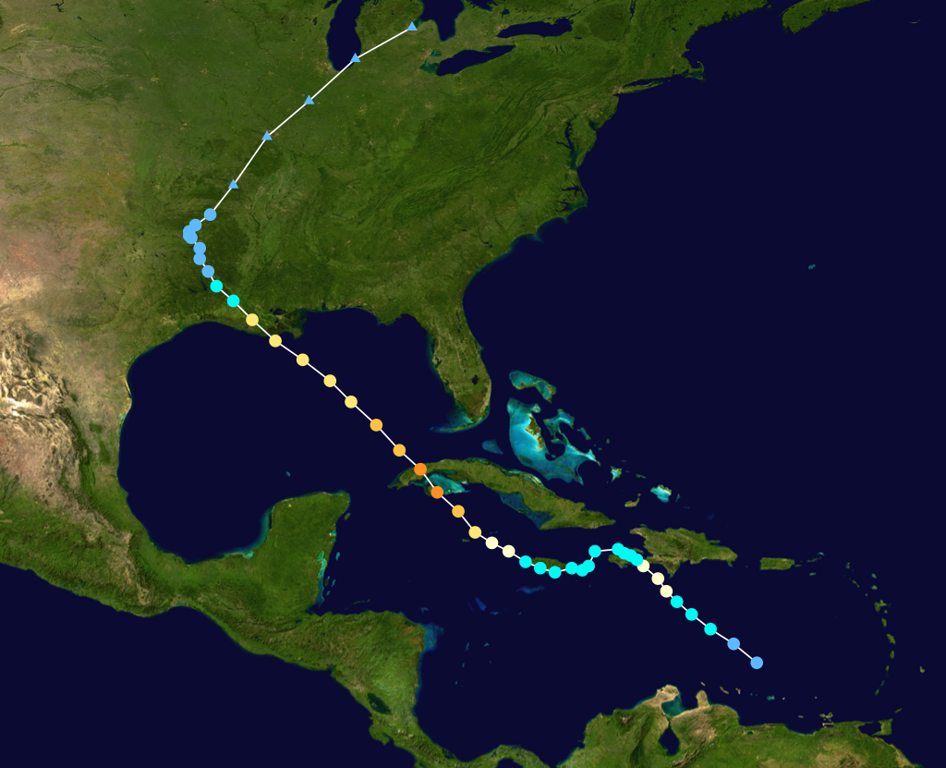
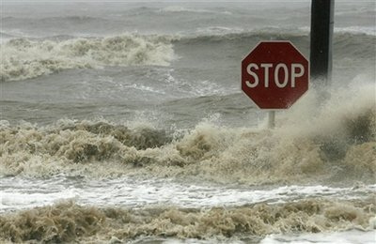
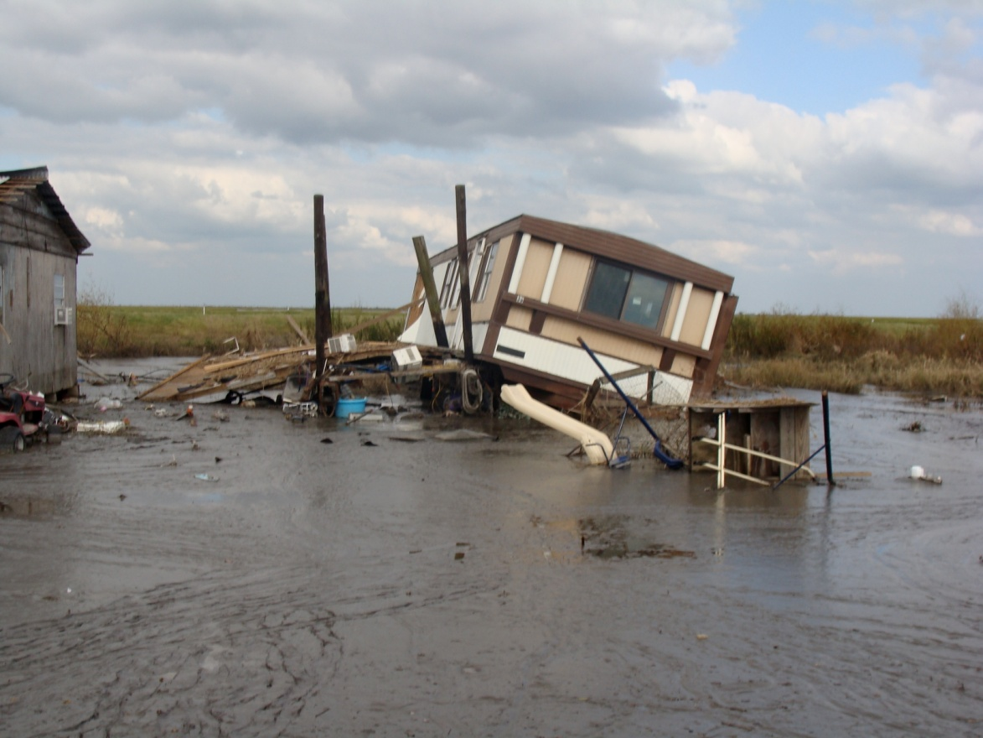
Louisiana August/September 2008
Hurricane Gustav/Ike

Slide 16
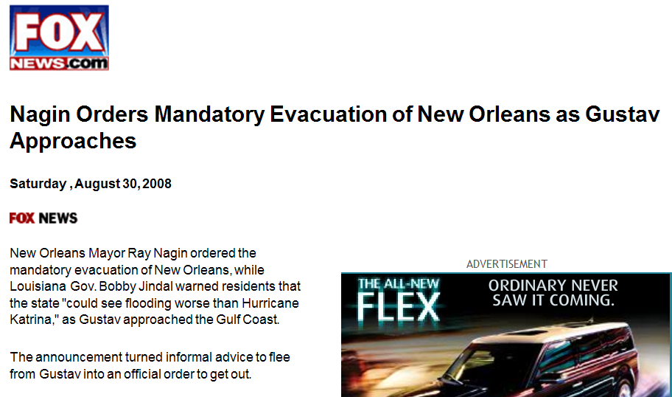
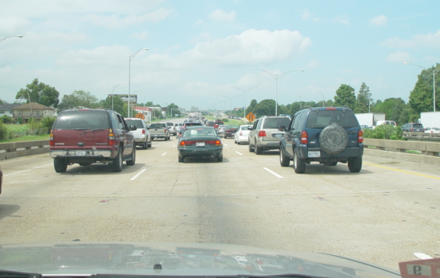
Hurricane Gustav
Approximately 2 million people evacuated
1st time in State history mandatory evacuations called for entire coastal area of Louisiana
1st time State conducted dual contra flow
for both Southwest & Southeast Louisiana

Slide 17
Gustav Motor Coach Evacuation
8/30/08 - 8/31/08
Transported 11,000 CTNS
& MSN to in-state shelters
by coach buses, school
buses & para-transits
Transported 15,611 CTNS
population to out-of-state
shelters by coach buses
Total - 26,611
Oklahoma
W
W
MOREHOUSE
E
MOREHOUSE
E
CLAIBORNE
CLAIBORNE
WEST
WEST
EAST
UNION
EAST
BOSSIER
B
UNION
BOSSIER
B
S
S
CARROLL
T
CARROLL
T
E
E
LINCOLN
R
LINCOLN
CADDO
R
CADDO
OUACHITA
RICHLAND
OUACHITA
RICHLAND
MADISON
Arkansas
JACKSON
MADISON
BIENVILLE
JACKSON
BIENVILLE
FRANKLIN
RED
FRANKLIN
RED
CALDWELL
N
CALDWELL
DESOTO
N
DESOTO
RIVER
RIVER
A
TENSAS
A
T
T
WINN
C
WINN
C
H
H
CATAHOULA
I
I
T
T
CATAHOULA
C
LASALLE
C
O
LASALLE
SABINE
O
SABINE
O
C
O
C
GRANT
H
GRANT
H
N
E
N
E
C
S
C
S
O
O
R
Texas
R
D
D
I
RAPIDES
I
RAPIDES
A
VERNON
A
VERNON
AVOYELLES
AVOYELLES
WEST
T
W.
EAST
E.
A
FELICIANA
A
WASHINGTON
SAINT
WASHINGTON
FELICIANA
FELICIANA
ST
FELICIANA
N
HELENA
N
Risk Parishes
HELENA
G
EVANGELINE
G
I
BEAUREGARD
I
BEAUREGARD
EVANGELINE
P
Shelter Parishes
ALLEN
SAINT
POINTE
P
SAINT
POINTE
A
ALLEN
LANDRY
COUPEE
E. BATON
A
ST
LANDRY
COUPEE
EAST
H
SAINT
ROUGE
H
Host States
BATON
TAMMANY
O
TAMMANY
WEST
O
W
ROUGE
LIVINGSTON
BATON
BATON
A
ROUGE
LIVINGSTON
A
ROUGE
ACADIA
SAINT
JEFFERSON
ACADIA
LAFAYETTE
ST
JEFFERSON
LAFAYETTE
MARTIN
CALCASIEU
MARTIN
CALCASIEU
DAVIS
ASCENSION
DAVIS
IBERVILLE
ASCENSION
IBERVILLE
SAINT
ST.
ST.JOHN
ORLEANS
ST.
JOHN
ORLEANS
JAM ES
ST.
J
JAM ES
SAINT
J
IBERIA
E
IBERIA
ASSUMPTION
ASSUMPTION
CHARLES
E
CAMERON
CHARLES
F
CAMERON
VERMILION
Alabama
VERMILION
ST.
F
ST BERNARD
ST.
F
SAINT BERNARD
ST.
F
P
L
P
MARTIN
L
MARTIN
E
MARY
E
L
A
L
SAINT
A
R
R
A
F
A
MARY
F
S
S
Q
O
Q
O
O
O
U
U
U
VER
U
N
Iberia
N
E
R
E
R
M
C
M
TERREBONNE
C
I
H
I
H
N
E
N
E
E
E
S
S

Slide 18
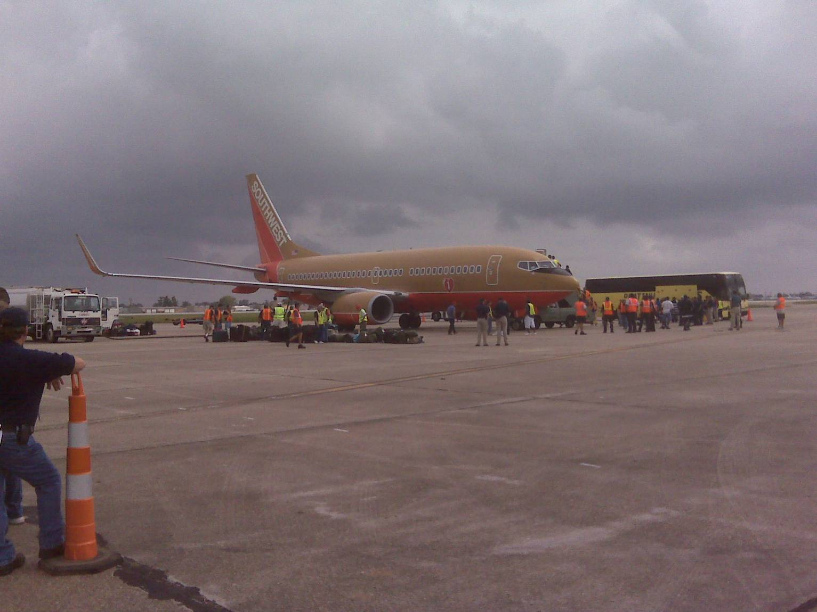
Gustav Air Evacuation
Hurricane Gustav Air Evacuation
Destination
Destination
Flights
Evacuees
Ft Smith, AR
15
15
1,744
1,744
Knoxville, TN
10
10
1,163
1,163
Louisville, KY
8
8
1,038
1,038
Nashville, TN
13
13
1,105
1,105
Totals
Totals
46
5,050
Support Personnel (i.e., FEMA,
Support Personnel
10
10
1,054
FAA, TSA,
DOD
, etc)
1,054
Grand Total:
56
6,104
Grand Total:
56
6,104

Slide 19
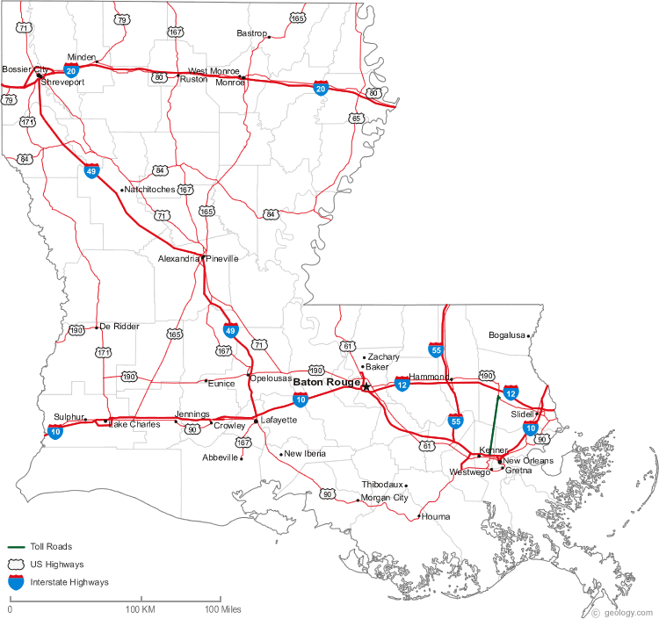
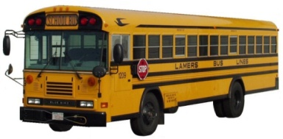
Critical Transportation Needs Shelters
Shreveport
Hirsch
1,600
Homer
Wade Correctional Ctr.
120
Bastrop
Former Wal-Mart
1,600
Shreveport
Jewella Building
2,400
Shreveport
Westpark
Potential 1,500
Alexandria
State Shelter
2,500
Shreveport
Riverview Theater
500
Baton Rouge
Undisclosed
60
Critical Transportation Needs Shelters
CTNS
Total 10,100
Sex Offenders
Total 120
Unaccompanied Minors
DOTD in coordination with contractor & DOE
Total 60

Slide 20
Federal Medical
Stations
Medical Special Needs
Bossier City
Bossier Civic Center
90
FMS - Monroe ULM
Ewing Coliseum
150
FMS- Baton Rouge Field House
500
FMS-Grambling
Intramural Sports Center
200
Alexandria
LSU-A State Shelter
200 FMS / 200 MSNS
Baton Rouge
LSU Maravich Ctr.
300
FMS-Alexandria
River Center
250
Lake Charles-McNeese
Recreation Complex
150
Hammond - SLU
Kinesiology Bldg.
200
MSNS Total 1,450
Thibodeaux
Nicholls State Ayo Hall
200
FMS Total 1,150
Lafayette
Heymann Center
160

Slide 21


State of Louisiana
Hurricane Scenario

Slide 22
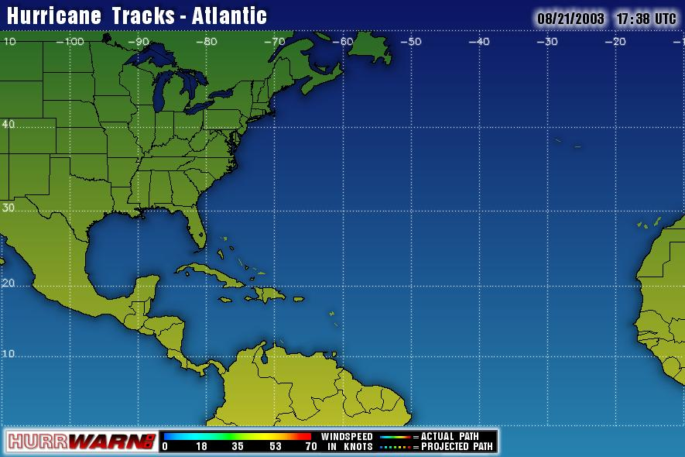


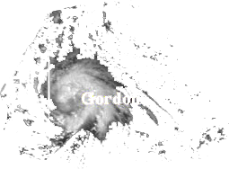

LA
GULF OF MEXICO
Tropical Depression 3
Invest 1
Notes:
Invest - A weather system for which a tropical cyclone forecast center is interested in collecting specialized data sets (e.g., microwave imagery) and/or running model guidance. Once a system has been designated as an invest, data collection and processing is initiated on a number of government and academic web sites, including the Naval Research Laboratory (NRL) and the University of Wisconsin Cooperative Institute for Meteorological Satellite Studies (UW-CIMSS). The designation of a system as an invest does not correspond to any particular likelihood of development of the system into a tropical cyclone
Tropical Depression: A tropical cyclone in which the maximum sustained surface wind speed 38 mph or less.

Slide 23

H-120
GOHSEP Crisis Action Team (CAT) activated - situation monitored
Initiate State Unified Command conference call
Prepare State Emergency Declaration
H-102
Develop & request Presidential Emergency Declaration
Activate contracts for commercial transportation for Assisted Transportation Plan
Activate contracts for trucks - Pet Transportation Plan
Activate Transportation Staging Areas
LA
GULF OF MEXICO
H-120
H-96
H-72
H-50
H-40
H-30
H-20
Landfall
H-120
Anticipated Storm Track
Cone of Uncertainty
Scenario based on previous or likely storm tracks derived from Hurrevac
Notes:
The Cone of Uncertainty represents the forecasted track of the center of a tropical storm or hurricane and the likely error in the forecast track based on predictive skill of past years as well as numerous additional details about the storm

Slide 24
H-96 Anticipated Shortfalls
Shelter Management Teams
Medical personnel for Amtrack Mission (currently an EMAC agreement)
H-96
CAT plus – partial EOC activation
Unified Command recommends State Declaration of Emergency
Task Force (SW, SE. Shelter & partner states) conference calls begin - initiate emergency declaration & evacuation discussions
SITREPs for Governor, Cabinet, Parish EOCs State ESFs, & FEMA Region VI
Review contracts for deliverables, fuel, Port-A-Lets, etc.
Feds begin work on AMTRAK & air carriers for potential evacuation
Request FEMA Region VI forward deploy FEMA Liaison to State EOC
LA
GULF OF MEXICO
H-120
H-96
H-72
H-50
H-40
H-30
H-20
Landfall
Anticipated Storm Track
Cone of Uncertainty
Scenario based on previous or likely storm tracks derived from Hurrevac

Slide 25
H-96
Feds activate Incident
Management Assistance Teams (IMAT)
Prepare to support Special Needs Shelters & Medical Evacuation
Prepare to support Phased Evacuation Plan & prison population evacuation
H-94
Transportation Staging Areas operational
H-84
Feds notifies air charter aircraft to assemble fleet
LA
GULF OF MEXICO
H-120
H-96
H-72
H-50
H-40
H-30
H-20
Landfall
Anticipated Storm Track
Cone of Uncertainty
Scenario based on previous or likely storm tracks derived from Hurrevac

Slide 26
H-72 Anticipated Shortfalls
Paratransit / Ambulances
Hospital Spaces
Aviation Support
H-72
State EOC at Level III or II depending on threat
Setup to support Contra-Flow
Parishes initiate Declarations of Emergency
Submit pre-scripted ARFs to FEMA
JOC activated
Joint Information Center (JIC) opens
Launch host state LNOs
LA
GULF OF MEXICO
H-120
H-96
H-50
H-40
H-30
H-20
Landfall
H-72
Anticipated Storm Track
Cone of Uncertainty
Scenario based on previous or likely storm tracks derived from Hurrevac

Slide 27
H-72
Initiate setup of Special Needs Shelters
Initiate dissemination of public information on early evacuation & shelter operations
Initiate prison population evacuations
Establish Regional Staging Area (RSA) operations
H-66
Request 300 school buses (if required)
H-54
Assisted evacuation begins
LA
H-120
H-96
H-50
H-40
H-30
H-20
Landfall
H-72
Anticipated Storm Track
Cone of Uncertainty
Scenario based on previous or likely storm tracks derived from Hurrevac

Slide 28
H-50
GOHSEP EOC at Level II or Level I based on threat
Phase 1 evacuation begins
Pet truck convoy moves with buses
Begin setup of Contra-Flow
Request closure of public schools
Execute LANG Security Anti-Looting Plan
LA
GULF OF MEXICO
H-120
H-96
H-72
H-50
H-40
H-30
H-20
Landfall
Anticipated Storm Track
Cone of Uncertainty
Scenario based on previous or likely storm tracks derived from Hurrevac

Slide 29
H-40
State EOC at Level I (if not already at this level)
Begin evacuation of the Phase II area
Begin movement of commodities forward
LA
GULF OF MEXICO
H-120
H-96
H-72
H-50
H-30
H-20
Landfall
H-40
Anticipated Storm Track
Cone of Uncertainty
Scenario based on previous or likely storm tracks derived from Hurrevac

Slide 30
H-30
Begin evacuation of the Phase III area
Support Phase III Contra-Flow
Contra-Flow coordination with Mississippi
LA
GULF OF MEXICO
H-120
H-96
H-72
H-50
H-40
H-30
H-20
Landfall
Anticipated Storm Track
Cone of Uncertainty
Scenario based on previous or likely storm tracks derived from Hurrevac

Slide 31
LA
H-20
State Assisted Evacuation completed
Registration/tracking/reporting of those evacuated
Discontinue Contra-Flow
Prepare for re-entry
Prepare for post storm damage assessment
EAS messages & public information continues
H-12
Feds conclude bus & rail operations
H+
Smart SAR operations begin
H+ Anticipated Shortfalls
MHE (Material Handling Equipment – Forklifts; Pallet Jacks, etc.)
GULF OF MEXICO
H+12 Anticipated Shortfalls
Post Certified Law Enforcement Personnel w/standard equipment load (with recommended vaccinations)
Public Works Infrastructure Assessment Teams
Aviation Support
Incident Management Teams
H+24 Anticipated Shortfalls
Disaster Food Stamp Program Personnel
Pumps (Sewer & Water)
H-120
H-96
H-72
H-50
H-40
H-30
H-20
Landfall
Anticipated Storm Track
Cone of Uncertainty
Scenario based on previous or likely storm tracks derived from Hurrevac

Slide 32
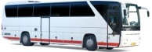
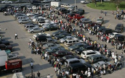









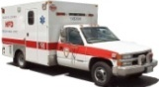
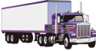
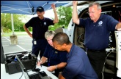


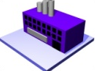

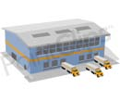


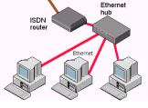


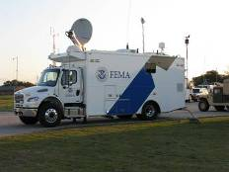
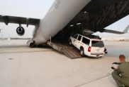
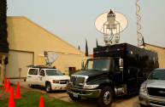
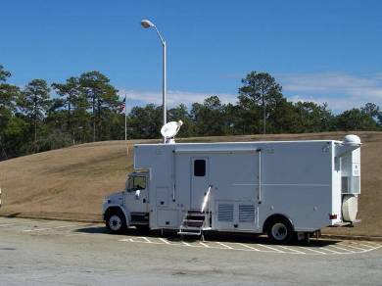
Louisiana Hurricane Response Story Board 2011 (Pre-Landfall)
H-120
H-96
H-84
H-72
Activate Bus
Contracts (600 Coach Buses)
(H-102)
State Decision To Evacuate CTN’s
(H-72)
Activate State School Bus
Contracts (300 School Buses)
(H-102)
GOHSEP CAT Activated
(H-120)
State EOC at Level 3
(H-96)
Gov Request Pre-Disaster Presidential Declaration
(Between H-102 to H-84)
State EOC at Level 2
(H-72)
Activate Transportation
Staging Areas
(H-102)
Region 6
Federal Staging
Areas
(H-96)
DHHS Conducts Fed Evac Conf Call
(H-74)
LA Conducts Evac Conf Call Identifies AMPs
(H-72)
RRCC at Level 3
(H-120)
FEMA
Activate Para-Transit Contract
(600 Ambulances)
(H-102)
FEMA
Ambulance IRT and Sherwood Forrest Operational
(H-74)
State Executes
Medevac Plan
(H-72)
Deploy FEMA State
LNO to State EOC
(if requested)
(H-120)
FEMA
Deploy Teams
and establish
Federal ISB
(H-96)
Pre-stage commodities
and Equipment
for GenPop Evac
(H-96)
Fort Worth Log Center
(H-102)
RRCC at Level 2
(H-72)
DCO Request TRANSCOM Conduct
“Market Survey”
(H-120)
Begin MSY Equipment Setup
(H-84)
TRANSCOM issues “Request For Proposal”
(H-80)
Activate advance elements of ICP, TSA, and FAMS support staff
(H-96)
MSY ICP Operational
(H-74)
TSA Screening Facility Operational
(H-72)
MERS Deploys
IRV to MSY
(H-96)
MERS IRV arrives at MSY West Ramp NLT
(H-72)
IMAT & DCE Deploys to State EOC & Establishes IOF
(H-120)
IMAT & DCE Operational at State EOC & IOF Operational
(H-96)
MERS Deploys MEOV to State EOC
(H-96)
MERS MEOV arrives at State EOC NLT
(H-72)

Slide 33


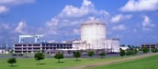
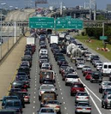
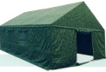
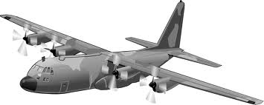



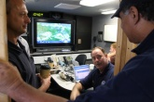




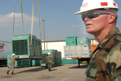


Louisiana Hurricane Response Story Board 2011 (Pre-Landfall)
H-60
H-48
H-24
H-Hr
LA Has Approx 54 hrs to Evac 44K by Bus
LA Bus Evac For
Gen Pop Begins
(H-54)
Bus Evac
Ends
(H-12)
LA Mandatory/Volunteer Self-Evacuation
Shutdown Waterford 3 Pressurized Water
Nuclear Reactor
(H-60)
Contra-Flow
Ends
(H-20)
Begin Phase I Contra-Flow Areas South of Inter-coastal Waterways
(H-50)
Begin Phase II Contra-Flow Areas South of the Mississippi River
(H-40)
Begin Phase III Contra-Flow of East Bank of the Mississippi River in the New Orleans area
(H-30)
LA Conducts Final Evac Conf Call
(H-18)
Approx 30 Hrs to Aero-Medical Evacuate (AE) Patients
DoD Medevac Forces
In Place
(H-56)
(At least Three AMPS:)
Southeast Strike: Southwest Strike:
1. Lakefront 1. Acadiana
2. Houma-Terrebonne 2. Chennault
3. Belle Chase (Alt)
1st DoD AE Aircaft Arrives at AMP(s)
(H-50)
FCC
MS
FCC
OK
FCC
TX
Patient Evac
Ends
(H-18)
Support Per
Evac Ends
(H-12)
Stage 2 Pallets of Water and Meals at Sherwood Forrest (Contingency Stock)
(H-48)
DFW Airport ICP & Staging Area Operational (Ready to Accept Up to 910 Fed, State and Local First Responders)
(H-24)
Recall
Ambulances
(H-12)
Approx 30 Hrs to Air Evacuate CTN’s
DoD Prepared to Bridge First Responders Radios at MSY
(H-60)
1st DoD General Population Aircraft Arrives at MSY
(H-50)
IN
2K
TN
3.5K
MO
3K
Gen Pop Air
Evacuation
Ends
(H-18)
Support Per
Evacuation to
DFW Ends
(H-12)
USACE Deploy
Generator PRTs
(H-48)
RRCC at Level 1
(H-54)
Verify All Fed Forces Sheltered
(H-8)
FEMA Div Supervisors Arrive at IOF
(H-50)
FEMA Div Supervisors Linked Up with State Regional Coordinators NLT (H-24)

Slide 34
Contraflow Process

Slide 35
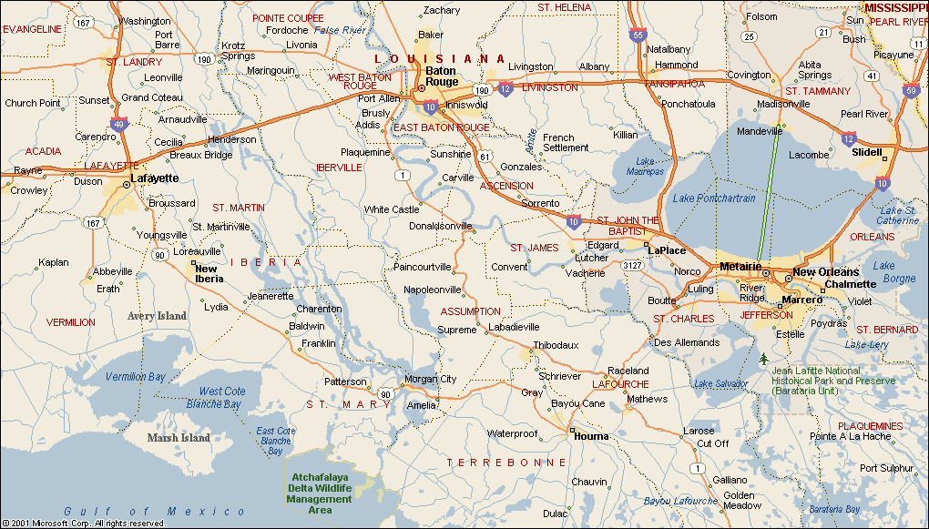
Phase 1 Evacuation
Portable Variable Message Sign
Permanent Variable Message Sign
Alternate Route
Contraflow Segment
29
27
22
28
14
15
7
13
6
8
30
21
26
5
17
3
16
4
25
2
20
19
10
12
1
18
9
11
23
24
Phase 1

Slide 36
Phase 2 Evacuation
Portable Variable Message Sign
Permanent Variable Message Sign
Alternate Route
Contraflow Segment
29
27
22
28
14
15
7
13
6
8
30
21
26
5
17
3
16
4
25
2
20
19
10
12
Phase 2
1
18
9
11
23
24

Slide 37
Phase 3 Evacuation
Portable Variable Message Sign
Permanent Variable Message Sign
Alternate Route
Contraflow Segment
29
27
22
28
14
15
7
13
6
8
30
21
26
5
17
3
16
4
25
2
20
Phase 3
19
10
12
1
18
9
11
23
24

Slide 38
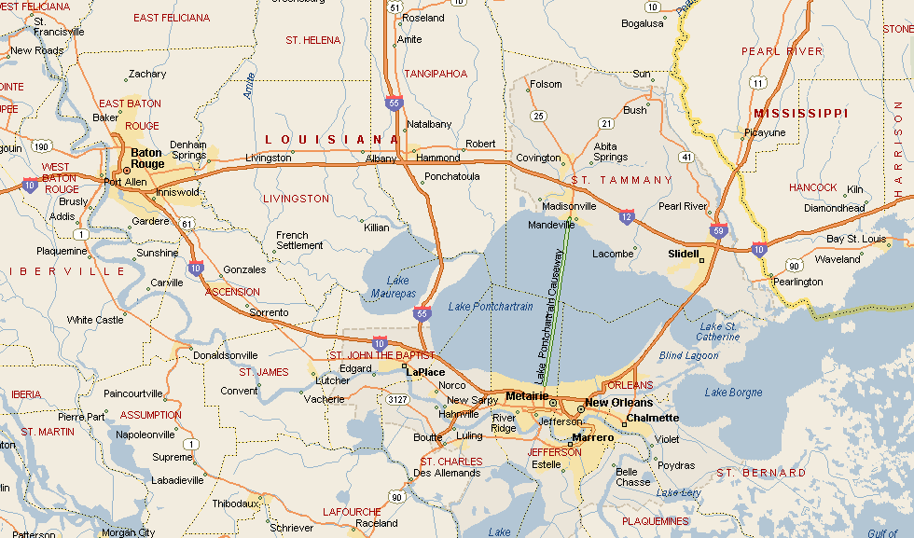
Contraflow
I-55 North Contraflow
I-12 to Mississippi Milepost 31 - 63 miles
Hammond to Lincoln County MS
1 Loading Point - I-12
I-59 North Contraflow
I-10 to Mississippi Milepost 21 - 32 miles
Slidell to Pearl River County MS
1 Loading Point - I-10
Causeway/US 190 North
2 Lanes NB from I-10 to I-12
30 miles
I-10 East
3 Lanes EB from I-510 to I-12
21 miles
I-10 West Contraflow
Clearview to US 51 - 17 miles
Metairie to LaPlace
4 Loading Points - Clearview (2 points), Veterans & Williams

Slide 39
Citizens Assisted Evacuation Plan

Slide 40
Goal 1: Create & maintain an environment where the decision to evacuate becomes more desirable than remaining behind
City of New Orleans Citizens Assisted Evacuation Plan
In conjunction with state officials, enhance the sheltering plan to make it more “user friendly”
Provide more information early in the season to enable citizens to better formulate their own evacuation plans

Slide 41
Goal 2: Provide greater support to citizens who need special assistance
City of New Orleans Citizens Assisted Evacuation Plan
Medical “special needs” citizens.
Elderly, hospital cases
No self evacuation transportation available

Slide 42
Goal 3: Implement measures to greatly enhance the security of city resources
City of New Orleans Citizens Assisted Evacuation Plan
To include:
  Accounting for and providing safety measures to city employees
  Comprehensive plans to protect vehicles and other equipment items
  Anti-looting plan

Slide 43

New Orleans City Assisted Evacuation Plan Model Timeline
June 1, 2007
AMTRAK leans forward with railcars
Launch CAEP; Dispatch buses and Security
Buses with last passengers leave city
Amtrak continues operations
City Hunkers Down
TSA/USDOT lean forward with packages
RTA begins Airport runs
Last Amtrak Train leaves City
TS Winds Reach Coastal LA
RTA begins pickups at 17 locations
RTA ends pickups at 17 locations
Regional information fusion CTR activated
EXECUTE CAEP
PHASE DOWN CAEP
84
72
60
58
54
50
40
36
30
24
12
6
0
Make Ready
NOPD, LSP, LANG, OPCS lean forward w/ security/staging areas established
State Phase 1: Evacuation of areas outside of any levee protection system
State Phase 3: Evacuation of areas north/east of the Mississippi River and south of Interstate 12; State implements Contraflow; Mayor orders Mandatory Evacuation
~12 hrs prior to hurricane landfall
MSY Shuts Down
RTA, MSY, NOMCVB, SPCA, and others activating hurricane plans
State Phase 2: Evacuation of areas north of Intracoastal Canal & south/west of Interstate 10 and Mississippi River
“H Hour” Tropical Force Winds Reach Coastal LA
State/Feds lean forward with Evacuation buses
Note: This is only to be used as a guideline. It is thought to be a reasonable timeline; however, in practice, there may be more or less time available depending on the circumstances of the actual event.

Slide 44
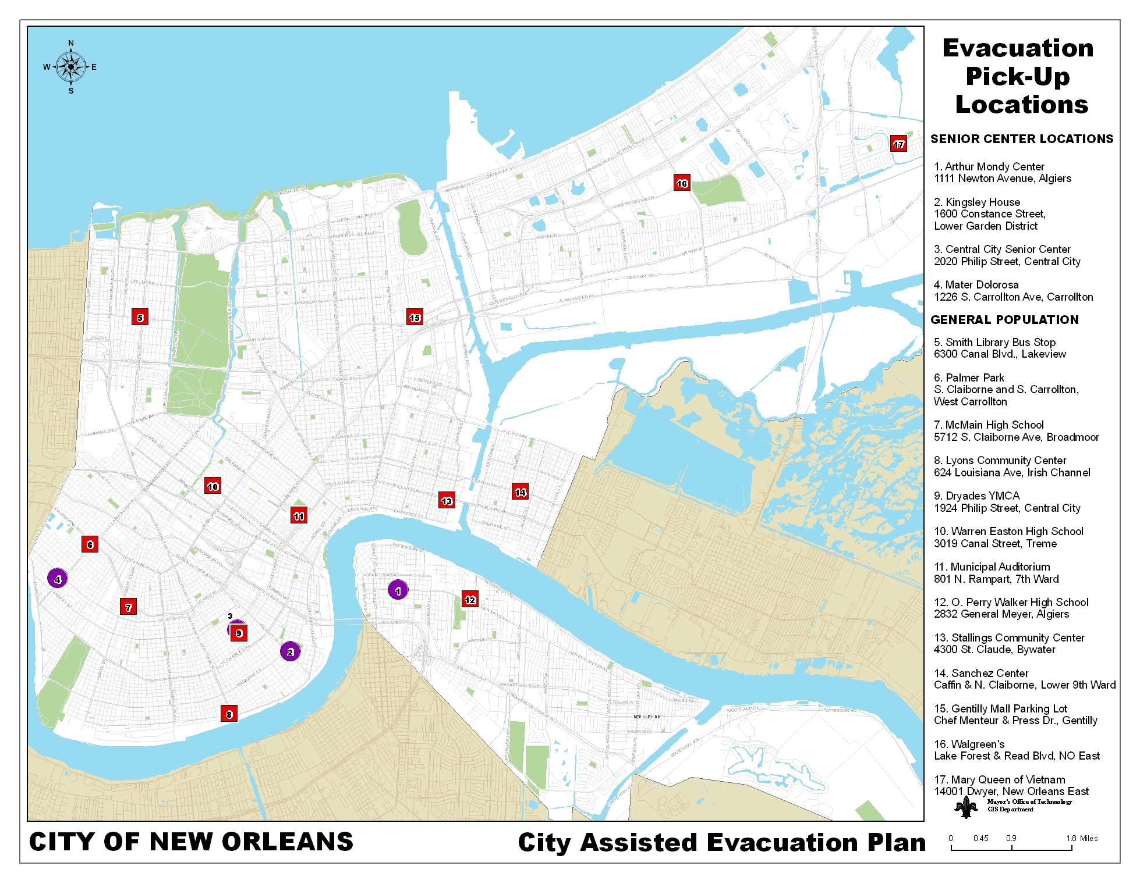

Slide 45
Critical Transportation Needs Shelters
Homer
Wade Correctional Ctr.
120
Shreveport
Hirsch
1,600
Bastrop
Former Wal-Mart
1,600
Shreveport
Jewella Building
2,400
Shreveport
Westpark
Potential 1,500
Alexandria
State Shelter
2,500
Shreveport
Riverview Theater
500
Baton Rouge
Undisclosed
60
CTNS
Total 10,100
Sex Offender
Total 120
Unaccompanied Minors
Total 60
DOTD in coordination with contractor & DOE

Slide 46
Declaration
Process
Authorizes
use of
Federal Resources
Authorizes
use of
State Resources
Authorizes
use of
Local Resources

Slide 47
The Emergency Management Process
LEGEND
State
Agency
Assets
Status Feedback
ESF
Contracts
Rents
etc.
Request for Support
Business
EOC
Parish
EOC
State
Operations
Federal
Assistance
Parish
Assets
EMAC
State
To State
Assets
Contracts
Rents
etc.

