Slide 1


















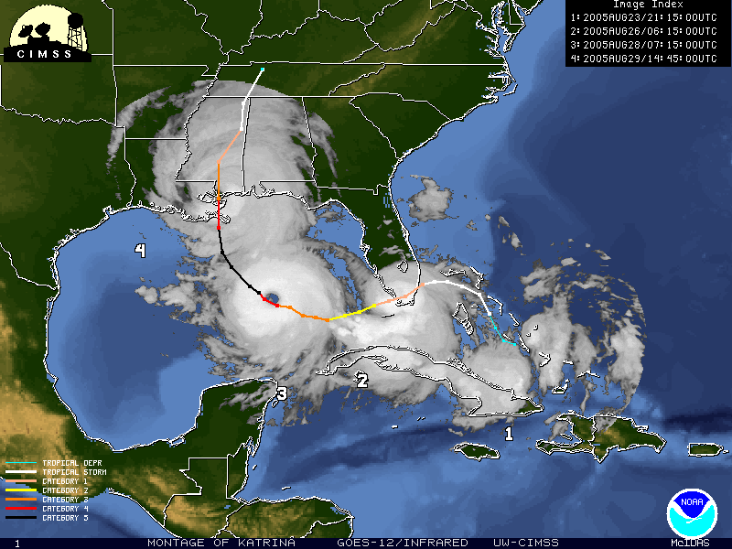
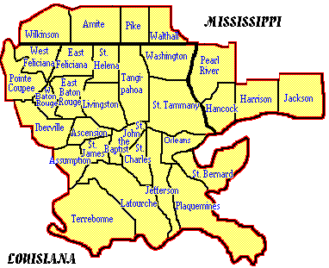
Frank Revitte
National Weather Service
New Orleans/Baton Rouge Area
www.srh.noaa.gov/lix

Slide 2




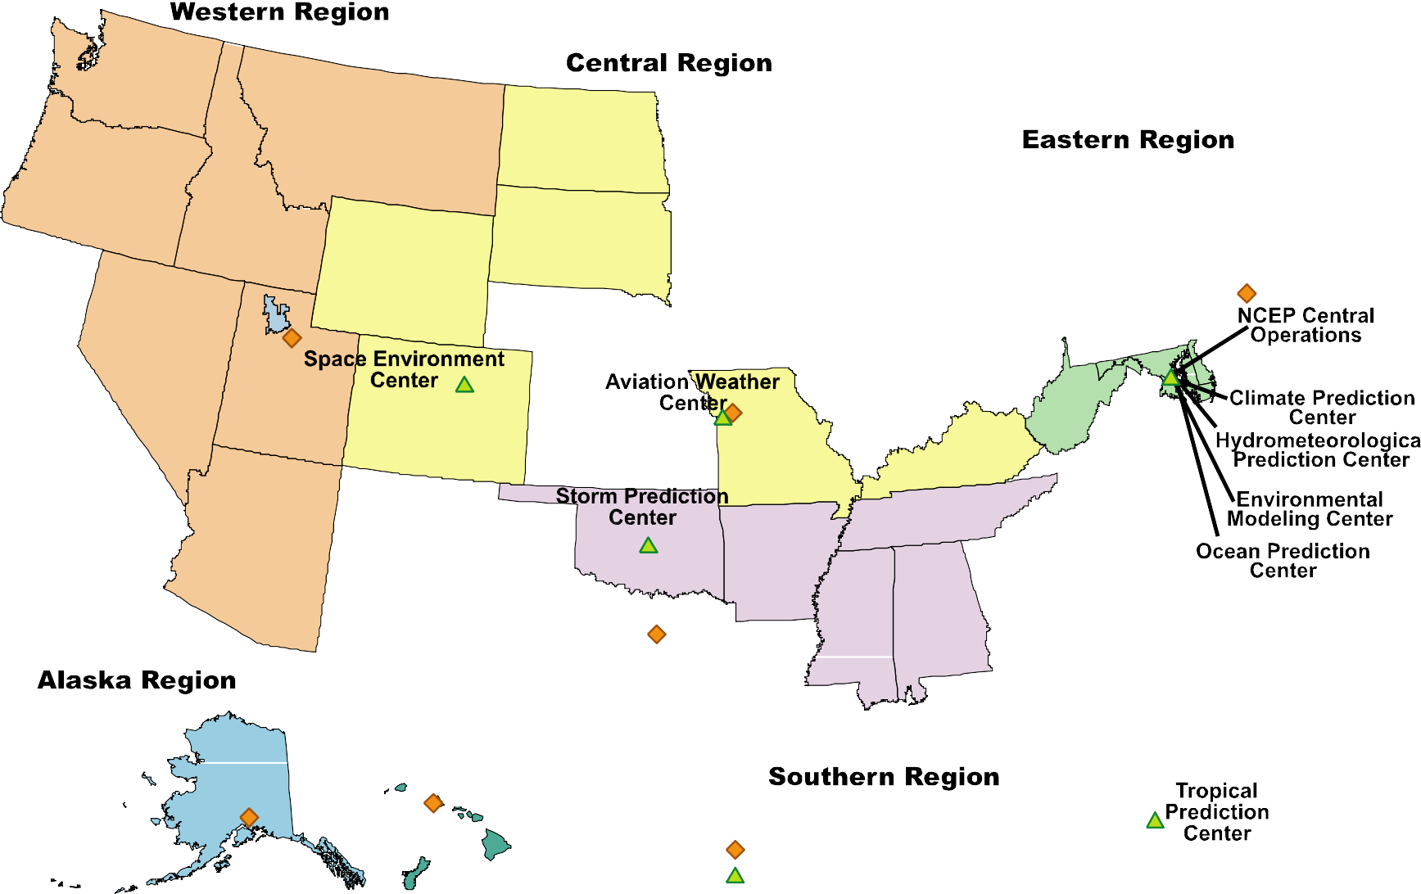
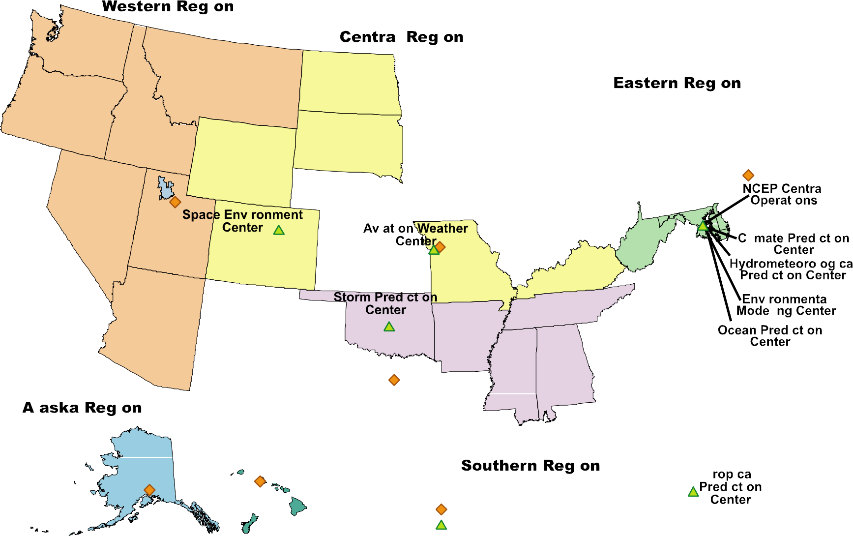
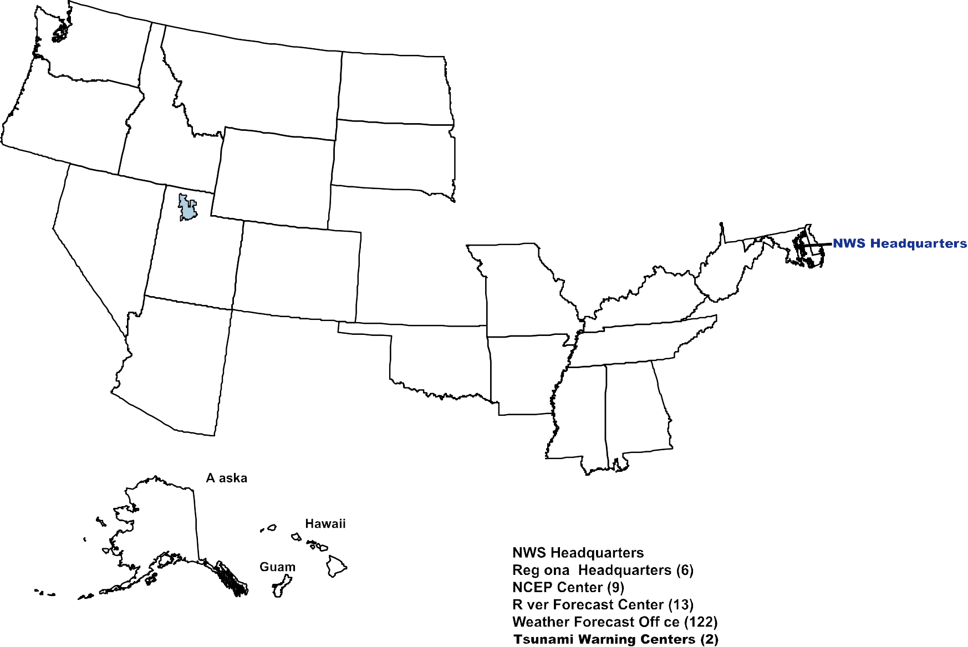
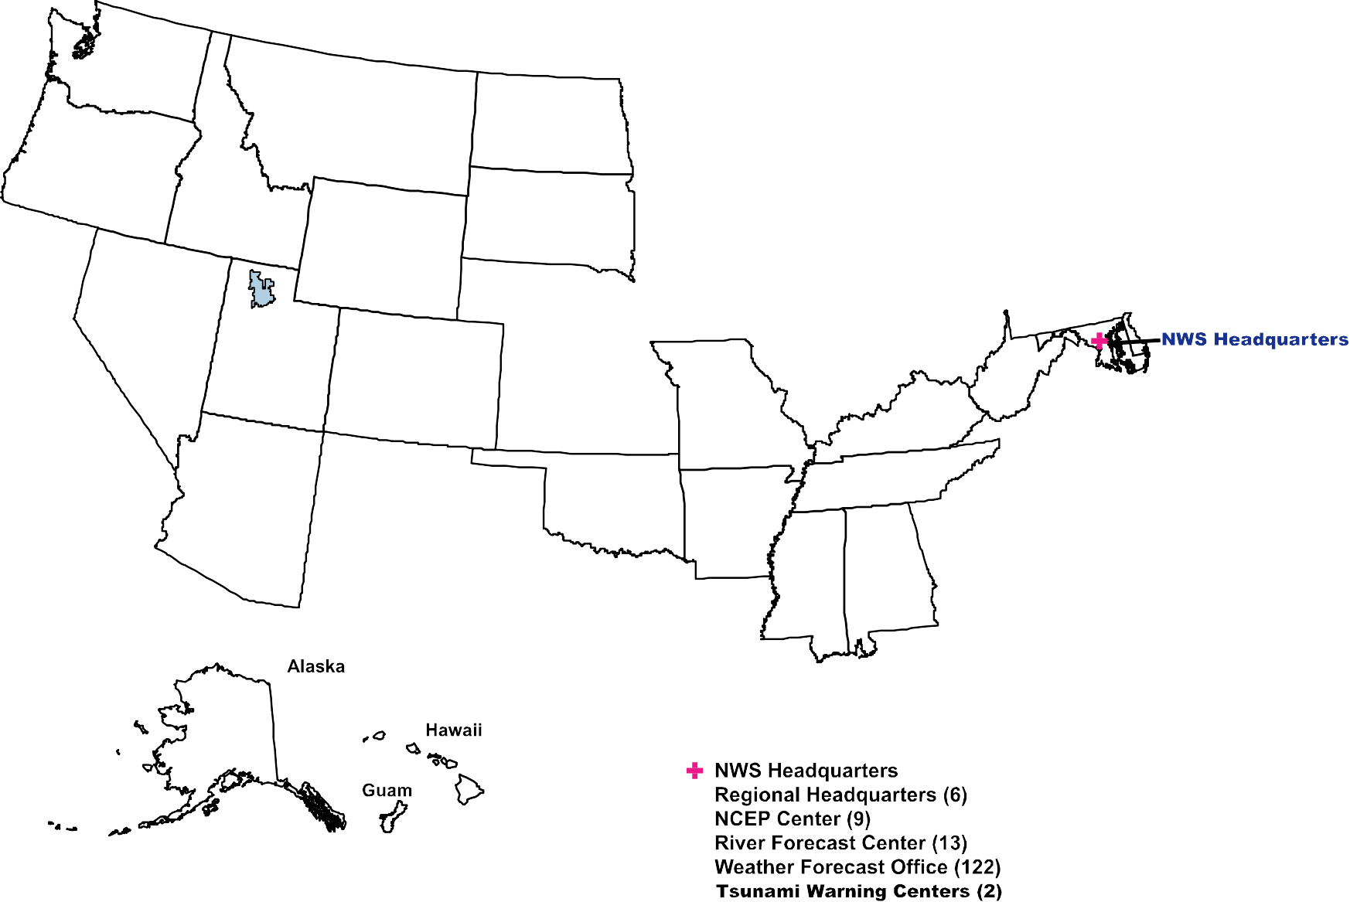
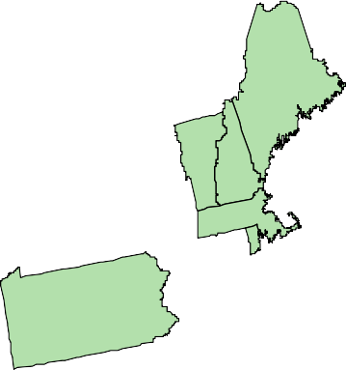
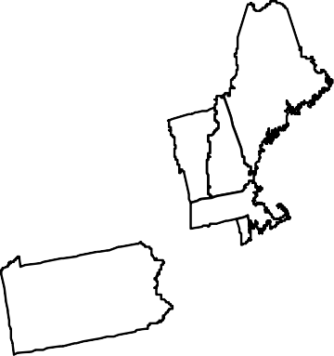
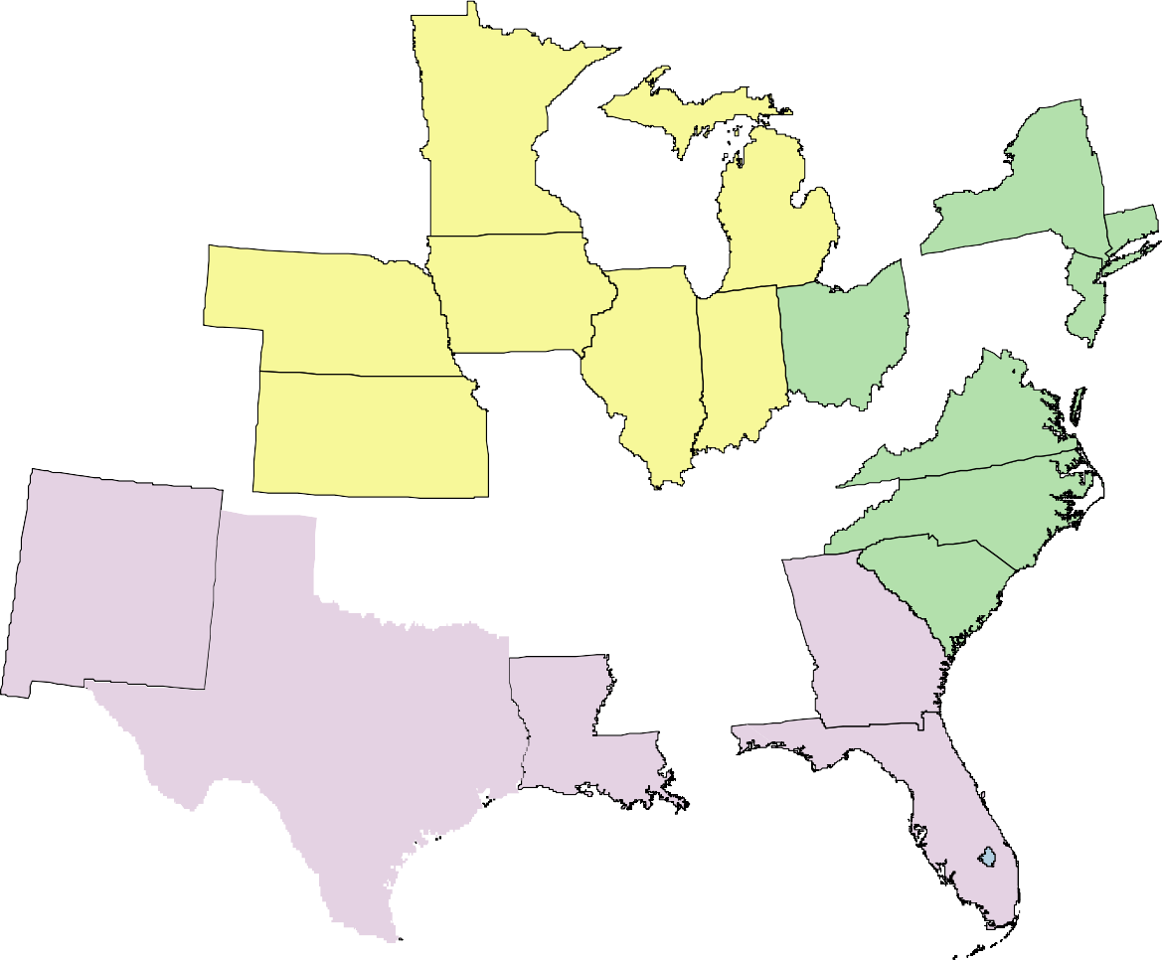

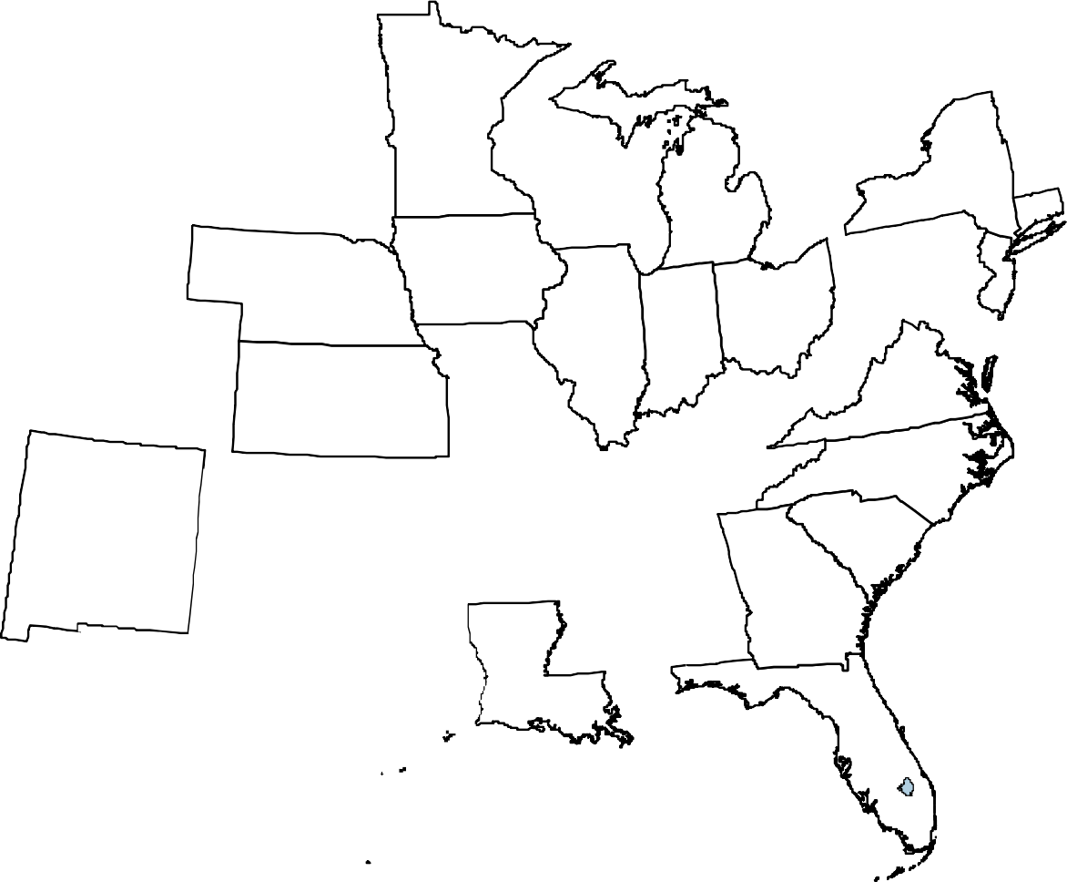

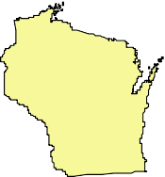
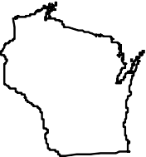
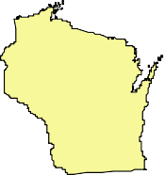
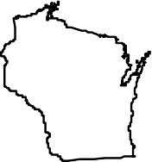
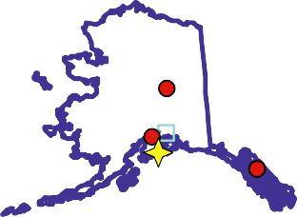
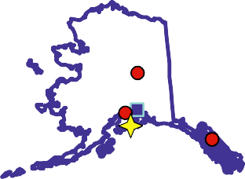





Slide 3
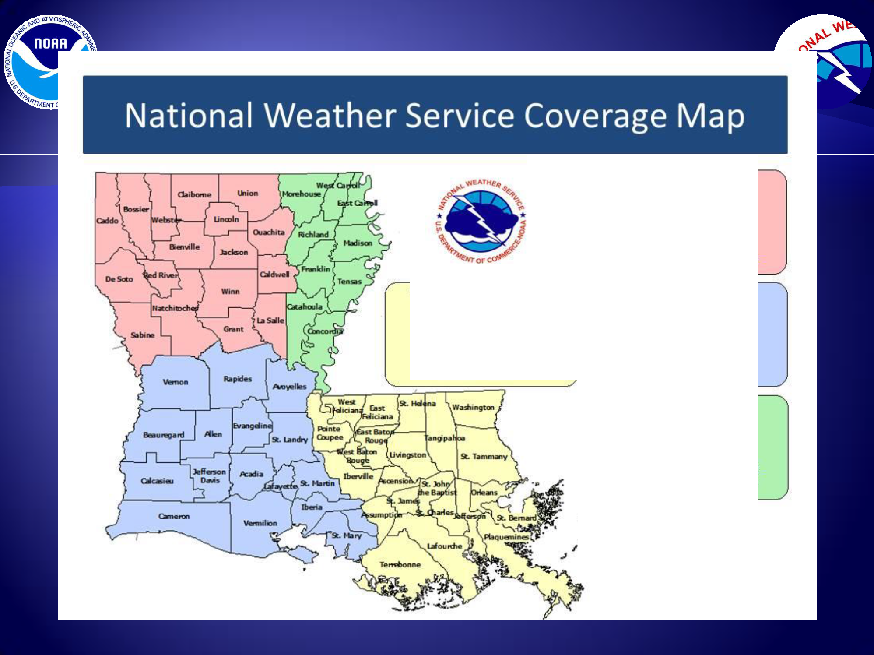
Shreveport SHV
MIC Mario Va lverde WCM Bill Parker (318) 636-7345
Mario. Valverd@ noaa.gov
Bill.Parker@ noaa. gov
sr-shvwebmaster@ noaa.gov
New Orleans / Baton Rouge LIX MIC Kenneth Graham WCM Frank Revitte
(504) 522-7330
Kennet h. Graham@ noaa . gov
Frank.Revitte@ noaa . gov sr-lixwebmaster@ noaa.gov
Lake Charles LCH MIC Andy Patrick WCM Roger Erickson (337) 477-5285
Andy.Patrick@ noaa.gov
Roger.Erickson@ noaa.gov sr-lchwebmaster@ noaa.gov
Jackson JAN MIC Alan Gerard
WCMStephan Wilkinson
(601) 936-2189
Alan.Gerard@ noaa.gov
Stephan.Wilkinson@noaa.gov
sr-janwebmaste r@noaa.gov
·Y
•'

Slide 4


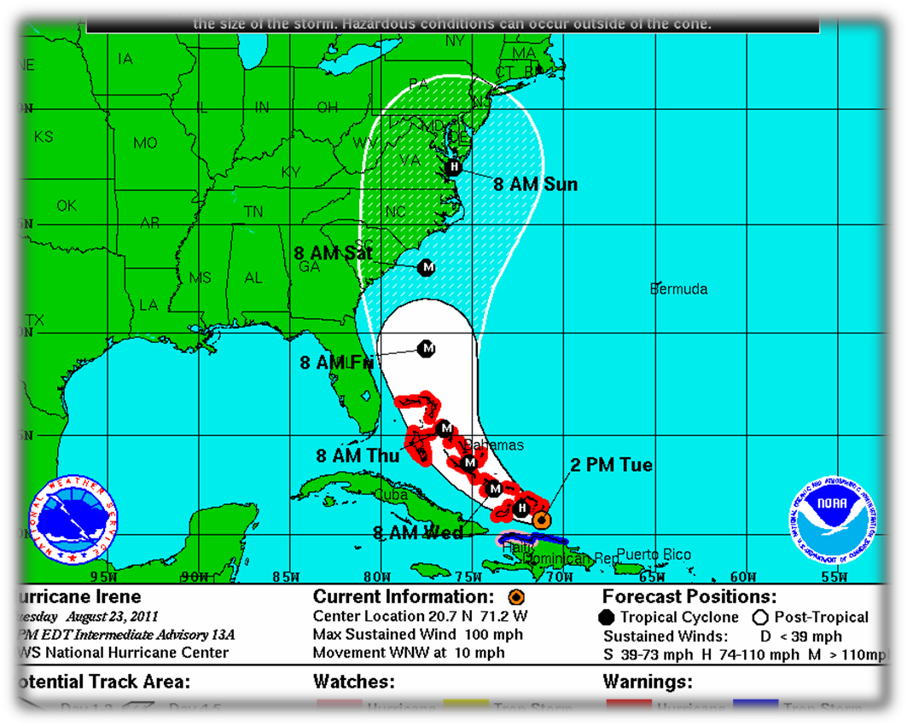
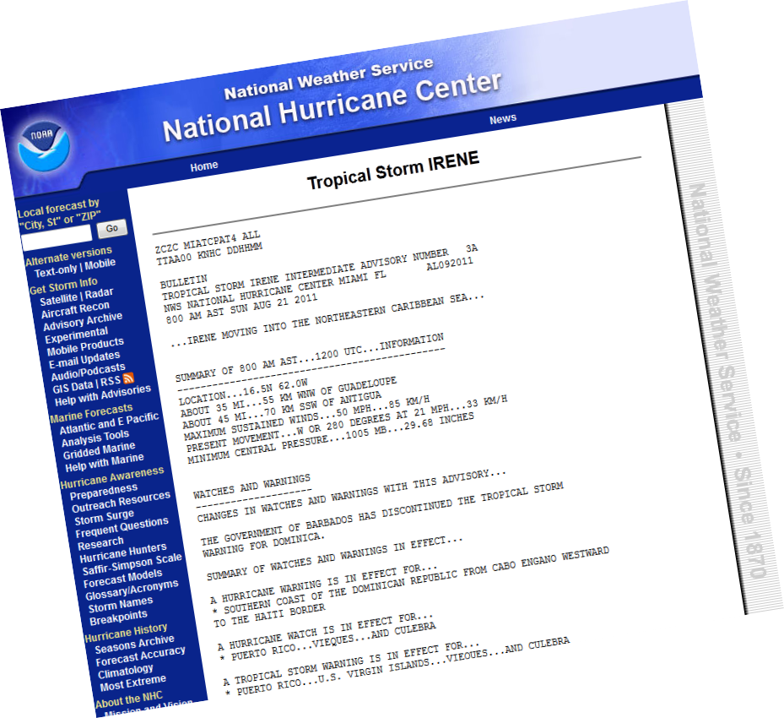
NHC Tropical Cyclone Products
NHC provides the “big picture” that complements and guides local NWS forecast office products, and provides guidance for international partners

Slide 5
NHC Text Products
Public Advisory
Forecast Advisory
Forecast Discussion
Wind Speed Probabilities
Tropical Cyclone Update
Tropical Weather Outlook
Tropical Cyclone Reports
Monthly Tropical Weather Summary

Slide 6

NHC Graphical Products
Track Forecast Cone
Surface Wind Field
Surface Wind Speed Probabilities
Cumulative Wind History
Graphical Tropical Weather Outlook
Storm Surge Probabilities
Storm Surge Inundation Graphic (Experimental)
Podcasts (Audio)

Slide 7


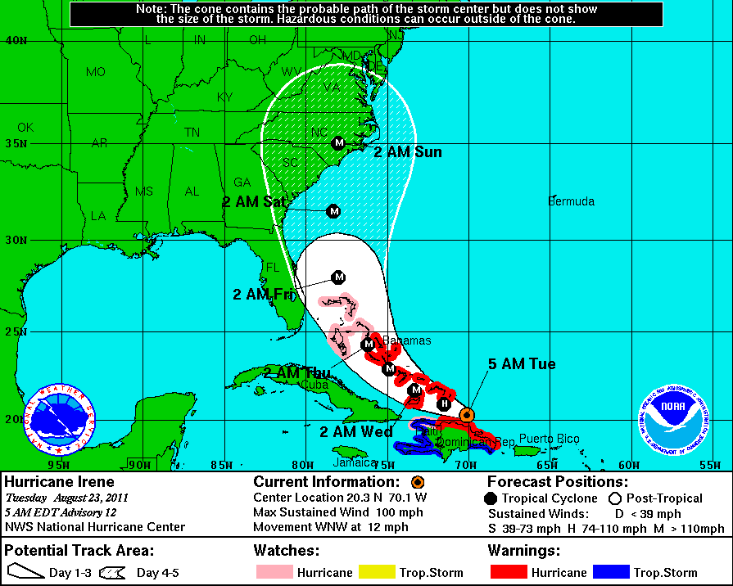







Represents probable track of tropical cyclone center
Formed by connecting circles centered on each forecast point (at 12, 24,
36 h, etc.)
Size of the circles determined so that, for example, the actual storm position at 48 h will be within the 48-h circle 67% of the time

Slide 8


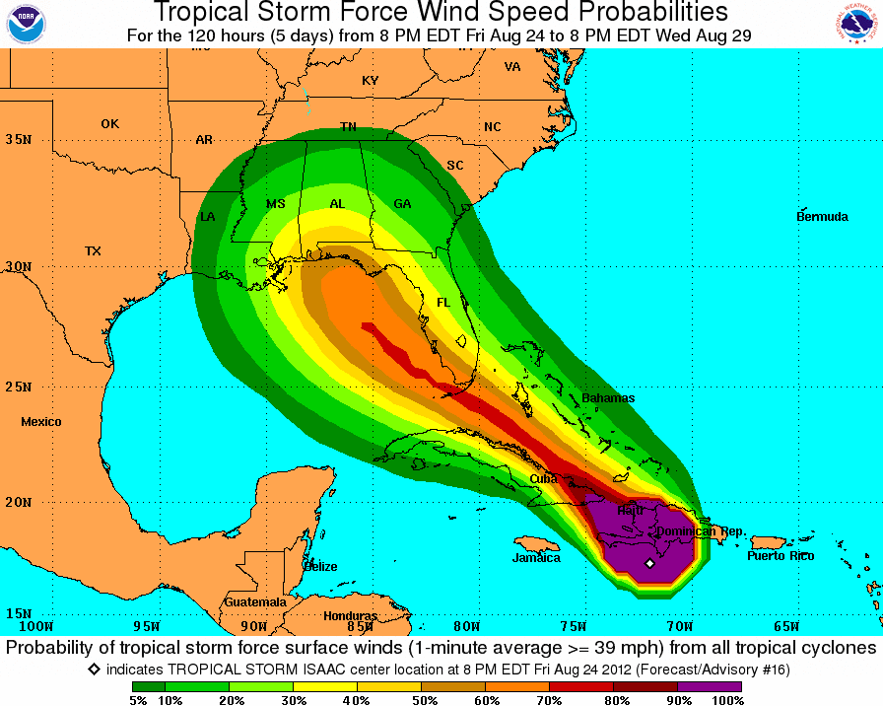
Pensacola TS: 51%
H: 8%
New Orleans TS: 25%
H: 2%
Tampa
TS: 48%
H: 3%
Miami
TS: 54%
H: 2%
Port Arthur
TS: 4%
H: 0%
8

Slide 9



→ SLOSH Model – Sea Lake Overland Surge from Hurricanes
✴ Synthetic tracks of hurricanes of similar intensity and similar track grouped together to show vulnerability.
Probabilistic Storm Surge – Real time during event
  Run SLOSH model numerous times varying intensity, forward speed, size and direction based on past history of forecast error.
  Developed probability of various surge levels.

Slide 10



Slide 11
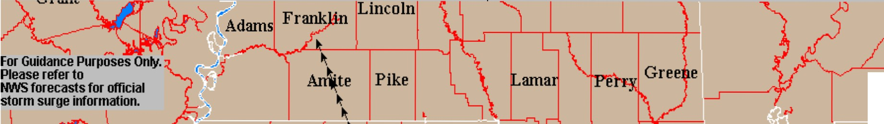
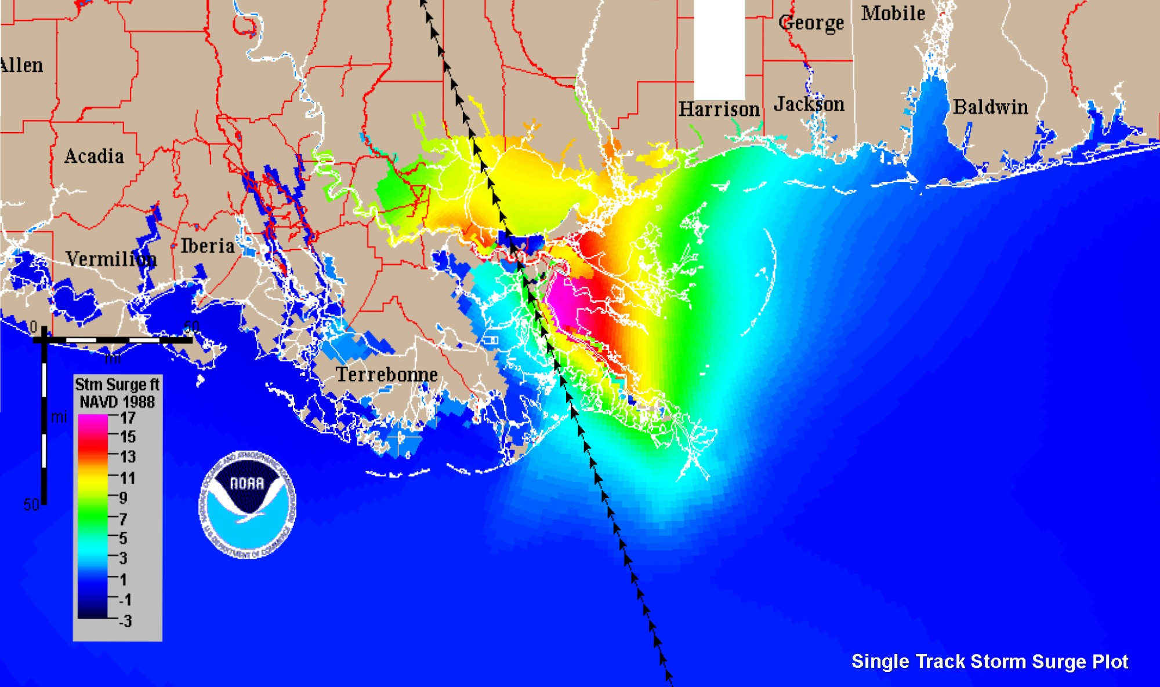
Basin: New OrleaJtS v4 <ms3>
IStorm: <f305LOlO.ms3>
Conecul
Esc Stone

Slide 12
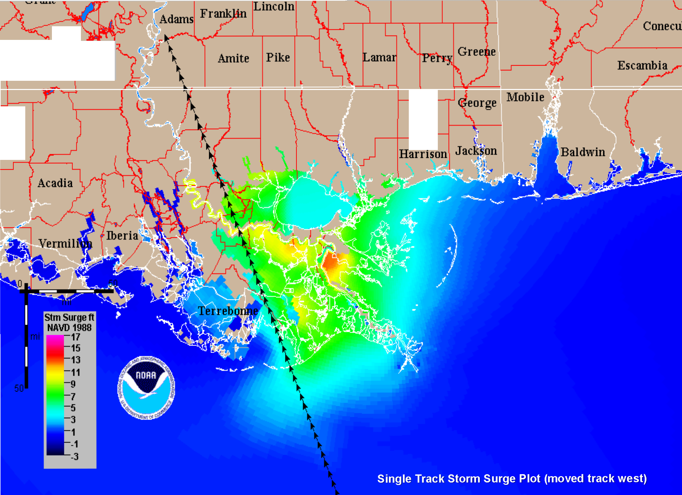
Basin: New Orleans v4 <ms3>
I Storm: <f305L040 .ms3>
For Guidance Purposes Only. Please refer to
NWS forecasts for official storm surge information.
Stone
\lien

Slide 13
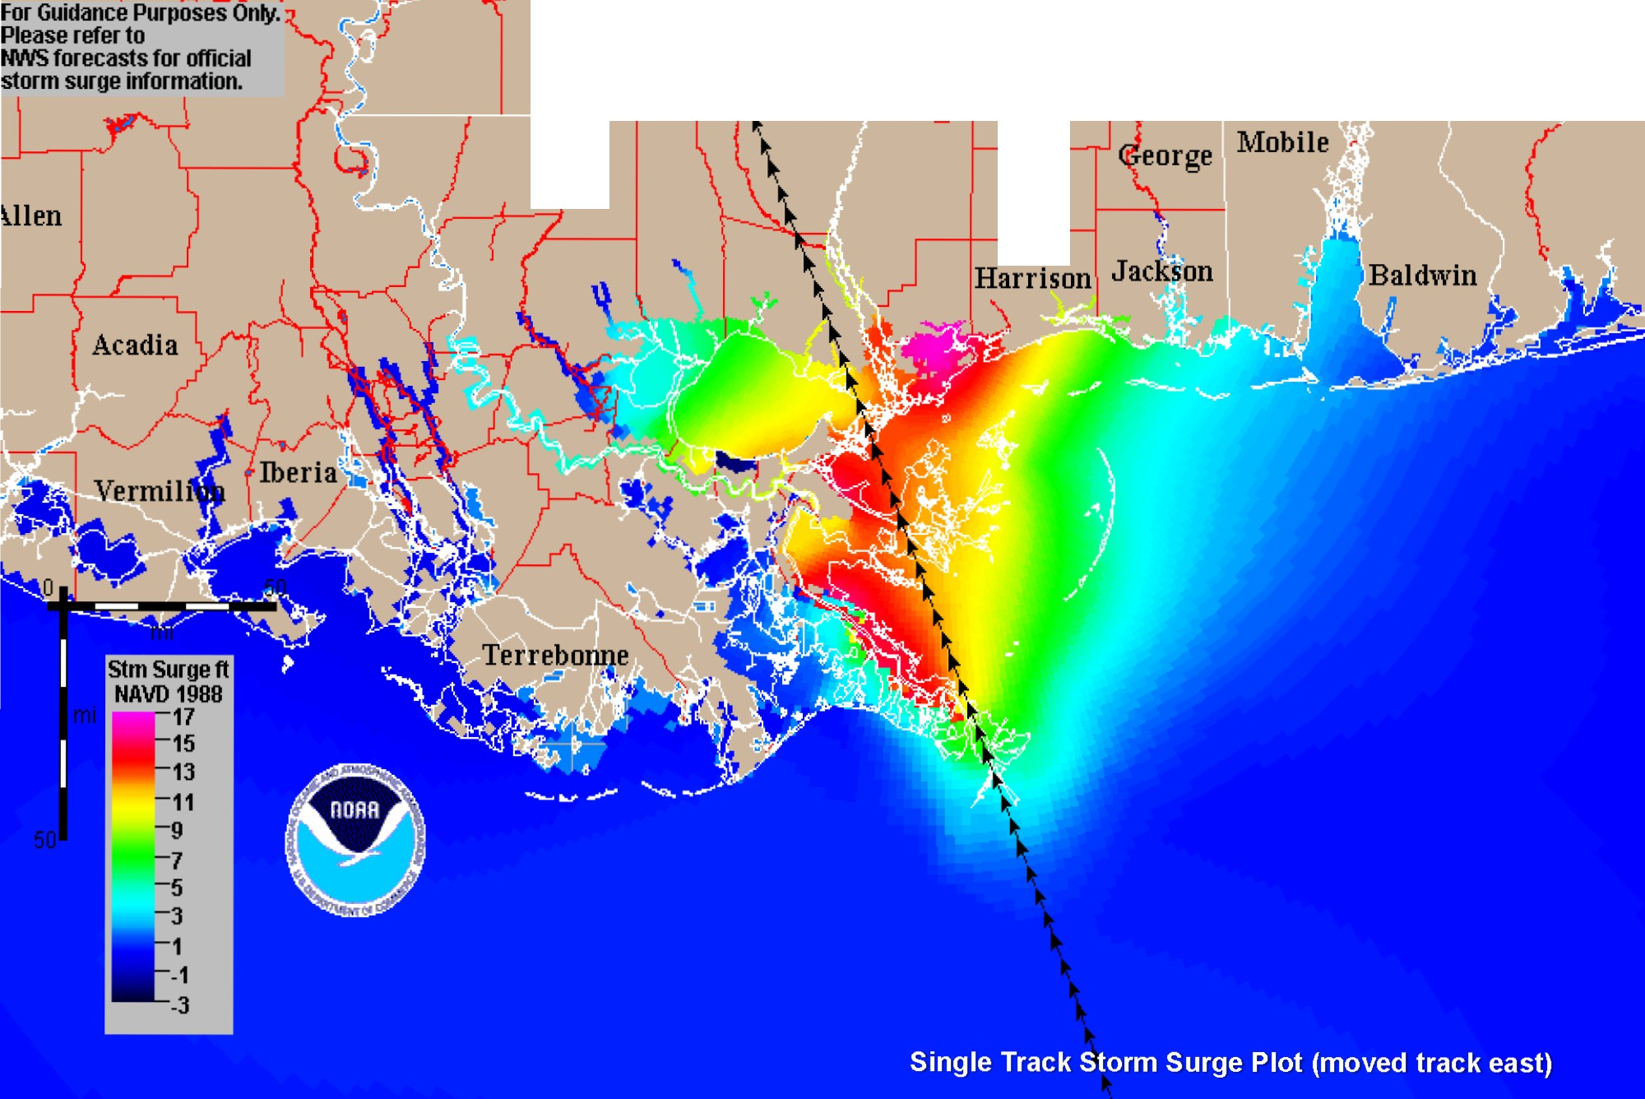
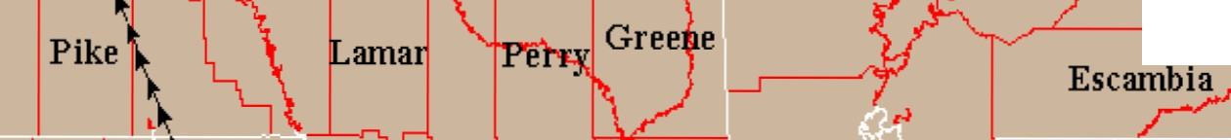
Basin: New Orleans v4 <ms3>
I Storm: <f305R020 .ms3>
Conec
Amite
Stone

Slide 14



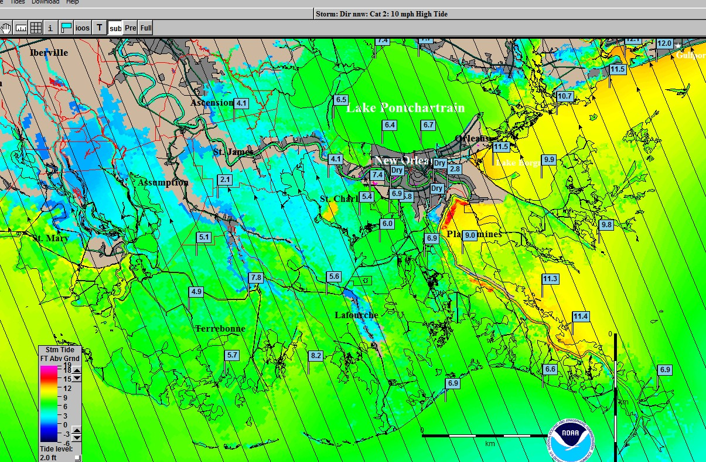

Slide 15


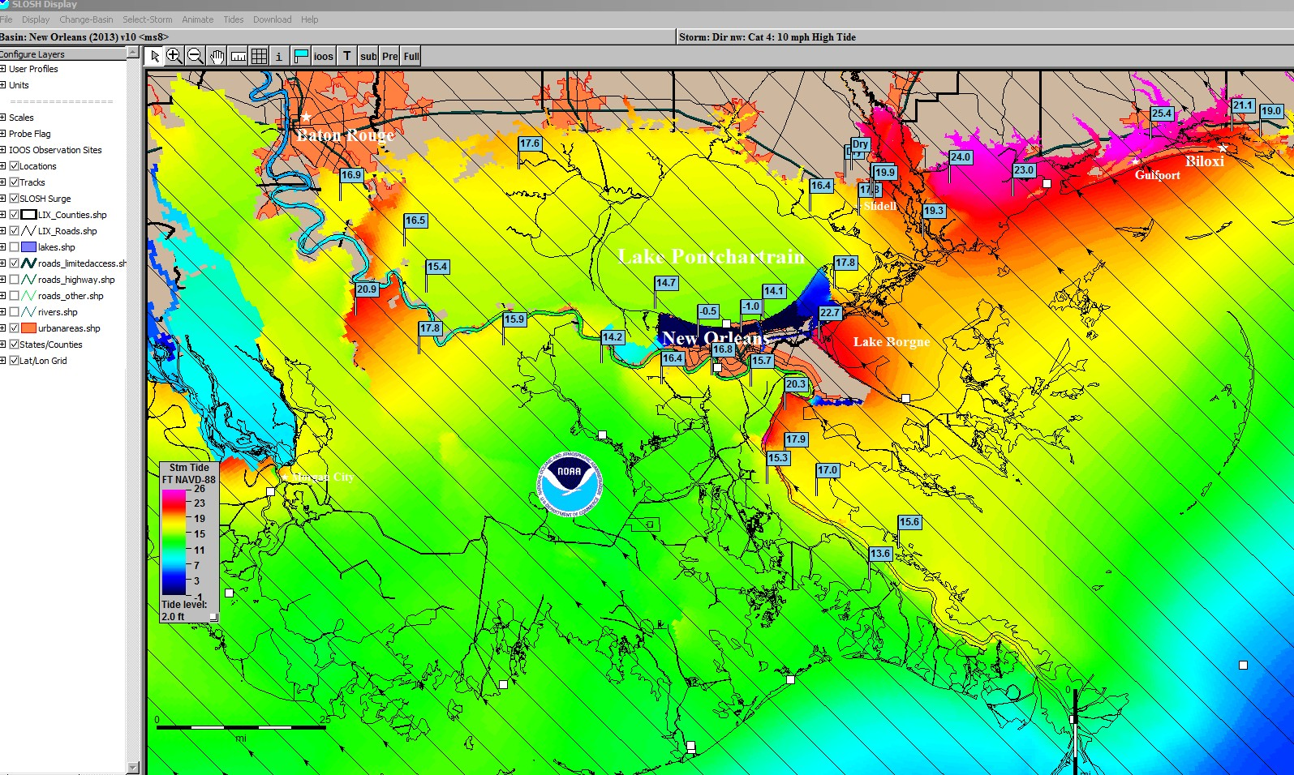

Slide 16









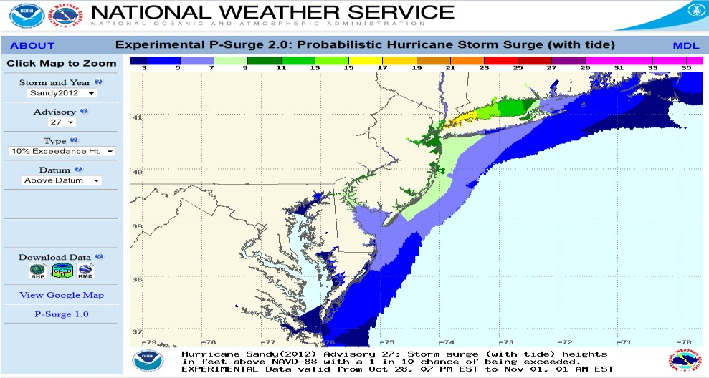









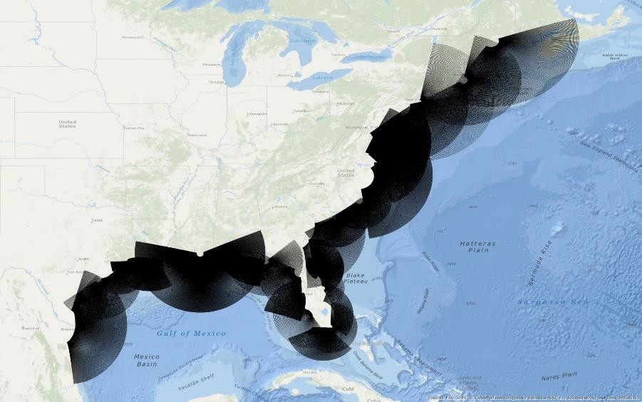



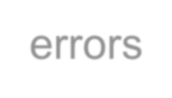


Storm surge probabilities based on
NHC official advisory
Available roughly 48 hours prior to arrival of TS winds
Accounts for meteorological
uncertainty in:
  Track
  Size
  Forward speed
  Intensity
Uncertainties based on historical errors
Version 2.0 (2014) also accounts for the tide and is above ground level

Slide 17
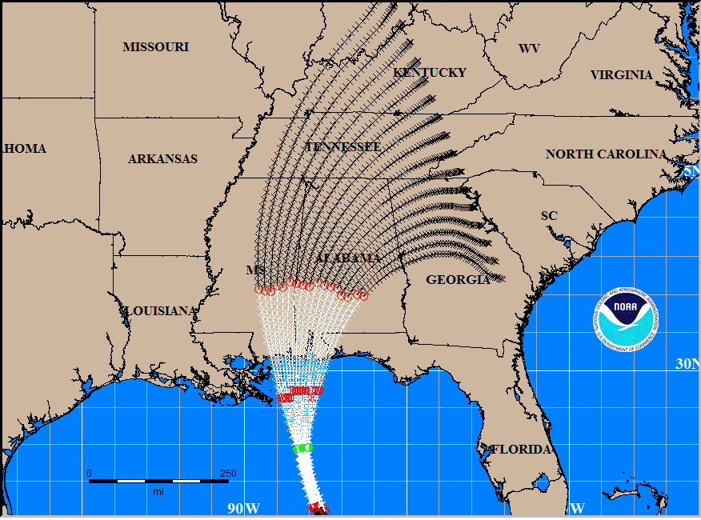

Slide 18
P-Surge 2.0 Web Site

Slide 19




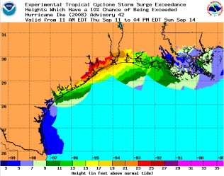





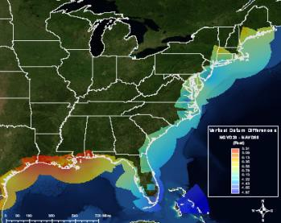








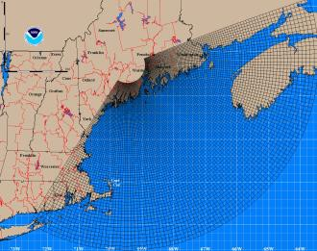




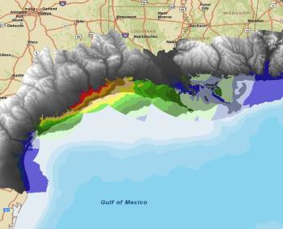





Driven by psurge2.0 (includes tides) 10% exceedance
Grids
  Latest SLOSH basins updated to NAVD88
Topography/DEMs
  NOAA CSC Sea-level rise DEM
    Resampled to smoother resolution
  Augmented with USGS NED
Processing
  Locally using ArcGIS for Server and Desktop
  Working toward leveraging NWS integrated dissemination program (IDP) for 2015 season

Slide 20
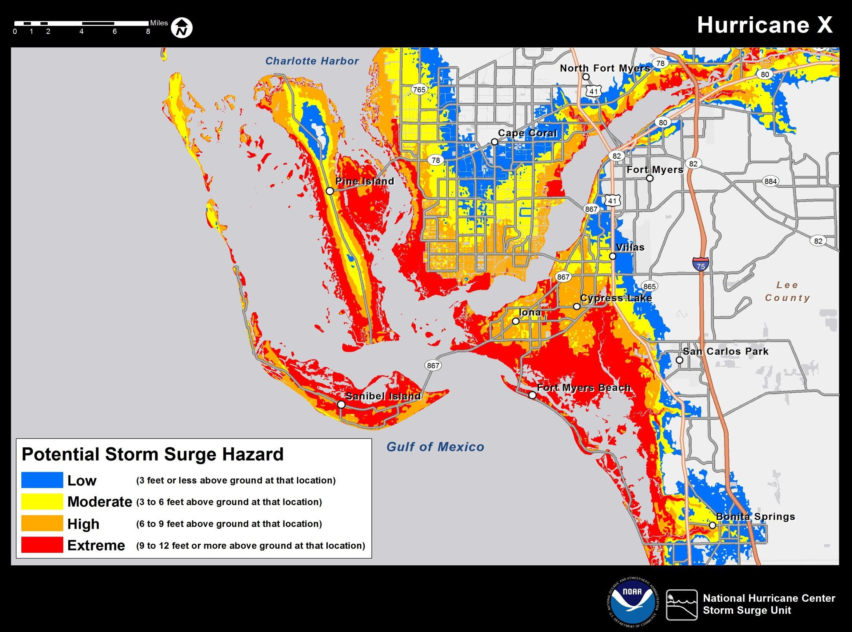
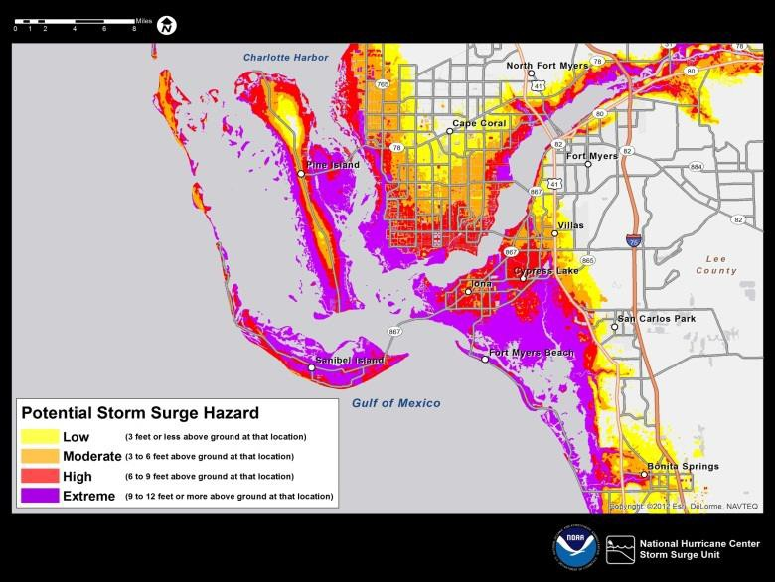
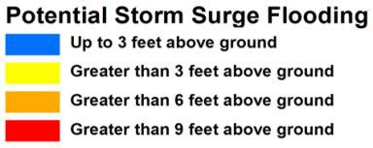

Slide 21
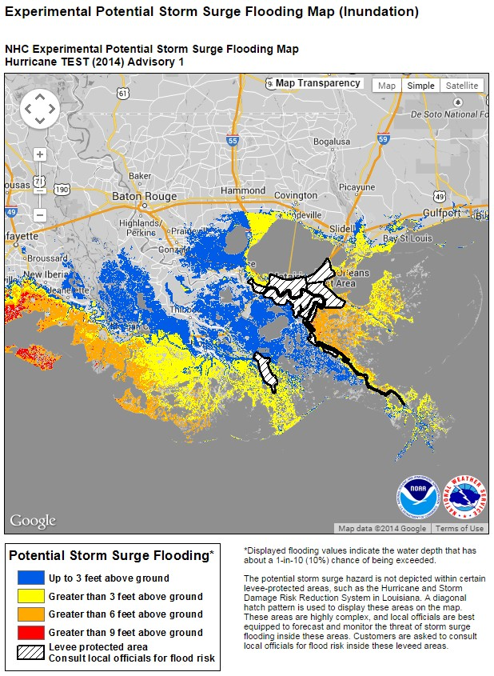
Potential Storm Surge Flooding Map
(Inundation Map)
Based on P-Surge 2.0 – 10 percent exceedance (90% percent at this depth or lower)
“Reasonable” worst case scenario Available when P-surge 2.0 is running
(Watches/Warnings in effect within 48 hours of the onset of Tropical Storm force winds)
Will be available approximately 80 minutes after the Public Advisory issuance
New map generated for each advisory
– so some subtle change is possible
Risk Reduction System is included but at current time does not show overtopping.
Inside the system is hatched

Slide 22
Available during the 2014 hurricane season
experimentally via the NHC website
For 2014 season, will be static graphic only
No GIS data dissemination during experimental phase
Interactive map with zoom capability that is available roughly 20-30 min after P-Surge 2.0
P-Surge 2.0 post-processed to produce a user- friendly graphic of potential storm surge depth
Marketing/outreach efforts underway
  Fact sheets, examples, website, video, etc.

Slide 23
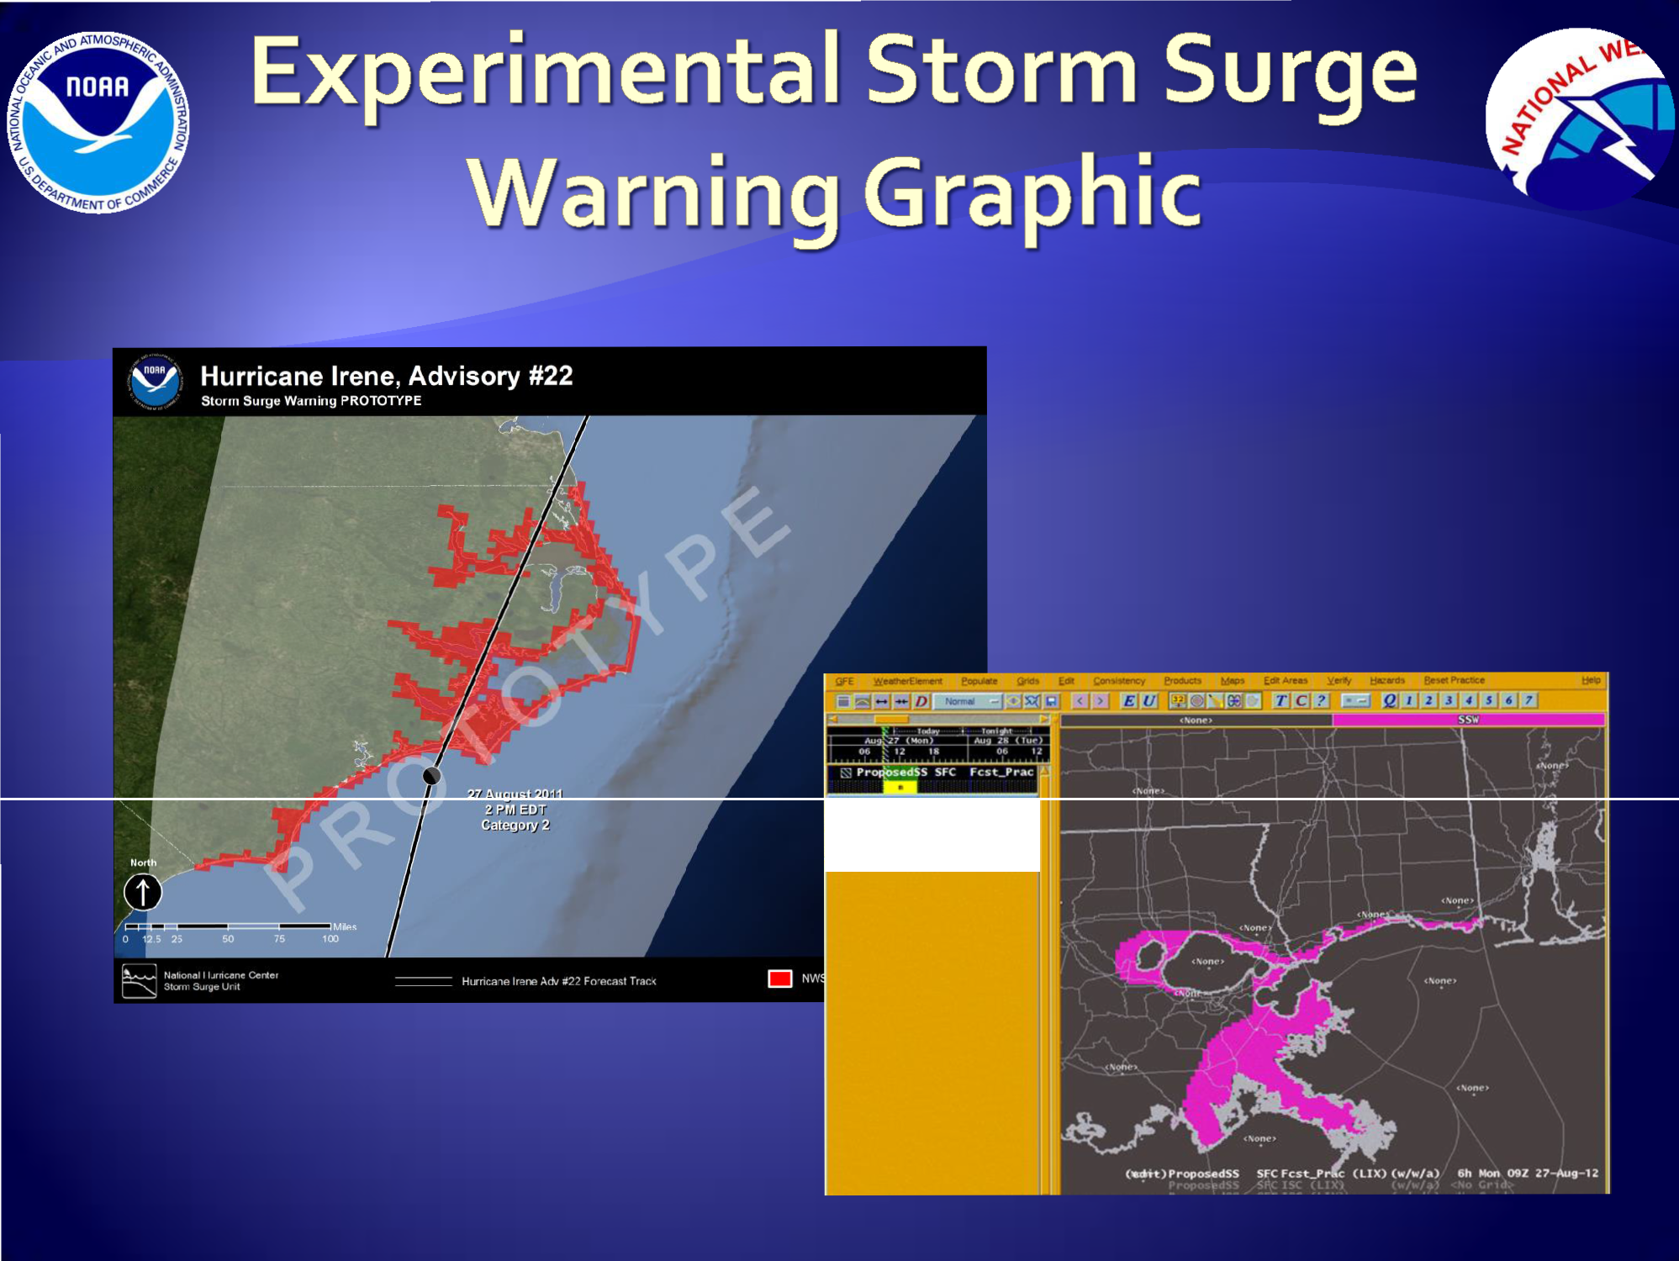
. Pr osedSS SFC ISC (LIX)
.. : Prop osedSSnc SFC lSC (ll
i

