Slide 1




Building Resilience in the Greater New Orleans Region
Monica Farris, PhD, CFM 2/26/2015

Slide 2

UNO-CHART
Mission:
– To assist residents, local and state officials, and communities in understanding and reducing risk to hazards
Applied Research with focus on mitigation
Multi-disciplinary
Established in 2001
www.uno.edu/chart

Slide 3

Applied Projects
➢ Repetitive Flood Loss
Community Rating System (CRS) Users’ Groups
➢ Sci-TEK
➢ Community Education & Outreach (CEO)
Continuity Planning for Community Organizations
Risk Literacy
Executive Risk Management
Resilience Curriculum
Disaster Resistant University Workshops

Slide 4

Community Education & Outreach

Slide 5



Community Education & Outreach
Continuity Planning for Community Organizations
Hazards Resiliency Curriculum
Risk Literacy
DRU Workshop
Executives Program in Risk Management

Slide 6
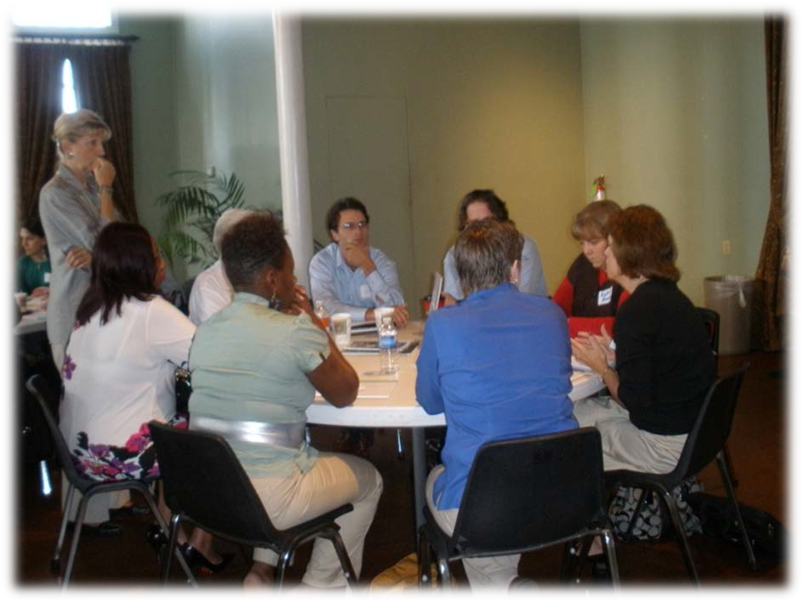
Continuity Planning for Community Organizations

Slide 7
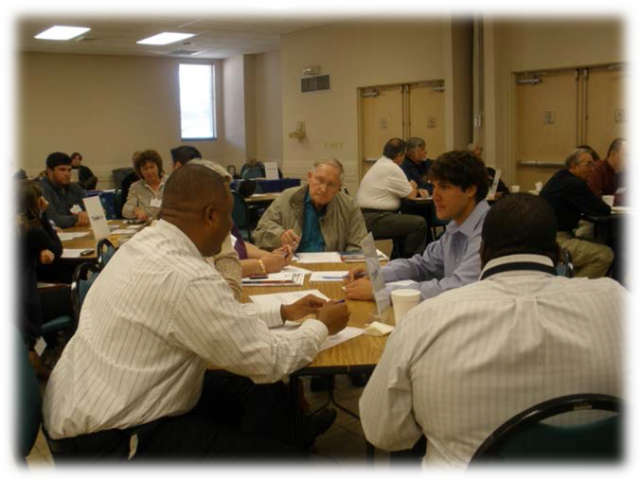

Project Background
Held statewide continuity workshops
Targeted small community organizations, nonprofits, and
faith-based groups

Slide 8

Curriculum Development
➢Through focus groups and workshops, created a curriculum for community continuity and resilience
Community Resilience
Understanding Your Hazards
Community Mapping
Ideas for Successful Response and Recovery
Strengthen Your Continuity Plan

Slide 9




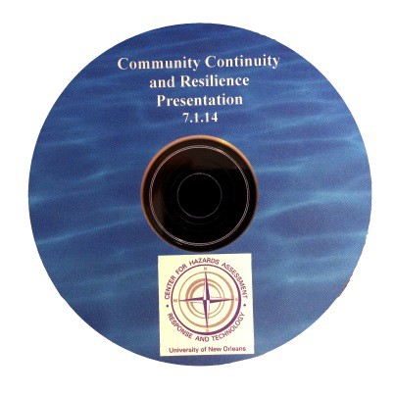
Creation of a Manual
So that agencies and communities can tra themselves
in

Slide 10

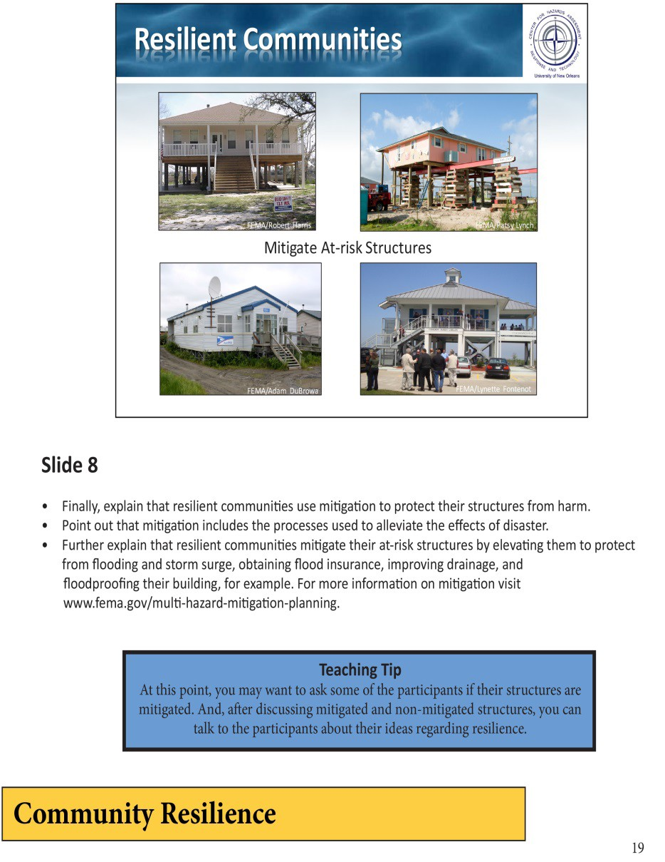

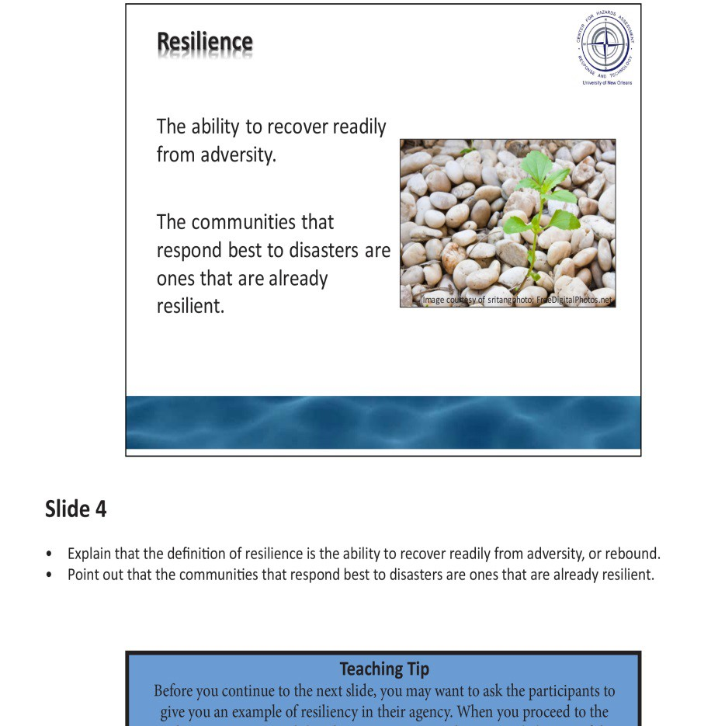
Inside the Manual
Defining resilience

Slide 11

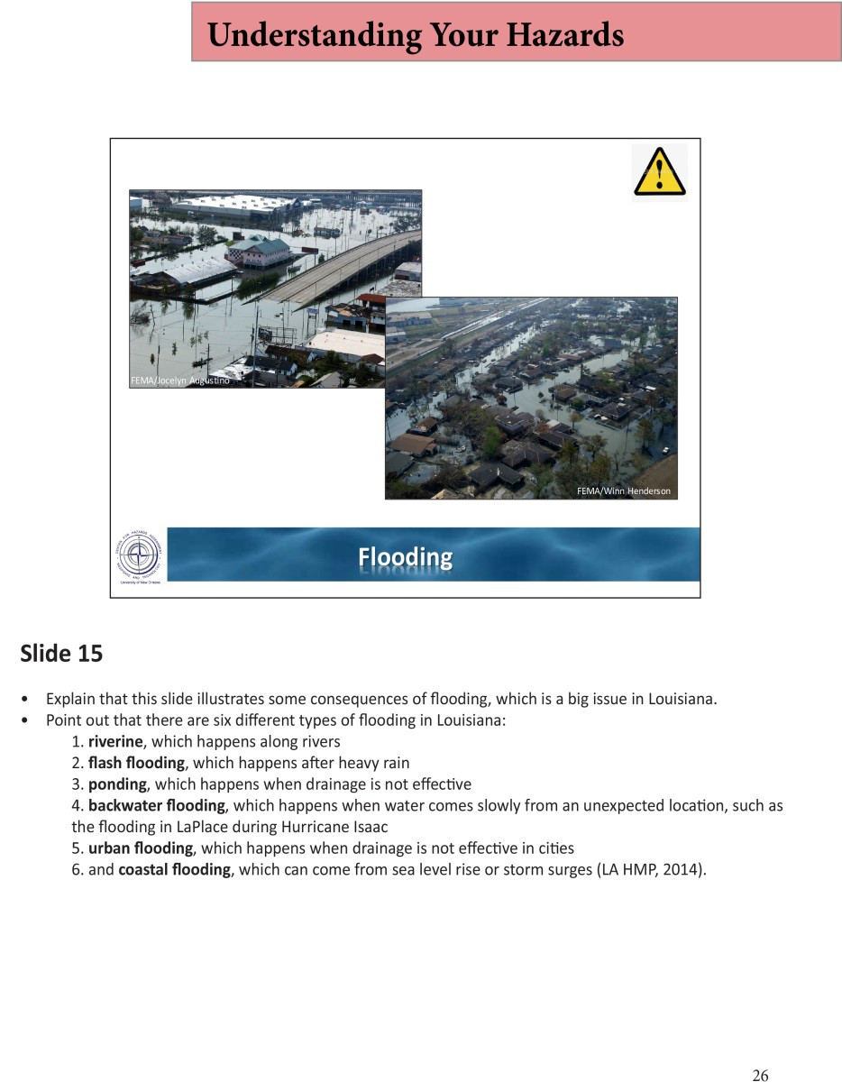

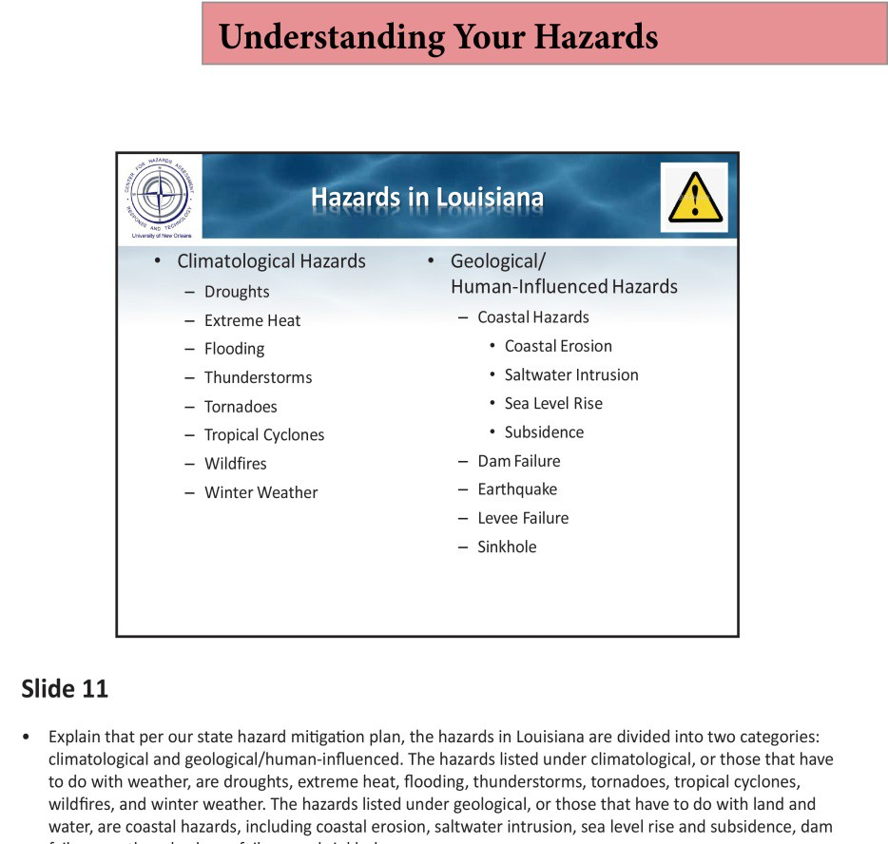
Inside the Manual
An in-depth look at hazards

Slide 12

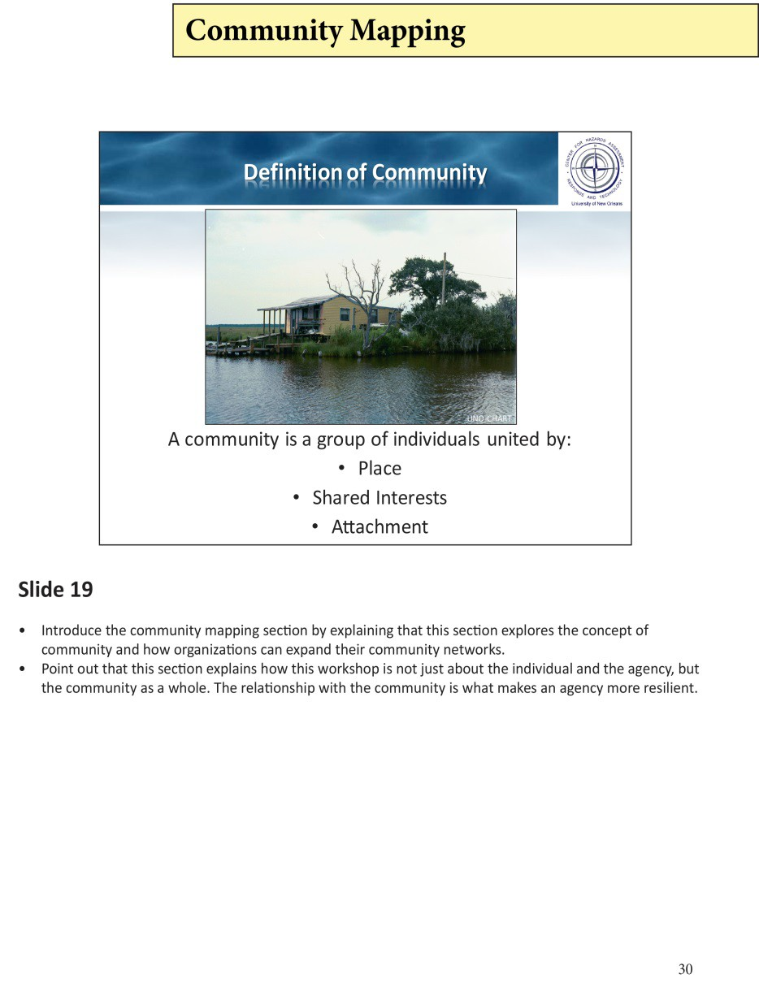

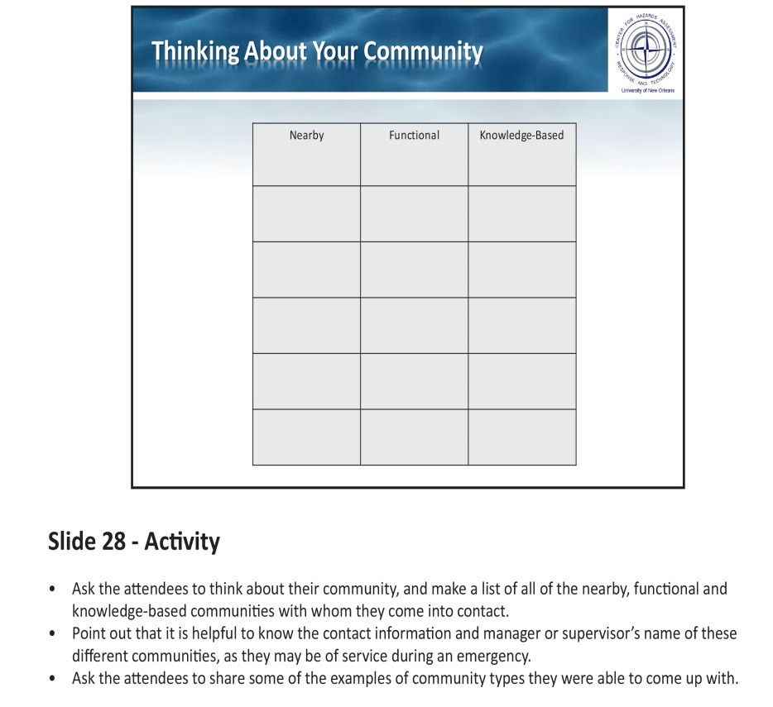
Inside the Manual
Understanding your r in the community
ole

Slide 13

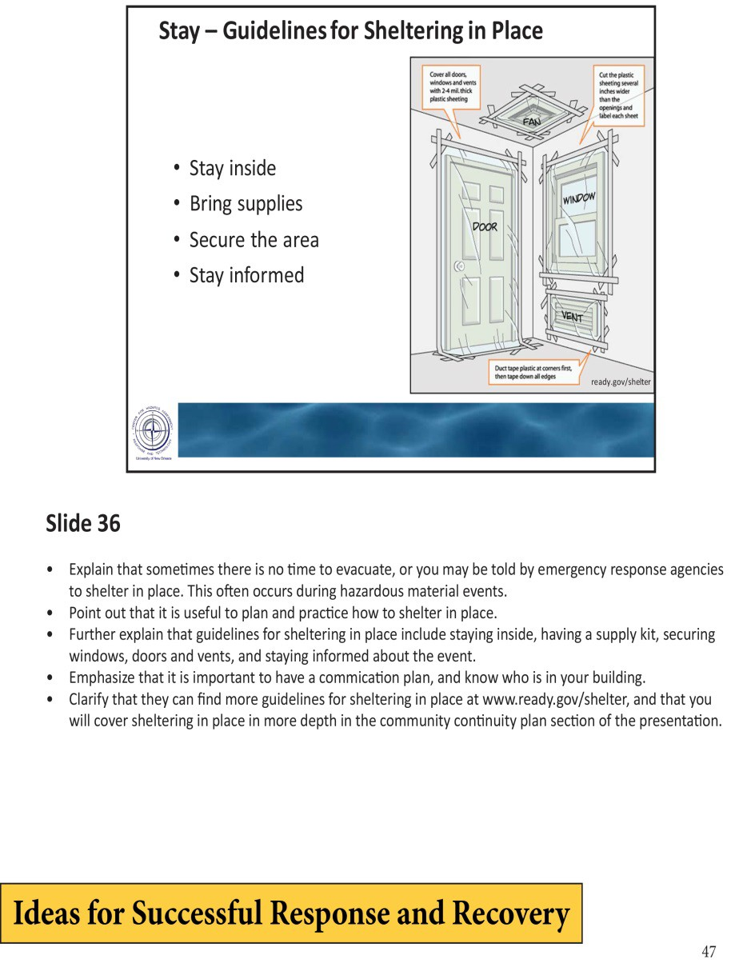

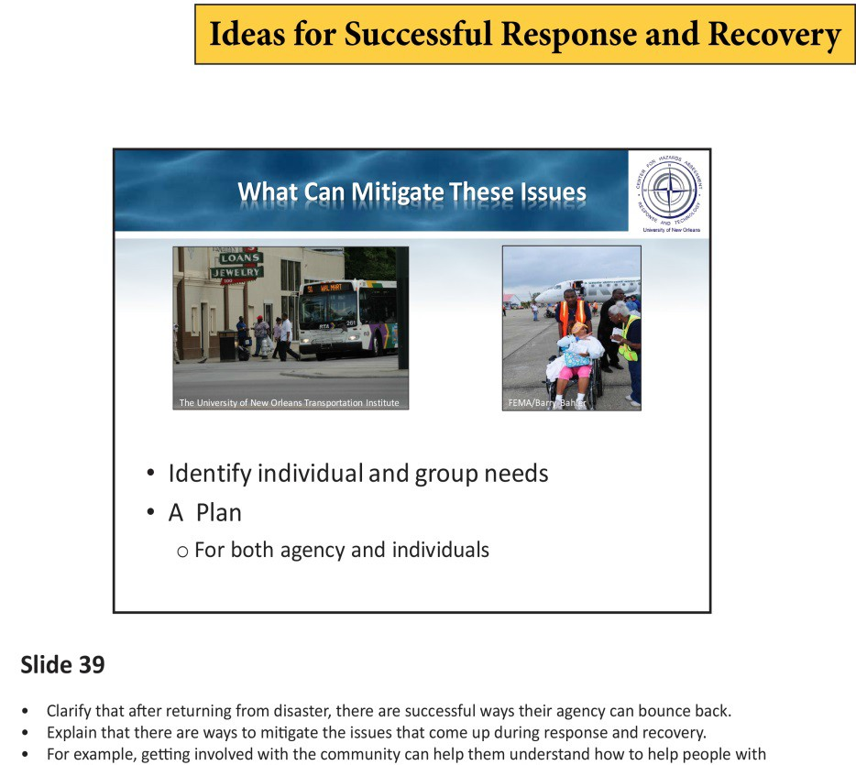
Inside the Manual
Responding to and recovering from events

Slide 14

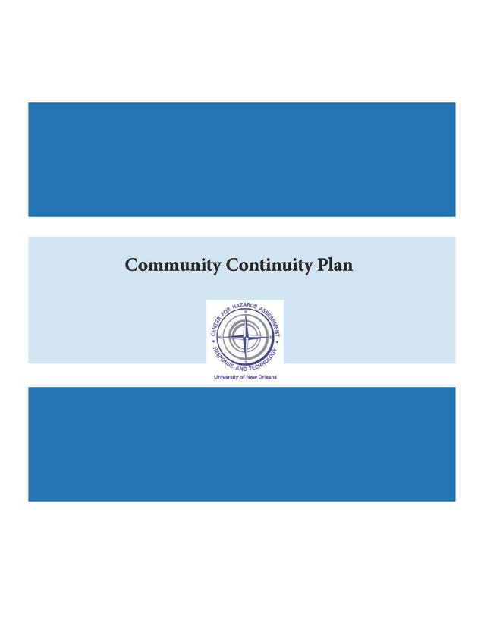

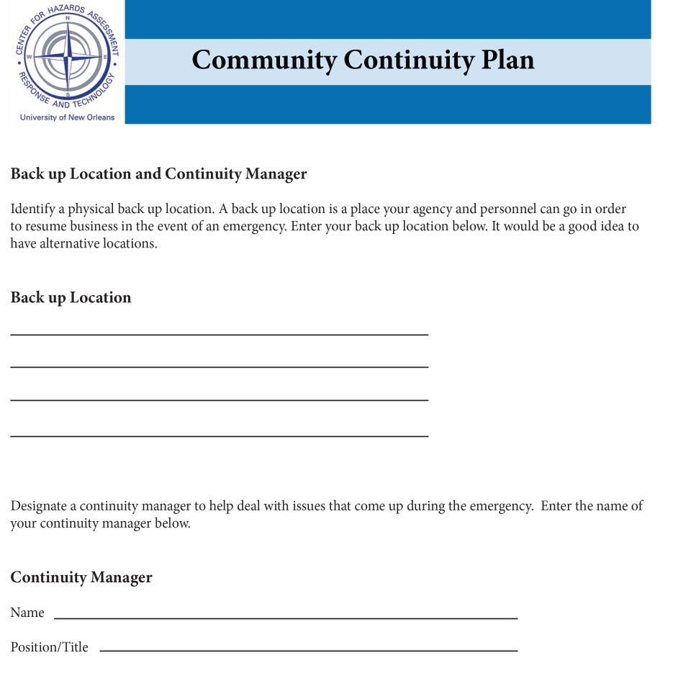
Inside the Manual
Making a plan

Slide 15
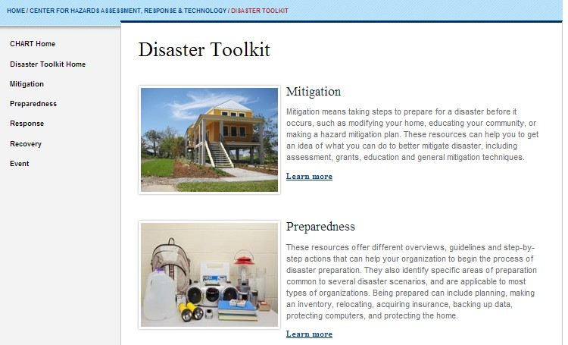
Sharing Resources
Online Disaster Toolkit: w
ww.uno.edu/chart

Slide 16
Community Education & Outreach
Continuity Planning for Community Organizations
Hazards Resiliency Curriculum
Risk Literacy
DRU Workshop
Executives Program in Risk Management

Slide 17
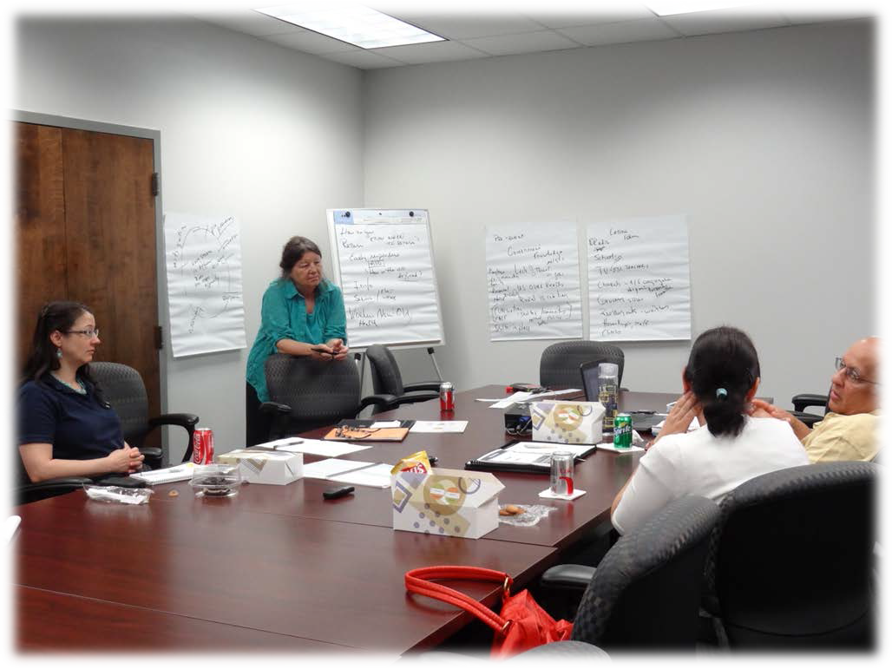
Risk Literacy

Slide 18
Literacy, Risk and Mitigation
Difficulties with vulnerable populations
Constructing risk message with awareness of literacy issues
National planning process geared toward high-level readers

Slide 19
Separate Yet Critical Tasks
Learning to Read
Understanding Risk

Slide 20


Process
Ongoing Collaboration with:
  Adult literacy groups
  Literacy providers
Review Materials
  Enhance content
  Improve structure

Slide 21


Overview of the Manual
Plain Language- writing that delivers clear and easy to understand information
With actions, deconstruct step by step
Graphics and text that are accessible to

Slide 22



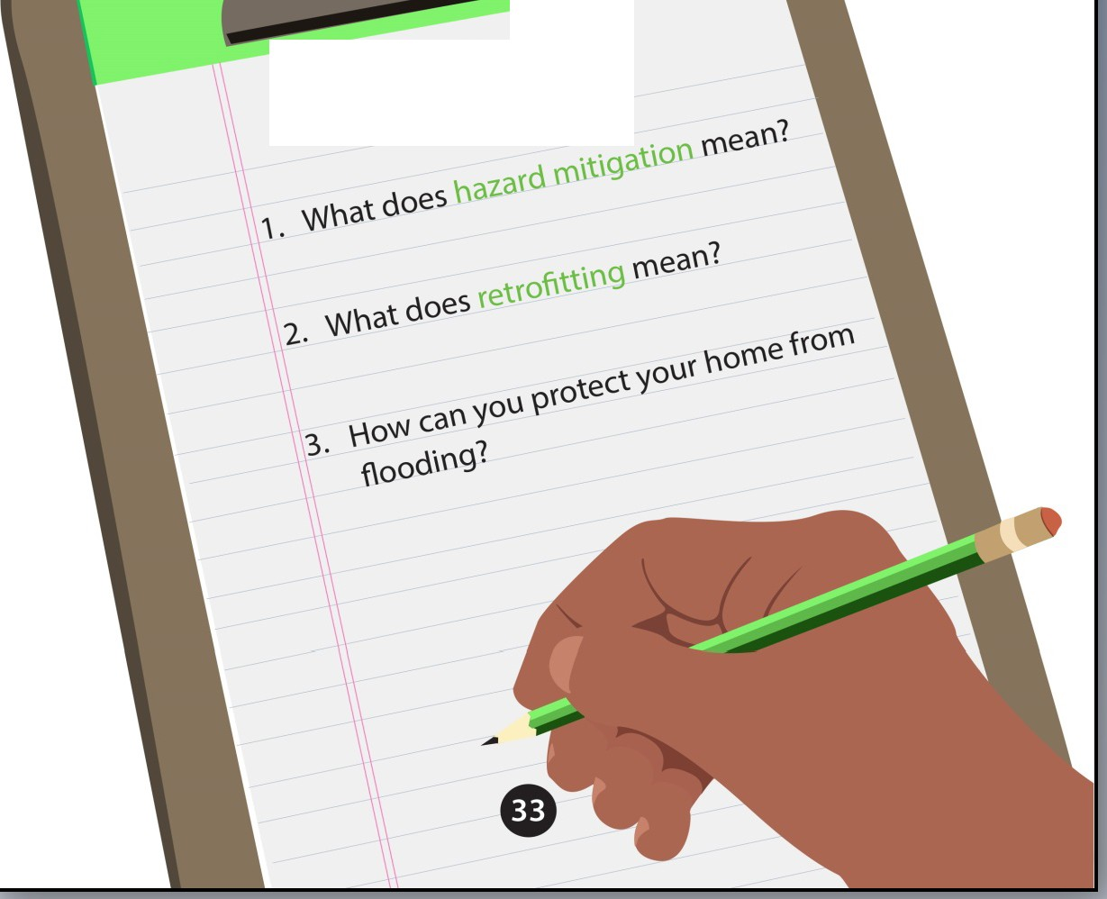
Flood Insurance
:Hazard Mitigation
Retrofitting
Long-\enn protection
{Of '(oU{ r\Oll"'e

Slide 23


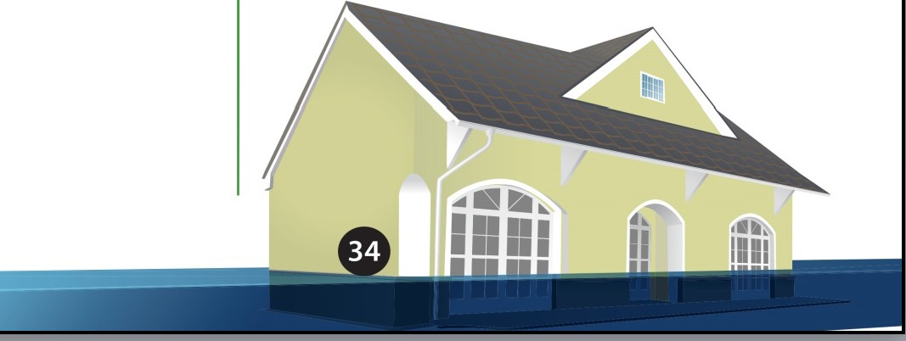
Things to Know...
Hazard mitigation is any action you take to protect your
life and property from future disaster damages.
Retrofitting
Retrofitting is a change you make to your home to strengthen it from flooding and high winds. Retrofitting is an example of hazard mitigation.
Insurance
Flood insurance helps cover the cost of damages from floods.
Only flood insurance covers flood damage from storms. There is a 30-day waiting period on new policies.
Homeowners insurance helps cover the cost of wind damage.
Homeowners insurance does not cover flood damage.
Tip:
Both renters and homeowners can get flood insurance.Visit www.floodsmart .gov or calll-888-379-953 1.

Slide 24

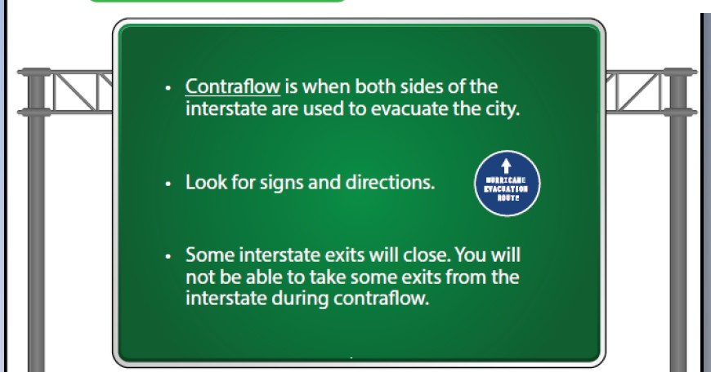


Contraf low
Normal Traffic Conditions
Contraflow Conditions
- -_{i} -· ­
- - --·. ₋ - ­
=-.
; ""'!"''''
Tip:
During contraflow,it can take 4 times as long to reach your destination.
Fill your gas tank because you will have to trave l a long distance before you can exit for gas. Hotels and shelters fill up quickly,so be ready to drive further.

Slide 25




Plan ahead for evacuation costs.
Keep your car in good shape.
Keep your gas tank full.
Check tire pressure.
Check your windshield-wiper blades. Check condition of engine oil.
Tip 1:
Leave early to avoid
traffic.
Rave Enougti Money To:
Fill your gas tank 4 times.
Pay for 3 nights at a hotel {$8o-$120/night).
Eat 3 meals a day at a restaurant for 3 days.
Sample Cost: A New Orleans family of four evac­ uates to a Shreveport hotel for 3 days. The cost is around $750.
Average Price of a Meal:
Fast Food
Chain Restaurants Fine Dining
$ $5-15/person
$$ S15-25/person
SSS $25-50/person
Tip2:
Stay at hotels with
microwaves and
refrigerators so you can
cook your own meals.
Ways to Save:
Bring food from home.
Shop at grocery stores.
Cook your own meals.

Slide 26




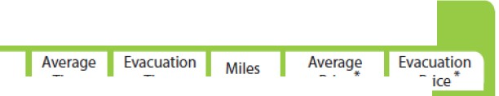
Driving from New Orleans,LA
City
Time
Average
Price*
Alexandria, LA | 3.5 hours | 12 hours | 220 | $105 | $205
Atlanta,GA | 7.5 hours | 30 hours | 480 | 220 | 440
Baton Rouge, LA | 1.5 hours | 8 hours | 80 | 40 | 75
Birmingham,AL | 5 hours | 20 hours | 340 | 160 | 320
Dallas, TX | 8.5 hours | 34 hours | 520 | 245 | 485
Houston,TX | 5.5 hours | 22 hours | 350 | 165 | 325
Jackso n,MS | 3 hours | 24 hours | 190 | 95 | 190
Memphis,TN | 6 hours | 24 hours | 400 | 185 | 370
Shreveport,LA | 5.5 hours | 20 hours | 340 | 160 | 320
*Round trip based on a gas price of $3.50 per gallon for a car that travels 15 miles per gallon.
Driving from Lafayette, LA
City
Alexandria, LA | 1.5 hours | 6 hours | 90 | $40 | $80
Austin,TX | 6 hours | 24 hours | 375 | 175 | 350
Baton Rouge, LA | 1hours | 4 hours | 60 | 30 | 55
Dallas, TX | 5.5 hours | 22 hours | 390 | 170 | 365
Houston,TX | 3.5 hours | 14 hours | 215 | 100 | 200
Jackson, MS | 3.5 hours | 14 hours | 230 | 110 | 215
Lake Charles,LA | 1.5 hours | 5.5 hours | 75 | 35 | 70
San Antonio,TX | 6 hours | 21 hours | 410 | 190 | 385
Shreveport,LA | 3 hours | 1o.s hours CD | 210 | 100 | 200

Slide 27
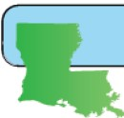

PREPARING FOR SlORMS IN LOUISIANA FACILITATOR'$ GWDE
Lesson 9
Parish Assistance for Evacuation, Know Your Rights,
Shelter Basics
(Pages 23,24 and 25 of the Preparing for Storms in Louisiana student manual)
Reading Comprehension Strategy: Think Aloud
Framework
Students learn where to find evacuation help and basic information about shelters.. The reading comprehension strategy of this lesson teaches students to generate questions as they are reading a passage.
Learning Objectives
The students will-
Review their personalized list of important words or phrases for Section Ill. React verba lly and inwriting to evacuation buses and shelters.
Engage with a passage by vocalizing questions. Learn where to find help during an evacuation. Learn their rights ina shelter.
Learn basic tips for staying at a shelter.
Materials
Inaddition to the materials listed on page 7 of this guide, the instructorwill need:
The lesson 9 previewing video: http://bit.ly/18CvtAO *(1:17 in length) 2 videos available at:
http://bit.ly/18os33P http://bit.ly/1giRMKG
*(0:23 in length)
*(0:41 in length)
Lesson 9
Cet1ter For Hanrds Assessment. Response & Tecltllology
72
uno.edu/chort

Slide 28



Preparing for Storms in Louisiana
Evacuation with Elderly or Disabled Persons
CheckList
D Extra Prescription Refills
0 Wheelchair or Walker
D Personal Medical Devices
D Backup power source for medical devices
0 Backup plan for health services
Preparaci6n para tormentas en Louisiana
Evacuaci6n con personas mayores o con discapacidad
Lista de verificaci6 n
0 Recetas adicionales de reabastecimiento s
de medicinas
0 Silla de ruedas o andador
0 Dispositivo medico personales
0 Fuente de energia de reserva para los
dispositivos medicos
0 Plan de respaldo para servicios de salud
H£cho par UNO-CHART

Slide 29
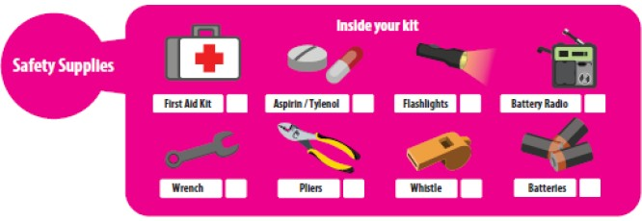
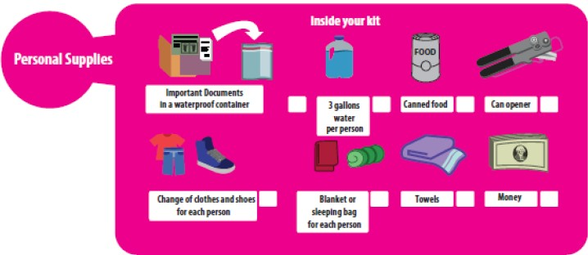
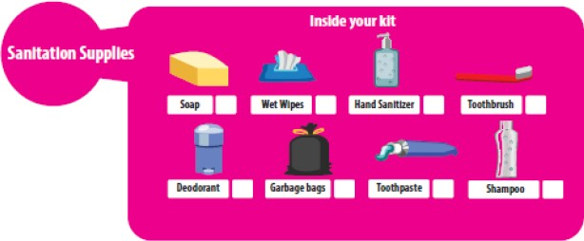
Supply Kit
•

Slide 30
Repetitive Flood Loss

Slide 31
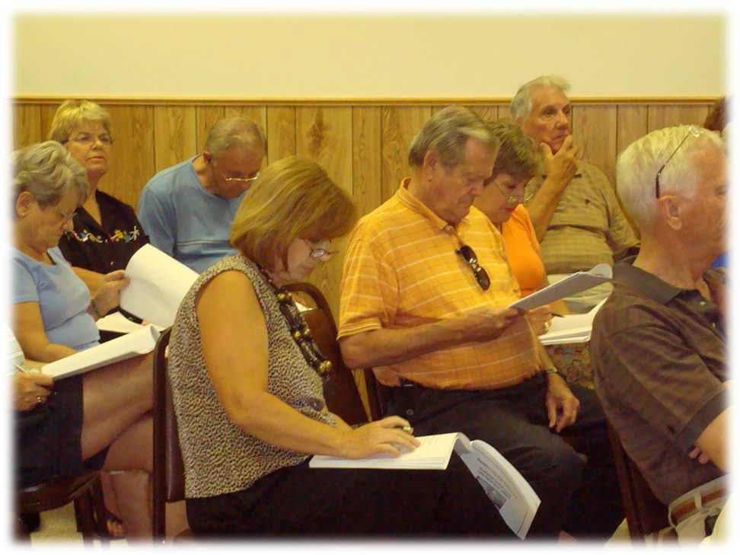

Slide 32
Project Background
Repetitive Loss (RL): two or more claim payments of more than $1,000
Severe Repetitive Loss (SRL):four or more claim payments of more than $5,000 each and the cumulative amount of claims exceeds $20,000 or two separate claims that cumulatively exceed the building's market value.
Privacy Act of 1974:restricts the release of certain types of data to the public

Slide 33
Project Background
FEMA funded (Region VI)
Project Partners: Solutient, French Wetmore, RL Communities
Deliverables
  Rep Loss database and web portal
    www.floodhelp.uno.edu
  Area analyses
  Outreach

Slide 34
The Repetitive Loss Area Analysis (RLAA)
Flood mitigation plan
  Identifies the source(s) of repetitive flooding
  Offers mitigation measures to combat that flooding
  Includes resident participation

Slide 35
RLAA Process
Step 1: Advise all property owners in the RL area
Step 2: Contact agencies/organizations that may have information
Step 3: Visit each building and collect data
Step 4: Review potential mitigation measures
Step 5: Document the findings

Slide 36
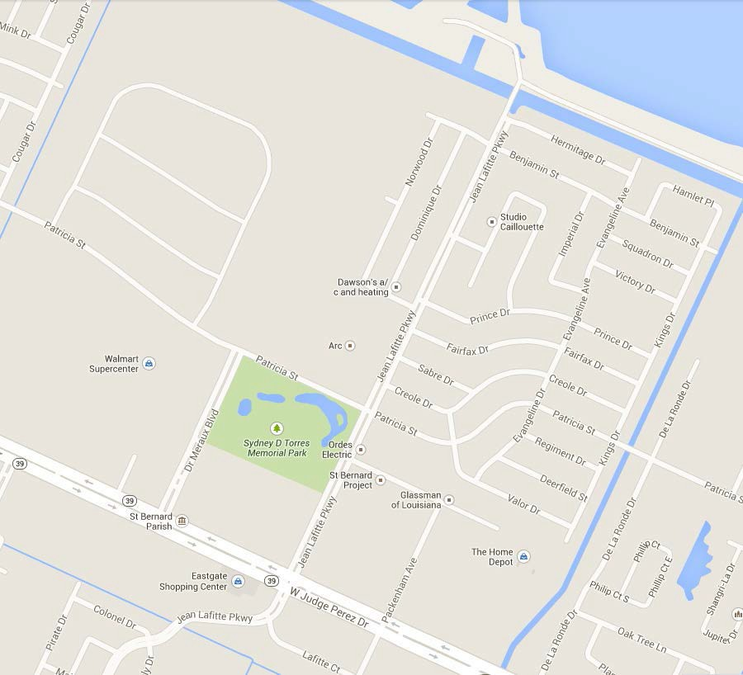
Selection of Study Area
52 RLs
185 Claims
$8,336,635.74

Slide 37
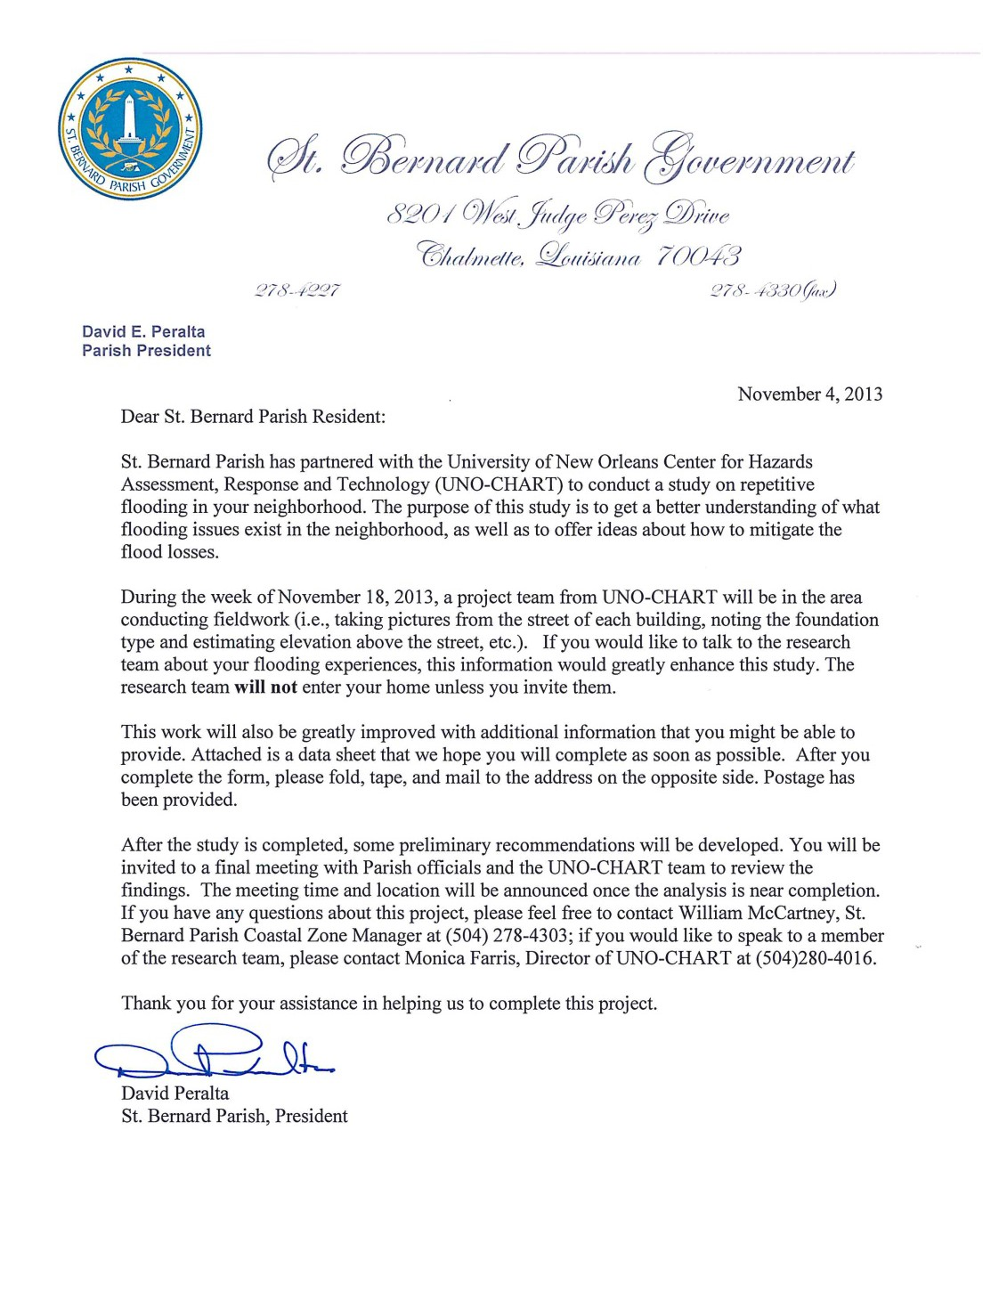
Step 1

Slide 38
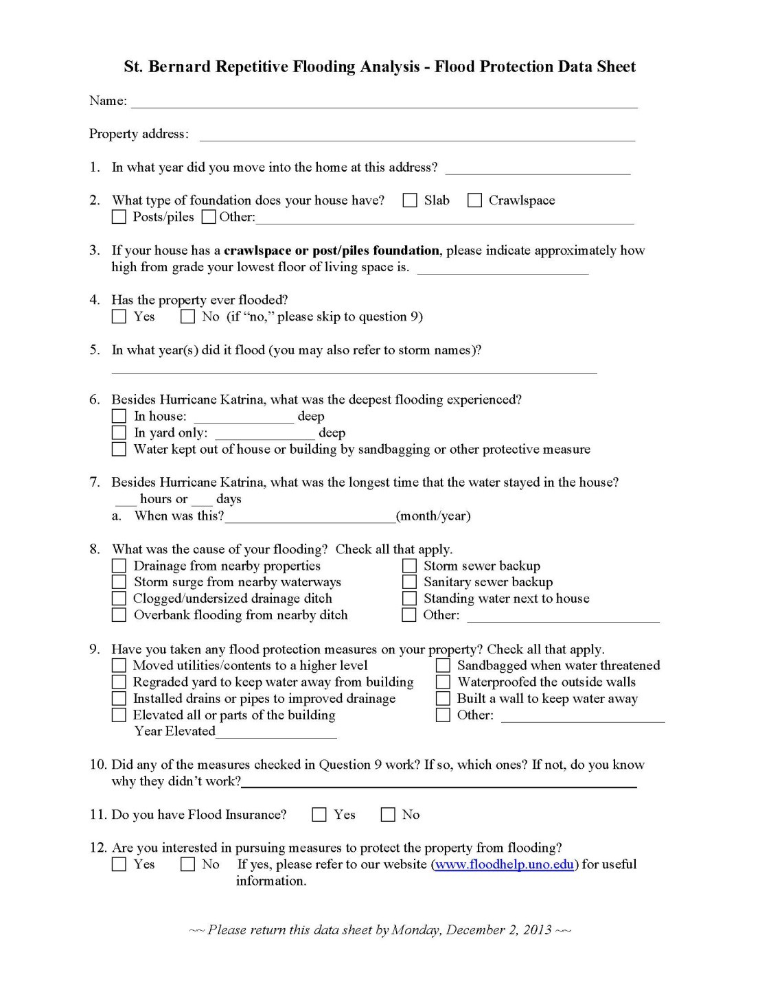
Step 1

Slide 39
Step 2
Identifying Agencies/Organizations
Making Contact
  Floodplain Manager
  Permits
  Stormwater Manager
  Levee District/flood control
  Engineers

Slide 40
Step 3 – Field Data
Street Name | Building number | Neighborhood | Occupied? EC Diagram |  | # of Stories | Elevated above grade Elevated above street |  | Structure type | Comments - adequate vents, foundation, HVAC, retrofit
Alexander |  | Arabi Area | yes | 8 | 2 | 2-3 | 3-4 | Masonry | only 2 vents visible
Alexander |  | Arabi Area | yes | 5 | 1 | 1-2 | 1-2 | w | mail box in bush
Alexander |  | Arabi Area | yes | 5 | 2 | 4-5 | 5-6 | w | red barn
Alexander |  | Arabi Area | yes | 1A | 1 | 0-1 | 1-2 | Masonry | tan brick, blue trim
Alexander |  | Arabi Area | yes | 5 | 1 | 1 | 1-2 | w | blue house four bushy columns
Alexander |  | Arabi Area | yes | 8 | 1 | 3-4 | 4-5 | w | pale yellow brick steps ?
Alexander |  | Arabi Area | yes | 5 | 1 | 3-4 | 4-5 | w | raised AC green house wood door
Alexander |  | Arabi Area | yes | 5 | 1 | 1-2 | 1-2 | w | green closed shutters, big wreath

Slide 41

Step 4 - Review Mitigation Measures
Acquisition
Elevation
Barriers to floodwaters
Dry Floodproofing
Wet Floodproofing
Utility Improvements
Maintaining Flood Insurance

Slide 42
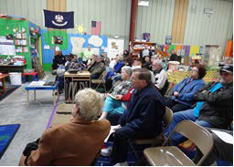
Step 5 – Document Findings
Summary of process
Problem statement and map
Building information
Mitigation options reviewed
Action Items

Slide 43

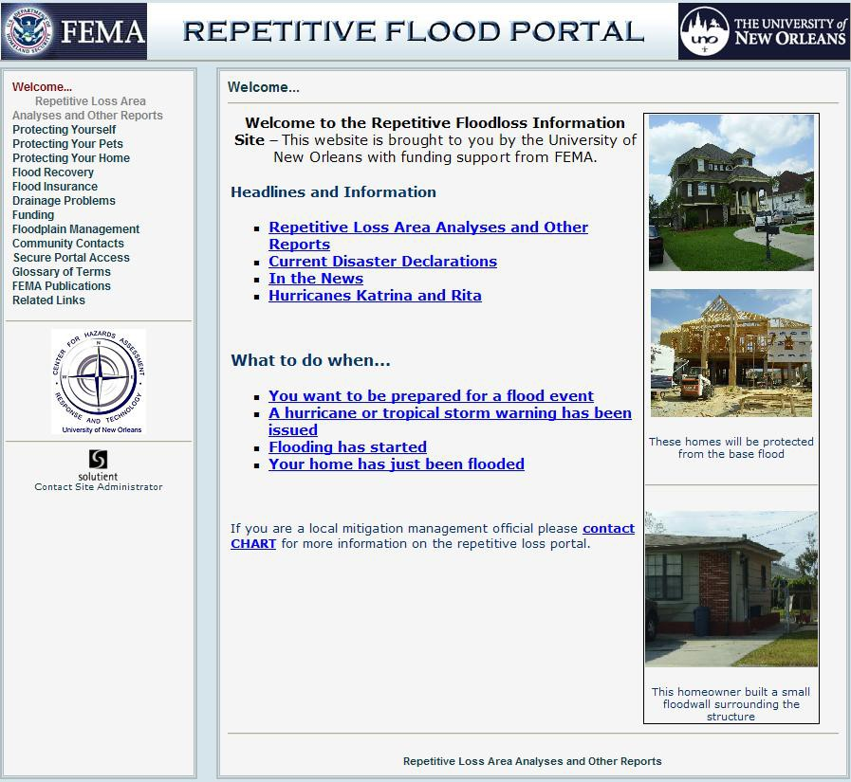

Website/Portal – www.floodhelp.uno.edu

Slide 44

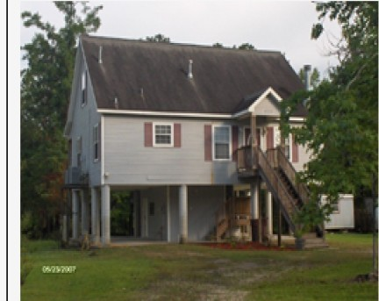
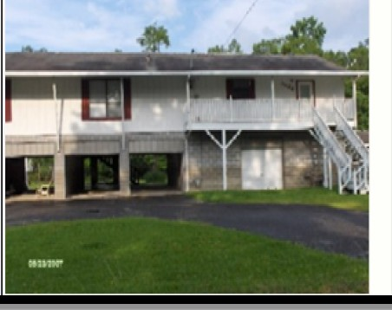


Public Information
Welcome ...
Repetitive Loss Area AnruysesandDtt1
Protecting Protecting Your Protecting Your Rood Recovery Flood Insurance Drainage Problem Funding
Floodplain M
Community Secure Portal Glossary ofT
FE.MA PUbli ""' ''"'n'"' •
FEMA
REPETITIVE FLOOD PORTAL
THE UN IVERSITY of
•
NEW ORLEANS
Welcome...
Protecting Your Home> Elevation
ProtectingYourself
ProtectingYour Pets
ProtectingYour Home
Elevation means raising the structure above the flood level.
This method is generally viewed as the best way to mitigate, short of removing the structure.
Elevation is easiest and less costly
for houses on posts/piles or
craw lspaces. It is possible to elevate a slab house, but it is more difficult and costs more.
Elevated buildings get lower flood
insurance rates.
Posts/Piles:
Most of the cost is in the setup and foundation construction, rather than in materials
Funding options are available through
FEMA programs and the U. S. Army
Corps of Engineers
Less disruptive because lifting
equipment can be placed under the house
What isyour tlood hazard?
Foundations
Mitigation Measures
Elevation
Barriers
Dry Floodproofing
Wet Floodproofing
Emergency Actions
Safety Precautions
Construction Rules
Dealing with Contractors
Flood Recovery
Flood Insurance
Note the elevated AC unit to the left of the
house
Drainage Problems
Funding
Floodplain Management
Community Contacts
Secure Portal Access
Glossary oflenns
FEMA Publications
Contact Site Ad
Related links
University of New Orleans

Slide 45

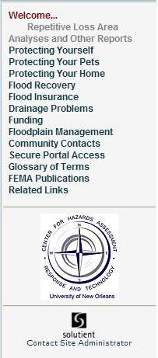

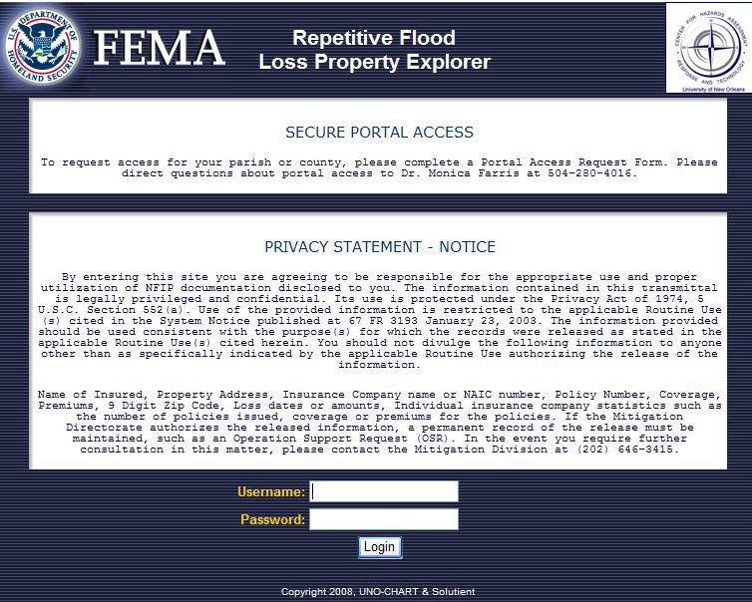
Secure Access to the Repetitive Loss Portal

Slide 46



 |  | REPETfT VE FLOOD PORTAL· .......... Secure Portal Access
 | FEMA City of Alvin Repetitive Flooding Portal Ma1n Menu Map V1ewer Search Select Portal Lo off Help SEARCH BY PROPERTY LOCATOR: Search By Locator # L--------------------- SEARCH BY DETAIL: O search for _{All Rls} vi 0Street Address : I_ "------------...,;;;;;t,j For best results do not add the street type ("DR ","A\'E", etc.) Deity: O state : lrexas v i O zip : I 0Community 10: I 0Community Name: I 0Insured Name Contains : I 0Claim Count is 0Total claim loss between: I Iand i I 0Claim Date Between: ^{I IG and l} ==,-:1 [=3· I Search By Detail )I
 |  | Tanaioahoa Pari sh Terrebonne Pari!<h Town ofJea n Lafitte Town of Madisonville Washington Parish All Pari shes Sign out of Repetilve flood Porta!
I
I
I> v | ^{JII}L..._r=======;'^{I}
University of New Orleans

Slide 47
QFEMA
Ma1n Menu Map V1ewer
City of Alvin Repetitive Flooding Portal
Selec t Portal Lo off Help
Search
SEARCH BY PROPERTY LOCATOR: _{L-----------------} Search By Locator #
SEARCH BY DETAIL:
v I
Osearch for 0Street Address: D eity:
Ostate:
0Zip:
Ocommunity ID:
0Community Name:
0Insured Name Contains:
0Claim Count is
0Total daim loss between:
Oclaim Date Between:
_{I}..;;,;.;,;,; For best results do not add the street type ("DR","A\IE", <te.)
All RLs
I
Texas v | i
I> I
i====='l and,.lb=='='I
i== = ===1'-G =·=-a.:_n.d.:...11!====; | '1G
Search By Detail
Search found the following 120 results.
Locator
₁ Property Insured Name _{Address} 0043136 |  | City :\1.-\i'<\'El | Stat TX | e Zip Community Name 775789709 ALVDI,CITY OF | Claim Count 2 | Total Loss $46,237.00
Portfolio Data She<t 0039608 |  | Al\1!\ | TX | 775119149 AlVDI, CITY OF | 2 | $26,56839
0025303 |  | .-\J.\1!\ | TX | 775119320 .-\1.VDI,CITY OF | 2 | $33,855.89
Portfolio Data She<t 00259,9 |  | .-\1.\1!\ | TX | 775119327 ALVDI, CIHOF | 2 | S20,093.
003#06 |  | .-\1.\1!\ | TX | 775119 05 .-\1.VDI,CITY OF | 2 | $22,603.52
Portfolio Data Sheet 0031725 |  | .-\1.\1!\ | TX | 775119206 ALVDI, CITY OF | 2 | S28,011.42
96 |  | .-\1.\1!\ TX | TX | 77511 .-\1.VDI,CITY OF |  | $42,795.95
Portfolio Data She<t 0045 113 |  | .-\1.\1!\ | TX | 775119513 ALVDI, CIHOF |  | $31,783.93
0012934 |  | .-\1.\1!\ | TX | 775110000.-\1.VDI,CITY OF | 2 | $24,69 .51
Portfolio Data Sheet 0017532 |  | Al\1!\ | TX | 7751136 AlVDI, em·OF |  | SSO,I90.94
0025767 |  | .-\1.\1!\ | TX | 775113648 .-\1.VDI,CITY OF | 2 | S15,013.86
Portfolio Data She<t 00186,9 |  | .-\1.\1!\ | TX | 775114321 AlVDI, em·OF | 2 | $16,362.74
0096877 |  | .-\1.\1!\ | TX | 775114321.-\1.VDI,CITY OF |  | $48,568.08
Portfolio Data Sheet 0025914 |  | .-\1.\1!\ | TX

Slide 48

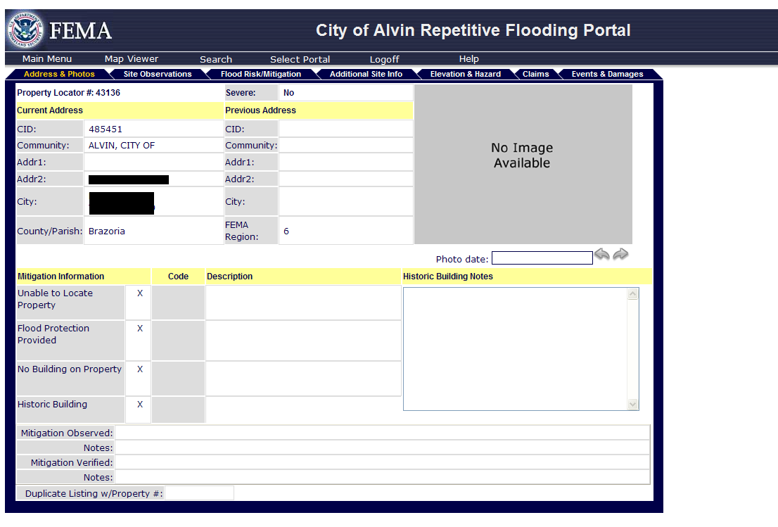

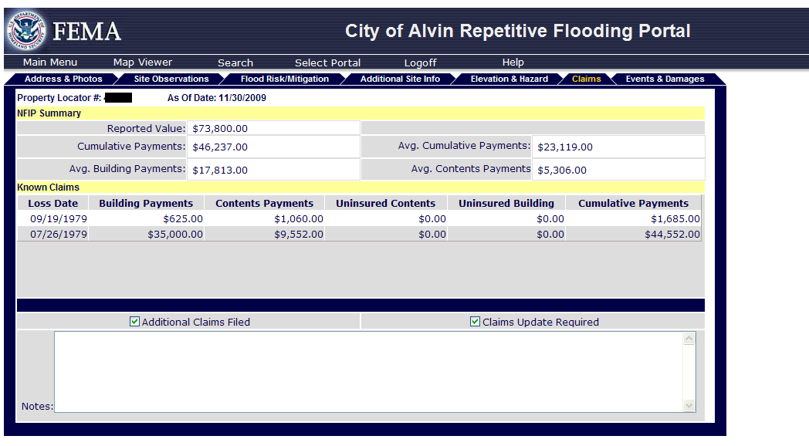
Repetitive Loss Property Portfolios

Slide 49
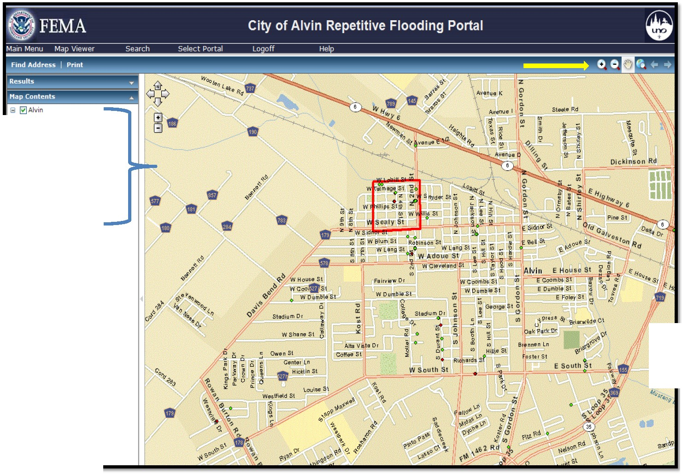
IB 0Aerials
ffi 0Repetitive Loss
ffi 0Analysis Study Areas
ffi 0Address Points May 2010
-o&....l..-
ffi 0Parcels
ffi 0FEMA Flood Zones
ffi DMustang Bayou Floodway
ffi 0Existing Drainage Ditches
ffi 0Basemap
E south

Slide 50
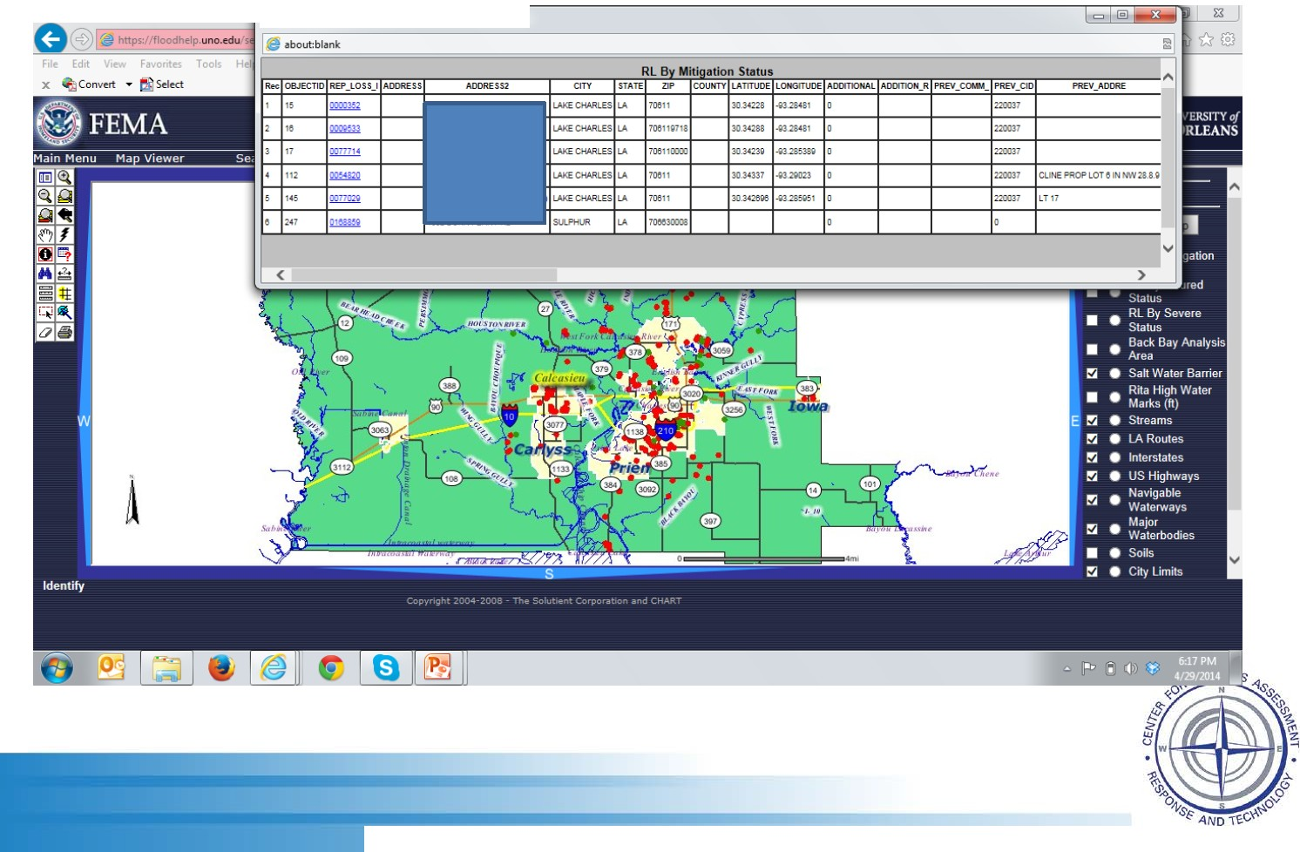
eQuery/Selection Results - Windows Internet Explo<er
University of New Orleans

Slide 51
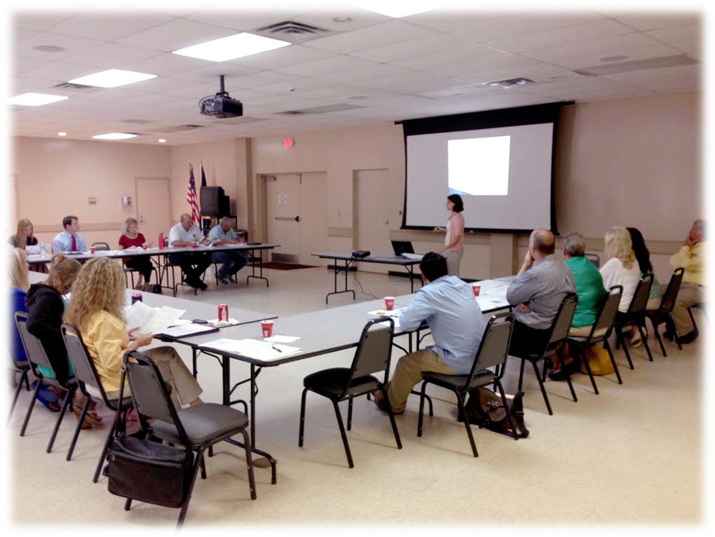
CRS Users’ Groups

Slide 52
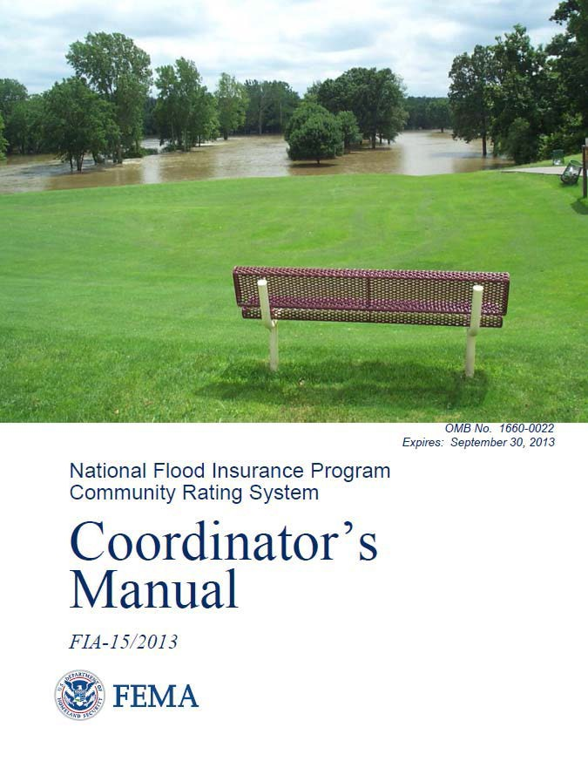
What is the CRS?
Voluntary Program
Provides incentives for going beyond minimum NFIP requirements
Administered for FEMA by the ISO since 1991

Slide 53
CRS Rating Scale
ter for chnology
Class Points SFHA Non-SFHA PRP
1 | 4,500 | 45% | 10% | 0
2 | 4,000 | 40% | 10% | 0
3 | 3,500 | 35% | 10% | 0
4 | 3,000 | 30% | 10% | 0
5 | 2,500 | 25% | 10% | 0
6 | 2,000 | 20% | 10% | 0
7 | 1,500 | 15% | 5% | 0
8 | 1,000 | 10% | 5% | 0
9 | 500 | 5% | 5% | 0
10 | < 500 | 0 | 0 | 0

Slide 54
CRS Communities in Louisiana
42 Communities
▪ Policies in Force: 391,362
▪ Premiums $284,871,427
▪ Savings: $35,071,512

Slide 55
CRAFT
ter for chnology
Ascension Parish (8)
East Baton Rouge Parish (6)
West Baton Rouge Parish (8)
City of Denham Springs (8)
City of Walker (8)
City of Gonzales (8)
City of Zachary (7)
City of Central (8)

Slide 56
FLOAT
ter for chnology
City of Mandeville (7)
Orleans Parish (8)
St. Bernard Parish (Not yet in CRS)
St. John the Baptist Parish (8)
St. Tammany Parish (7)
City of Covington (Not yet in CRS)
City of Slidell (8)
Tangipahoa Parish (9)
Terrebonne Parish (6)

Slide 57
Jefferson Parish
ter for chnology
Jefferson Parish (6)
City of Gretna (8)
City of Westwego (8)
Town of Jean Lafitte (Not yet in CRS)
City of Kenner (7)
City of Harahan (8)
City of Grand Isle (Not yet in CRS)

Slide 58
SWIFT
ter for chnology
Calcasieu Parish (8)
Cameron Parish (Not yet in CRS)
Vermilion Parish (Not yet in CRS)
City of Lake Charles (8)
City of Sulphur (Not yet in CRS)
Town of Iowa (Not yet in CRS)
City of Abbeville (Not yet in CRS)
Iberia Parish (Not yet in CRS)

Slide 59

ter for chnology
Benefits of a CRS Users Group
Share information
ISO
CECs for CFMs
Joint projects
Attract new communities
Provide feedback on CRS

Slide 60

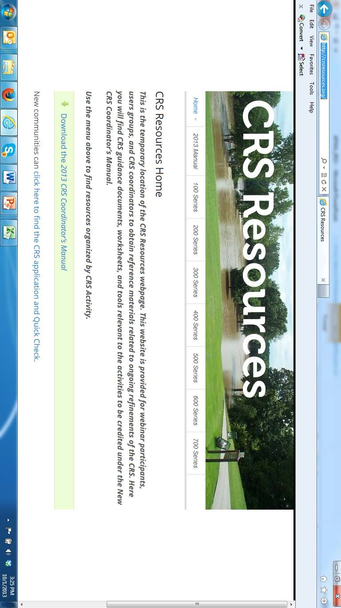
•
•
For more information www.fema.gov http://crsresources.org/
ter for chnology

Slide 61
Questions?
Thank you.

Slide 62



Contact Information
Monica Farris - mateets@uno.edu
Tara Lambeth - tlambet1@uno.edu
Online Resources –
www.uno.edu/chart
Follow UNO-CHART

