Slide 1
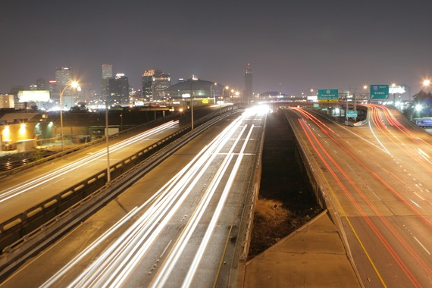
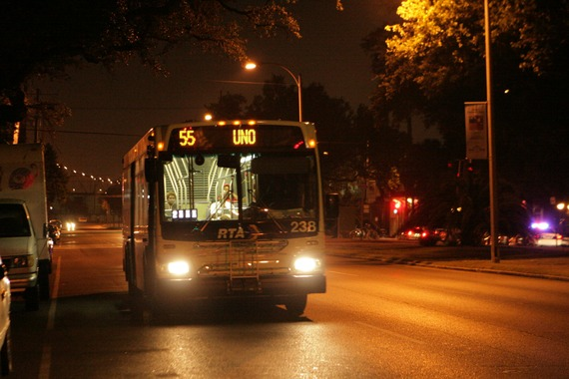

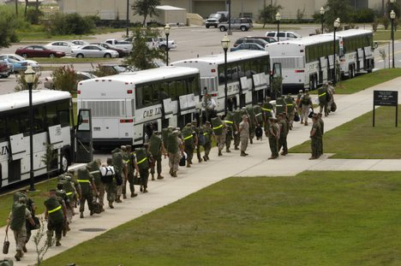
Resilience and Vulnerable Populations
John L. Renne, Ph.D., AICP
Associate Provost, Director and Associate Professor
University of New Orleans
Senior Visiting Research Associate
Transport Studies Unit, School of Geography and the Environment
University of Oxford

Slide 2
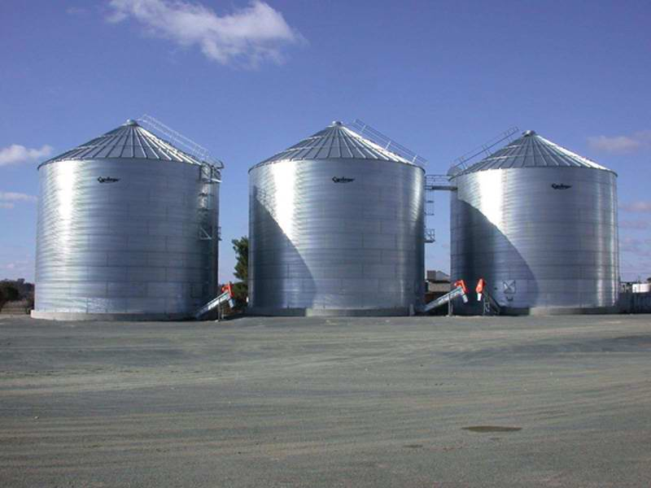
Professional Silos
Emergency
Public
Transportation
Management
Safety

Slide 3
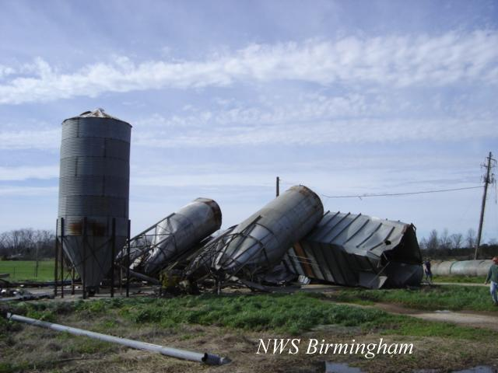
Disasters Don’t Care about silos

Slide 4
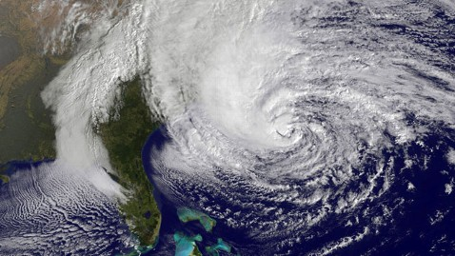
They Also don’t Care about Political Boundaries

Slide 5
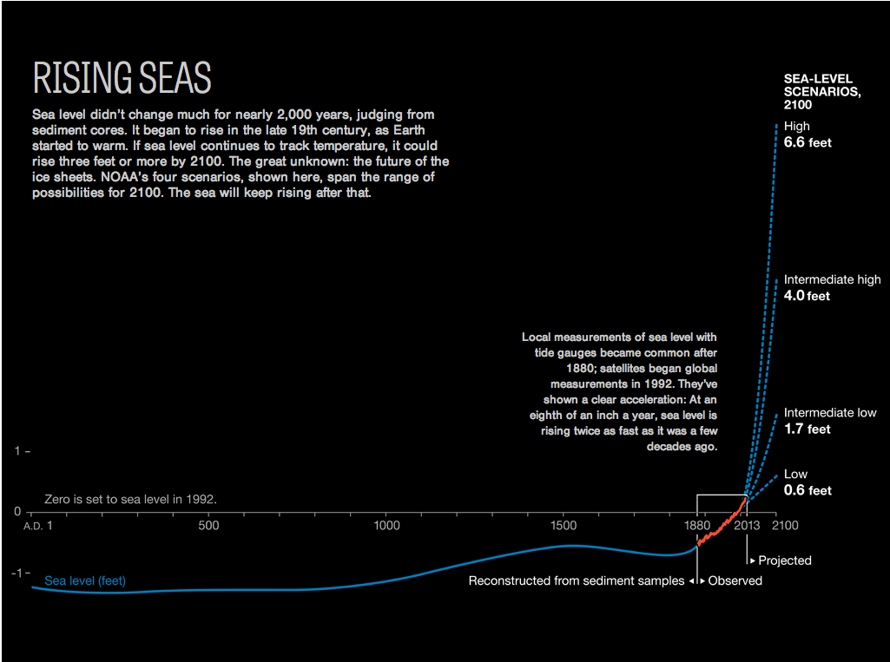


Slide 6
Why Transportation Planners should Plan for Disasters

Slide 7
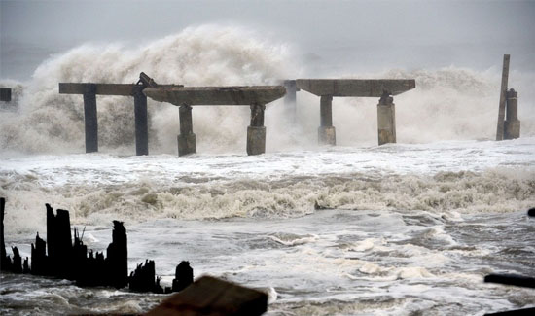
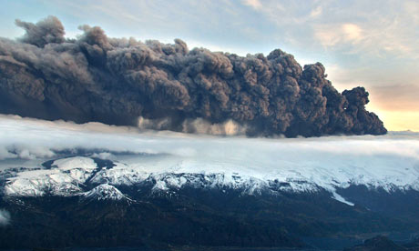
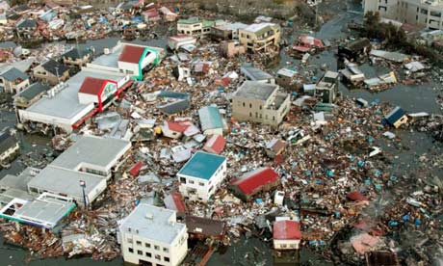
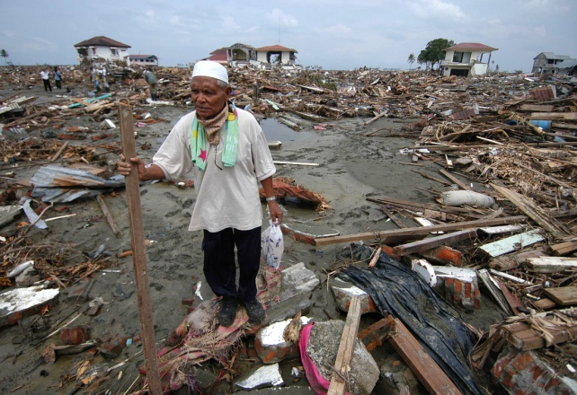
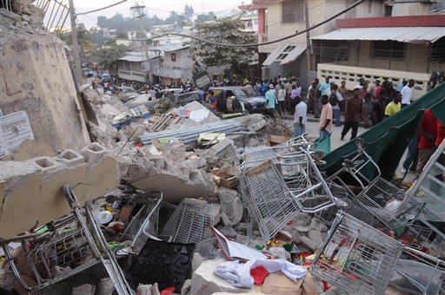
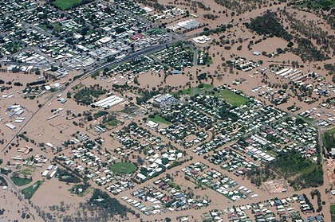
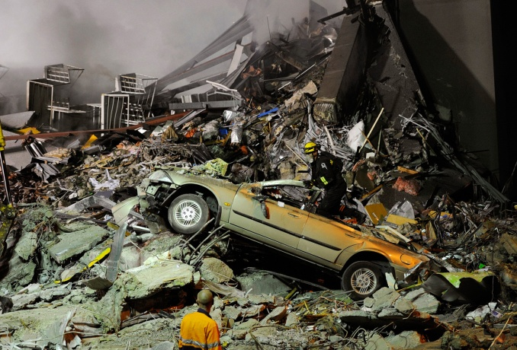
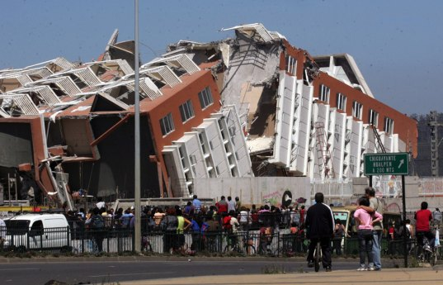
New York
Iceland
Japan
Indonesia
Haiti
Australia
New Zealand
Chile

Slide 8
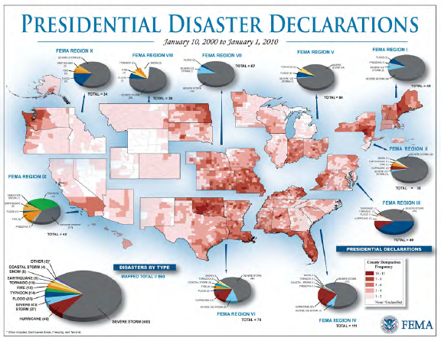

Slide 9
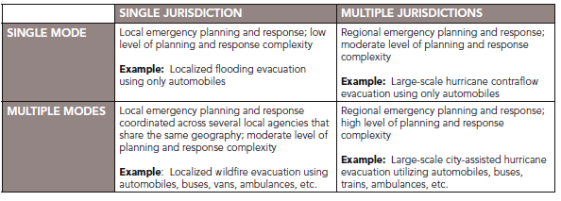

Slide 10
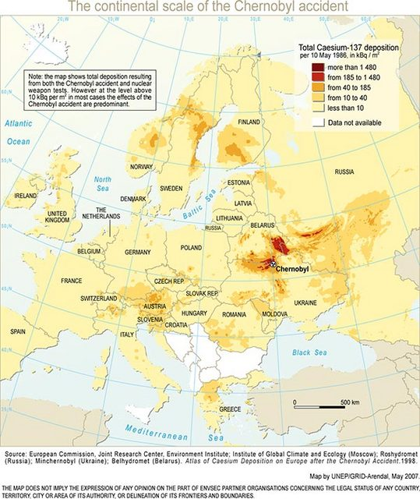
From 1989 – 2009, 953 disasters killed 88,671 people in Europe, effected more than 29 million others and caused a total of $269 billion (USD) in economic losses. Compared to the rest of the world, economic loss per capita is high in Europe partly because it is very densely populated.
–United Nations

Slide 11
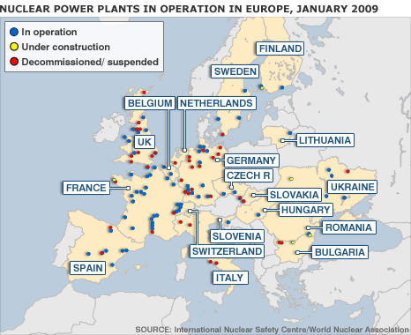
From 1989 – 2009, 953 disasters killed 88,671 people in Europe, effected more than 29 million others and caused a total of $269 billion (USD) in economic losses. Compared to the rest of the world, economic loss per capita is high in Europe partly because it is very densely populated.
–United Nations

Slide 12
Carless & Vulnerable Populations

Slide 13
Source: Census, ACS, 2009 American Community Survey 1-Year Estimates
Notes:
13

Slide 14
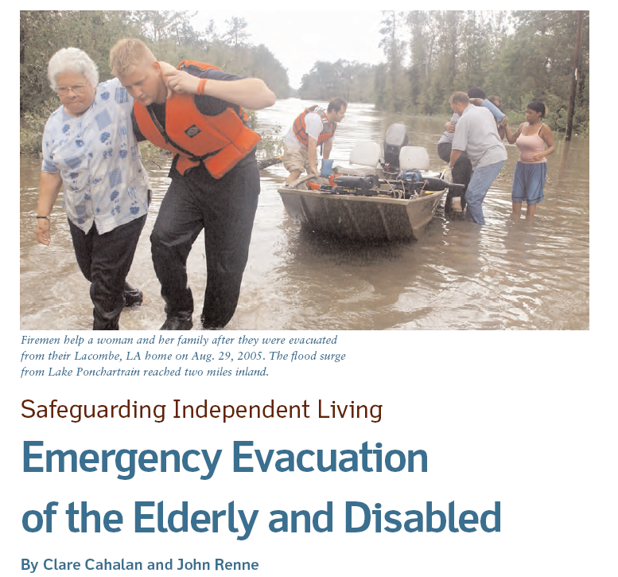
Of the 1,800 deaths during Hurricane Katrina,
71% of the victims were older than 60, and
47% were over the age
of 75.

Slide 15
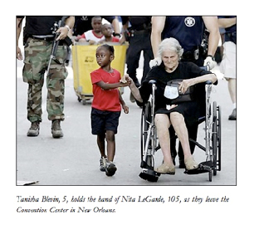
Evacuation accessibility is mandated under the
Americans with Disabilities Act.
Executive Order 13347 in 2004 requires federal agencies to address the needs of the disabled in their emergency preparedness plans and assist state, local, and tribal governments in doing the same. It also created the Interagency Coordinating Council on Emergency Preparedness and Individuals with Disabilities, and charged it with “ensuring that the Federal government appropriately supports safety and security for individuals with disabilities in situations involving disasters.”

Slide 16
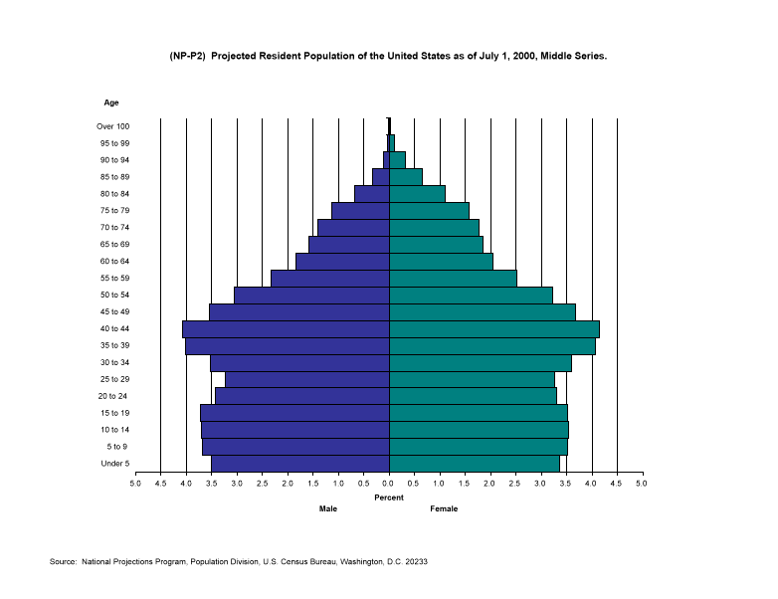
Growing Trend of Elderly Populations
2009
Persons 65+ =
39.6 million
(12.9% of Americans)

Slide 17
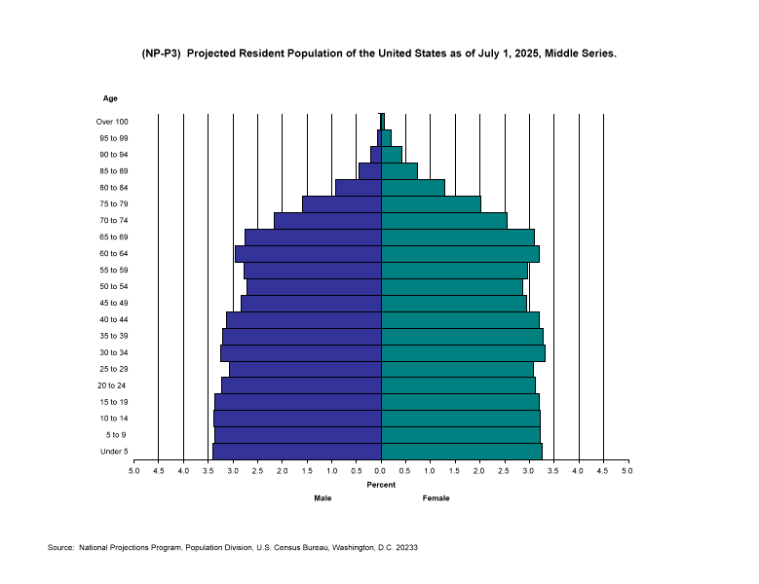
Growing Trend of Elderly Populations
2009
Persons 65+ =
39.6 million
(12.9% of Americans)
2030
Persons 65+ =
72.1 million
(19% of Americans)

Slide 18
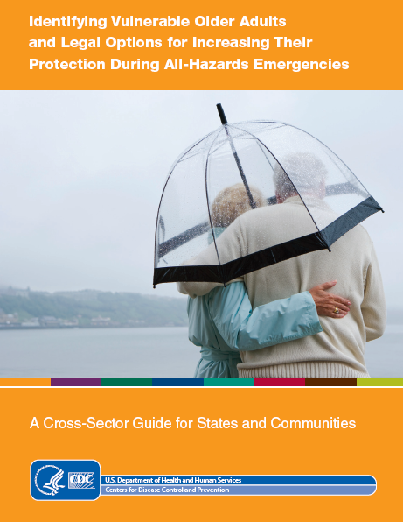
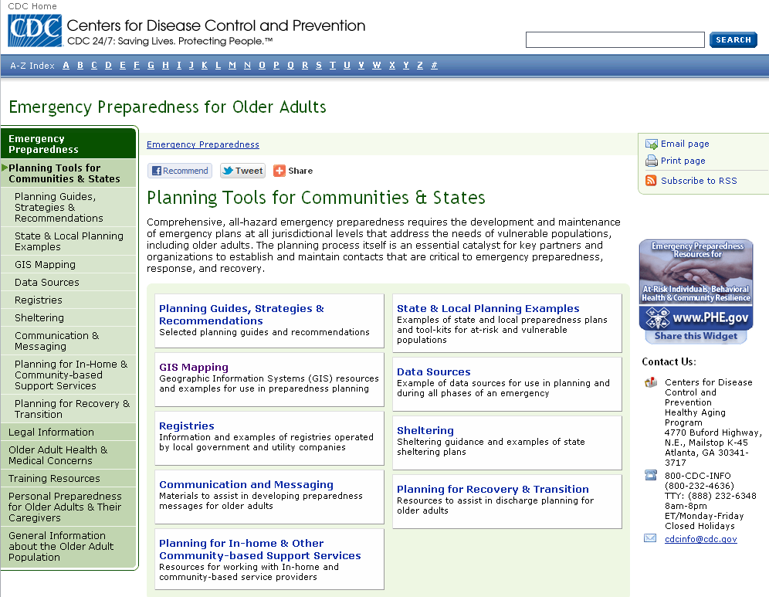
http://www.cdc.gov/aging/emergency/planning_tools/index.htm

Slide 19


Chapter on Evacuation Planning for Vulnerable Populations:
Lessons from the New Orleans City Assisted Evacuation Plan

Slide 20
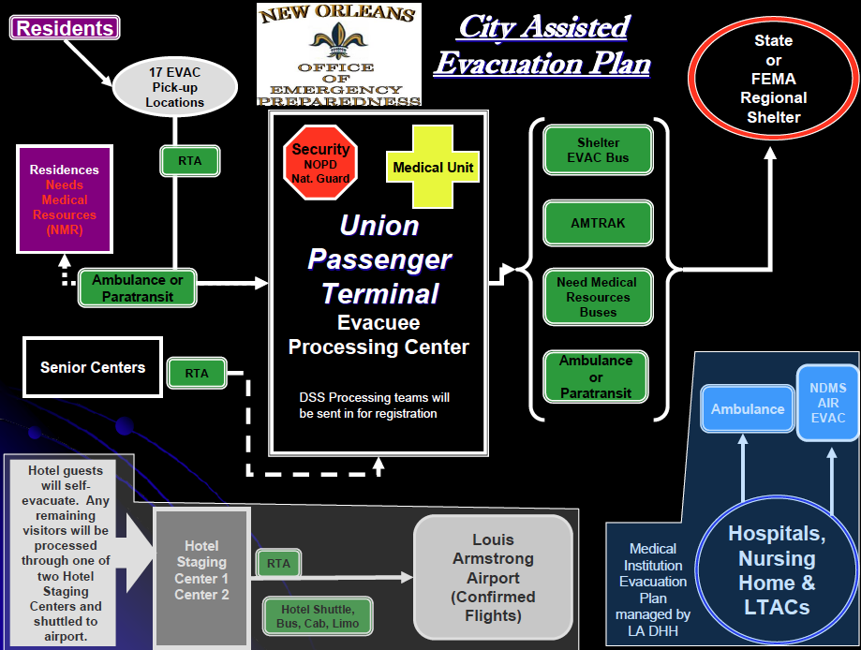
New Orleans
Notes:
2 August 2001
20

Slide 21
New Orleans
New Orleans Office of Homeland Security and Public Safety
New Orleans Office of Emergency Preparedness
New Orleans Police Department (NOPD)
New Orleans Fire Department (NOFD)
New Orleans Mayor’s Office of Technology (MOT)
New Orleans Emergency Medical Services (EMS)
New Orleans Health Department (NOHD)
New Orleans Council on Aging (NOCA)
Jefferson Parish OEP
Plaquemines Parish OEP
St. Bernard Parish OEP
Port Authority Harbor Police
Louisiana Office of Homeland Security and Emergency Preparedness (LOHSEP)
Louisiana Department of Transportation and Development (LOTD)
Louisiana Department of Social Services (LDSS)
Louisiana Department of Health and Hospitals (LDHH)
Louisiana National Guard (LNG)
Louisiana State Police (LSP)
AMTRAK
Morial Convention Center (MCC)
Union Passenger Terminal (UPT)
Louis Armstrong Airport (MSY)
Regional Transit Authority (RTA)
Louisiana Society for the Prevention of Cruelty to Animals (SPCA)
American Red Cross (ARC)
New Orleans Hotel and Lodging Association (NOHLA)
Lakefront Airport (LA)
Citizens Emergency Response Team (CERT)
Notes:
2 August 2001
21

Slide 22
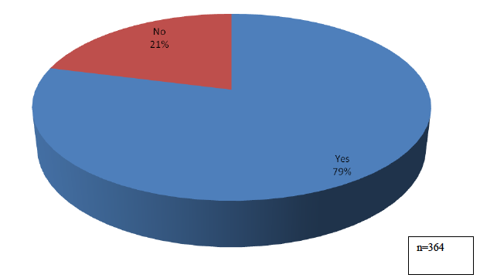
New Orleans
For those that were registered for CAEP:
Would you use CAEP again?
Source: Kiefer, Jenkins and Laska, 2009

Slide 23

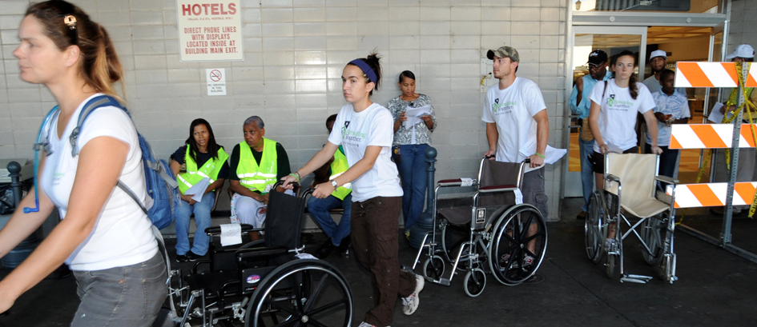
New Orleans

Slide 24

Transportation Resilience

Slide 25


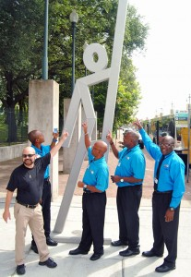

Evacuspots

Slide 26
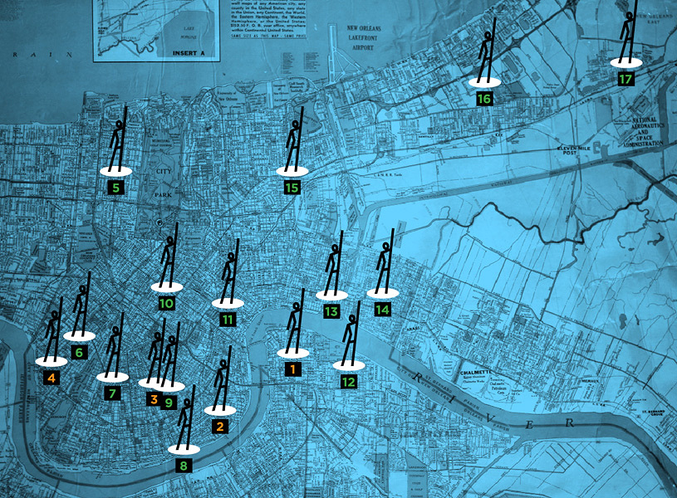

Slide 27
National Study on Carless and Special Needs Evacuation Planning
The objective of this study was to research how state Departments of Transportation (DOTs), metropolitan planning organizations (MPOs), transit agencies, and local governments are considering, in the context of their emergency preparedness planning, the unique needs of carless individuals and people with specific and/or special needs.

Slide 28
National Study on Carless and Special Needs Evacuation Planning
Chicago
Miami
New Orleans
New York
San Francisco

Slide 30
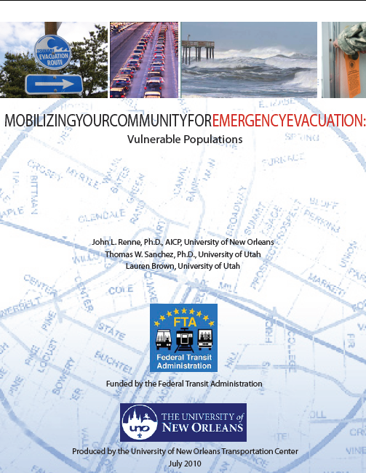
Purpose and Overview
Purpose
The purpose of Mobilizing Your Community for Emergency Evacuation: Vulnerable Populations Guidebook provides background on planning issues. The guidebooks follows the general outline provided in the guidebook with sections on:
• Planning Process
• Plan-Making
• Process Evaluation
• Recommendations

Slide 31
Chicago | Miami | New Orleans | New York | San Francisco
Center for Neighborhood Technology Chicago Metropolitan Agency for Planning Chicago Transit Authority Chicago Department of Transportation Illinois Department of Public Health Mayor’s Office for People with Disabilities Office of Emergency Management and Communications Regional Transportation Authority | Alliance for Aging, Inc. American Red Cross Community Partnership for the Homeless, Inc. Florida Department of Emergency Management Florida Department of Transportation Florida International University Miami Coalition for the Homeless Miami-Dade County Public Schools Miami-Dade Emergency Management Miami-Dade Transit Monroe County Board of County Commissioners Monroe County Emergency Management Monroe County Health Department South Florida Regional Planning Council The Arc of South Florida | American Red Cross Catholic Charities Evacuteer.org Natural Hazard Mitigation Association New Orleans Council on Aging New Orleans Homeland Security Regional Planning Commission University of New Orleans, Center for Hazards, Assessment, Response and Technology | Con Edison Metropolitan Transportation Authority New York City Department for the Aging New York City Department of Health and Mental Hygiene New York City Office of Emergency Management New York City Transit New York State Department of Transportation New York University Public Safety New York University Wagner Graduate School of Public Service The City University of New York – John Jay College World Cares Center | San Leandro City Emergency Preparedness Eden Medical Center Alta Bates Sutter Health Children’s Hospital and Research Center Livermore-Pleasanton Fire Department Alameda Sheriff’s Office City of San Francisco Department of Emergency Management City of Oakland Office of Emergency Services Berkeley Unified School District American Red Cross Holy Names University Mills College California College of the Arts City of Oakland Parks and Recreation CARD, Collaborating Agencies Responding to Disasters Alameda County Medical Center City of Oakland Department of Human Services Private Consultant

Slide 32
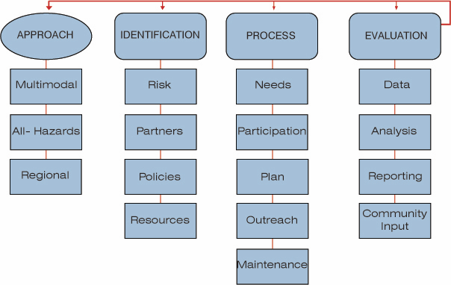
Guidebook Framework

Slide 33
Creating a Planning Process for Special Needs and Carless Populations

Slide 34
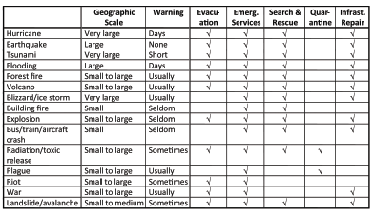
Creating a Planning Process
• Disasters and Types of Evacuations

Slide 35
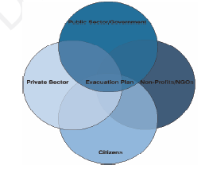
Creating a Planning Process
• Partners and Roles
  Counties, Local Utilities, Municipalities, Transit Agencies, MPOs, State Agencies, Emergency Management Agencies, Special Needs Providers, Private Bus Companies, Community Emergency Response Teams (CERTs), Community Transportation Providers, Non-English Speaking Community Leaders, Area Agency on Aging, Other Advocates

Slide 36
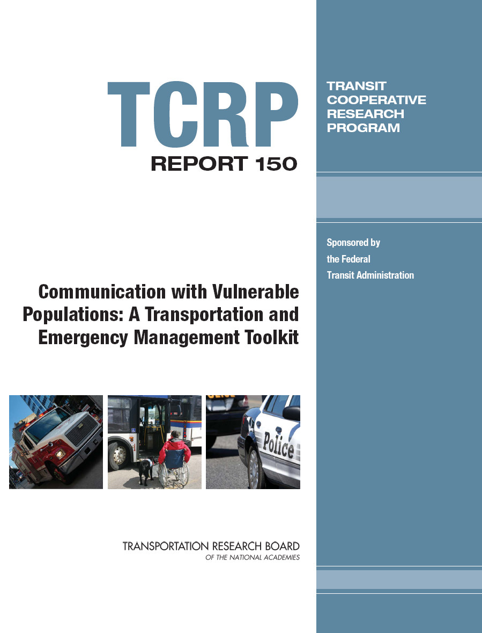
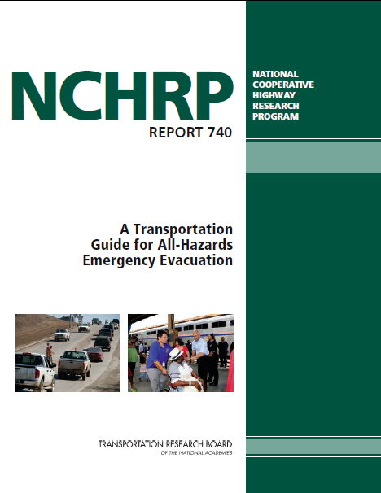

Slide 37
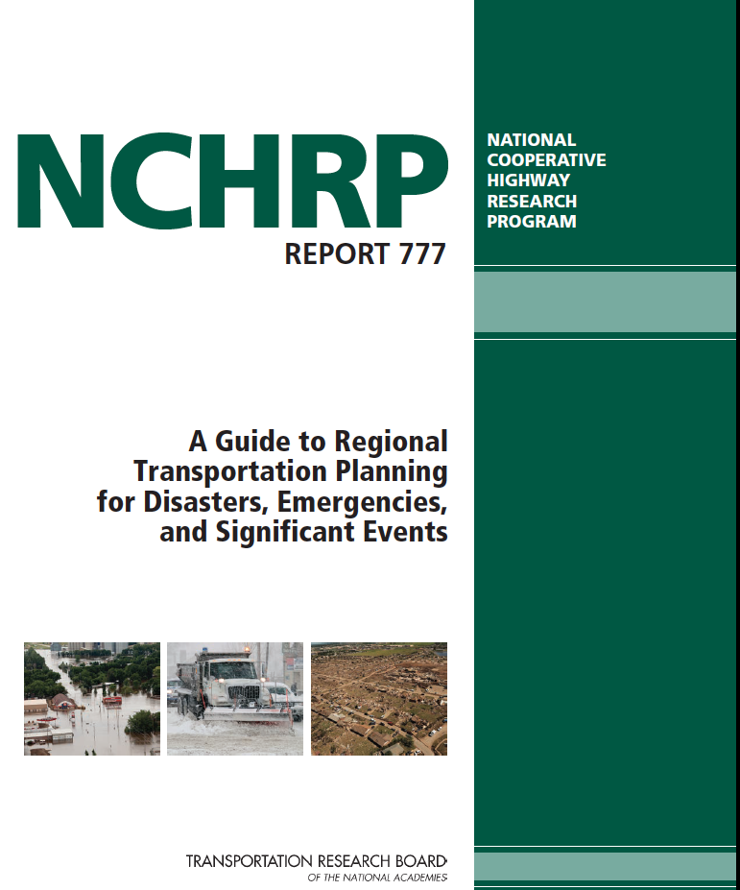

Slide 38
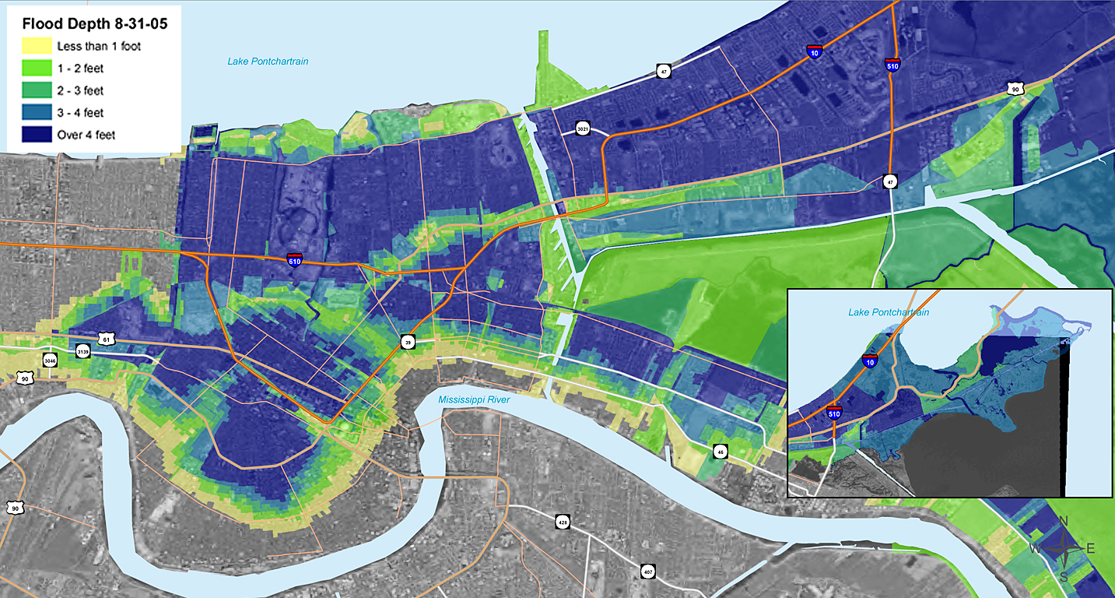

Slide 39
The Urban Land Institute Plan – November 2005
FEMA’s ESF 14: Long-term Recovery Planning
Louisiana Recovery Authority
The Bring New Orleans Back Commission
The New Orleans City Planning Commission
The Lambert Plans
The Unified New Orleans Plan
Office of Recovery Management – Ed Blakely
New Orleans Master Plan for the 21st Century
Planning for Recovery

Slide 40
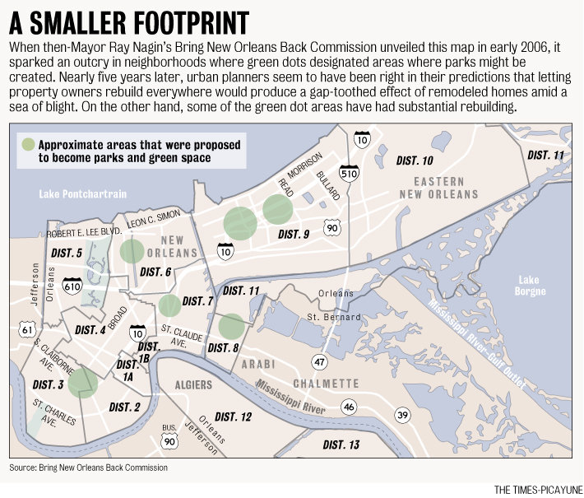

Slide 41
IMPLEMENTATION
FUNDING
Unified New Orleans Plan
UNIFIED PLAN
BNOB
COMMISSION
LOUISIANA
SPEAKS
UNOP
DISTRICT
and
NEIGHBORHOOD
PLANNING`
LAMBERT
PLANS
FEMA
ESF-14
INDEPENDENT
NEIGHBORHOOD
PLANS

Slide 42

On, Jan. 8, 2007, Dr. Ed Blakely appointed Director of the Office of Recovery Management
Recovery Strategy:
1. Healing and consultation
2. Improving safety and security
3. 21st century infrastructure
reconfiguration
4. Economic diversification
5. Develop a sustainable settlement pattern
Recovery Czar

Slide 43
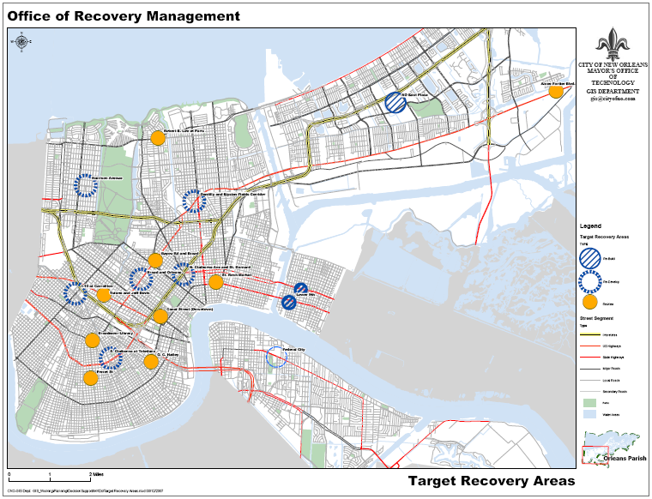
Targeted Recovery

Slide 44

Master Plan

Slide 45

Local Boom, National Bust

Slide 46

Deepwater Horizon

Slide 47

Deepwater Horizon

Slide 48

To put this in the context of the Deepwater Horizon disaster, imagine that seventy percent of the 68,0000 square miles of oil that was floating in the Gulf of Mexico was destined to be consumed by America’s transportation sector. The area covered by the oil intended for the transportation sector would cover an area slightly larger than the entire state of Pennsylvania (47,600 square miles). Perhaps more shocking is that despite the massive amount of oil spilled in Gulf of Mexico, the quantity used just by the transportation sector would be consumed in just under 3 days.
A Transportation Disaster?

Slide 49
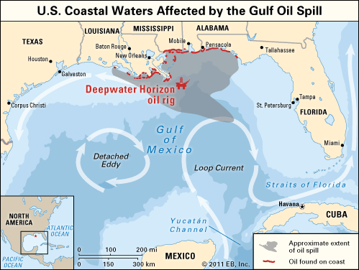
A Transportation Disaster?

Slide 50
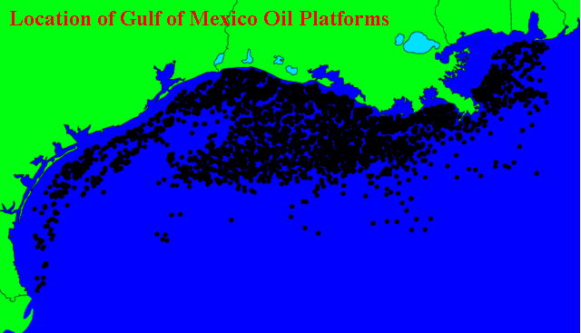

Slide 51
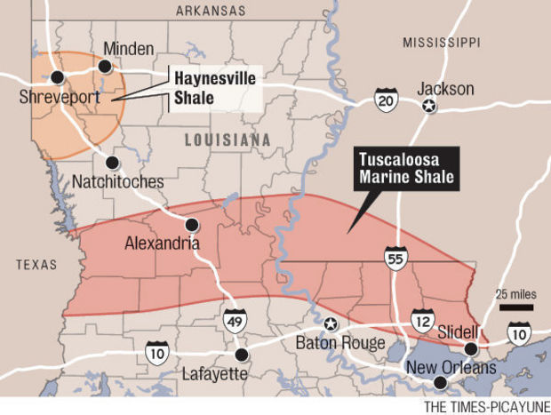
Oil and Gas Boom

Slide 52
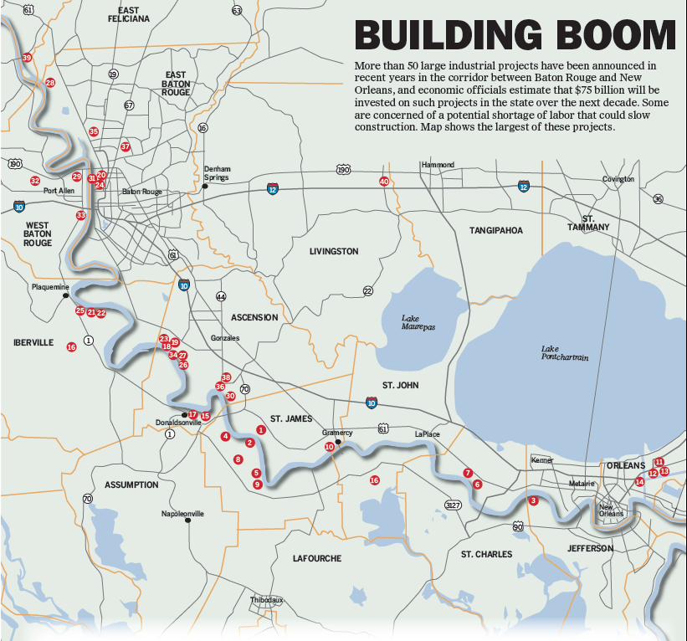
$90+ Billion Investment

Slide 54
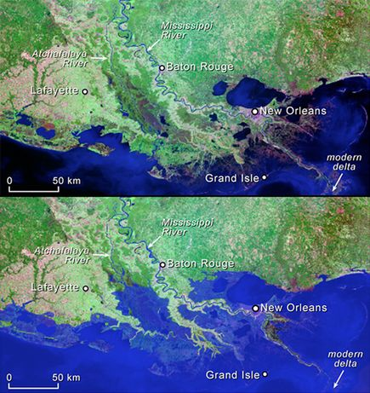

Slide 55
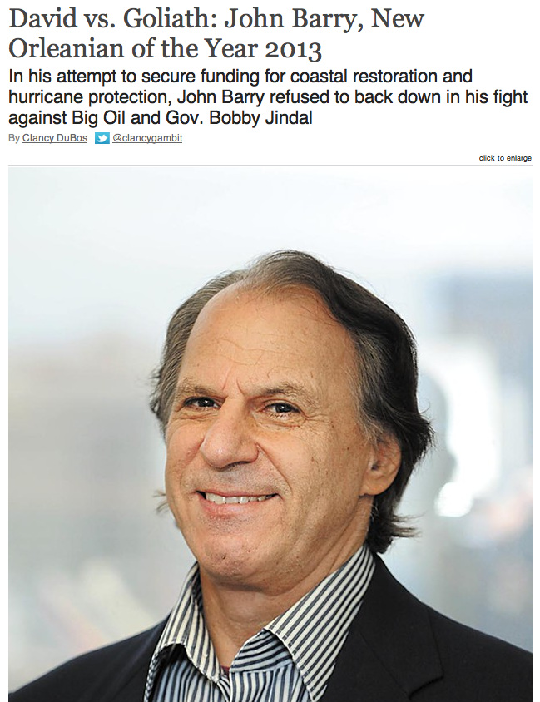

Coastal Crusader

Slide 56

“By 2012, New Orleans had less than half the
amount of transit service that was available pre-
Katrina – while our population had rebounded to 86% of its pre-Katrina size.”
Declining Transit Service

Slide 57
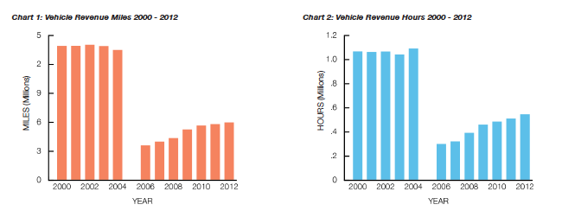

Slide 58
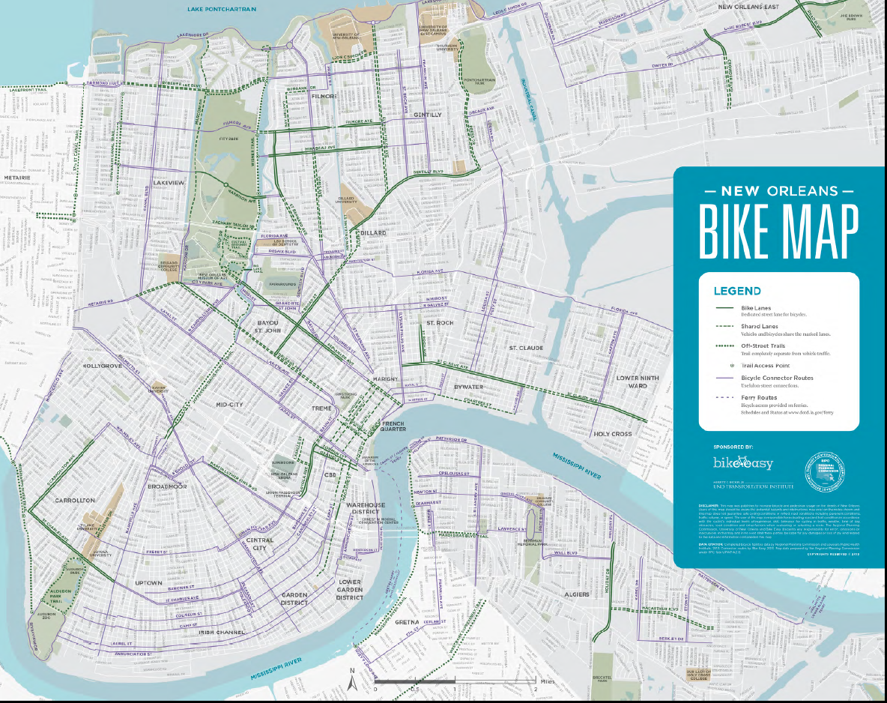
100 Miles of Bike Facilities

Slide 59
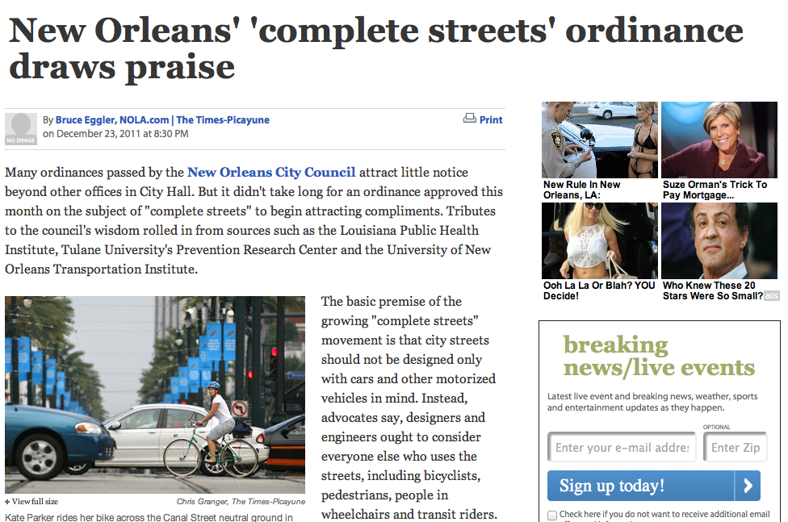
Complete Streets Ordinance

Slide 60
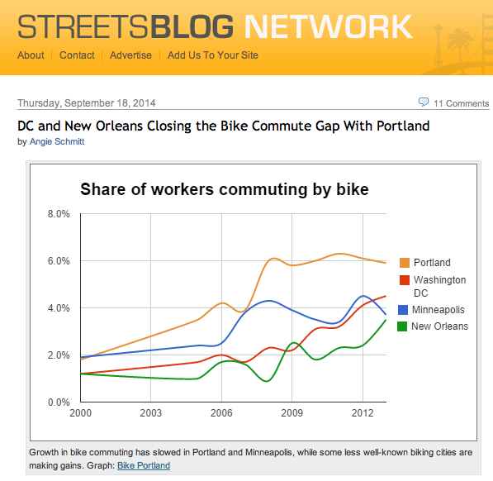

Slide 61
Thank
You
Contact Information:
John L. Renne, Ph.D., AICP
jrenne@uno.edu
(504) 717-1744

