Slide 1
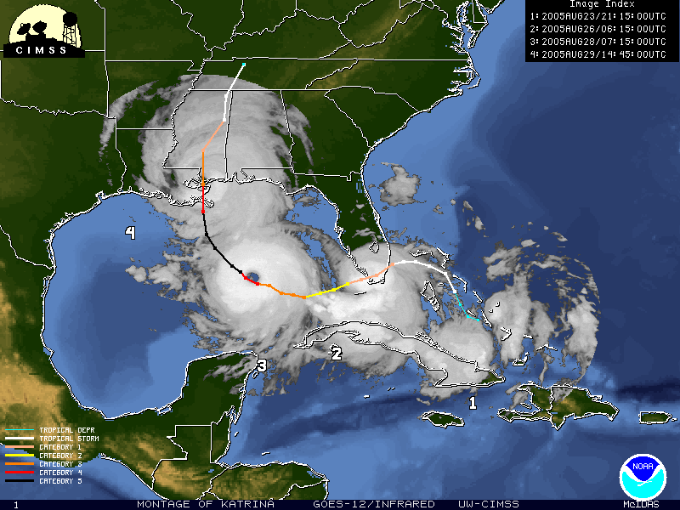
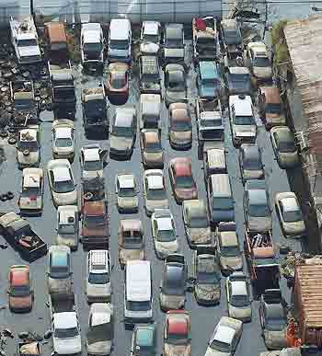
Flood control, risk reduction and preparedness 10 years after Katrina
John H Pardue
Louisiana State University

Slide 2
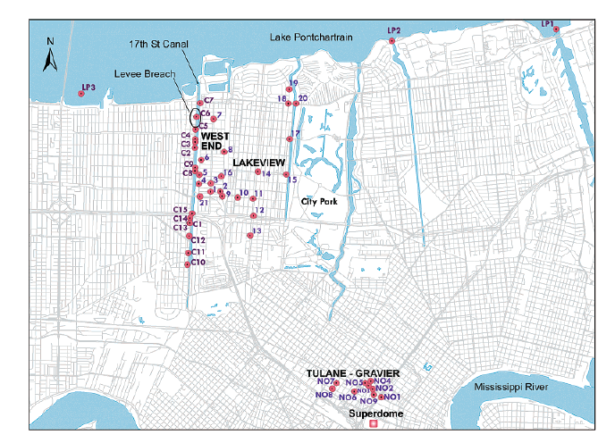
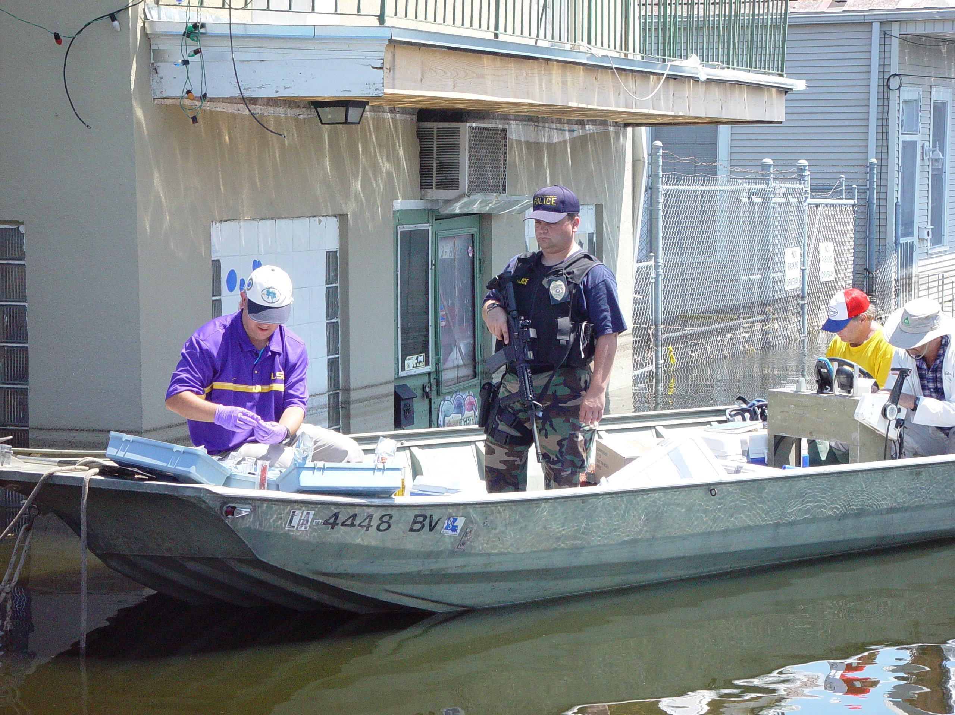
Conducted early environmental sampling of
Katrina floodwaters/sediments
Air sampling adjacent to debris piles
Analysis of debris handling procedures and
techniques
Analysis and prediction of bulk chemical storage
problems during flooding events

Slide 3
Where are we?
Flood control and surge attenuation
  Structural elements (Greater New Orleans Hurricane and Storm Damage Risk Reduction System)
  Non-structural elements (Louisiana Coastal Master Plan 2012)
Environmental Risk
  Debris removal, landfills and contaminated soil

Slide 4
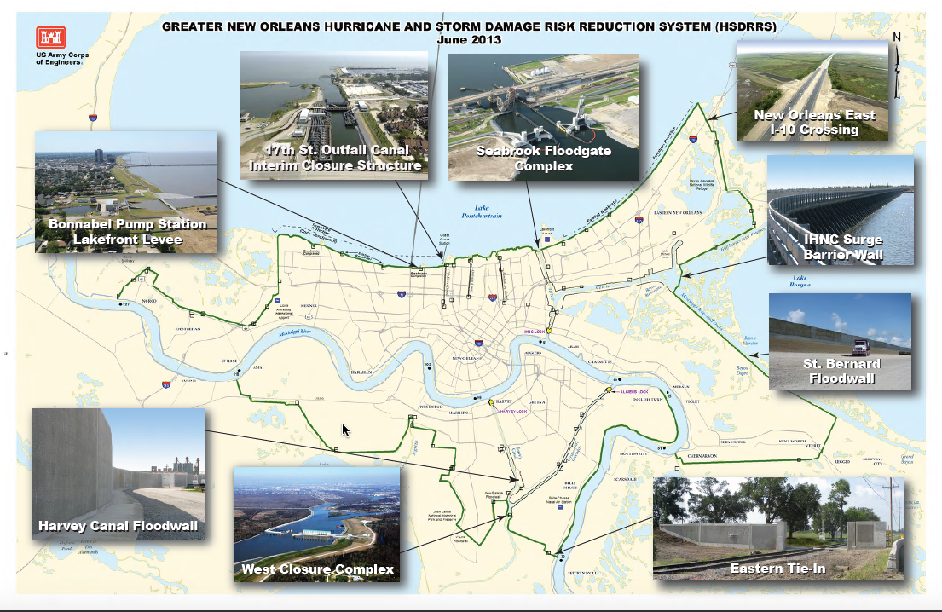
Total cost: 14.6 billion

Slide 5
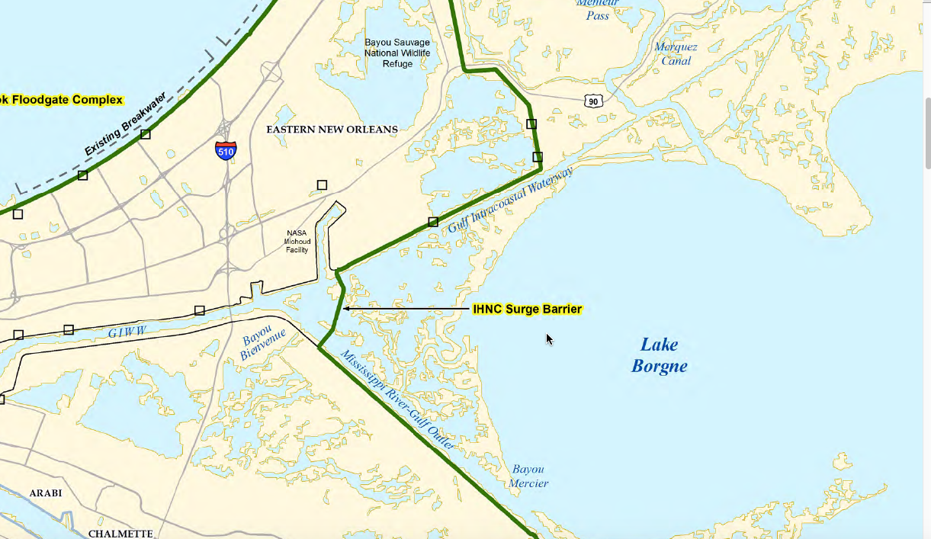

Slide 6
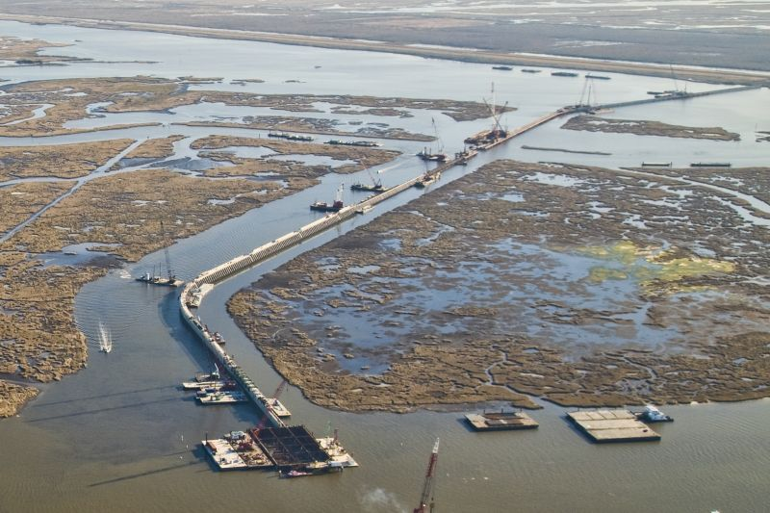
IHNC Surge Barrier

Slide 7
The criteria for commencing IHNC gate closure operations are:
Water elevations of 3 ft or greater in Lake Borgne
A storm is predicted to make landfall in the ‘area’ within three days
The general procedure is as follows:
  Closure of the Seabrook Gate by USACE, approximately 20 min;
  Closure of the Bayou Bienvenue Gate by USACE, approximately 20 min
  Closure of the GIWW Sector Gate by USACE, approximately 2 hours for sector gate and 7 hours for barge gate.
  Closure of the IHNC Navigation Lock by USACE.
Storm occurs
  GIWW Sector gate opened first (when maximum water elevation differential is ~3 ft) by USACE, approximately 2 hrs.
  Bayou Bienvenue Gate is opened by USACE, approximately 2 hrs.
  Once Lake Pontchartrain has drained, Seabrook Gate opened by USACEG, approximately 2 hrs.

Slide 8
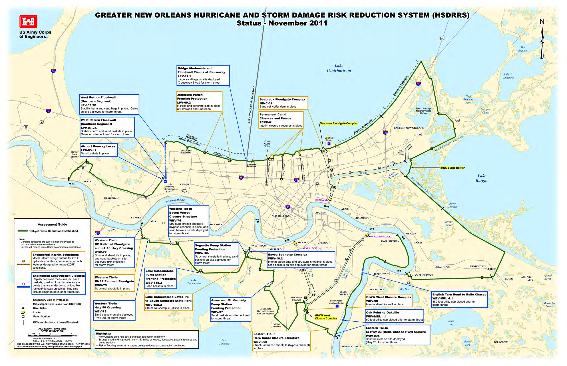

Slide 9
Total cost: 14.6 billion

Slide 10
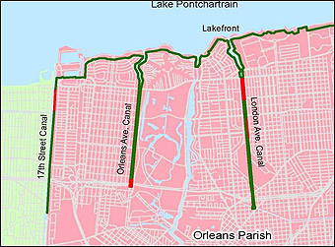
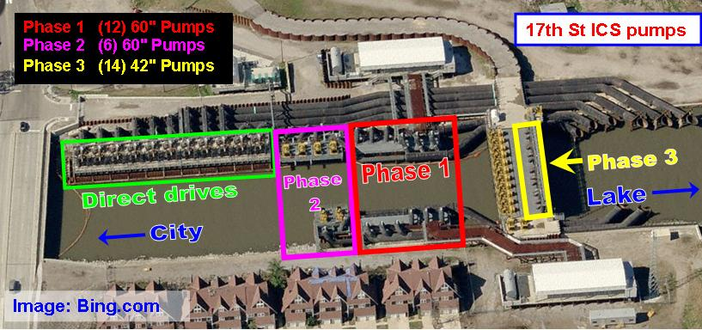
17th Street Canal
Interim Closure
Structure
7,600 cfs

Slide 12
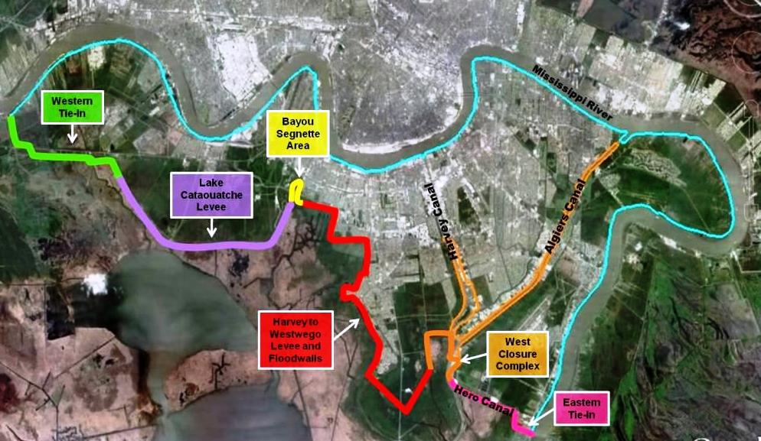

Slide 13
How do you build a system in 5 years?
NEPA (allowed USACE to to break up comprehensive Environmental Impact Statements (EISs) into smaller units of assessment)
Contracts (Design-build; early contractor involvement)
Non-traditional techniques (deep soil mixing, wick drains)

Slide 14
NEPA
National Environmental Policy Act
  Establishes environmental review processes that apply to governmental actions
  Seek reasonable alternatives to actions that harm the environment
  An Environmental Impact Statement is prepared, public comment and review, followed by review by the Environmental Protection Agency
  Very long process

Slide 15
NEPA (alternative arrangement)
In an emergency, an alternative arrangement is possible for compliance with NEPA
  Implemented in consultation with the Council on Environmental Quality, state and federal resource agencies
  Breaks impact studies up into smaller pieces directed at each individual action
  Still substantial alternatives discussed and mitigation efforts, still a significant public comment period

Slide 16
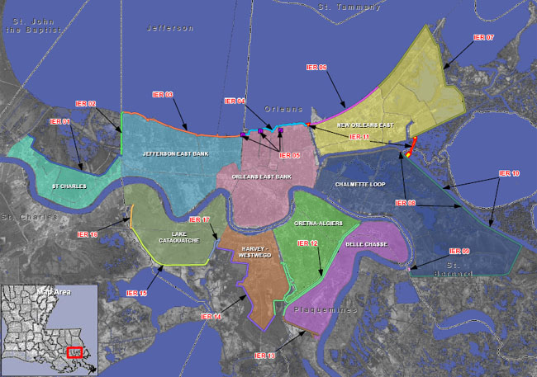

Slide 17
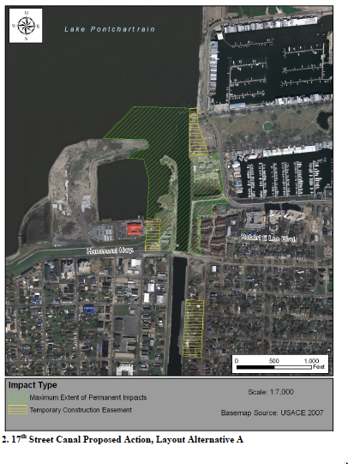
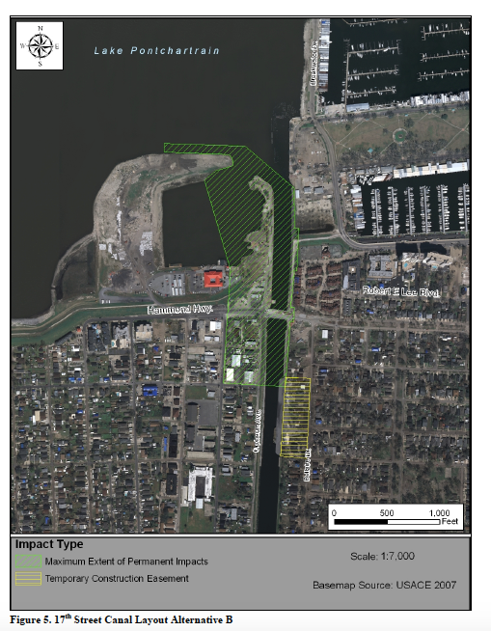
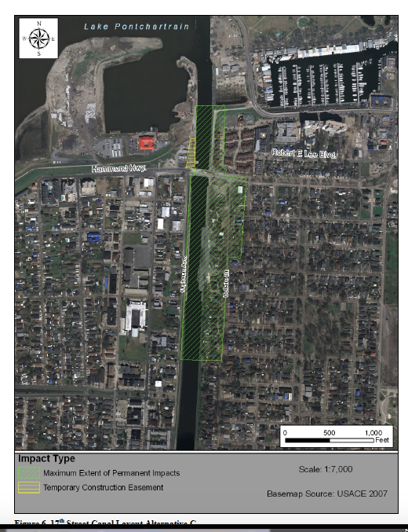

Slide 18
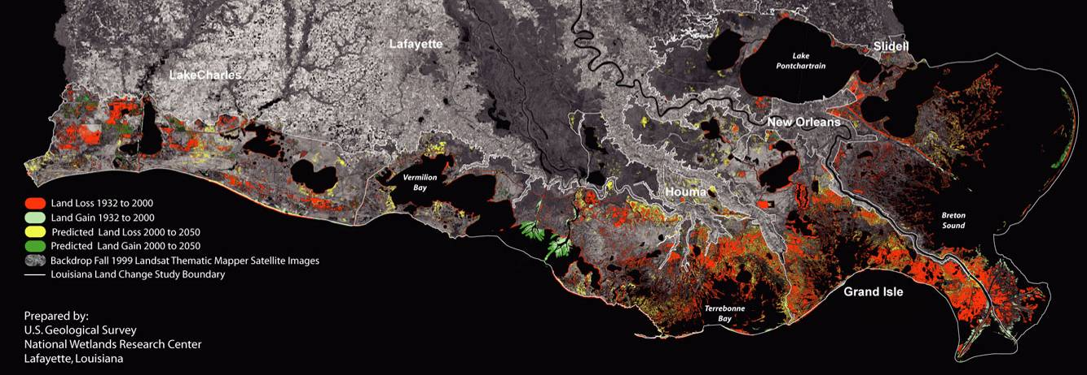
Coastal Land Loss
Over 2300 square miles lost since 1930
Notes:
18
18
18

Slide 19
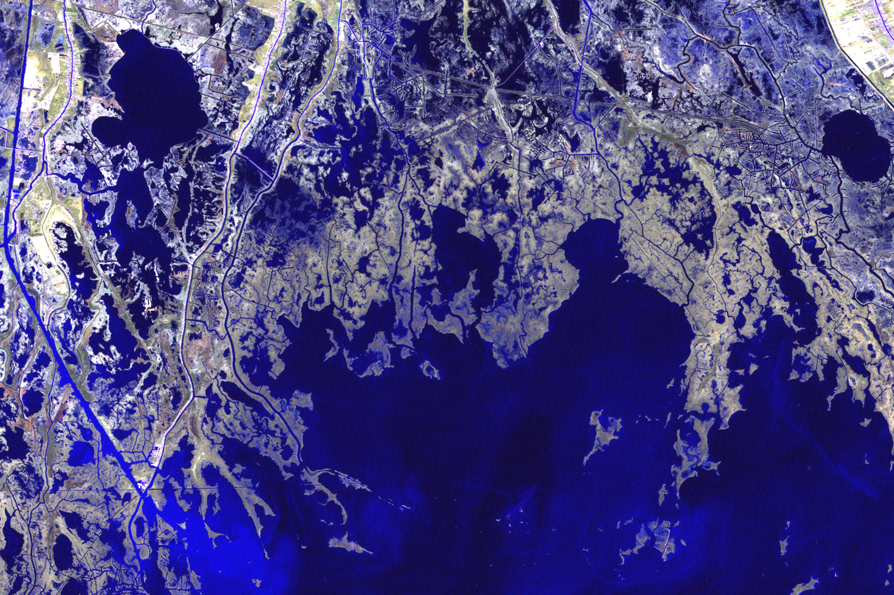
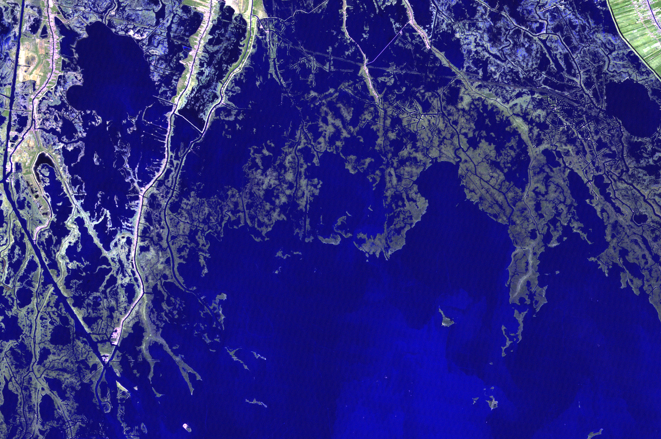
Terrebonne Land/Water Change 1988-2005
Chauvin
Lafourche
Point Barre
Dulac
Cocodrie
Landsat TM 1998
DeWitt Braud, LSU Coastal Studies Institute
Notes:
19
Cocodrie is in the lower left corner of the image.

Slide 20
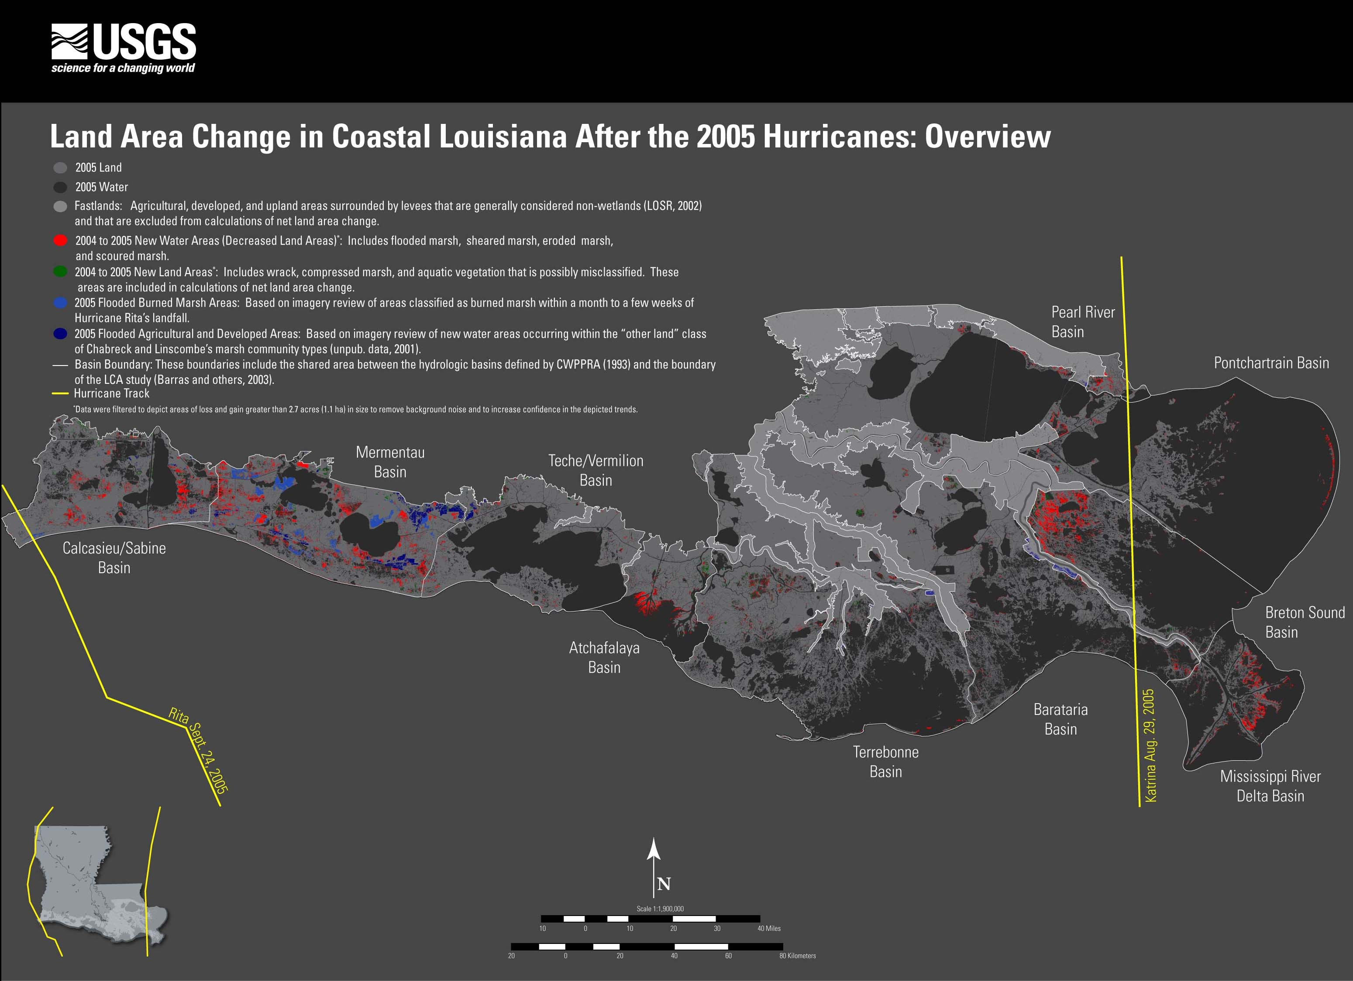

Slide 21
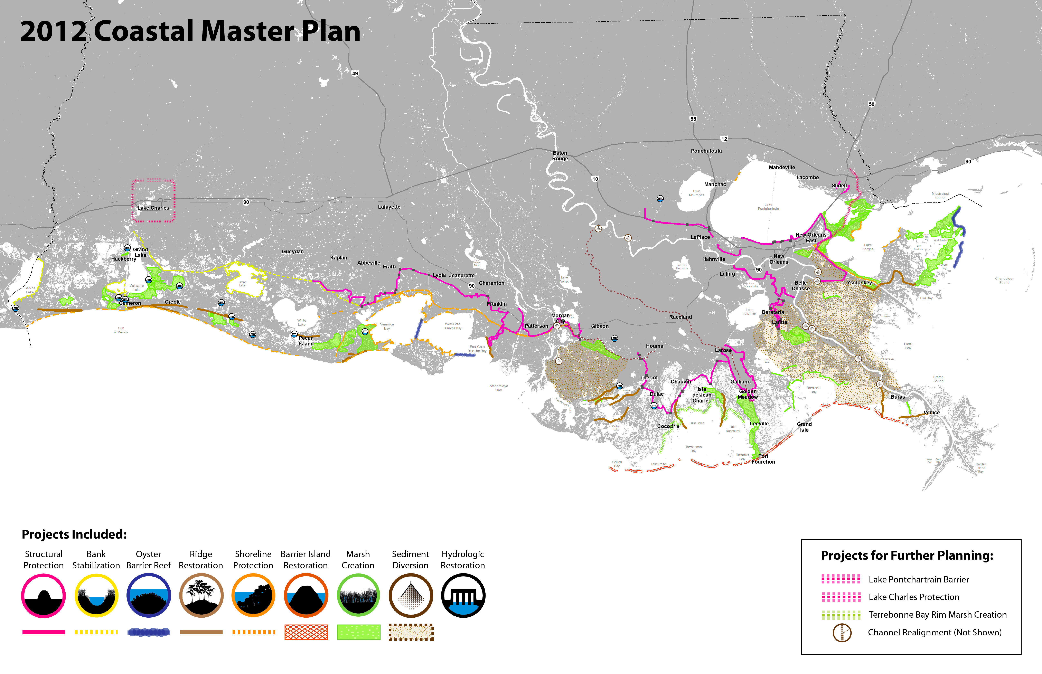

Slide 22
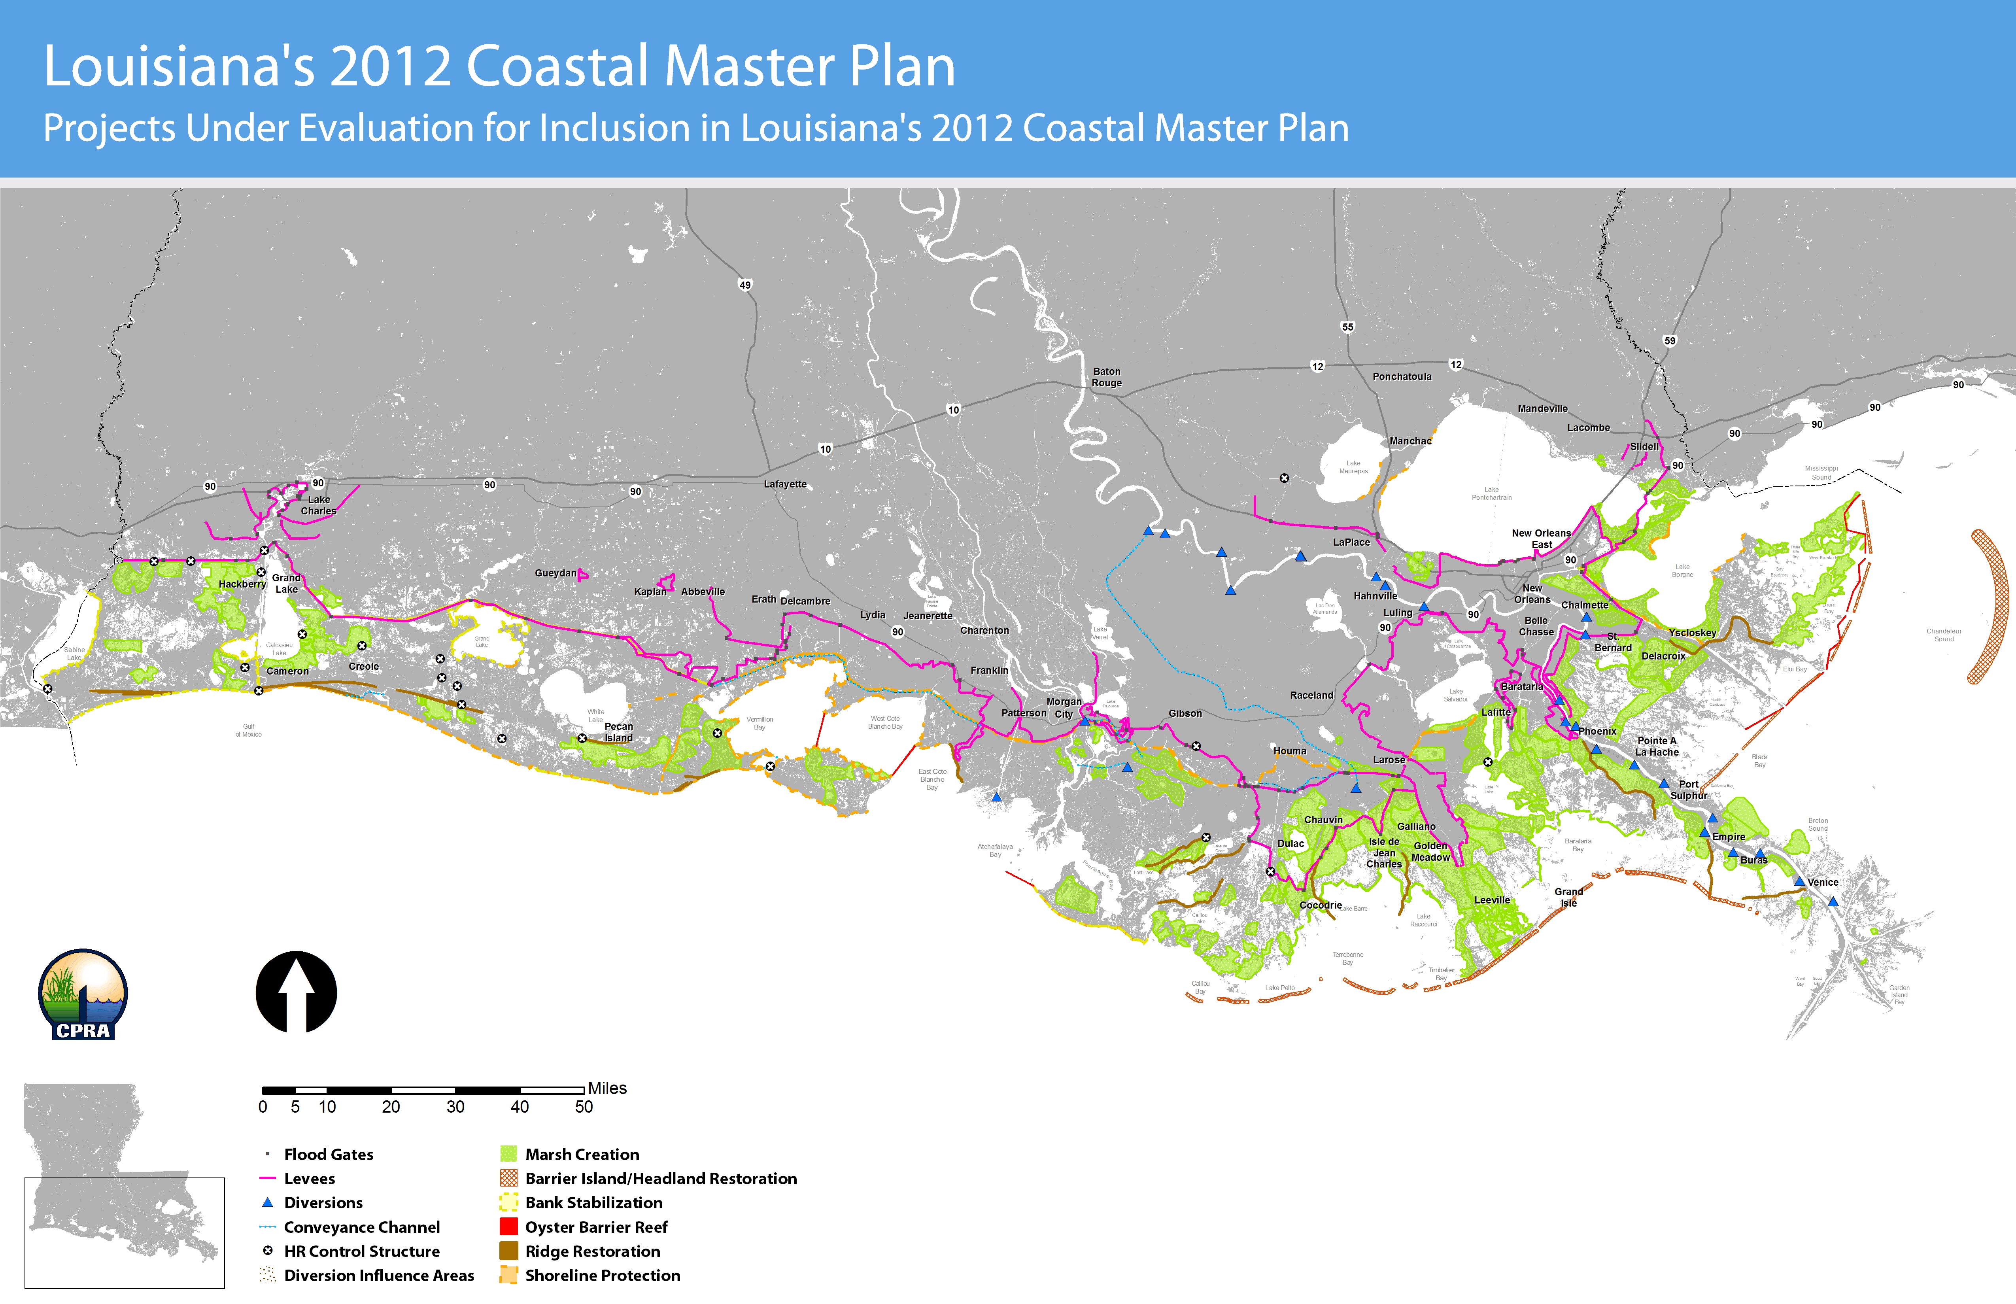
50 million dollar—estimated costs of all projects

Slide 23
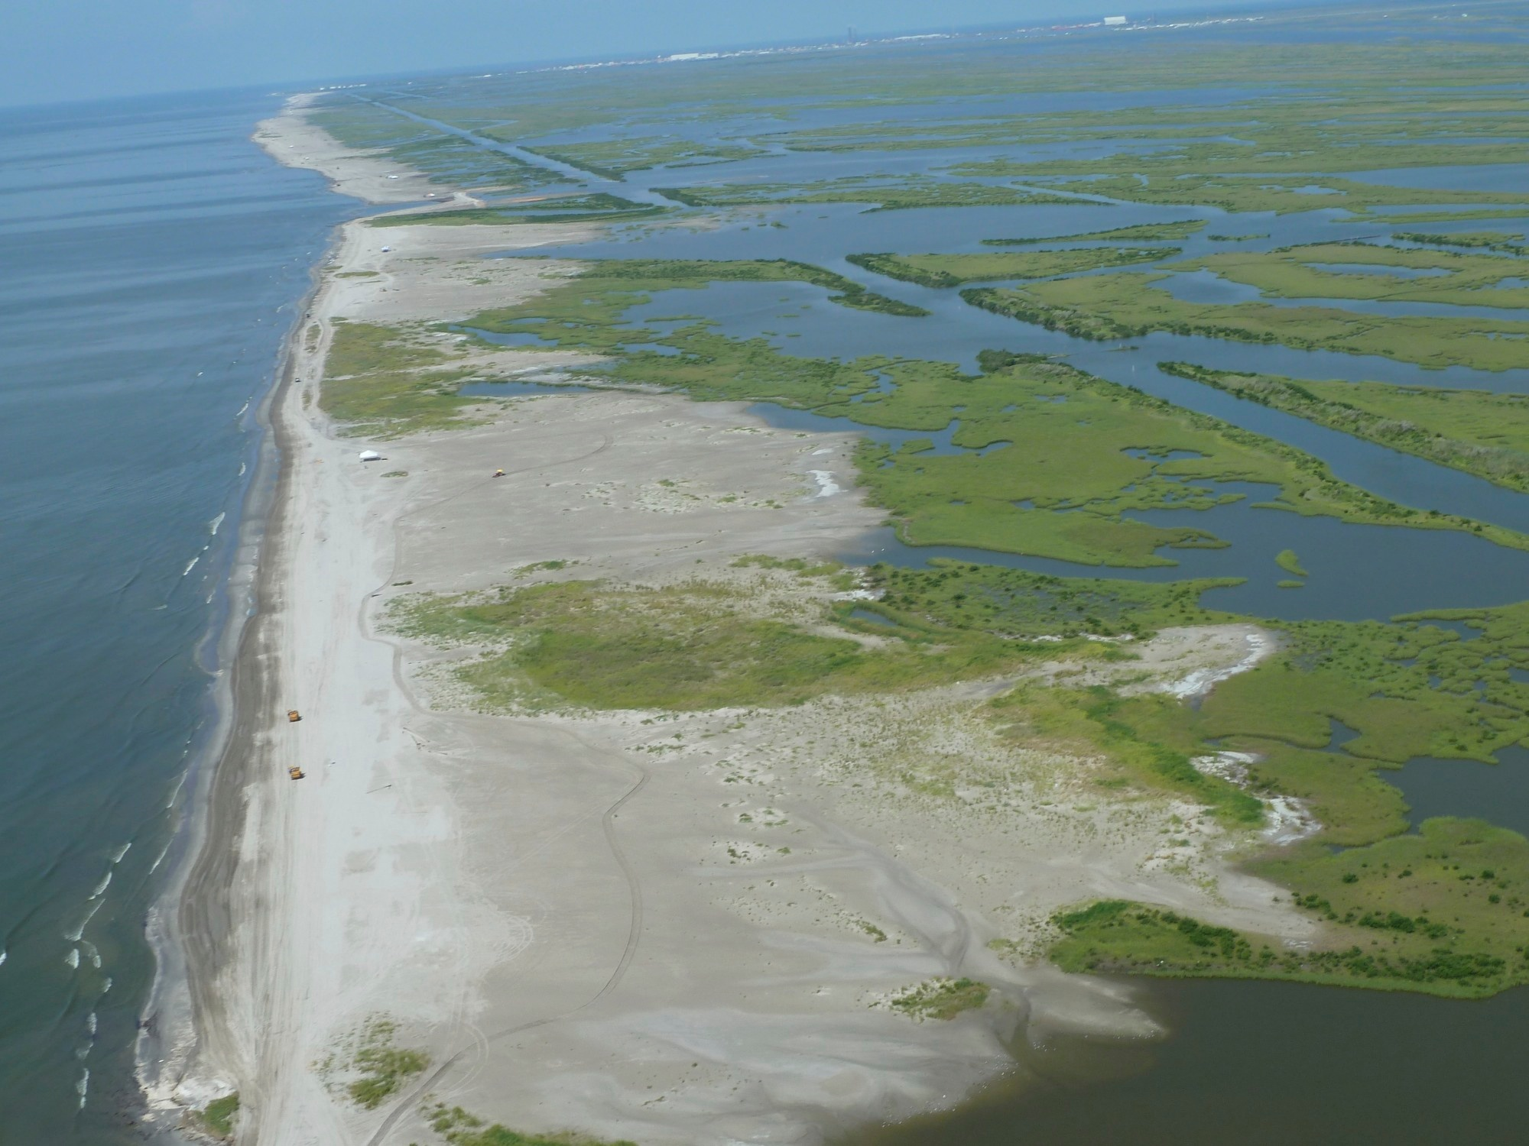
Caminada Headland Beach
(Fourchon Beach and Elmer’s Island)

Slide 24
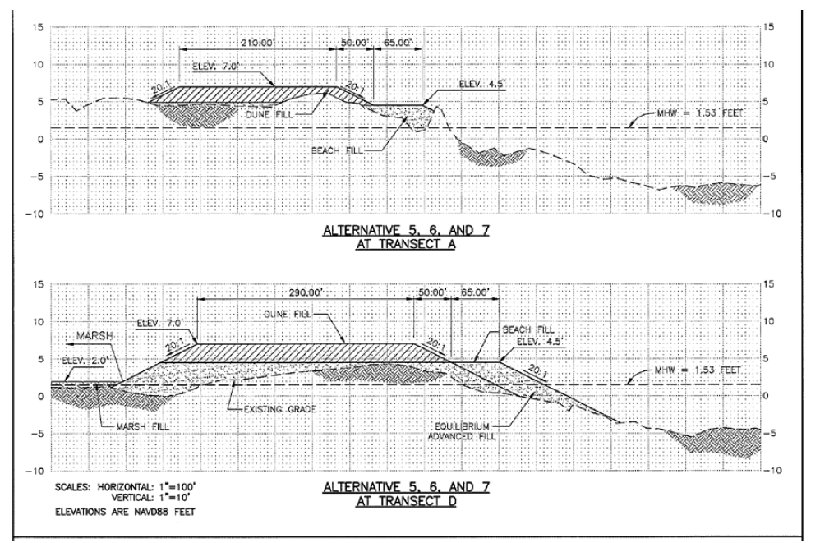
5.1 milliion cubic yards for the beach/dune
5,36 million cubic yards for the marsh

Slide 25
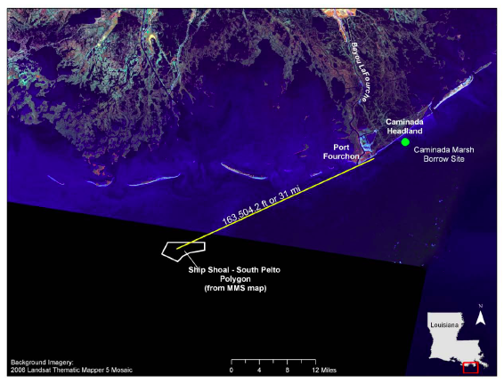

Slide 26
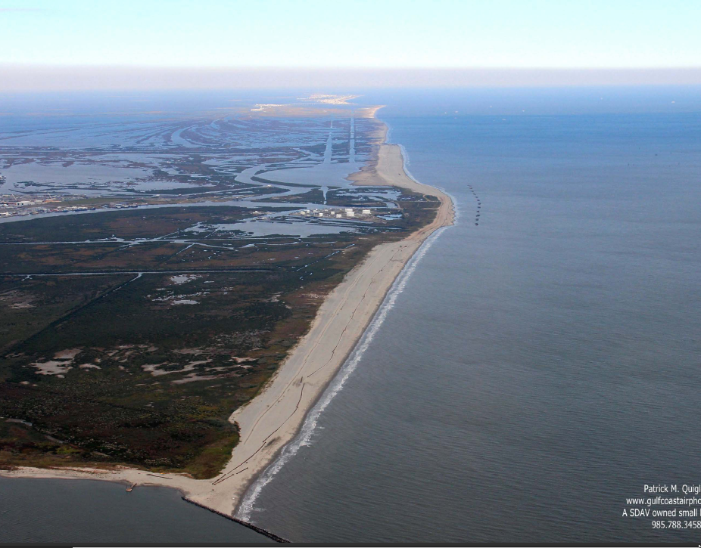

Slide 27
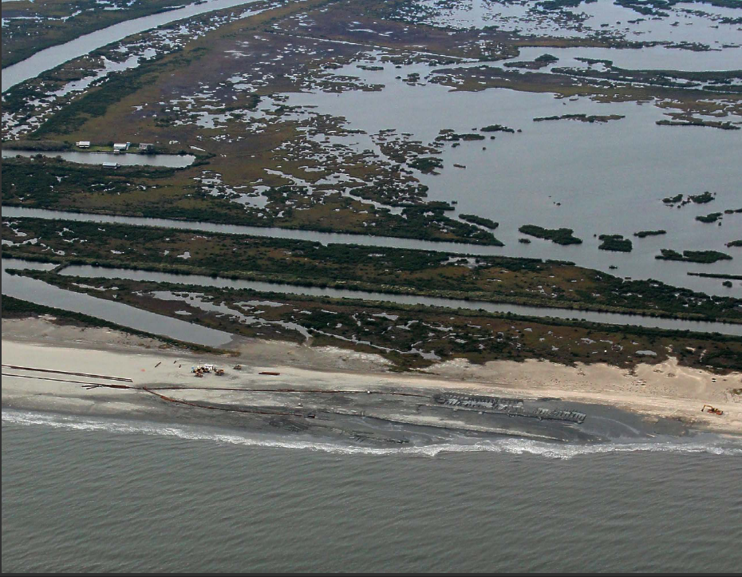

Slide 28
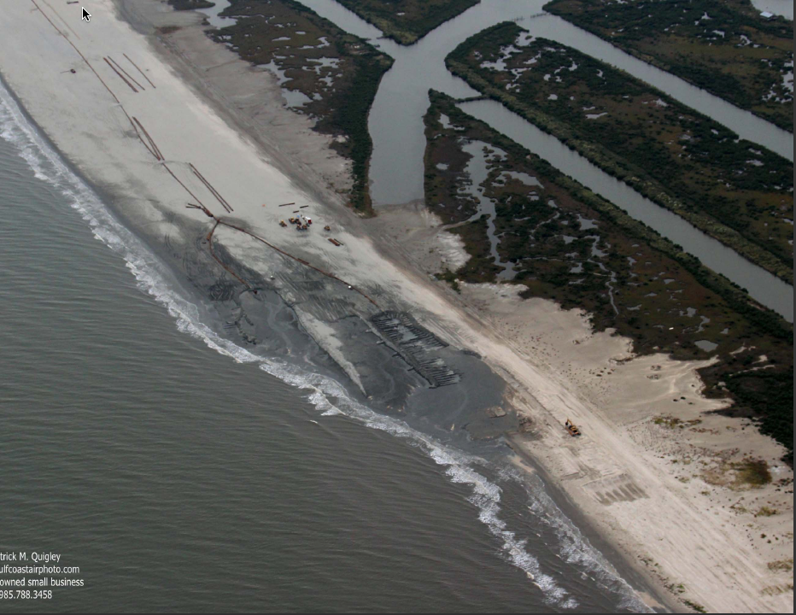

Slide 29
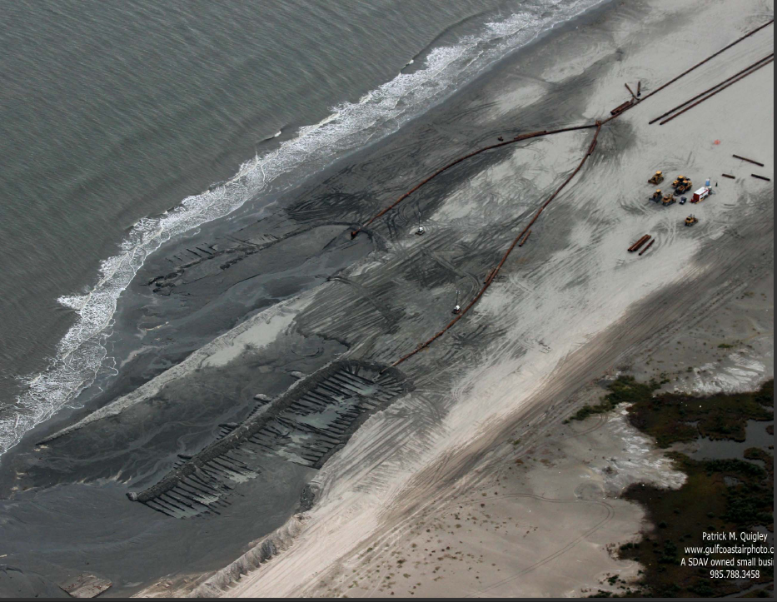

Slide 30
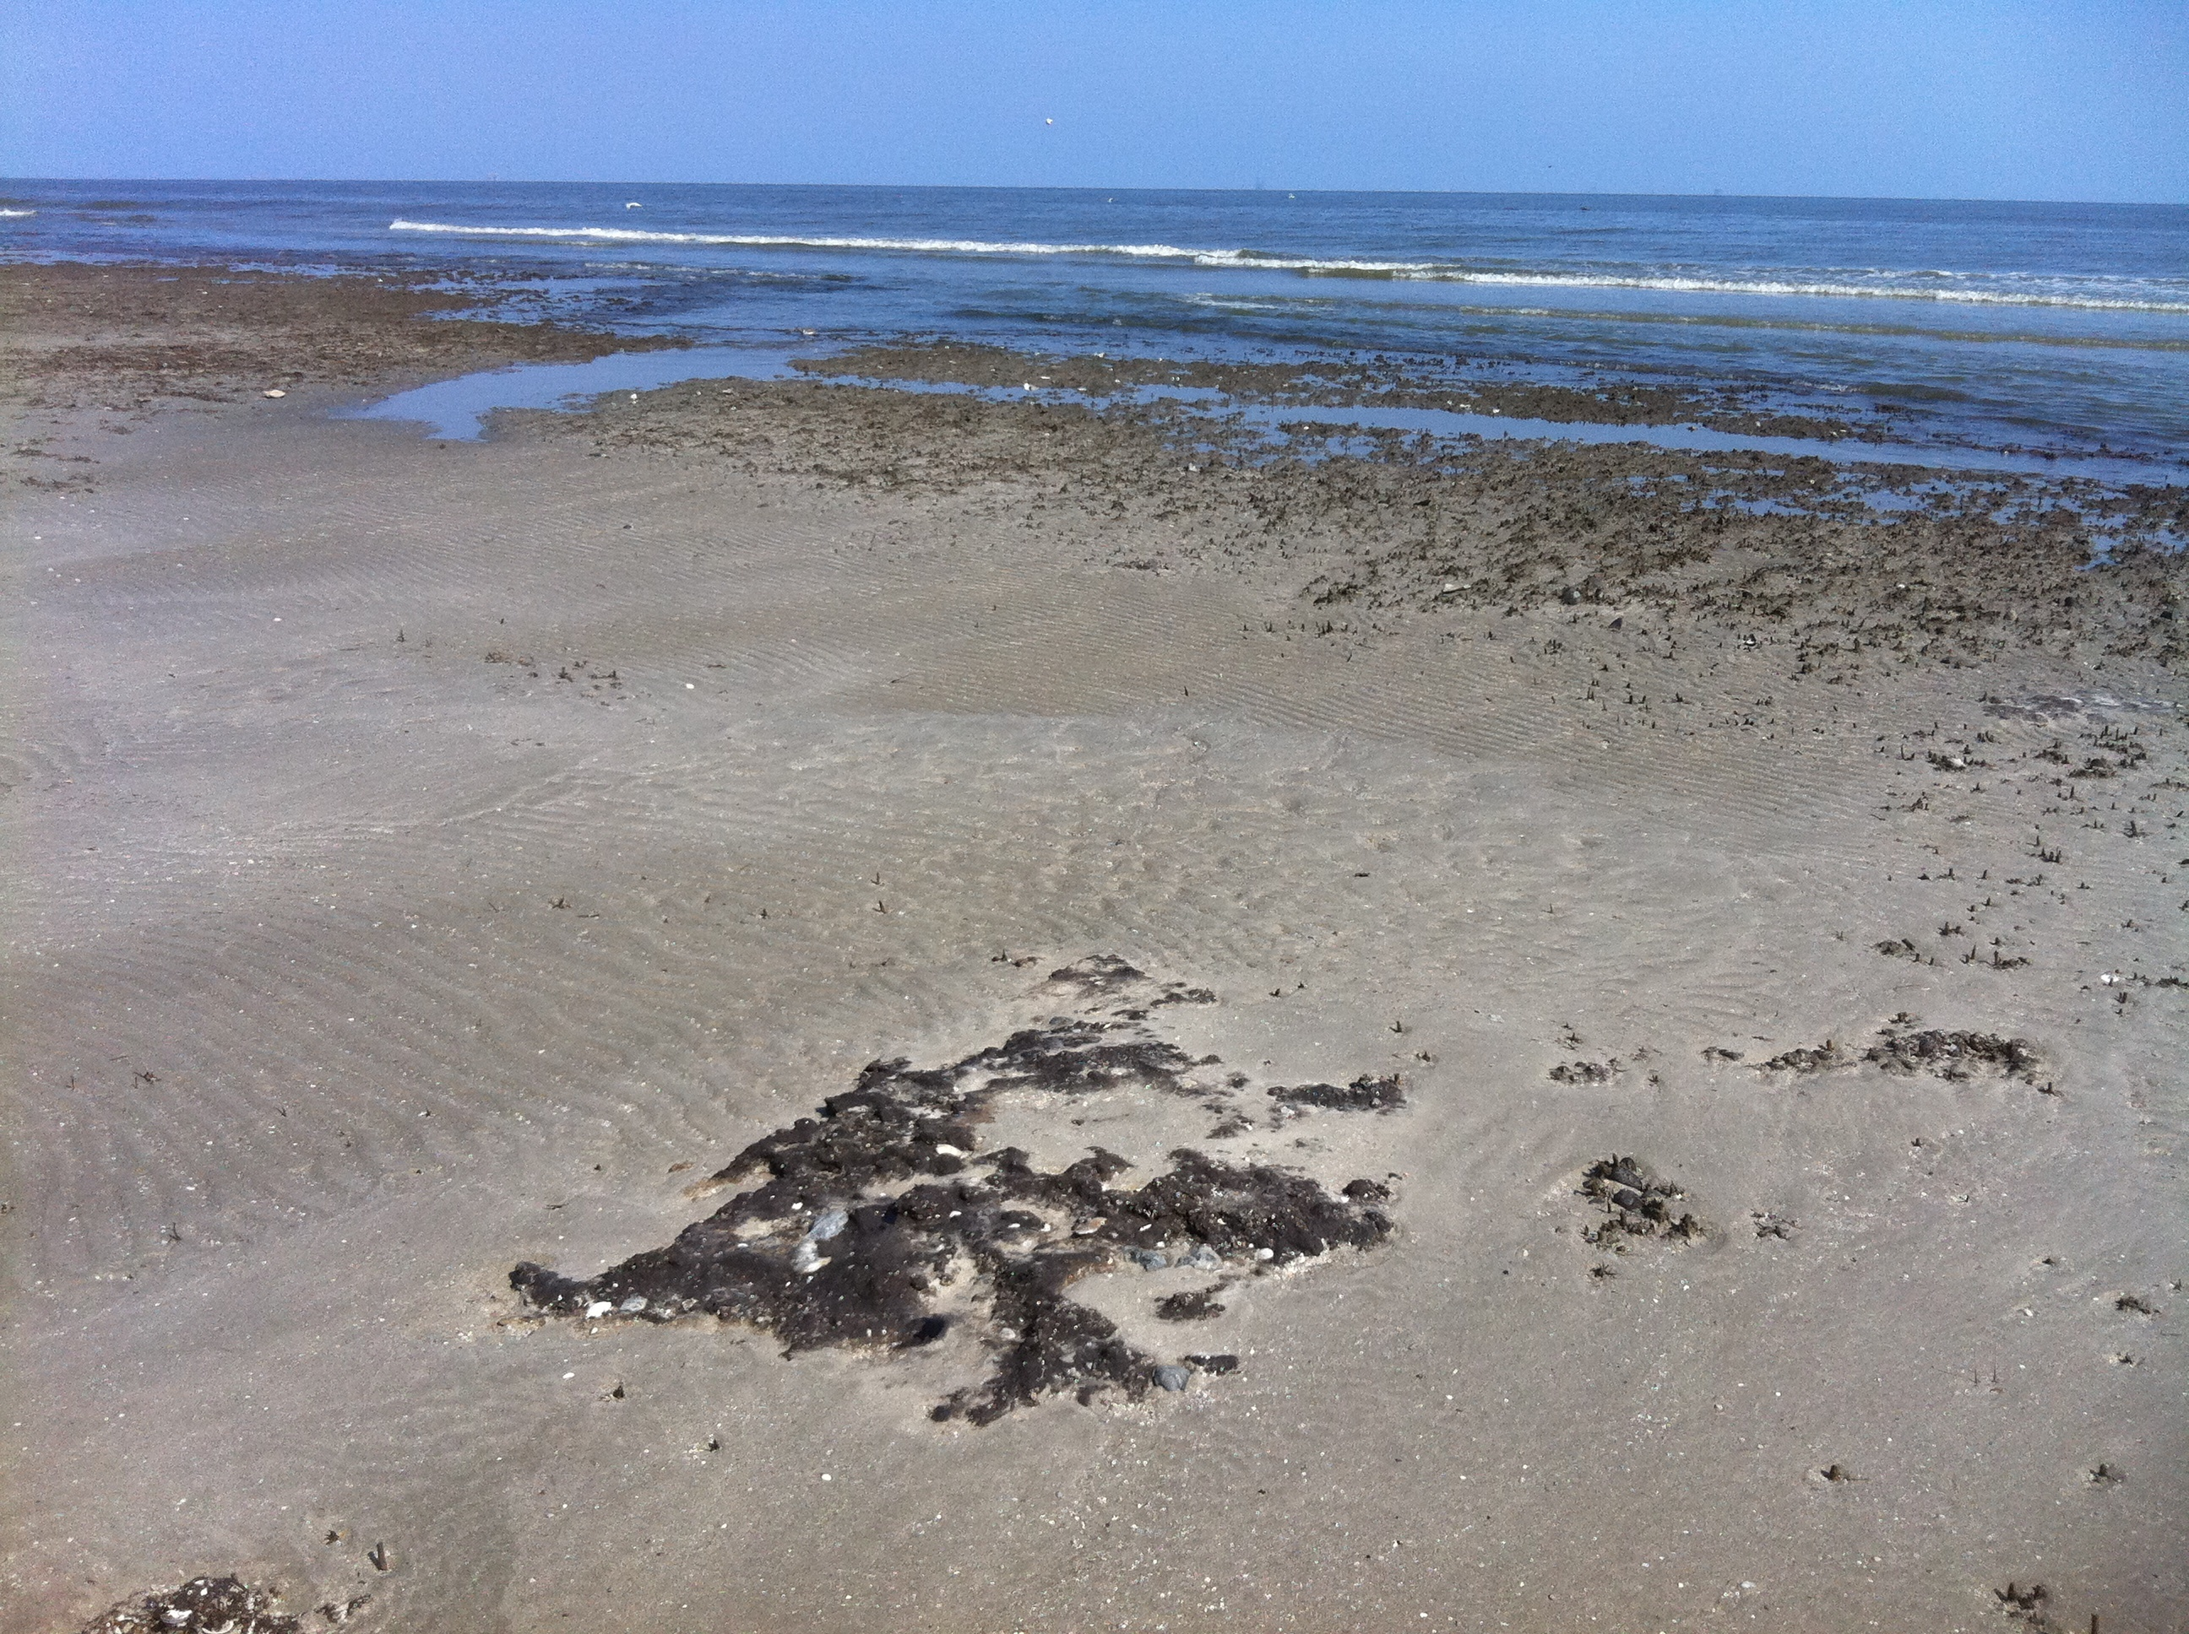

Slide 31
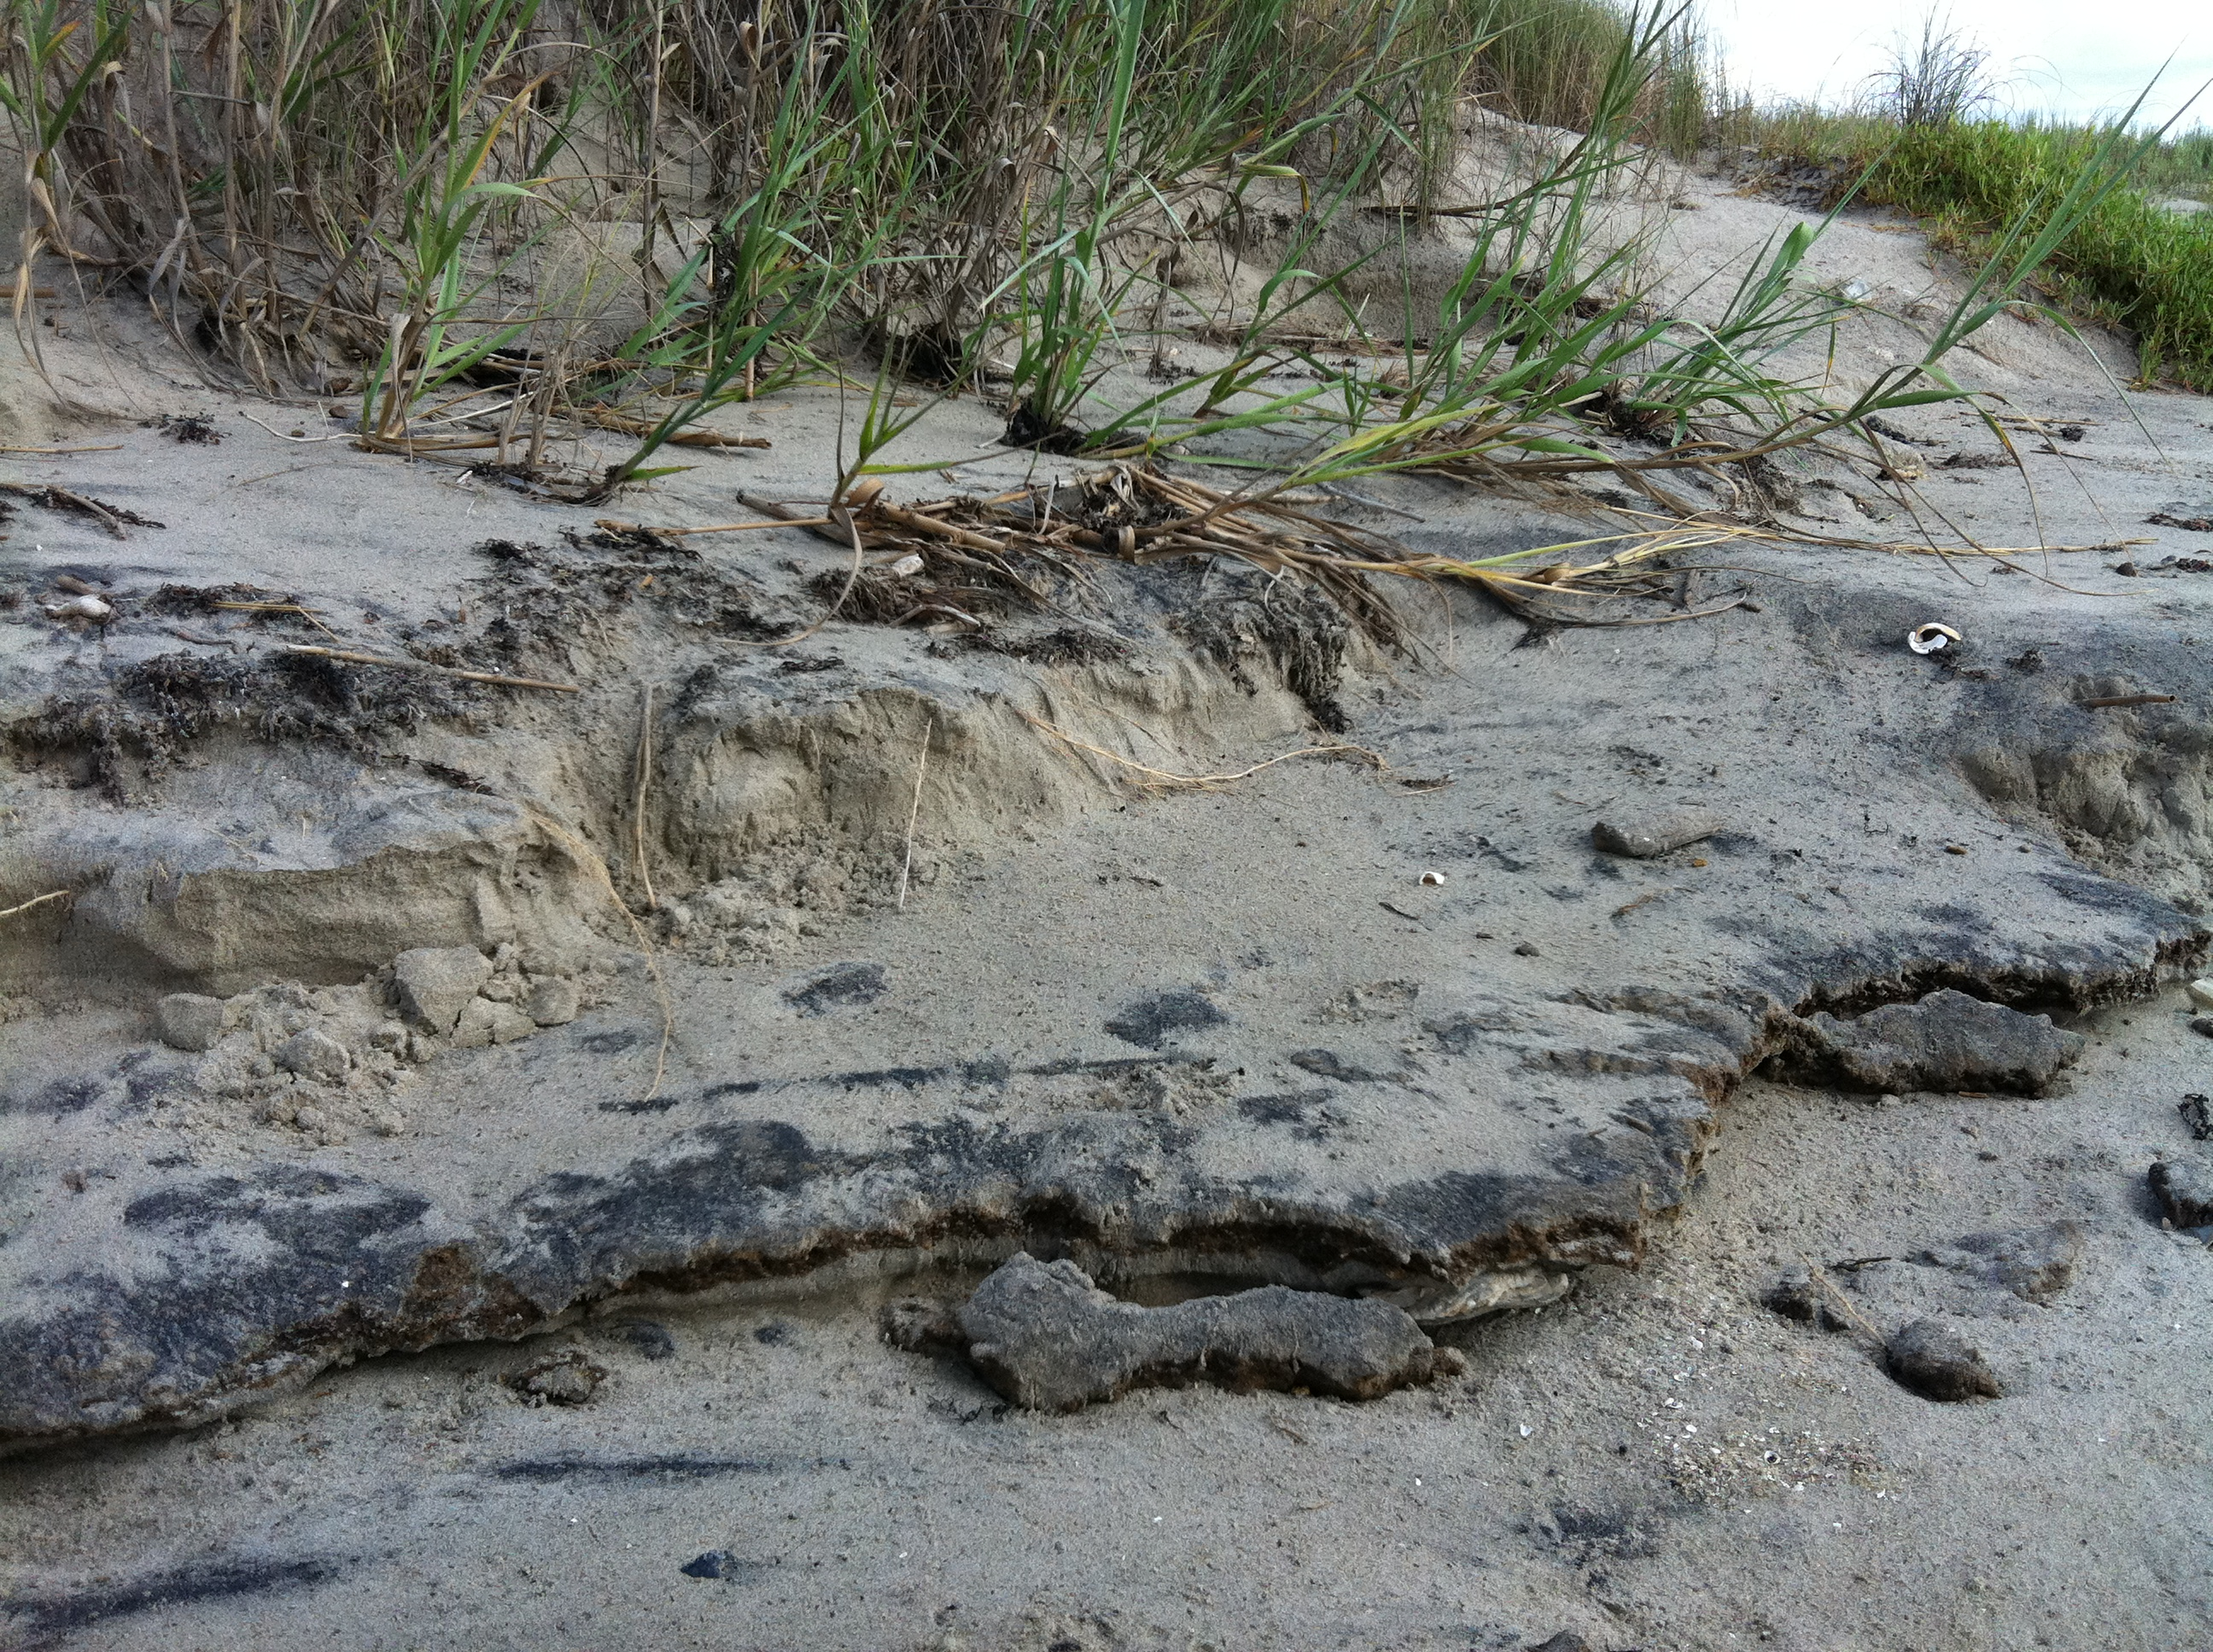

Slide 32
Data and knowledge gaps
How do structural and non-structural flood control/surge attenuation work together as a system to minimize damage?
How do non-structural elements of the system mitigate surge?
How resilient are the non-structural elements after storm impacts?

Slide 33
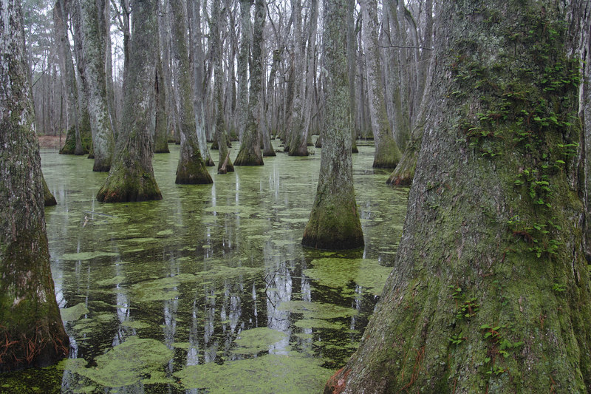
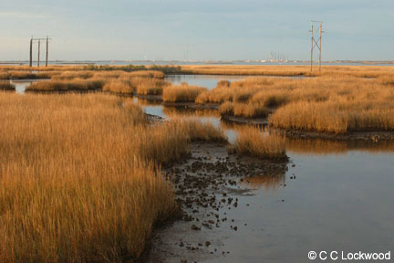

Depth-dependent roughness
Cypress-tupelo and bottomland hardwood forest dominated by vegetation that is on the scale of relevant surges, marshes by vegetation much shorter than relevant storm surges

Slide 34
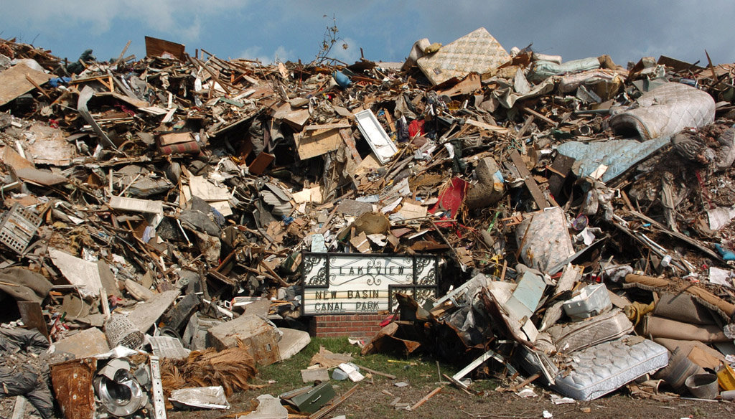
Chris Granger, The Times-Picayune archive
> 100 million cubic yards of debris

Slide 35
Debris Handling System
Housing contents to curbside
by resident
Staging area followed by
proper disposal
[14.3 M lbs HHW
794,891 White goods
5 M orphan containers
940,000 e-waste]
Environmental and disposal teams circulate through neighborhoods and remove visible wastes targeted for
segregation
Remaining debris to C&D landfill
Inspection at tower and
by spotters assigned to
landfill face
Disposal

Slide 36
Analysis and critique of Katrina debris-handling system
No diversion of arsenic-treated lumber
  Potential impacts: arsenic contamination of groundwater
  LWRRI White Paper “Anticipating environmental problems in landfills in New Orleans East ”
  Quantities of Arsenic-Treated Wood in Demolition Debris Generated by Hurricane Katrina; B. Dubey, H. M. Solo-Gabriele, and Timothy G. Townsend; Environ. Sci. Technol.; 2007; 41(5) pp 1533 – 1536
No diversion of wallboard
  Potential impacts: generation of H₂S in landfill
  SWANA analysis of Katrina debris plan (2005)
  LWRRI White Paper

Slide 37
Analysis and critique of Katrina debris handling system
Inefficient household hazardous waste diversion
  Potential impacts: contamination of groundwater by HHW
  LWRRI White Paper “Anticipating environmental problems in landfills in New Orleans East ”
  LSU pile sampling and air sampling
Utilization of C&D landfills for disposal
  Potential impacts: groundwater contamination
  NISTAC (FEMA) Draft Report, 2006
  Criticized by a very wide range of constituencies

Slide 38
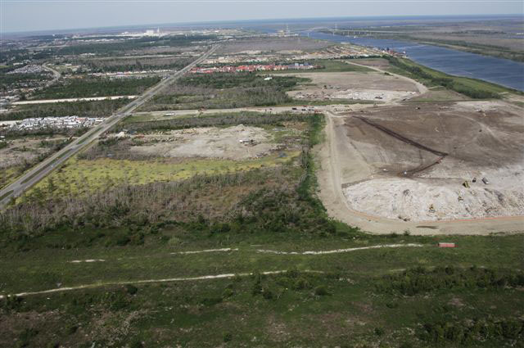
Old Gentilly Monitoring Well Data
Maximum metal concentrations:
As: 1.4 mg/L
Zn: 6,850 mg/L
Ni: 0.97 mg/L

Slide 39
“Old Gentilly Landfill Not the Disaster Once Feared” 2012
Limited sampling for limited set of analytes
No air sampling for H₂S (of primary concern due to deposition of very large volumes of gypsum wallboard)
Nearly zero information to inform future events (Joplin tornado using very similar debris handling methodology)

Slide 40
Soil contamination issues continue
Lead, PAH contamination remain extremely common
Katrina dropped blood lead levels in children (Mielke, ES&T) presumably due to a fresh layer of soil covering
Very large soil removal action underway at B.F. Cooper housing development

Slide 41

Questions??

