Slide 1
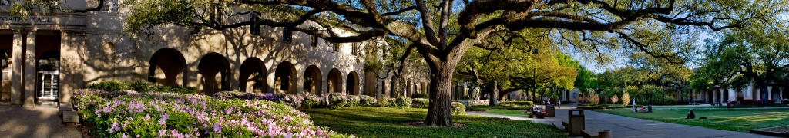

SDMI Overview
for
Swedish Delegation
25 February 2015

Slide 2
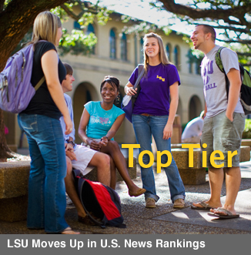

Louisiana State University
Ranked in the first tier for Best National Universities
  U.S. News and World Report
One of the Nation’s Top 25 Most Popular Universities
  U.S. News and World Report
Land-grant, sea-grant, and space-grant status
LSU’s recognized leadership during Katrina and BP Oils Spill

Slide 3
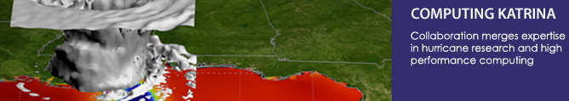

LSU Research
Home of more than 120 research centers, institutes, labs and programs
Each year, LSU conducts more than 2,500 sponsored research projects funded by more than $140 million in external grants from sources including:
    National Science Foundation
    National Institute of Health
    NASA
    National Endowment for the Humanities
    Department of Homeland Security

Slide 4
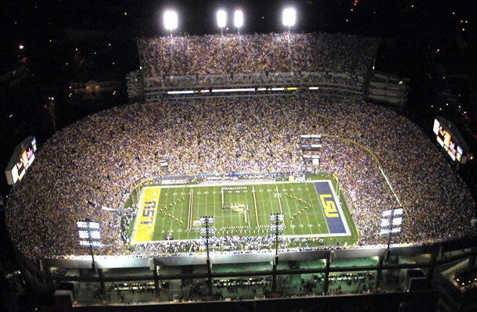

Slide 5


Slide 6
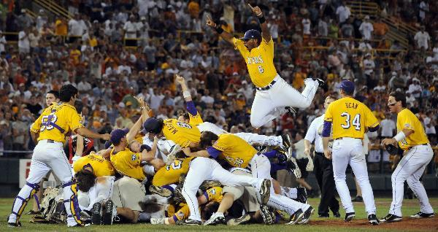

Slide 7
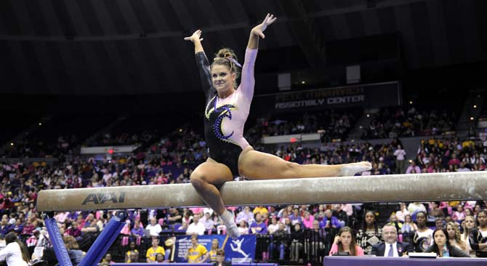

Slide 8
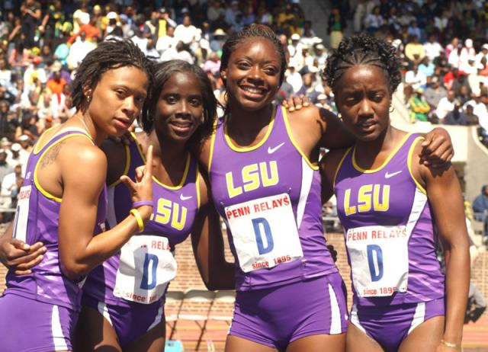

Slide 9







Stephenson National
Center for Security
Research and Training
Stephenson Disaster Management Institute
(SDMI)
National Center for Biomedical Research and Training
(NCBRT)
Carrol L. Herring Fire and Emergency Training Institute
(FETI)
National Center for Disaster Fraud
(NCDF)
Law Enforcement Online
(LEO)

Slide 10
Mission
  The mission of the Stephenson Disaster Management Institute is to save the lives of people and animals by continuously improving disaster management through thought leadership, applied research and executive education.
Goals
  Bring business principles and research to bear on disasters
  Produce applied research and disseminate best practices to the business and practitioner communities
  Build partnerships between academic scholars, emergency management practitioners, and the private sector

Slide 11
SDMI Bench of Experts
Staff | Research Affiliates | Senior Fellows | WAEs | Consultants | GAs | Board of Experts | LSU (Add Comp)
18 | 17 PhDs | 10 | 14 | 6 | 5 | 12 | 3
Total of 80+
Full-Time Staff
Retired LTC, Deputy Superintendent of LSP
2 Former Deputy Director of GOHSEP
2 Former Chairman of SIEC
1 Member of FEMA’s NAC
3 U.S. Army Reserve LTCs
2 w/Top Secret Security Clearance
1 w/Secret Security Clearance
3 PhD Candidates
1 JD
9 Masters Degrees
Red Cross Board Member
1 Master Exercise Practitioner
1 CISSP
2 GISP / 9 GIS Technicians
Board of Experts
2 Harvard MBAs
1 Retired LTG of U.S. Army
1 Retired CAPT, USCG
1 Current Director of GOHSEP
1 Former Directors of GOHSEP
1 FEMA Technical Hazards Director
3 Chief Executive Officers
Notes:
Note:::Don Byrne is named as a Senior Fellow on our website.
Add Comp: Added Carey King (video work); What about Nash?

Slide 12

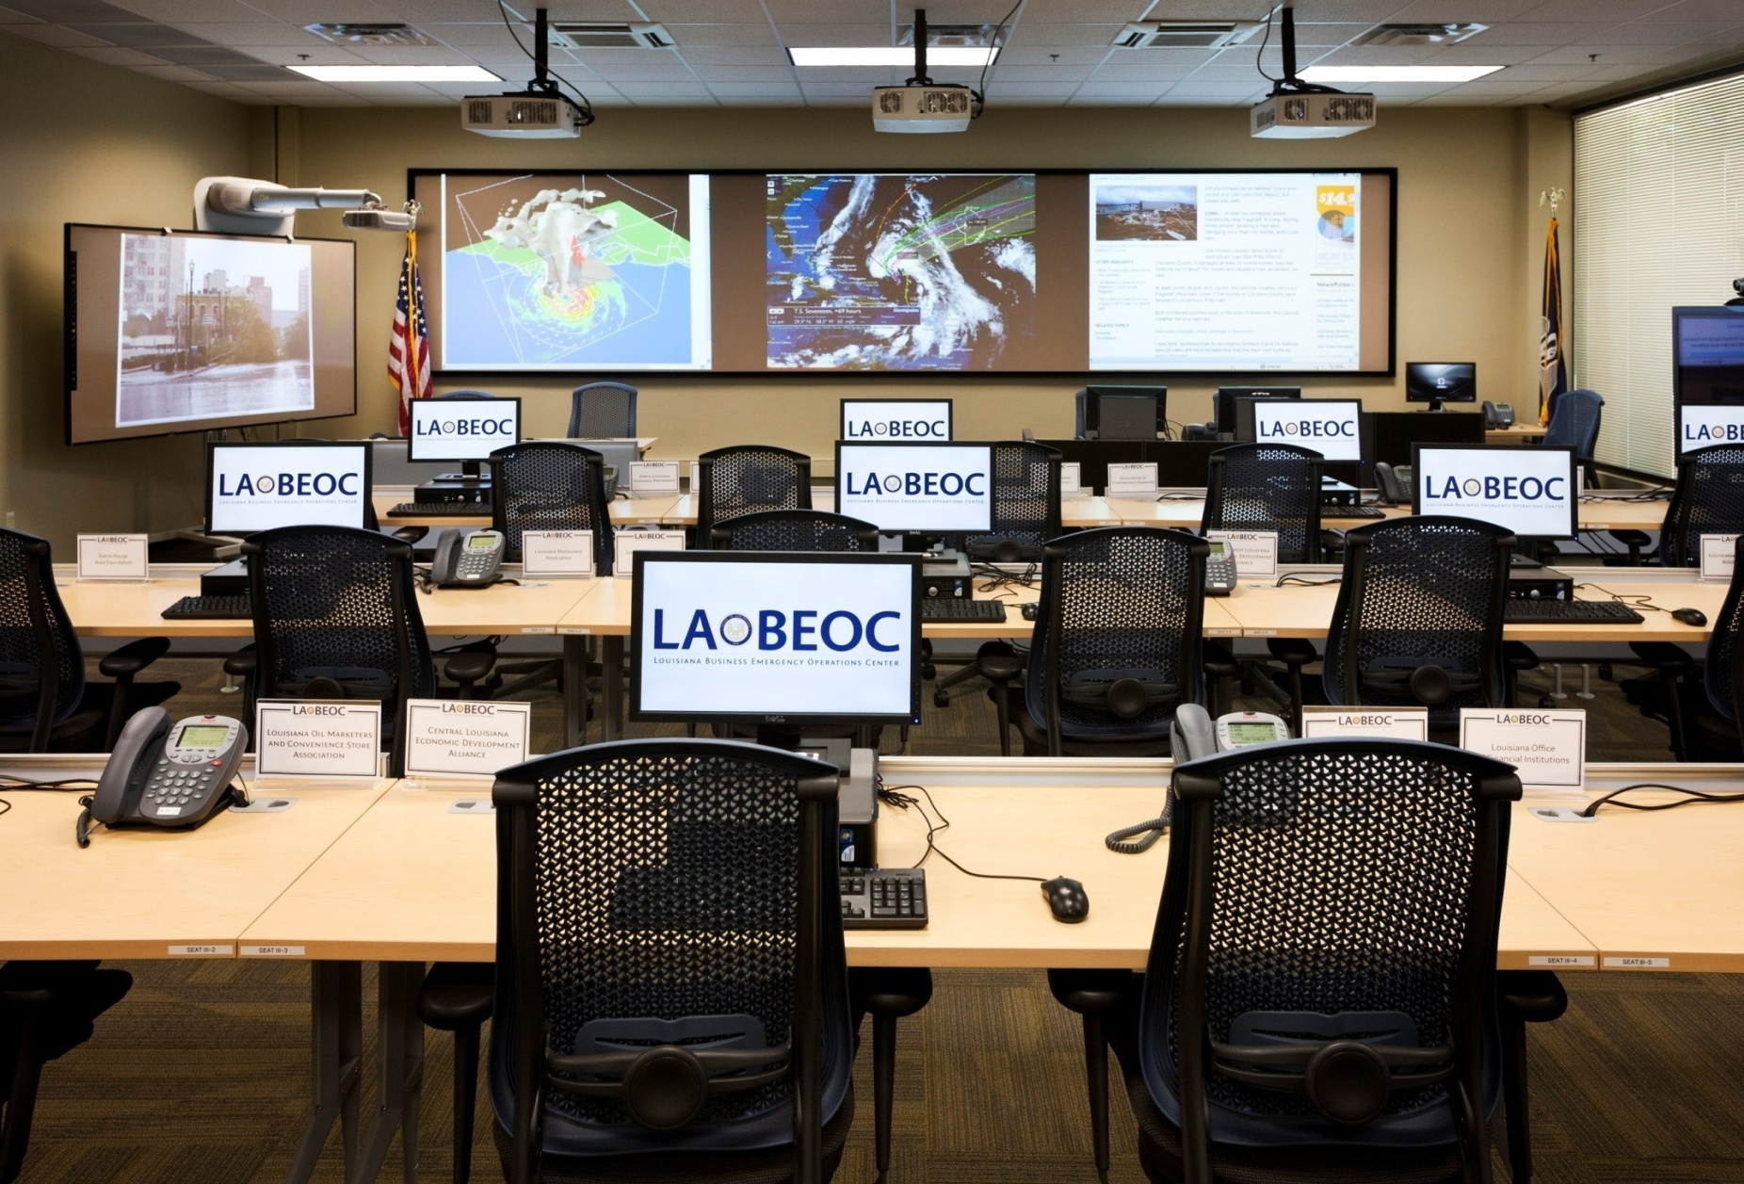

Slide 13















Built Through Public – Private Collaboration

Slide 14


SDMI’s Center for Business Preparedness
  GOALS
    Bridge the gap between academic research, business preparedness, and continuity of operations
    Apply proven business management techniques to the challenge of disaster preparedness and community resilience
    Create a cultural shift in the value of preparedness by creating a central point of collaboration for:
      Enhance and evolve private sector resilience
      Research
      Knowledge sharing
      Outreach
    Global collaboration with academic institutions, private sector organizations, public entities:
      Connect, collaborate, and share smart practices
      Gain insight, knowledge, and support
      Serve as a source for the latest tools and research

Slide 15
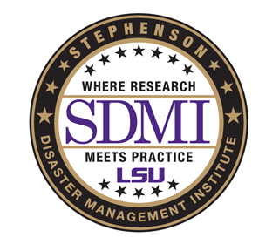
Does your business have a written emergency response plan?
GOHSEP / SDMI Small Business Initiative

Slide 16
Were your normal operations interrupted following Hurricane Katrina/Gustav ?
GOHSEP / SDMI Small Business Initiative

Slide 17
For how many days did Hurricane Katrina/Gustav disrupt normal operations?
GOHSEP / SDMI Small Business Initiative

Slide 18
Did your business make any changes following Hurricane Katrina/Gustav to become better prepared for future disasters?
GOHSEP / SDMI Small Business Initiative

Slide 19
Did these changes reduce Hurricane Isaac's impact on your business?
GOHSEP / SDMI Small Business Initiative

Slide 20


Expanding Domestic Applications
  Partnered with LSU Civil Engineering and UNO to sponsor the National Evacuation Conference
  Participated in a New York City Evacuation Planning Meeting with LSU Civil Engineering and UNO
  Working with the National Emergency Management Association to conduct a study on state to state support for private sector resources and volunteer organizations
  Participating with FEMA on a Hurricane Evacuation Study for Southeast Louisiana

Slide 21
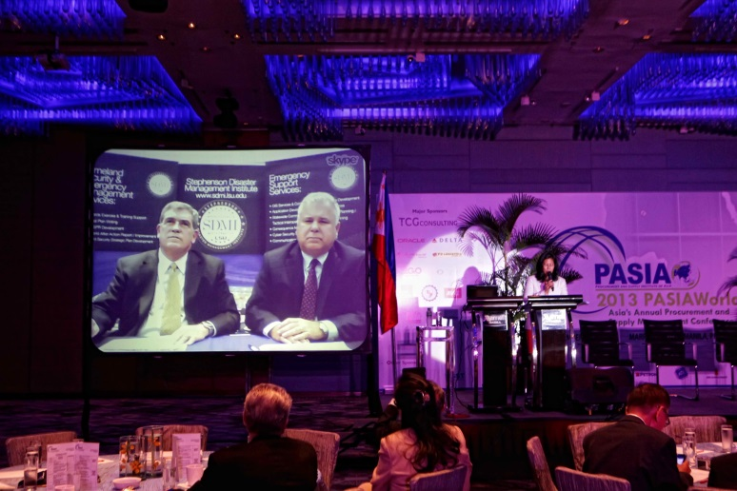





International Influence
  Working with the Japanese Consulate
  Hosting a Swedish Delegation on Resiliency
  Collaborating with UN on R!SE
  Invited to Speak at the Following Conferences:
    Australian Association of Professional Communication Officials
    Melbourne Fire Brigade
    Keynote for 13th Annual Emergency Management Conference
  Conducted a Webinar for PASIA following Typhoon Haiyan
  Hosting Latin American University Delegation for USAID

Slide 22
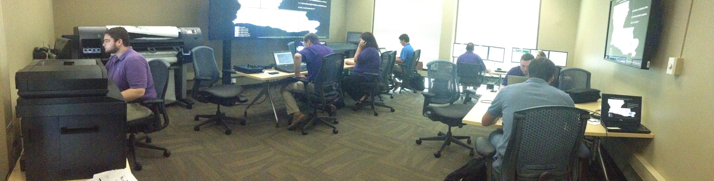
SDMI Disaster Lab & Research
Research, simulation, and training facility for the state and the nation’s efforts of advancing crisis leadership education for emergency managers and the private sector.

Slide 23
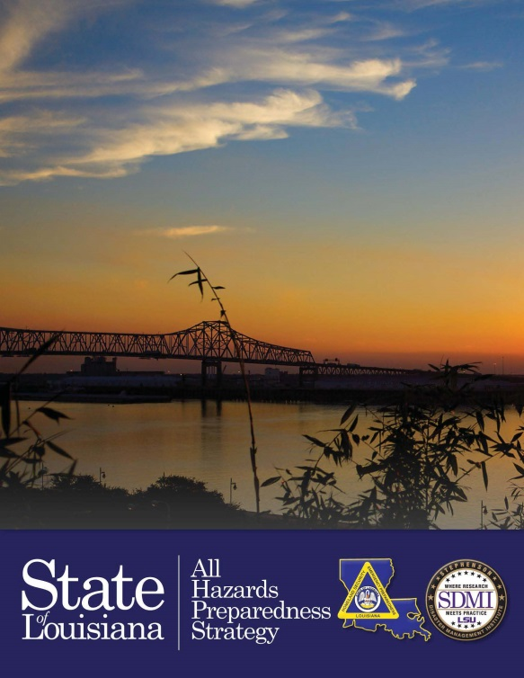

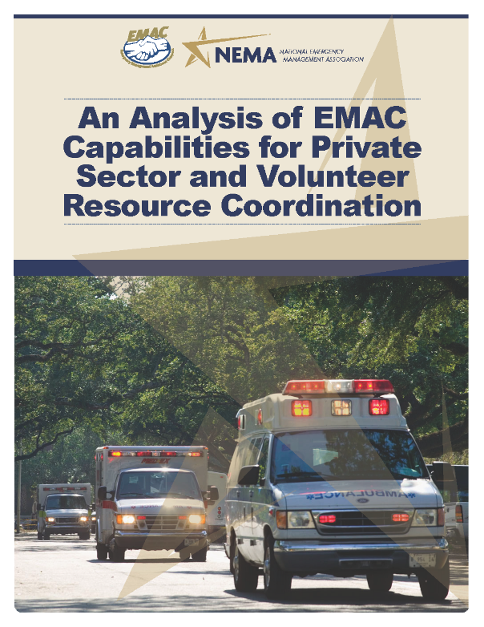
Current / Previous SDMI Projects
State Homeland Security Strategy
Capitol Emergency Response Plan
Capitol Continuity of Operations Plan
9-1-1 Mapping
Critical Infrastructure Mapping
Small Business Disaster Preparedness Initiative
Shell Oil Company Oil Response Outreach Initiative
State Exercise and Training Program
Cyber Security Initiative
Consequence Modeling for Storm Surge

Slide 24
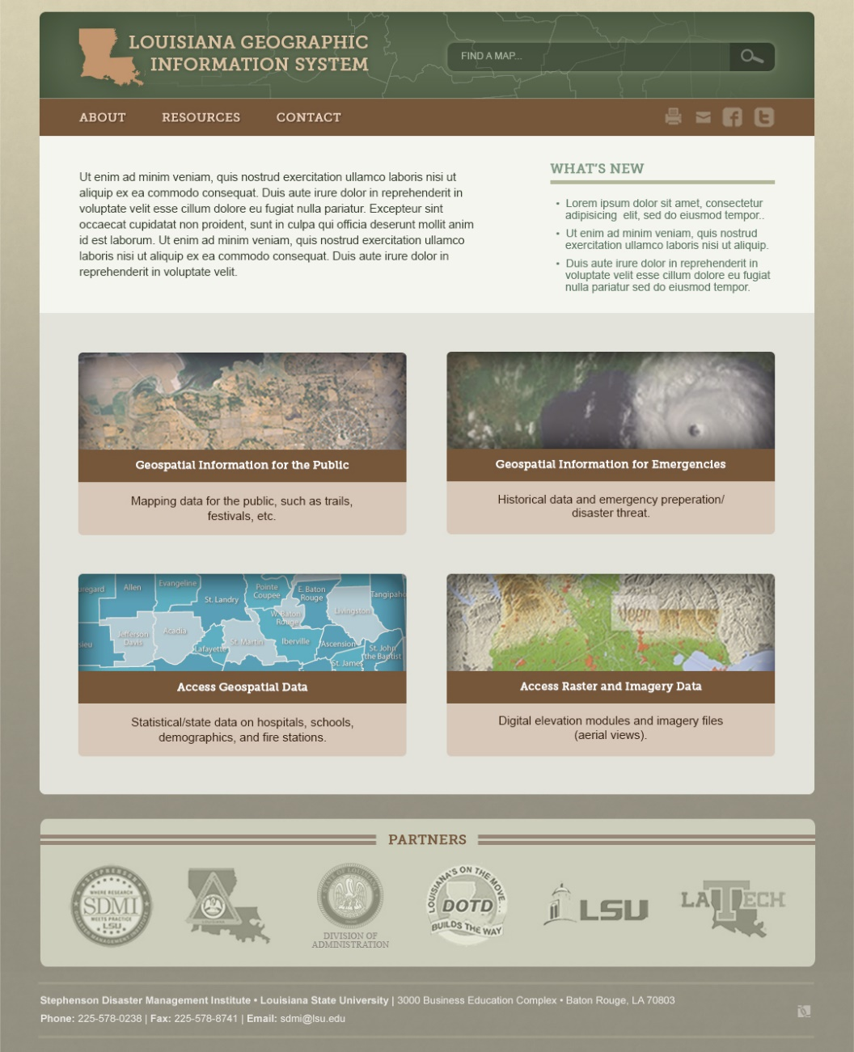
SDMI GIS Based Projects
GIS Emphasis on
Vector Data
Raster Data
Data for the Public
Data for Emergencies
Mapping 9-1-1 for Rural Parishes
Mapping the State’s CI/KR

Slide 25
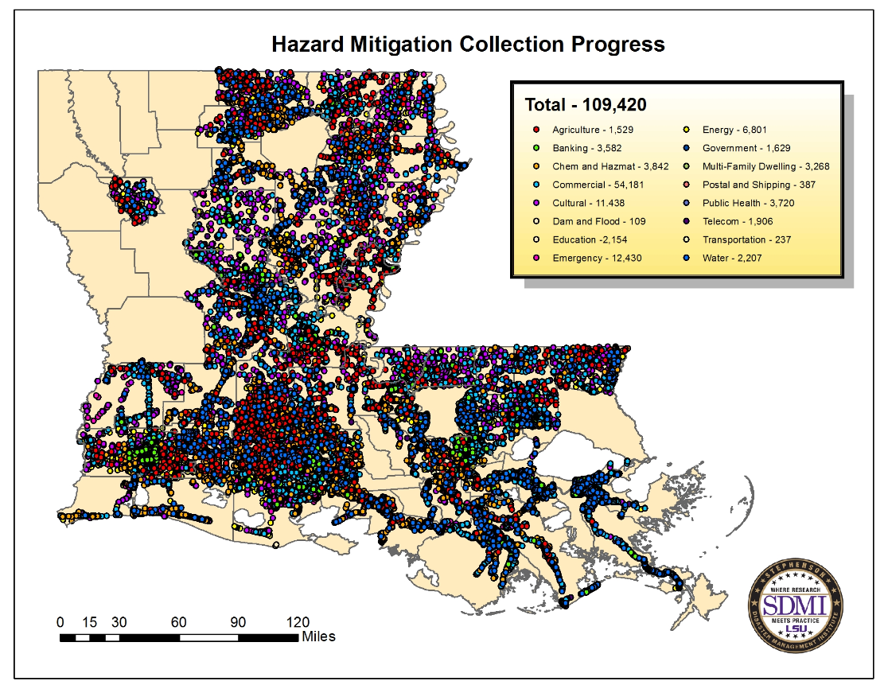
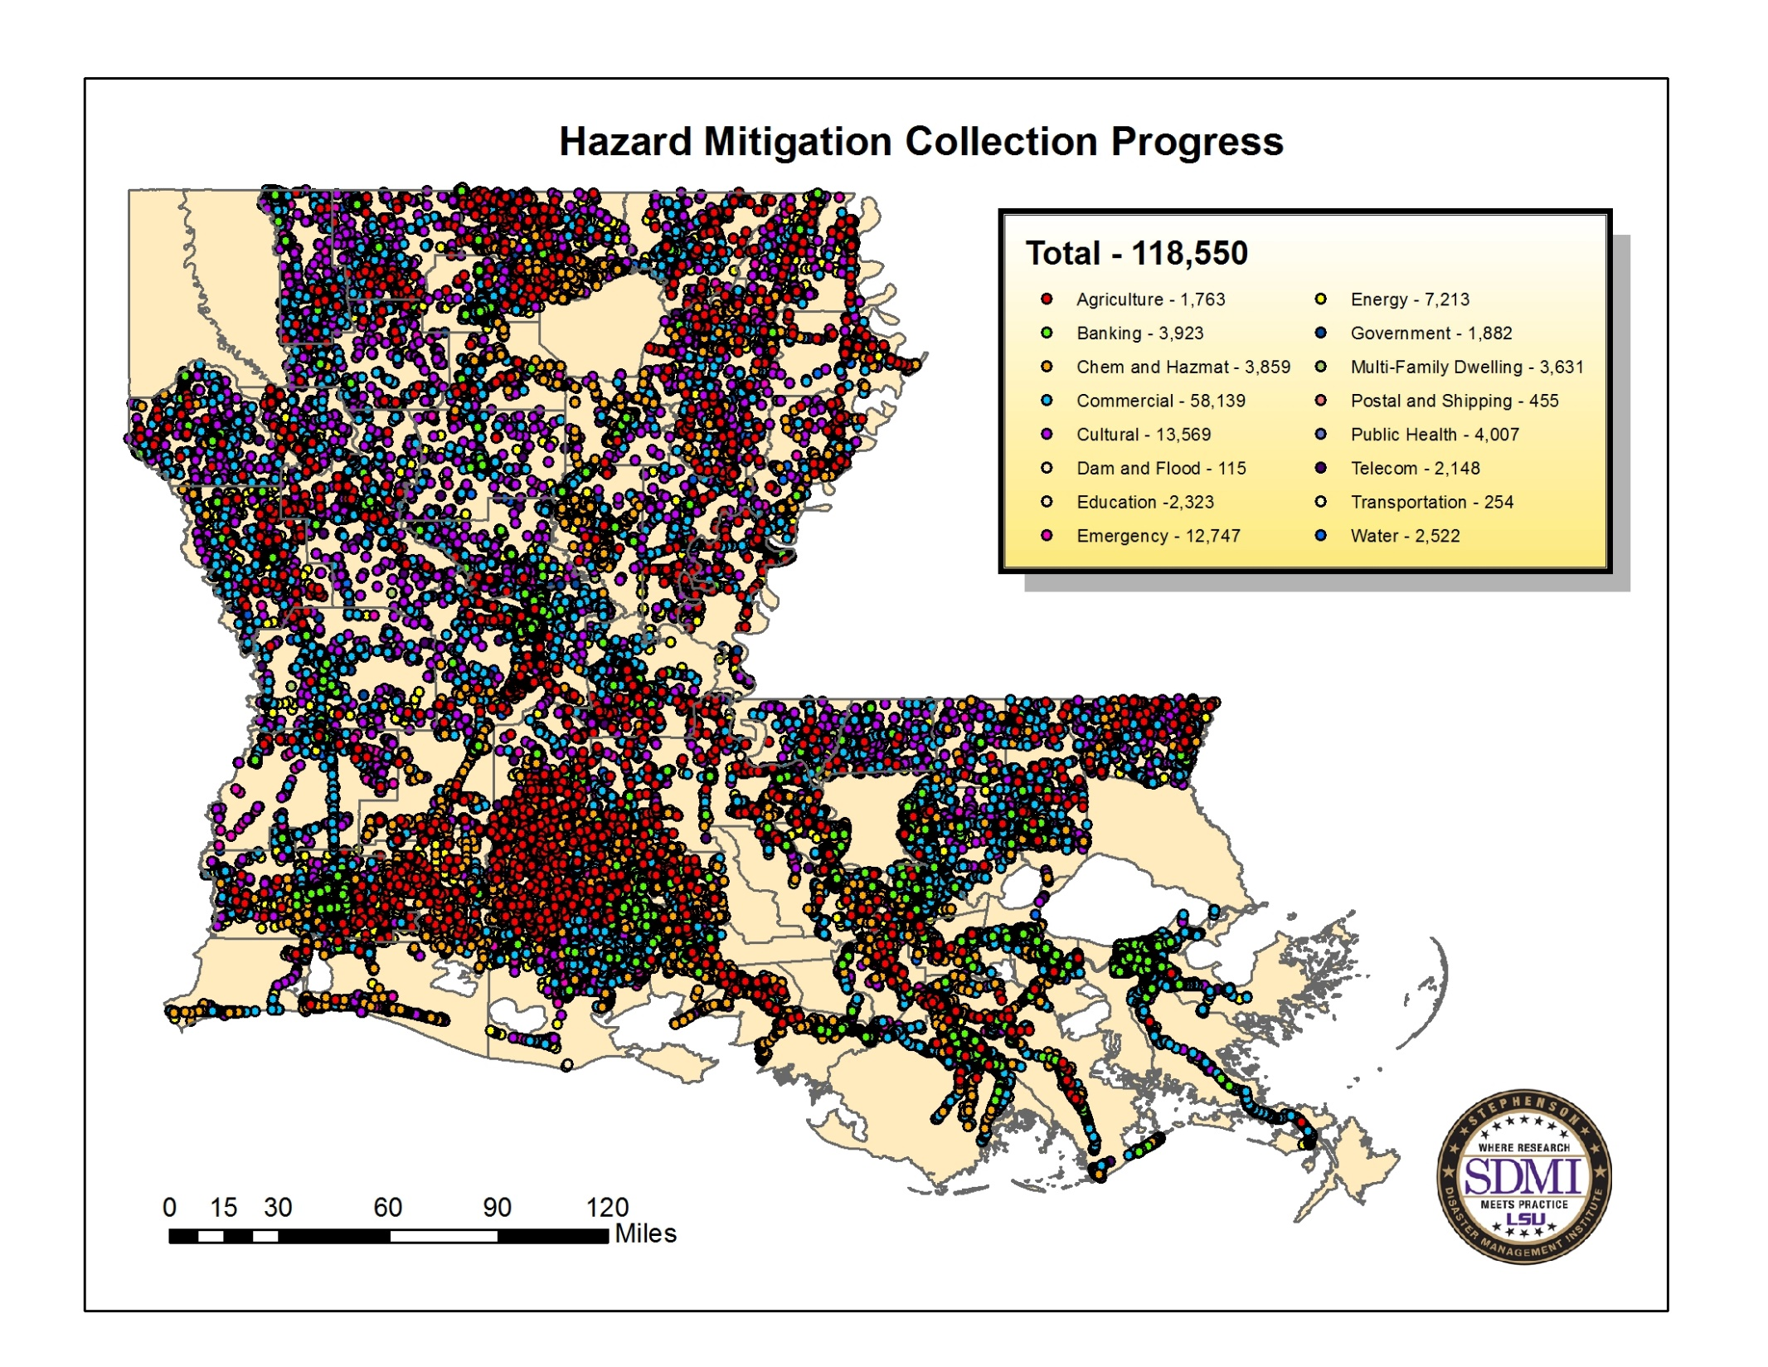

Slide 26


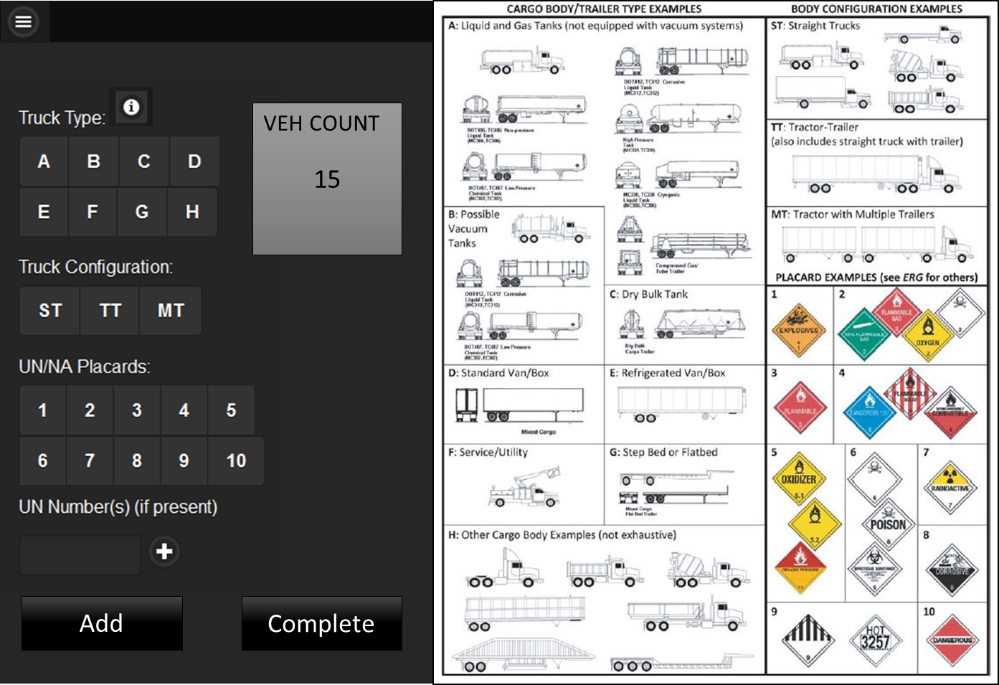
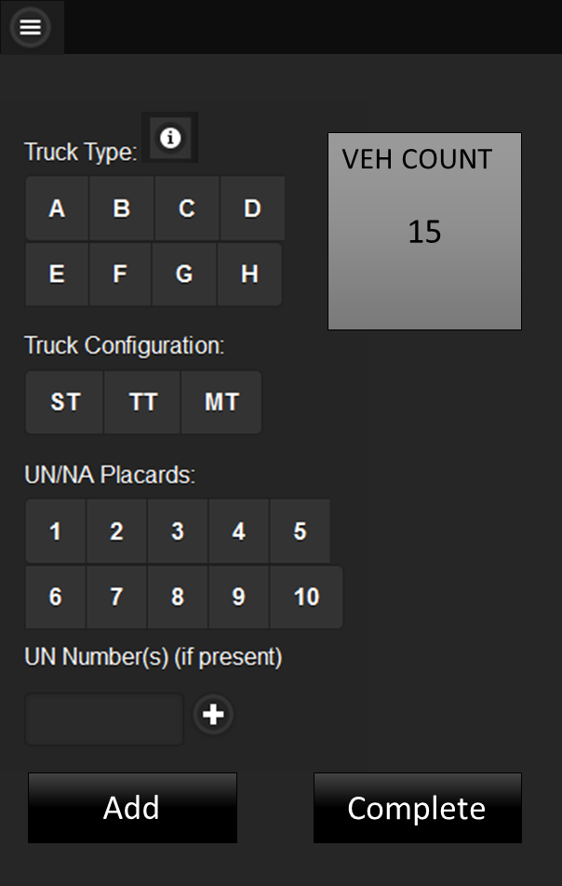
Mobile Web Application
Features
  HTML5
  CSS3
  jQuery Mobile
  Local Storage and Manifest for offline capabilities

Slide 27
SDMI School Safety Program

Slide 28
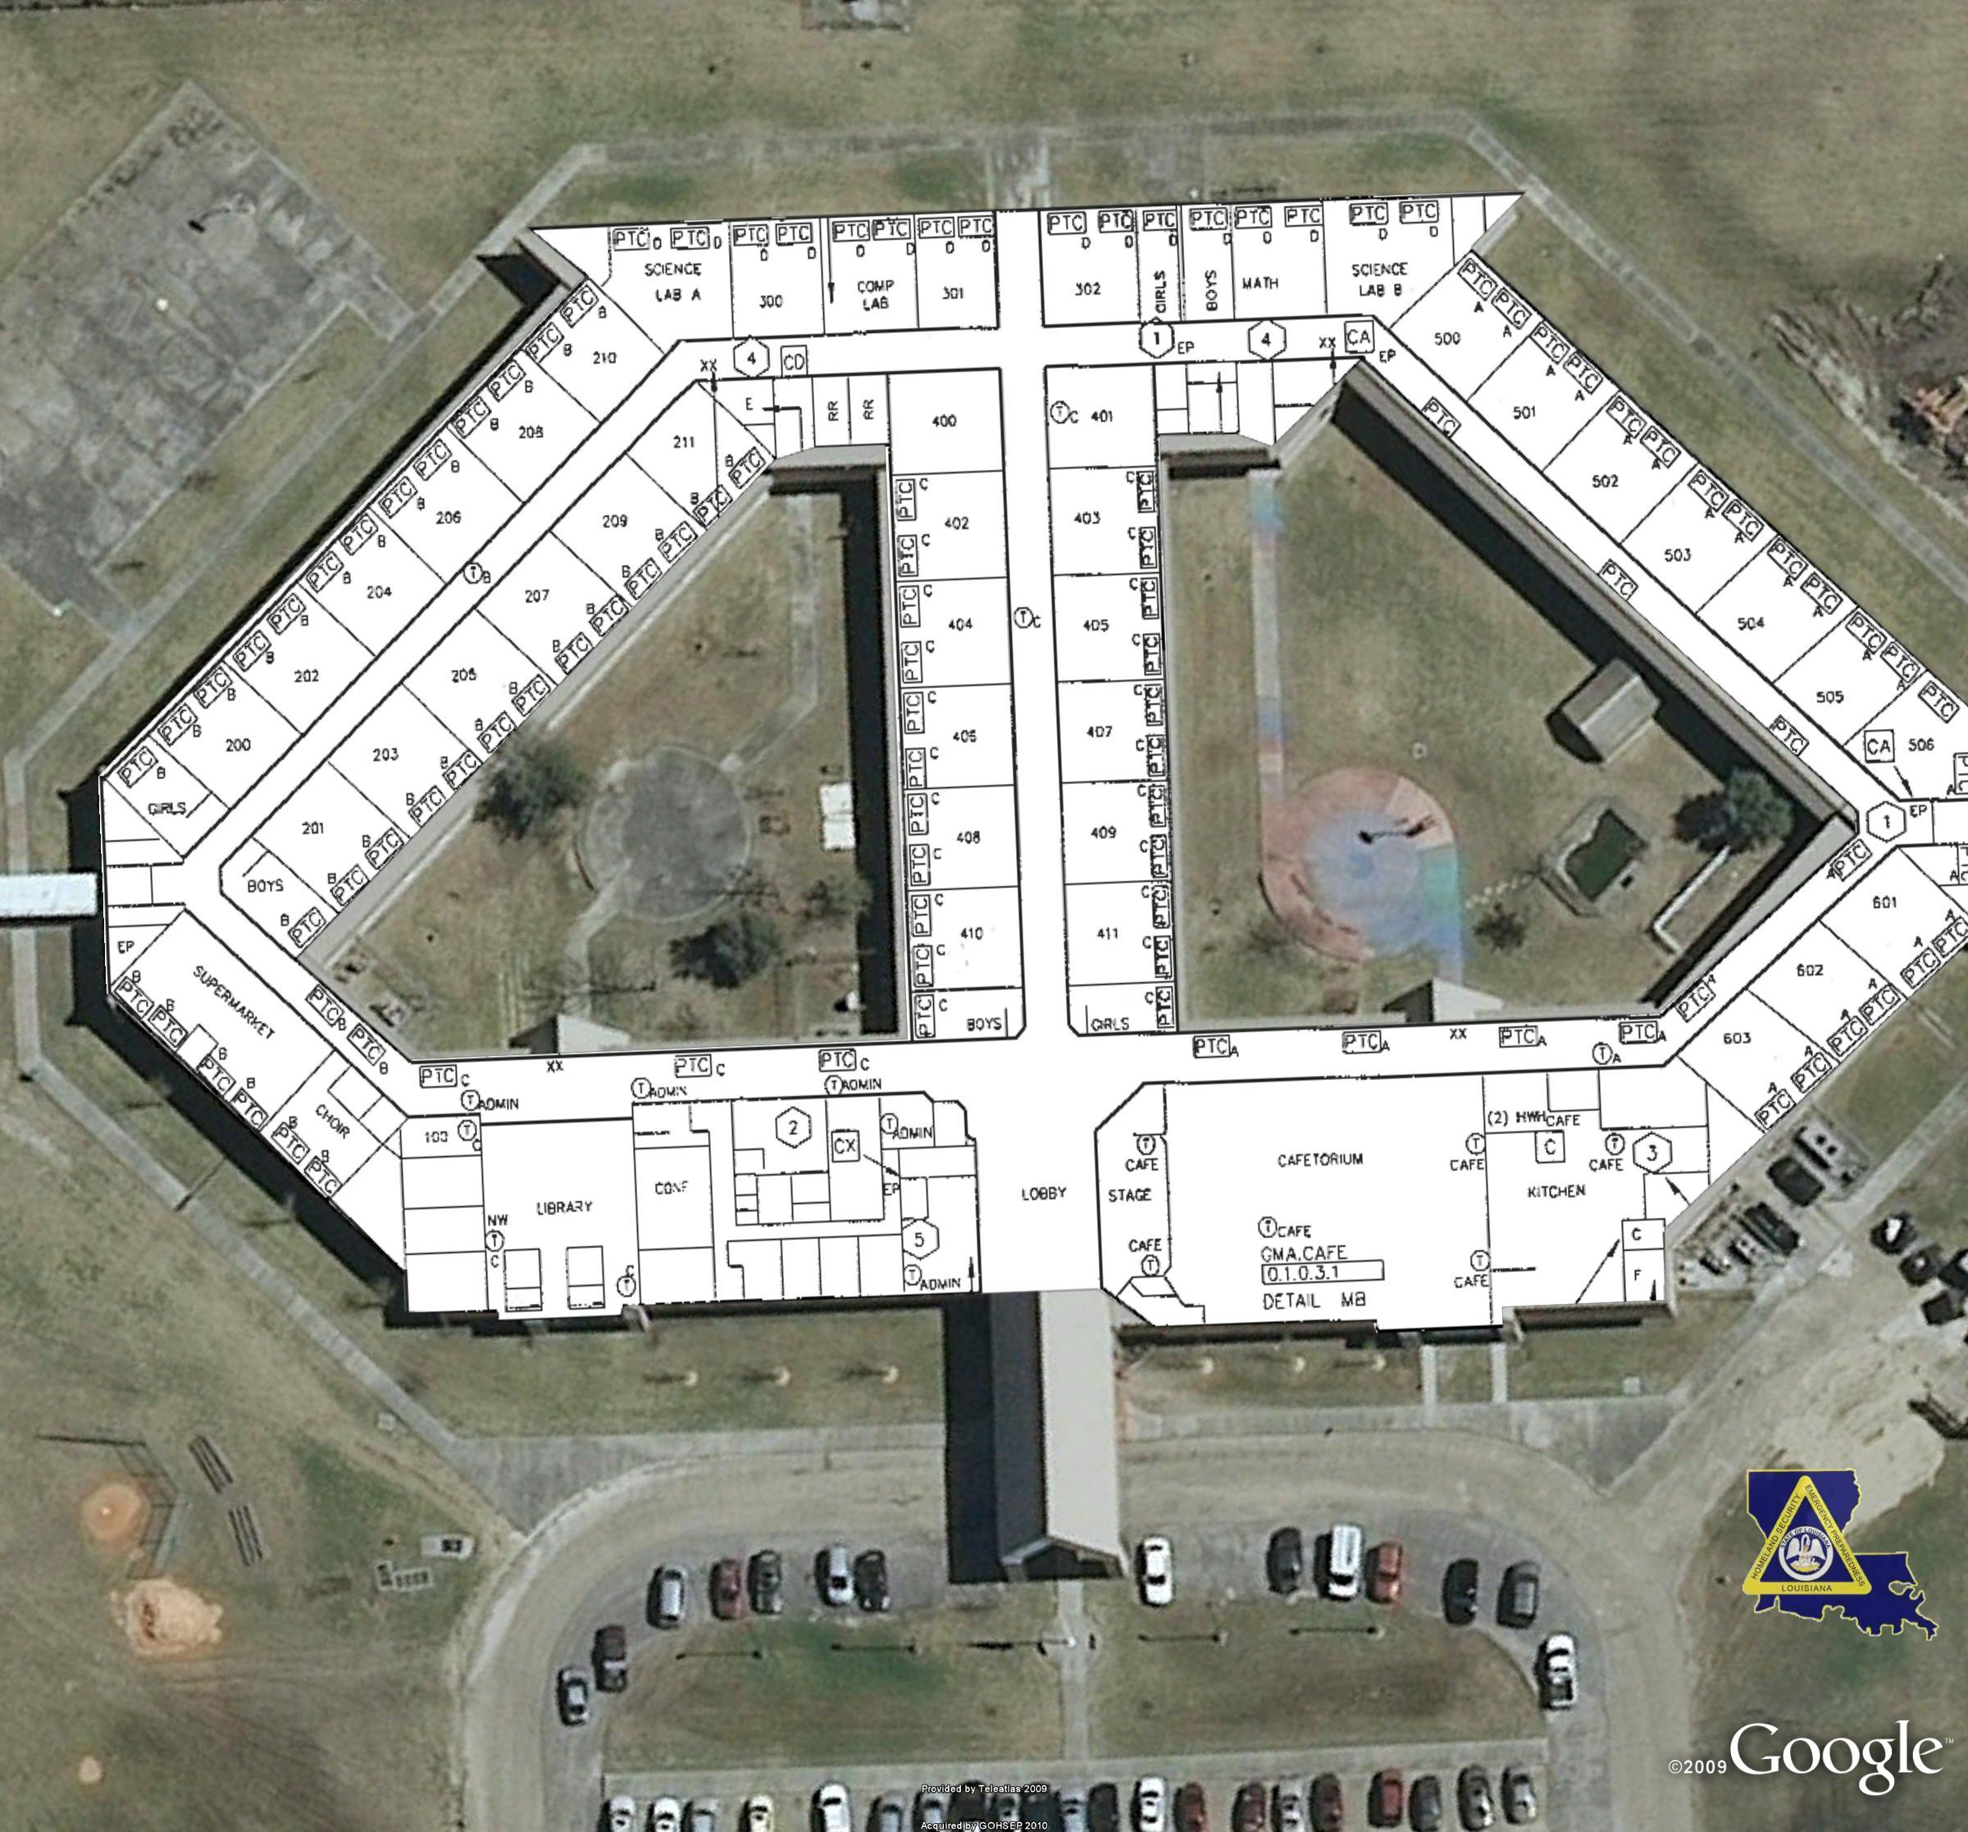

Slide 29
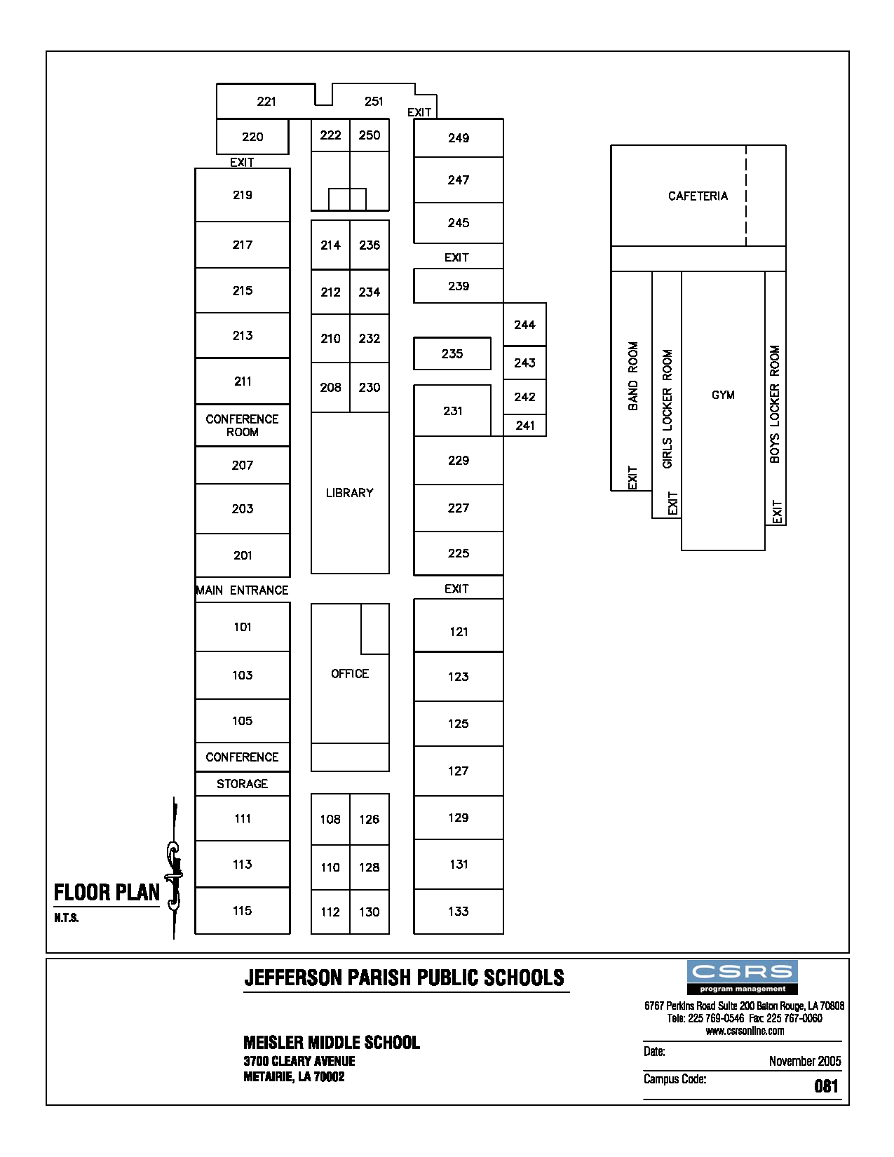

Slide 30
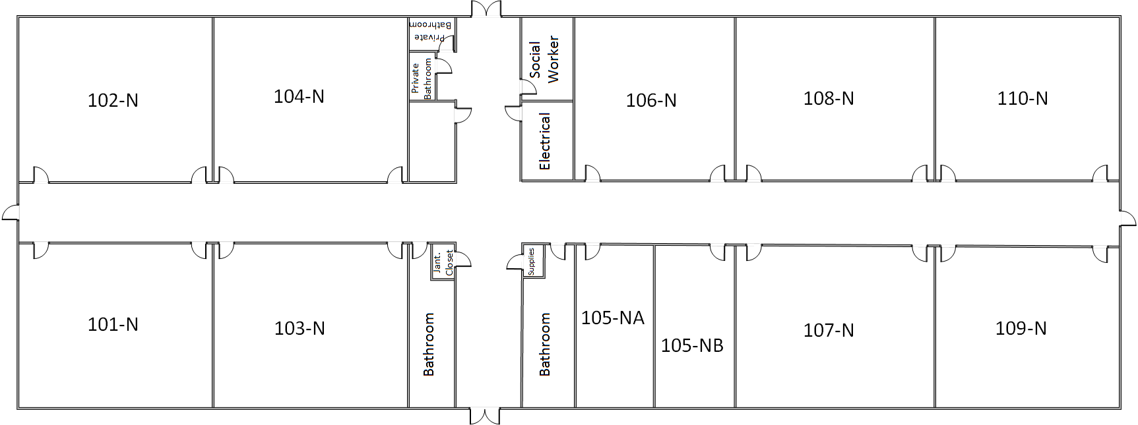


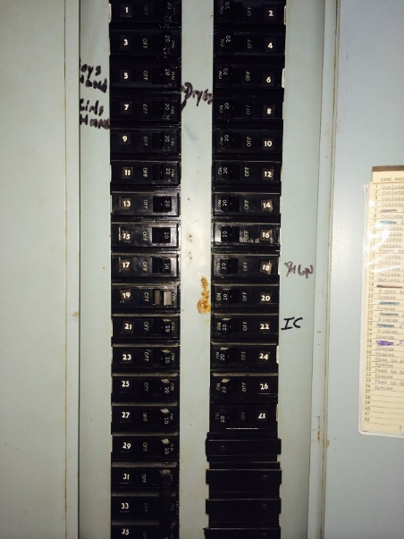
Classrooms
Bathrooms
117
115
119
Hallways
Electrical
Utility
Administrative
CCTV
Outlets Classroom #120
Outlets Classroom #121
Boy’s Hand Dryers
Girls Hand Dryers
Outlets Classroom 105 & 106
11. Outlets Classroom 106 and Corridor
13. Outlets Classroom 107
Outlets Classroom 124
17. Outlets Classroom 123
Power to Energy Management Panel AC-A
Spares
Men’s Hand Dryer
Ladies Hand Dryer
Spare
Spare
Feed to Section B of 1 LA
Feed to Section B of 1 LA
35. Feed to Section B of 1 LA
Outlets Classroom 113 & 111
Outlets Classroom 111 & 110
Outlets Classroom 110 & 109
Outlets for Drinking Fountain & Corridor
Outlets for Drinking Fountain & Corridor
Power to Bathroom Exhaust Fan
Outlets Classroom 104 & 102
Outlets Classroom 101 & 103
Outside Sign
Spares
Spares
Spares
Spares
28. IPF Camera Black Box
119
Fire Extinguisher
Fire Alarm

Slide 31
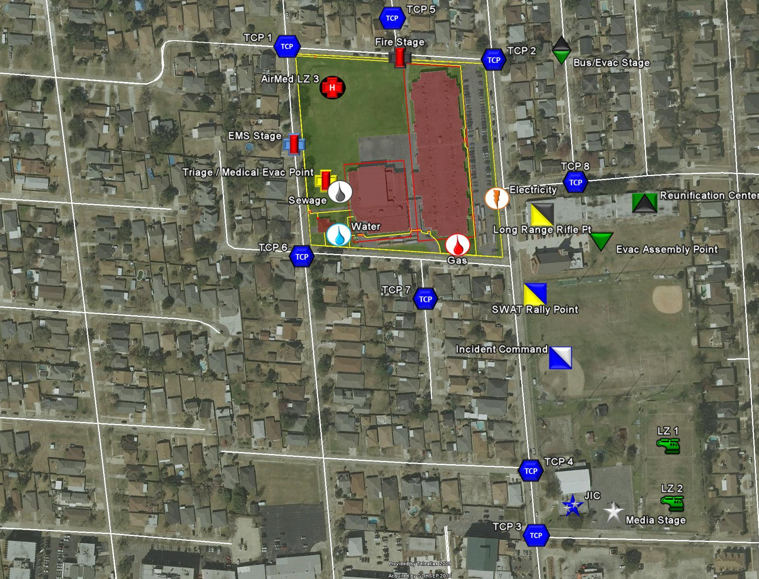
Principle | Asst Principle | Custodian
Mrs. Semaj Allen-Raymond | Mr. Kevin Lusagnin | Mr. James Anderson
(504) 885-3456 | (504) 885-4125 | (504) 885-4212
(504) 205-8546 | (504) 254-8745 | (504) 257-8965
Faculty | Students | Special Needs
52 | 788 | 45

Slide 32
Joint CyberSecurity and Training Lab (JCTL)
Developed in partnership with the Louisiana National Guard
Objectives
  Objective 1 – Provide capabilities for LANG CPT to train/validate METL
  Objective 2 – Establish an controlled environment to train/validate CND, IA, exploitation and attack cyber events
  Objective 3 – Conduct CIKR Incident Response Exercises
  Objective 4 – Develop CIKR and Industry Specific Cybersecurity and Standards and Certification Coursework
  Objective 5 – Research, Testing and Evaluation of New Cyber Capabilities
The JCTL will also be integrating Industrial Control System environments
  Partnership with FBI and Louisiana State Analytical and Fusion Exchange (LA-SAFE)

Slide 33
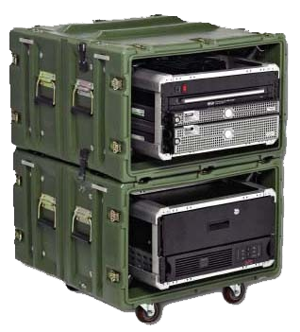
Joint CyberSecurity and Training Lab (JCTL)
Capabilities
Train as We Fight – Simulated operational networks to safely test capabilities
Closed network to allow real force on force attacks in a controlled environment
Immersive training, tactics, techniques and procedures development and validation
Tier I through Tier III environment for simulation and modeling
LANG CPT Mobile Response Cart
Cyber Mobile Response Cart
Range SIM 1

Slide 34


