Slide 1

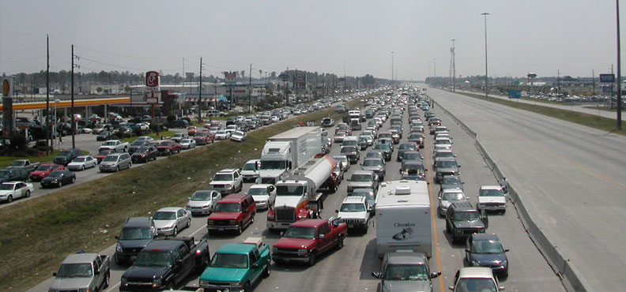
Gulf Coast Center for Evacuation and
Transportation Resiliency
Evacuation and Resilience
Practice and Research
Brian Wolshon
Louisiana State University
Making Cities Resilient Exchange February 25, 2015

Slide 2
What is Disaster Resilience?
The term "resilience" means the ability to prepare for and adapt to changing conditions and withstand and recover rapidly from disruptions*
In the context of community resilience, the emphasis is not solely on mitigating risk, but implementing measures to ensure that the community recovers to normal, or near normal function, in a reasonable timeframe.
*As defined in Presidential Policy Directive 21.

Slide 3


Resilience Concept
Maintain acceptable levels of functionality during and after disruptive events
Recover full functionality within a specified period of time
Functionality
Modifications before disruptive events
that improve system performance
Lost
Functionality
Aging System
Repairs after disruptive event to restore system functionality
Time
Residual Functionality
Event
Time to Full Recovery
Adapted from Bruneau, 2003 and McDaniels, 2008

Slide 4
Attributes of Resilience
Functionality – Resilience should be based on the ability of social systems to resume function within a prescribed period of time following an expected event. Buildings and infrastructure must be functional to support these social systems.
Interdependence – Resilience must consider the interdependence of buildings and infrastructure (functionality) and the relationship of individuals and organizations with the built environment.

Slide 5
Performance Levels for After- Event Evaluations
Category | Infrastructure System Performance Standard
I | Resume 100% service within days
II | Resume 90% service within weeks and 100% within months
III | Resume 90% service within months and 100% within years

Slide 6
Disaster Resilience Framework 1.0
The Disaster Resilience Framework 1.0 will focus on the role that buildings and infrastructure lifelines play in ensuring community resilience.
The Framework will:
  Establish types of performance goals and ways to express them
  Identify existing standards, codes, and best practices that address resilience
  Identify gaps that must be addressed to enhance resilience
  Capture regional differences in perspectives on resilience
The Disaster Resilience Framework will be informed through a series of stakeholder workshops.

Slide 7
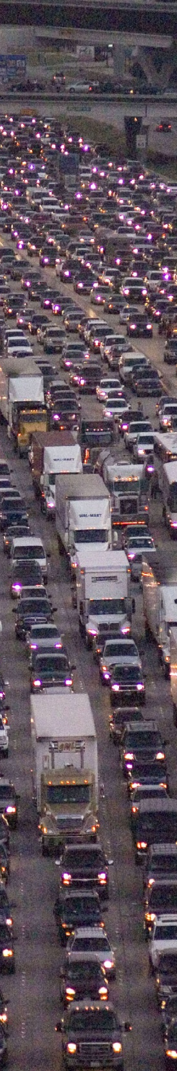
Evacuation Basics
TEMPORAL AND SPATIAL
Hazard Characteristics
  Scale (how “big?” -> How far to evacuate), Amount of advanced notice, Shelter-in-place options
Evacuee Characteristics
  Who are they? Where are they? How many? How mobile? Behavior (if/when will they leave?), What are their needs?
Transportation Resources
  Modes, Highway Transit, Traffic Control, Traffic Management
Communications
To/from, Across and between all levels, jurisdictions, agencies, and evacuees, Need for situational awareness
Gulf Coast Center for Evacuation and Transportation Resiliency
Notes:
These topics will be addressed from a transportation engineering perspective.
Using examples from recent evacuations in other states and Louisiana.
And showing examples of what were doing at LSU to address some of these issues here and nationally

Slide 8
Evacuation by Hazard
(1990 – 2003)
n=230, 1993-2003
(Source: F. Walton, Sandia National Laboratory)

Slide 9
(Source: F. Walton, Sandia National Laboratory)

Slide 10
Hurricane Rita Evacuation - Interstate 45 (north of Houston)
Photo Source: Lt. John Denholm
Harris Co. (TX) Sheriff's Office
Notes:
These topics will be addressed from a transportation engineering perspective.
Using examples from recent evacuations in other states and Louisiana.
And showing examples of what were doing at LSU to address some of these issues here and nationally

Slide 11

Photo Source: Yi-Chang Chiu, University of Arizona
Notes:
These topics will be addressed from a transportation engineering perspective.
Using examples from recent evacuations in other states and Louisiana.
And showing examples of what were doing at LSU to address some of these issues here and nationally

Slide 12
Recent History in Louisiana
Gulf Coast Center for Evacuation and Transportation Resiliency

Slide 13
Recent History in Louisiana
Prior to Hurricane Georges in 2000, there was no regional traffic management plan in LA
No “designated” evacuation routes
1st plan was developed in 2000 and included contraflow in New Orleans
Used for the first time in 2004 for Hurricane Ivan - with questionable results
“Revised plan” was developed in 2004-2005 and implemented for the first time for Hurricane Katrina
Evacuation was quite effective for those with the desire and means to evacuate
Plans for the evacuation of low-mobility populations were obviously “lacking”
Gulf Coast Center for Evacuation and Transportation Resiliency

Slide 14
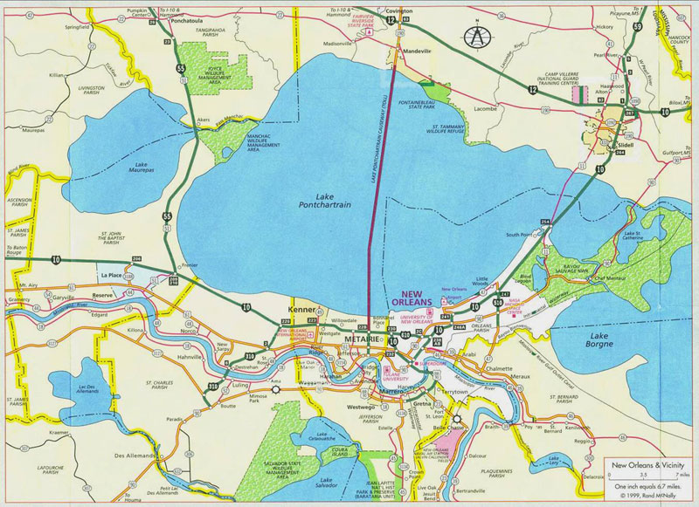
Primary Evacuation Routes
In the “Ivan Plan”
Normal Flow
Contraflow

Slide 15
Problems Identified in Ivan
An over-reliance on the westward movement of traffic
Confluence congestion created by the confluence of major evacuation routes in Baton Rouge, Hammond, Lafayette, Covington, and Slidell
Inefficient loading of contraflow in New Orleans
Inability to access up-to-date traffic information and provide timely and accurate traveler information to evacuees
Gulf Coast Center for Evacuation and Transportation Resiliency

Slide 16
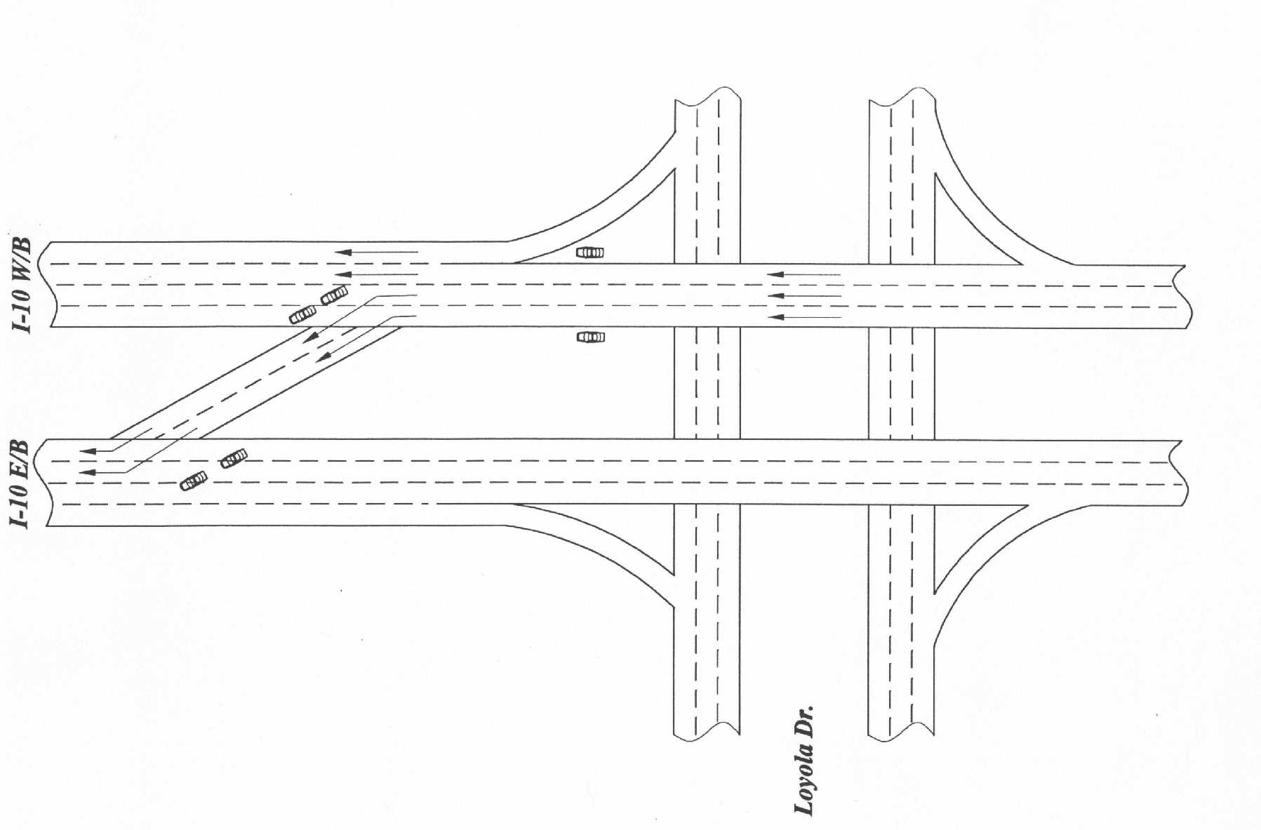
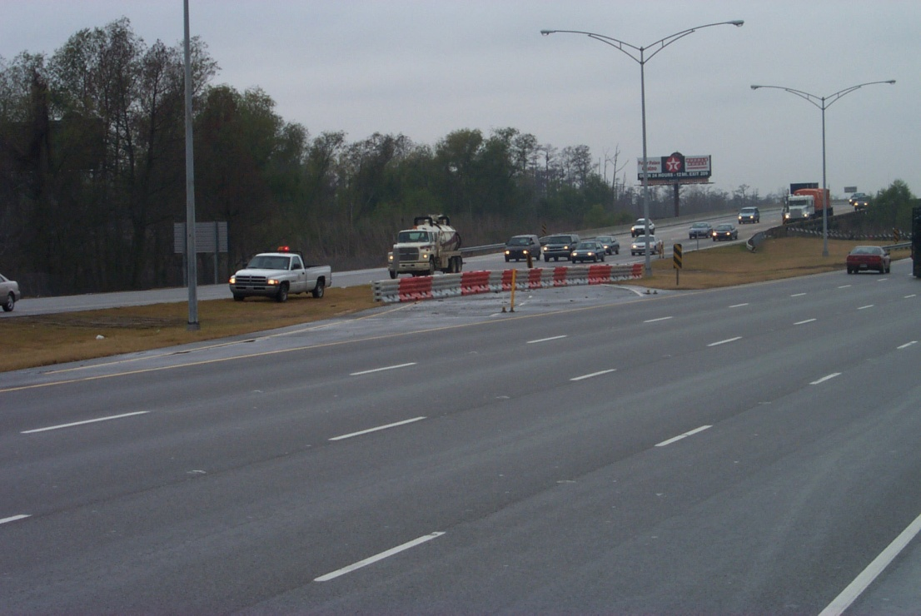
New Orleans Contraflow Initiation Point
  Westbound I-10/Loyal Drive Interchange
  Median Crossover

Slide 17
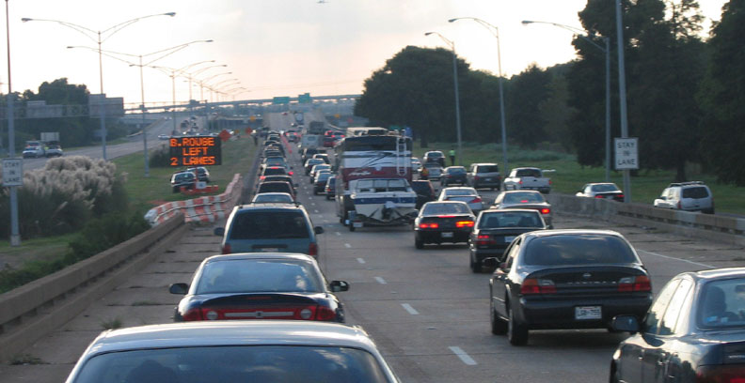
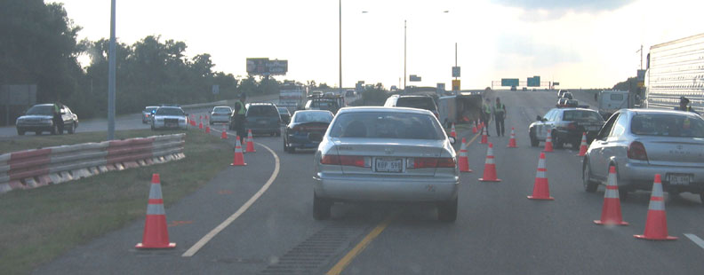
Hurricane Ivan Evacuation - Interstate 10 (west of New Orleans)
Photo Source: A. Caterella-Michel
Urban Systems, Inc.
Notes:
These topics will be addressed from a transportation engineering perspective.
Using examples from recent evacuations in other states and Louisiana.
And showing examples of what were doing at LSU to address some of these issues here and nationally

Slide 18
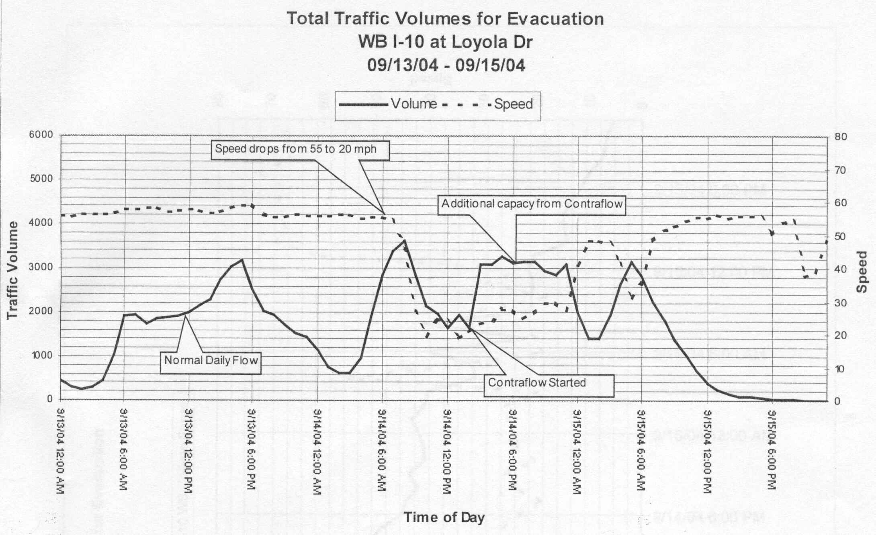
Figure Source: LaDOTD
Notes:
These topics will be addressed from a transportation engineering perspective.
Using examples from recent evacuations in other states and Louisiana.
And showing examples of what were doing at LSU to address some of these issues here and nationally

Slide 19
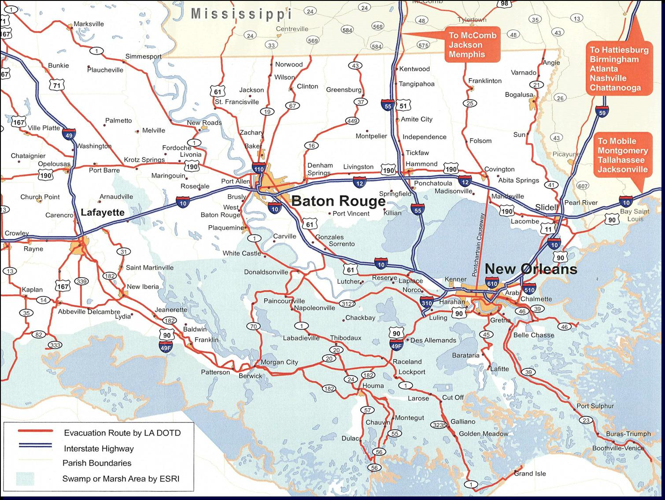
48-hour Traffic Volume Counts
September 14th and 15th, 2004
N.B. I-49
57,986 veh.
N.B. I-55 60,721 veh.
W.B. I-12
73,550 veh.
W.B. US190
54,847 veh.
W.B. I-10 79,417 veh.
W.B. I-10 126,241 veh.
E.B. I-10 30,644 veh.
W.B. I-10 64,026 veh.
W.B. US-61 33,612 veh.
N.B. I-49/US-90 64,510 veh.
Map Source: Regional Planning
Commission (10/04)
Traffic Data Source: LDOTD

Slide 20
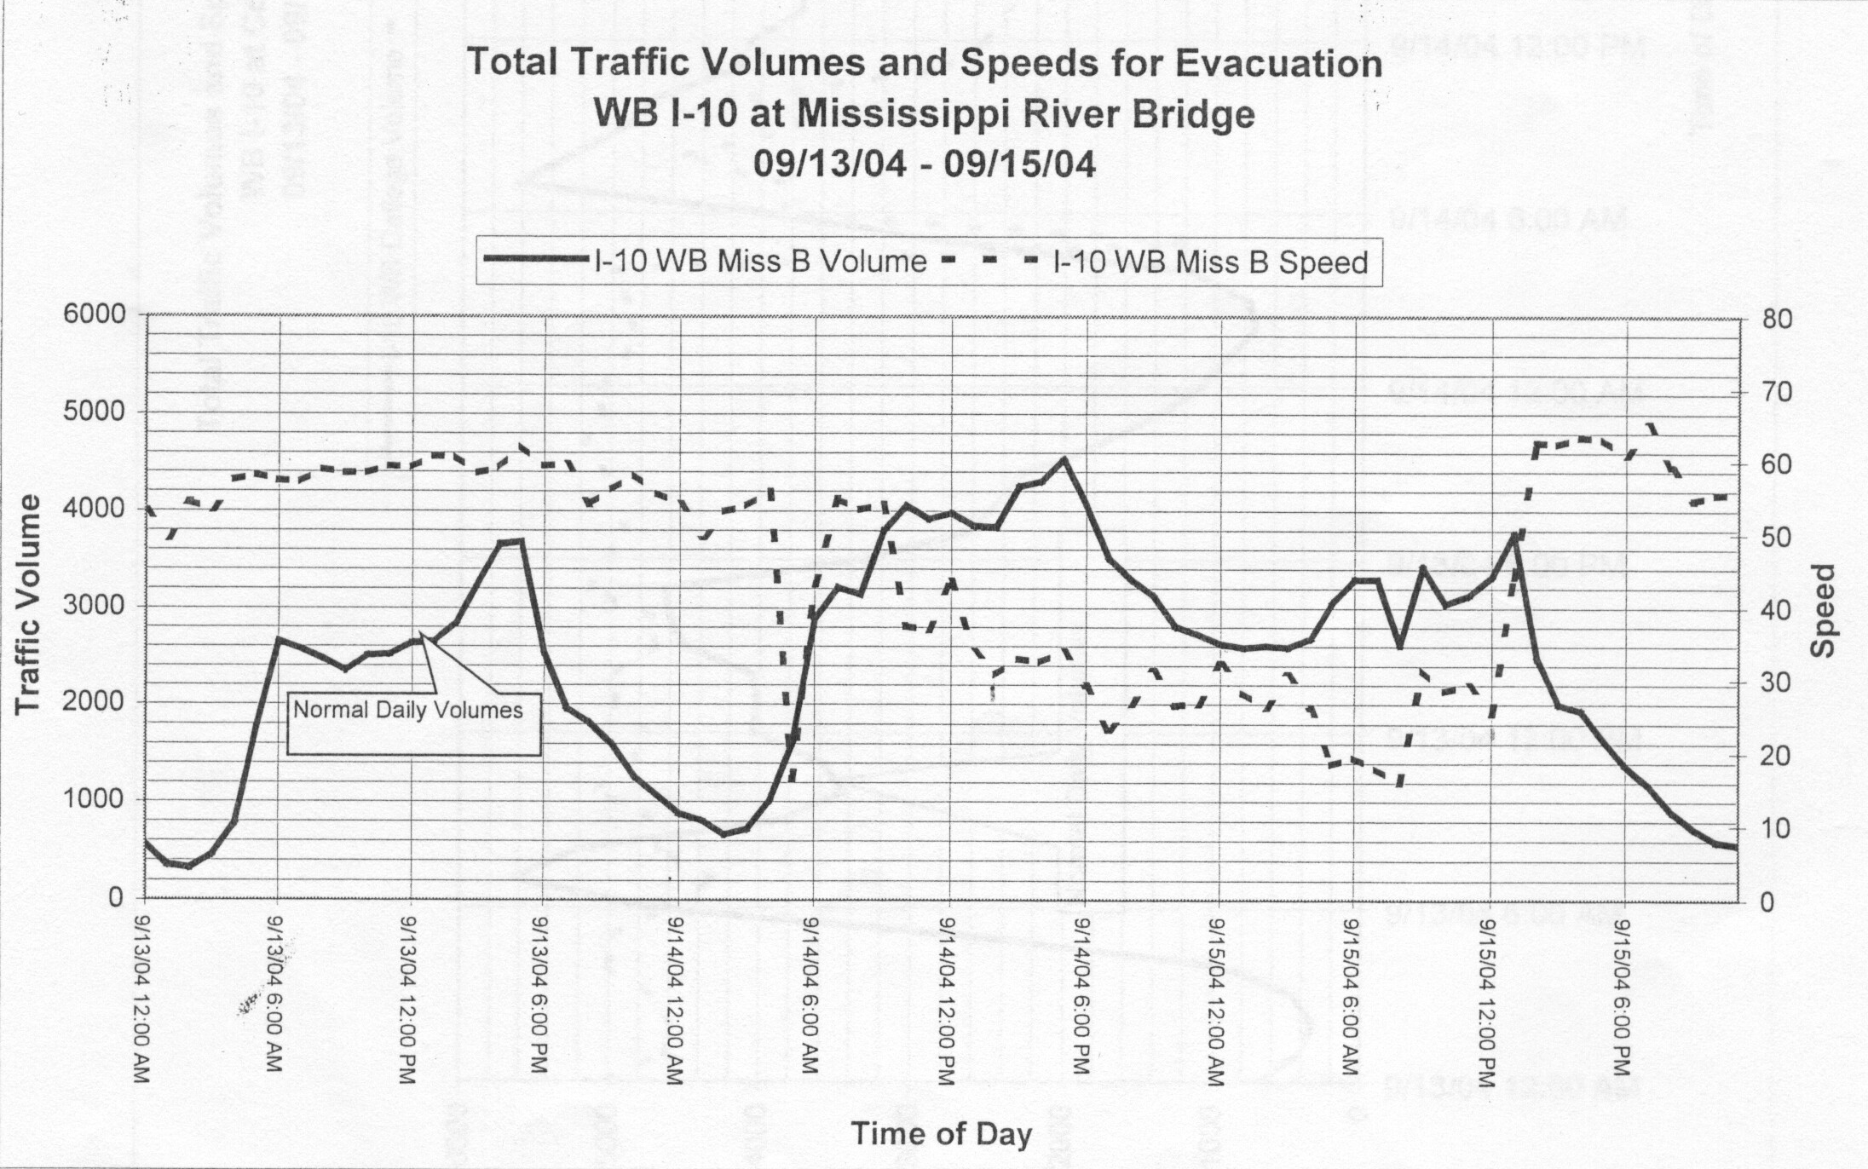
Figure Source: LaDOTD
Notes:
These topics will be addressed from a transportation engineering perspective.
Using examples from recent evacuations in other states and Louisiana.
And showing examples of what were doing at LSU to address some of these issues here and nationally

Slide 21
Proposed Solutions
Maximize the available routes out of the New Orleans area
Improve the loading of contraflow segments in New Orleans
Mitigate (eliminate?) the congestion in Baton Rouge
Inability to access up-to-date traffic information and provide timely and accurate traveler information to evacuees
Gulf Coast Center for Evacuation and Transportation Resiliency

Slide 22
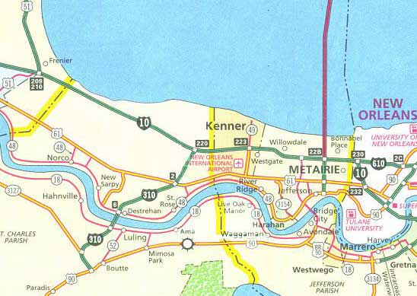
New Orleans Alternatives
Scenario 12h volume at max. flow Evacuees moved Increase over no-c/f
Ivan w/o contraflow 49,464 veh 123,660 people -----
Ivan w/contraflow 67,224 veh 168,060 people 35.9%
I-10/I-610 Loading Plan 97,572 veh 243,930 people 97.3%

Slide 23
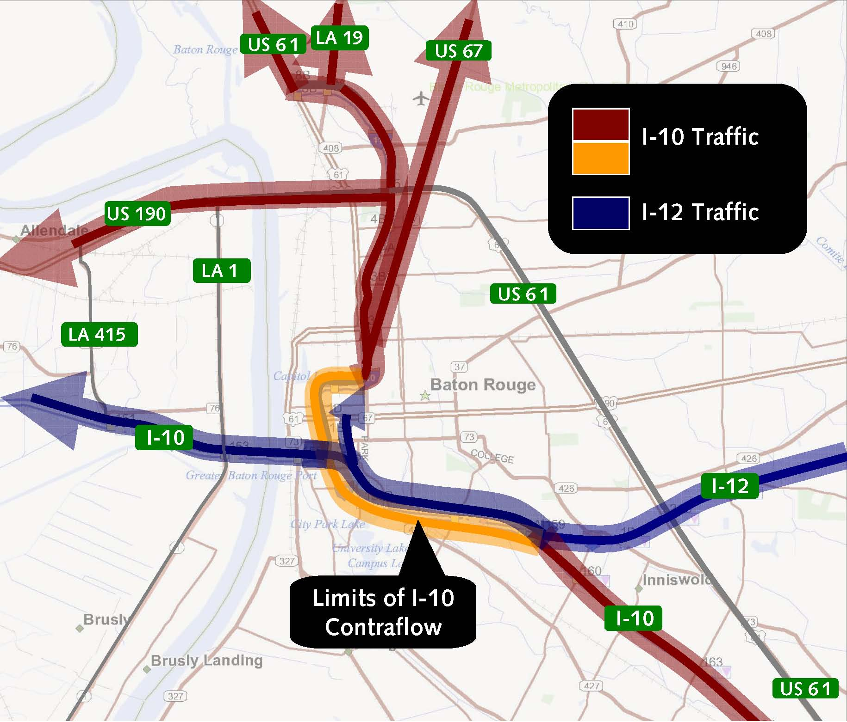
Baton Rouge Alternatives
3
2
1
Figure source: ABMB, Inc.
Location Ivan – Speed Flow Rate w/Contraflow – Speed Flow Rate
1
I-12 (bef. interchange) 16 mph 2,834 vph 56 mph 5,422 vph
I-10 (MS River Bridge) 28 mph 4,029 vph 22 mph 4,399 vph
I-110 (aft. interchange) 48 mph 2,067 vph 55 mph 3,701 vph
2
3
Notes:
These topics will be addressed from a transportation engineering perspective.
Using examples from recent evacuations in other states and Louisiana.
And showing examples of what were doing at LSU to address some of these issues here and nationally

Slide 24
The Plan and
Its Effects
Gulf Coast Center for Evacuation and Transportation Resiliency

Slide 25
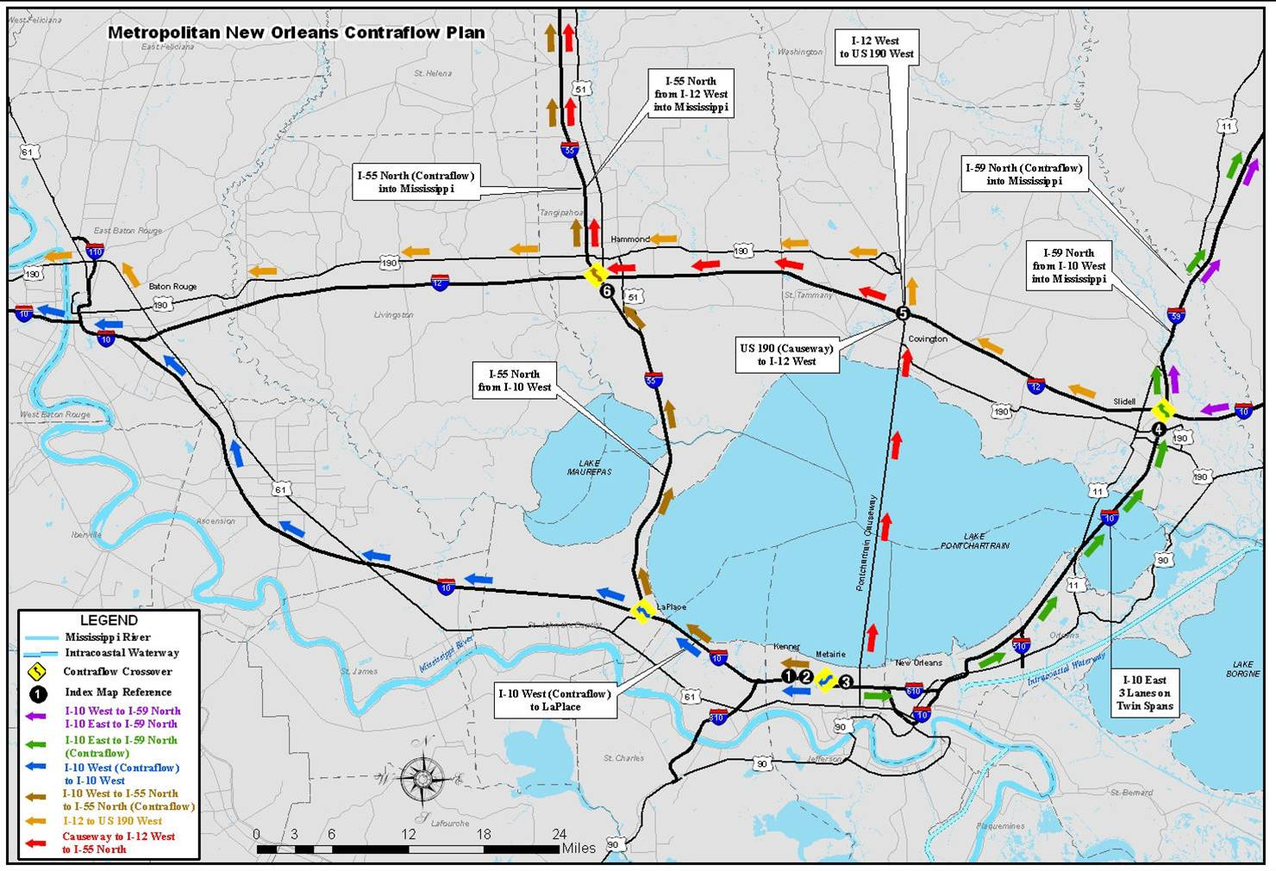
Map Source: LaDOTD
http://www.dotd.state.la.us/maps
Notes:
These topics will be addressed from a transportation engineering perspective.
Using examples from recent evacuations in other states and Louisiana.
And showing examples of what were doing at LSU to address some of these issues here and nationally

Slide 26
  August 28th and 29th, 2005
  September 14th and 15th, 2004
N.B. I-49
62,143 veh.
57,986 veh.
N.B. I-55
84,660 veh. (w c/f)
60,721 veh.
W.B. US190
43,508 veh.
54,847 veh.
W.B. I-12
33,669 veh.
73,550 veh.
N.B. I-59
73,779 veh. (w c/f)
37 hrs.
W.B. I-10 113,748 veh.
126,241 veh.
W.B. I-10
72,066 veh.
79,417 veh.
W.B. I-10 96,388 veh.
W.B. I-10
57,376 veh.
64,026 veh.
W.B. US-61 43,572 veh.
33,612 veh.
N.B. I-49/US-90 66,845 veh.
64,510 veh.
  Traffic Data Sources: LA DOTD and MS DOT
  Map Source: New Orleans Regional Planning Commission (10/04)

Slide 27
Duration of Evacuation Volume
Storm Landfall
3000
2500
2000
Ave. of Prior
3 Weeks
1500
Katrina
Evacuation
1000
500
0
0
12
24
12
24
12
24
12
24
12
24
THURSDAY FRIDAY SATURDAY SUNDAY MONDAY
Westbound (outbound) Lanes – LaPlace, Louisiana
(Data source: LA DOTD)

Slide 28
Effect of Contraflow on Traffic Volume
5000
Hurricane Ivan
Hurricane Katrina
9/14 and 9/15, 2004
8/26 thru 8/29, 2005
Total
4500
Northbound
Volume
4000
w/ contraflow
3500
3000
Total
Northbound
Volume
2500
2000
Northbound Volume
in “Normal” Lanes
1500
1000
500
0
0
12
24
12
24
12
24
12
24
12
24
12
24
12
24
TUESDAY WEDNESDAY FRIDAY SATURDAY SUNDAY MONDAY
(Data source: LA DOTD)

Slide 29
Evacuation Traffic Control
Gulf Coast Center for Evacuation and Transportation Resiliency

Slide 30
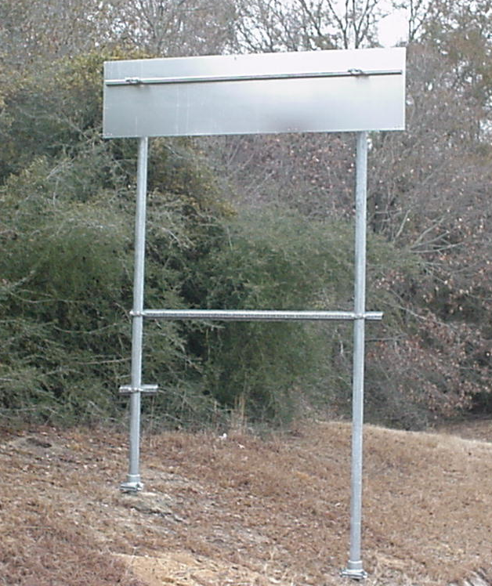
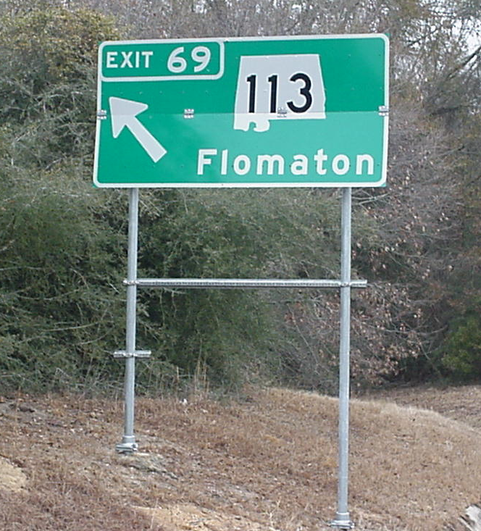
Examples of Control Devices
Notes:
These topics will be addressed from a transportation engineering perspective.
Using examples from recent evacuations in other states and Louisiana.
And showing examples of what were doing at LSU to address some of these issues here and nationally

Slide 31
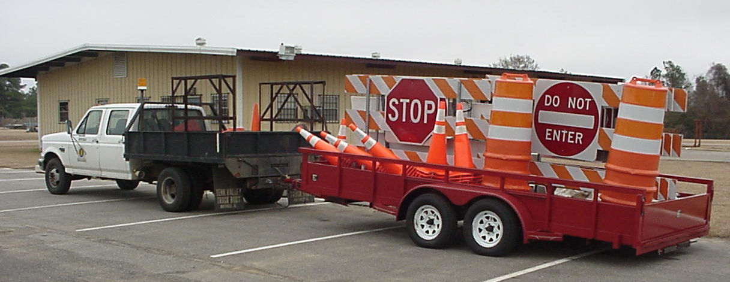
Examples of Control Devices
Notes:
These topics will be addressed from a transportation engineering perspective.
Using examples from recent evacuations in other states and Louisiana.
And showing examples of what were doing at LSU to address some of these issues here and nationally

Slide 32
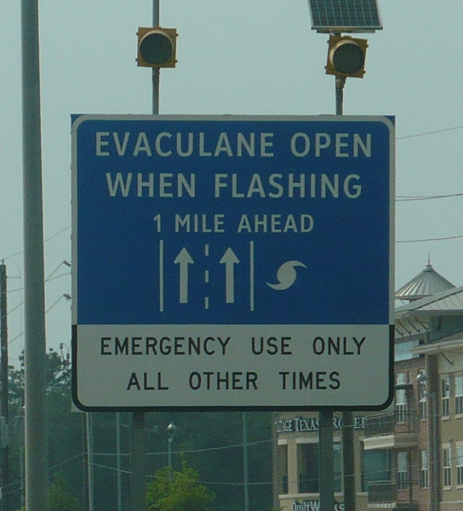
Texas EVACULANE Shoulders
US 290
Houston to Hempstead
Notes:
These topics will be addressed from a transportation engineering perspective.
Using examples from recent evacuations in other states and Louisiana.
And showing examples of what were doing at LSU to address some of these issues here and nationally

Slide 33
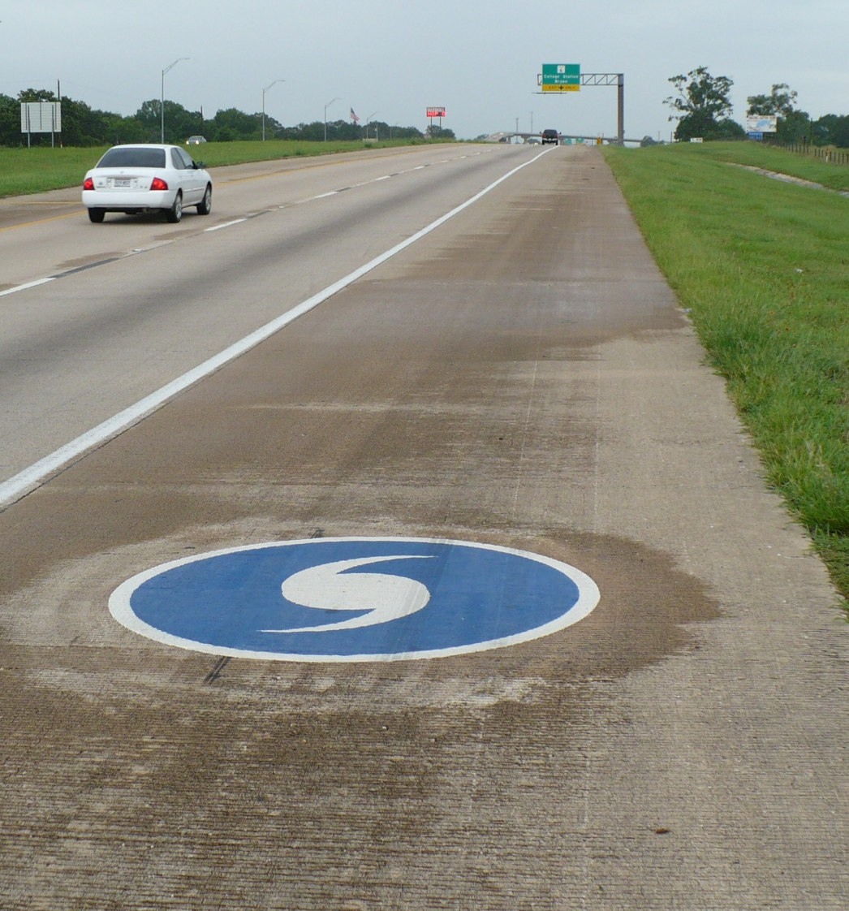
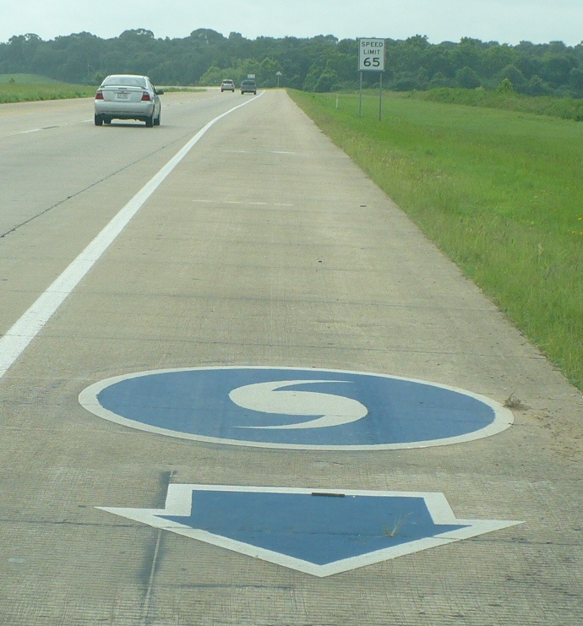
Examples of Control Devices
Notes:
These topics will be addressed from a transportation engineering perspective.
Using examples from recent evacuations in other states and Louisiana.
And showing examples of what were doing at LSU to address some of these issues here and nationally

Slide 34
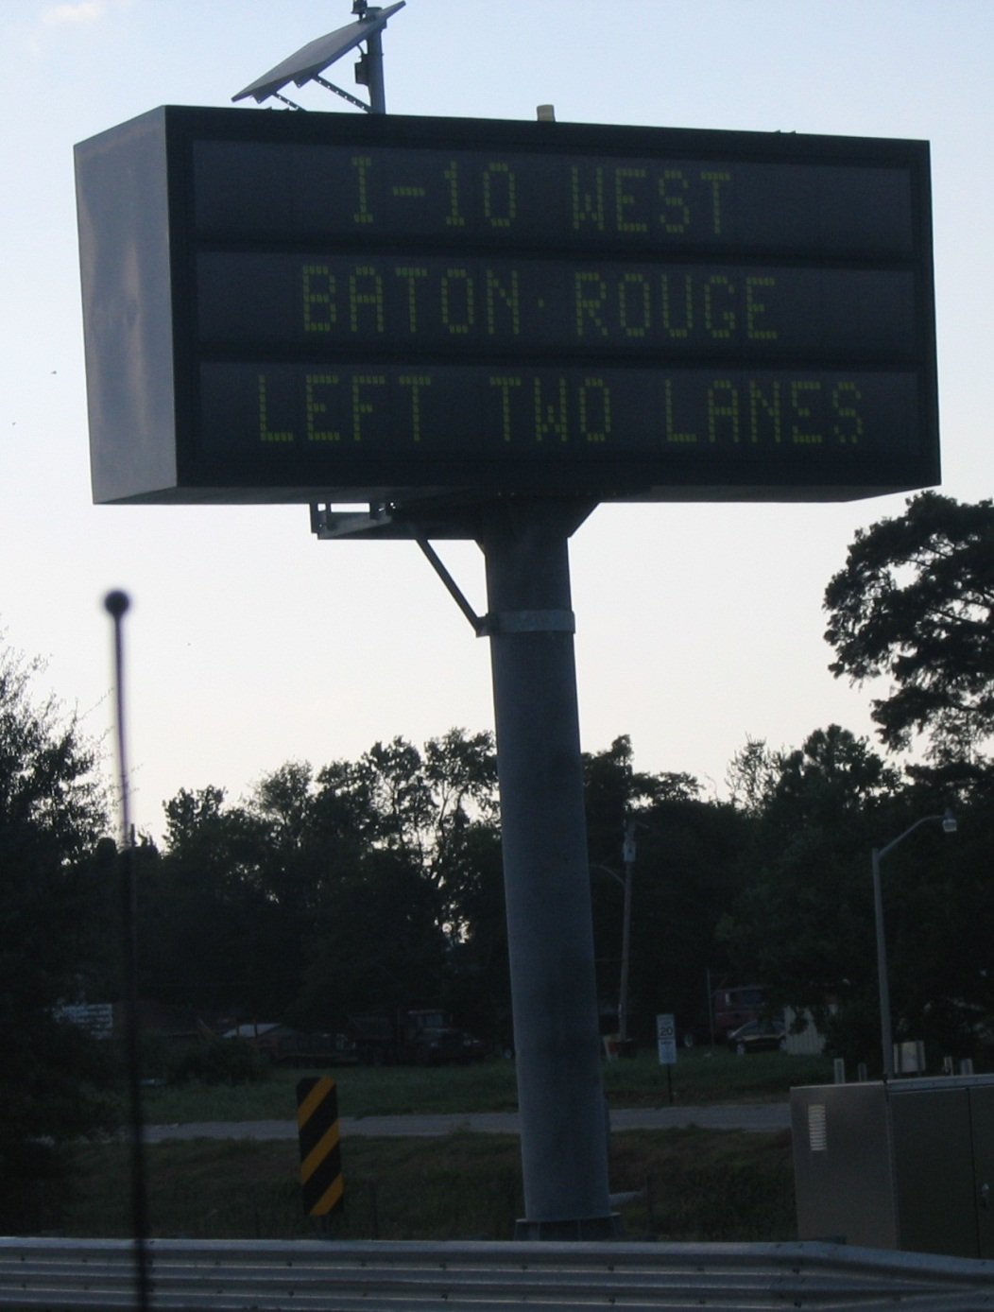
Variable Message Signs
Notes:
These topics will be addressed from a transportation engineering perspective.
Using examples from recent evacuations in other states and Louisiana.
And showing examples of what were doing at LSU to address some of these issues here and nationally

Slide 35
Assisted Evacuations
Gulf Coast Center for Evacuation and Transportation Resiliency

Slide 36
“Low Mobility” Evacuees
Individuals without personal transportation, elderly, infirm, tourists, economically disadvantaged, prisoners, homeless, etc.
How many persons fit these description?
Where are they located?
Who are they and what are there needs? medicine, oxygen, dialysis, etc.
Who is responsible for them if they are unable to take of themselves?
Where do they go? How do they come back?
Gulf Coast Center for Evacuation and Transportation Resiliency

Slide 37
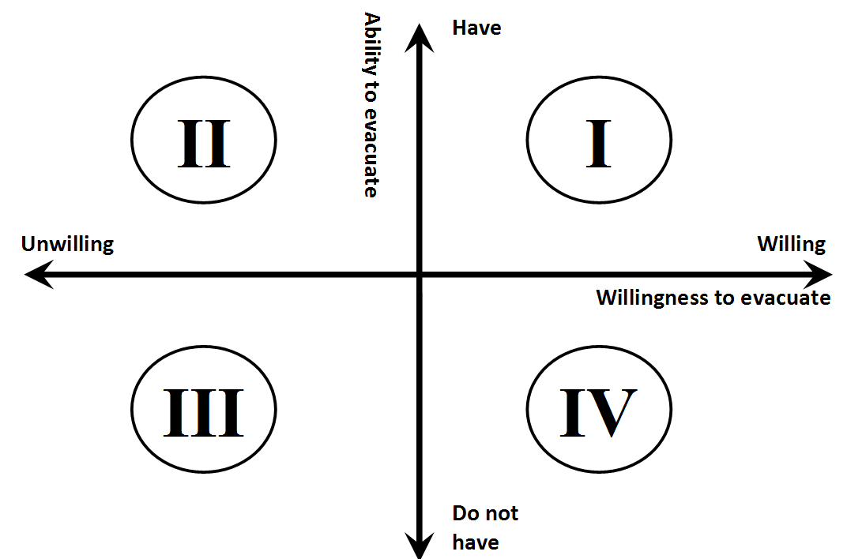
Evacuee Categorization
Notes:
These topics will be addressed from a transportation engineering perspective.
Using examples from recent evacuations in other states and Louisiana.
And showing examples of what were doing at LSU to address some of these issues here and nationally

Slide 38
Problems of Low Mobility Evacuation Planning
Existing traffic/transportation simulation systems are not created to model evacuation conditions
  Scale (e.g., number of vehicles)
  Scope (e.g. duration, geographic area)
Existing models do not permit the modeling and simulation of multiple modes of transportation simultaneously
Most models are not able to give analysts the MOE’s they’d like or decision-makers the answers to questions they pose
Limited understanding and development of underlying behaviors of evacuation travel for different evacuee and mode types
Gulf Coast Center for Evacuation and Transportation Resiliency

Slide 39
Problems of Modeling Evacuation Transportation Plans
Existing traffic/transportation simulation systems are not created to model evacuation conditions
  Scale (e.g., number of vehicles)
  Scope (e.g. duration, geographic area)
Existing models do not permit the modeling and simulation of multiple modes of transportation simultaneously
Most models are not able to give analysts the MOE’s they’d like or decision-makers the answers to questions they pose
Gulf Coast Center for Evacuation and Transportation Resiliency

Slide 40
Recognized Limitations
Existing traffic/transportation simulation systems are not created to model evacuation conditions
  Scale (e.g., number of vehicles)
  Scope (e.g. duration, geographic area)
Existing models do not permit the modeling and simulation of multiple modes of transportation simultaneously
Most models are not able to give analysts the MOE’s they’d like or decision-makers the answers to questions they pose
Limited understanding and development of underlying behaviors of evacuation travel for different evacuee and mode types
Gulf Coast Center for Evacuation and Transportation Resiliency

Slide 41
Evacuation
Modeling
Gulf Coast Center for Evacuation and Transportation Resiliency

Slide 42
Evacuation Modeling Spectrum
From: “Structuring Modeling and Simulation Analyses for Evacuation Planning and Operations”
By: Hardy, Wunderlich, Bunchand, and Smith

Slide 43
Current Research
Application of the TRANSIMS system
Can be used to model very large geographical regions and large numbers of travelers
Effort and expertise required to code and run
Issues of verification, validation, and calibration
Hardware and software requirements
History, experience, and acceptance within the professional transportation community
Not developed for the purpose of evacuation
Gulf Coast Center for Evacuation and Transportation Resiliency

Slide 44
Evacuation Traffic Simulation
Has proven value
Permits bottlenecks to be identified and potential solutions to be analyzed before they become problems
Gives quantitative MOE results to decision-makers
Allows effects of alternative strategies and adverse conditions to be assessed without consequence
Gulf Coast Center for Evacuation and Transportation Resiliency

Slide 45
Recognized Limitations
Existing traffic/transportation simulation systems are not created to model evacuation conditions
  Scale (e.g., number of vehicles)
  Scope (e.g. duration, geographic area)
Existing models do not permit the modeling and simulation of multiple modes of transportation simultaneously
Most models are not able to give analysts the MOE’s they’d like or decision-makers the answers to questions they pose
Limited understanding and development of underlying behaviors of evacuation travel for different evacuee and mode types
Gulf Coast Center for Evacuation and Transportation Resiliency

Slide 46
TRANSIMS
Project
Gulf Coast Center for Evacuation and Transportation Resiliency

Slide 47
TRANSIMS System
Incorporates aspects of planning and operations
Model large geographical regions and large numbers of travelers
Model populations, travel activities, routing, and analyses it with a microsimulator
Open source and available
Effort and expertise required to code and run
Issues of verification, validation, and calibration
Hardware and software requirements
History, experience, and acceptance within the professional transportation community
Not developed for the purpose of evacuation
Gulf Coast Center for Evacuation and Transportation Resiliency

Slide 48
TRANSIMS Structure
Network Input
  Structure and characteristics of the transportation network (control, capacity, etc.) and activity locations
Population Synthesizer
  Creates a disaggregate synthetic population based on aggregate census zonal information
Activity Generator
  Travel surveys or observation of past evacuations
Router
  Spatial and temporal travel behavior and route assignments
Microsimulator
  Tracks and compiles movements and statistics of each agent (vehciles & peds)
Visualizer
  3rd party developer Balfour Technologies Inc.
Gulf Coast Center for Evacuation and Transportation Resiliency

Slide 49
LSU Study - Approach
Step 1 – Network development
Step 2 - “Base Model” validation and calibration based on 2005 Katrina evacuation
Step 3 - Code “New” New Orleans multimodal plan
Step 4 - “Base Model” validation and calibration based on 2005 Katrina evacuation
Step 5 - Code and test alternative plans and ideas
Gulf Coast Center for Evacuation and Transportation Resiliency

Slide 50
Map Source: LaDOTD
http://www.dotd.state.la.us/maps
Notes:
These topics will be addressed from a transportation engineering perspective.
Using examples from recent evacuations in other states and Louisiana.
And showing examples of what were doing at LSU to address some of these issues here and nationally

Slide 51
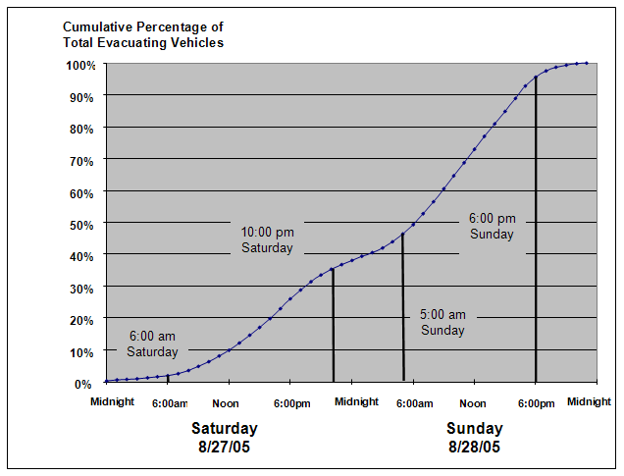
Gulf Coast Center for Evacuation and Transportation Resiliency
Notes:
Hazard analysis to identify the area that would need to be evacuated for a particular hazard condition
Vulnerability analysis to ascertain the number of households and people that are susceptible to the threat condition
Behavioral analysis to project how people will respond to the threat
Transportation analysis to assess roadway capacities within the transportation network and identify conditions such as bottlenecks or links vulnerable to the hazard. The objective of the transportation analysis is to develop clearance times within an evacuation area. Clearance times are estimates of the time that would be required to evacuate an area.
Shelter analysis to evaluate the capability of buildings to withstand the hazards conditions and their suitability to be used as refuges for evacuees
Decision making to develop procedures to assess whether a hazard presents a level threat to warrant an evacuation and, if so, when to initiate an evacuation order
Development management to regulate the growth of population and land development that could make evacuation more difficult

Slide 52
Map Source: LaDOTD
http://www.dotd.state.la.us/maps
Notes:
These topics will be addressed from a transportation engineering perspective.
Using examples from recent evacuations in other states and Louisiana.
And showing examples of what were doing at LSU to address some of these issues here and nationally

Slide 54
Map Source: LaDOTD
http://www.dotd.state.la.us/maps
Notes:
These topics will be addressed from a transportation engineering perspective.
Using examples from recent evacuations in other states and Louisiana.
And showing examples of what were doing at LSU to address some of these issues here and nationally

Slide 55
LaPlace Data Station
10:00am - Sunday
Baton Rouge
New Orleans
Westbound I-10 Traffic Speed

Slide 56
Map Source: LaDOTD
http://www.dotd.state.la.us/maps
Notes:
These topics will be addressed from a transportation engineering perspective.
Using examples from recent evacuations in other states and Louisiana.
And showing examples of what were doing at LSU to address some of these issues here and nationally

Slide 58
Map Source: LaDOTD
http://www.dotd.state.la.us/maps
Notes:
These topics will be addressed from a transportation engineering perspective.
Using examples from recent evacuations in other states and Louisiana.
And showing examples of what were doing at LSU to address some of these issues here and nationally

Slide 60
Thursday Friday Saturday Sunday Monday

Slide 61
Conclusions
Evidence that TRANSIMS can be an effective tool for evacuation modeling and planning
Constituent models can be useful in whole or when used separately
Development of the TRANSIMS model has added benefits beyond evacuation
User interface for coding and output results was cumbersome
Gulf Coast Center for Evacuation and Transportation Resiliency

Slide 62
Assisted Evacuation Modeling
Gulf Coast Center for Evacuation and Transportation Resiliency

Slide 63
Assisted Evacuations
Evacuation planning has historically been targeted at persons with personal vehicles
A substantial percentage of potential vulnerable populations do not have personal vehicles
Plans to evacuate “carless” populations in many locations have been created relatively recently or are currently in development
There have been few actual activations to gain knowledge and experience, nor tests, drills or simulations to evaluate potential weakness and needs
Gulf Coast Center for Evacuation and Transportation Resiliency

Slide 64
Study Questions
Proof-of-Concept - Can TRANSIMS be used for evacuation analysis? Are its results reasonable?
Develop a variety and range of hazard-response scenarios
How many buses might be needed under various scenarios? What routes should they take?
Potential to estimate the number of location of evacuees
Examine the potential of alternate plans
Gulf Coast Center for Evacuation and Transportation Resiliency

Slide 65
Research Methodology
Model Development
  Spatial distribution, loading, and temporal movements 40,000 assisted evacuees (including 10,000 tourists)
Scenario Development (8 cases)
  Routing: I-10 vs. US-61
  Response “Urgency”: 24, 32, 36, 48 hours
MOE’s
  Total evacuation time and average travel time
Develop and Evaluate Alternative Management Strategies
  “Off-peak” movements
  “Forced” routing
Gulf Coast Center for Evacuation and Transportation Resiliency

Slide 66
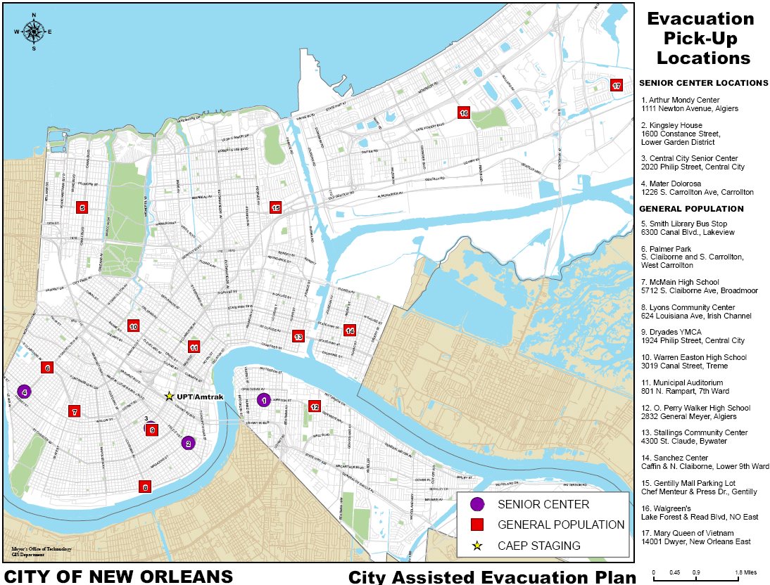
Notes:
66
Hazard analysis to identify the area that would need to be evacuated for a particular hazard condition
Vulnerability analysis to ascertain the number of households and people that are susceptible to the threat condition
Behavioral analysis to project how people will respond to the threat
Transportation analysis to assess roadway capacities within the transportation network and identify conditions such as bottlenecks or links vulnerable to the hazard. The objective of the transportation analysis is to develop clearance times within an evacuation area. Clearance times are estimates of the time that would be required to evacuate an area.
Shelter analysis to evaluate the capability of buildings to withstand the hazards conditions and their suitability to be used as refuges for evacuees
Decision making to develop procedures to assess whether a hazard presents a level threat to warrant an evacuation and, if so, when to initiate an evacuation order
Development management to regulate the growth of population and land development that could make evacuation more difficult

Slide 67
Jefferson Parish Bus Routes
Notes:
67
Hazard analysis to identify the area that would need to be evacuated for a particular hazard condition
Vulnerability analysis to ascertain the number of households and people that are susceptible to the threat condition
Behavioral analysis to project how people will respond to the threat
Transportation analysis to assess roadway capacities within the transportation network and identify conditions such as bottlenecks or links vulnerable to the hazard. The objective of the transportation analysis is to develop clearance times within an evacuation area. Clearance times are estimates of the time that would be required to evacuate an area.
Shelter analysis to evaluate the capability of buildings to withstand the hazards conditions and their suitability to be used as refuges for evacuees
Decision making to develop procedures to assess whether a hazard presents a level threat to warrant an evacuation and, if so, when to initiate an evacuation order
Development management to regulate the growth of population and land development that could make evacuation more difficult

Slide 68
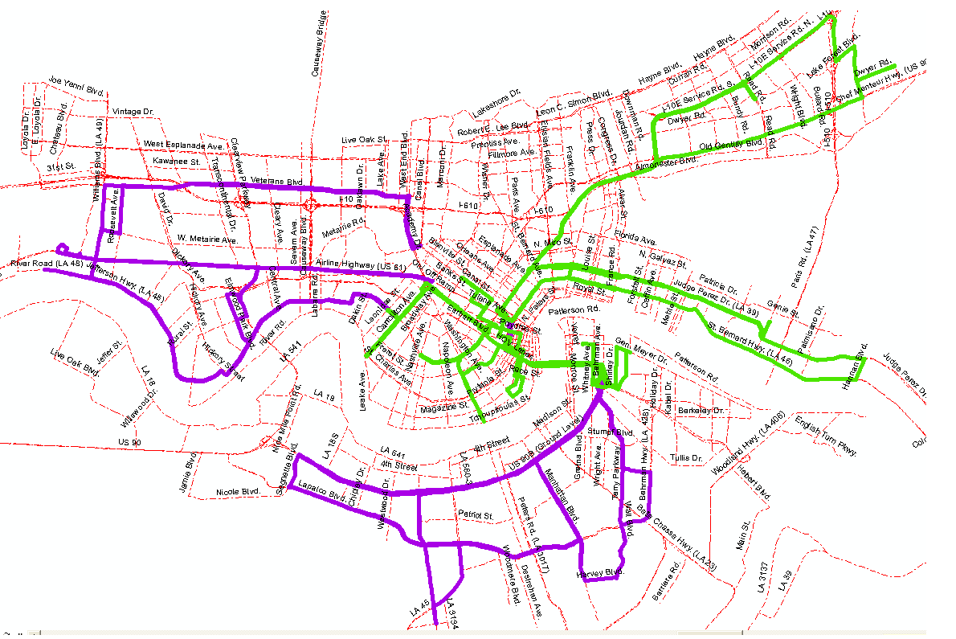

Slide 69
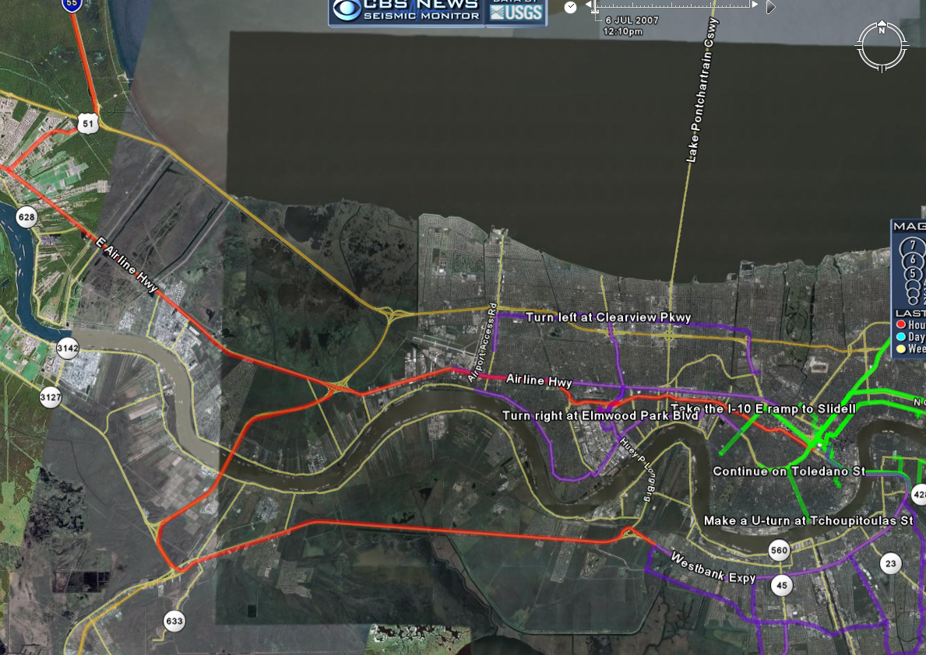

Slide 70
Quantitative Results
Evacuation Scenario | Total Evacuation Time (hr) |  | Percent Reduction
 | I-10 | US-61
A | 34.95 | 32.79 | 6.2 %
B | 47.27 | 46.44 | 1.8 %
C | 29.89 | 25.76 | 13.8 %
D | 41.35 | 36.49 | 11.8 %
Evacuation Scenario | Average Travel Time (hr) |  | Percent Reduction
 | I-10 | US-61
A | 4.81 | 2.55 | 47.0 %
B | 5.03 | 2.84 | 43.5 %
C | 4.54 | 2.20 | 51.5 %
D | 4.80 | 2.61 | 45.6 %

Slide 71
Conclusions
Evidence that TRANSIMS is an effective tool for multimodal evacuation modeling and planning
Constituent models can be useful in whole or when used separately
Quantify Process and Evaluate Alternatives
Management Strategy | Total Evacuation Time | Average Travel Time
Off Peak Evacuation | 45% | 10%
Alternative Routing | 14% | 52%
Gulf Coast Center for Evacuation and Transportation Resiliency

Slide 72


http://www.trb.org/
Notes:
72

Slide 73
Florida Keys Evacuation Planning
Gulf Coast Center for Evacuation and Transportation Resiliency

Slide 74
Gulf Coast Center for Evacuation and
Transportation Resiliency
Evacuation Planning in
The Florida Keys:
Unique Challenges and Emerging Knowledge
Brian Wolshon, Ph.D., P.E.
Louisiana State University
2012 National Evacuation Conference March 29, 2012

Slide 75
Discussion Topics
Background on the unique nature of The Florida Keys and the challenges they present to evacuation
Transportation network in The Keys
Social and political concerns influencing evacuation
Transportation analyses and emerging knowledge
Applicability to other locations
Gulf Coast Center for Evacuation and Transportation Resiliency

Slide 76
Unique Nature of The Florida Keys
High risk potential
Effectively one route out
  Susceptible to traffic and roadway incidents
  Use of contraflow is problematic
Approximately 80,000 resident and tourists evacuees
  Highest concentration in the Lower Keys
Long travel distance
Potential effects of “mainland” traffic
Gulf Coast Center for Evacuation and Transportation Resiliency

Slide 77
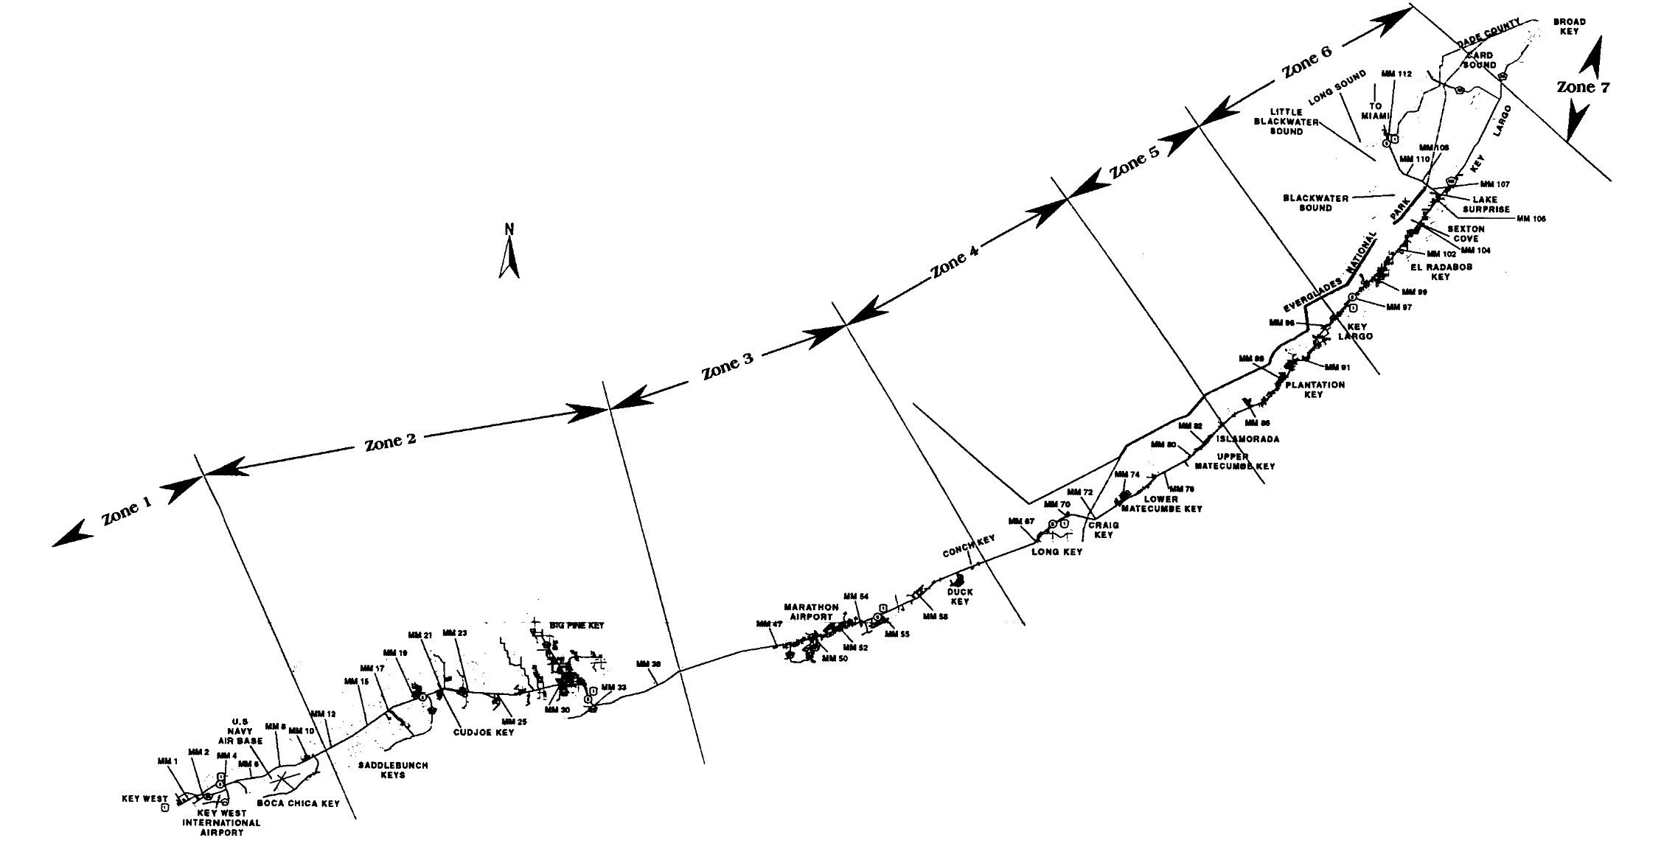
(Map source: 2001 Florida Keys Hurricane Evacuation Study)

Slide 78
Unique Nature of The Florida Keys
Designated as a Florida “Area of Critical State Concern”
  Unique nature and value of the area makes The Keys important to the State as a whole
  State, rather than local government, has authority over many key civil issues
Evacuation
  Must be able to undertake a full evacuation in 24 hours
Growth and Development
  New construction is limited by the ability to serve water, sewer, evacuation, etc.
Gulf Coast Center for Evacuation and Transportation Resiliency

Slide 79
Transportation Analysis History
Long history of traffic analysis and modeling in The Keys
2001 Florida Keys Hurricane Evacuation Study (aka “The Miller Model”)
  Linear model of link flows
More complex models as part of the Florida Statewide Study
The models rely on estimates of roadway capacity
Gulf Coast Center for Evacuation and Transportation Resiliency

Slide 80
General Modeling Process
Spatial and temporal generation of travel demand
  Who leaves, when do they leave, where do they come from, where do the go, what route(s) do they take?
What is the carrying capacity of the road network?
What are the travel conditions?
  Speed, travel time, delay, congestion
Convert to a clearance time
Gulf Coast Center for Evacuation and Transportation Resiliency

Slide 81
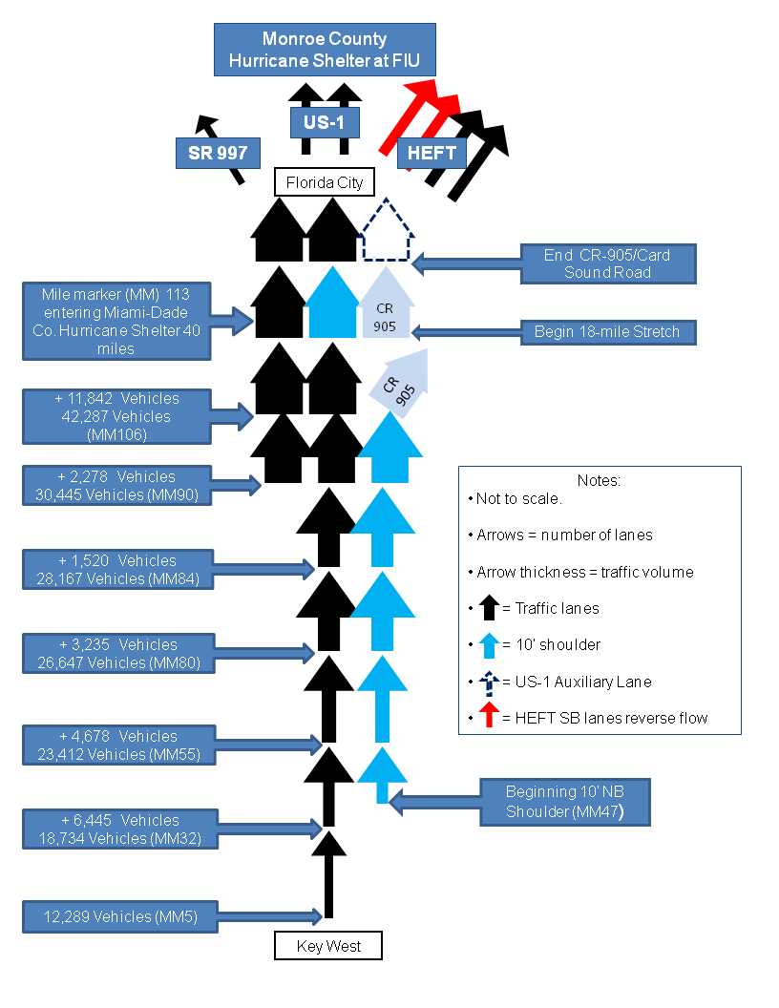

Slide 82
Model Findings 2001
2001 Florida Keys Hurricane Evacuation Study
  Examined clearance time under numerous scenarios including existing road configuration and various lane and intersection capacity improvements
Existing (no-build) condition would result in an clearance time of 25hr 58min
Through various improvements, it was suggested that this could be lowered to just under 19 hours
  Lane additions where expected flow were highest – Upper Keys
FDOT implementing these improvements since
Gulf Coast Center for Evacuation and Transportation Resiliency

Slide 83
Research Findings
Numerous major evacuations (1999 – 2008) afforded the opportunity to collect and analyze flow patterns and characteristics
The observed data showed consistent patterns that actual flow during events were not consistent with prior assumptions
  They also vary at different times
Research suggests the use of “Maximum Sustainable Evacuation Traffic Flow Rates” for modeling and analysis
Gulf Coast Center for Evacuation and Transportation Resiliency

Slide 84
Maximum Sustainable
Evacuation Traffic Flow Rates
The anticipated highest vehicle flow rates that can be practically sustained over an extended period of time during an evacuation
Although Maximum Sustainable Evacuation Traffic Flow Rates are similar to the “capacity” of the road segment, they are quite different
They vary by segment – and will also vary based on specific conditions that exist at the time of the event
Gulf Coast Center for Evacuation and Transportation Resiliency

Slide 85
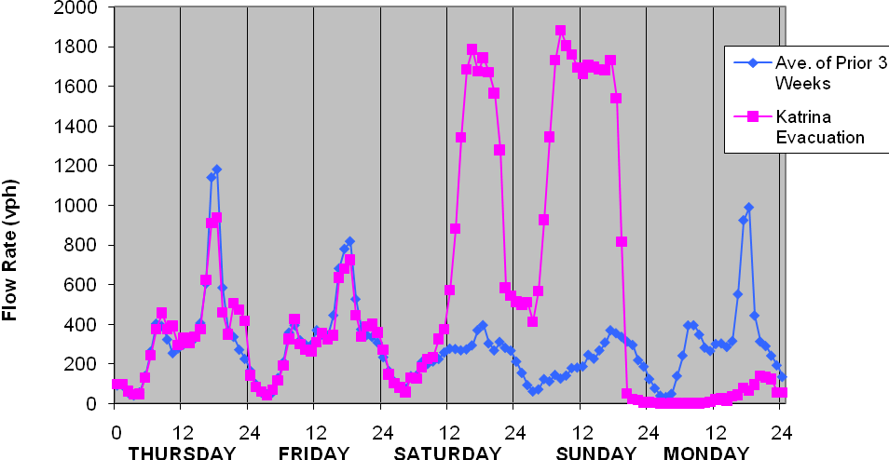
Louisiana Observations
Time and Day
Northbound Evacuation (2-lane) Traffic Volume - US-61 LaPlace Louisiana

Slide 86
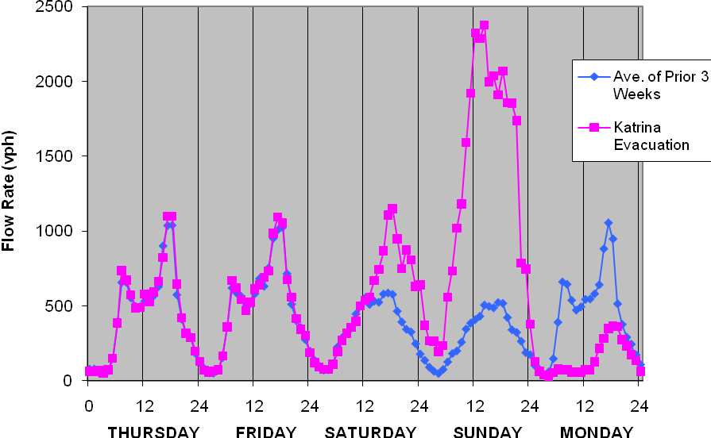
Louisiana Observations
Time and Day
Westbound Evacuation (2-lane) Traffic Volume - US-190 (Mississippi River Bridge departure) Port Allen, Louisiana

Slide 87
Louisiana Observations
Time and Day
Westbound Evacuation (2-lane) Traffic Volume - US-190 (Mississippi River Bridge departure) Port Allen, Louisiana

Slide 88
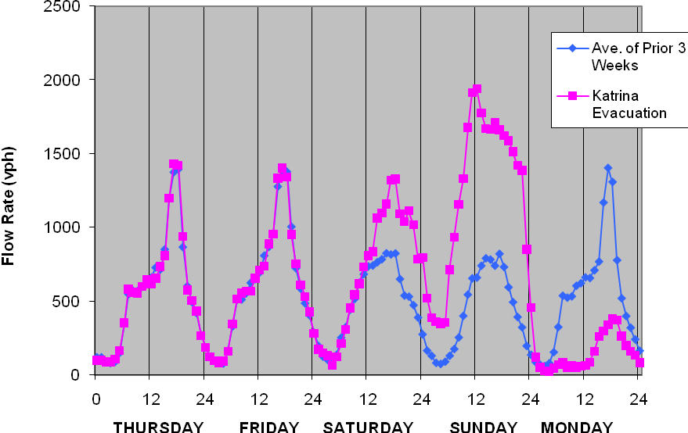
Louisiana Observations
Time and Day
Westbound Evacuation (2-lane) Traffic Volume - US-190 Port Allen Louisiana

Slide 89
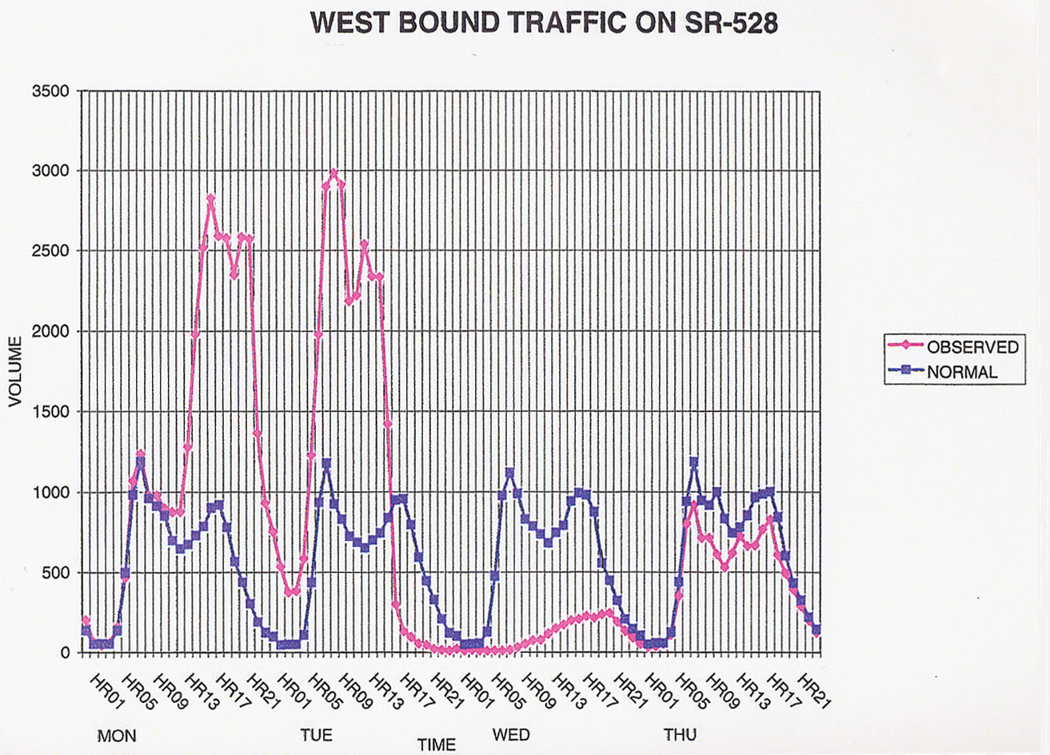
Florida Observations
Westbound SR-528 Traffic Volume Data

Slide 90
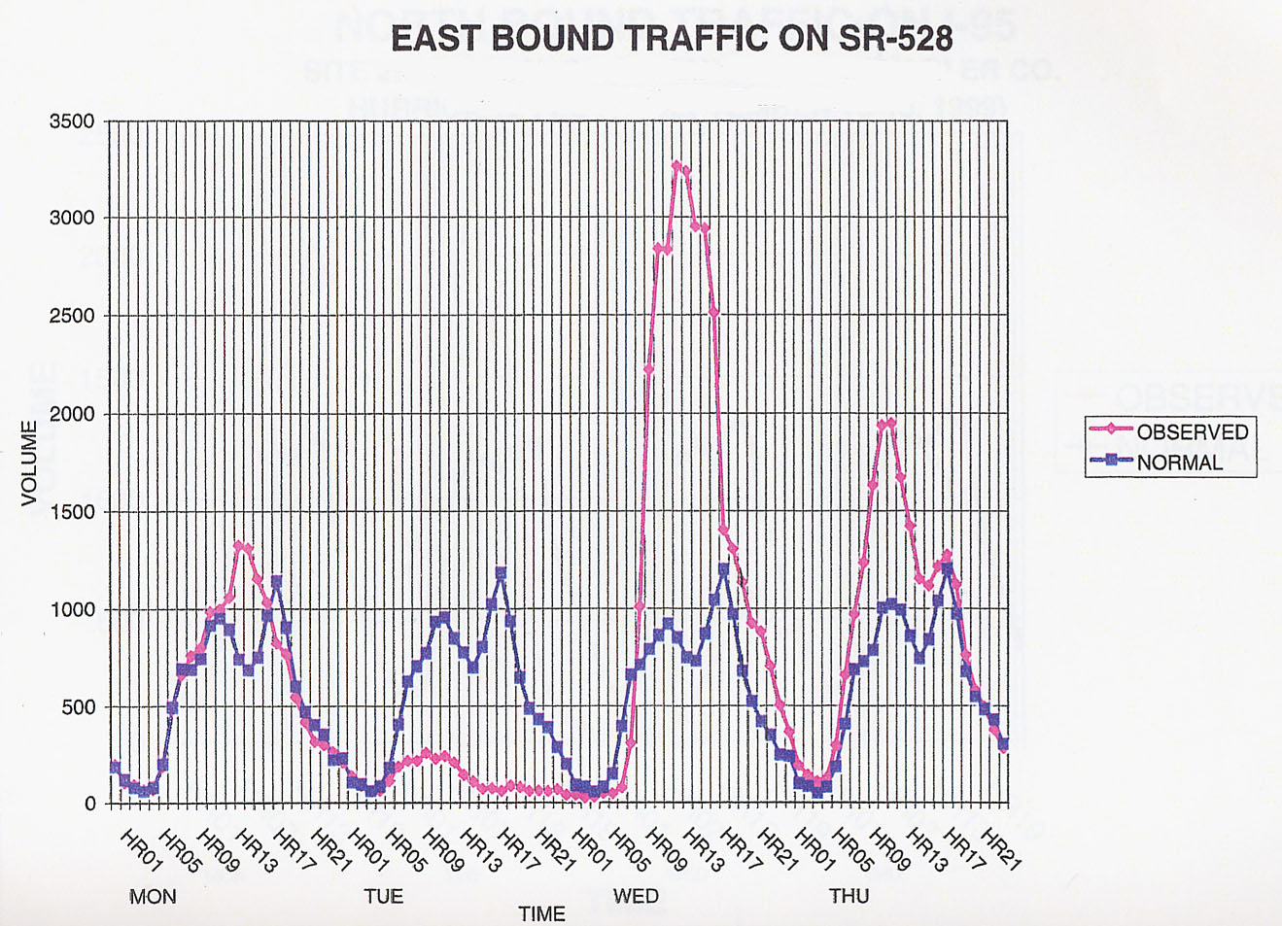
Florida Observations
Eastbound SR-528 Traffic Volume Data

Slide 91
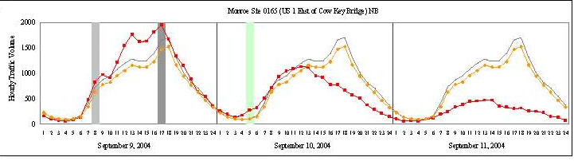
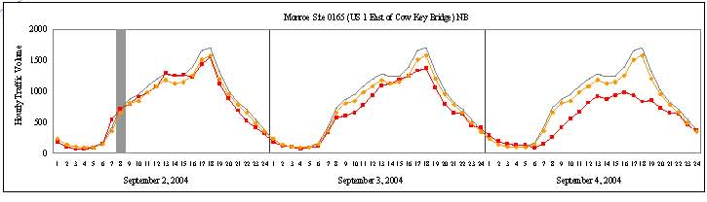
Florida Keys Observations
Northbound US-1 Traffic Volume Data at Cow Key Bridge
Hurricane Ivan (top) and Hurricane Frances (bottom)

Slide 92
Maximum Observed Flows
Event | Cow Key Bridge MM 4 (vphpl) | Big Pine Key MM 28 (vphpl) | Key Largo MM 106 (vphpl)
Hurricane Charley | 1,125* | 1,100* | 725*
Hurricane Francis | 800* | 595* | 450*
Hurricane Ivan | 600* | 810* | 625*
Hurricane Wilma | 650* | 590* | 650*
Hurricane Dennis | 650* | 1,180* | 748*
Trop. Storm Fay | 855 | 1,030 | 874
Trop. Storm Ike | 584 | 680 | 502
Highest Hrly Vol. of 2010 | 1,092 | 1,066 | 903
2nd Highest Hrly Vol. 2010 | 1,061 | 1,065 | 869
3rd Highest Hrly Vol. 2010 | 1,058 | 1,063 | 849
4th Highest Hrly Vol. 2010 | 1,055 | 1,059 | 824
Maximum Sustainable Evacuation Traffic Flow Rates | 900 – 1,100 | 1,050 - 1,100 | 900 - 1,200
* Denotes approximate value based on graphical data
Notes:
Can you spell out MSETRF. Can you remove the asterisk, aren’t all of these observed?

Slide 93
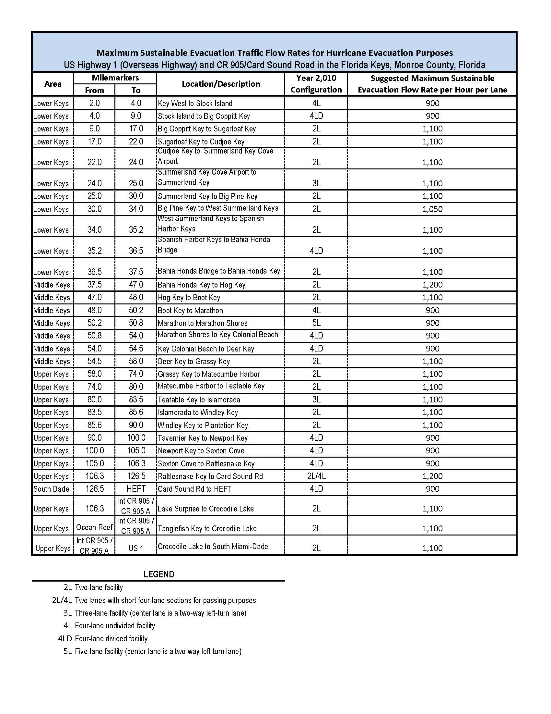
Notes:
We are going to have one of consultants convert this to graph and have copies of your tech memo avialable.

Slide 94
Model Findings - 2010
2010 Statewide Regional Evacuation Study Program Models
  More than 30 scenarios
  Using FDOT recommended MSETFR’s
Will be used by the State of Florida to set policy
Enormous range of clearance times from 12 - 47 hours, based on amount of population, behavioral response, downstream traffic, etc., etc., etc.
  Comparable assumptions to 2001 (using MSETFR’s is now about 26 hours)
Gulf Coast Center for Evacuation and Transportation Resiliency

Slide 95
Conflicting Concerns and Needs
Improvements would be needed most in Upper Keys to serve Lower/Middle Keys populations
Additional road capacity would bring more traffic, diminishing the quality of life and the existing nature of The Keys
Building prohibitions would amount to government “takes” of private property, involving of hundreds of millions
Compromise?
Gulf Coast Center for Evacuation and Transportation Resiliency

Slide 96
Current Research
Gulf Coast Center for Evacuation and Transportation Resiliency

Slide 97
Behavioral Modeling
Forecast time-dependent evacuation demand
Notes:
Sequential logit model developed which predicts whether a household will evacuate and when it will do so.
Prob (hh evacuates in time period t) is function of:
distance of storm from household in each time interval
forward speed of the hurricane in each time interval
flooding potential of home
whether the home is a mobile home or not
evacuation orders in effect in each time interval.

Slide 98
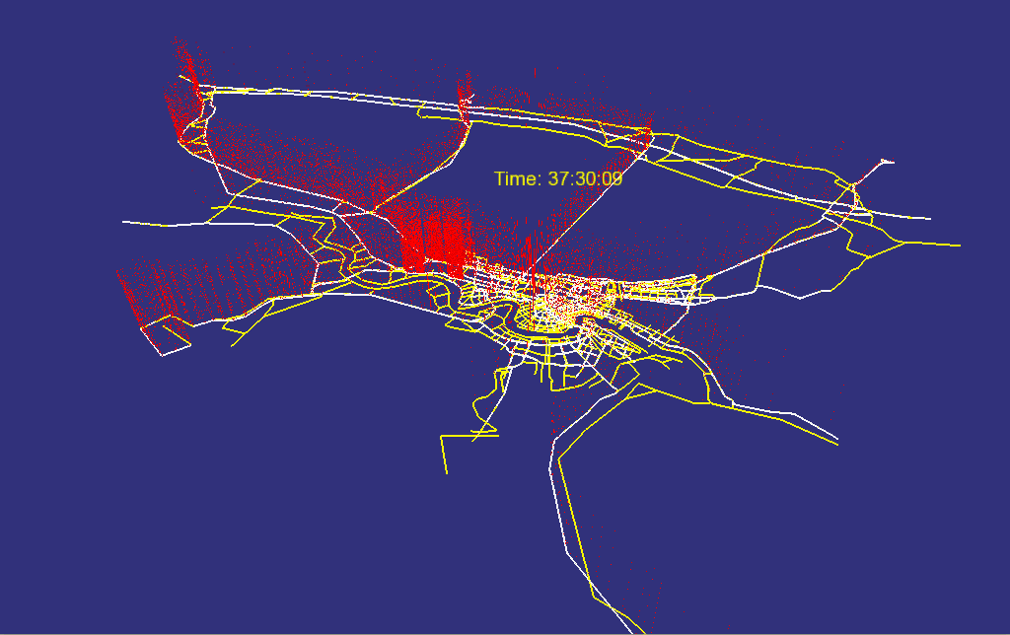
Regional-Level Modeling and Visualization

Slide 99
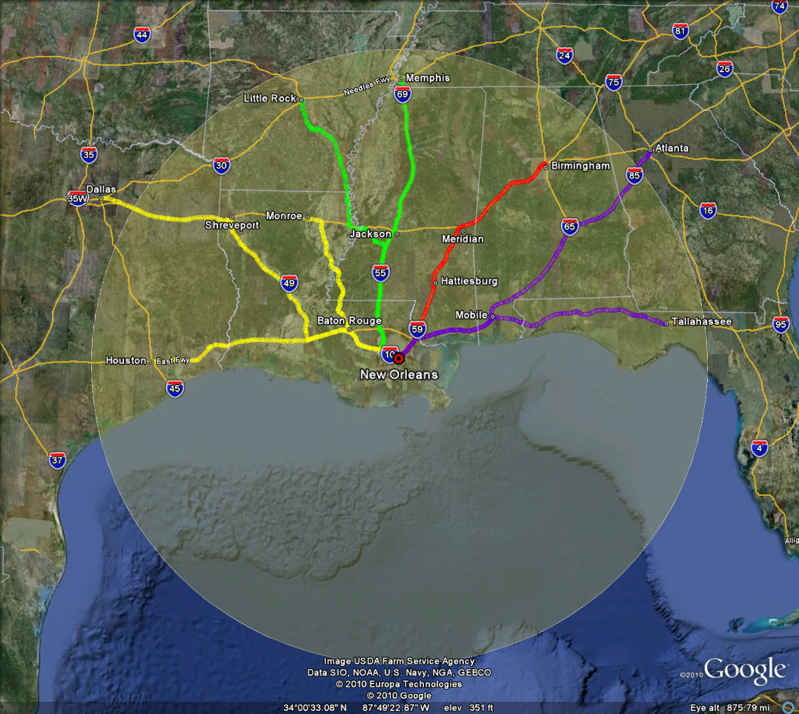
Scenario Testing and Evaluation
Analysis of “variable” hazards and responses
Temporal –
  More/less time to evacuate
  implementation of phasing strategies
  Spatial –
    Storm size and direction of approach
    network management
Notes:
Sequential logit model developed which predicts whether a household will evacuate and when it will do so.
Prob (hh evacuates in time period t) is function of:
distance of storm from household in each time interval
forward speed of the hurricane in each time interval
flooding potential of home
whether the home is a mobile home or not
evacuation orders in effect in each time interval.

Slide 100
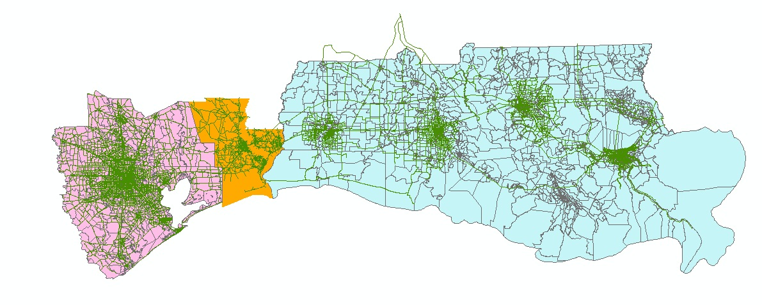
Future Modeling
  Police enforcement control
  MegaRegion evacuation network analysis
Baton
Rouge
Lake
Charles
Houston
N
Lafayette
New
Orleans
Beaumont
Port Arthur

Slide 101
Acknowledgements
    Financial support for this project provided by the United States Department of Transportation through the Federal Highway Administration’s Transportation Model Improvement Program
    Additional technical support provided by the New Orleans Regional Planning Commission, Louisiana Department of Transportation and Development, Louisiana State University, and the LSU-UNO UTC
    Continuing work is currently being funded by the United Stated Department of Homeland Security through the DHS Centers of Excellence Program
Gulf Coast Center for Evacuation and Transportation Resiliency
Notes:
These topics will be addressed from a transportation engineering perspective.
Using examples from recent evacuations in other states and Louisiana.
And showing examples of what were doing at LSU to address some of these issues here and nationally

Slide 102
Acknowledgements
    Financial support for research provided by the United States Department of Transportation through the Federal Highway Administration’s University Transportation Centers Program
    Technical assistance and data provided by:
      Florida Department of Transportation, District Six
      TrafTech Engineering, Inc.
      Stanley Consultants, Inc.
Gulf Coast Center for Evacuation and Transportation Resiliency
Notes:
These topics will be addressed from a transportation engineering perspective.
Using examples from recent evacuations in other states and Louisiana.
And showing examples of what were doing at LSU to address some of these issues here and nationally

